Slide 1



VIRTUALIZED SECURITY LAB
Build an isolated attack lab — then prove a SIEM catches every move
attacks
the SIEM watches
Samuel Weiss · LIS4905 Directed Individual Study · Fall 2026 · Instructor: E. Randeree

Slide 2
The big idea, in plain terms
Two computers inside one laptop: an attacker and a deliberately weak victim.
Attack the victim with real hacker tools.
A SIEM (security monitor) records everything and shows the attack.
Fully sealed — no route to the real internet.
All on one 8 GB Apple-M1 laptop (which ruled out the usual tools).
SIEM watches & records
attacks
KALI
(attacker)
TARGET
(weak on purpose)
Virtualized Security Lab · LIS4905 DIS · S. Weiss
2

Slide 3

How the lab is wired — and sealed
Host-Only network · 192.168.128.0/24 · NO route to the internet (verified)
attacks (scan → exploit)
KALI — attacker
192.168.128.2
Metasploitable2 — target
192.168.128.4
Elastic SIEM (on the Mac) · .1 — captures all traffic
Virtualized Security Lab · LIS4905 DIS · S. Weiss
3

Slide 4
Recon → break in
Recon first: nmap scanned all 65,535 ports and found 23 open, outdated services — then four of them became a way in.
Service | Technique / CVE | What we got
Full port scan | T1046 — recon | 65,596 ports probed; 23 services found
FTP (port 21) | T1110 — brute force | Cracked login msfadmin : msfadmin
UnrealIRCd (6667) | CVE-2010-2075 | Remote shell on the target
Samba (445) | CVE-2007-2447 | Remote shell (runs as root)
Bind shell (1524) | T1190 — exposed backdoor | Instant root — uid=0, no password
A weak password, two unpatched services, and a literal backdoor.
Virtualized Security Lab · LIS4905 DIS · S. Weiss
4

Slide 5
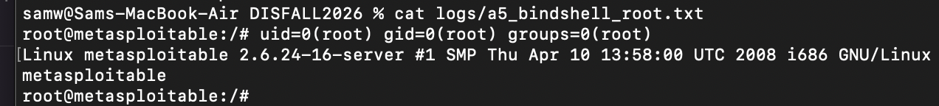
Proof: we became root
The real terminal output from the attack — captured as evidence.
uid=0(root) = complete control of the target machine.
hydra guessed the FTP password in seconds: msfadmin : msfadmin.
Virtualized Security Lab · LIS4905 DIS · S. Weiss
5

Slide 6
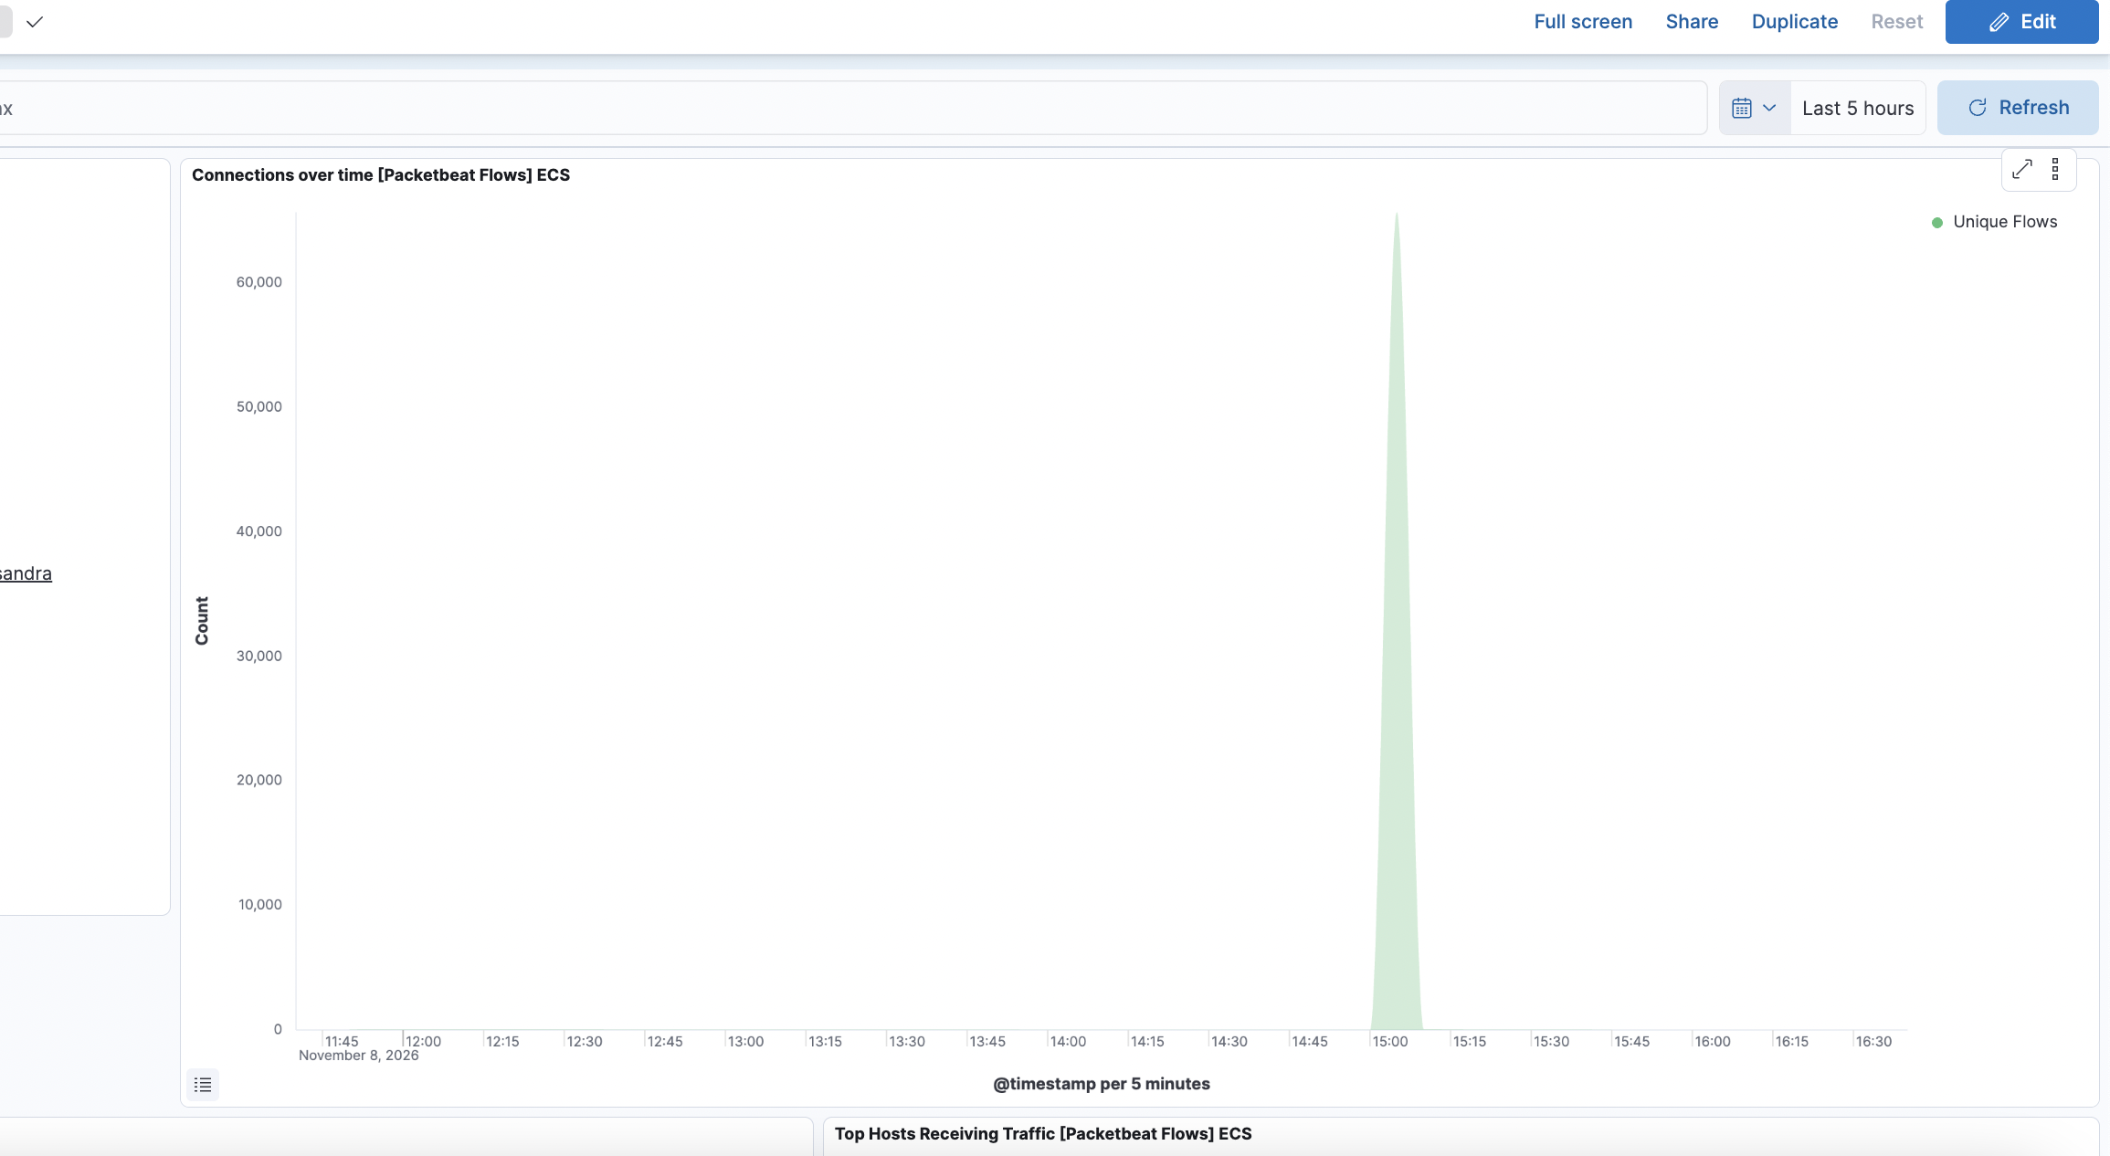
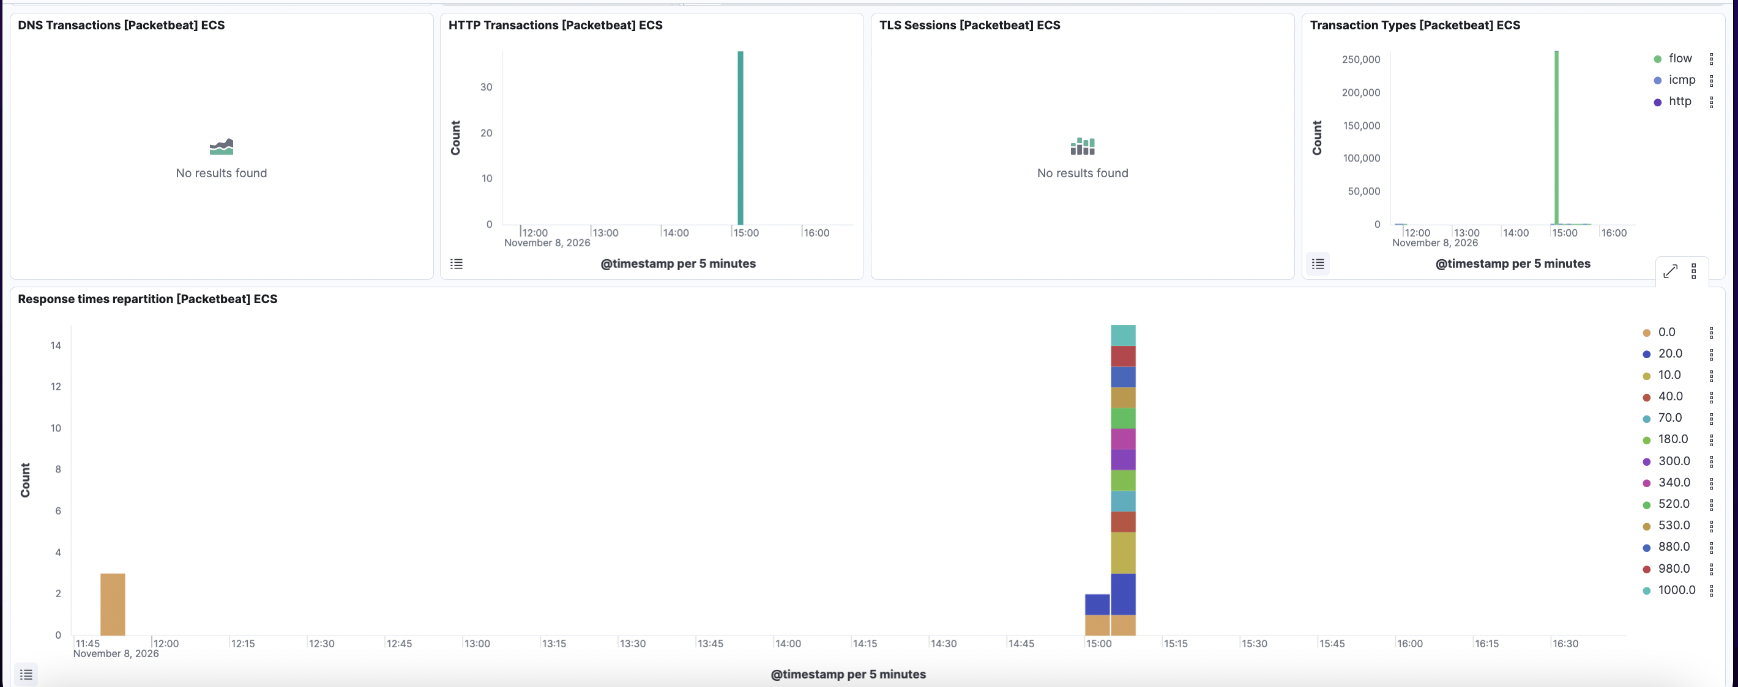
The SIEM sees it all
Packetbeat records every packet. The attack is impossible to miss.
▲ ~260,000 flow events indexed during the attack window.
▲ The port scan: one giant spike to ~65k flows.
Virtualized Security Lab · LIS4905 DIS · S. Weiss
6

Slide 7
Every attack → how the SIEM caught it
Attack | MITRE ATT&CK | What the SIEM showed
Port scan | T1046 | 65,596 distinct ports from .2 → .4
FTP brute force | T1110 | 72 flows to port 21 (burst)
UnrealIRCd backdoor | T1190 | 25 flows to 6667 + reverse shell
Samba usermap | T1190 | 8 flows to 445 + reverse shell
Root bind shell | T1190 | 30 flows to unusual port 1524
Isolation, proven: the only IPs in the SIEM were .1 / .2 / .4 — no public internet address anywhere.
Virtualized Security Lab · LIS4905 DIS · S. Weiss
7

Slide 8
What it proves — and what’s next
A complete security loop — build → attack → detect — on one 8 GB laptop.
Five real exploits (incl. CVE-2010-2075 & CVE-2007-2447), all captured.
ARM + emulation forced creative fixes: serial-console install, native Elastic.
Documenting the failures was the real learning.
Next steps
Custom alert rules · richer dashboards · more attack scenarios · finalize the report.
github.com/samweiss6/virtualized-security-lab

