Slide 1
Clinic Management System

Slide 2
-Purpose : -
The purpose of this document is to describe the project to customers and developers .

Slide 3
- product perspective
The project is considered a site, and it is considered as an application of a previous system, but it has been updated through which the user can inquire and book examinations.

Slide 4
- Product Scope : -
Through this project, the clinic is managed in modern ways, and through it, it is easier for the doctor to work and provide care to the patient by collecting his health data

Slide 5
-Product Functions
patient functions :-
login
Registration
Reservation(web site)
patientEnquiry

Slide 6
Admin Functions :-
Search(all data)
Update
login

Slide 7
Doctor functions: -
Add Admin
Enquiry (database)
Registration (dashboard)

Slide 8
-user Classes and Charateristics
1- user Who Can Register
2- Admin who Can Update
3- owner who can do any function in system

Slide 9
-Design and implementation constraints : -
We will use C# (asp.net core (mvc))for Backend , Html , css and java Script for fornt End , MSsql for database

Slide 10
The user can see some scenes by entering the site

Slide 11
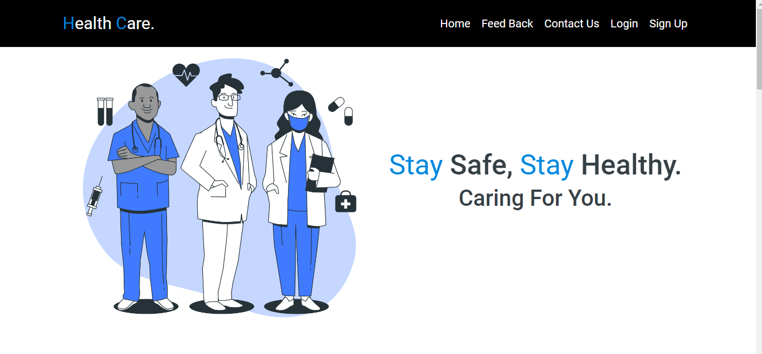

Slide 12
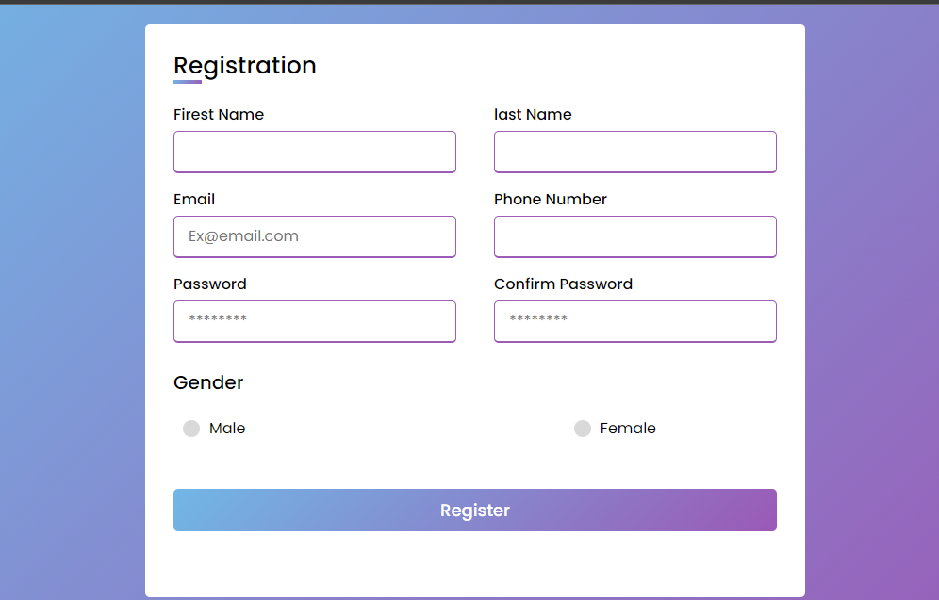

Slide 13
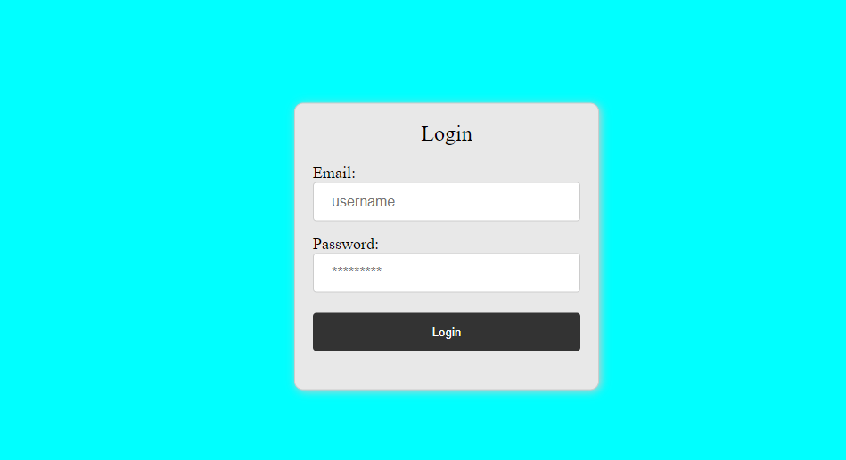

Slide 14
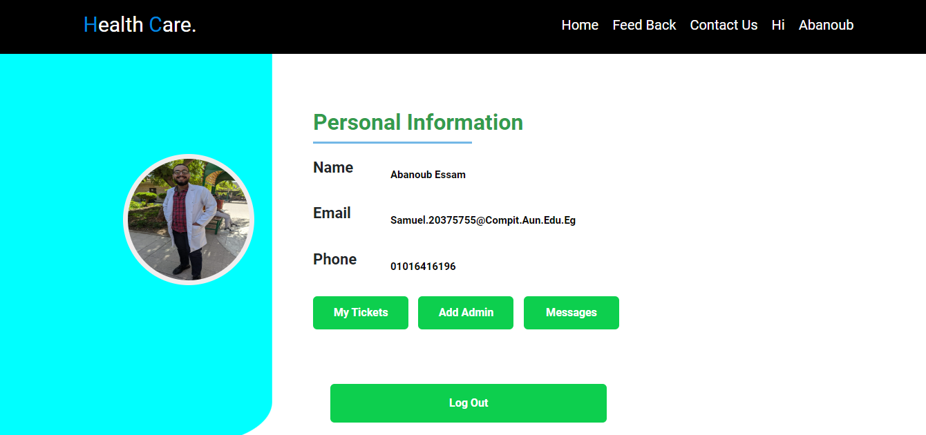

Slide 15
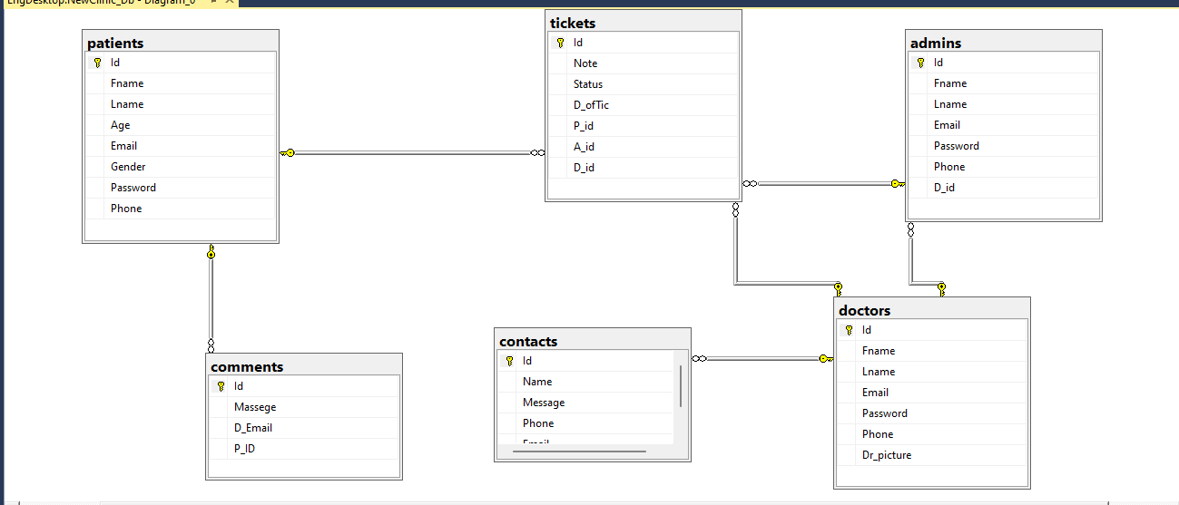
- Erd :-

Slide 16
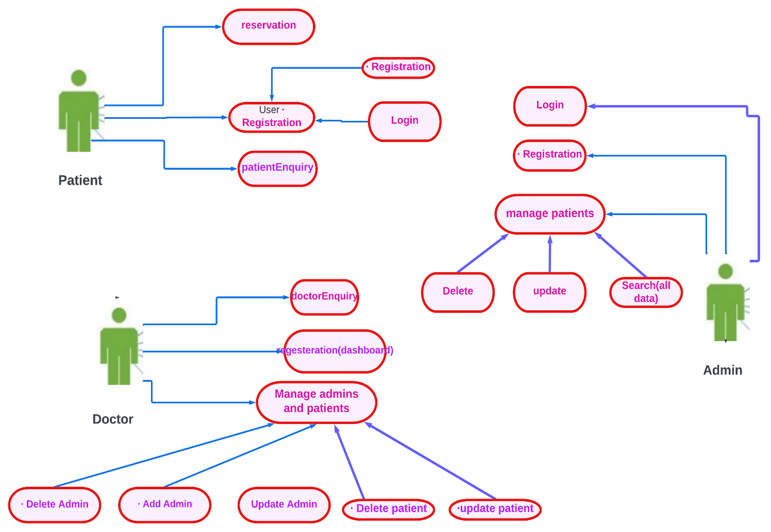
-Use Case Diagram:

Slide 17
Use Case Scenarios:
Use case Name | Reservation (clinic)
Goal | Patient do a reservation
Primary Actors | Patient
Secondary Actors | none
Precondition | Patient must login in our application
Post condition
Triggers
Main flow | Step | Action
 | 1- 2- | User use email and password to login if he have ,if he have not do registeration. Take an appointment if exist and pay in a clinic .
Extensions | 4.1 | If data invalid display “Invalid selections” redirect to inventory section window

Slide 18
Use case Name | Registration (login and Registration)
Goal | Register in system
Primary Actors | patient
Secondary Actors | none
Precondition | Patient must have an email.
Post condition
Triggers
Main flow | Step | Action
 | 1- 1- 2- | If user has registered before Write an email and password If user has not registered before User will use sin up to create email Write his personal data

Slide 19
Use case Name | patientEnquiry
Goal | Patient can search about his appointment
Primary Actors | patient
Secondary Actors | none
Precondition | Patient must have an account
Post condition
Triggers
Main flow | Step | Action
 | 1- 2- 3- | User login Click on enquiry textbox Search about his appointment

Slide 20
Use case Name | Login
Goal | Admin can login patient
Primary Actors | admin
Secondary Actors | none
Precondition | The patient is not registered
Post condition
Triggers
Main flow | Step | Action
 | 1 2 | Write an email and password Determine the patient appointment.
Extensions | 4.1 | Patient input is invalid and fast Show an unsuccessful message

Slide 21
Use case Name | update patient
Goal | Admin can update for the patients
Primary Actors | admin
Secondary Actors | none
Precondition | Patient not must have an email.
Post condition
Triggers
Main flow | Step | Action
 | 1 2 3 | admin clicks “update patient ” button Write an email and password Determine the patient appointment.
Extensions | 3.1 | Incorrect patient details, presentation The message "unsuccessful" and Offer to add a sick option

Slide 22
Team Members : -
1- صموئيل مرزوق رزق
2- صديق حليم صادق
3- ابانوب عصام عياد
4- صبحي محمد صبحي
5- طارق عبدالعزيز

Slide 23
Thank You

