Slide 1

DAR TEKNOHAMA BUSINESS INCUBATOR LIMITED.

Slide 2
Dar Teknohama Business Incubator is (DTBi).
DTBi was established by the Tanzania Commission for Science and Technology (COSTECH in 2011 to support the growth and commercialization of Tanzanians’ digital innovation startups for improving socio-economic livelihood and the country’s wealthy.

Slide 3
DTBi SERVICES
Shared Space and services;
A room full furnished
Boardroom for meetings
Internet,
Kitchen
Water service.
Electricity
Security.
washrooms
By occupying the space the tenant pays a space fee of 100 dollars per month

Slide 4
DTBi SERVICES CONT…
Training Programs; DTBi conducts different technical and business training programs to enhance their business and technical capabilities these include
Training on Marketing and conducting market research
Training on Leadership and Management
Training on Revenue and Taxes Law
Training on Business Planning, Pitch Development and Pitching
Training on customer services and product quality assurance
Technical training are offered on demand because most of the incubatees are tech people.
These training programs are set and provided by the experienced experts on a related field and are provided based on incubatees’ needs and or gap.

Slide 5
DTBi SERVICES CONT…
Coaching and Mentorship; DTBi provided coaching and mentorship services to its incubatees to improve their business perspectives and sharpen their solutions to suit the needs of the market and also to prepare them as digital innovation companies. DTBi provides mentorship in the following areas.
Technical support
Business Management support
Mindset change
Product development
Intellectual Property Rights (IP)

Slide 6
DTBi SERVICES CONT…
Legal support; On the other side of legal support, DTBi helps innovators on the following;
IP documentation and registration
Patenting and Copyrighting
Contract negotiation and signing
Business/Company Registration

Slide 7
DTBi SERVICES CONT…
Networking;
DTBi assists incubatees to network with potential stakeholders for promotion of their innovative solutions by strategically participating in different forums, meetings, events, programs and projects.
Through this efforts DTBi has been able to support most of its incubatees to improve their products/services and in acquiring market through events such as; Innovation week and Traders event (7/7).

Slide 8
DTBi SERVICES CONT…
Market Linkages
DTBi also links its incubatees with potential market and consumers of their innovation. Since the establishment of DTBi, number of incubatees linked to their potential buyers. Wilbroad Nyirenda, Geofrey Magila and Ahadi Katera are few references of incubatees DTBi benefited from this service. Market Linkage service has strengthened the incubatees-incubator relationship and prototypes for their potential markets.

Slide 9
ON-GOING PROJECTS

Slide 10
PRE-PAID WATER METER PROJECT
DTBi awarded tender to develop and fabricate Pre-Paid Water meters for public water points and households by RUWASA in order to support the rural water supply schemes.
For the piloting phase, DTBi will fabricate and install 150 pre-paid water meter, 100 for public water points and 50 for households.

Slide 11

PRE-PAID WATER METER PROJECT
PROBLEM
Poor Water Service Delivery
SOLUTIONS
Pre-Paid Water Meter
Value Proposition
Instant water bills
Recording system
Determine water leakage
Anti-theft of water to both user and service provider

Slide 12
HUBIQUITOUS PROJECT
HUBiquitous is an innovation action aiming at creating a joint Africa-Europe Startup and innovation ecosystem for long-term collab- orations and partnerships. The project has the ambition to increase the technology level and capacity building of 30 local DIHs/TechHubs in 5 African countries. See more on Website: https://hubiquitous.eu/
DTBi through Hubiquitous Project has been able to do the following;
Complete the Innovation Handbook for African Ecosystem
Access the solution lab kit that will enable innovators to develop and test their prototypes hence increasing innovation in the country.

Slide 13
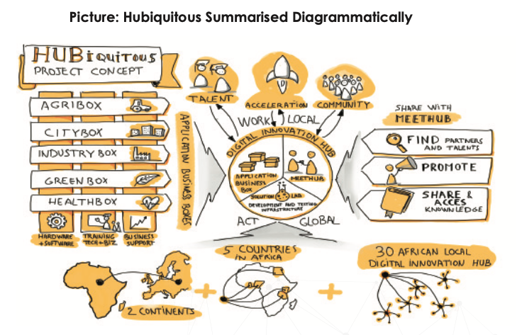

Slide 14
FUTURE STEM BUSINESS LEADER PROJECT
Future Stem Business Leaders (FSBL) is IoP funded project under DTBi with the objective of encouraging secondary school students to apply their scientific training to solve local problems, through the creation of science-based enterprise. The Future Stem Project Leader has currently supported 85 students from 17 schools in Tanzania, where 7 schools are in Arusha and 10 schools are in Dar es Salaam. Supported School in Arusha are; Edmund Rice Secondary School, Ilboru Secondary School, St Mary’s Duluti Secondary School, Arusha Girl’s Secondary School, St. Judy Secondary School, Bishop Darning Secondary School and Arusha Secondary School while in Dar es Salaam are; Jangwani High School Chang’ombe Secondary School, Baobab Girls Secondary School, Loyola High School, Tambaza High School, Alfa Secondary School, Temeke High School, Shamsiye High School, Baobab Boys Secondary School, and Azania Secondary School. See more on Website: https://fsbl.or.tz/

Slide 15
ENDED PROJECTS

Slide 16
WAZIHUB PROJECT
WAZIHUB was an innovation project for Africa aimed to create an Open HUB of IoT and Big data cutting-edge and African grade solutions, co-designed by African people with the aim of; IoT-Cloud development kit for rapid prototyping, IoT capacity building, IoT accelerator for innovative service creation and organizing and implementing different innovative programs. See more on Website: https://wazihub.com/
Project ended in 2021, but successfully implemented.

Slide 17
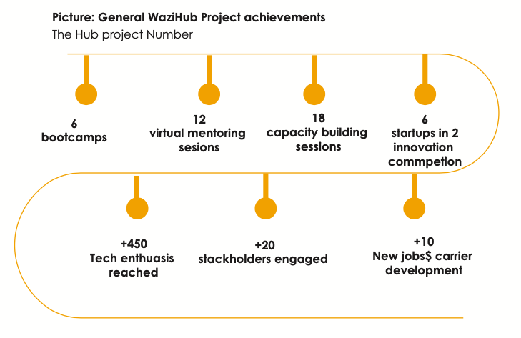

Slide 18
DLi CHALLENGE PROJECT

Slide 19
TANZAiCT PROJECT

Slide 20
CODE LIKE A GIRL PROJECT

Slide 21
TADIYE PROJECT

Slide 22
AFRICA CODE WEEK PROJECT

Slide 23
DRONES PROJECT

Slide 24
VIRTUAL INCUBATION PROJECT

Slide 25
INNOVATION FUND PROJECT

