Slide 1
Web Client
Ahmad Wilda Yulianto
Rekayasa dan Aplikasi Internet

Slide 2
Layer-layer Halaman Web
Behavior
JavaScript
Presentation
Cascading
Style Sheet
Content
Hypertext
Markup Language

Slide 3
DOM (Document Object Model)

Slide 4
Konsep DOM dan Kemampuan Javasript
"The W3C Document Object Model (DOM) is a platform and language-neutral interface that allows programs and scripts to dynamically access and update the content, structure, and style of a document."
JavaScript bisa merubah elemen-element HTML di suatu halaman.
JavaScript bisa merubah atribut-atribut HTML di suatu halaman.
JavaScript bisa merubah style CSS di suatu halaman.
JavaScript mampu menambah/menghapus elemen-element dan atribut-atribut HTML.
Javascript mampu membuat event HTML baru

Slide 5

ReactJS

Slide 6
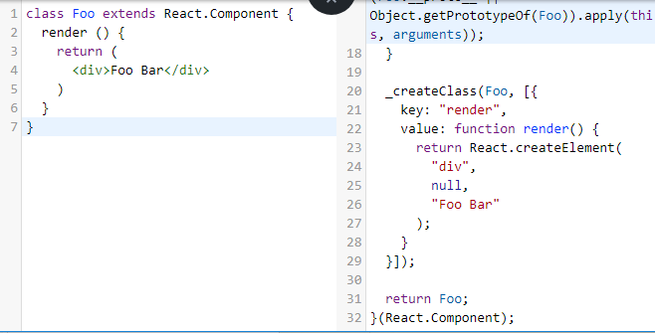
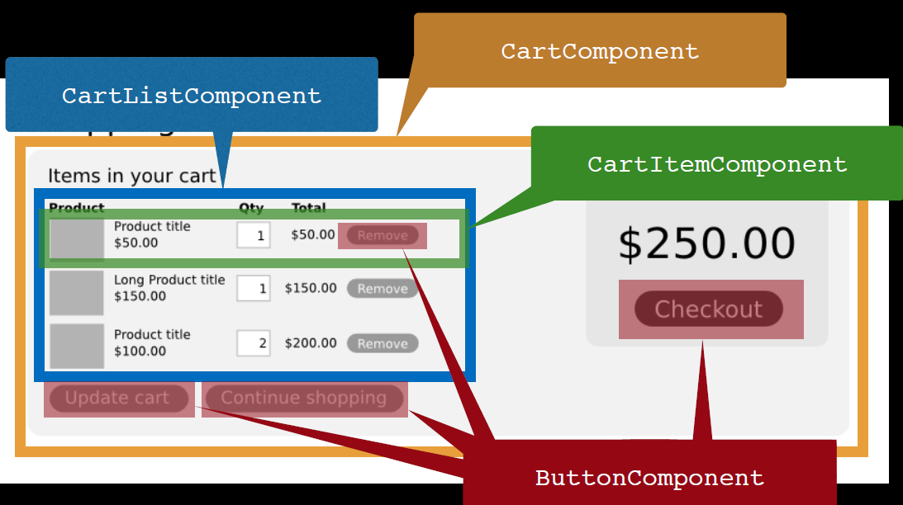
Fitur-fitur React
JSX
JavaScript extension
Coba : http://babeljs.io/repl
Komponen-komponen
Reusable, Maintainable, Testable
Virtual DOM

Slide 7
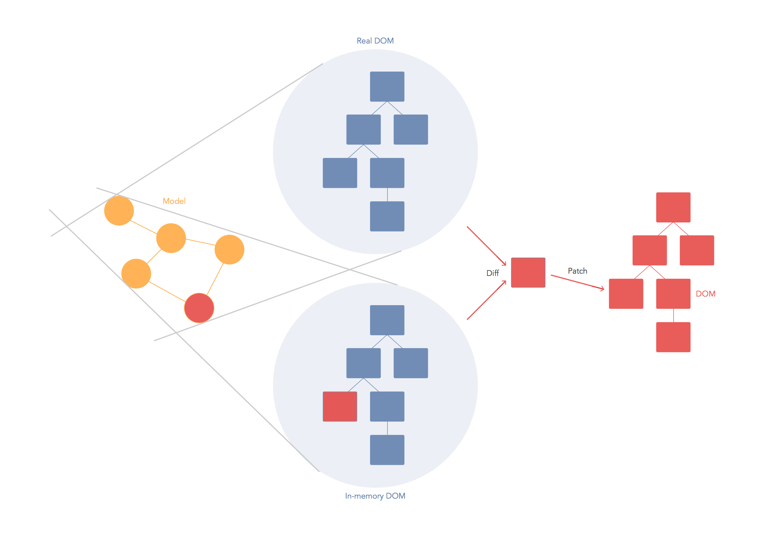
DOM Virtual
Reference: https://stackoverflow.com/questions/21109361/why-is-reacts-concept-of-virtual-dom-said-to-be-more-performant-than-dirty-mode

Slide 8
Persiapan
Software
node & npm
IDE: Web storm, VS Code, Atom, Sublime, vi
Quick start
npm install -g create-react-app
create-react-app my-app
cd my-app
npm start
Reference: https://reactjs.org/tutorial/tutorial.html

Slide 9
React: Start from scratch
Prepare and create package.json:
npm init -y
Install global package:
npm install -g babel babel-cli
npm install -g webpack-dev-server
Add dependencies and plugins:
npm install webpack webpack-dev-server --save
npm install react react-dom --save
npm install babel-core babel-loader --save
npm install babel-preset-react babel-preset-es2015 --save

Slide 10
Compiler, Server dan Loaders
create webpack.config.js
var config = {
entry: './src/index.js',
output: {
path:'/',
filename: 'bundle.js',
},
devServer: {
inline: true,
port: 8080
},
module: {
loaders: [
{
exclude: /node_modules/,
loader: 'babel-loader',
query: {
presets: ['es2015', 'react']
}
}
]
}
}
module.exports = config;

Slide 11
Compiler, Server dan Loaders
edit package.json
"scripts": {
"start": "webpack-dev-server --hot"
"test": "echo \"Error: no test specified\" && exit 1"
},
npm start
index.html
app.jsx
main.js
<!DOCTYPE html>
<html lang = "en">
<head>
<meta charset = "UTF-8">
<title>React App</title>
</head>
<body>
<div id = "app"></div>
<script src = "index.js"></script>
</body>
</html>
import React from 'react’;
class App extends React.Component
{
render() {
return ( <div> Hello World!!! </div> );
}
}
export default App;
import React from 'react';
import ReactDOM from 'react-dom';
import App from './app.jsx';
ReactDOM.render(
<App />, document.getElementById('app')
);
Try to modify in app.jsx and check result at browser

Slide 12
Berbasis Komponen
import React from 'react';
class App extends React.Component {
render() {
return (
<div>
<Header/>
<Content/>
</div>
);
}
}
class Header extends React.Component {
render() {
return ( <div> <h1>Header</h1> </div> );
}
}
class Content extends React.Component {
render() {
return (
<div>
<h2>Content</h2> <p>The content text!!!</p>
</div>
);
}
}
export default App;
Prakteknya, Header dan Content harus dipisahkan dalan pembuatan maupun export nya.

Slide 13
Data passing (props vs. state)
React memiliki 2 obyek data passing untuk mengontrol data ke tiap komponen
Props
Melewatkan dari komponen induk ke anak
Immutable
Props CANNOT be CHANGED inside a component
Single source of the truth
Fixed throughout the component
State
Reside within component
Mutable
State CAN be CHANGED

Slide 14
Props: Melewatkan ke sebuah komponen
import React, { Component } from 'react'; class Foo extends Component { render() { return ( <div> <h1> Foo: {this.props.name} </h1></div> ) } } class App extends Component { render() { return ( <div> <Foo name="FooName" /> </div> ); } } export default App;
Define a new property ‘name’

Slide 15
State: Inisialisasi dan Update
class App extends Component { constructor(props){ super(props) this.state = { fooState: "Foo State" } } render() { return ( <div> Message: {this.state.fooState} <br/> </div> ); } }
Initial state object
Read state object

Slide 16
State: bind method to context
class App extends Component { constructor(props){ super(props) this.state = { fooState: "Foo State" } this.updateMessage = this.updateMessage.bind(this) } updateMessage(e) { this.setState( {fooState: "New Foo State: "
+ e.target.value }) } render() { return ( <div> <div> Message: <input type='text' onChange={this.updateMessage}/> <br/> {this.state.fooState} <br/> </div> </div> ); } }
Have to bind method to ‘App’ context, otherwise a new method will not be known
Define the method to update state
Trig the method

Slide 17
State: bind otomatis
class App extends Component { constructor(props){ super(props) this.state = { fooState: "Foo State" } } updateMessage = (e) => { this.setState( {fooState: "New Foo State: " + e.target.value }) } render() { return ( <div> <div> Message: <input type='text' onChange={this.updateMessage}/> <br/> {this.state.fooState} <br/> </div> </div> ); } }
Arrow function binds a method automatically

Slide 18
State: Komponen Induk dan Anak
class Foo extends Component { render() { return ( <div> <h3> Foo: {this.props.name} </h3> {this.props.fooState} </div> ) } } class App extends Component {
...
render() { return ( <div> <div> Message: <input type='text' onChange={this.updateMessage}/> <br/> {this.state.fooState} <br/> </div> <Foo name="FooName" fooState={this.state.fooState} updateMessage={this.updateMessage.bind(this)} /> </div> ); } }
Membaca ‘state’ sebagai ‘props’
Pass ‘state’ as ‘props’
Update ‘state’ dari parent namun berakibat ke komponen anak

Slide 19
React – AJAX Request
Target API: https://api.github.com/users/samwildan
Example: axios
npm install axios --save
import React, { Component } from 'react'; import axios from 'axios'; const USER = 'wwarodom'; class Profile extends Component { constructor(props){ super(props) this.state = { data: {} } } componentDidMount() { axios.get(`https://api.github.com/users/${USER}`) .then(response => { this.setState({data: response.data}) console.log(response.data) } ) }
Send Http request

Slide 20
Read object
render() { const dataOption = Object.keys(this.state.data) .map( (key,index) => <option value={index}> {index+1 +'. ' +key+ ': ' + this.state.data[key]} </option> ) return ( <div> <h2> Github Profile</h2> <ul> <li>{this.state.data.url}</li> <li>{this.state.data.login}</li> <li>{this.state.data['blog']}</li> </ul> <dd><select>{dataOption}</select></dd> </div> ); } } export default Profile;
Pick a value

Slide 21
Firebase
Backend As A Service : sebuah model layanan cloud computing di middleware yang menghubungkan aplikasi Web dan Mobile via API dan SDK
Kemampuan Firebase:
Real time database
Push notification
Firebase Analytic
Firebase Authentication
Firebase Cloud Messaging
Firebase Storage
Firebase Hosting

Slide 22
Firebase - Realtime Database
NoSQL cloud database
Data disimpan dengan format JSON dan sinkronisasi setiap klien secara realtime.
Setiap terjadi perubahan data, maka semua clien yang terhubung akan mendapatkan pemberitahuan.

Slide 23
Layanan Hosting Node
Modulus - https://modulus.io/
Digital Ocean - https://www.digitalocean.com/
Heroku - https://www.heroku.com/ (Recommended)
Dibahas di materi ini
Instalasi dan operasi layanan Heroku
Cloud9 - https://c9.io/
Joyent - https://www.joyent.com/ (komersil)
Nodejitsu - https://www.nodejitsu.com/ (komersil)

Slide 24
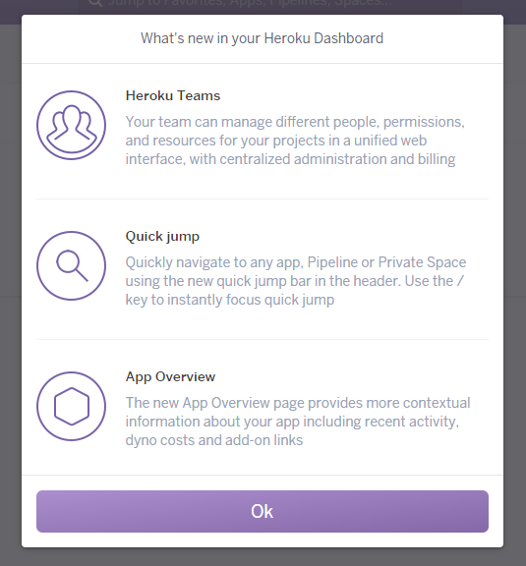
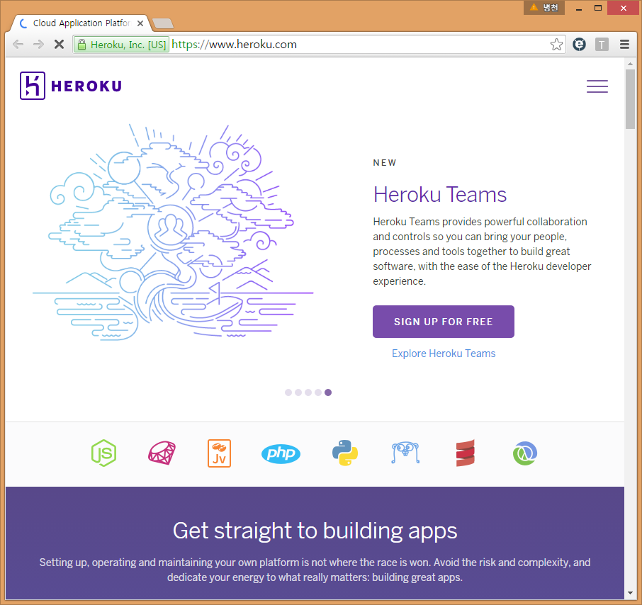
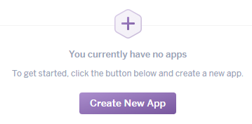
Heroku
https://www.heroku.com/

Slide 25
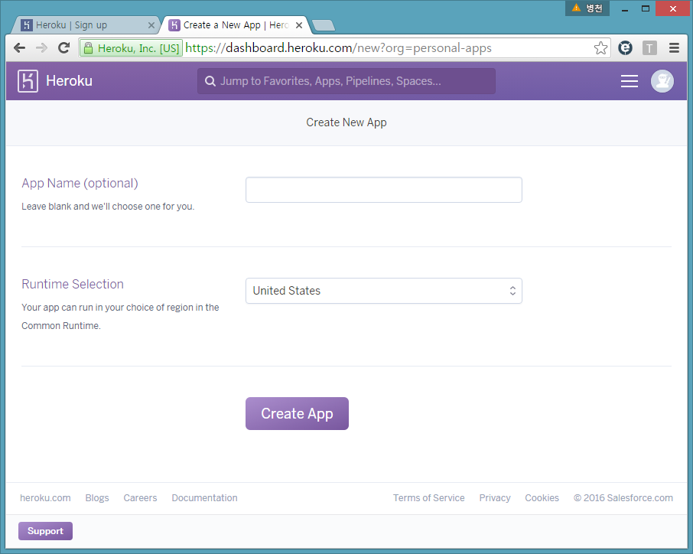
Pembuatan Aplikasi - Heroku
Jangan memberikan nama aplikasi, akan di grenerate otomatis

Slide 26
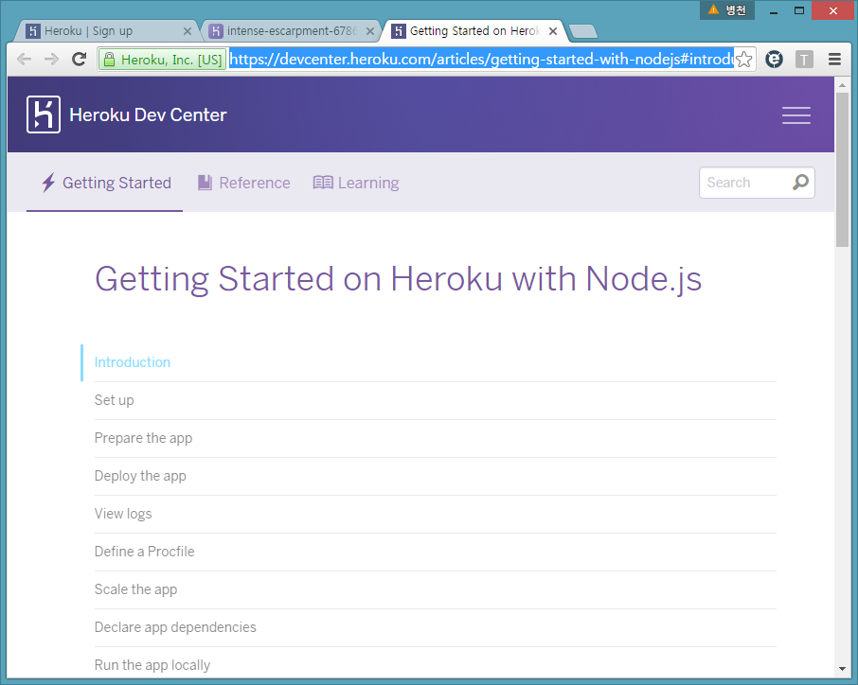
Heroku’s Node deployment instructions
https://devcenter.heroku.com/articles/getting-started-with-nodejs#introduction

Slide 27
Alat yang dibutuhkan
Node dan npm
Git
https://git-scm.com/
sistem kontrol versi terdistribusi open source gratis (alat control versi)
Heroku Toolbelt
https://toolbelt.heroku.com/
Alat bantu penting untuk menggunakan Heroku. Jalankan perintah di CMD/terminal.

Slide 28
Membuat Repo
Local git repository
cd folder project
> git init (membuat git repository)
> git add . (menambahkan semua file-file dalam folder ke repository)
> git commit –m ‘adding first files’ (commit)
Membuat Git remote di Heroku
Menggunakan Heroku toolbelt
Push kode ke Heroku
Menggunakan Heroku toolbelt

Slide 29
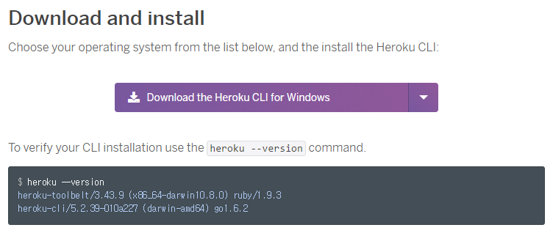
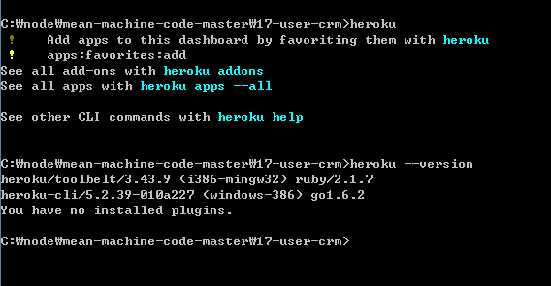
Toolbet Heroku
https://toolbelt.heroku.com/
Perintah di CMD
Memastikan berfungsi
heroku
Cek di jendela perintah

Slide 30
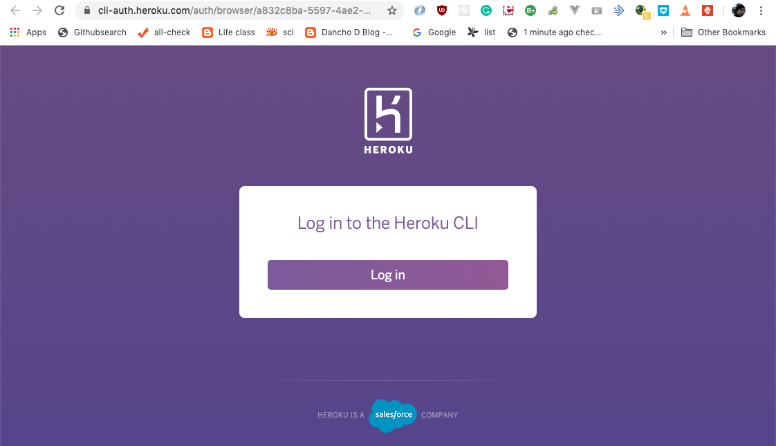
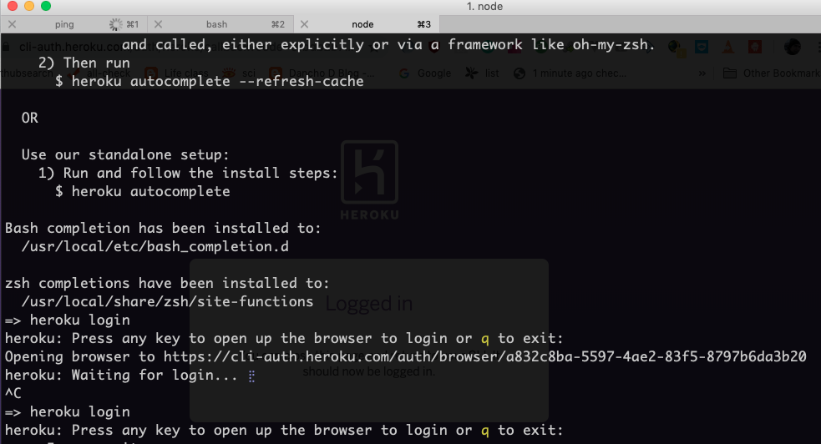
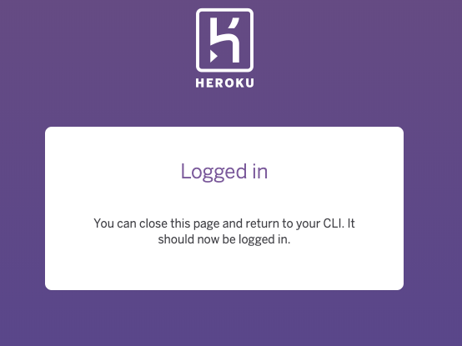
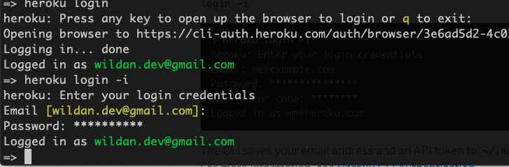
Login Heroku
> heroku login
Email, password
https://devcenter.heroku.com/articles/heroku-cli

Slide 31
Deploy App
1. Create a remote repository (Remote repository)
> heroku create (membuat remote repository)
> git remote –v (melihat remote repository)
> heroku apps:rename nama_baru --app secret-taiga-90781 (mengganti nama)
> heroku create [nama aplikasi unik] (membuat nama app sendiri)
2. Push the repository!
> git push heroku master (push kode dari local git repository ke heroku remote repository pada master branch)
Tambahkan semua dependency yang terdapat pada file Package.json
Node siap dijalankan (server.js)
> heroku ps:scale web=1 (pastikan aplikasi berjalan)

Slide 32
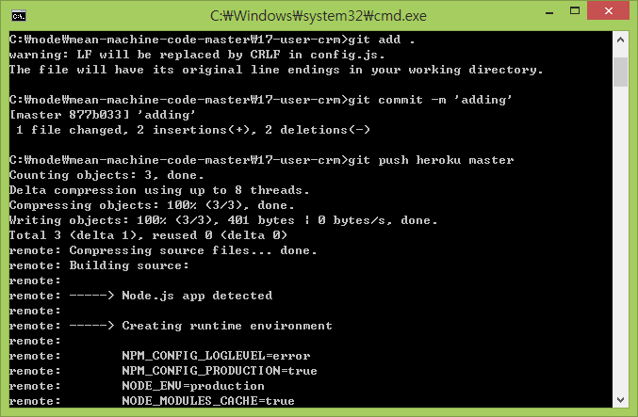
Deploy App
Ringkasan perintah Git
> git init
> git add .
> git commit –m ‘adding’
> git push heroku master
> heroku ps:scale web=1

Slide 33
Deploy App
> heroku open

Slide 34
Menggunakan PC lain
Download the Heroku Toolbelt
Login:
heroku login
Tambahkan public key anda:
heroku keys:add
Pull down aplikasi anda
heroku git:clone -a app-name
Lakukan perubahan
Git add dan commit perubahan
Push kembali ke heroku:
git push heroku master

Slide 35
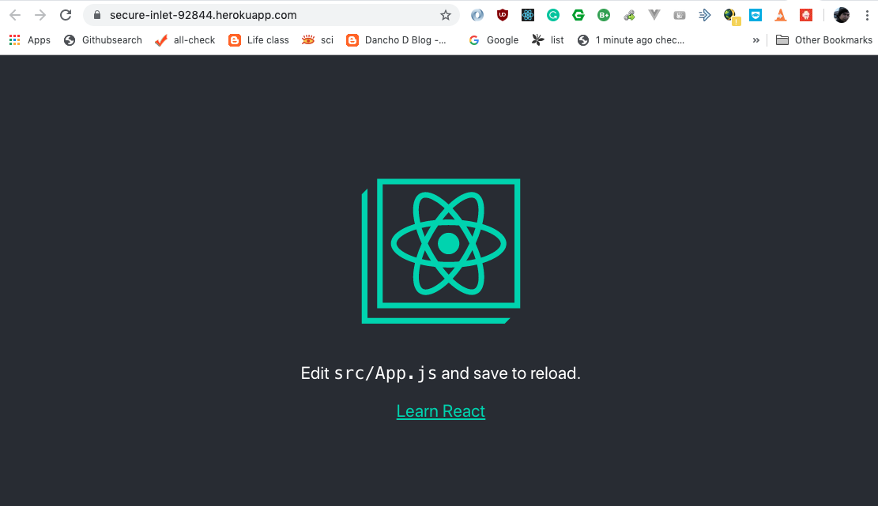
Best Practise
npm install -g create-react-app
create-react-app my-app
cd my-app
git init
heroku create -b https://github.com/mars/create-react-app-buildpack.git
atau
heroku create MY-AWESOME-APP --buildpack https://github.com/mars/create-react-app-buildpack.git
git add .
git commit -m "react-create-app on Heroku"
git push heroku master
heroku open
https://github.com/mars/create-react-app-buildpack

Slide 36
Update Package
npm outdated
npm install -g npm-check-updates
ncu -u
npm update
npm install

Slide 37
React + Firebase
> npm install -g firebase-tools
> create-react-app firebase-deploy
> cd firebase-deploy/
> firebase login
> firebase init
[Instalasi yarn] ➔ MAC: brew install yarn
> yarn build
> firebase use --add
> firebase deploy

Slide 38
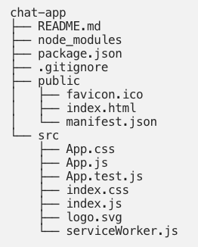
Aplikasi CHAT
create-react-app app-chat
npm install firebase –save
cd chat-app
npm start

Slide 39
User.js

Slide 40
Chat.js

Slide 41
App.js

Slide 42
Index.js

