Slide 1


Railway Online Booking Database and System design
Submitted by:
Sam William .D 2023-11-22

Slide 2
I am hereby declare that I complete this project on the topic entitle Railway Online Booking database and system design. I prepared the project report and submitted to the I.T Vedant. This project is submitted to fulfill the requirement for Master in data software engineering.
Declaration
I claim that project work which is demonstrated in this report is out own work . I
also declare that this work has not been submitted anywhere for publication.
Sam William .d
2023-11-22

Slide 3
Abstract
My designed Railway Reservation System facilitates the passengers to enquire about the trains available on the basis of source and destination, booking and payment of tickets. The aim of this project is to design and develop a database maintaining the records of different trains, and passenger.
In our country, there are number of counters for the reservation of the seat and one can easily make reservation and get tickets. And this project contains entity relationship model diagram based on railway booking and introduction to relation model.

Slide 4
Table of Contents
CHAPTER-01
Introduction…………………………………………………………………….
1.1 Purpose………………………………………………………………………
1.2 Scope…………………………………………………………………………
1.3 Objective……………………………………………………………………….
CHAPTER-02
2.1 System Overview………………………………………………………………………………………
2.2 database design………………………………………………………………………………………
2.3 ER Model………………………………………………………………………………………………..
CHAPTER-03
3.1 System Requirements…………………………………………………………………………………..
1. Web Server (Apache Server(XAMPP) Version 3.3.0 and above……………………………..
2. Database Management System(MySQL)………………………………………………………...
3. Server-side Language(PHP)…………………………………………………………………………
3.2 Activity Diagram…………………………………………………………………………………………

Slide 5
CHAPTER-04
Database management……………..................................................................................
Database Design: …………………………………………………………………………………
4.1 Database Tables………………………………………………………………………………
4.2 List of tables: …………………………………………………………………………………...
4.2.1 Passenger Table…………………………………………………………………………..
4.2.2 Ticket table…………………………………………………………………………………
4.2.3 Train table…………………………………………………………………………………..
4.2.4 Payment table ……………………………………………………………………………
CHAPTER-05
Specification of query……………………………………………………………………………
5.1 XAMPP Source code ………………………………………………………………………..
CHAPTER-06
Conclusion…………………………………………………………………………………………..
6.1 Conclusion………………………………………………………………………………………
Appendix…..............................................................................................................................
Acronyms…………………………………………………………………………………………..
Reference: …………………………………………………………………………………………….

Slide 6
CHAPTER-01
Introduction
Rail transport is one of the most important means of transport, has played an important role in the transport industry in India. With rapid economic development, the railway lines and passengers have been increasing year by year in the country. A huge customer base, buying train tickets problem has been very prominent. The electronic commerce could solve the problem of railway ticketing. Introduced a new online ticketing system is not only technological innovation, but also will improve the railway services, to a certain extent, solve the difficult problem of railway ticketing.

Slide 7
1.1 Purpose
The purpose of this project is to describe the railway booking system which provides
details for the railway reservation system like the train timing details, reservation and
Payment. Various types of reservation namely,
Confirm reservation and seat
Online reservation
1.2 Scope
Technology has transformed many aspects of life in the 21st century, including the way
many of us make train booking. For example, to make ticketing more convenient for travelers,
an online booking system help us in booking tickets from the comfort of our homes or offices.
While this is convenient for most people, it has made things particularly easier for people residing
in remote locations.

Slide 8
This project includes the following features which help it easy to use, understand
and modify it:
• No need to do paper work.
• To save the environment by using paper free processing
• To increase efficiency and accuracy of the software
• Management of online database
• Management of online payment
The various advantages of using the online reservation system are as follows:
Convenient – You can book or cancel your tickets sitting in the comfort of your home or office.
2) Saves Time and Effort - You can save the time needed to travel to the railway reservation office and waiting in the queue for your turn.
3) Towards a greener planet – Instead of printing your ticket you can also choose to travel with the soft copy of your booked ticket in your laptop or even on your mobile Freight Revenue enhancement.
4) Passenger Revenue enhancement. Improved & optimized service.

Slide 9
1.3 Objective
The information of user will be collected and saved in the database for the purpose
of safety and reliability. Administrator has the authority to add, delete or edit any
Information of use or any data in the database.

Slide 10
CHAPTER-02
2.1 System Overview
A typical layer structure is used in the system: the database layer,
The database layer - The database is used to hold data, including user registration information, ticket ordering information, ticket information and all of the other information.

Slide 11
2.2 Database design
Database Conceptual Design- In the database conceptual design phase, the entity - relationship diagram can be used to establish the data model to form an ER graph model independent of the machine and DBMS. ER diagram provides entities (i.e. data object), properties, and associated methods, in order to describing the conceptual model of the real world. The basic elements of ER diagram are constituted by entities, attributes and links. The representation is as following: Entity type: It is expressed by rectangle. The entity name is written in the rectangle. Attribute: It is expressed by oval and linked with the corresponding entity by line; multi-valued attributes is connected by the two-lane; line is added under the name of the main attribute. Contact: It is expressed by the diamond and linked with the corresponding entity by line. The contact name is written in the diamond box. The contact type is written near by the line. The relationship of 1 to 1, 1 to n, n to m should be clearly shown in the ER diagram

Slide 12
2.3 ER Model
An Entity Relationship (ER) Diagram is a type of flowchart that illustrates how “entities” such as people, objects or concepts relate to each other within a system. ER Diagrams are most often used to design or debug relational databases in the fields of software engineering, business information systems, education and research. Also known as ERDs or ER Models, they use a defined set of symbols such as rectangles, diamonds, ovals and connecting lines to depict the interconnectedness of entities, relationships and their attributes.
ER diagrams are related to data structure diagrams (DSDs), which focus on the relationships of elements within entities instead of relationships between entities themselves. ER diagrams also are often used in conjunction with data flow diagrams (DFDs), which map out the flow of information for processes or systems.
ER Diagrams are composed of entities, relationships and attributes. They also depict cardinality, which defines relationships in terms of numbers. Here’s a glossary:

Slide 13
• Entity
A definable thing—such as a person, object, concept or event—that can have data stored about it. Think of entities as nouns. Examples: a customer, student, car or product. Typically shown as a rectangle.
• Relationship How entities act upon each other or are associated with each other. Think of relationships as verbs. For example, the named student might register for a course. The two entities would be the student and the course, and the relationship depicted is the act of enrolling, connecting the two entities in that way. Relationships are typically shown as diamonds or labels directly on the connecting lines.

Slide 14
Customer id
Figure-2.3 : ER diagram
gender
No of passenger
issue
address
passenger
Ticket
destination
cancellation
Authentication proof
name
Train no
Reservation general
done
age
checks
date
Train name
Customer id
Payment method
Train details
Start time
payment
Train no
End time
Total amount
Start station
End station

Slide 15
Chapter-03
3.1 System Requirements
1.Web Server (Apache Server (XAMPP) Version: 3.3.0 and above:
Apache is the most widely used web server software. Developed and maintained by Apache Software Foundation, Apache is an open source software available for free. It runs on 67% of all web servers in the world. It is fast, reliable, and secure. It can be highly customized to meet the needs of many different environments by using extensions and modules. Most Word Press hosting providers use Apache as their web server software.

Slide 16
2. Database Management System (MySQL):
MySQL is a freely available open source Relational Database Management System (RDBMS) that uses Structured Query Language (SQL). SQL is the most popular language for adding, accessing and managing Content in a database. it is most noted for its quick processing, proven reliability, ease and flexibility of use.
3. Server-side Language (PHP)
PHP The most popular server-side language on the web, PHP is designed to pull and edit information in the database. Its most commonly bundled with databases written in the SQL language. PHP was designed strictly for the web and remains one of the most widely used languages around. It’s easy to install and deploy, is staying competitive with lots of modern frameworks, and is the foundation for a number of content-management systems. PHP-powered sites: Word Press, Wikipedia, Facebook.

Slide 17
3.2 Activity Diagram
Start
Check for seat
reservation
Reserve ticket
Cancel Ticket
NO
Check reservation
list
Inform Customer
YES
NO
View details
Give Details
YES
Give form
Submit form
Issue ticket
Stop
Return payment
Figure-3.2: Activity Diagram

Slide 18
CHAPTER-04
Database Management
Database Design: Database design is the process of producing a detailed data model of a database. This data model contains all the needed logical and physical design choices and physical storage parameters needed to generate a design in a data definition language, which can then be used to create a database. My database name is [Railway_ticket_booking]

Slide 19
4.1 Database Tables
In relational databases and flat file databases, a table is a set of data elements (values) using a model of vertical columns (identifiable by name) and horizontal rows, the cell being the unit where a row and column intersect. A table has a specified number of columns, but can have any number of rows. I have total of 4 tables.
They are-
• passenger
• ticket
• train
• payment

Slide 20
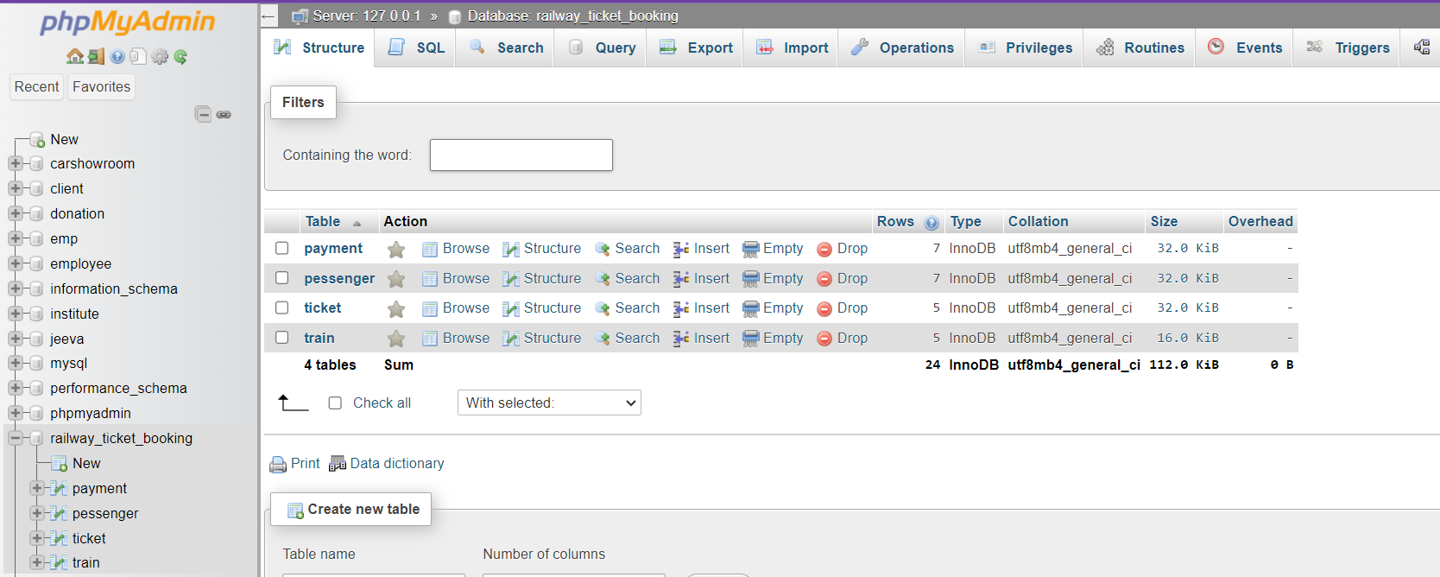
4.2 List of Tables:
Figure 4.2: List of tables.

Slide 21
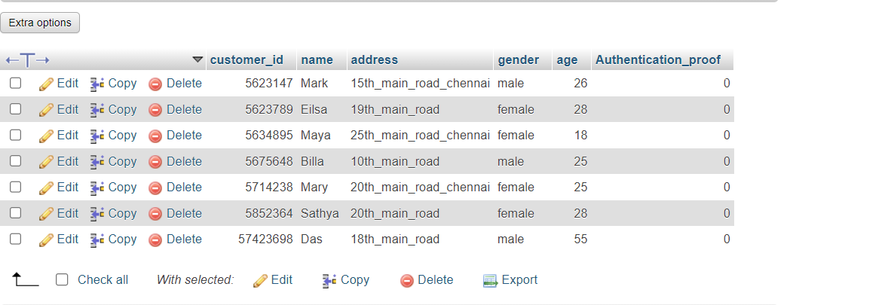
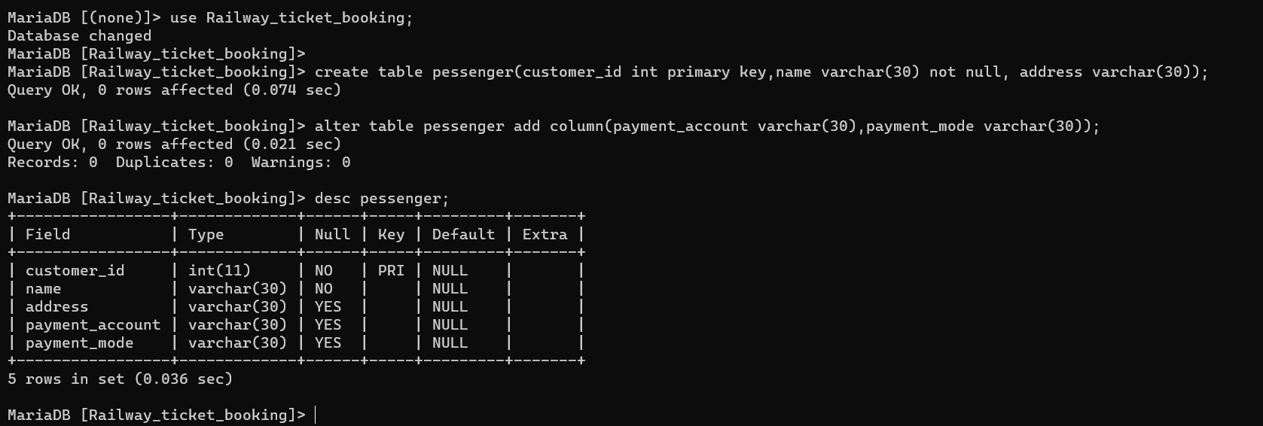
4.2.1 Passenger Table
Figure 4.1: Passenger Table

Slide 22
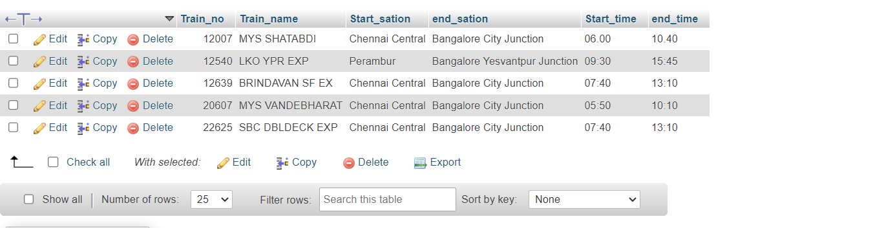
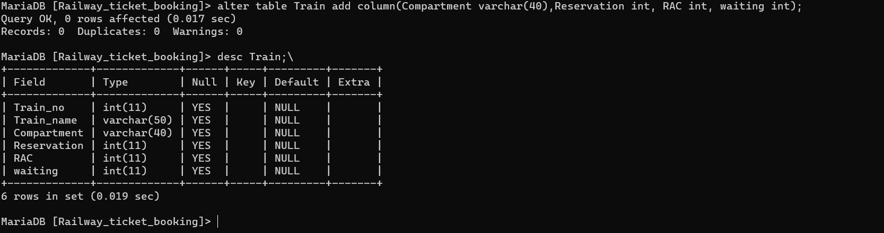
4.2.2 Train Table
Figure 4.2: Train Table

Slide 23
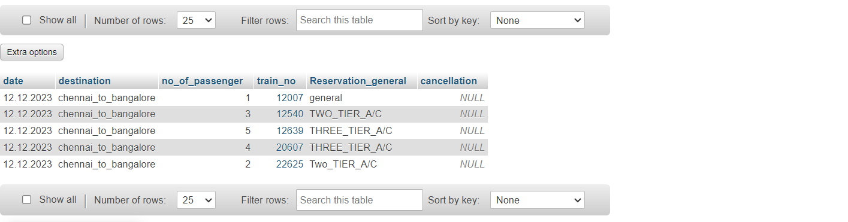
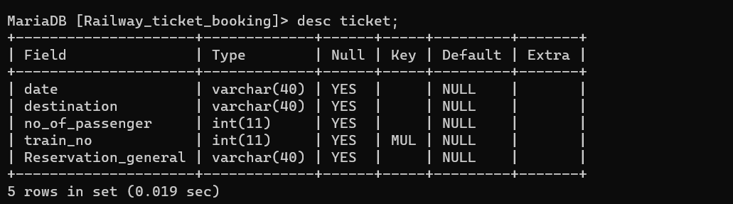
4.2.3 Ticket Table:
Figure 4.3: Ticket Table

Slide 24
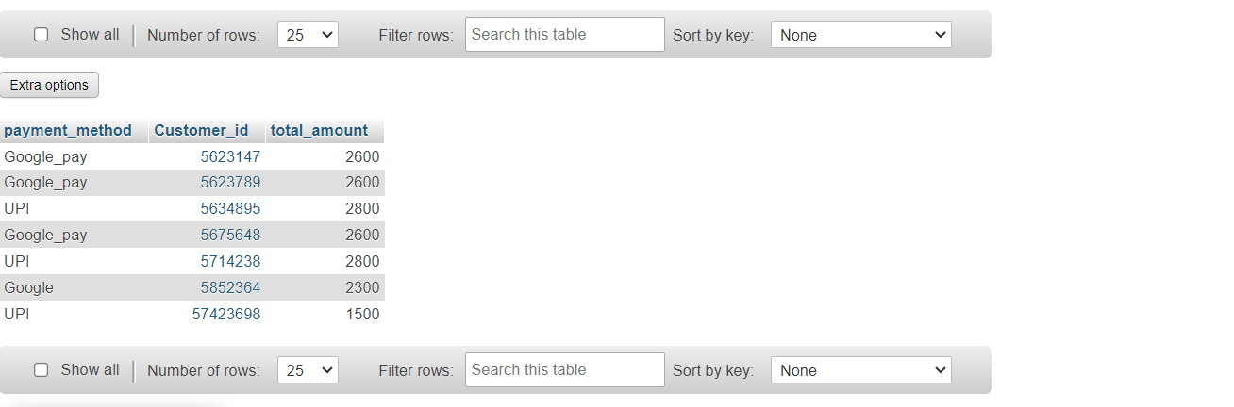
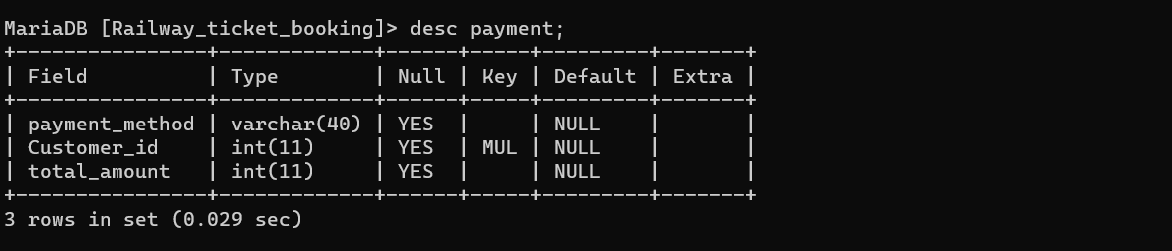
4.2.4 Payment Table
Figure 4.4: Payment Table

Slide 25
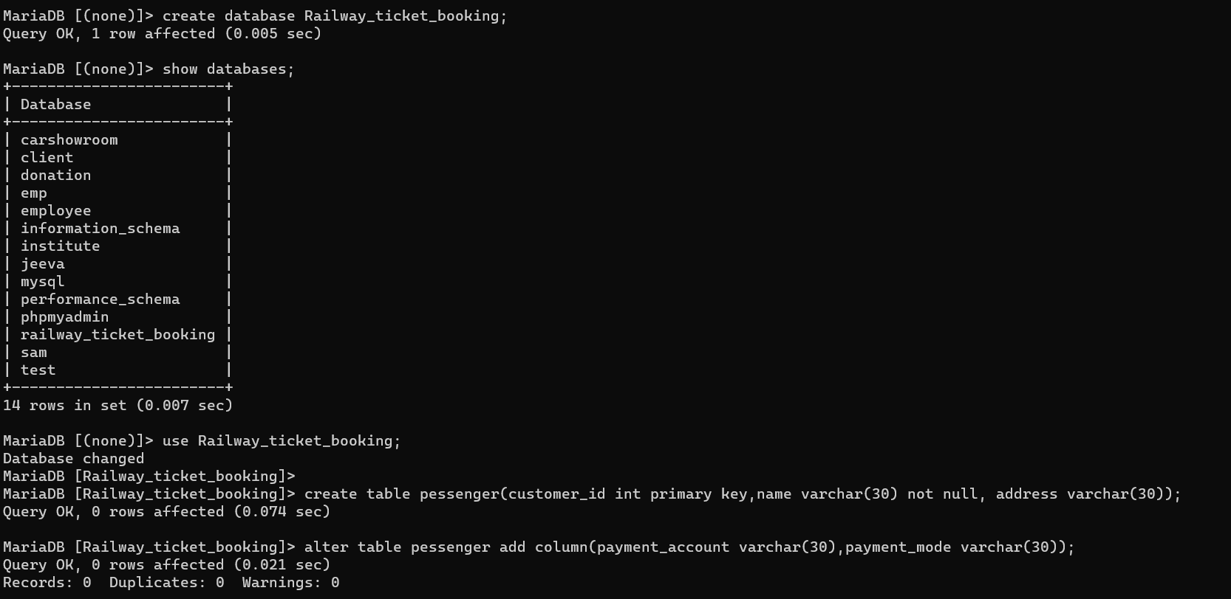
CHAPTER-05
Specification of Query
5.1 XAMPP server:

Slide 26
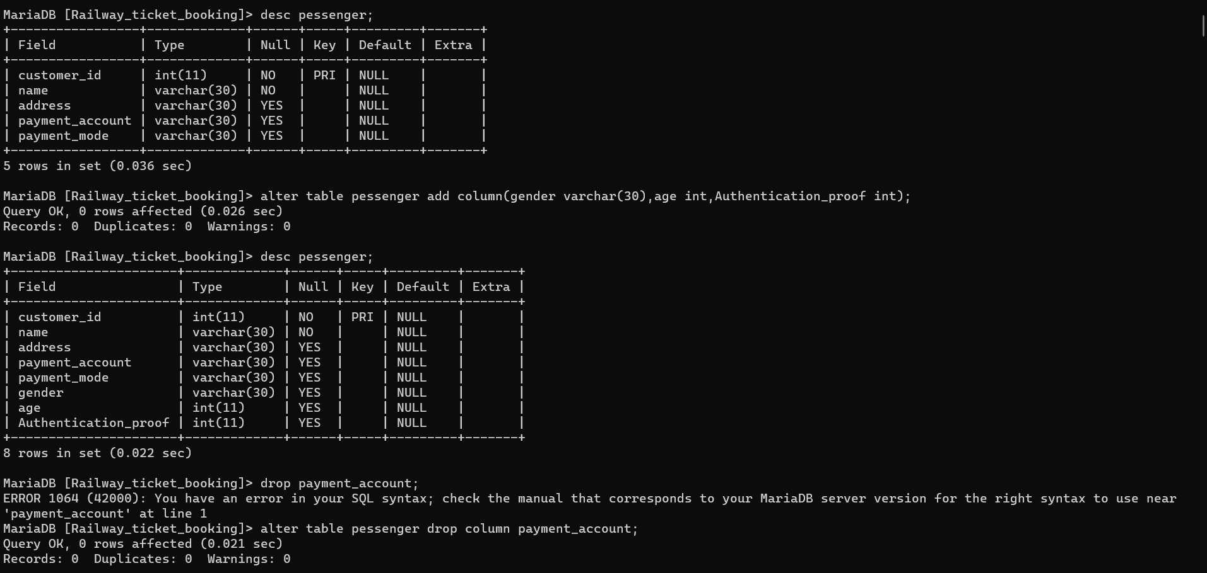

Slide 27
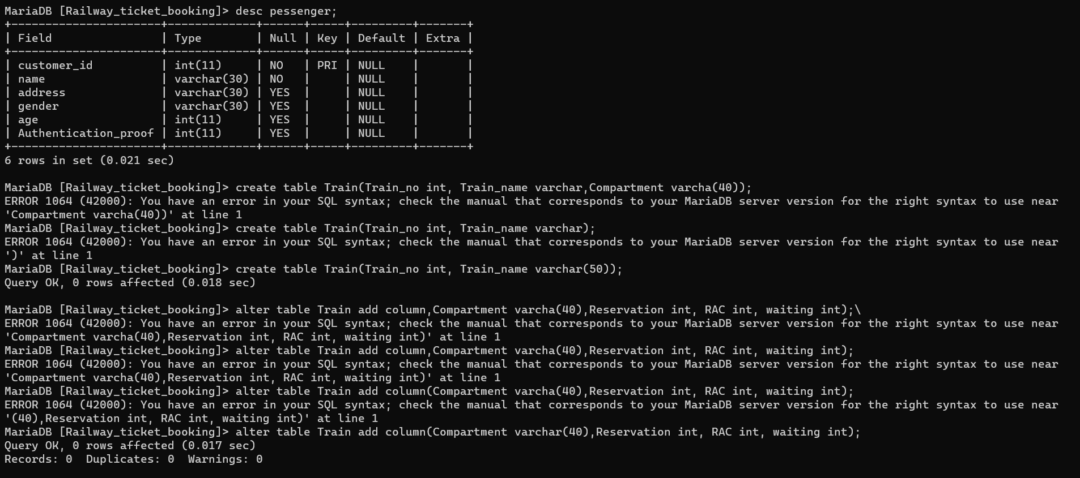

Slide 28
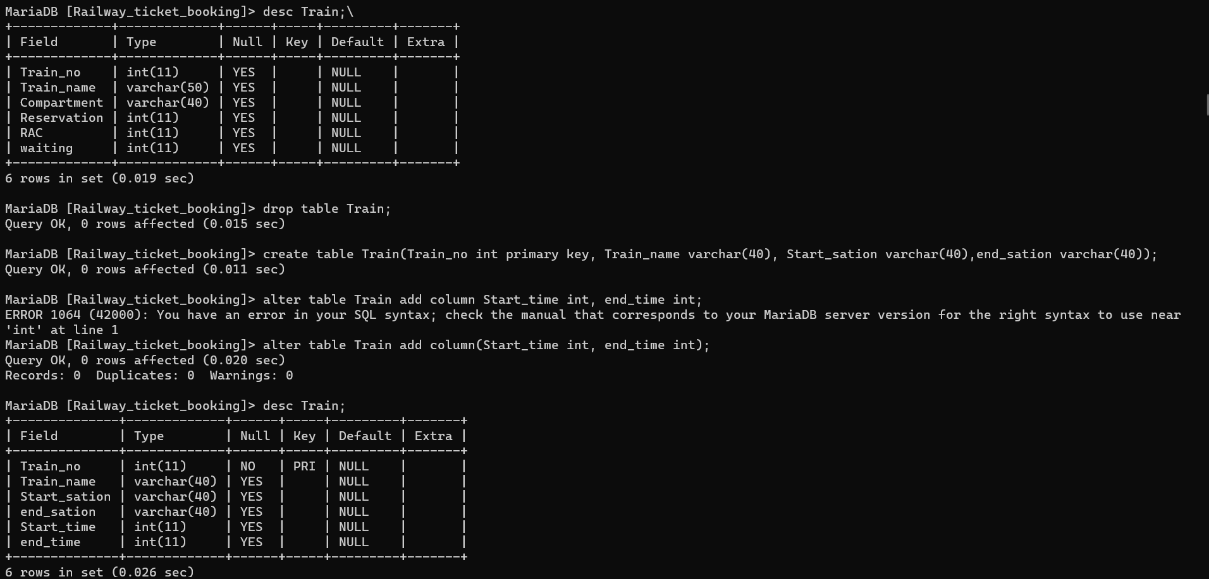
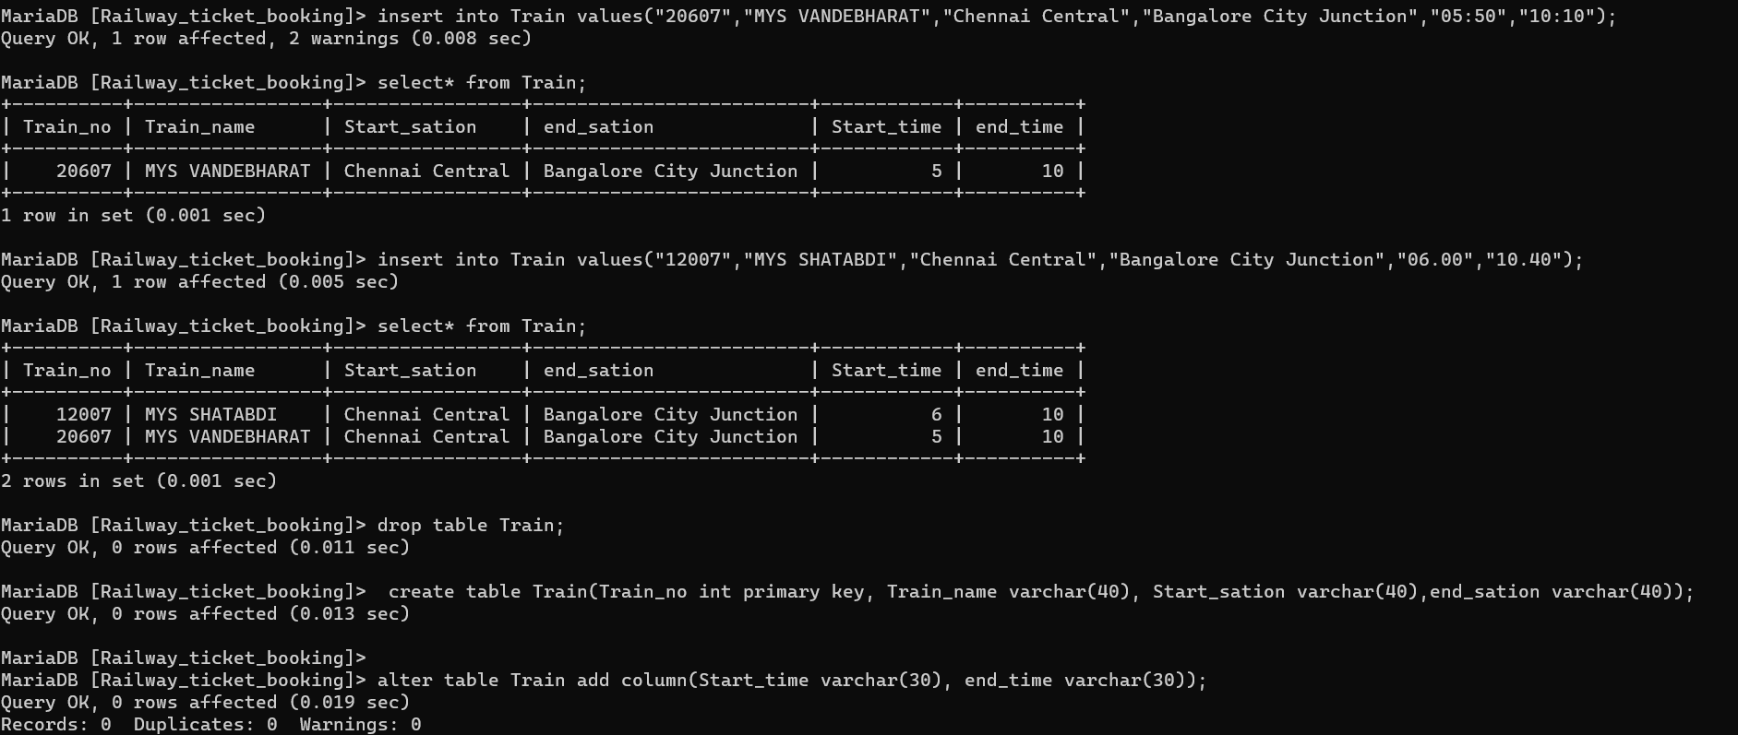

Slide 29
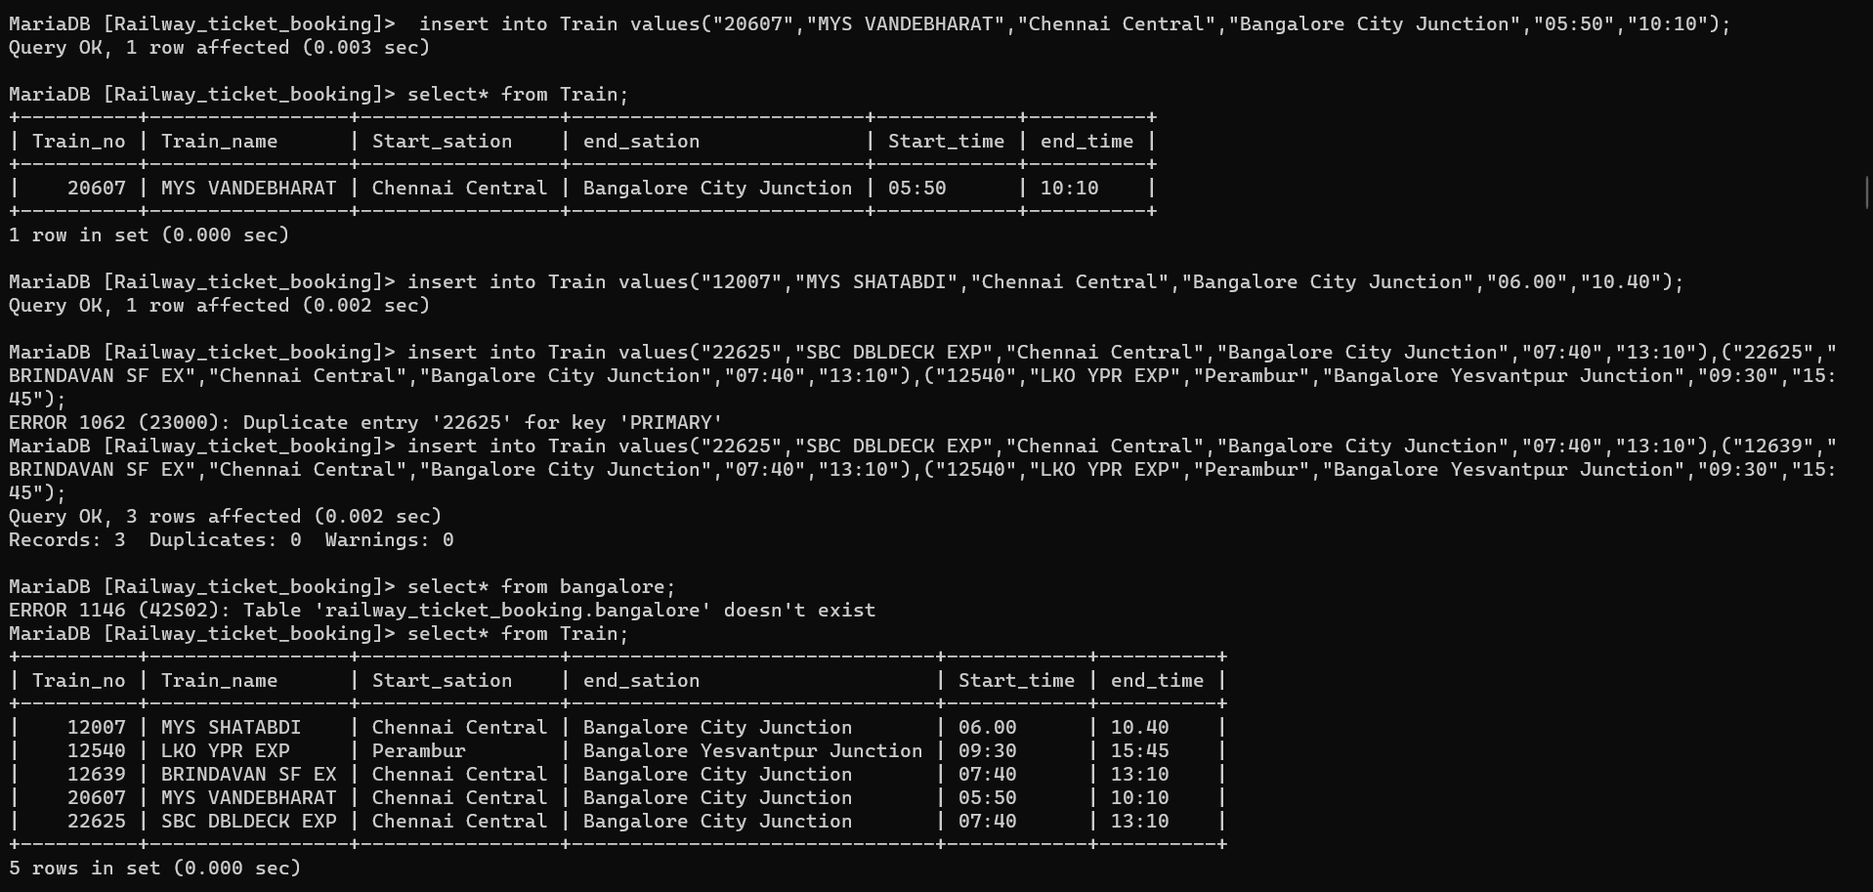
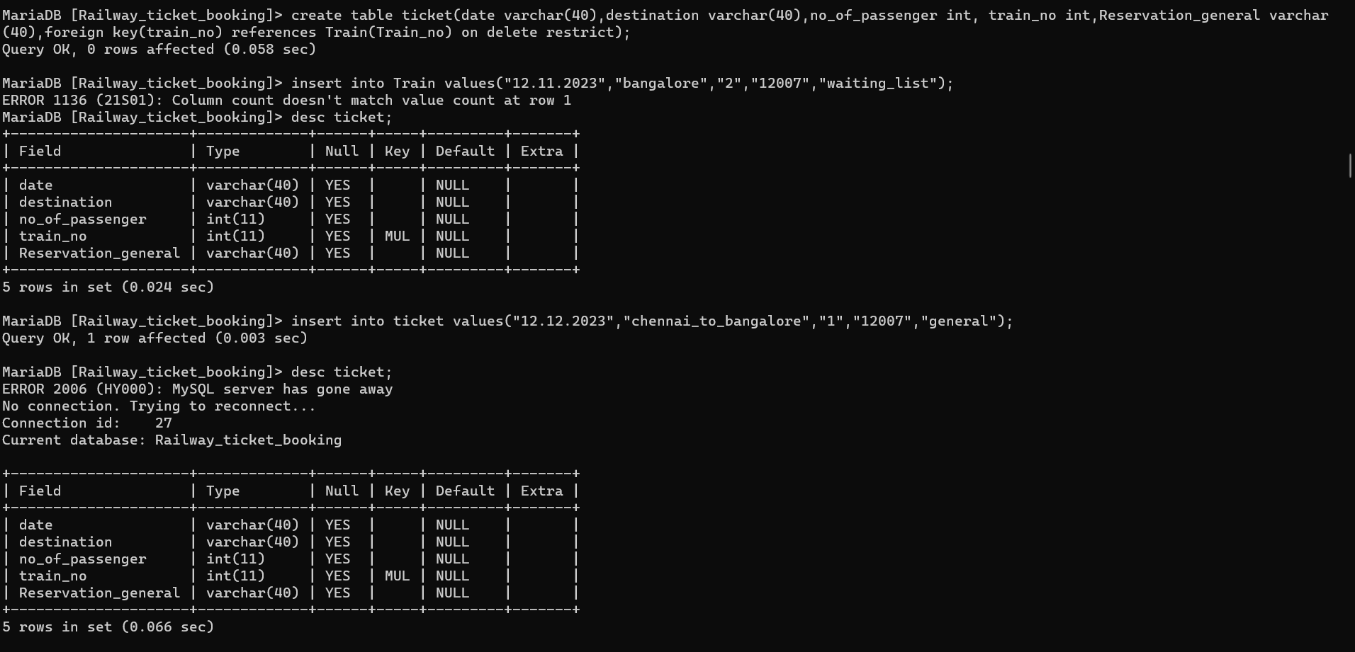

Slide 30
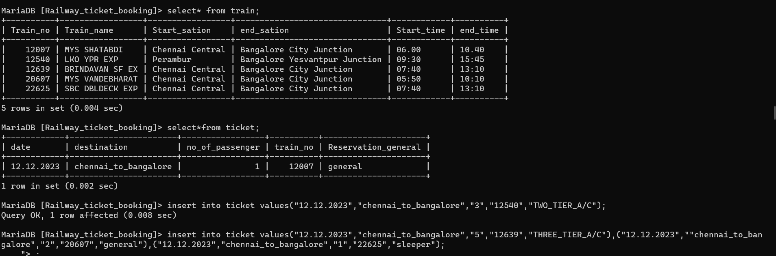
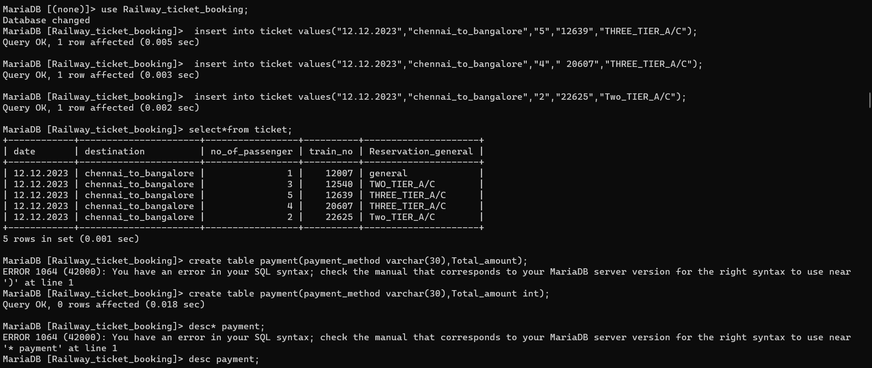
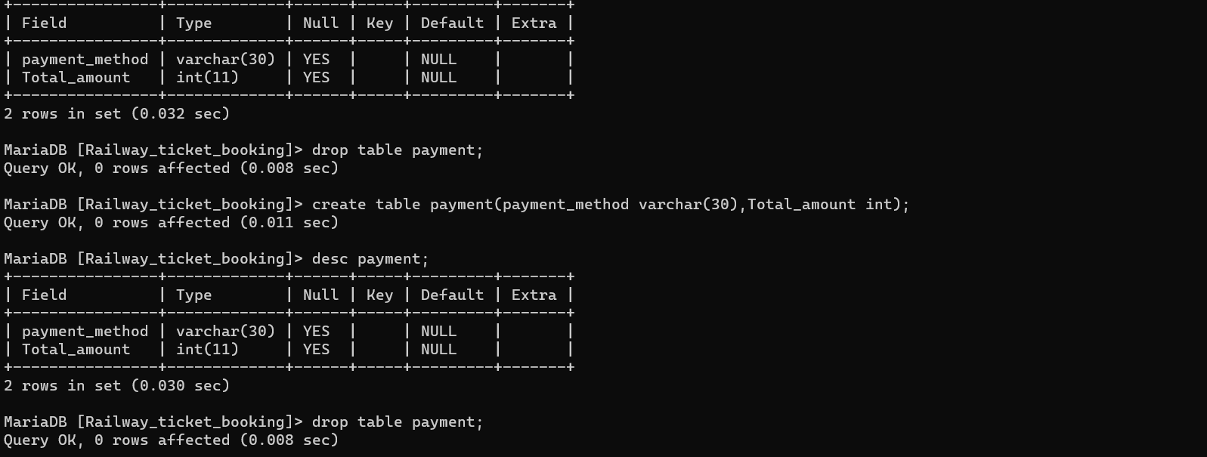

Slide 31
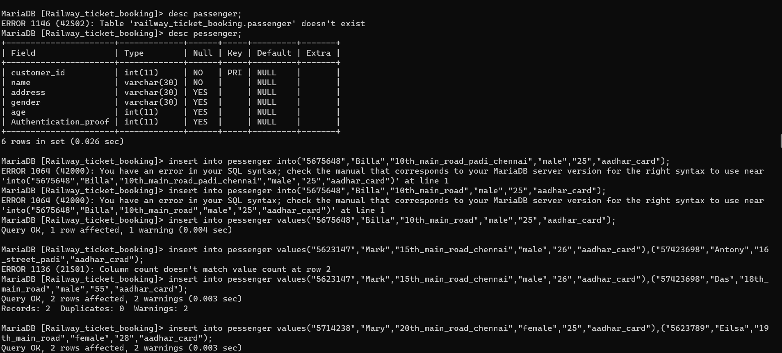
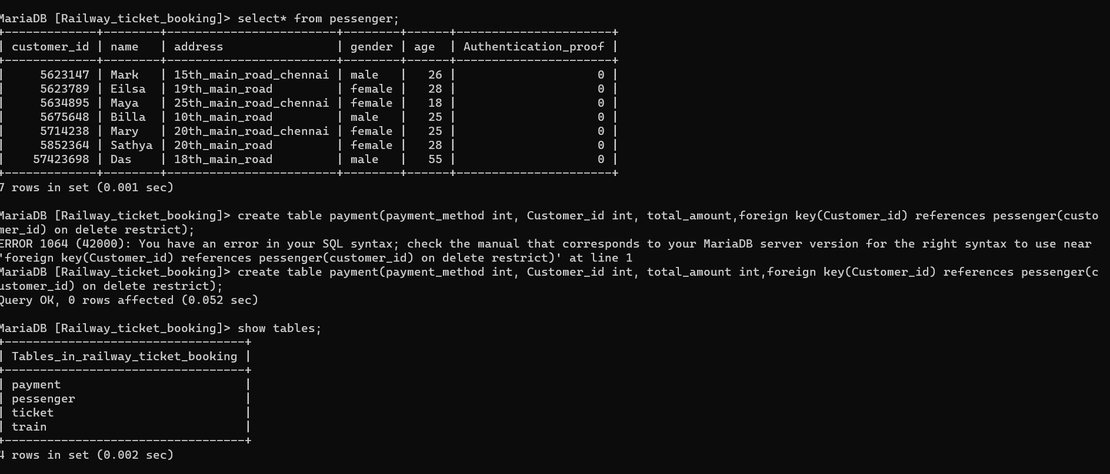

Slide 32
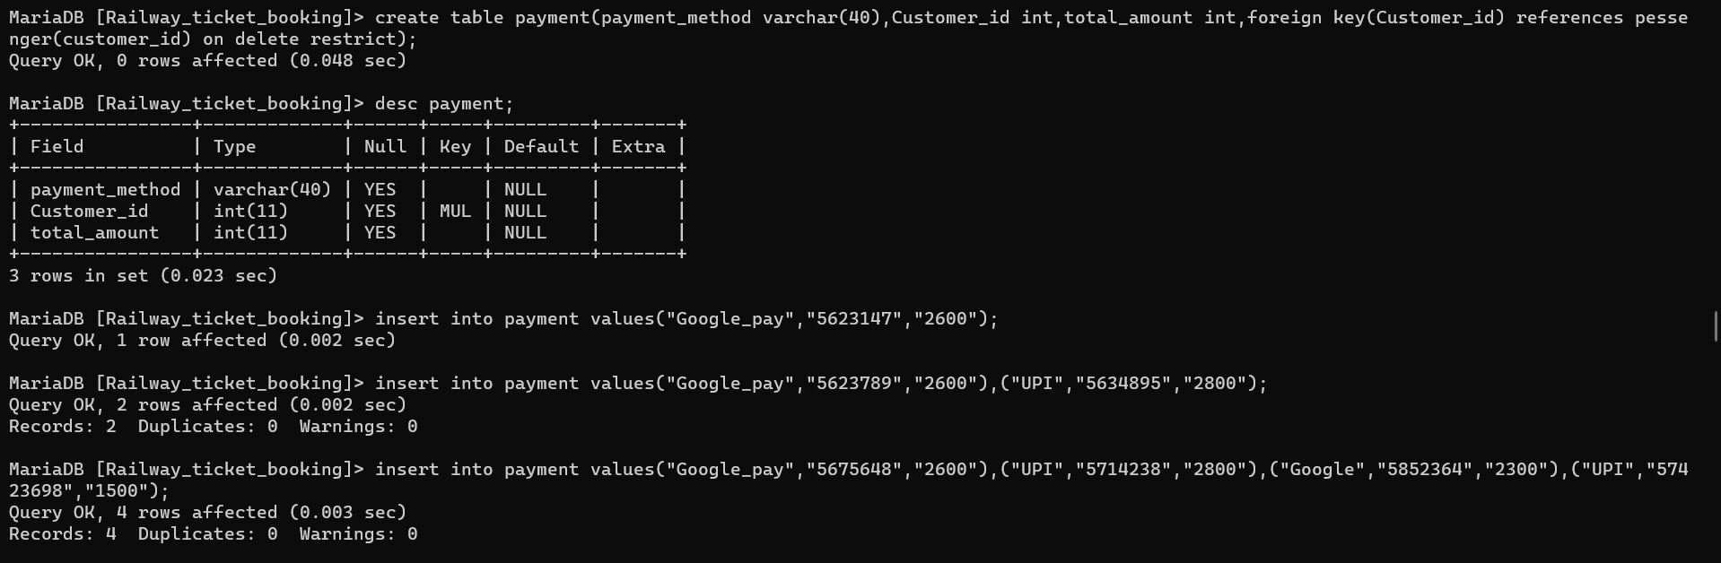
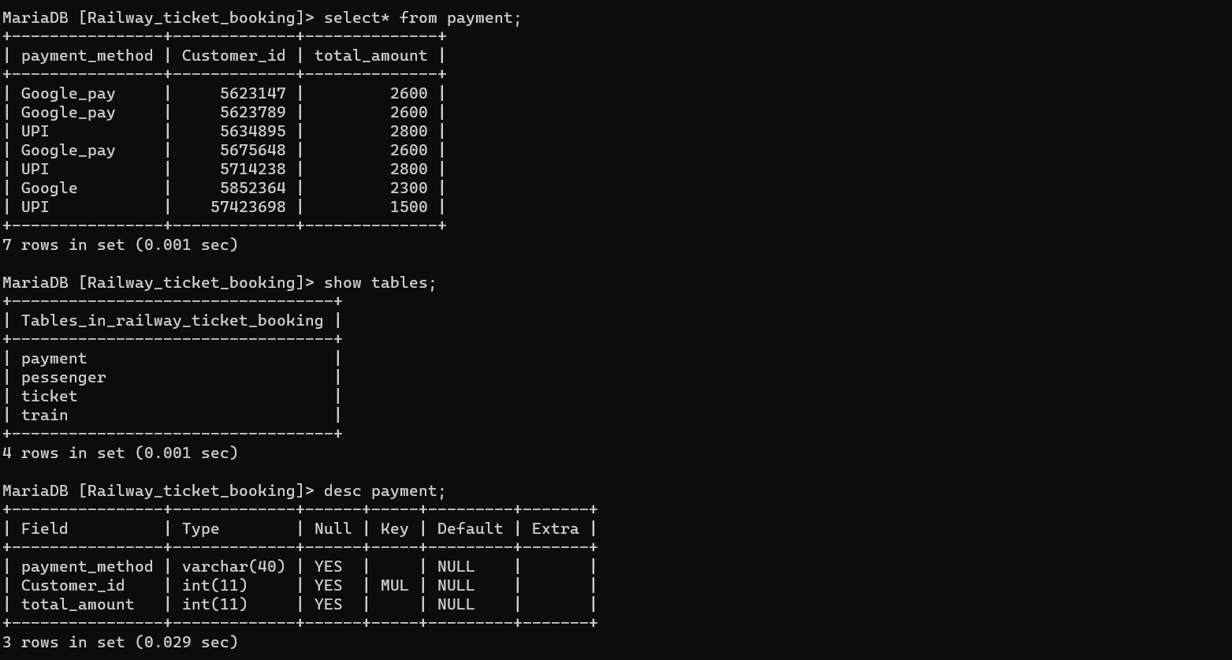

Slide 33
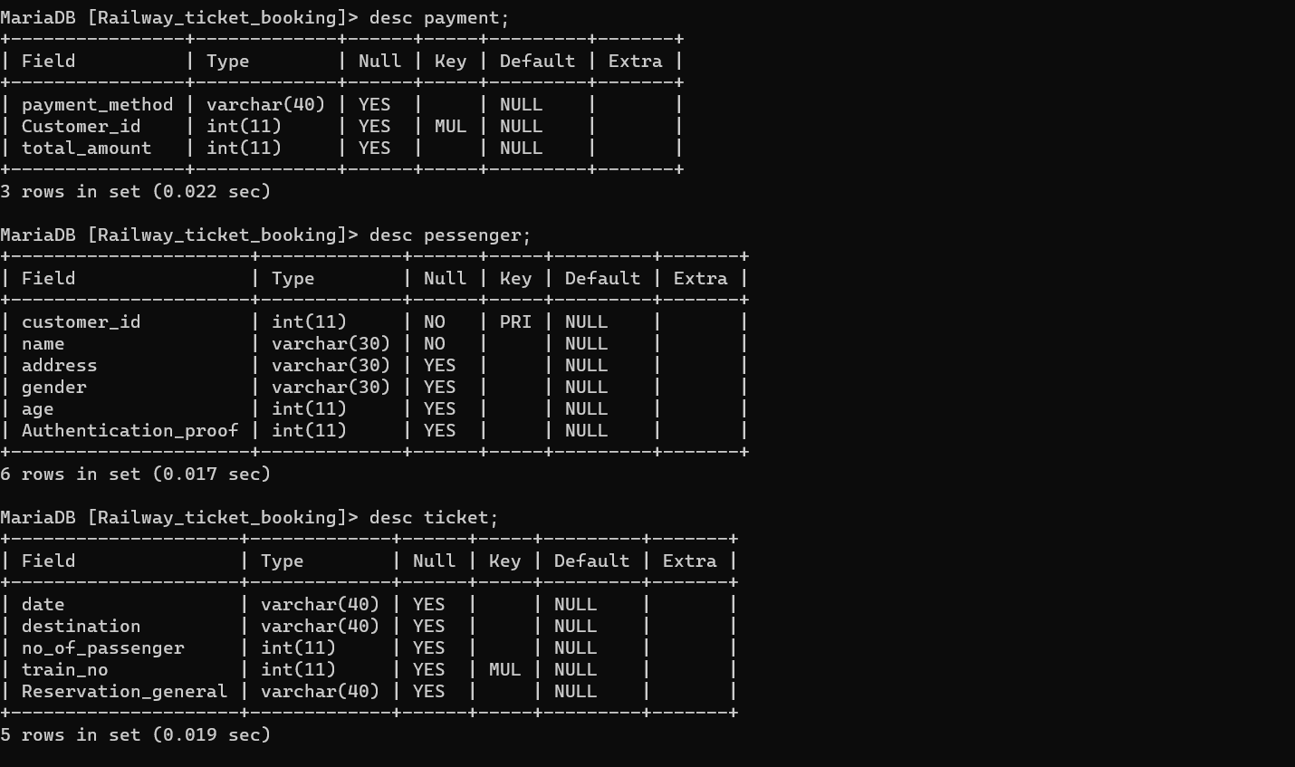
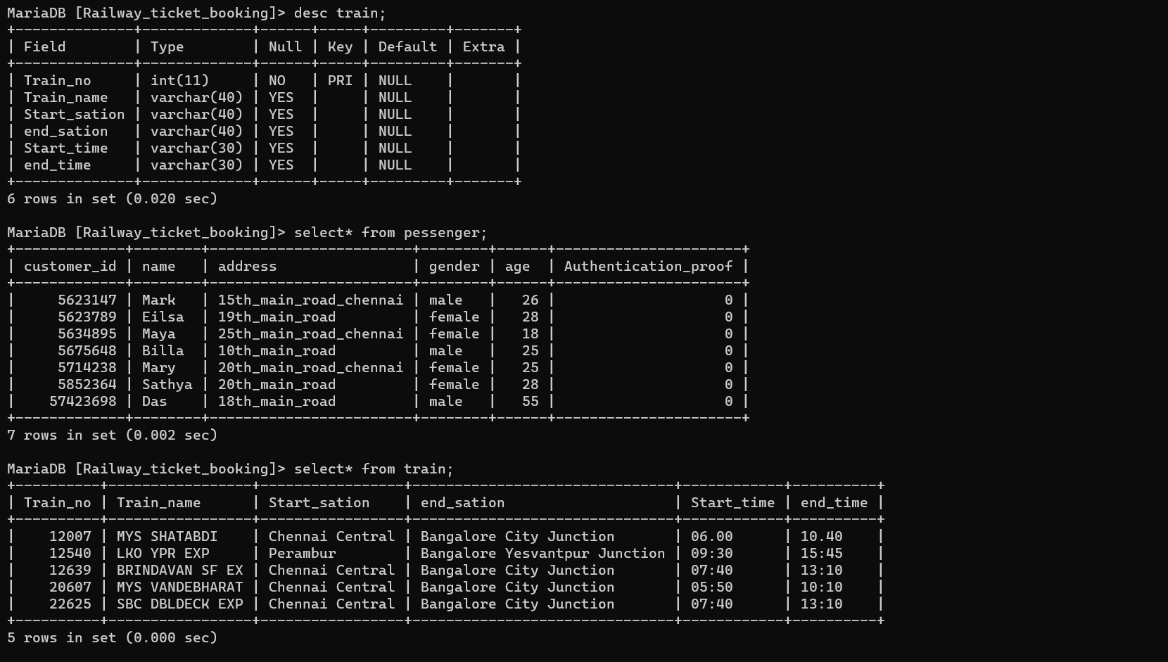

Slide 34
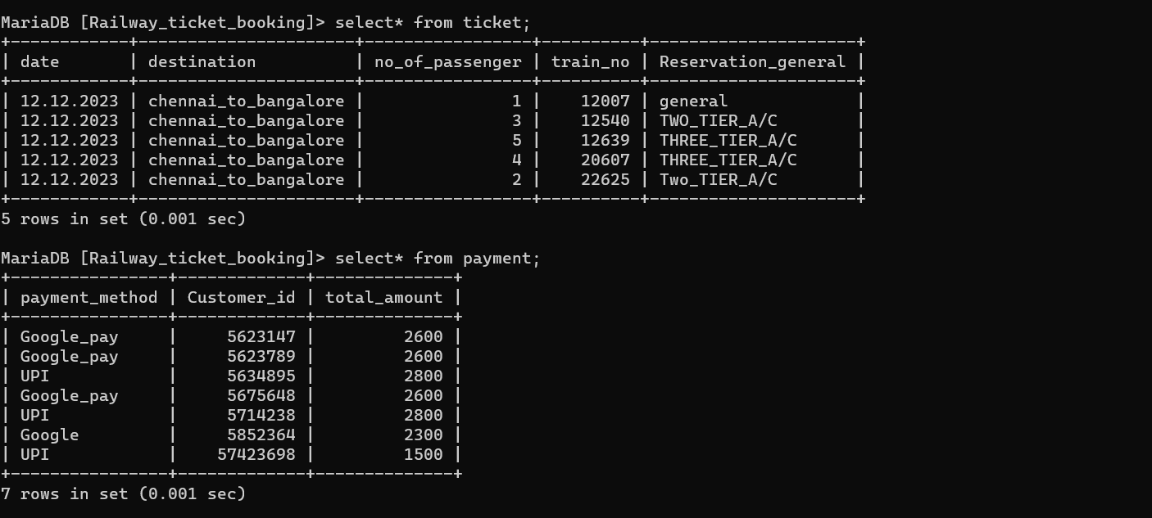

Slide 35
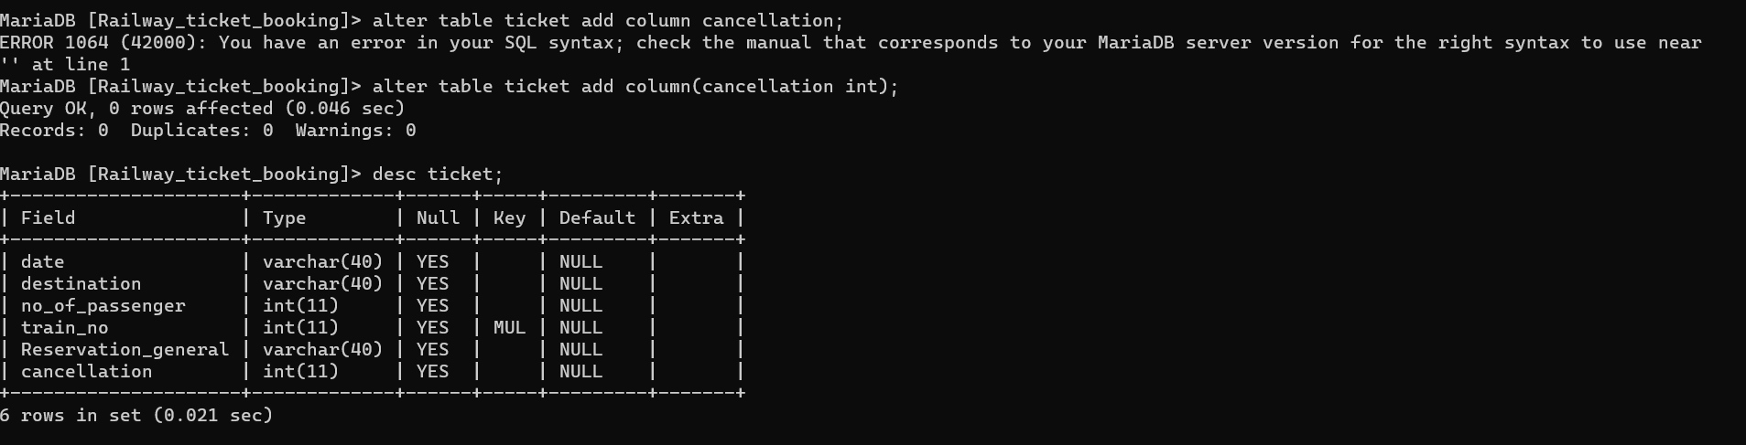

Slide 36
CHAPTER-06
6.1 Conclusions
The train is still the most cheap and reliable way for travelling in India. People can easily travel cities by avoiding any kinds of traffic jams. Beside these, train journey is comfortable due to the availabilities of sanitation, freedom of moving around and enjoying the nature. But, in our country. Let alone this advantage; In our country, we cannot even get the ticket in a proper way. By using this feature, people can arrange their time schedule to reach the train station and which is very easy to use and understand.

Slide 37
Appendix
Acronyms
DBMS= Database Management System
PHP=Personal Home Page (recursive acronym=Hypertext Preprocessor)
RDBMS= Relational database management system
SQL= Standard Query Language
XAMP= Operating system(X) for APACHE, MySQL, PHP and PERL

Slide 38
Reference:
[1] https://www.scribd.com/document/403234423/Er-Diagram-Railway-Reservation-System
[2] https://en.wikipedia.org/wiki/XAMPP
[3] PHP Tutorial (w3schools.com)
[4] Web browser - Wikipedia

