Slide 1
Towards scalable graphlet-adjacency counting

Slide 2
The problem

Slide 3
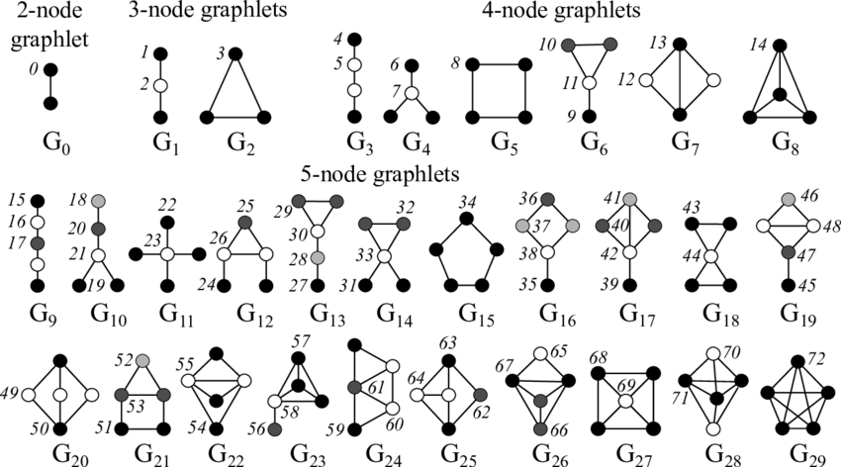
Brute Force Graphlet counting: Depth First Search (DFS)
b
e
a
c
f
d
“Simple” Dummy network H
Up to four node graphlets

Slide 4
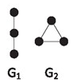
How many time does node A touch graphlets G1 and G2? -> DFS two ‘hops’ deep
b
e
Walk | G1 | G2
a – b – e | 1 | 0
Total
a
c
f
d
DFS on H: first walk from node a

Slide 5
How many time does node A touch graphlets G1 and G2?
b
e
Walk | G1 | G2
a – b – e | 1 | 0
a – b – f | 1 | 0
Total
a
c
f
d
DFS on H: second walk from node a

Slide 6
How many time does node A touch graphlets G1 and G2?
b
e
Walk | G1 | G2
a – b – e | 1 | 0
a – b – f | 1 | 0
a – c – f | 1 | 0
Total
a
c
f
d
DFS on H: third walk from node a

Slide 7
How many time does node A touch graphlets G1 and G2?
b
e
Walk | G1 | G2
a – b – e | 1 | 0
a – b – f | 1 | 0
a – c – f | 1 | 0
a – c – d | 0 | 1
Total
a
c
f
d
DFS on H: fourth walk from node a

Slide 8
How many time does node A touch graphlets G1 and G2?
b
e
Walk | G1 | G2
a – b – e | 1 | 0
a – b – f | 1 | 0
a – c – f | 1 | 0
a – c – d | 0 | 1
a – d – c | 0 | 1
Total
a
c
f
d
Same graphlet!
DFS on H: fifth walk from node a

Slide 9
We correct for over-visiting a posteriori
b
e
Walk | G1 | G2
a – b – e | 1 | 0
a – b – f | 1 | 0
a – c – f | 1 | 0
a – c – d | 0 | 1
a – d – c | 0 | 1
Total | 2/1 | 2 / 2
a
c
f
d
Over-visit
correction
constant
DFS on H: from node ‘a’

Slide 10
Over-visiting also occurs between isomorphic orbits
a
c
d
b
e
Walk | G1 | G2
a – b – e | 1 | 0
a – b – f | 1 | 0
a – c – f | 1 | 0
a – c – d | 0 | 1
a – d – c | 0 | 1
Total | 2/1 | 2 / 2
Walk | G1 | G2
c – a – b | 1 | 0
c – a – d | 0 | 1
c – d – a | 0 | 1
c – f – b | 1 | 0
Total | 2/1 | 2 / 2
Walk | G1 | G2
d – a – b | 1 | 0
d – a – c | 0 | 1
d – c – a | 0 | 1
d – c – f | 1 | 0
Total | 2/1 | 2 / 2
a
c
f
d
Dummy network H
DFS from a
DFS from c
DFS from d
PROBLEM: triangle {a,c,d} is visited SIX times

Slide 11
DFS: time complexity is O(nd²) for three-node graphlets
1st neighbors
2nd neighbors
Notation:
n: number of nodes in the graph
d: the max degree in the graph
b
e
TIME COMPLEXITY ANALYSIS:
a has at most d 1st neighbors
each 1st neighbor has at most d neighbors
-> DFS from a two hops deep takes O(d²) time
-> DFS for the network takes O(nd²) time
-> O(nd³) time for four node graphlets
a
c
f
d

Slide 12
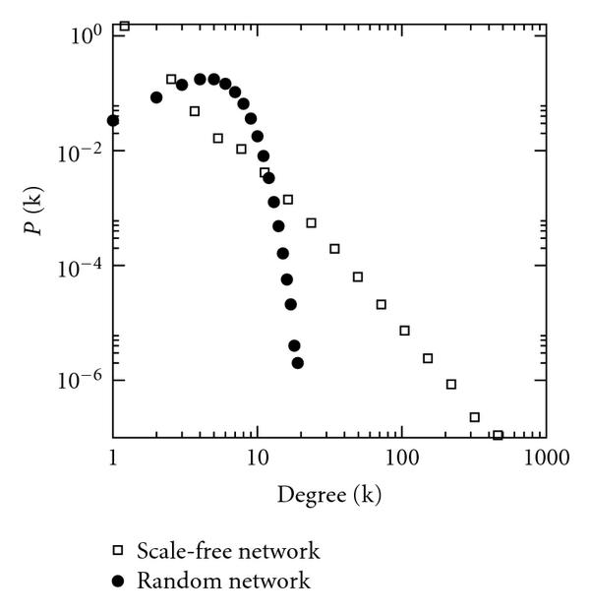
O(nd³) complexity is problematic for real networks

Slide 13
Problem
The current counter is to slow as it is a basic DFS
Time complexity is O(nd³) for four-node graphlets
Lots of overcounting
Lots of room for improvement:
human PPI takes a day, ORCA finishes in 4 seconds
Human COEX takes a week, ORCA finishes in 10 minutes
The current counter uses too much memory:
Given a graph of n nodes, it uses O(14n²) memory. (1 matrix per orbit)
Human PPI and COEX use 100+GB.

Slide 14
Strategies to speed up subgraph counting
Less computations
Redundancy equations = Avoid brute-force DFS all 4-node graphlets
Add graph orientation = Limit search space via Directed DFS = lowers d in O(nd³)
Avoid over-visiting = O(nd³/#over-visit-correction)
Graph coloring = Avoid exhausted searches = dynamically lowers d in O(nd³)
…
Add computational power
CPU-based parallelization
GPU-based parallelization
Distributed computing

Slide 15
Strategies to speed up subgraph counting
Less computations
Redundancy equations
Graph orientation
Avoid over-visiting
Graph coloring
…
Add computational power
CPU-based parallelization
GPU-based parallelization
Distributed computing

Slide 16
The state-of-the-art
Redundancy equation based

Slide 17
Orca (2014)
 | year | Counts | level | Brute Force | Count inferencing
ORCA | 2014 | orbits | node | G8 (clique) | System of equations
^{Method} |  | DFS | DFS | Infer | Infer | Infer | Infer | Infer | DFS
Complexity |  | O(nd²) | O(nd²) | O(nd²) | O(nd²) | O(nd²) | O(nd²) | O(nd²) | O(nd³)

Slide 18
PGD (2015)
 | year | Counts | level | Brute Force | Count inferencing
ORCA | 2014 | orbits | node | G8 (clique) | System of equations
PDG | 2015 | Connected and disconnected Graphlets | network | G8 (clique) and G4 (cycle) | Individual equations
Method |  | DFS | DFS | Infer | Infer | DFS | Infer | Infer | DFS
Complexity |  | O(nd²) | O(nd²) | O(nd²) | O(nd²) | O(nd³) | O(nd²) | O(nd²) | O(nd³)

Slide 19
ESCAPE (2017)
 | year | Counts | level | Brute Force | Count inferencing
ORCA | 2014 | orbits | node | G8 (clique) | System of equations
PGD | 2015 | Connected and disconnected graphlets | network | G8 (clique) and G4 (cycle) | Individual equations
ESCAPE | 2017 | Non-induced subgraphs | network | G8 (clique) and G4 (cycle) | Individual equations
Method |  | DDFS | DDFS | Infer | Infer | DDFS | Infer | Infer | DDFS
Complexity |  | O(nd²) | O(nd²) | O(nd²) | O(nd²) | < O(nd³) | O(nd²) | O(nd²) | < O(nd³)

Slide 20
The state-of-the art
 | year | Counts | level | Brute Force | Count inferencing
ORCA | 2014 | orbits | node | G8 (clique) | System of equations
PGD | 2015 | Connected and disconnected graphlets | network | G8 (clique) and G4 (cycle) | Individual equations
ESCAPE | 2017 | Non-induced subgraphs | network | G8 (clique) and G4 (cycle) | Individual equations
EVOKE | 2020 | Orbits of non-induced subgraphs | network | G8 (clique) and G4 (cycle) | Individual equations
The state-of-the-art is hard to evaluate:
Is it the definition of a graphlet, the equations or the brute force algorithm that make it faster?
Comparisons are lacking:
PGD does not compare to ORCA
ESCAPE and EVOKE compare to PGD but their problem is much easier

Slide 21
State-of-the-art take-aways:
Use the ORCA/PGD system of equations to infer graphlet/orbit counts
Brute force count graphlets/orbits that can be solved with Directed Breadth First Search to limit traversal and overcounting
None of the counters using redundancy equations uses graph coloring, yet

Slide 22
Graphlet adjacency counter design
Method |  | DDFS | DDFS | hybrid | Infer | Infer | Infer | DDFS | DDFS
Complexity |  | O(nd²) | O(nd²) | < O(nd³) | O(nd²) | O(nd²) | O(nd²) | <O(nd³) | <O(nd³)

Slide 23
Graphlet adjacency counter: progress report
Method |  | DDFS | DDFS | DDFS | Infer | Infer | Infer | Infer | DDFS
complexity |  | O(nd²) | O(nd²) | O(nd³) | O(nd²) | O(nd²) | O(nd²) | O(nd²) | O(nd³)
implemented |  | V | V | X | X | x | X | In python | V
+ the redundancy equations are defined

Slide 24
Contribution
Software:
Graphlet-adjacency counter
Algorithmic:
Adjacency-based redundancy equations (generalizing ORCA’s)
Generalizing DDFS*:
From G5 (cycle) and G8 (clique) counting,
to G3 (four node path) and G7 (chord cycle) counting.

Slide 25
Next steps
Software:
1a. Combine orbit-adjacency equations into graphlet-adjacency equations ?
1b. Implement the brute force counters in C
2. Implement the redundancy equations
3. Implement hybrid approach for G3
Analysis:
Create a benchmark dataset
Install relevant state of the art
Reporting:
Present adjacency equations
Present graph-orientation-based counting (DDFS)
Paper:
Start organising background section
Write redundancy equations digitally

Slide 26
Graph orientation
b
e
b
e
a
c
f
a
c
f
d
d
“Simple” Dummy network H
H’: the alphabetically oriented graph of H
Graph orientation: assigning a direction to each edge based on some node ordering (alphabet, degree, core number).
Degree ordering: a < b if degree(a) < degree(b). So there is an edge: a->b
Benefits:
The max in-degree or out degree in H’ is < the max degree in H
H’ is a directed acyclic graph (DAG)

Slide 27
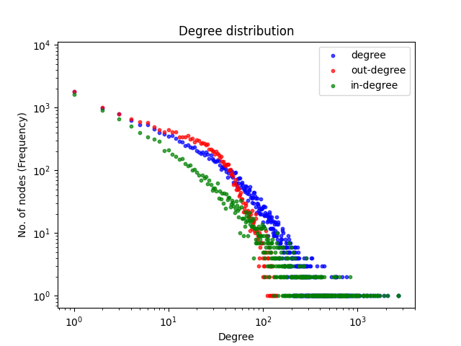
Impact on ‘d’: human PPI degree distribution
 | Degree | Out-degree | In-degree
max | 2.717 (d) | 137 (d+) | 2.717 (d-)
median | 228 | 66 | 207
=> Traverse H’ as much as possible on out-edges

Slide 28
Types of directed wedges (3-node paths)
out-out wedge
In-Out wedge
Out-In wedge

Slide 29
Time complexity counting directed wedges
a
b
c
O(nd⁺d⁺)
in-out wedge
b
a
c
O(nd⁺d⁺) (avoid overcounting: c > b)
out-Out wedge
a
b
c
O(nd⁺d⁻) (avoid overcounting: a < c)
In-in wedge
Overall time complexity to count all wedges = O(nd⁺d⁺) + O(nd⁺d⁺) + O(nd⁺d⁻) < O(nd²)

Slide 30
There is only only one type of acyclic triangle

Slide 31
Three ways of counting triangles
Extending out-out wedge
Extending in-out wedge
Extending in-in wedge
b
b
b
?
a
a
a
?
c
?
c
c

Slide 32
Counting triangles is fast
Extending out-out wedge
Extending in-out wedge
Extending in-in wedge
b
b
c
?
a
a
b
?
c
?
c
a
O(n(d⁺d⁺/2))
^{Avoid overcounting (c > b)}
O(nd⁺d⁺)
O(nd⁺d⁻)

Slide 33
Types of four-node acyclic cycles

Slide 34
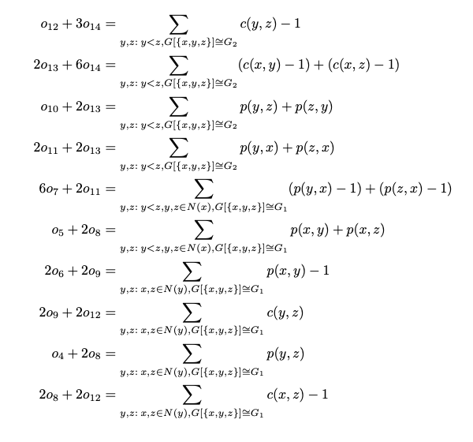
ORCA redundancy equations for 4 node graphlets

Slide 35

How to read a ORCA redundancy equation
The number of times node x touches o12 and 3o14
The number of times Y, Z form a triangle (graphlet G2) -1
Iterate over all triangles including x
13
14
y
12
x
?
G7
G8
z
The number of time x touches o12 or three times the number of times x touches o14 = the number of shared neighbors of y and z

Slide 36
How redundancy equations are applied
Precomputed
Iterate triangles including x
system of equations:
Precomputed
13
14
12
G7
G8

