Slide 1
Towards scalable graphlet-adjacency counting

Slide 2
The problem

Slide 3
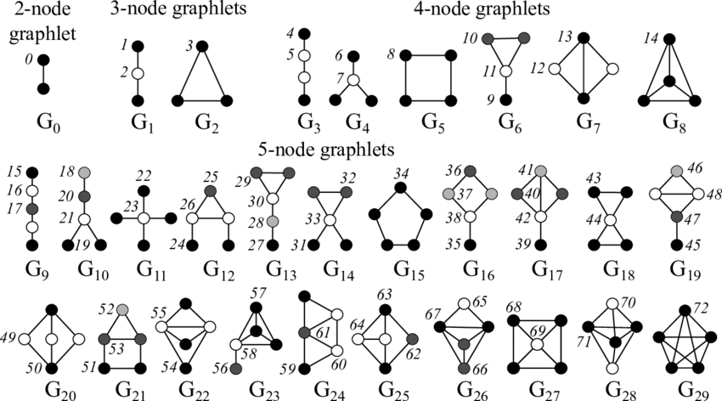
Brute Force Graphlet counting: Depth First Search (DFS)
b
e
a
c
f
d
“Simple” Dummy network H
Up to four node graphlets

Slide 4
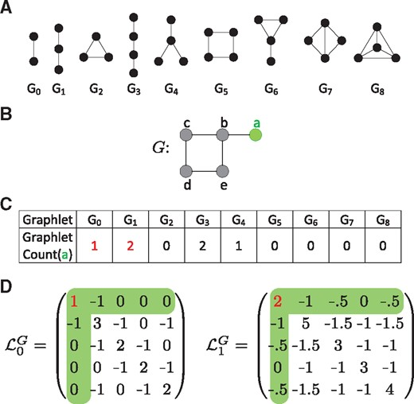
How many time does node A touch graphlets G1 and G2? -> DFS two ‘hops’ deep
b
e
Walk | G1 | G2
a – b – e | 1 | 0
Total
a
c
f
d
DFS on H: first walk from node a

Slide 5
How many time does node A touch graphlets G1 and G2?
b
e
Walk | G1 | G2
a – b – e | 1 | 0
a – b – f | 1 | 0
Total
a
c
f
d
DFS on H: second walk from node a

Slide 6
How many time does node A touch graphlets G1 and G2?
b
e
Walk | G1 | G2
a – b – e | 1 | 0
a – b – f | 1 | 0
a – c – f | 1 | 0
Total
a
c
f
d
DFS on H: third walk from node a

Slide 7
How many time does node A touch graphlets G1 and G2?
b
e
Walk | G1 | G2
a – b – e | 1 | 0
a – b – f | 1 | 0
a – c – f | 1 | 0
a – c – d | 0 | 1
Total
a
c
f
d
DFS on H: fourth walk from node a

Slide 8
How many time does node A touch graphlets G1 and G2?
b
e
Walk | G1 | G2
a – b – e | 1 | 0
a – b – f | 1 | 0
a – c – f | 1 | 0
a – c – d | 0 | 1
a – d – c | 0 | 1
Total
a
c
f
d
Same graphlet!
DFS on H: fifth walk from node a

Slide 9
We correct for over-visiting a posteriori
b
e
Walk | G1 | G2
a – b – e | 1 | 0
a – b – f | 1 | 0
a – c – f | 1 | 0
a – c – d | 0 | 1
a – d – c | 0 | 1
Total | 2/1 | 2 / 2
a
c
f
d
Over-visit
correction
constant
DFS on H: from node ‘a’

Slide 10
Over-visiting also occurs between isomorphic orbits
a
c
d
b
e
Walk | G2
a – b – e | 0
a – b – f | 0
a – c – f | 0
a – c – d | 1
a – d – c | 1
Total | 2 / 2
Walk | G2
c – a – b | 0
c – a – d | 1
c – d – a | 1
c – f – b | 0
Total | 2 / 2
Walk | G2
d – a – b | 0
d – a – c | 1
d – c – a | 1
d – c – f | 0
Total | 2 / 2
a
c
f
d
Dummy network H
DFS from a
DFS from c
DFS from d
PROBLEM: triangle {a,c,d} is visited SIX times

Slide 11
DFS: time complexity is O(nd³) for four-node graphlets
1st neighbors
2nd neighbors
Notation:
n: number of nodes in the graph
d: the max degree in the graph
b
e
TIME COMPLEXITY ANALYSIS:
a has at most d 1st neighbors
each 1st neighbor has at most d neighbors
-> DFS from a two hops deep takes O(d²) time
-> DFS for the network takes O(nd²) time
-> O(nd³) time for four node graphlets
a
c
f
d

Slide 12
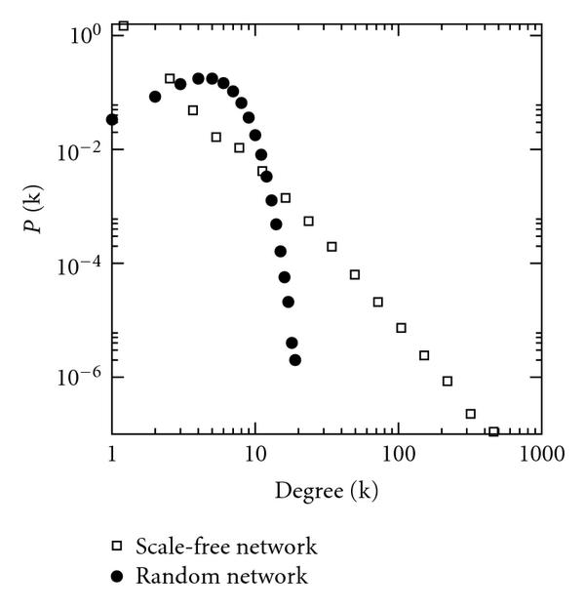
O(nd³) complexity is problematic for real networks

Slide 13
Problem
The current counter is to slow as it is a basic DFS
Time complexity is O(nd³) for four-node graphlets
Lots of overcounting
Lots of room for improvement:
human PPI takes a day, ORCA finishes in 4 seconds
Human COEX takes a week, ORCA finishes in 10 minutes
The current counter uses too much memory:
Given a graph of n nodes, it uses O(14n²) memory. (1 matrix per orbit)
Human PPI and COEX use 100+GB.

Slide 14
The state-of-the-art
Redundancy equation based

Slide 15
Orca (2014)
 | year | Counts | level | Brute Force | Count inferencing
ORCA | 2014 | orbits | node | G8 (clique) | System of equations
^{Method} |  | DFS | DFS | Infer | Infer | Infer | Infer | Infer | DFS
Complexity |  | O(nd²) | O(nd²) | O(nd²) | O(nd²) | O(nd²) | O(nd²) | O(nd²) | O(nd³)

Slide 16
PGD (2015)
 | year | Counts | level | Brute Force | Count inferencing
ORCA | 2014 | orbits | node | G8 (clique) | System of equations
PDG | 2015 | Connected and disconnected Graphlets | network | G8 (clique) and G4 (cycle) | Individual equations
Method |  | DFS | DFS | Infer | Infer | DFS | Infer | Infer | DFS
Complexity |  | O(nd²) | O(nd²) | O(nd²) | O(nd²) | <O(nd³) | O(nd²) | O(nd²) | <O(nd³)

Slide 17
ESCAPE (2017)
 | year | Counts | level | Brute Force | Count inferencing
ORCA | 2014 | orbits | node | G8 (clique) | System of equations
PGD | 2015 | Connected and disconnected graphlets | network | G8 (clique) and G4 (cycle) | Individual equations
ESCAPE | 2017 | Non-induced subgraphs | network | G8 (clique) and G4 (cycle) | Individual equations
Method |  | DDFS | DDFS | Infer | Infer | DDFS | Infer | Infer | DDFS
Complexity |  | O(nd²) | O(nd²) | O(nd²) | O(nd²) | < O(nd³) | O(nd²) | O(nd²) | < O(nd³)

Slide 18
The state-of-the art
 | year | Counts | level | Brute Force | Count inferencing
ORCA | 2014 | orbits | node | G8 (clique) | System of equations
PGD | 2015 | Connected and disconnected graphlets | network | G8 (clique) and G4 (cycle) | Individual equations
ESCAPE | 2017 | Non-induced subgraphs | network | G8 (clique) and G4 (cycle) | Individual equations
EVOKE | 2020 | Orbits of non-induced subgraphs | network | G8 (clique) and G4 (cycle) | Individual equations
The state-of-the-art is hard to evaluate:
Is it the (1) definition of a “graphlet”, (2) the equations or (3) the brute force algorithm that make it faster?
Comparisons are lacking:
PGD does not compare to ORCA
ESCAPE and EVOKE compare to PGD but their problem is much easier

Slide 19
State-of-the-art take-aways:
Use the ORCA/PGD system of equations to infer graphlet/orbit counts
Use Directed DFS to limit graph traversal and avoid overcounting
Brute force counting 2 graphlets simplifies solving redundancy equations
No one combines node coloring and redundancy equations yet

Slide 20
Strategies to speed up subgraph counting
Less computations
Redundancy equations = Avoid brute-force DFS all 4-node graphlets
Add graph orientation = Limit search space via Directed DFS = lowers d in O(nd³)
Avoid over-visiting = Avoid over-visiting via Directed DFS = O(nd³/#over-visit-correction)
Node colouring = Dynamically prune the search space = lowers d in O(nd³)
Add computational power
CPU-based parallelization
GPU-based parallelization
Distributed computing

Slide 21
Our strategies to speed up subgraph counting
Less computations
Redundancy equations
Graph orientation
Avoid over-visiting
Node colouring
Add computational power
CPU-based parallelization
GPU-based parallelization
Distributed computing

Slide 22
Contribution
Software:
Graphlet-adjacency counter
Algorithmic:
Adjacency-based redundancy equations (generalizing ORCA’s)
Generalizing Directed DFS*:
From G5 (cycle) and G8 (clique) counting,
to G3 (four node path) and G7 (chord cycle) counting.

Slide 23
Applying a Graph orientation
b
e
b
e
a
c
f
a
c
f
d
d
“Simple” Dummy network H
H’: the alphabetically oriented graph of H
Graph orientation: assigning a direction to each edge based on some node ordering (alphabet, degree, core number…).
Degree ordering: a < b if degree(a) < degree(b). So there is an edge: a->b
Benefits:
The max out degree in H’ is << the max degree in H
H’ is a directed acyclic graph (DAG)

Slide 24
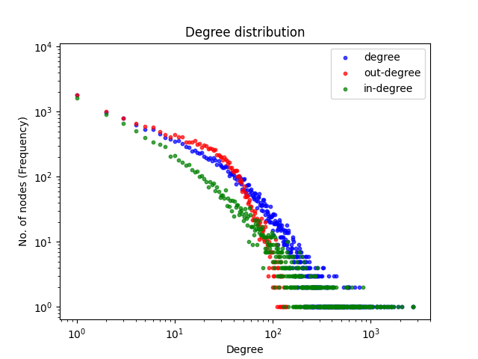
Impact of degree-ordering on ‘d’: human PPI degree distribution
 | Degree (d) | Out-degree (d+) | In-degree (d-)
max | 2.717 | 137 | 2.717
median | 228 | 66 | 207
=> Traverse H’ as much as possible on out-edges

Slide 25
Types of directed wedges (3-node paths)
Out-out wedge
In-Out wedge
Out-In wedge
In-In wedge

Slide 26
The counting trick
Out-out wedge
Counting trick:
- avoid visiting predecessors (i.e. d⁻)
- Out-out wedge is isomorphic to In-In wedge
- It suffices to count
Out- out wedges
in-out wedges
out-in wedges to count
In-Out wedge
Out-In wedge
In-In wedge

Slide 27
Time complexity counting directed wedges
a
b
c
O(nd⁺d⁺)
Out-out wedge
b
a
c
O(nd⁺d⁺) (avoid overcounting: c > b)
In-out wedge
a
b
c
O(nd⁺d⁻) (avoid overcounting: a < c)
Out-in wedge
Overall time: O(nd⁺d⁺) + O(nd⁺d⁺) + O(nd⁺d⁻) < O(nd²)

Slide 28
There is only only one type of acyclic triangle

Slide 29
Three ways of counting triangles
Extending in-out wedge
Extending out-out wedge
Extending Out-in wedge
b
b
b
?
a
a
a
?
c
?
c
c

Slide 30
Counting triangles is fast
Extending in-out wedge
Extending out-out wedge
Extending out-in wedge
b
b
c
?
a
a
b
?
c
?
c
a
O(n(d⁺d⁺/2))
^{Avoid overcounting (c > b)}
O(nd⁺d⁺)
O(nd⁺d⁻)

Slide 31
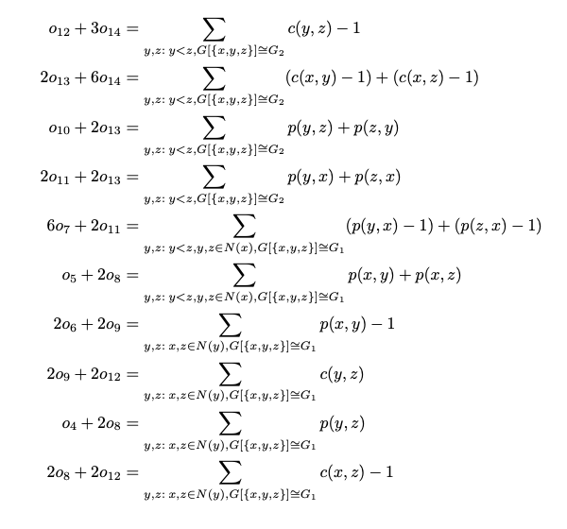
ORCA redundancy equations for 4 node graphlets
Up to four node graphlets

Slide 32

How to read a ORCA redundancy equation
The number of times node x touches o12 and 3o14
The number of times Y, Z form a triangle (graphlet G2) -1
Iterate over all triangles including x
13
14
y
12
x
?
G7
G8
z
the number of shared neighbors of y and z minus one = the times x touches o12 or three times o14

Slide 33
Graphlet adjacency counter design: Option 1
Method |  | DDFS | DDFS | DDFS | Infer | Infer | Infer | Infer | DDFS
Complexity |  | O(nd⁺d⁻) | O(nd⁺d⁺) | O(nd⁺d⁺d⁻) | O(nd⁺d⁻) | O(nd⁺d⁻) | O(nd⁺d⁻) | O(nd⁺d⁻) | O(nd⁺d⁺d⁺)
We have to brute force compute G3; redundancy equations only consider nodes 1 and 2 hops away
Technically, counting G3 is sufficient to infer all other graphlets
However, counting G8 as well greatly simplifies solving the redundancy equations

Slide 34
Graphlet adjacency counter design: Option 2
Method |  | DDFS | DDFS | DDFS | Infer | Infer | Infer | DDFS | DDFS
Complexity |  | O(nd⁺d⁻) | O(nd⁺d⁺) | O(nd⁺d⁺d⁻) | O(nd⁺d⁻) | O(nd⁺d⁻) | O(nd⁺d⁻) | O(nd⁺d⁺d⁻) | O(nd⁺d⁺d⁺)
In real networks #triangles << # wedges
Counting G7 should be a lot faster than counting G3 in practice
Relevant for counting individual Graphlet Adjacencies -> e.g. Graph Crunch?

Slide 35
Graphlet adjacency counter: progress report
Method |  | DDFS | DDFS | DDFS | Infer | Infer | Infer | Infer | DDFS
complexity |  | O(nd²) | O(nd²) | O(nd³) | O(nd²) | O(nd²) | O(nd²) | O(nd²) | O(nd³)
implemented |  | V | V | X | X | x | X | In python | V
+ the redundancy equations are defined

Slide 36
Next steps
Software:
1. Implement the brute force counters in C
2. Implement the redundancy equations in C
Analysis:
Create a benchmark dataset
Test G3 vs G7 and choose between counter design option 1 or 2
Compare against state-of-the-art
Reporting:
Present adjacency equations
Paper:
Start organizing background section
Write redundancy equations digitally

Slide 37
Types of four-node acyclic cycles

Slide 38
How redundancy equations are applied
Precomputed
Iterate triangles including x
system of equations:
Precomputed
13
14
12
G7
G8

