Slide 1



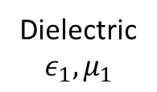



$$\hat{y}$$
PEC
$$\hat{z}$$
$$\hat{x}$$
PEC
$$b$$
Dielectric$ε_{1}, μ_{1}$
$$l$$
$$a$$

