Slide 1












(a)
(b)
$$\hat{y}$$
$$\hat{z}$$
PEC
$$\hat{z}$$
$$\hat{y}$$
Dielectric$ε_{1}, μ_{1}$
$$\hat{x}$$
$$\hat{x}$$
PEC
$$E_{y,src}$$
Dielectric$ε_{1}, μ_{1}$
$$b$$
$$l$$
Mur ABC or PEC
TF/SF
1-Way Source
$$a$$

Slide 2
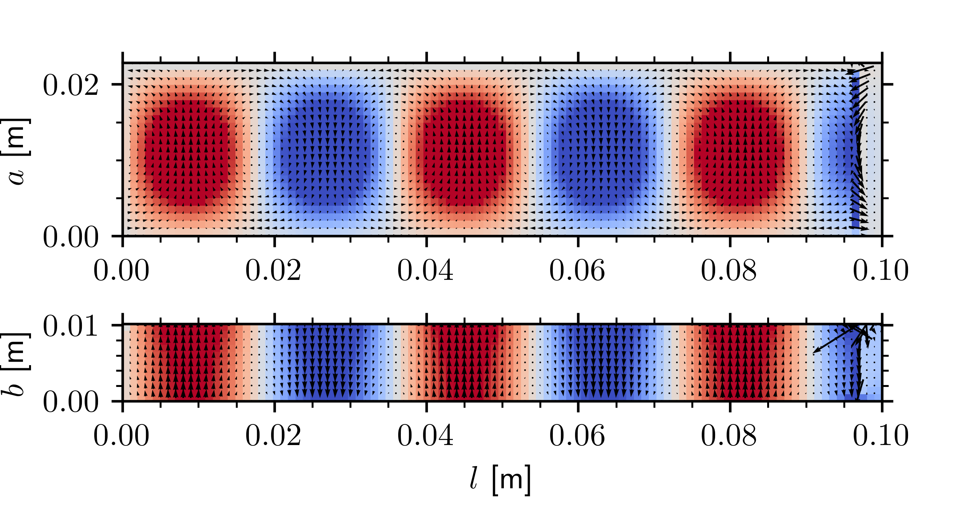
(a)
(b)

Slide 3



$$φ_{3}^{(e)}$$
e
$$φ_{1}^{(e)}$$
$$φ_{2}^{(e)}$$

