Slide 1
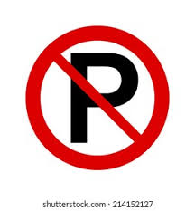

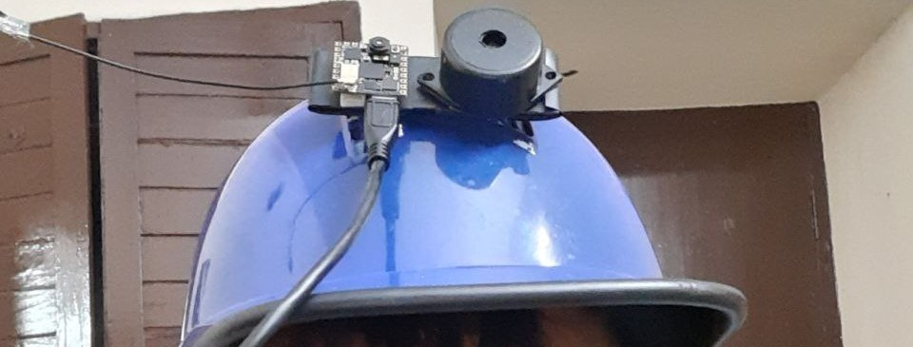
AI Helmet
Real-Time Road Sign Detection and Alerting System for Two-Wheelers
Code: https://github.com/samy101/ai-helmet

