Slide 1


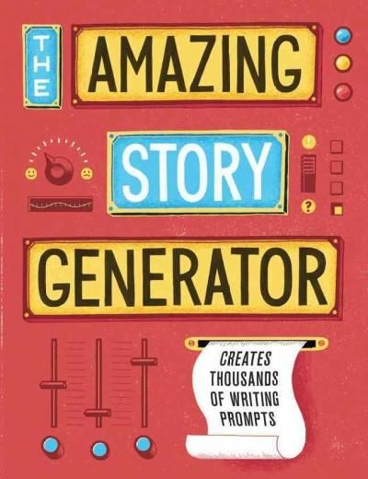
Automatic Story Generator
Writing Random content is not easy task…
SANYAM JAIN 41
SONAAL KALRA 45 SHIVANI SHARMA 57

Slide 2

Contents
Abstract
Introduction
Objectives Achieved
Methodology techniques(DFD, flowchart, ER diagram)
Pseudocode Running code Execution result(screen shots of output)
References

Slide 3


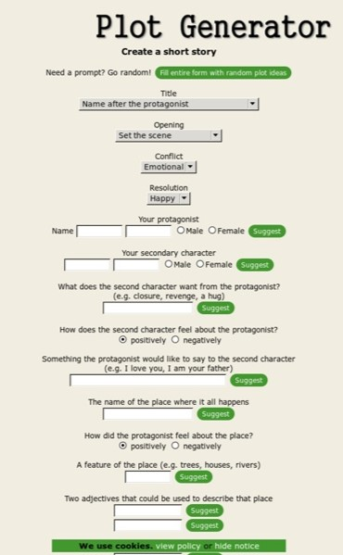
Abstract
The figure shown left is a sample of real life Plot Generations. User must enter sufficient required details for the sufficiently generated paragraphs.
There are sufficient well developed bots/spinners that generate well structured stories.
Our program differs by the programming language, complexity, ease of use, customization, open source approach.
More basic (Uses naïve approach of English sentence and grammar algorithms )

Slide 4

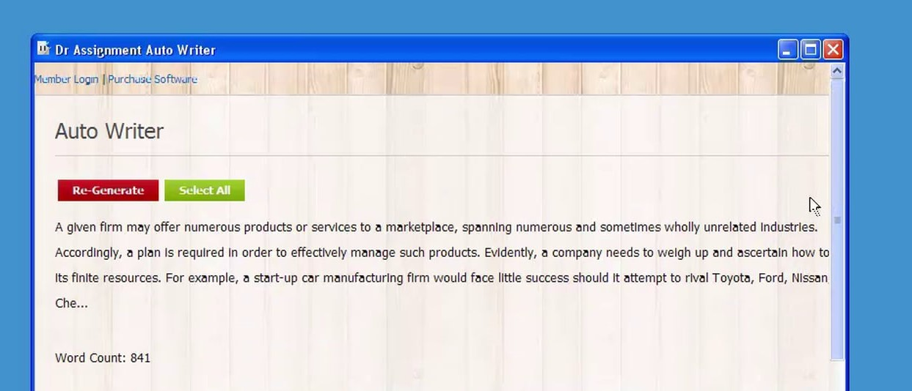
Abstract
AutoWriter is also one of the tool available online. The scholar edition is even used by many organizations to fetch best content related some user input keywords. From existing word base (Fetched from Wordnet) which is just an Information Retrieval
Our Program have some dictionary keywords stored in array. Arrays passes through Random function and spinning functions produces some sentences with concatenation of each word.
One more filter make sure that the sentence going to generate is actually meaningful.

Slide 5

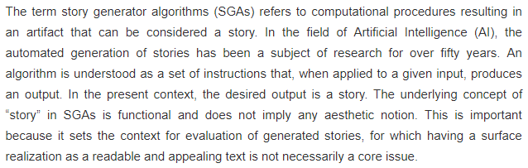
Introduction
What do you think when you hear automatic story generation or Story Generator Algorithms?
Must relate this to AI or ML.

Slide 6
Objective
THE GRAMMAR ALGORITHM
The Objective of this project is to generate the random content automatically. The Program have some dictionary keywords stored in an array. Arrays passes through random function and spinning functions produces some sentence with concatenation of each word.

Slide 7
Objectives Achieved
Program is compiled with best of compiler GNU C or GCC and gedit is used
Analysed with different compilers to check which is best. The compiler with least compilation time will be chosen as best. The compilation time can be traced with certain time.h library functions. (BORLAND- TURBO C- Windows, GCC UBUNTU LINUX 16.04)
Effective Procedural Code
Manages System Resources. Ubuntu 16.04 (Linux) is well optimized for native C
S.M.A.R.T. project objectives
SPECIFIC: Writing any random content is not easy task, so as to generate random sentences collectively stories.
MEASURABLE: The distinguished importance of the ASG is that it creates random stories within itself and output is more accurate in terms of meaning of actual English sentence generated. The desired random() function was coded in mid September which generated random output of meaningless sentences. Then late number we Applied Grammar Algorithm. Failing in that resulted to make our own functions similar to SGA/GA to make meaningful sentences.

Slide 8
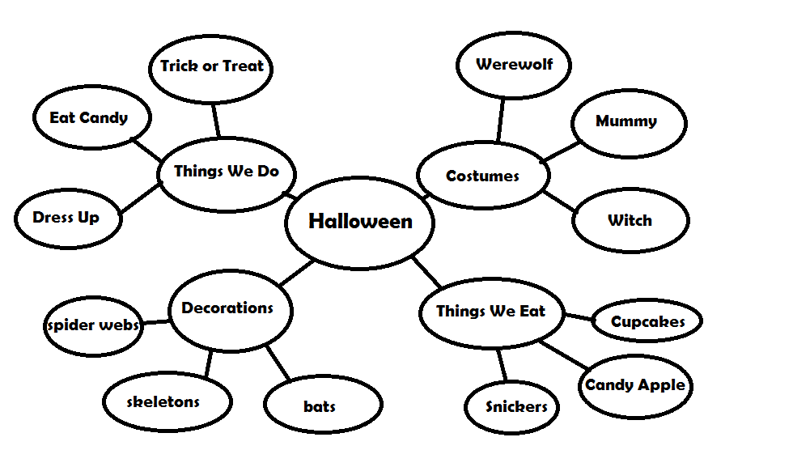
Objectives Achieved
3. Attainable/Achievable: The goal is to achieve a collection of inter related meaningful sentences. We have reach to the meaningful sentences generations. The inter relativity is achieved by functionalizing each short SGAs.(Having same array stores, interrelated keywords, which should make a net like structure of words.

Slide 9
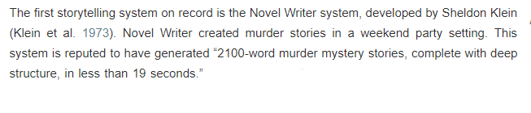
Objectives Achieved
4. Relevancy: The relevancy of each function which mark its importance to generate each meaningful sentence proves the relevancy of the program. The program is relevant in real life scenarios as :
A popular application of SGA is TALESPIN used late 70’s using lisp language to generate stories of cartoon characters.
MINSTREL (Turner 1993) was a computer program that told stories about King Arthur and his Knights of the Round Table.
5. Time-Bound : The complete project should end up before end semesters

Slide 10
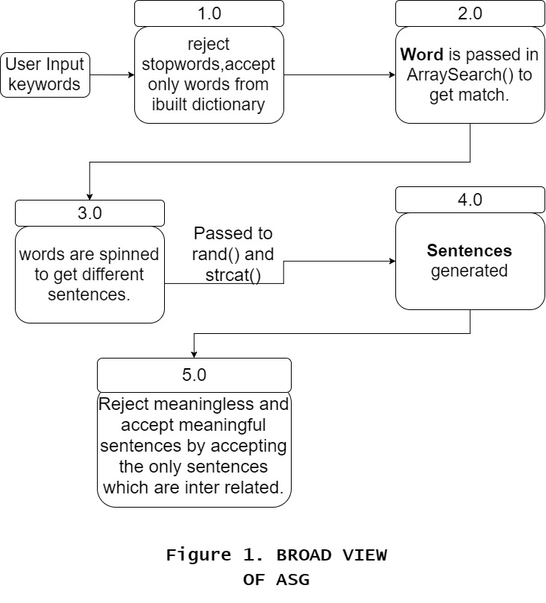
Methodology technique
1. DFD

Slide 11
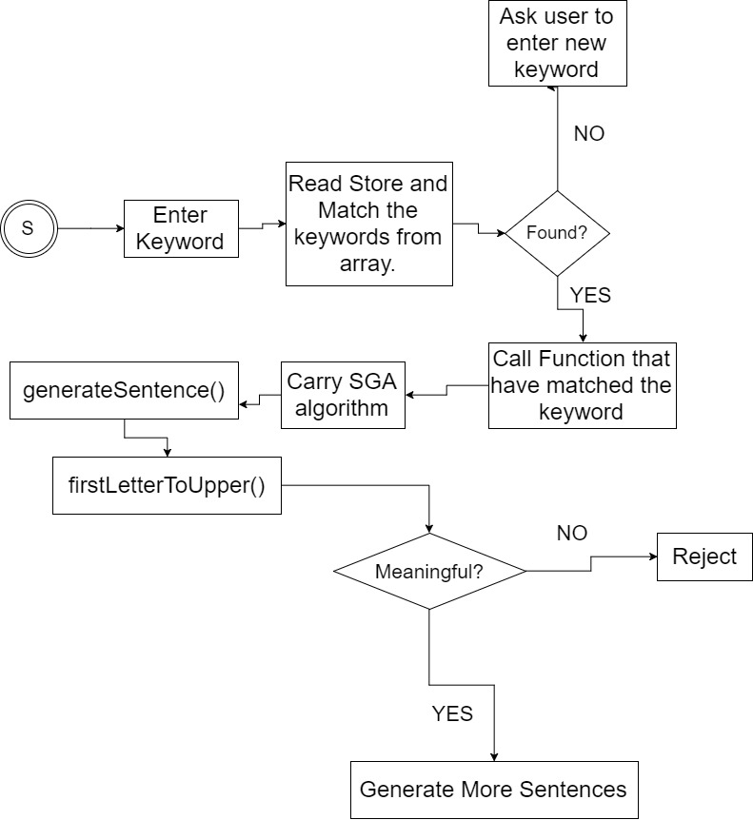
2.1 Flow Chart

Slide 12
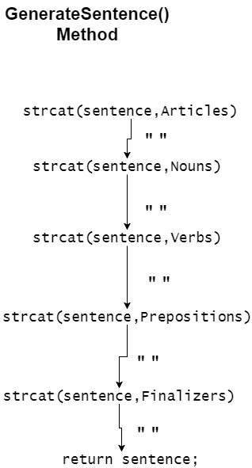
2.2 Flow Chart

Slide 13
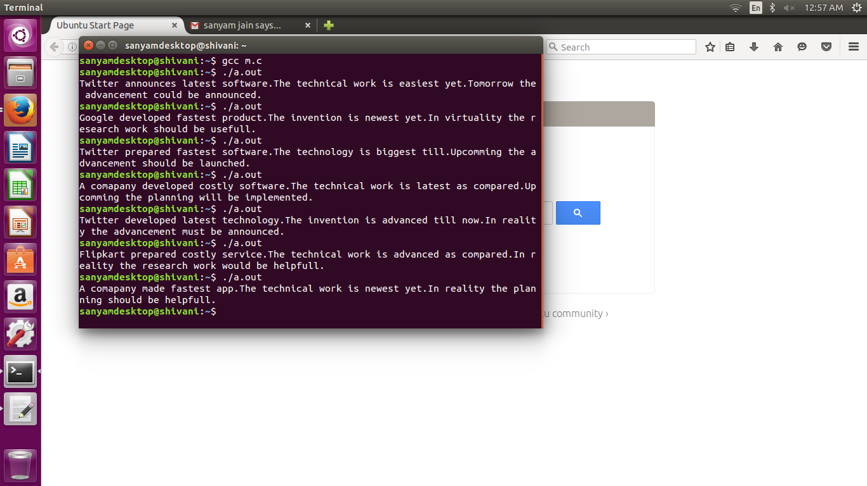
Pseudocode Running code Execution result(screen shots)

Slide 14
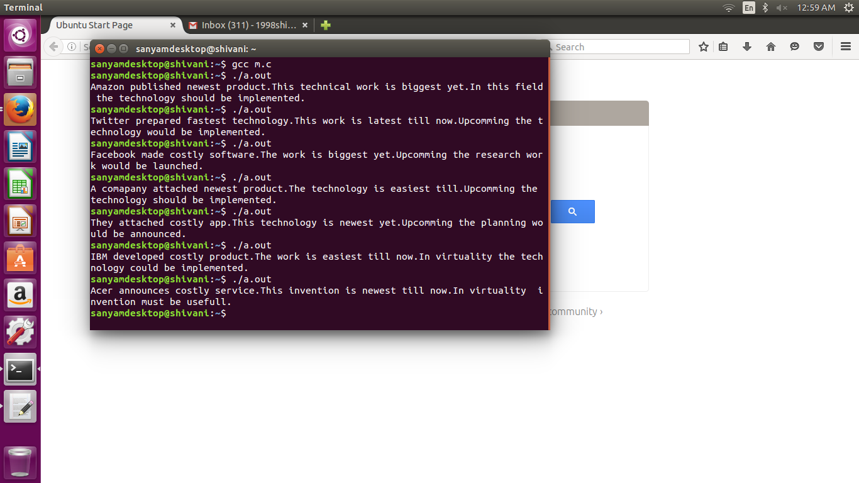

Slide 15
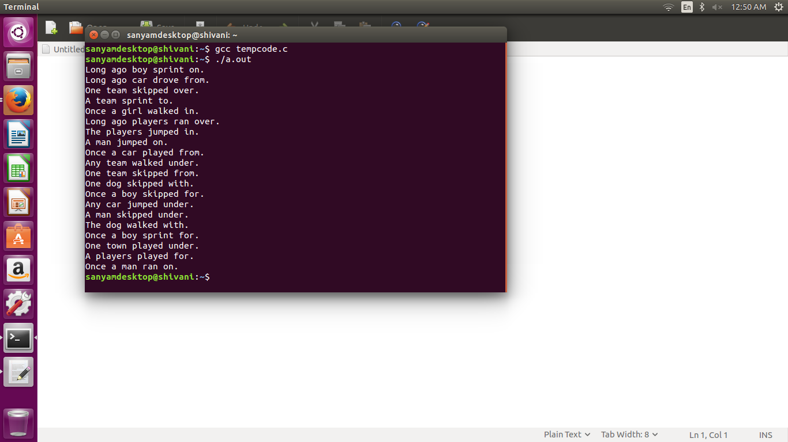

Slide 16
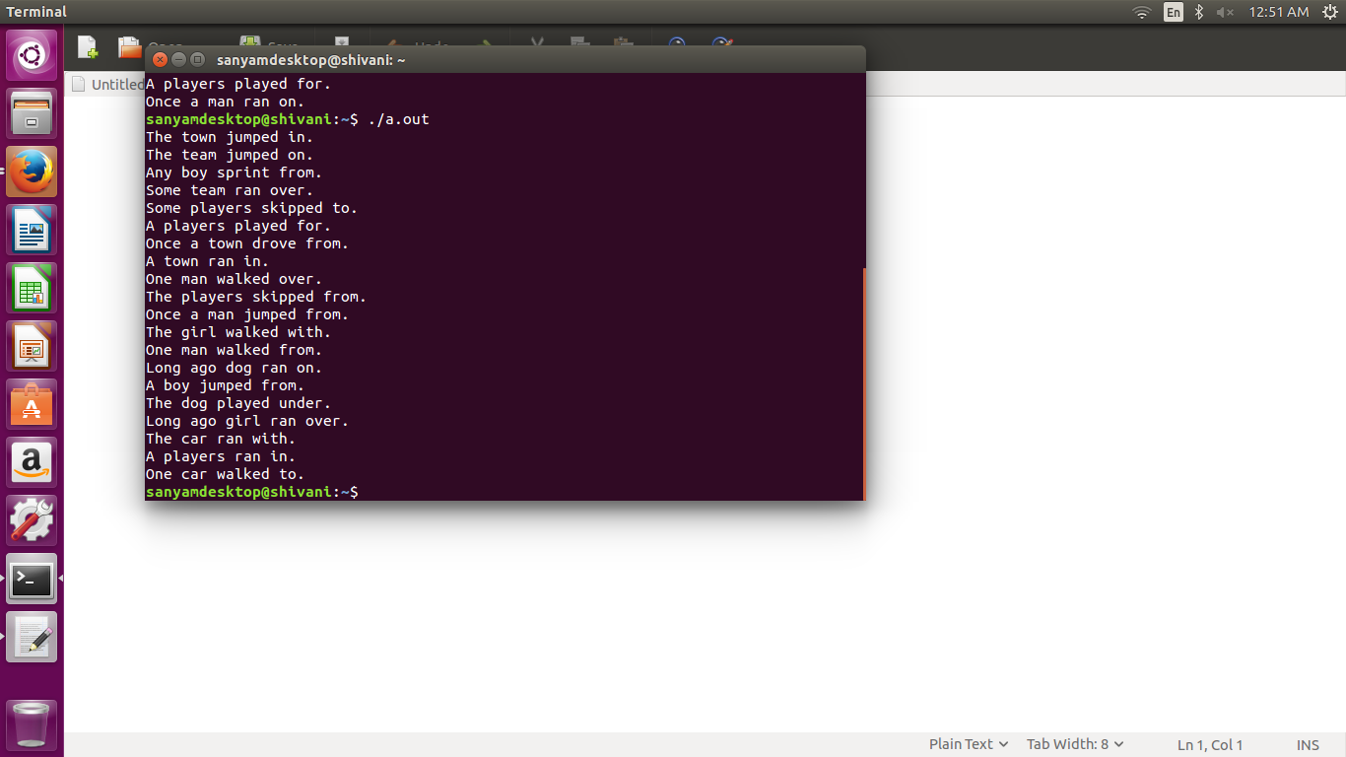

Slide 17
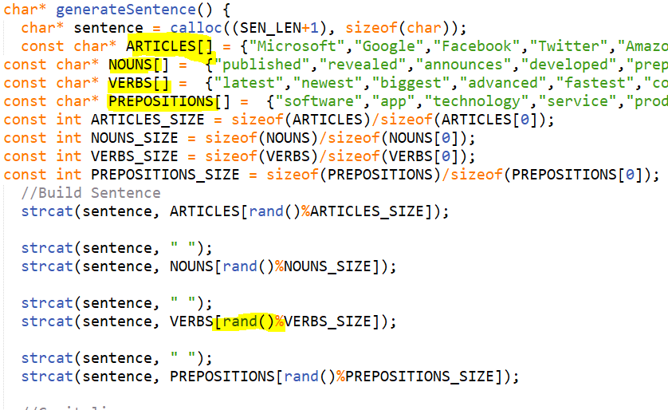
Pseudocode: generatesentence()

Slide 18
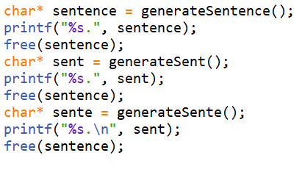
Pseudocode: main()

Slide 19
Libraries Used:
The stdio.h header defines three variable types, several macros, and various functions for performing input and output.
The string.h header defines one variable type, one macro, and various functions for manipulating arrays of characters.
The stdlib.h header defines four variable types, several macros, and various functions for performing general functions.
The time.h header defines four variable types, two macro and various functions for manipulating date and time.
The ctype.h header file of the C Standard Library declares several functions that are useful for testing and mapping characters.
All the functions accepts int as a parameter, whose value must be EOF or representable as an unsigned char.

Slide 20
Functions Used:
The C library function void *calloc(size_t nitems, size_t size) allocates the requested memory and returns a pointer to it.
Sizeof is a much used in the C programming language. It is a compile time unary operator which can be used to compute the size of its operand. The result of sizeof is of unsigned integral type which is usually denoted by size_t. sizeof can be applied to any data-type, including primitive types such as integer and floating-point types, pointer types, or compound datatypes such as Structure, union etc.
The C library function int rand(void) returns a pseudo-random number in the range of 0 to RAND_MAX.

Slide 21
References
http://wikis.sub.uni-hamburg.de/lhn/index.php/Story_Generator_Algorithms

