Slide 1
RE-SEARCH
CSE299 Project Presentation
Presented to: Meem Tasfia Zaman ma’am
Nazmul Hasan 1911742042
Samya Sunibir Das 1911563642
Mahir Afser Pavel 1911580042

Slide 2
Why RE-SEARCH?

Slide 3
Why RE-SEARCH?
Conventional Search Engine
RE-SEARCH
-Cannot provide search results based on the depths users set.
-Gives output of rather overwhelming amount of data that maybe irrelevant from what the user was looking for
- No option of keeping search results structured for future usage.
-Users set their own depths of crawl.
-Gives search results based on the URLs the users crawl themselves. Limited, Robust, Precise.
-Can keep the search results and the parameters saved in the form of clusters.

Slide 4
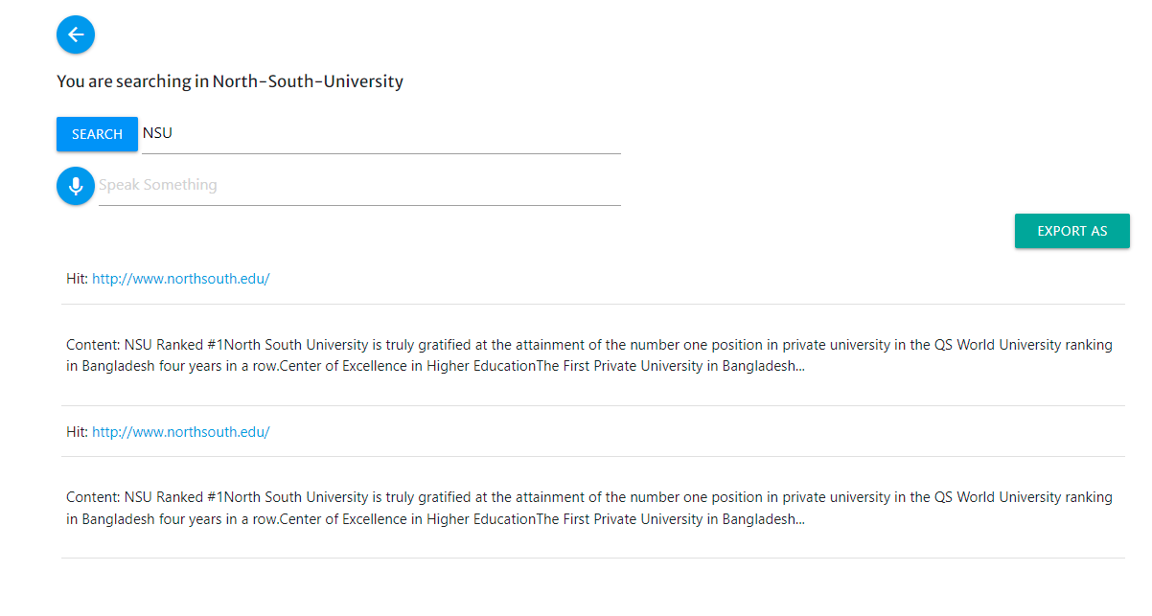
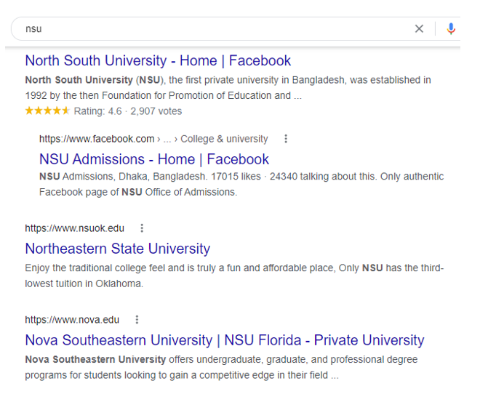
Precise, Robust Searching

Slide 5
RE-SEARCH
Real life applications of RE-SEARCH
RE-SEARCH is made to serve the researchers, teachers, students, and private search companies. It is useful to find specific topics of interests inside the search parameters they provide.
Context
Problem statement
RE-SEARCH saves your valuable time while searching
Our goal is to make RE-SEARCH available and easy to use for all kind of users and provide accurate search results against every keywords to be searched.
Support of wildcard search, voice search, exporting results differ RE-SEARCH from other search engines out there.

Slide 6
Aims and Goals
Goal 1
Goal 2
Goal 3
Accurate Search Results
Search results are robust and accurate as the user inputs in their desired links, depth, type of files or contents they want to search for. And they provide the keywords themselves.
Safe, Secured Searching
RE-SEARCH follows crawling ethics and provides its users a safe, secured searching as it does not unethically collect user data.
Giving Users Freedom
RE-SEARCH makes searching accurate and easy for its users with no strings attached. Users can find whatever they are looking for with ease and its even enjoyable to use.

Slide 7
Entire Workflow of the Project
Week 1:
Week 3:
Week 5:
Designing the UI,
Implement All Authentications,
Connect to DB,
Add User Profiles
Implement Searching,
Implement Voice Searching,
Implement Crawling Strategies,
Scheduled Crawling in Clusters
Finishing the Project,
Testing, Debugging,
Build REST APIs,
Present the Project
21.03.2022
28.03.2022
04.04.2022
11.04.2022
18.04.2022
Week 2:
Week 4:
Create DB models for Clusters, URLs,
Implement Crawling Strategies,
Index Scraped Content in Elasticsearch
Finish Developing the Front End
Make Search Results Exportable,
Building Admin Dashboard,
Adding Payment Subscriptions

Slide 8


Week 1
Tasks completed:
Designing the UI,
Implement All Authentications,
Connect to DB,
Add User Profiles
Tools:

Slide 9


Week 2
Tasks completed:
Create DB models for Clusters, URLs,
Implement Crawling Strategies,
Index Scraped Content in Elasticsearch
Tools:

Slide 10

Week 3
Tasks completed:
Implement Searching in Clusters,
Implement Voice Searching,
Implement Crawling Strategies,
Scheduled Crawling in Clusters
Tools:

Slide 11
Week 4
Tasks completed:
Finish Developing the Front End
Make Search Results Exportable,
Building Admin Dashboard,
Adding Payment Subscriptions
Building REST APIs
Tools:

Slide 12
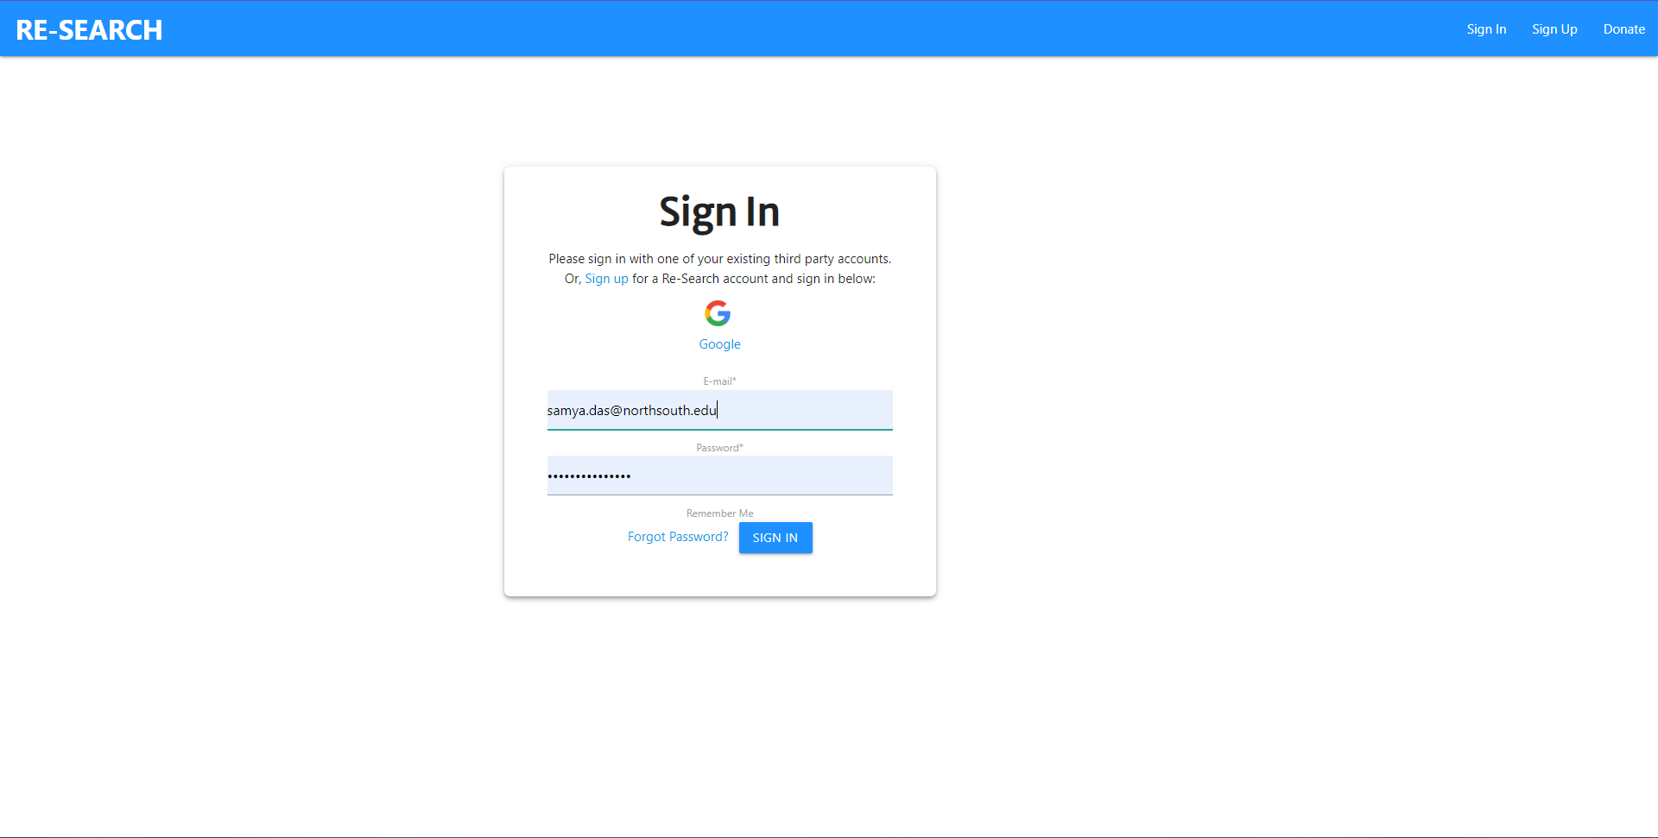
Results
UI of Login Page

Slide 13
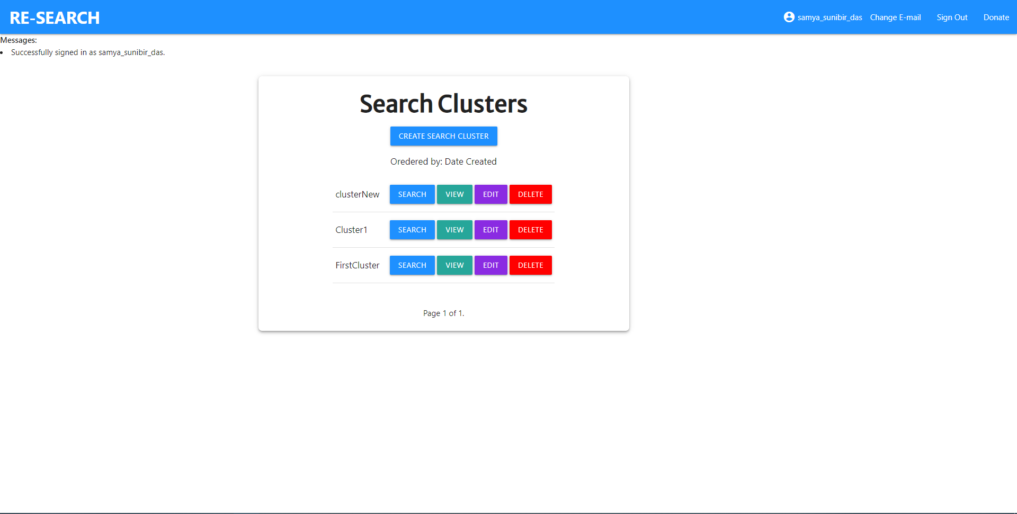
Results (continued)
Cluster view page for individual users

Slide 14
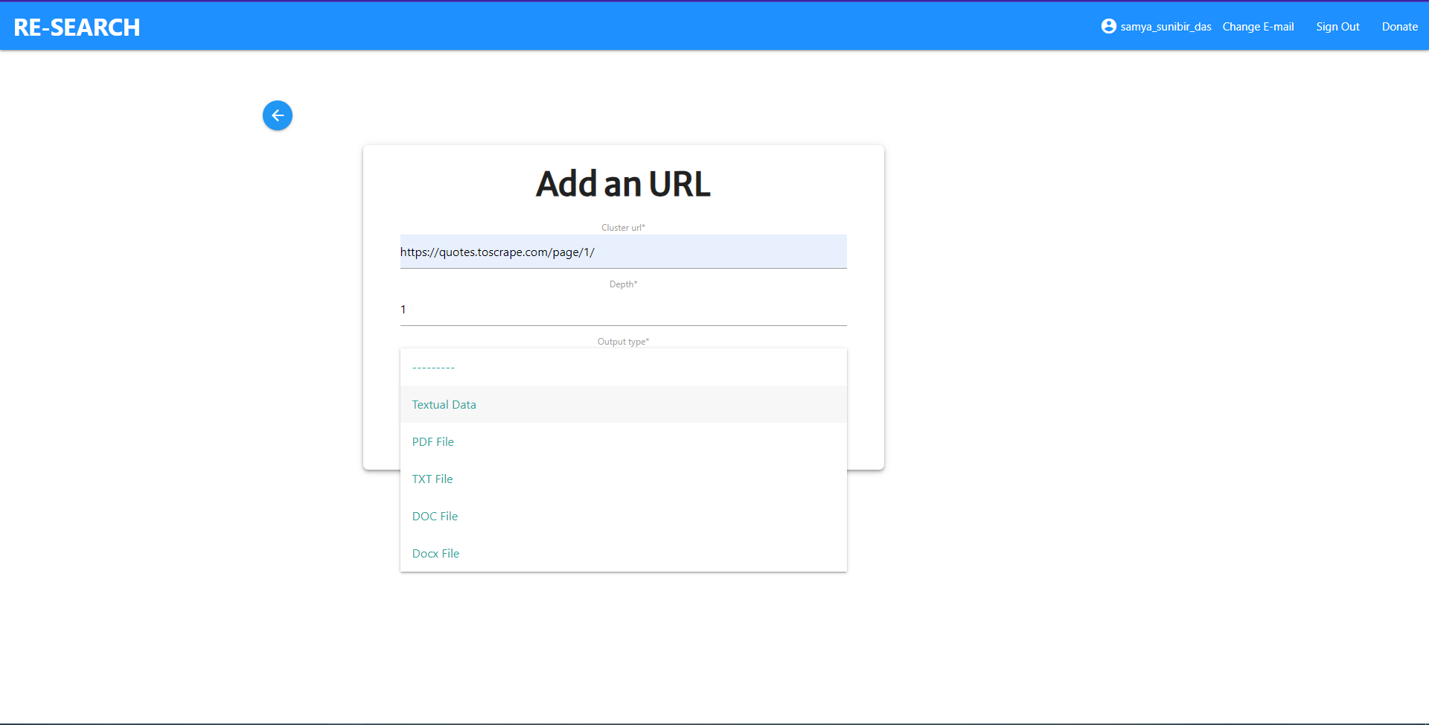
Results (continued)
Cluster view page for individual users
Adding URLs and setting output types in a Cluster

Slide 15
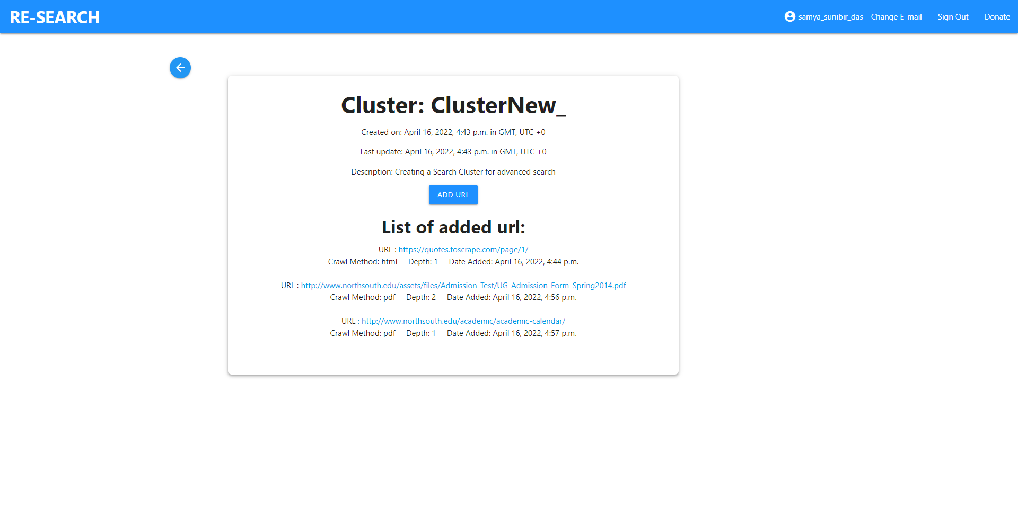
Results (continued)
A cluster with multiple links and types of outputs set by the user
Adding URLs and setting output types in a Cluster

Slide 16
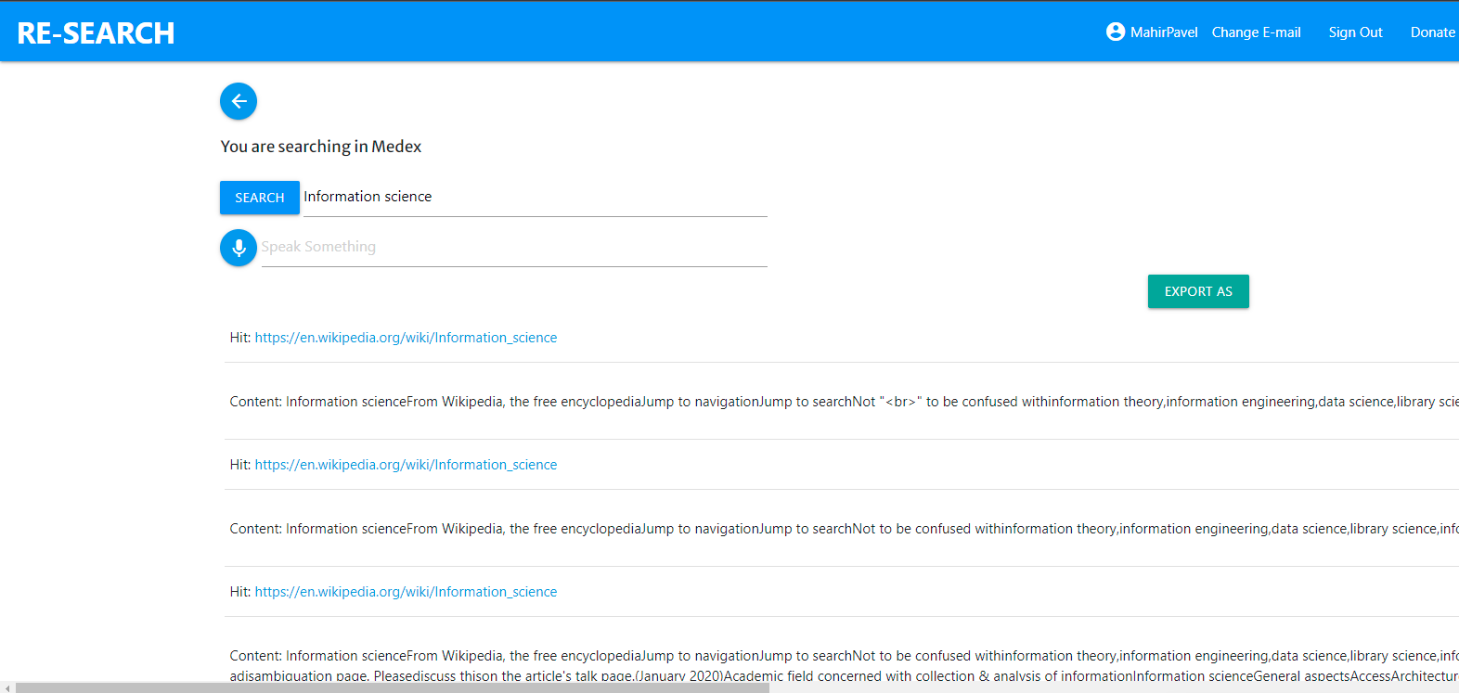
Results (continued)
A cluster with multiple links and types of outputs set by the user
Adding URLs and setting output types in a Cluster
Searching within a Cluster

Slide 17
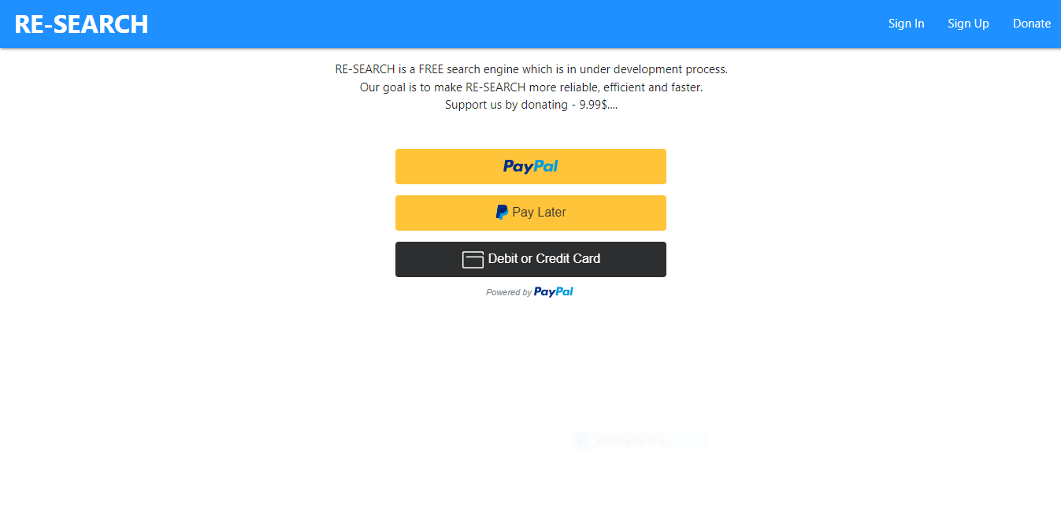
Results (continued)
A cluster with multiple links and types of outputs set by the user
Adding URLs and setting output types in a Cluster
Donations Portal with Paypal Gateway (1)

Slide 18
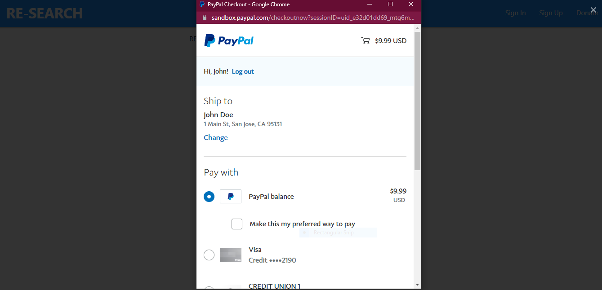
Results (continued)
Donations Portal with Paypal Gateway (2)

Slide 19
Future Work
Development of API
We have finished making the necessary APIs which would be useful in future to provide cross-platform support for other operating systems such as Android, and iOS.
Context
Problem statement
Plans for deployment
We plan to make this software open for all to use and as mentioned before, we will provide multi platform support for Web, Android.

Slide 20

Conclusion
The project focuses on to build a more user friendly search engine that provides a safer, more secured, and smoother searching experience. This is why the search engine is named ‘RE-SEARCH’. It makes searching easier.
Context
Problem statement

Slide 21
THANK YOU!

