Slide 1
Data Mining Classification: Alternative Techniques
Imbalanced Class Problem
Introduction to Data Mining, 2nd Edition
by
Tan, Steinbach, Karpatne, Kumar

Slide 2
Class Imbalance Problem
Lots of classification problems where the classes are skewed (more records from one class than another)
Credit card fraud
Intrusion detection
Defective products in manufacturing assembly line
COVID-19 test results on a random sample
Key Challenge:
Evaluation measures such as accuracy are not well-suited for imbalanced class

Slide 3
Confusion Matrix
Confusion Matrix:
 | PREDICTED CLASS
ACTUAL CLASS |  | Class=Yes | Class=No
 | Class=Yes | a | b
 | Class=No | c | d
a: TP (true positive)
b: FN (false negative)
c: FP (false positive)
d: TN (true negative)

Slide 4
Accuracy
Most widely-used metric:
 | PREDICTED CLASS
ACTUAL CLASS |  | Class=Yes | Class=No
 | Class=Yes | a (TP) | b (FN)
 | Class=No | c (FP) | d (TN)

Slide 5
Problem with Accuracy
Consider a 2-class problem
Number of Class NO examples = 990
Number of Class YES examples = 10
If a model predicts everything to be class NO, accuracy is 990/1000 = 99 %
This is misleading because this trivial model does not detect any class YES example
Detecting the rare class is usually more interesting (e.g., frauds, intrusions, defects, etc)
 | PREDICTED CLASS
ACTUAL CLASS |  | Class=Yes | Class=No
 | Class=Yes | 0 | 10
 | Class=No | 0 | 990

Slide 6
Which model is better?
 | PREDICTED
ACTUAL |  | Class=Yes | Class=No
 | Class=Yes | 0 | 10
 | Class=No | 0 | 990
A
Accuracy: 99%
 | PREDICTED
ACTUAL |  | Class=Yes | Class=No
 | Class=Yes | 10 | 0
 | Class=No | 500 | 490
B
Accuracy: 50%

Slide 7
Which model is better?
 | PREDICTED
ACTUAL |  | Class=Yes | Class=No
 | Class=Yes | 5 | 5
 | Class=No | 0 | 990
A
B
 | PREDICTED
ACTUAL |  | Class=Yes | Class=No
 | Class=Yes | 10 | 0
 | Class=No | 500 | 490

Slide 8
Alternative Measures
 | PREDICTED CLASS
ACTUAL CLASS |  | Class=Yes | Class=No
 | Class=Yes | a | b
 | Class=No | c | d

Slide 9
Alternative Measures
 | PREDICTED CLASS
ACTUAL CLASS |  | Class=Yes | Class=No
 | Class=Yes | 10 | 0
 | Class=No | 10 | 980

Slide 10
Alternative Measures
 | PREDICTED CLASS
ACTUAL CLASS |  | Class=Yes | Class=No
 | Class=Yes | 10 | 0
 | Class=No | 10 | 980
 | PREDICTED CLASS
ACTUAL CLASS |  | Class=Yes | Class=No
 | Class=Yes | 1 | 9
 | Class=No | 0 | 990

Slide 11
Which of these classifiers is better?
 | PREDICTED CLASS
ACTUAL CLASS |  | Class=Yes | Class=No
 | Class=Yes | 40 | 10
 | Class=No | 10 | 40
A
B
 | PREDICTED CLASS
ACTUAL CLASS |  | Class=Yes | Class=No
 | Class=Yes | 40 | 10
 | Class=No | 1000 | 4000

Slide 12
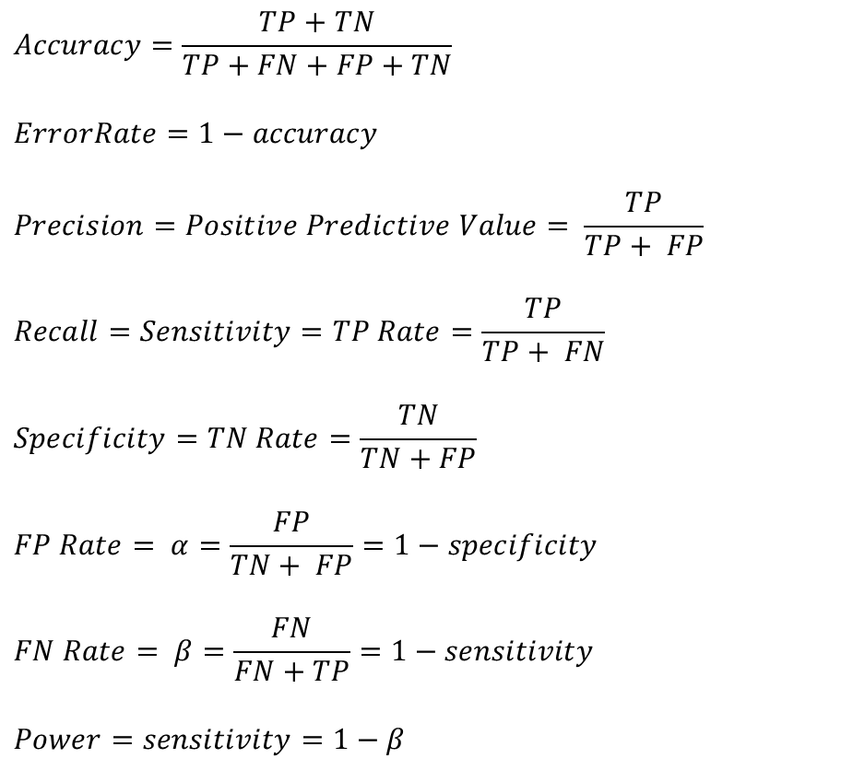
Measures of Classification Performance
 | PREDICTED CLASS
ACTUAL CLASS |  | Yes | No
 | Yes | TP | FN
 | No | FP | TN
α is the probability that we reject the null hypothesis when it is true. This is a Type I error or a false positive (FP).
β is the probability that we accept the null hypothesis when it is false. This is a Type II error or a false negative (FN).

Slide 13

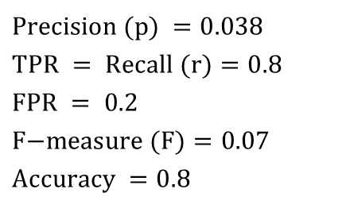

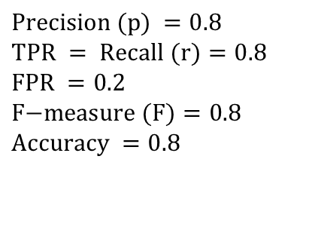
Alternative Measures
A | PREDICTED CLASS
ACTUAL CLASS |  | Class=Yes | Class=No
 | Class=Yes | 40 | 10
 | Class=No | 10 | 40
$$\text{Precision} (p) =0.8 \\ \text{TPR} = \text{Recall} (r)=0.8 \\ \text{FPR} =0.2 \\ \text{F}\text{−}\text{measure} (F)=0.8 \\ \text{Accuracy} =0.8$$
$$\frac{TPR}{FPR}=4$$
B | PREDICTED CLASS
ACTUAL CLASS |  | Class=Yes | Class=No
 | Class=Yes | 40 | 10
 | Class=No | 1000 | 4000
$$\text{Precision} (p) =0.038 \\ \text{TPR} = \text{Recall} (r)=0.8 \\ \text{FPR} =\text{ 0.2} \\ \text{F}\text{−}\text{measure} (F)=0.07 \\ \text{Accuracy} =0.8$$
$$\frac{TPR}{FPR}=4$$

Slide 14
Which of these classifiers is better?
A | PREDICTED CLASS
ACTUAL CLASS |  | Class=Yes | Class=No
 | Class=Yes | 10 | 40
 | Class=No | 10 | 40
B | PREDICTED CLASS
ACTUAL CLASS |  | Class=Yes | Class=No
 | Class=Yes | 25 | 25
 | Class=No | 25 | 25
C | PREDICTED CLASS
ACTUAL CLASS |  | Class=Yes | Class=No
 | Class=Yes | 40 | 10
 | Class=No | 40 | 10

Slide 15
ROC (Receiver Operating Characteristic)
A graphical approach for displaying trade-off between detection rate and false alarm rate
Developed in 1950s for signal detection theory to analyze noisy signals
ROC curve plots TPR against FPR
Performance of a model represented as a point in an ROC curve

Slide 16
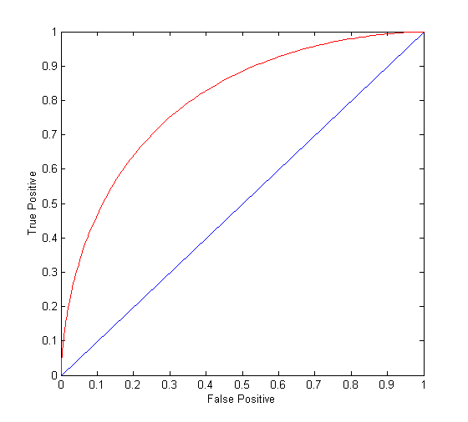
ROC Curve
(TPR,FPR):
(0,0): declare everything to be negative class
(1,1): declare everything to be positive class
(1,0): ideal
Diagonal line:
Random guessing
Below diagonal line:
prediction is opposite of the true class

Slide 17
ROC (Receiver Operating Characteristic)
To draw ROC curve, classifier must produce continuous-valued output
Outputs are used to rank test records, from the most likely positive class record to the least likely positive class record
By using different thresholds on this value, we can create different variations of the classifier with TPR/FPR tradeoffs
Many classifiers produce only discrete outputs (i.e., predicted class)
How to get continuous-valued outputs?
Decision trees, rule-based classifiers, neural networks, Bayesian classifiers, k-nearest neighbors, SVM

Slide 18
Example: Decision Trees
Decision Tree
Continuous-valued outputs

Slide 19
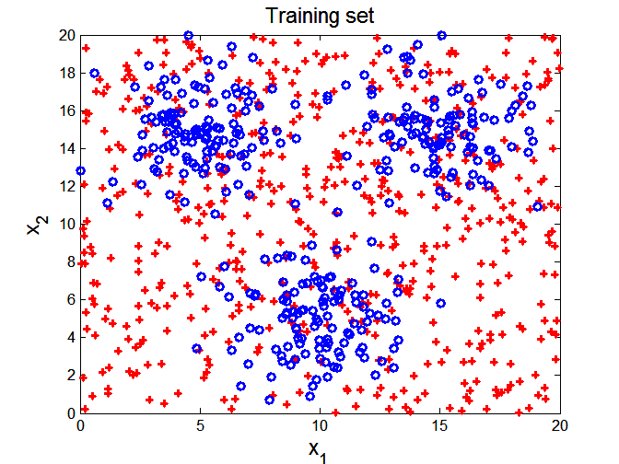

ROC Curve Example

Slide 20
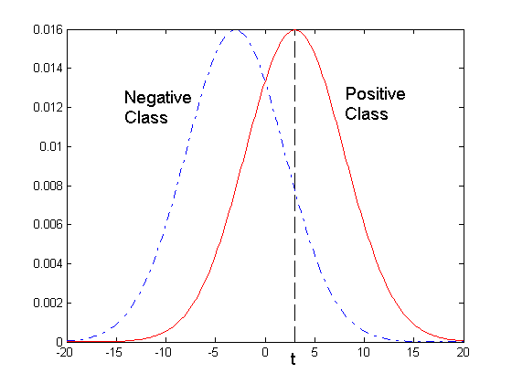
ROC Curve Example
- 1-dimensional data set containing 2 classes (positive and negative)
- Any points located at x > t is classified as positive
At threshold t:
TPR=0.5, FNR=0.5, FPR=0.12, TNR=0.88

Slide 21
How to Construct an ROC curve
Use a classifier that produces a continuous-valued score for each instance
The more likely it is for the instance to be in the + class, the higher the score
Sort the instances in decreasing order according to the score
Apply a threshold at each unique value of the score
Count the number of TP, FP, TN, FN at each threshold
TPR = TP/(TP+FN)
FPR = FP/(FP + TN)
Instance | Score | True Class
1 | 0.95 | +
2 | 0.93 | +
3 | 0.87 | -
4 | 0.85 | -
5 | 0.85 | -
6 | 0.85 | +
7 | 0.76 | -
8 | 0.53 | +
9 | 0.43 | -
10 | 0.25 | +

Slide 22
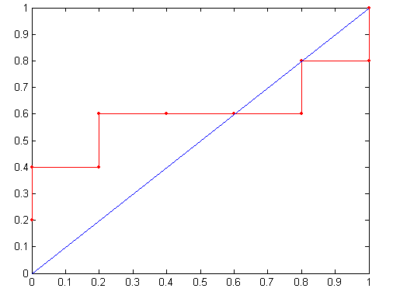
How to construct an ROC curve
Threshold >=
ROC Curve:

Slide 23
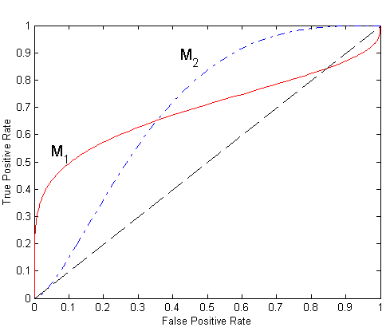
Using ROC for Model Comparison
No model consistently outperforms the other
M₁ is better for small FPR
M₂ is better for large FPR
Area Under the ROC curve (AUC)
Ideal:
Area = 1
Random guess:
Area = 0.5

Slide 24
Dealing with Imbalanced Classes - Summary
Many measures exists, but none of them may be ideal in all situations
Random classifiers can have high value for many of these measures
TPR/FPR provides important information but may not be sufficient by itself in many practical scenarios
Given two classifiers, sometimes you can tell that one of them is strictly better than the other
C1 is strictly better than C2 if C1 has strictly better TPR and FPR relative to C2 (or same TPR and better FPR, and vice versa)
Even if C1 is strictly better than C2, C1’s F-value can be worse than C2’s if they are evaluated on data sets with different imbalances
Classifier C1 can be better or worse than C2 depending on the scenario at hand (class imbalance, importance of TP vs FP, cost/time tradeoffs)

Slide 25
Which Classifier is better?
T1 | PREDICTED CLASS
ACTUAL CLASS |  | Class=Yes | Class=No
 | Class=Yes | 50 | 50
 | Class=No | 1 | 99
T2 | PREDICTED CLASS
ACTUAL CLASS |  | Class=Yes | Class=No
 | Class=Yes | 99 | 1
 | Class=No | 10 | 90
T3 | PREDICTED CLASS
ACTUAL CLASS |  | Class=Yes | Class=No
 | Class=Yes | 99 | 1
 | Class=No | 1 | 99

Slide 26
Which Classifer is better? Medium Skew case
T1 | PREDICTED CLASS
ACTUAL CLASS |  | Class=Yes | Class=No
 | Class=Yes | 50 | 50
 | Class=No | 10 | 990
T2 | PREDICTED CLASS
ACTUAL CLASS |  | Class=Yes | Class=No
 | Class=Yes | 99 | 1
 | Class=No | 100 | 900
T3 | PREDICTED CLASS
ACTUAL CLASS |  | Class=Yes | Class=No
 | Class=Yes | 99 | 1
 | Class=No | 10 | 990

Slide 27
Which Classifer is better? High Skew case
T1 | PREDICTED CLASS
ACTUAL CLASS |  | Class=Yes | Class=No
 | Class=Yes | 50 | 50
 | Class=No | 100 | 9900
T2 | PREDICTED CLASS
ACTUAL CLASS |  | Class=Yes | Class=No
 | Class=Yes | 99 | 1
 | Class=No | 1000 | 9000
T3 | PREDICTED CLASS
ACTUAL CLASS |  | Class=Yes | Class=No
 | Class=Yes | 99 | 1
 | Class=No | 100 | 9900

Slide 28
Building Classifiers with Imbalanced Training Set
Modify the distribution of training data so that rare class is well-represented in training set
Undersample the majority class
Oversample the rare class

