Slide 1
CSE499A: Research Paper Presentation
Selected Paper: Quantum Machine Learning - Jacob Biamonte et al. (2017) (Review Paper)
Presented by: Samya Sunibir Das (1911563642) & Nazmul Hasan (1911742042)

Slide 2
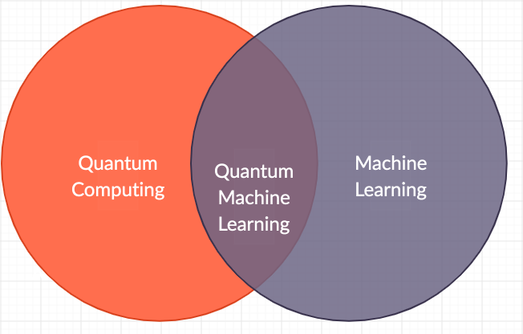
Introduction
Classical machine learning methods
Quantum machine learning methods-
Makes use of quantum algorithms as part of a larger implementation.
They have the potential to outperform classical algorithms for specific problems and the potential is known as Quantum Speedup.

Slide 3
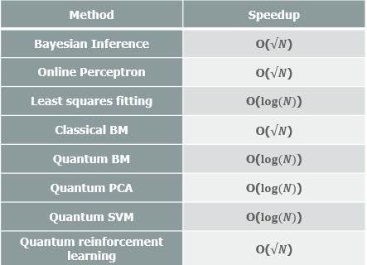
Quantum Speedup
Quantum speedup is characterized on Query complexity and gate complexity. Query and gate complexity are idealized models that helps to determine the resources needed to solve a problem.
Quantum computers use effects such as quantum coherence and entanglement to process information in ways that classical computers cannot.
The figure shows the speedup of various quantum machine-learning algorithms on the best classical algorithms.

Slide 4
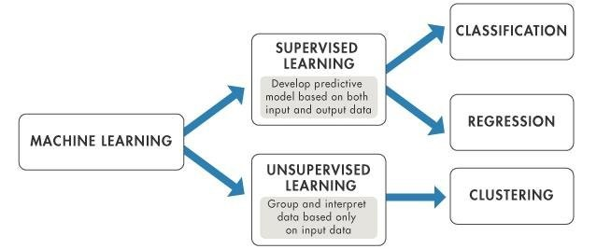
Classical Machine Learning
Aside from these methods, there are machine-learning tasks, such as playing Go, that combines supervised and unsupervised learning together.

Slide 5
Linear Algebra based Quantum Machine Learning
Quantum mechanics is all about matrix operations on vectors in high dimensional vector spaces. A quantum state of n qubits is a vector in a 2n dimensional complex vector space
Quantum computing performs exponentially faster in linear algebraic operations than its classical counterpart

Slide 6
Quantum Principal Component Analysis (PCA)
For a vector of dimension d, classical algorithms perform PCA on a complexity of O(d2).
For quantum PCA, we use a qRAM (quantum random access memory) to map that vector into a quantum state. The quantum state that summarizes the vector has Log(d )qubits, and the operation of the qRAM requires O(d) operations divided over O(Log d) steps

Slide 7
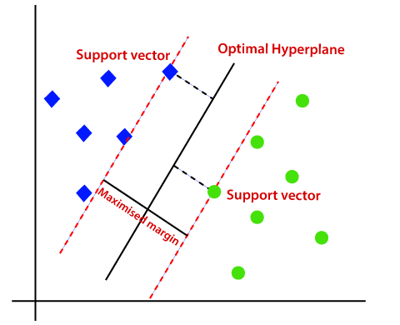
Quantum support vector machines
SVMs seek to find an optimal separating hyperplane between two classes of data in a data set such that, with high probability, all training examples of one class are only found on one side of the hyperplane.
Finding s support vectors from N vectors take √(N/s) iterations. Input data can come from qRAM accessing classical data or a quantum subroutine preparing quantum states. Then the QDevice processes the data with quantum phase estimation and matrix inversion (HHL). All operations construct optimal hyperplane to check which class does a vector belong to.

Slide 8
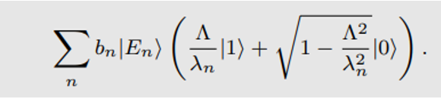
HHL Algorithm (Quantum Matrix Inversion)
This algorithm computes linear equations like Ax = b exponentially faster than its polynomial counterparts.
Steps:
Initialize: Initialize vector b as |b⟩ quantum state.
Estimate the Eigenvalues of the matrix A. Calculate value of λ using phase estimation algorithm. After that we get,

Slide 9
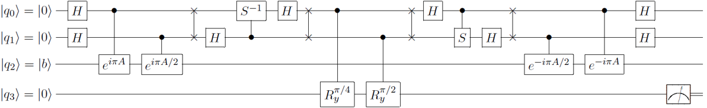
(..continued)
3. Controlled rotation: Controlled rotation of auxiliary qubit is performed according to the estimated eigenvalues. The Sin of the approximate value is the reciprocal of the eigenvalue.
4. Reset |q0q1⟩ as |00⟩ using the reverse phase estimation algorithm.
5. Measure |q3⟩; If the result is 1, the corresponding quantum state |q2⟩=|x⟩. Then the approximate solution of the equations can be obtained.

Slide 10
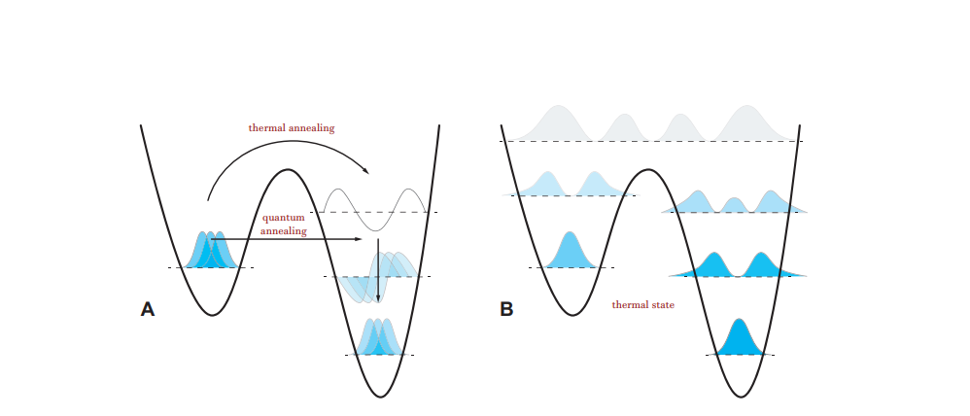
Quantum tunneling vs thermalization
A: A quantum state must traverse a local minimum in thermal annealing whereas a coherent quantum state can tunnel when brought close to resonance.
B: Coherent effects decay through interaction with an environment, resulting in a probability distribution in occupancy of a systems energy levels following a Gibbs distribution.

Slide 11
Quantum Linear Algebra Based Optimizations
D-Wave quantum processors, are being used to solve optimization problems by the means of quantum annealing.
HHL in single shot solutions can lead to exponential boosts
Modified qPCA implemented with Gradient Descent leads to exponential boosts opposed to classical counterpart.
QAOA provides unique optimizing approach on alternating qubit rotations with applying the penalty function for the particular problem.

Slide 12
Reading classical data into quantum machines
Input Problem: Classical data must be inputted before being processed on a quantum computer, presents a serious bottleneck for certain algorithms.
Output Problem: faced when reading out data after being processed on a quantum device. Both slows down operations.
All methods seen previously require huge data that may lead to exponential time.
qRAM may mitigate optimization problems but may bring other problems to data.
Optimization is crucial. Else, circuit size and depth may get out of control.

Slide 13
Deep Quantum Learning
Quantum annealers and programmable photonic circuits are well-suited for constructing deep quantum learning networks.
Boltzmann Machines are the simplest neural nets to quantize. Quantum computers can accelerate Boltzmann training by providing improved ways of sampling. They can also make the system thermalize quadratically faster than its classical counterpart. Quantum information processing provides new fundamentally quantum models for deep learning.
Such deep quantum learners may recognize and classify patterns that classical computers can not. Quantum networks can learn to generate quantum states representative of a wide variety of systems

Slide 14
Quantum Boltzmann Machine
Quantum computers can accelerate Boltzmann training by providing improved ways of sampling
Classical Boltzmann machine requires many repetitions to find success probabilities.
In training a quantum Boltzmann machine, by contrast, quantum coherence can reduce the number of samples needed to learn the performance

Slide 15
Quantum machine learning for quantum data
The immediate application of quantum machine learning is to quantum data.
Quantum machine learning algorithms can be applied directly to the quantum states to reveal their patterns.
A particularly powerful quantum data analysis technique is the use of quantum simulators

Slide 16
Designing and controlling quantum systems
Major challenge: Quantum Error Calculation by tuning the quantum gates
Genetic algorithms have been used to simulate CNOT gates
Learning methods have also seen ample success in developing control sequences
Classical machine learning is also a powerful tool to extract theoretical insights about quantum states

Slide 17
Perspectives on Future Work and Problems
Small scale Quantum Computers with 50-100 qubits are available publicly via cloud
Quantum annealers with 2000 qubits have been built and operated using integrated superconducting circuits.
Learning the full solution from some quantum algorithms as a bit string requires learning an exponential number of bits.
Four problems we identified so far apart from hardware problems:
1. Input Problem, 2. Output problem. 3. Costing Problem, 4. Benchmarking Problem

Slide 18
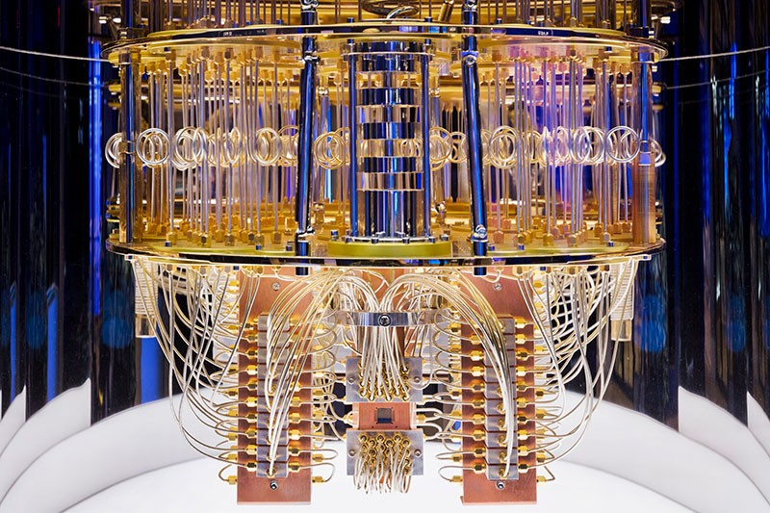
Problems apart from Hardware Limitations
Problem 1
Problem 2
Problem 3
Input/Output Problem
Costing Problem
Benchmarking Problem
100 qubit IBM QC

Slide 19
THANK YOU!

