Slide 1
Evaluating Time Complexity

Slide 2
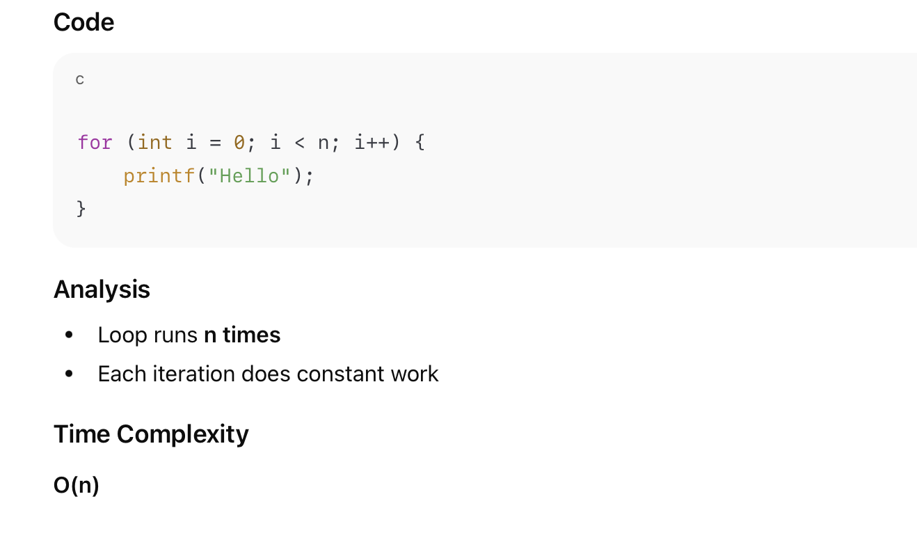
Single Loop

Slide 3
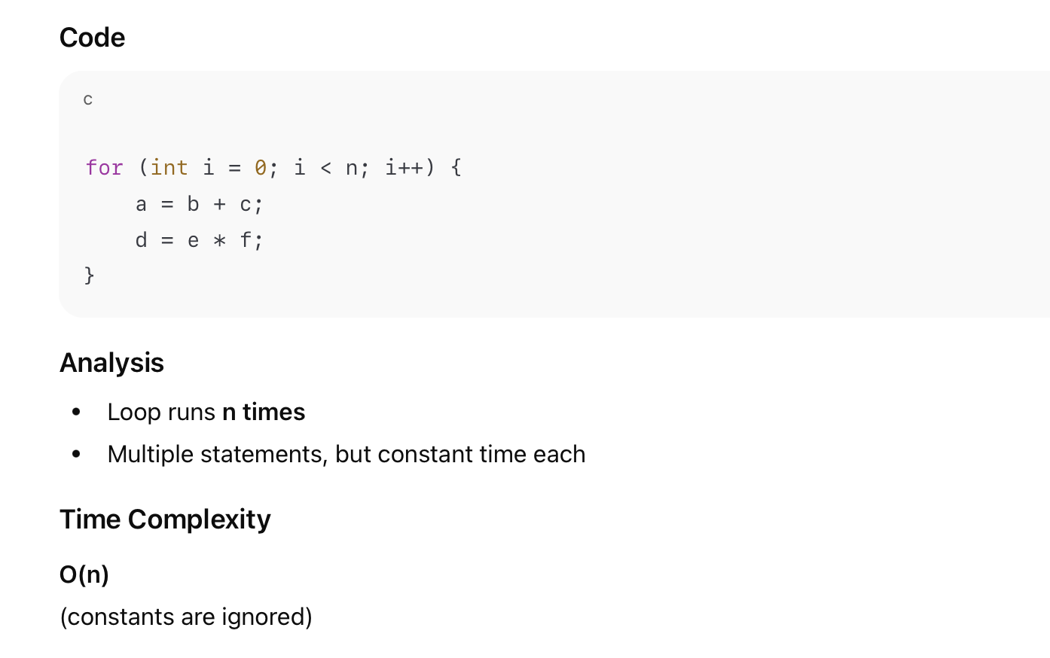
Loop with Constant Work Inside

Slide 4
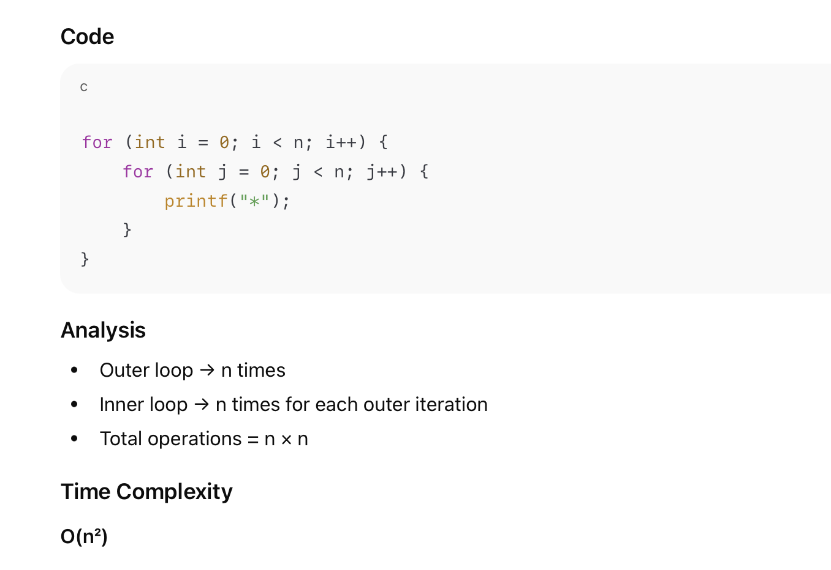
Nested Loop (n × n)

Slide 5
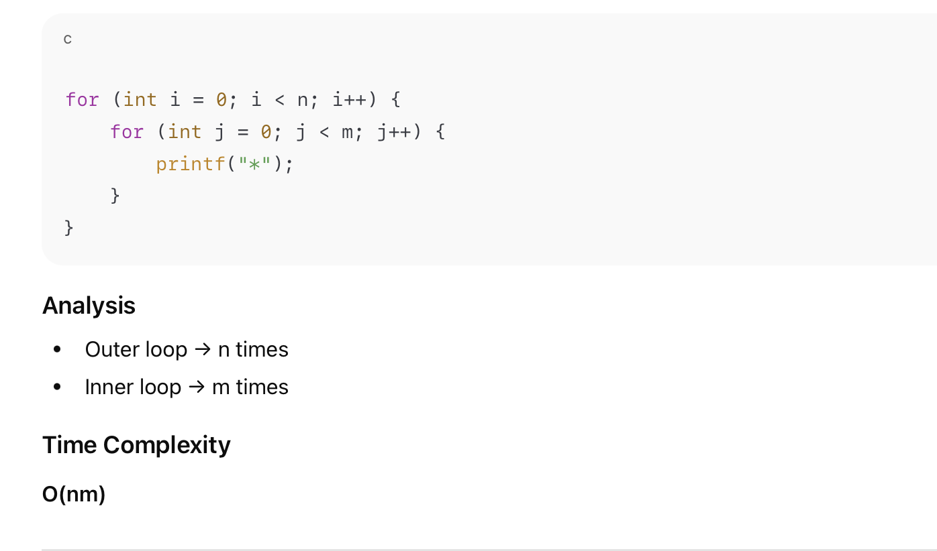
Nested Loop with Different Limits

Slide 6
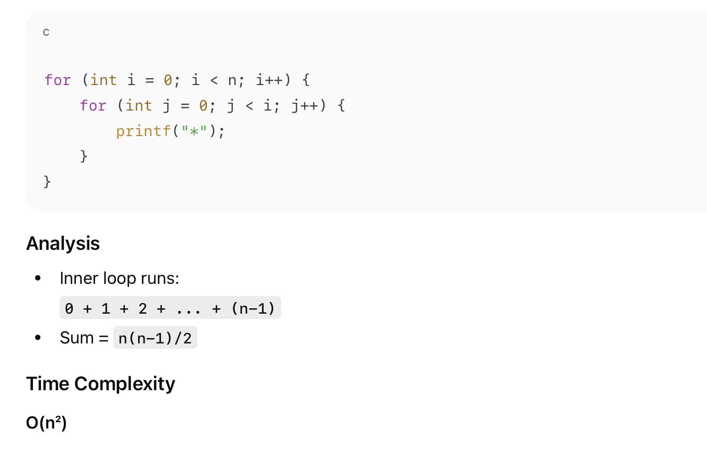
Triangular Nested Loop

Slide 7
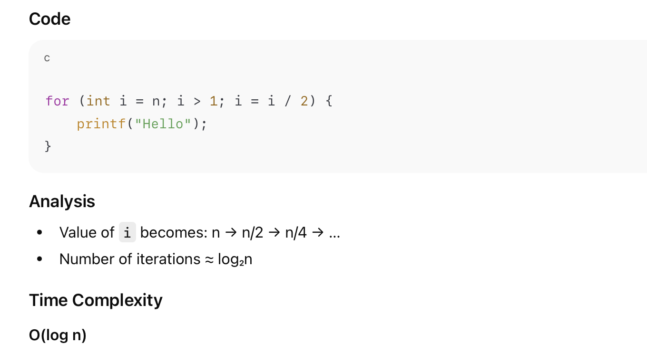
Loop That Halves the Input (Logarithmic)

Slide 8
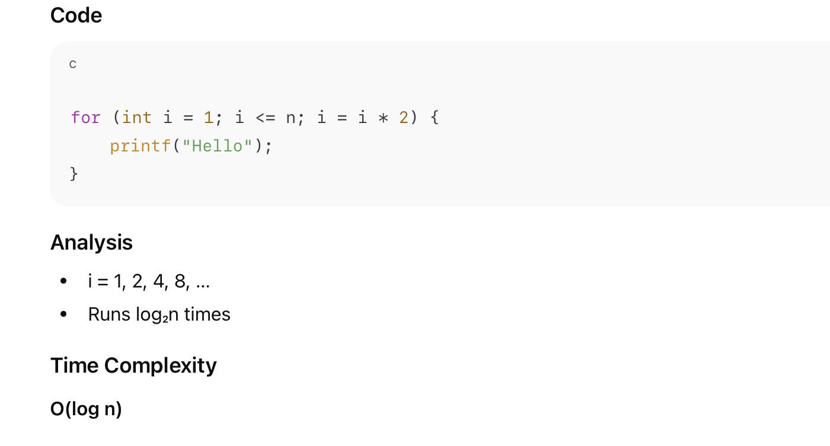
Loop That Doubles the Counter
n → n/2 → n/4 → n/8 → n/16 → ... → 1
n / 2^k = 1
n = 2^k
k = log₂ n

Slide 9
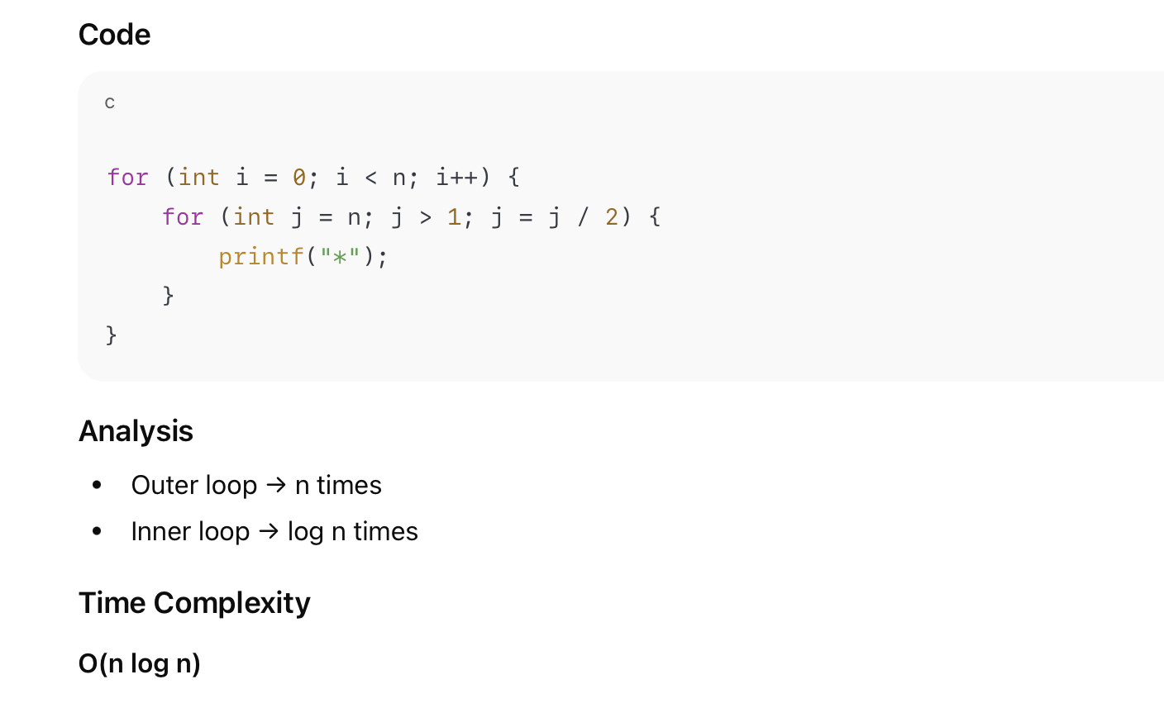
Loop Inside a Log Loop

Slide 10
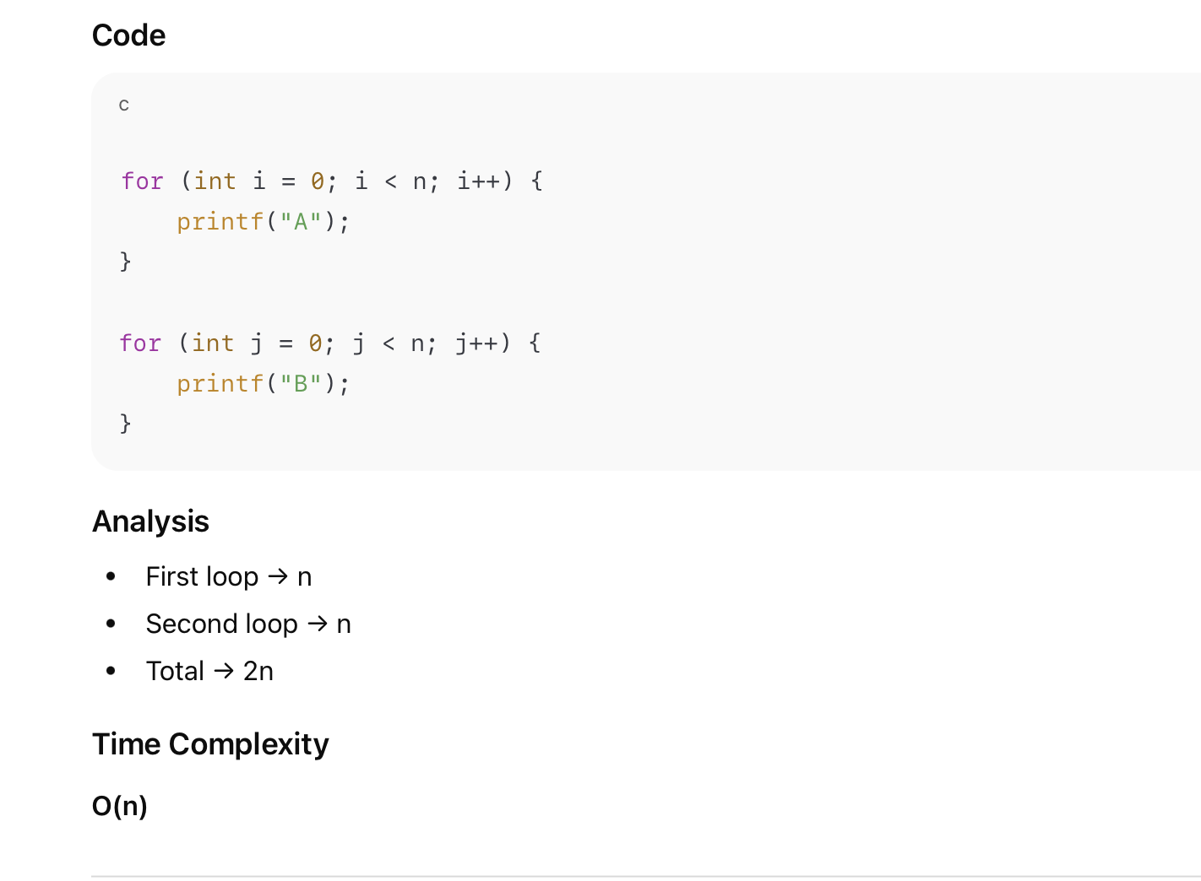
Two Separate Loops (Not Nested)

Slide 11
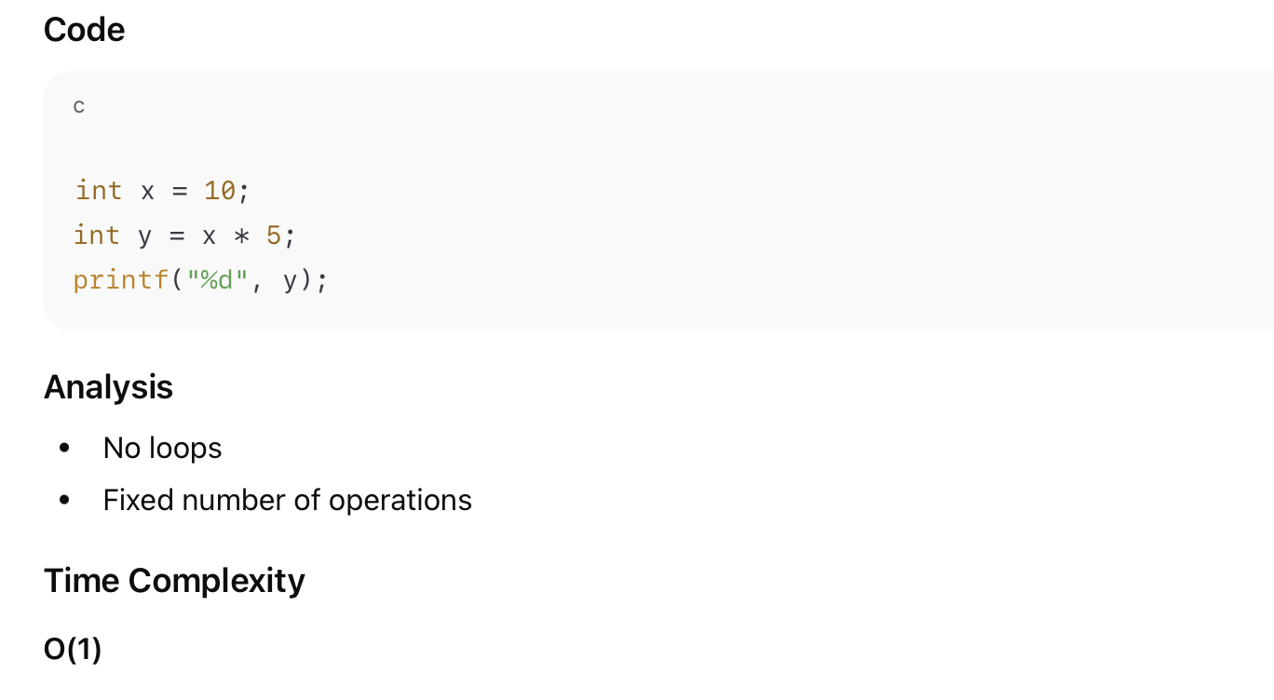
Constant Time Code

Slide 12
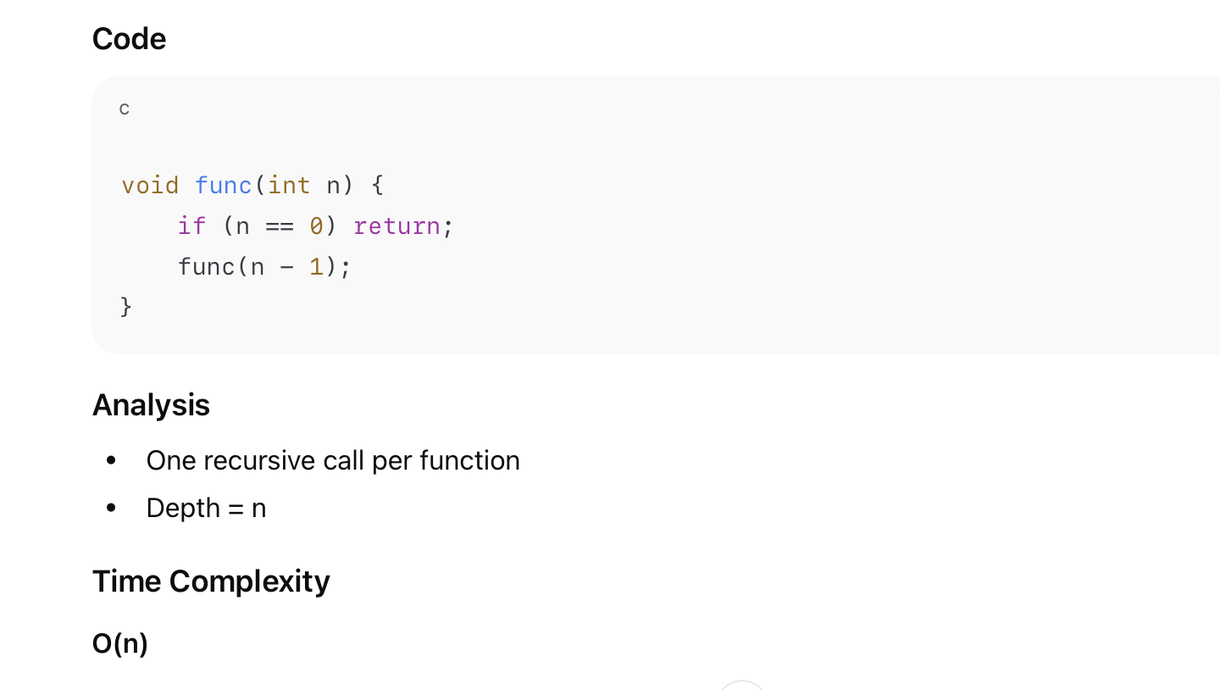
Recursive Example

Slide 13
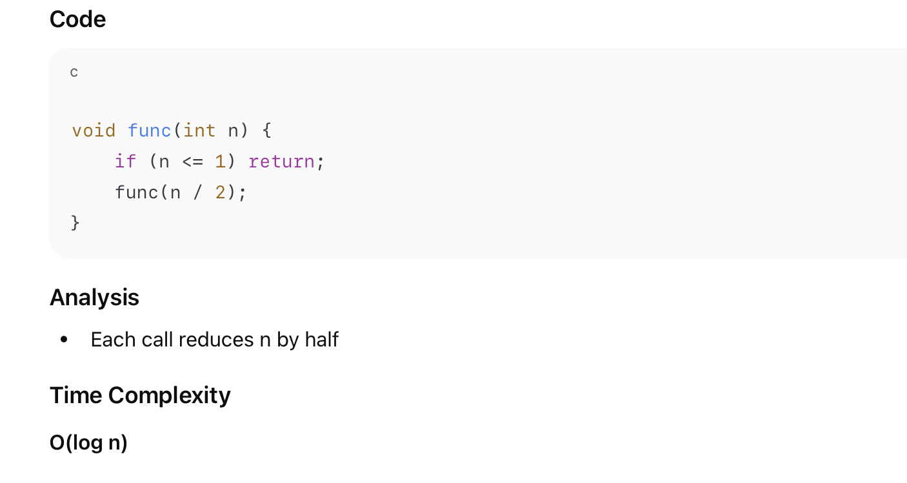
Recursive Example (Divide and Conquer)
n → n/2 → n/4 → n/8 → ... → 1
n / 2^k = 1
n = 2^k
k = log₂ n

Slide 14
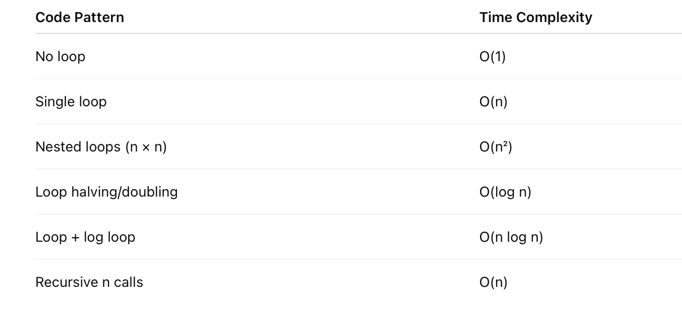
Summary

