Slide 1
IIID INDRAPRASTHA INSTITUTE of
INFORMATION TECHNOLOGY DELHI
ECE | DEPARTMENT OF ELECTRONICS &
IIID COMMUNICATIONS ENGINEERING
Review of Literature on Performance and Architectural Trade-offs in Kubernetes Container Network Interfaces
Samyak Kr Sharma
Roll No: MT25039 | IIIT-Delhi | Research Methods Presentation
1 / 8
Notes:
Welcome everyone. My presentation today evaluates the performance trade-offs of various Kubernetes networking plugins.

Slide 2
IIID INDRAPRASTHA INSTITUTE of
INFORMATION TECHNOLOGY DELHI
1. Kubernetes Scales, But the Network Lags
• Orchestration Standard: Kubernetes orchestrates workloads from massive clouds to constrained edge environments.
• The CNI Role: The Container Network Interface (CNI) dictates all pod-to-node communication flows.
• Evolving Demands: Modern data-intensive workloads require microsecond latency and high throughput.
2 / 8
Notes:
To provide some context, while Kubernetes scales applications beautifully, the underlying network often struggles to keep up with the demands of modern data-intensive workloads.

Slide 3
IIID INDRAPRASTHA INSTITUTE of
INFORMATION TECHNOLOGY DELHI
2. The Heavy Toll of Traditional Network Overlays
• The Encapsulation Tax: Standard CNIs cause a 40–50% bandwidth drop for UDP traffic (9000 MTU) vs. bare-metal networks.
• Legacy Frameworks: Traditional overlays rely on older, sequential Linux kernel frameworks like iptables.
• Edge Inefficiency: Deploying these plugins on constrained hardware yields problematic resource footprints.
3 / 8
Notes:
The problem is that traditional overlay networks add a massive encapsulation tax. We are losing up to 50% of our bandwidth just by turning the CNI on, largely due to legacy iptables processing.

Slide 4
IIID INDRAPRASTHA INSTITUTE of
INFORMATION TECHNOLOGY DELHI
ECE | DEPARTMENT OF ELECTRONICS &
IIID COMMUNICATIONS ENGINEERING
3. Evaluating Modern Routing and eBPF Alternatives
• System Tuning: Measuring bandwidth recovery through custom kernel-level TCP/UDP optimizations.
• Edge Distributions: Quantifying RAM/CPU footprints of complex CNIs on lightweight OSs (K3s, MicroK8s).
• eBPF Data Planes: Analyzing technologies (like Cilium) that bypass kube-proxy by running programs directly in the kernel.
4 / 8
Notes:
To solve this, our literature survey evaluates three shifts: tuning the Linux kernel, deploying on stripped-down edge distributions, and utilizing eBPF to bypass the traditional networking stack entirely.

Slide 5
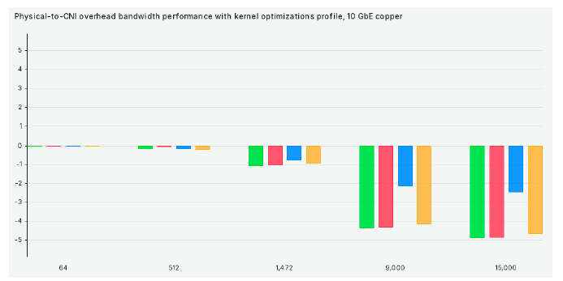
IIID INDRAPRASTHA INSTITUTE of
INFORMATION TECHNOLOGY DELHI
ECE | DEPARTMENT OF ELECTRONICS &
IIID COMMUNICATIONS ENGINEERING
4. Calico Thrives on Tuning, Flannel Wins on Latency
Inferences:
• Throughput: Kernel optimizations allow direct-routing CNIs (Calico) to recover ~2 Gbit/s of bandwidth.
• Latency: Flannel exhibits the lowest latency overhead (20% faster than peers), despite using VXLAN encapsulation.
Fig. 1 – TCP Bandwidth Efficiency Comparison across CNI Plugins
5 / 8
Notes:
Looking at the results, the chart shows Calico handles kernel optimizations incredibly well. However, for sheer latency, Flannel is surprisingly the winner, defying the assumption that encapsulation always slows response times.

Slide 6
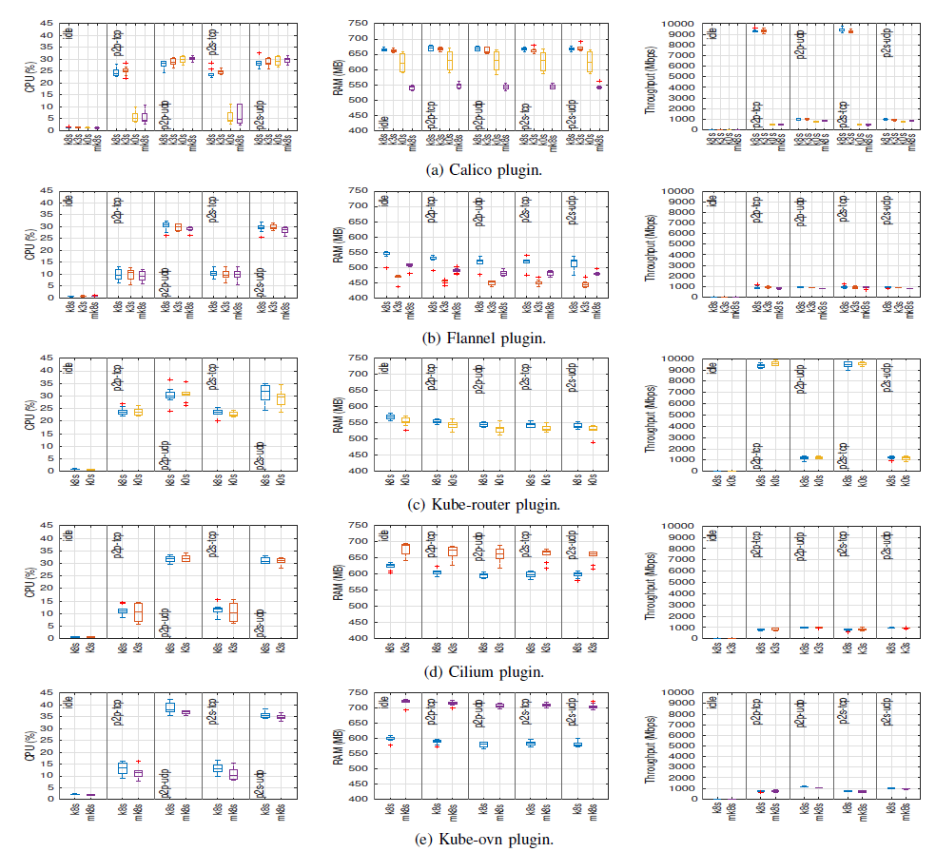
IIID INDRAPRASTHA INSTITUTE of
INFORMATION TECHNOLOGY DELHI
5. Lightweight OS Does Not Mean Lightweight CNI
Inferences:
• CPU Stability: CPU utilization remains largely static across vanilla and edge Kubernetes distributions.
• RAM Penalty: Flannel reduces RAM usage by 28% in K3s, but complex plugins (Cilium) see a 14% memory increase.
Fig. 2 – CPU and RAM Utilization across Vanilla and Edge K8s Distributions
6 / 8
Notes:
At the edge, the results are counter-intuitive. Deploying a lightweight OS like K3s doesn't magically make your network lightweight. Complex plugins like Cilium actually consume more memory on edge distributions.

Slide 7
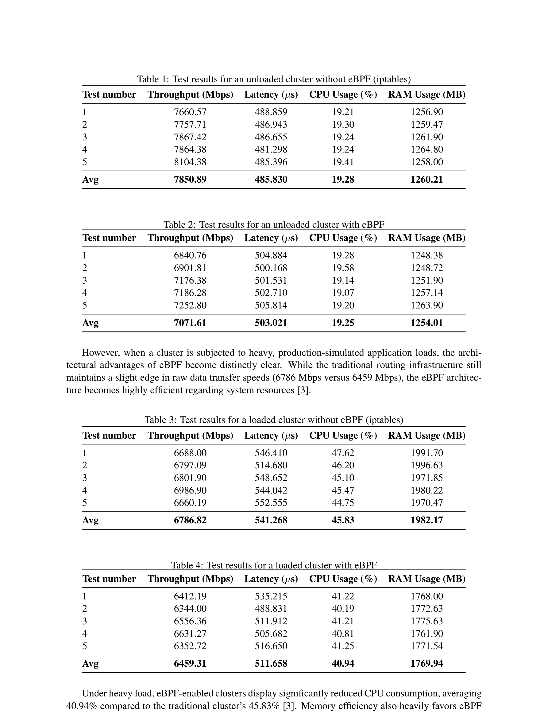
IIID INDRAPRASTHA INSTITUTE of
INFORMATION TECHNOLOGY DELHI
6. eBPF Maximizes Resource Efficiency Under Load
Inferences:
• Idle State: Traditional iptables achieves higher throughput (7850 Mbps) when cluster is unloaded.
• Production Load: Under heavy stress, eBPF cuts CPU usage by ~5% and saves nearly 200 MB of RAM.
Tables 1–4: iptables vs. eBPF – Unloaded and Loaded Cluster Results
7 / 8
Notes:
Under idle conditions, traditional iptables is actually faster. But under heavy stress, eBPF saves significant system resources—cutting CPU usage by 5% and saving 200MB of RAM, preventing cluster failure.

Slide 8
IIID INDRAPRASTHA INSTITUTE of
INFORMATION TECHNOLOGY DELHI
ECE | DEPARTMENT OF ELECTRONICS &
IIID COMMUNICATIONS ENGINEERING
7. Aligning CNI Architecture to Deployment Needs
• The Verdict: Use Flannel for edge/latency, tuned Calico for throughput, and Cilium (eBPF) for massive scale.
• Future Work: Investigate hardware offloading via Data Processing Units (DPUs) for 100 Gbit/s networks.
• Future Work: Quantify the 'observability tax' of Deep Packet Inspection (DPI) in eBPF plugins.
8 / 8
Notes:
To summarize, match the CNI to the use case. Future systems engineering research must look toward DPUs and SmartNICs to offload this routing overhead entirely. Thank you, I am open to questions.

