Slide 1
The ibm hack challenge
Problem Statement
User Query on Stack Overflow
The problem statement aims at building a solution that helps to find the right answers that are relevant to the developer issues on Stack Overflow.
A lot of content is present in form of stack overflow questions and answers, various studies point that developers face problems while development life cycles and they ask questions on stack overflow which gets answered by fellow developers across the globe. For a new developer to understand a concept or solve an issue, it could be very difficult to identify the problems. The proposed solution should help to identify most relevant questions to a query using text similarity including identify the matching tags and pick top relevant questions from stack overflow and identify top (k) solutions of the problem based on sentiment analysis of reviews of the given solutions on the Stack Overflow.

Slide 2



Team size - 3
Yudhik Agrawal
Sayak kundu
Samyak jain

Slide 3
About/contribution Team Members
Samyak Jain: [Deep Learning, NLP, CV]
Optimizing deployment of server by making it faster.
Universal Sentence Encoder to further trim the set of questions achieved by Tag filtration.
UI/UX design.
Sayak Kundu: [Pipeline design, API handling, NLP]
Smartly handling the API’s for identifying Tag and generating the questions based on tag similarity and upvotes.
Limiting the set of top solutions using statistical analysis.
ML model that extracts relevant tags from the question titles.
Yudhik Agrawal: [Deep Learning, NLP, CV]
Top(k) answers of a query by formulating a metric which involves sentiment-analysis on the feedback of each answer.
Data Collection from StackExchange Data Explorer and Google BigQuery.
Universal Sentence Encoder to further trim the set of questions achieved by Tag filtration.

Slide 4
Technology/platform/api’s used
Platform:
Django
Technology
Linux/Unix
StackExchange Data Explorer
Python
Deep Learning Libraries [Tensorflow]
Api’s
Tensorflow-Hub [Universal Sentence Encoder]
IBM Watson [Sentiment Analysis]
Stack Overflow API’s

Slide 5
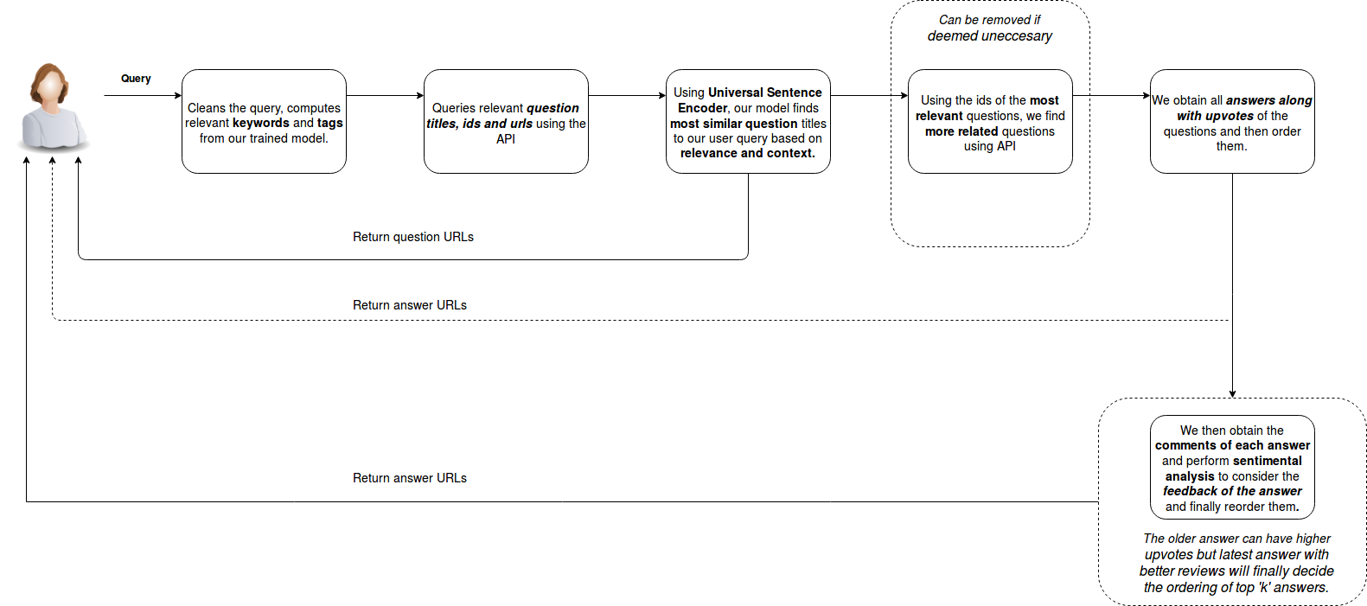
ARCHITECTURE DIAGRAM

Slide 6
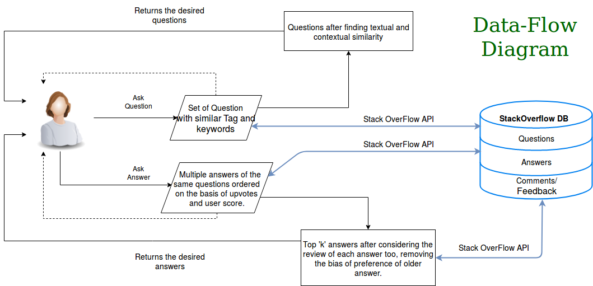
Data-Flow DIAGRAM

Slide 7
Novelty’S
Identifying Most relevant questions
We do not just rely on text similarity
We use Universal Sentence Encoder (USE) which is a better metric than Bleu Score based on ‘context and relevance’ along with text similarity.
Identifying Most Relevant Tags from questions
Tag extraction happens using a neural network, which removes the dependency on sequence matching. It reduces the search space which increases efficiency.
Identifying top ‘k’ solutions
We consider the feedback of the answer by doing sentiment analysis on the comments along with the upvotes of the answer and give score [here].
Model Deployment
Improved UX by making it faster to resolve a query by loading all the pre-trained models and creating sessions while starting the server.

Slide 8
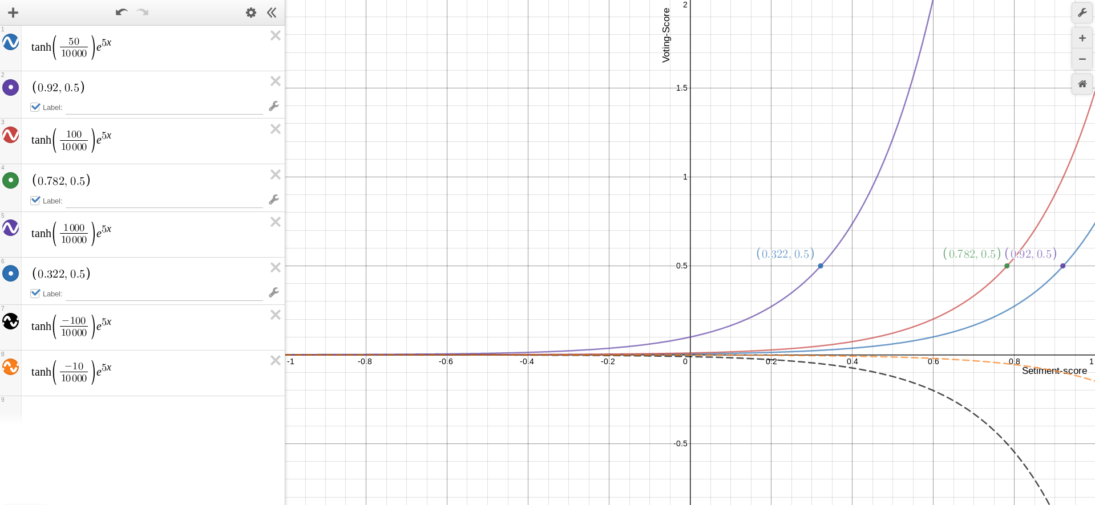

x-Axis: Sentiment Score
Y-axis: Voting Score
Formula-Range
Upvotes: [-10000, 10000] (General Assumption for scaling)
SentimentScore: [ -1, 1] (Output of the IBM-Watson)

Slide 9
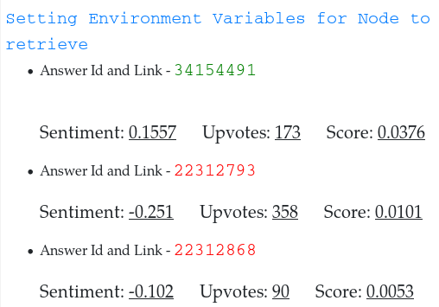

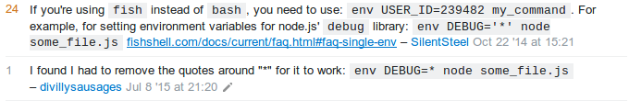


The Graph
Three Answers with upvotes having 50, 100, 1000 votes have the top priority with Sentiment Score (0.92, 0.782, 0.322) and all have Voting Score of 0.5.
This removes the bias of older answer with high upvotes from the more accurate with lower upvotes.
Real-Like Example:
Answer with 173 upvotes was given higher priority over answer with 358 upvotes due to sentiment score and the positive comments in the above example is good evidence.
Ref:https://stackoverflow.com/questions/22312671/setting-environment-variables-for-node-to-retrieve

Slide 10
Frameworks/tools used
for ui/ux design
References
Text similarity
Universal Sentence Encoder
Infersent
Sentimental analysis
IBM Watson Sentimental analysis
Reading Wikipedia to Answer Open-Domain Questions
Scalable API
Django Documentation
TensorFlow Hub | TensorFlow
We used Django as it is easily scalable and compatible while deploying various deep learning models.
As the Django uses DRY principle it makes the process of creating sessions one-time while deployment making it faster for the rest of the world.
Jinja2 is a templating library which simplifies the process of generating HTML for Python web apps.

