Slide 1
ShareCommute
Campus ride sharing
and fare splitting
Project Based Learning III
MIT World Peace University, Pune
Siddhant Bangar / Samyak Doshi / Dipesh Savardekar
Notes:
ShareCommute is a campus-focused website for discovering shared journeys and dividing the cost transparently. The team is presenting a local academic implementation. Mentor: Mrs. Gauri Dhongade. Team names and institution come from the supplied synopsis. The synopsis guides the idea, while the implemented scope defines the feature claims.
Project sources: sharecommute/docs/PROJECT_BRIEF.md; sharecommute/public/favicon.svg

Slide 2
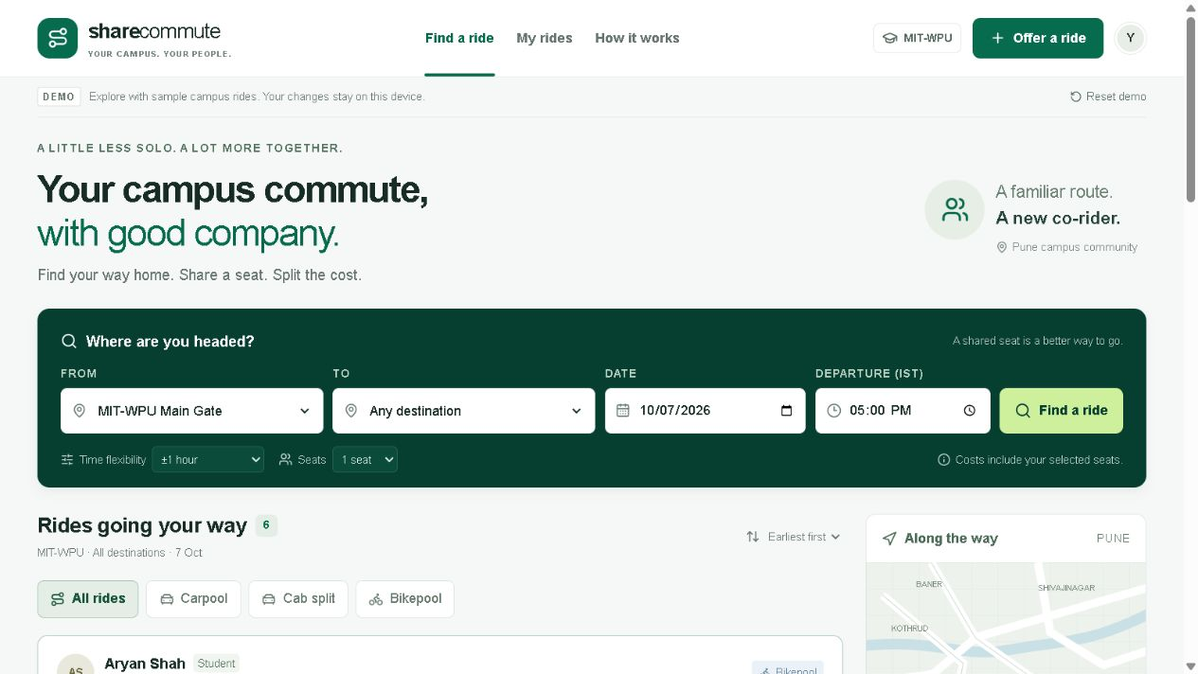
WHAT IT IS
Website overview
A campus community
for shared journeys
Students and faculty can find compatible rides, offer empty seats and see their share of the journey cost.
Carpooling, cab splitting
and bikepooling
Website interface from the Phase 1 local preview
ShareCommute
02
Notes:
The website turns the find-or-offer model into a campus-specific interface. The screenshot shows the retained Phase 1 interface. The current source connects this interface to the local Node and SQLite backend. Quick Ride inspired the find/offer pattern, while ShareCommute uses original branding and a smaller campus scope. Reference: https://quickride.in/ and https://quickride.in/help.php.
Project sources: sharecommute/docs/PROJECT_BRIEF.md; sharecommute/components/commute-app.tsx; sharecommute/lib/commute.ts

Slide 3
THE CAMPUS PROBLEM
Why the website is needed
01
Scattered coordination
Ride details get lost across chats and personal contacts.
02
Unused seats
People travel along similar routes while seats remain empty.
03
Unclear costs
Travellers need to know how the journey cost will be shared.
04
Changing plans
Bookings and cancellations need a visible, consistent record.
ShareCommute
03
Notes:
These are the problems the project aims to address, rather than findings from a completed campus survey. Informal coordination makes it difficult to compare departure times, seat availability and expected contributions. The proposed solution keeps those details in one place.
Project sources: sharecommute/docs/PROJECT_BRIEF.md; sharecommute/docs/PLAN.md

Slide 4
BENEFITS FOR THE COMMUNITY
How ShareCommute helps
01
Lower individual cost
02
Easier coordination
Travellers share a journey’s cost instead of one person bearing the whole amount.
Pickup points, departure times and bookings stay together in one website.
03
Better use of seats
04
More predictable plans
Hosts can offer space on a journey they already plan to take.
Recurring schedules and visible cancellations help regular commuters organise travel.
ShareCommute
04
Notes:
Explain these as intended benefits of the workflow. The project has not measured adoption, travel-cost savings across users, traffic reduction or carbon savings. For a particular journey, the app calculates the equal share explicitly. Broader campus impact would require a real pilot and evidence.
Project sources: sharecommute/docs/PROJECT_BRIEF.md; sharecommute/server/rides.ts

Slide 5
WHAT USERS CAN DO
Main website features
Find and join a ride
Offer and manage a ride
Route and time search
Ride offers
Select pickup, destination, date and a departure window.
Set the route, vehicle, capacity and total journey cost.
Useful comparisons
Weekday schedules
Filter by ride type and sort by time or estimated cost.
Repeat a commute on selected weekdays until an end date.
Seat reservations
My rides
Review the meeting point, reserve seats and see the cost share.
Review joined or offered rides and cancel when plans change.
ShareCommute
05
Notes:
Search supports named Pune landmarks, an inclusive time tolerance and the requested number of seats. Ride types are carpool, cab split and bikepool. The default dataset contains fictional rides clearly labelled as samples. The current interface exposes the server-backed booking and offer operations.
Project sources: sharecommute/components/commute-app.tsx; sharecommute/components/offer-form.tsx; sharecommute/server/rides.ts

Slide 6
USER WORKFLOW
How a shared journey works
01
02
03
04
05
Sign in
Find a ride
Review details
Reserve seats
Manage the ride
Use a campus email
and enter a code.
Choose a route, date
and departure window.
Check the host, seats,
meeting point and cost.
Confirm the booking.
Availability updates.
View the booking or
cancel in My rides.
Current local mode shows a test code. Real email ownership verification requires email delivery.
ShareCommute
06
Notes:
Walk through the flow in this order. Sign-in accepts the configured institutional domain, currently mitwpu.edu.in. Development mode deliberately displays a test code and does not prove that the user owns the email address. When real delivery is configured, the backend can send a code through Resend. The booking operation validates availability on the server.
Project sources: sharecommute/components/sign-in-panel.tsx; sharecommute/server/auth.ts; sharecommute/server/app.ts; sharecommute/server/rides.ts

Slide 7
A SIMPLE EXAMPLE
Transparent fare splitting
₹180
3
₹60
Total journey cost
Travellers
Per traveller
1 host + 2 passengers
If four people share the same ₹180 journey, each person contributes ₹45.
Illustrative amounts. The website records cost shares and does not collect payments.
ShareCommute
07
Notes:
Capacity includes the host, and cost sharing includes every traveller. The backend stores money as integer paise. If a total does not divide evenly, the algorithm allocates extra paise deterministically so all shares add exactly to the original total. For example, ₹100 split among three people becomes ₹33.34, ₹33.33 and ₹33.33. The displayed share can change when people join or cancel.
Project sources: sharecommute/lib/commute.ts; sharecommute/server/rides.ts; sharecommute/tests/commute.test.mjs

Slide 8
FOR REGULAR CAMPUS TRAVEL
Recurring commutes and My rides
One schedule,
separate daily rides
Joined rides
Check confirmed bookings and your current cost share.
Offered rides
Choose the weekdays and end date. Each occurrence keeps its own departure time, seat count and bookings.
Review available seats and confirmed co-riders.
Cancellation
Release booked seats or close an offer.
Example: MIT-WPU to Shivajinagar
Monday to Friday at 5:00 PM IST
Stopping a schedule
Cancel future occurrences while retaining past records.
ShareCommute
08
Notes:
The scheduler uses a unique template/date constraint, so repeated runs do not create duplicates. Cancelled occurrences stay recorded so the scheduler does not recreate them. Stopping the complete schedule closes future ride offers and their active bookings. The scheduler runs only while the local server is running.
Project sources: sharecommute/server/rides.ts; sharecommute/server/migrations/003_recurring_and_reports.sql; sharecommute/server/index.ts

Slide 9
HOW THE SYSTEM SUPPORTS USERS
Access, privacy and reliability
Campus account access
The website accepts the configured institutional email domain.
Protected seat capacity
Server checks and database transactions prevent overbooking.
Controlled contact sharing
Confirmed riders can see the host’s email. Hosts can see their confirmed co-riders.
Clear ownership
Users manage their own offers and bookings. Administrators handle reports.
ShareCommute
09
Notes:
Avoid presenting these controls as a guarantee of personal safety. Students should still meet in public and confirm whom they travel with. Sessions use an HttpOnly cookie. Sign-in codes expire, have limited attempts and cannot be reused. Booking/cancellation writes enforce ownership. Test mode does not provide email ownership verification, even though it restricts the email suffix.
Project sources: sharecommute/server/auth.ts; sharecommute/server/app.ts; sharecommute/server/rides.ts; sharecommute/server/migrations/001_core.sql

Slide 10
SUPPORT FOR THE CAMPUS COMMUNITY
Administration and moderation
Members can report
a ride issue
Administrator tools
01
View member, ride and booking counts
A short description gives administrators the context they need to review a problem.
02
Read and resolve ride reports
03
Suspend or restore member access
Reports remain in a review queue
until an administrator resolves them.
04
Cancel future travel linked to a suspended member
ShareCommute
10
Notes:
Administrator access is a distinct server-side permission. A local CLI grants that role after an account exists. Suspending a member removes sessions, stops schedules and cancels their upcoming bookings and offers. Restoring access does not restore cancelled travel automatically. The report form does not contact emergency services.
Project sources: sharecommute/server/admin.ts; sharecommute/components/admin-panel.tsx; sharecommute/components/report-form.tsx; sharecommute/scripts/admin.mjs

Slide 11
PROJECT APPROACH
Implementation in two phases
Phase 1
Phase 2
Frontend foundation
Shared local application
Responsive interface
Ride search and offer forms
Booking and fare rules
Demonstration with sample data
Accounts and shared SQLite data
Server-authorised bookings
Weekday recurring schedules
Reports and administration
React + TypeScript frontend Node.js API SQLite database Local Git history
ShareCommute
11
Notes:
The user approved two phases, with the original frontend retained for the final application. The current code uses Vite with React and TypeScript, a Node server and SQLite. Drizzle was an unused starter dependency and was removed. The 24-test suite passed in the prior development session, including simultaneous final-seat requests and recurrence/moderation checks. Do not claim that this constitutes a live campus pilot. Source remains local and no GitHub remote has been configured.
Project sources: sharecommute/package.json; sharecommute/server/database.ts; sharecommute/tests/server.test.mjs; sharecommute/docs/PLAN.md

Slide 12
LOCAL PROJECT DEMONSTRATION
Current scope and next steps
Available locally
Future integrations
Accounts and shared ride data
Search, offers and reservations
Fare splitting and cancellations
Recurring rides and admin tools
Real email delivery after sender setup
Road maps and address suggestions
Payment integration if required
A campus pilot to measure benefits
ShareCommute brings campus ride coordination and transparent cost sharing into one website.
ShareCommute
12
Notes:
The application runs locally. Its current mail mode shows development codes. Resend support exists, but the provided account had no verified sender domain during the check, so real email delivery remains untested. The route illustration is a landmark schematic rather than live navigation. The project does not collect payments, use AI matching or claim measured carbon savings. Proposed integrations are optional follow-ups, not implemented capabilities.
Project sources: sharecommute/server/mailer.ts; sharecommute/components/route-overview.tsx; sharecommute/docs/PLAN.md; sharecommute/server/index.ts

