Slide 1

DATA ANALYSIS ON OLA
Name : Apurv Toshniwal
PRN : 22310547
Roll No. BTECH3A431020

Slide 2

ABOUT OLA
Ola is India’s largest mobility platform and one of the world’s largest ride-hailing companies, serving 250+ cities across India, Australia, New Zealand, and the UK. The Ola app offers mobility solutions by connecting customers to drivers and a wide range of vehicles across bikes, auto-rickshaws, metered taxis, and cabs, enabling convenience and transparency for hundreds of millions of consumers and over 1.5 million driver-partners.
Ola’s core mobility offering in India is supplemented by its electric-vehicle arm, Ola Electric; India’s largest fleet management business, Ola Fleet Technologies and Ola Skilling, that aims to enable millions of livelihood opportunities for India's youth. India’s leading public transportation app and investment in Vigo, a dockless scooter sharing solution, Ola is looking to build mobility for the next billion Indians.

Slide 3



TOOLS USED FOR PROJECT
PYTHON IN VS CODE
Handling the missing values
Analysis of dataset
Connecting with MySQL
MYSQL
Exploring the dataset
POWER BI
Creating the dashboards

Slide 4
Analysis of the dataset in python

Slide 5
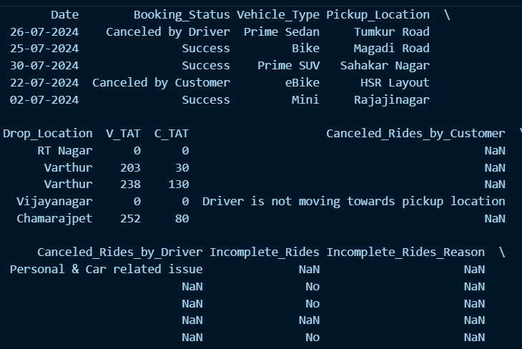
Loading the Dataset in Vs Code

Slide 6
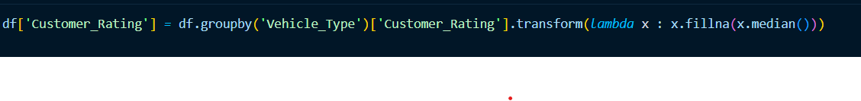
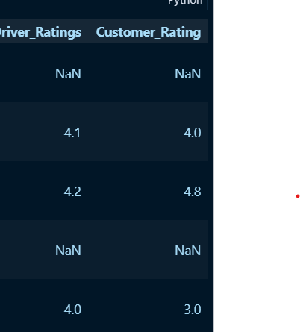
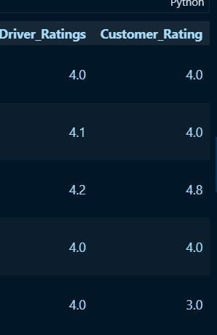
Handling the missing data

Slide 7
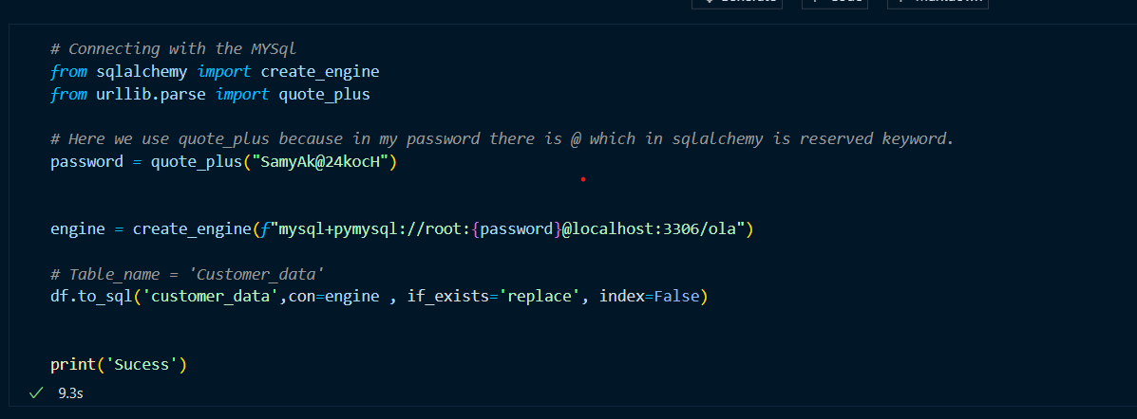
Connecting with MySQL

Slide 8
Exploring the dataset in MySQL

Slide 9

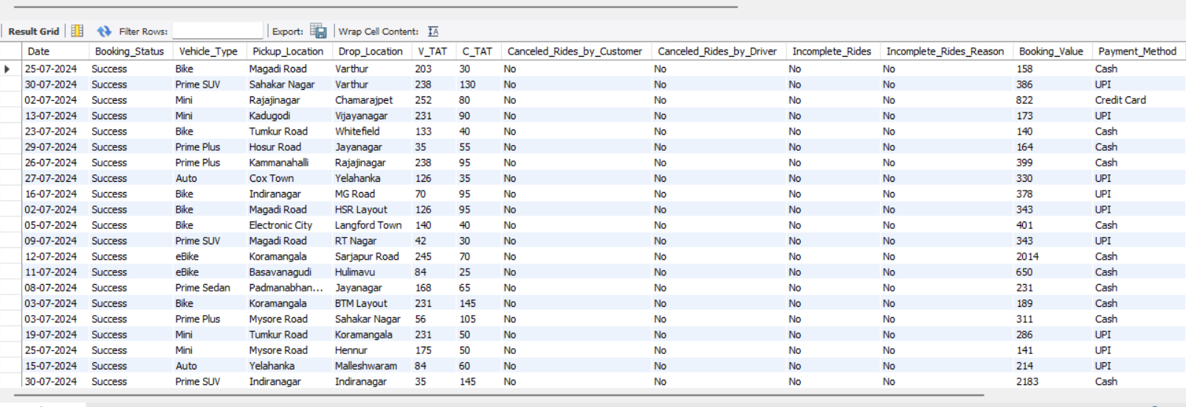
1. Retrieve all successful bookings from dataset.
Query:
Result:

Slide 10
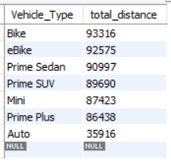
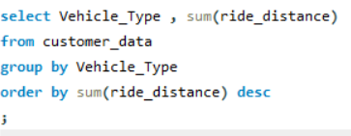
2. Find Average Ride Distance for each vehicle type
Query:
Result:

Slide 11
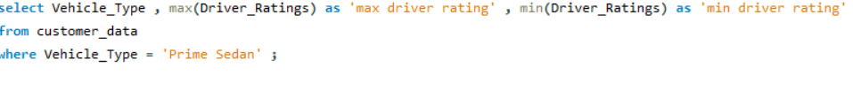
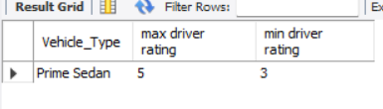
3. Find maximum and minimum driver ratings for prime sedan bookings
Query:
Result:

Slide 12

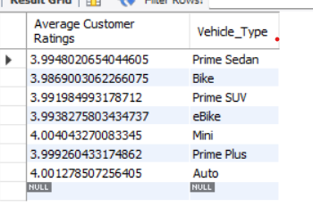
4. Find average Customer Rating as per vehicle type
Query:
Result:

Slide 13
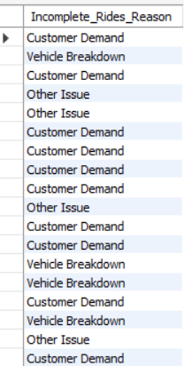

5. List all incomplete rides along with the reason
Query:
Result:

Slide 14
Creating the dashboard in power bi

Slide 15
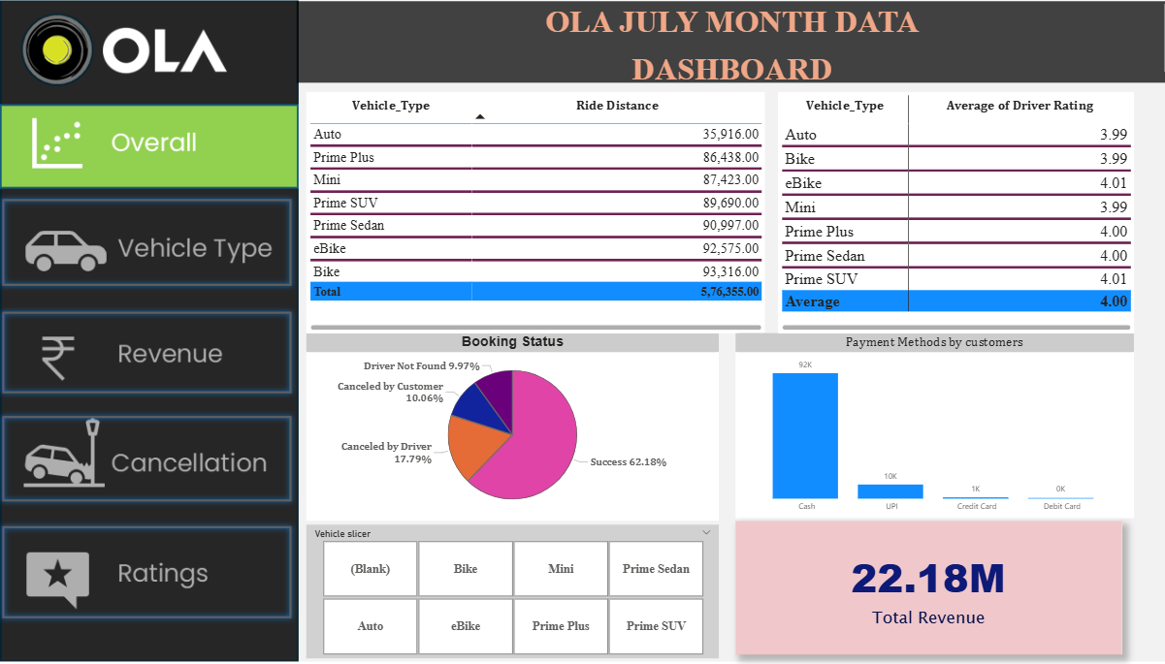
Overall

Slide 16
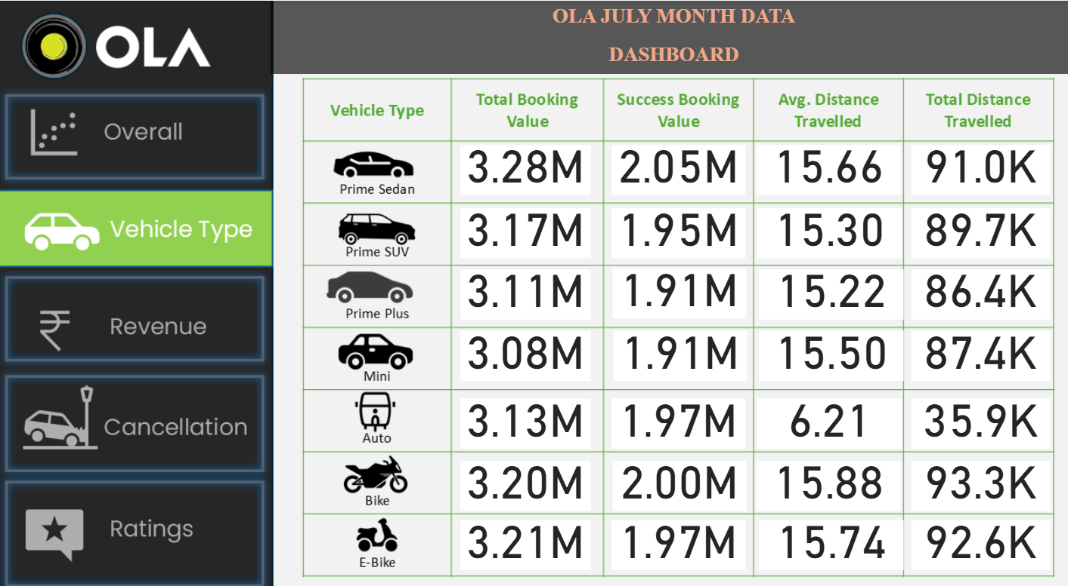
Vehicle type

Slide 17
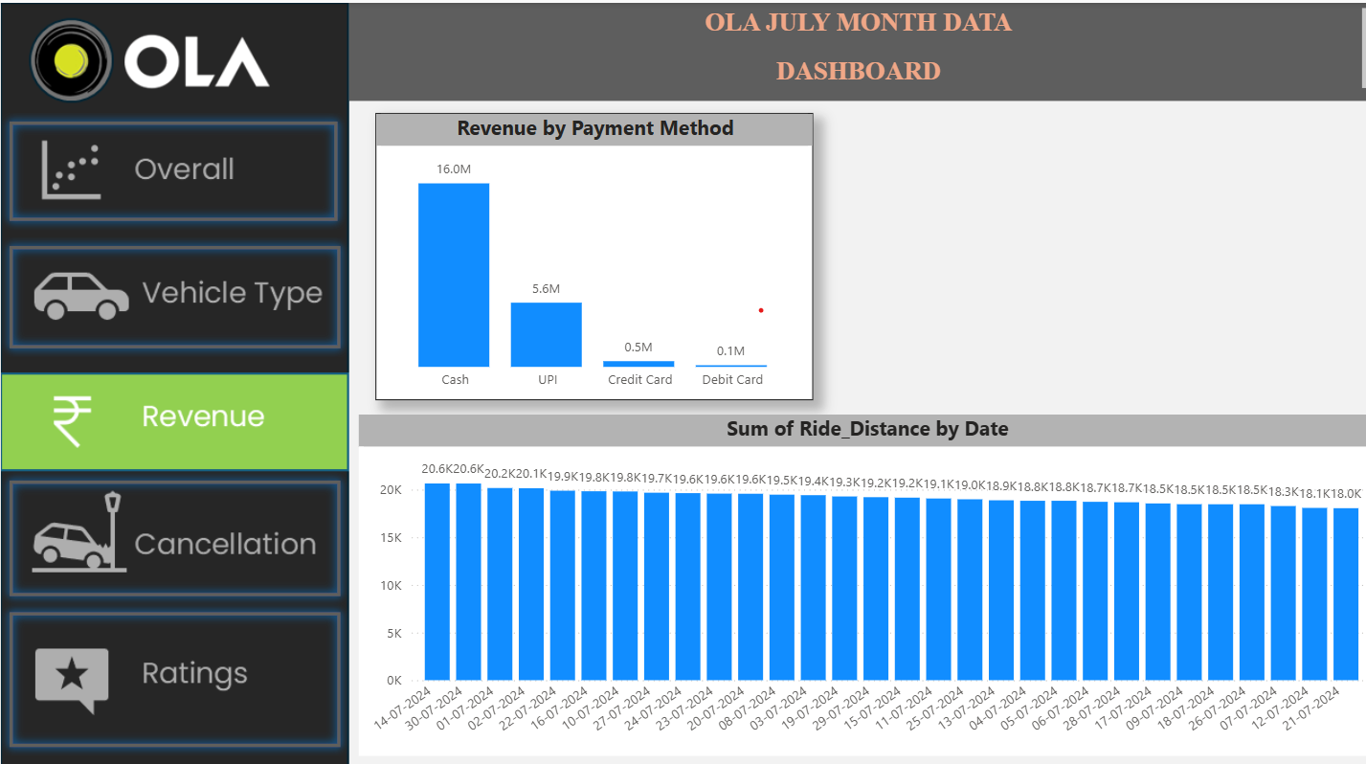
revenue

Slide 18
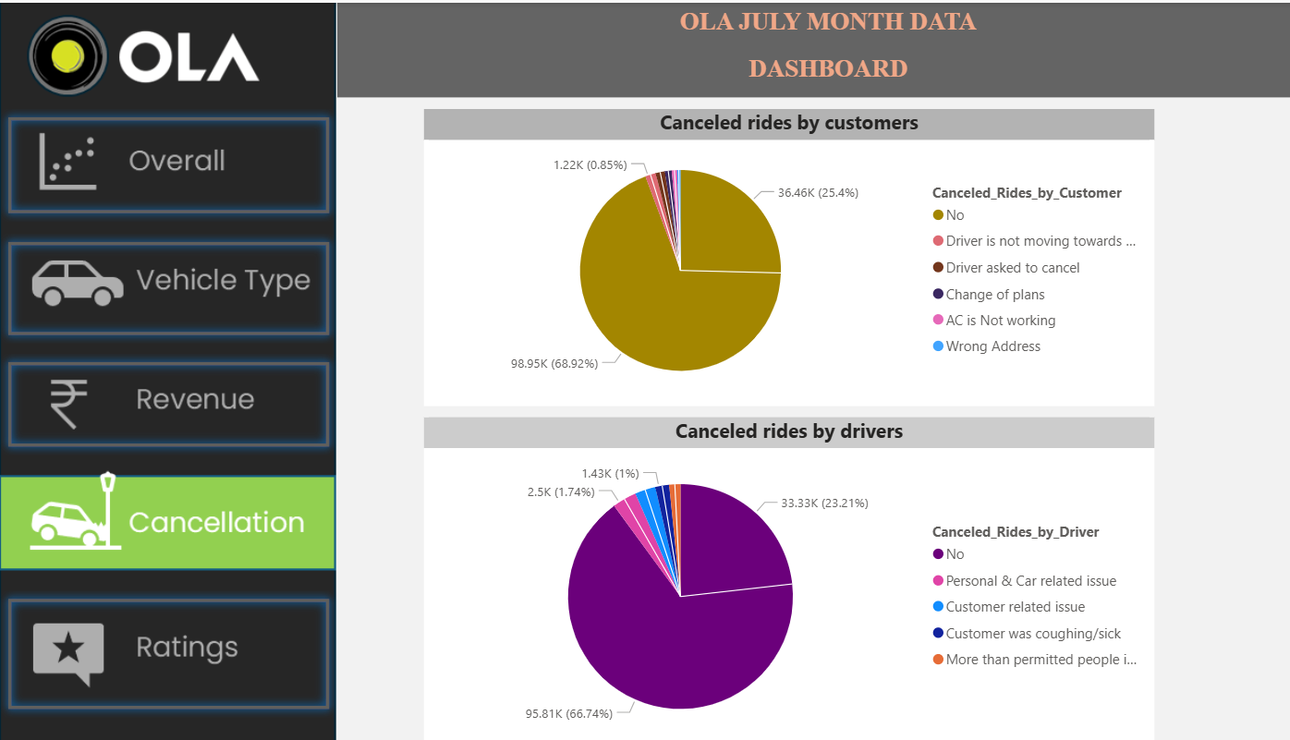
cancelLation

Slide 19
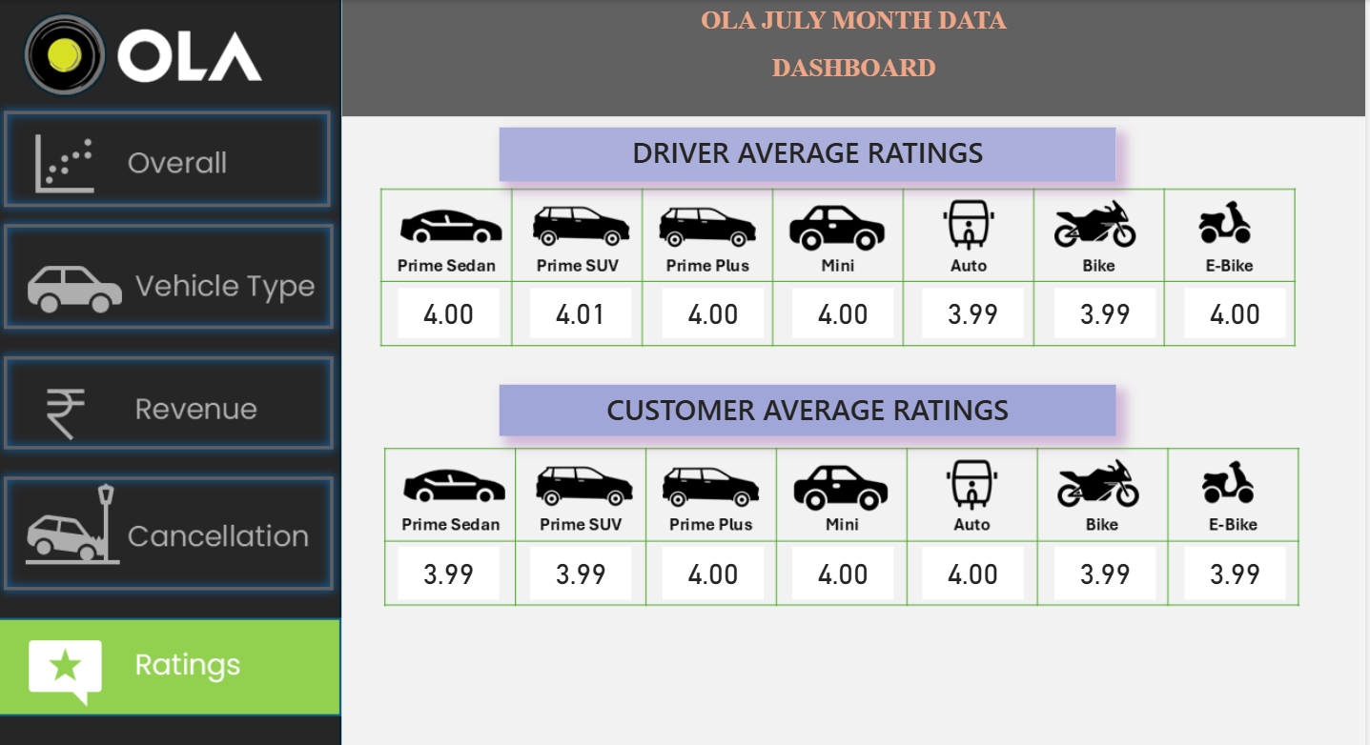
ratings

Slide 20
Thank you

