Slide 1
When does RL beat a supervised recommender on long-term utility?
RL for Sequential Recommendation (course project topic 3.9) | Mid-semester review
Samyak Bansal
18 October 2026
Code: github.com/samyakbansal5-eng/rl-seqrec
Notes:
Introduce yourself and the project: topic 3.9, RL for sequential recommendation. The one-line question is when an RL recommender actually beats a supervised next-click recommender on long-term utility, and what changes when we show a slate of several items instead of one. Every number in this talk is produced by a script in the repository; the README lists the commands.

Slide 2
The question: a click now, or engagement later?
■ Supervised next-click model: maximises CTR now (short-term)
■ RL recommender: maximises discounted future clicks (long-term)
■ RL can trade a click now for a longer, happier session
■ Topic 3.9 asks: when does RL actually win on long-term utility?
■ Extension: re-ranking, showing a slate of K items at once
Short-term metric
First-slate CTR = 1 - P(no click)
Long-term metric
Clicks per session (return, γ = 1) and session length
Approach: put both recommenders inside one model, so the comparison is precise rather than anecdotal
Samyak Bansal | 2
Notes:
A supervised sequential recommender is trained to predict the next click, so it optimises short-term engagement, i.e. click-through rate. An RL recommender maximises a discounted sum of future rewards, so in principle it can give up a click now for more engagement later. Papers report RL gains, but often on one-step metrics, and it is unclear where the gains come from. The topic asks when the RL recommender actually wins on long-term utility, and suggests the extension to re-ranking, where K items are shown at once. Our answer strategy: put both in one model so the comparison is exact.

Slide 3
One model for both: combinatorial MDP with MNL choice
■ State s: user, recent clicks, step. Action: slate A of ≤ K items
■ User picks a ∈ A or no click a₀ with MNL probability
■ Reward 1 per click; next state depends on what was picked
■ K = 1: sequential recommendation; K > 1: re-ranking
■ Best slate = linear-fractional program (LP via Charnes-Cooper, or bisection; checked vs brute force)
Choice model and slate value
P(a | s, A) = e^v(s,a) / (1 + Σ_{a'∈A} e^v(s,a'))
Q̄(s,a) = r(s,a) + γ E[V(s')]
Q(s,A) = Σ_{a ∈ A ∪ {a₀}} P(a | s, A) · Q̄(s,a)
Lemma 1: supervised = myopic (γ = 0)
Click prob. W/(1+W) grows in W = Σ e^v, so top-K by utility is myopic-optimal; a CE next-click model recovers utilities up to a constant
"Supervised vs RL" becomes "γ = 0 vs γ > 0" in the same model
Samyak Bansal | 3
Notes:
We use the episodic combinatorial MDP with multinomial-logit choice from Lee and Oh, ICML 2025. At each step the recommender shows a slate of at most K items; the user clicks one item or the outside option 'no click' with MNL probabilities, gets reward 1 per click, and the next state depends on what was picked. Only item-level values Q-bar need to be learned; the slate value is the choice-probability-weighted average. The best slate is a linear-fractional program, solved as an LP after Charnes-Cooper or by bisection, both verified against brute force on 300 random instances. Lemma 1: with unit click rewards the best immediate slate is the top-K by utility, and a cross-entropy next-click model recovers utilities up to a constant, so supervised = the gamma = 0 policy. That turns 'supervised vs RL' into 'gamma = 0 vs gamma > 0' in one model.

Slide 4
When can RL help? Two propositions
Proposition 1: RL can be arbitrarily better
For any n there is an MDP with optimal long-term return > n × myopic return.
Intuition: clickable junk makes the user leave; myopic always shows it and gets ≤ 1 click.
Dual of Labarca et al. Thm 4.3 (RL-optimal can be arbitrarily worse at next-item prediction).
Proposition 2: no advantage without choice-dependent dynamics
If p(s' | s, a) does not depend on the chosen item a, myopic is optimal for every γ.
Intuition: the future term is the same for every item, so Q(s,A) = immediate reward + c(s).
Corollary: RL helps only if the user's choice changes their future
Axes of the regime map: strength of that dependence (s), slate size K (two-type toy model, formulation.tex Section 4), and γ.
Samyak Bansal | 4
Notes:
Proposition 1: for any n there is an MDP where the optimal long-term return is more than n times the myopic return. Construction: a junk item that is more clickable than a good item but makes the user leave; myopic always shows junk and gets at most one click, while showing the good item collects H times c_g clicks. This is the dual of Labarca, Parra and Toro Icarte's Theorem 4.3, which shows an RL-optimal policy can be arbitrarily worse at next-item prediction. So neither objective dominates: the metric and the dynamics decide. Proposition 2: if the transition does not depend on the chosen item, including no-click, the future term is a constant c(s), choice probabilities sum to one, so Q(s,A) = immediate reward + c(s) and myopic is optimal for every gamma. Corollary: RL helps only if the choice changes the future. Full proofs are in formulation.tex; Section 4 there has a two-type good/junk toy model for the dependence on K (not a proposition; to be analysed for the end-semester).

Slide 5
What was built: S1 to S9
foundations
reproductions
controlled experiment + demo
S1
S2
S3
S4
S5
S6
S7
S8
S9
Data
Theory
Slate solver
Repro 1
Repro 2
Simulator
Sanity
Main exp.
Demo
RetailRocket,
MovieLens-1M
Lemma 1,
Props 1-2
LP / bisection
MNL assortment
Labarca et al.
RetailRocket
Lee & Oh
synthetic
MovieLens-1M
user model
Oracle
policies
Supervised vs
RL, K = 1
Streamlit
live session
■ Status: S2, S3, S5-S9 done; S4 partial (full grid running on a Colab GPU)
■ Every number in the talk comes from a script in scripts/ (README lists the commands)
Samyak Bansal | 5
Notes:
This is the pipeline of what exists now. S1 data: RetailRocket and MovieLens-1M preprocessing, matching the paper's RetailRocket statistics, 195,524 sessions, 70,852 items, 57,269 purchases. S2 formulation and proofs. S3 the exact MNL assortment solver, LP and bisection, tested against brute force. S4 and S5 are the two reproductions; S6 and S7 the MovieLens simulator and its oracle sanity check; S8 the main supervised-vs-RL experiment at K = 1; S9 the Streamlit demo. Everything is a script in the repo, reproducible from the README.

Slide 6
Reproduction 1: Labarca et al. (ICML 2024) on RetailRocket
Claim: an SQN (RL) head improves next-item prediction, but non-RL heads (EVAL, HIST) do as well, so the gain is representation learning, not RL.
Model | best epoch (of run) | buy HR@5 | buy HR@20 | click HR@20
GRU4Rec (CE) | 2 of 3 | 0.380 | 0.458 | 0.292
GRU4Rec-SQN | 2 of 2 | 0.327 | 0.386 | 0.249
SASRec (CE) | 3 of 3 | 0.469 | 0.551 | 0.346
SASRec-SQN | 2 of 2 | 0.411 | 0.461 | 0.267
Repeat-item finding
67% of purchase targets = the item viewed just before (73% in 10-item history)
Explains purchase HR@20 ≈ 2× the paper's (0.46 vs 0.23)
Partial CPU run: 1 seed, 2-3 epochs (full table in report)
■ Setup as SQN: views = clicks, add-to-cart = purchases; data matches paper (195,524 sessions, 70,852 items)
■ Compare relative gains between heads; SQN < CE after 2-3 epochs is too early to judge
■ Status: full grid (8 models × 5 seeds) running on Colab GPU
Samyak Bansal | 6
Notes:
Labarca, Parra and Toro Icarte claim that adding an RL loss (SQN: a Q-head trained by TD with click reward 1 and purchase reward 5) to GRU4Rec or SASRec improves next-item prediction, but that non-RL auxiliary heads (EVAL, HIST) give similar gains, so the gain is representation learning, not RL. We reproduce their protocol: time-based 80/10/10 split, hidden 64, state length 10, gamma 0.5, full-ranking HR and NDCG, model selection on validation purchase NDCG@20. Our data matches: 195,524 sessions, 70,852 items, 57,269 purchases. Partial CPU results, 1 seed, 2-3 epochs: e.g. SASRec CE purchase HR@20 0.551, GRU4Rec CE purchase HR@20 0.458. Our purchase metrics are about twice the paper's (0.46 vs 0.23 for GRU4Rec CE HR@20): 67% of purchase targets equal the item viewed just before, 73% are in the 10-item history. So we compare relative differences between heads; SQN is still below CE after 2-3 epochs, which is too early to conclude. The full grid, 8 models x 5 seeds, runs on a Colab GPU.

Slide 7
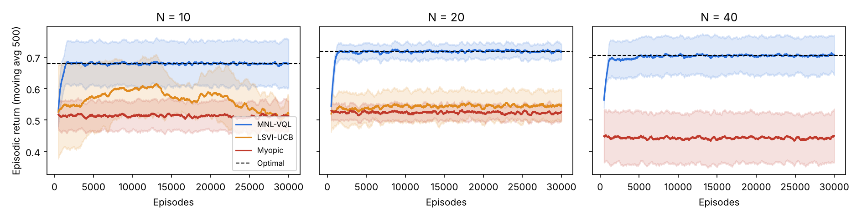
Reproduction 2: Lee & Oh (ICML 2025) synthetic MDP
N | Optimal | Myopic | LSVI-UCB | MNL-VQL
10 | 0.680 ± 0.071 | 0.513 ± 0.050 | 0.513 ± 0.041 | 0.678 ± 0.074
20 | 0.719 ± 0.024 | 0.524 ± 0.029 | 0.546 ± 0.049 | 0.718 ± 0.026
40 | 0.705 ± 0.061 | 0.444 ± 0.079 | not run | 0.706 ± 0.060
■ MNL-VQL within 1% of optimal
■ Myopic 25-37% below optimal
■ LSVI-UCB = Myopic at N = 10 (0.513 ± 0.041 vs 0.513 ± 0.050); slow (combinatorial actions)
Takeaway: RL beats myopic when transitions depend on the choice (first clean instance)
Samyak Bansal | 7
Notes:
This is the paper's synthetic 'budget' MDP: N items, 5 states, horizon 5, slates of up to 6 items, MNL choice with linear utilities, and rewards and transitions that depend on the chosen item. The optimum is computed exactly by dynamic programming with the exact assortment solver. Three agents: myopic (OFU-MNL+-style), LSVI-UCB treating each assortment as an action, and MNL-VQL, the paper's algorithm. 30,000 episodes, 5 seeds; numbers are the mean return over the last 2,000 episodes. N = 10: optimal 0.680 ± 0.071, myopic 0.513 ± 0.050, MNL-VQL 0.678 ± 0.074. N = 20: optimal 0.719 ± 0.024, myopic 0.524 ± 0.029, MNL-VQL 0.718 ± 0.026. N = 40: optimal 0.705 ± 0.061, myopic 0.444 ± 0.079, MNL-VQL 0.706 ± 0.060. MNL-VQL is within 1% of optimal for all N; myopic is 25-37% below optimal because it ignores how the choice changes the next state. LSVI-UCB is not in between: at N = 10 it equals myopic (0.513 ± 0.041 vs 0.513 ± 0.050, optimal 0.680 ± 0.071); it is slow because assortments grow combinatorially, so we ran it only up to N = 20. This reproduces the paper's Figure 1 qualitatively.

Slide 8
MovieLens-1M user simulator
■ Catalogue: 500 most-rated movies; ALS (rank 32) gives predicted rating r̂(u,i)
■ Junk: bottom 25% by mean rating, made more clickable (κ = 1), like clickbait
■ Choice: MNL, v = b₀ + (r̂ − 3.5) + κ·junk − s·λ·fatigue·genres
■ Satisfaction: good clicks raise it, bad/junk clicks lower it
■ Exit: junk click → leave w.p. 0.3 s; each step leave w.p. 0.05 + 0.4 s (1 − σ); cap 30 steps
One knob: strength s ∈ [0, 1]
Scales every long-term effect (satisfaction, fatigue, leaving)
s = 0 is the Prop. 2 control
Choice does not affect the future, so myopic is optimal
Samyak Bansal | 8
Notes:
KuaiRec was not obtainable, so the simulator is calibrated on MovieLens-1M, as Lee and Oh do. Catalogue: 500 most-rated movies; preferences from rank-32 ALS on all 1M ratings. Junk items: the bottom 25% by mean rating, popular but poorly rated, made more clickable with kappa = 1, like clickbait. The strength s scales all long-term effects: clicking changes hidden satisfaction by s·eta·(q - q_ref), a junk click makes the user leave with probability 0.3 s, and the per-step exit probability is 0.05 + 0.4 s (1 - satisfaction); sessions are capped at 30 steps. At s = 0 nothing the user picks affects the future, so Prop. 2 says myopic is optimal: this is our control. The dynamics are assumed, not learned, so conclusions are about the mechanism.

Slide 9
Sanity check: oracle policies in the simulator
setting | myopic oracle (clicks/session) | quality oracle (clicks/session)
s = 0, K = 1 | 6.19 | 4.95
s = 0.25, K = 1 | 3.24 | 3.29
s = 0.25, K = 5 | 5.50 | 7.90
s = 1, K = 5 | 2.40 | 6.03
Oracles (use hidden state)
Myopic: top-K by true current utility
Quality: best predicted rating, never junk
■ s = 0: myopic wins (Prop. 2). With s > 0, quality wins on long-term clicks
■ Myopic always has the higher first-slate CTR, yet loses the session
■ Gap grows with slate size K, as the two-type toy model predicts (formulation.tex, Sec. 4)
Samyak Bansal | 9
Notes:
Before learning anything we check the simulator with two oracles that use hidden information. The myopic oracle shows the top-K by true current utility; the quality oracle shows the best predicted rating and never junk. At s = 0, K = 1: myopic 6.19, quality 4.95 clicks per session. At s = 0.25, K = 1: myopic 3.24, quality 3.29 clicks per session. At s = 0.25, K = 5: myopic 5.50, quality 7.90 clicks per session. At s = 1, K = 5: myopic 2.40, quality 6.03 clicks per session. So at s = 0 myopic wins, as Prop. 2 says; once effects are on, the quality oracle wins, and the gap grows with K, as the two-type toy model in formulation.tex Section 4 predicts. The myopic oracle always has the higher first-slate CTR.

Slide 10
Agents compared (K = 1)
agent | trained on / sees | optimises
Supervised (CE) | MNL choice likelihood on logs | next click (myopic, Lemma 1)
SQN-style | CE + TD Q-head (auxiliary) | recommends from CE head
Offline RL (CQL) | logs, conservative penalty | discounted clicks
Offline RL (MNL-Q, ours) | logs; p, Q_c, N heads by TD | discounted clicks
Online RL (DQN) | interacts with simulator; top-20 of CE | discounted clicks
Est.-rating heuristic | history rating model only | not learned
MNL-Q (ours, K = 1)
Q(s,a) = p(a|s)·Q_c(s,a) + (1 − p(a|s))·N(s)
p: click prob.; Q_c: return after click; N: after no click
What agents see
user id, last 10 clicks, step, history-model factors. Never satisfaction or junk flag
Logs: 2 sessions per training user (popularity policy, 30% random). Eval: held-out 20% of users, 3 seeds.
Samyak Bansal | 10
Notes:
Learned agents see only what a real recommender sees: user id, the last 10 clicks, the step, and factors of a separate rating model fitted on half of each user's ratings, with per-user correlation 0.77 to the simulator's true ratings. They never see satisfaction, fatigue or the junk flag. Logs: 2 sessions per training user from a popularity behaviour policy with 30% exploration; evaluation on held-out users, 3 seeds. Supervised CE uses the MNL choice likelihood, so by Lemma 1 it targets the myopic policy. SQN-style adds a TD head but still recommends from CE. CQL is conservative offline Q-learning. MNL-Q is ours: the Lee and Oh decomposition for K = 1, Q = p·Q_c + (1 - p)·N. DQN is online, re-ranking the supervised top-20.

Slide 11
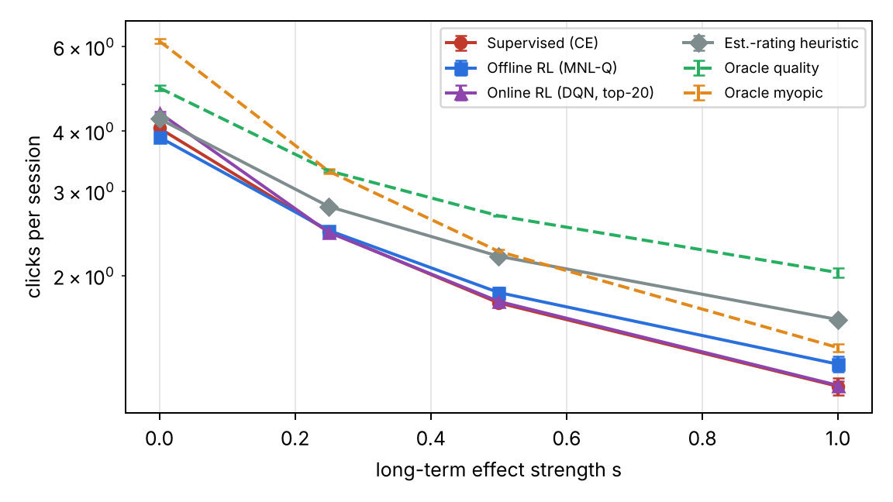
Main result: clicks per session vs strength s
agent | s = 0.0 | s = 0.25 | s = 0.5 | s = 1.0
Popularity | 3.05 ± 0.04 | 2.08 ± 0.01 | 1.61 ± 0.01 | 1.18 ± 0.01
Est.-rating heuristic | 4.25 ± 0.05 | 2.79 ± 0.02 | 2.20 ± 0.01 | 1.62 ± 0.02
Supervised (CE) | 4.06 ± 0.01 | 2.47 ± 0.02 | 1.76 ± 0.02 | 1.18 ± 0.05
SQN-style (CE+TD) | 3.85 ± 0.03 | 2.40 ± 0.02 | 1.75 ± 0.03 | 1.20 ± 0.03
Offline RL (CQL) | 3.44 ± 0.03 | 2.22 ± 0.03 | 1.71 ± 0.01 | 1.23 ± 0.02
Offline RL (MNL-Q, ours) | 3.89 ± 0.00 | 2.49 ± 0.03 | 1.85 ± 0.04 | 1.31 ± 0.05
Online RL (DQN, top-20) | 4.37 ± 0.03 | 2.46 ± 0.01 | 1.77 ± 0.02 | 1.18 ± 0.02
Oracle myopic | 6.17 ± 0.07 | 3.30 ± 0.04 | 2.25 ± 0.02 | 1.42 ± 0.03
Oracle quality | 4.93 ± 0.06 | 3.31 ± 0.02 | 2.67 ± 0.01 | 2.03 ± 0.04
Mean ± std over 3 seeds, held-out users. Figure: log y-axis; dashed = oracles (hidden information).
Samyak Bansal | 11
Notes:
This is the main experiment at K = 1, mean and std over 3 seeds on held-out users. At s = 0.0: supervised 4.06, MNL-Q 3.89, DQN 4.37, rating heuristic 4.25. At s = 0.25: supervised 2.47, MNL-Q 2.49, DQN 2.46, rating heuristic 2.79. At s = 0.5: supervised 1.76, MNL-Q 1.85, DQN 1.77, rating heuristic 2.20. At s = 1.0: supervised 1.18, MNL-Q 1.31, DQN 1.18, rating heuristic 1.62. At s = 0 RL brings nothing, as Prop. 2 predicts. As s grows, the supervised model keeps recommending clickable junk and loses users early; the RL agents' relative position improves with s. The y-axis of the figure is logarithmic; the dashed lines are oracles that use hidden information.

Slide 12
Findings, including the honest negatives
■ s = 0: offline RL adds nothing (MNL-Q −4%), as Prop. 2 predicts; online DQN best, for a short-term reason (better click estimates)
■ s > 0: MNL-Q vs supervised: +1% at s = 0.25, +5% at s = 0.5, +11% at s = 1.0
■ At s = 1.0: 43% less junk, longer sessions, slightly lower CTR
■ Negative 1: plain DQN over 500 items worse than supervised (≈1.05 clicks/session at s = 1 in a single tuning run, vs 1.21 for supervised in that run); top-20 DQN only matches supervised for s > 0
■ Negative 2: est.-rating heuristic beats all learned agents for s > 0: RL learns the direction, not the full gain
agent | CTR s=0.0 | CTR s=1.0 | junk s=1.0 | length s=1.0
Est.-rating heuristic | 0.295 | 0.295 | 0.07 | 7.3
Supervised (CE) | 0.290 | 0.299 | 0.58 | 4.6
SQN-style (CE+TD) | 0.275 | 0.293 | 0.52 | 4.8
Offline RL (CQL) | 0.246 | 0.240 | 0.13 | 6.0
Offline RL (MNL-Q, ours) | 0.271 | 0.275 | 0.33 | 5.6
Online RL (DQN, top-20) | 0.304 | 0.275 | 0.44 | 5.0
Short-term CTR vs junk clicks and session length (from the report)
Samyak Bansal | 12
Notes:
First, at s = 0 offline RL brings no advantage: MNL-Q is slightly worse than supervised (3.89 vs 4.06), as Prop. 2 predicts. The online DQN is better at s = 0 (4.37), but for a short-term reason: interacting with the simulator gives it better click estimates; its first-slate CTR is also the highest, 0.304. At s = 0 the best possible policy is myopic. Second, for s > 0 supervised keeps showing clickable junk: at s = 1.0 it is no better than popularity (1.18 clicks/session, length 4.6). MNL-Q gives up a little CTR (0.275 vs 0.299), clicks 43% less junk (0.33 vs 0.58), keeps users longer (5.6 steps) and its advantage over supervised grows with s: −4% at s = 0.0, +1% at s = 0.25, +5% at s = 0.5, +11% at s = 1.0. Negatives: a plain DQN over all 500 items was worse than supervised (about 1.05 clicks/session at s = 1 in a single tuning run, against 1.21 for supervised in that run) because the max over noisy Q estimates picks overestimated items; the top-20 re-ranker fixed that but only matches supervised for s > 0 after 3,000 interaction steps. And the 'highest estimated rating' heuristic beats every learned agent for s > 0 (1.62 at s = 1.0) because it avoids low-rated movies by construction; the quality oracle reaches 2.03, so our agents recover only part of the gain. Closing that gap is a second-half goal.

Slide 13
Demo: Streamlit live session
■ One simulated user, two recommenders side by side, identical random draws
■ Per step: movie shown (junk flagged), click prob., click, satisfaction, left?
■ Totals: clicks, session length, first-step CTR
■ Slider for strength s: watch the supervised session end early as s grows
■ Results tab: all tables and figures of the report
How to run
python scripts/train_demo_models.py
streamlit run app/demo.py
Samyak Bansal | 13
Notes:
The demo is app/demo.py, run with 'streamlit run app/demo.py' after training the demo models. In the live session one simulated user meets two recommenders side by side with identical random draws, so any difference is due to the policy. Per step it shows the movie (junk flagged), click probability, whether the user clicked, satisfaction and whether the user left, plus totals for clicks, session length and first-step CTR. A slider sets the strength s: at s = 0 the two sessions look alike; at high s the supervised one ends early. A second tab shows all tables and figures from the report.

Slide 14
Limitations and plan for pre-compre
Limitations
CPU only: RetailRocket partial (1 seed, 2-3 epochs)
Simulator dynamics assumed, not learned: claims are about the mechanism
3 seeds; KuaiRec replaced by MovieLens-1M
Rating heuristic still beats learned agents
■ Regime map: RL advantage over K ∈ {1,3,5,10} × s × γ vs two-type toy model (formulation.tex, Sec. 4)
■ Neural MNL-Q re-ranker (K > 1): item choice + value heads, exact LP slates, conservative offline
■ Baselines: PISDR-style offline RL re-ranker, SQN/EVAL heads, quality re-ranking
■ Ablations: logging policy, candidate set size, γ, junk vs fatigue
■ Close the gap to the rating heuristic; full RetailRocket GPU results
Samyak Bansal | 14
Notes:
Limitations: CPU only, so RetailRocket results are partial (1 seed, 2-3 epochs) until the GPU run finishes; the simulator's long-term dynamics are assumed, not learned from data, which is why s is a knob and s = 0 a control; 3 seeds only; KuaiRec replaced by MovieLens-1M; datasets from GitHub mirrors. Plan: first a regime map of the RL advantage over K in {1, 3, 5, 10}, strength s and gamma, compared to the toy-model prediction. Second, a neural MNL-Q re-ranker for K > 1 with item-level choice and value heads and the exact LP assortment solver, trained offline with a conservative penalty. Third, baselines: a PISDR-style offline RL re-ranker from Yuan et al., SQN/EVAL heads, and a diversity/quality re-ranking heuristic. Then ablations on logging policy, candidate set size and gamma, closing the gap to the rating heuristic, and the full RetailRocket results.

Slide 15
Questions?
RL helps only if the user's choice changes their future.
Code and report: github.com/samyakbansal5-eng/rl-seqrec | proofs: report/formulation.tex
Notes:
Close with the one-sentence takeaway and invite questions. Likely questions: why the rating heuristic wins (our learned agents only see 2 logged sessions per user), whether the simulator is realistic (dynamics assumed; s = 0 is the control), and why SQN is below CE on RetailRocket (only 2-3 epochs; GPU run pending).

