Slide 1
Improving Customer Experience through Root Cause Analysis
Customer Churn Analysis Project
By: Samyak Pratap Shah

Slide 2
Objective
Identify the key reasons customers leave (churn).
Use data to reduce churn and improve customer retention.

Slide 3
Why It Matters
Subscription businesses lose revenue when customers leave.
Reducing churn means higher profit and loyalty.
We aim to uncover the root causes using data.

Slide 4
Tools Used
Power BI – for dashboarding and trend visuals.
Python – for data processing, model building, and predictive analytics.

Slide 5
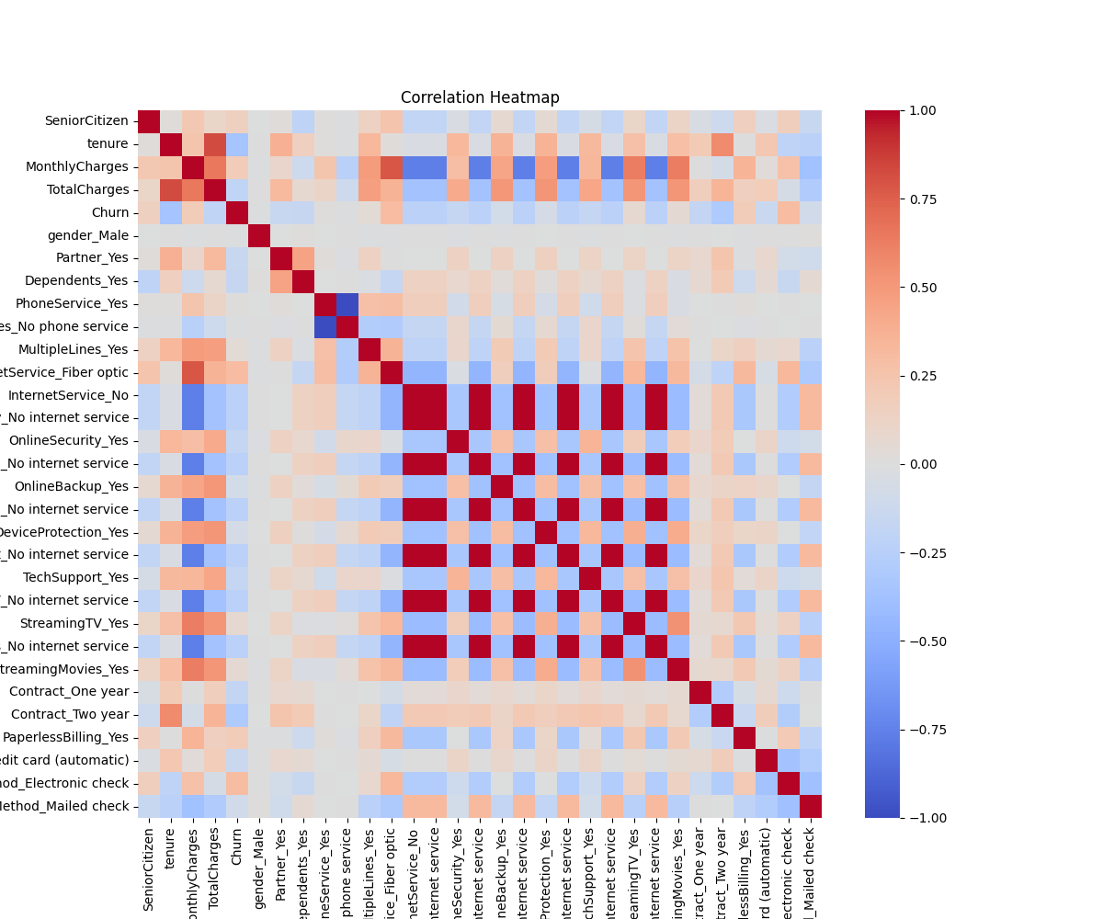
Correlation Heatmap
Shows relationships between variables.
Contract type, tenure, and internet service show strong correlation with churn.

Slide 6
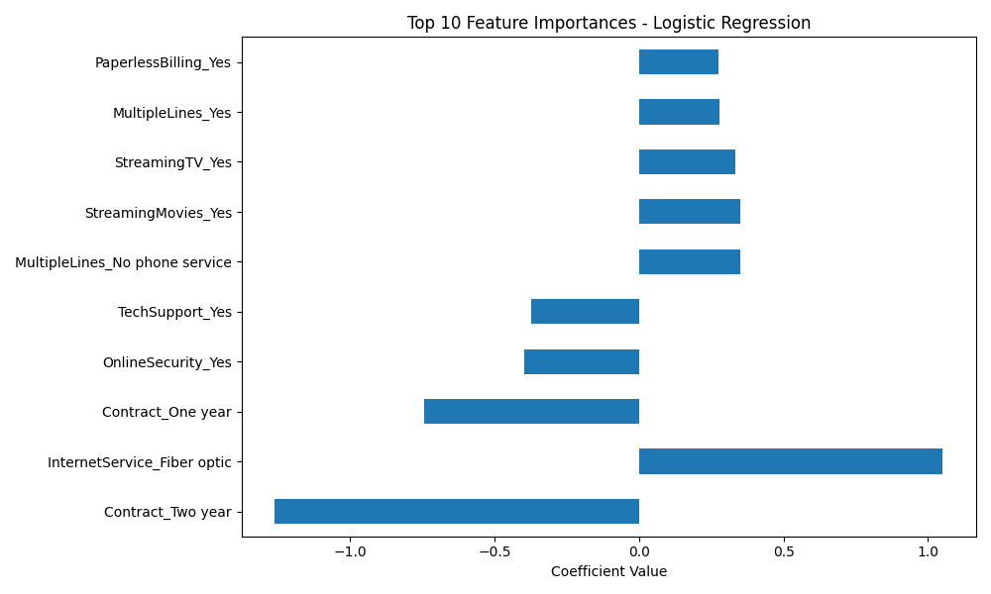
Feature Importance - Logistic Regression
Highlights top drivers of churn.
Month-to-month contracts and fiber internet increase churn risk.

Slide 7
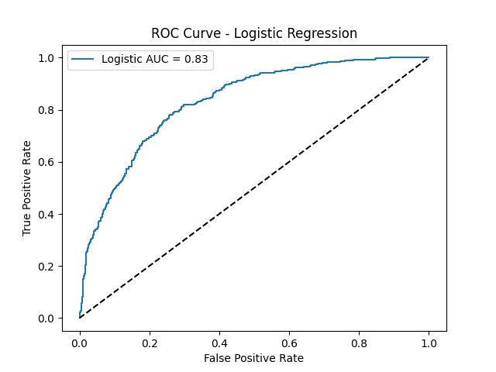
ROC Curve & AUC Score
AUC = 0.83 – strong model performance.
Model effectively predicts churn vs. retention.

Slide 8
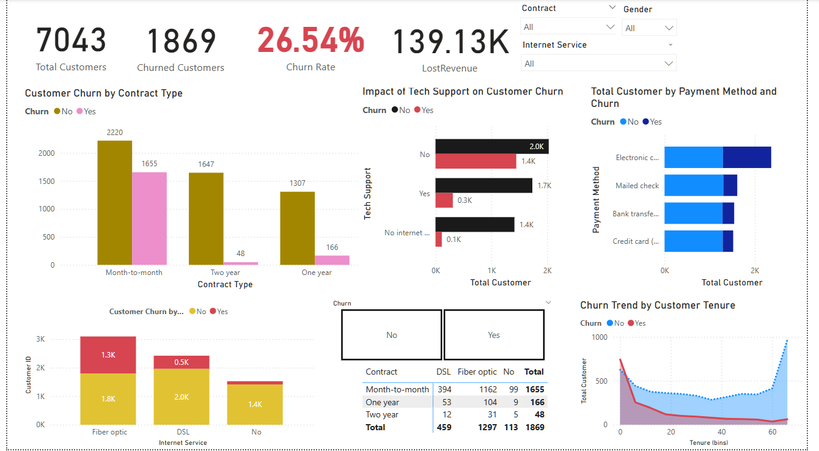
Power BI Dashboard Snapshot
Shows churn breakdown by contract, tenure, and services.

Slide 9
Model Comparison
Logistic Regression AUC: 0.8318
Random Forest AUC: 0.8457
Both models perform well; Random Forest is slightly better.

Slide 10
Recommendations
Incentivize long-term contracts to reduce churn.
Improve service for fiber optic users.
Expand access to technical support.
Enhance onboarding for new users.
Promote easier, auto-payment methods.

Slide 11
Conclusion
Python and Power BI helped visualize and predict churn.
Clear drivers of churn identified.
Actionable steps now available to reduce churn and improve customer satisfaction.

Slide 12
Thank You

