Slide 1

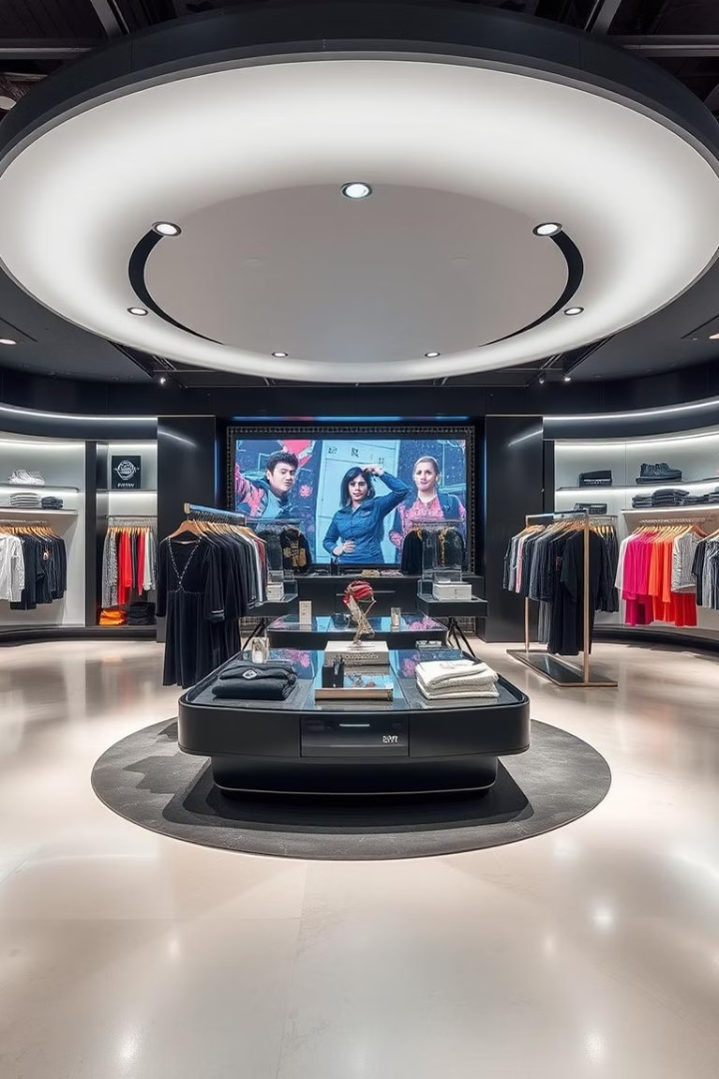

ZUDIO Sales Dashboard – 2024
Overview The "Zudio Sales in 2024" Power BI Dashboard provides actionable insights by transforming raw sales data into clear visual trends. It supports strategic decisions by highlighting product performance, market trends, and regional contributions in a dynamic retail environment.
by Samyak Lavhande

Slide 2





Key Business Objectives
Monitor Overall Sales Performance
Provide a clear view of key sales metrics like total sales, profit, and average margin.
Track Store Performance
Analyze sales and profitability across different store locations and types (owned vs. rented).
Understand Product Performance
Identify best-selling clothing types and categories (Men, Women, Kids).
Analyze Regional Performance
Evaluate sales and profit contributions from different states and cities.

Slide 3

Dashboard Overview and Features
The "Zudio Sales in 2024" dashboard is a sophisticated Power BI solution with a user-friendly, dark-themed interface for optimal visual clarity. It integrates various data visualizations, including bar charts, donut charts, line charts, and a geographical map, to present a multi-faceted view of Zudio's sales landscape.
The dashboard is highly interactive, allowing users to apply filters for specific clothing types and cities, dynamically updating all related visuals to provide granular insights. The core of the dashboard revolves around answering critical business questions related to "What," "Where," and "When" of Zudio's sales and profitability.

Slide 4

Key Performance Indicators (KPIs)
36K
100
Total Sales
Total Stores
Total revenue generated from sales.
Number of ZUDIO stores contributing to sales.
701.56
25.05M
Average Margin
Total Profit
Average profit margin achieved on sales.
Total profit generated from sales.

Slide 5
Dashboard Visualizations
Top 3 States by Sales Profit
Pie Chart showing sales profit contribution of top performing states (Gujarat, Karnataka, Maharashtra).
Total Sales by Category
Pie Chart displaying sales distribution across Kids, Women, and Men categories.
Total Sales by Store Type
Donut Chart breaking down sales between Rented and Owned store types.
Total Sales by Clothing Type
Bar Chart illustrating total sales for each clothing type (Skirts, Dresses, Hoodies, etc.).
Top 10 Avg Margin by City
Horizontal Bar Chart listing cities with the highest average sales margin (Pondicherry, Ahmedabad, Patna).
Total Profit by State
Map Visualization geographically displaying total profit by state, with darker shades indicating higher profit.
Average of Sales Profit by Quarter
Line Chart showing trend of average sales profit across quarters
(Qtr 1, Qtr 2, Qtr 3, Qtr 4).

Slide 6
Target Audience & Business Questions
Target Audience
Key Business Questions Answered
Sales & Marketing Teams
What are our total sales and profit for 2024?
Retail Operations Management
Which states and cities generate the most sales profit?
Category Managers
Which clothing types are our top sellers?
Regional Managers
How do sales compare between owned and rented stores?
Senior Management & Executives
What is the trend of our average sales profit by quarter?

Slide 7
Strategic Recommendations
Short-Term Actions:
Long-Term Actions:
Promote underperforming products (e.g., Shoes, Jeans)
Explore store ownership opportunities based on city profitability
Expand in high-margin cities (Pondicherry, Ahmedabad)
Align campaigns to boost underrepresented categories
Prepare inventory in Q2 for Q3 surge
Use profit heatmaps to guide regional expansion

Slide 8
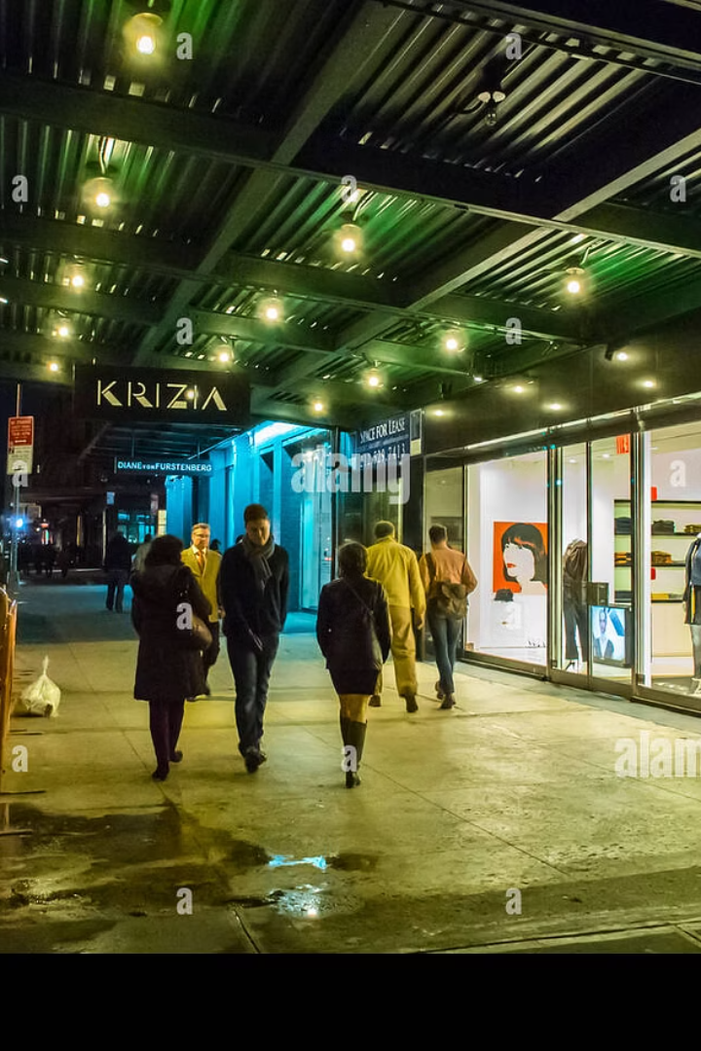
Conclusion & Impact
Comprehensive Analysis
Empowering Decision-Making
The Zudio Sales in 2024 Power BI dashboard provides a 360-degree view of Zudio's performance, from overall KPIs to granular insights by clothing type, category, city, and state.
Its interactive nature empowers stakeholders to extract relevant information, identify patterns, and uncover actionable insights efficiently.

