Slide 1

Project Title - Seasonal Agriculture Performance Analysis
Student Name : Samyak Jain
College Name : Delhi Technological University (DTU)
AICTE STU ID : STU6a6cdf370fb751785519927

Slide 2

PROBLEM STATEMENT
Core Challenge: Agricultural productivity, input efficacy, and farm profitability experience significant shifts due to seasonal environmental swings.
Research Focus: Identify seasonal variations, explore trends across Kharif, Rabi, and Zaid seasons, and examine the impact of resource utilization on harvest outcomes.

Slide 3
Project Description
Analytical Scope: Statistical analysis and exploratory data visualization of 4,000 farm records across diverse districts and farming setups.
Methodology: Data cleaning with group median imputation, multivariate correlation analysis, resource efficiency assessment, and economic viability benchmarking across cropping cycles.

Slide 4

WHO ARE THE END USERS?
Farmers & Farmer Producer Organizations (FPOs): For choosing suitable crops and allocating fertilizer and irrigation budgets effectively by season.
Agronomists & Policy Planners: For setting regional irrigation priorities and formulating targeted fertilizer subsidy interventions.
Agricultural Credit & Insurance Providers: For designing seasonal underwriting models and identifying climate-related risks.

Slide 5

Technology Used
  Language & Runtime: Python 3 on Google Colab
  Data Processing: Pandas, NumPy
  Data Visualization: Matplotlib, Seaborn
  Presentation & Documentation: Microsoft PowerPoint

Slide 6
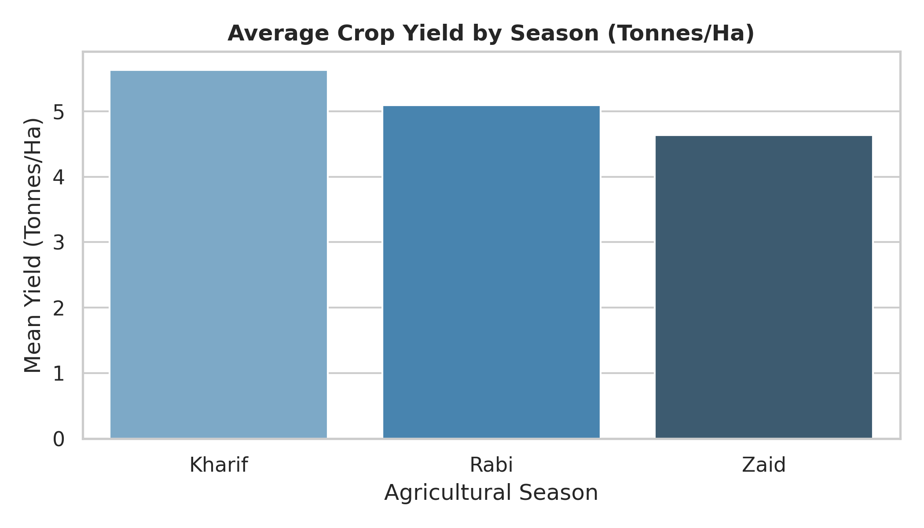
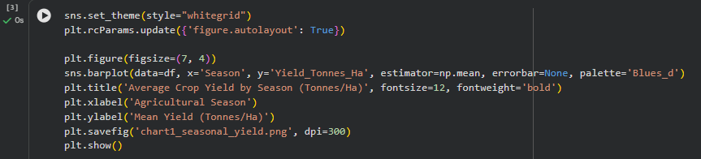
Results – Seasonal Crop Yield Trends
Key Observations:
Kharif delivers the highest mean yield at 5.63 tonnes/ha, supported by seasonal monsoon moisture.
Rabi follows at 5.09 tonnes/ha, while Zaid drops to 4.64 tonnes/ha due to higher heat and reduced water retention.

Slide 7
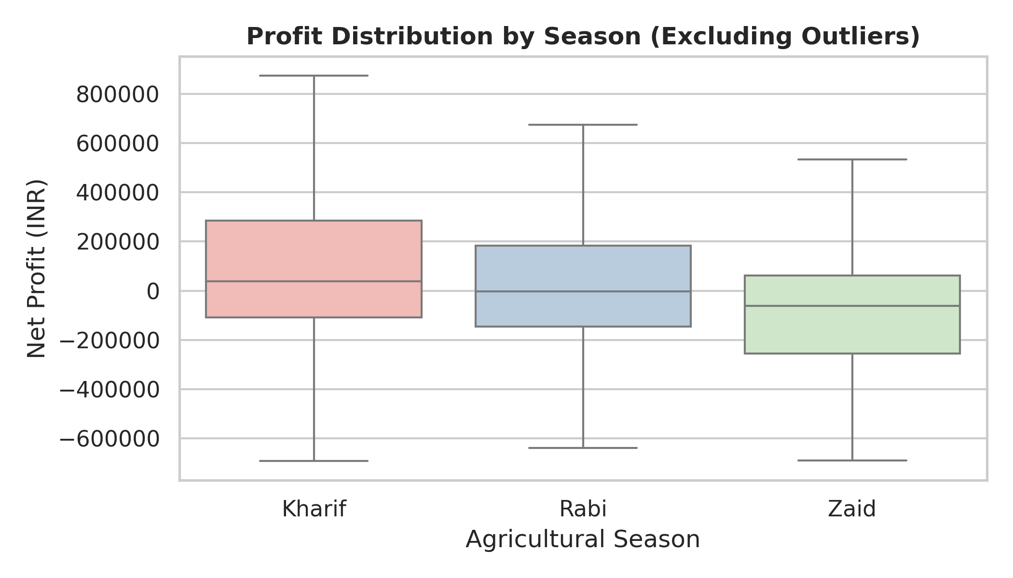
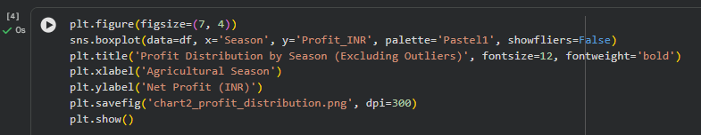
Results – Economic Profitability by Season
Key Observations:
Kharif achieves the strongest profitability, averaging ₹1,78,915 net profit per farm.
Rabi records a moderate average profit of ₹87,689, whereas Zaid registers an average loss of -₹24,805 driven by high input and supplementary irrigation expenses.

Slide 8
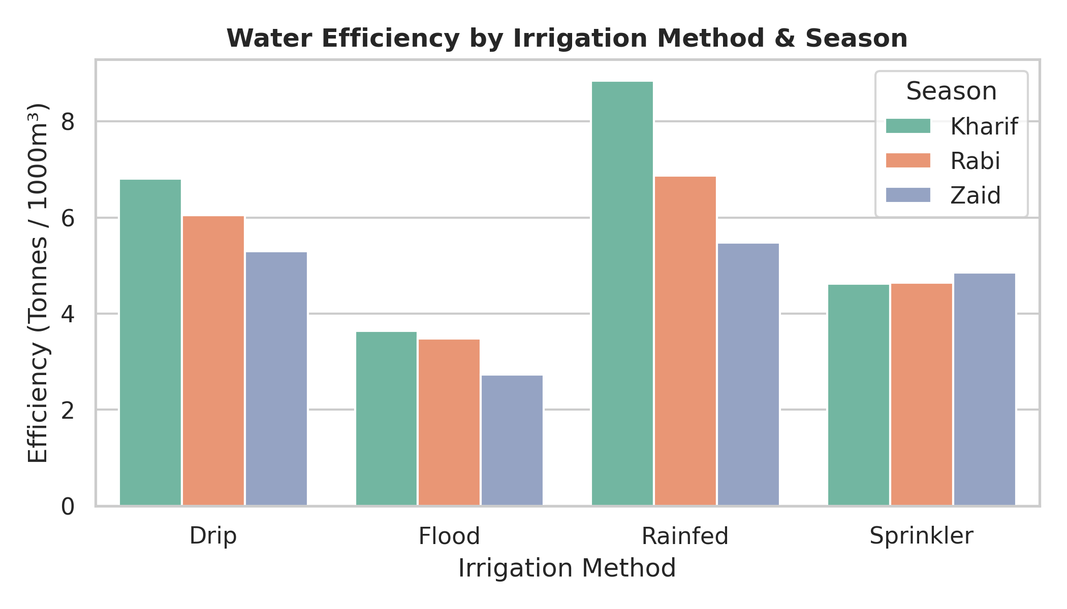
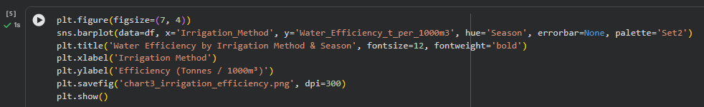
Results – Water Efficiency & Irrigation Systems
Key Observations:
Drip irrigation yields the most stable output across seasons with high water-use efficiency.
Traditional flood irrigation shows the lowest efficiency (3.44 t/1000m³), indicating high water loss through runoff and evaporation.

Slide 9
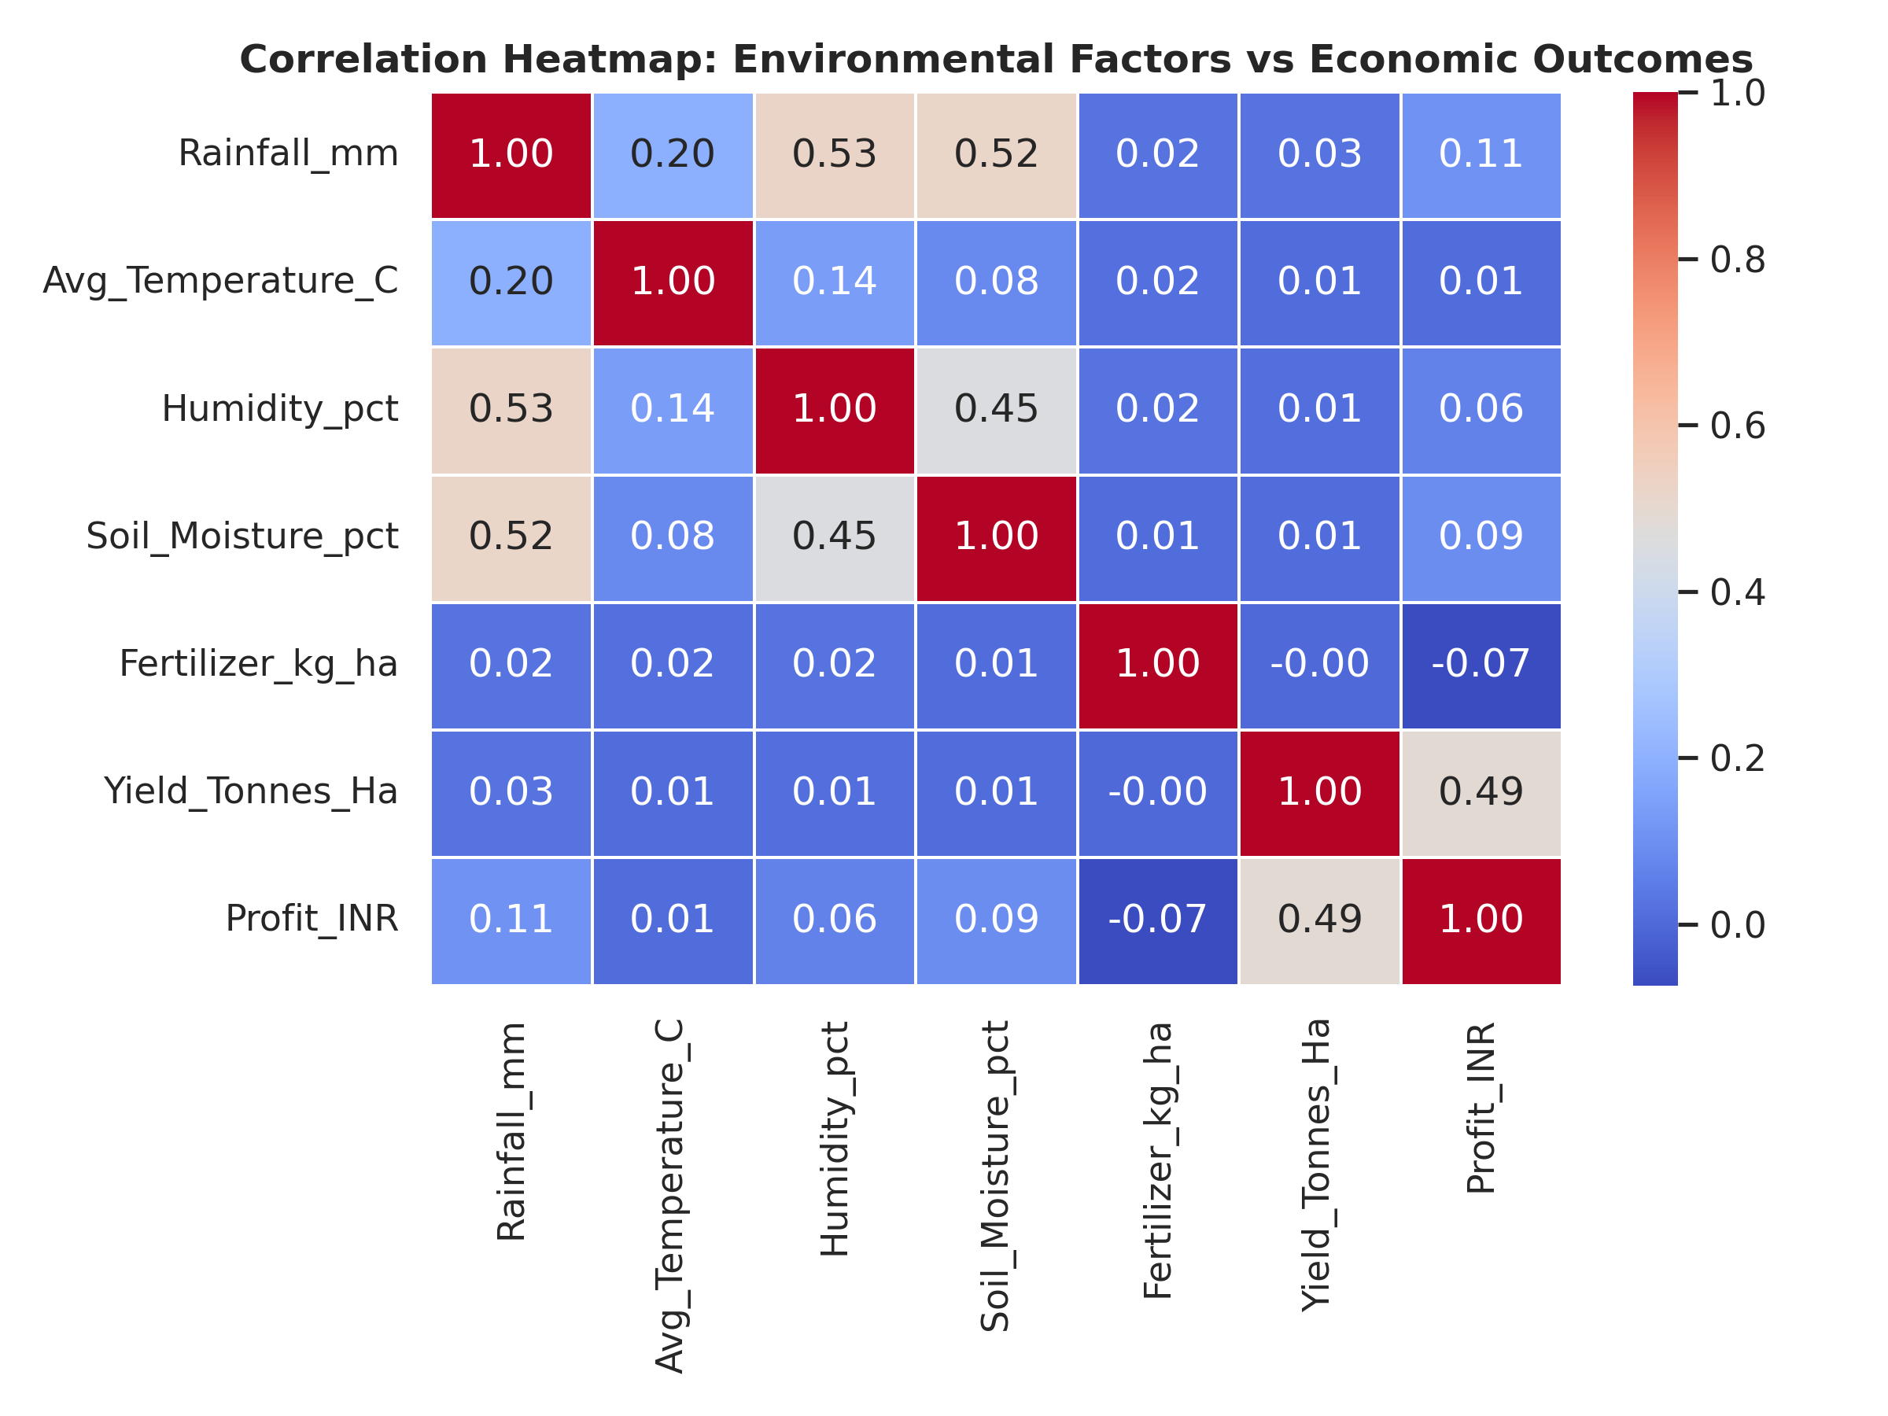
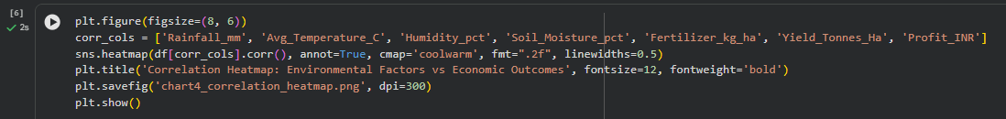
Results – Environmental & Economic Heatmap
Key Observations:
Soil moisture and fertilizer application rates correlate positively with final crop yield.
Extreme temperatures and water stress correlate with reduced net margins, particularly outside the monsoon period.

Slide 10
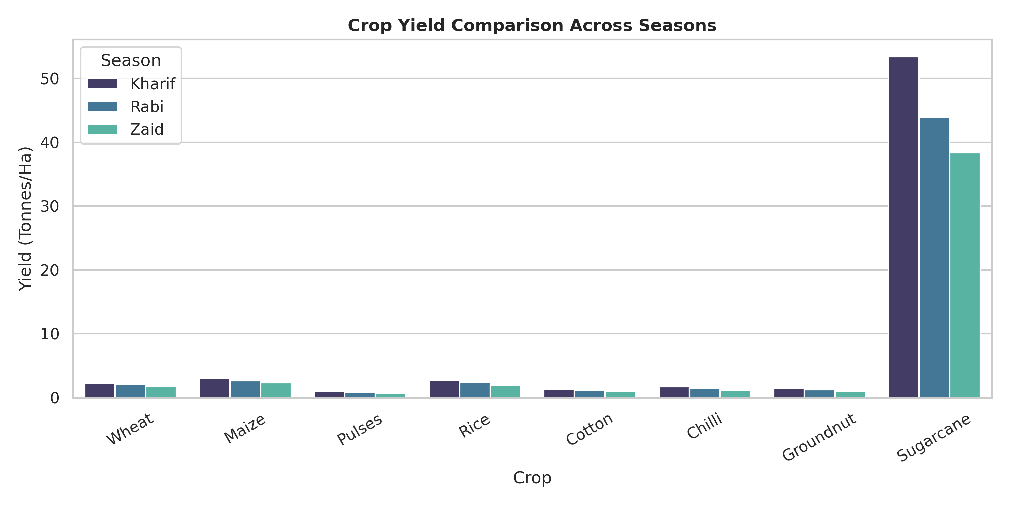
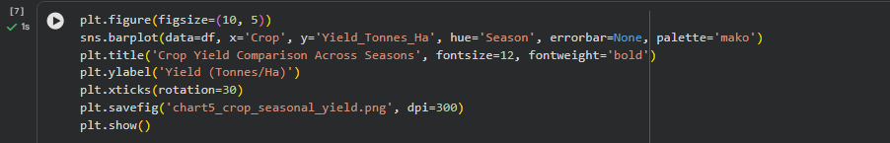
Results – Crop Performance Comparison
Key Observations:
Cash crops like Sugarcane show consistent volume differences across seasons (53.5 t/ha in Kharif vs. 38.4 t/ha in Zaid).
Grains and pulses (Rice, Maize, Pulses) maintain peak productivity during Kharif and Rabi cycles.

Slide 11
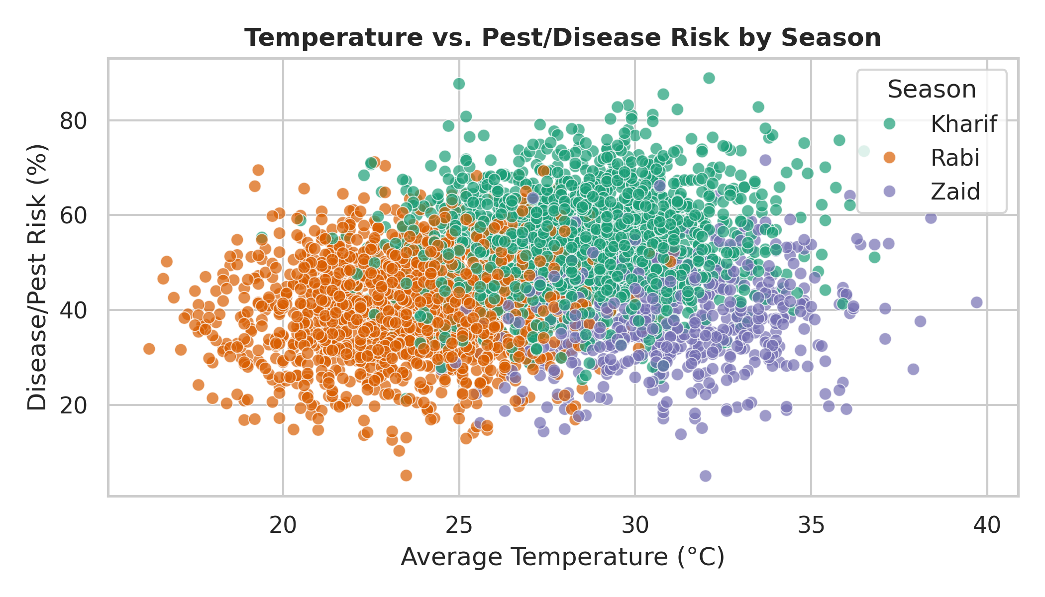
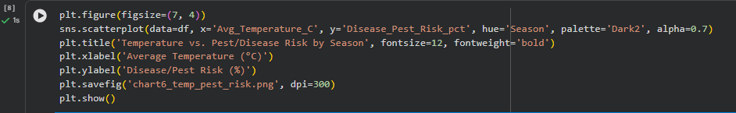
Results – Temperature & Pest Risk Dynamics
Key Observations:
Disease and pest risk is highest during the high-humidity Kharif season (averaging 54.5%).
Rabi and Zaid exhibit lower average pest risks (40.5% and 38.2%), but require targeted pesticide management during localized heat spikes.

Slide 12
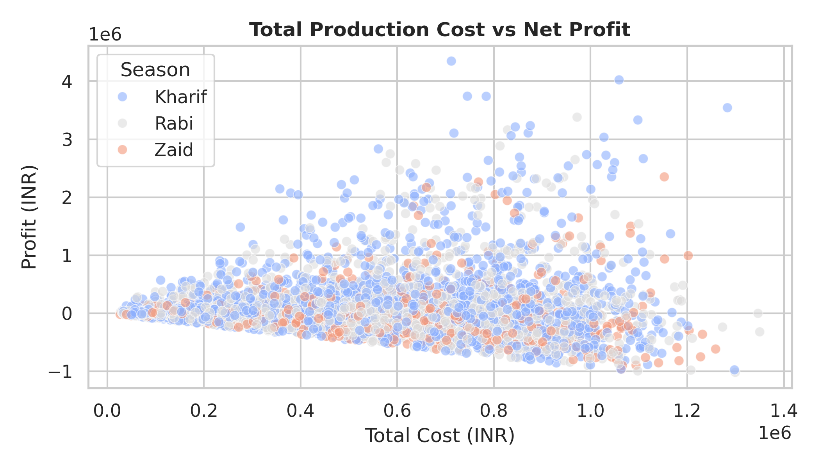
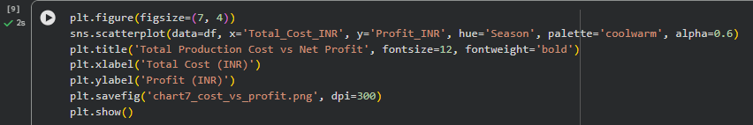
Results – Production Cost vs. Net Profit
Key Observations:
Higher production expenditure does not ensure proportional net profit gains across all seasons.
High-cost Zaid farming often yields lower margins, emphasizing the need for cost-efficient input budgeting.

Slide 13
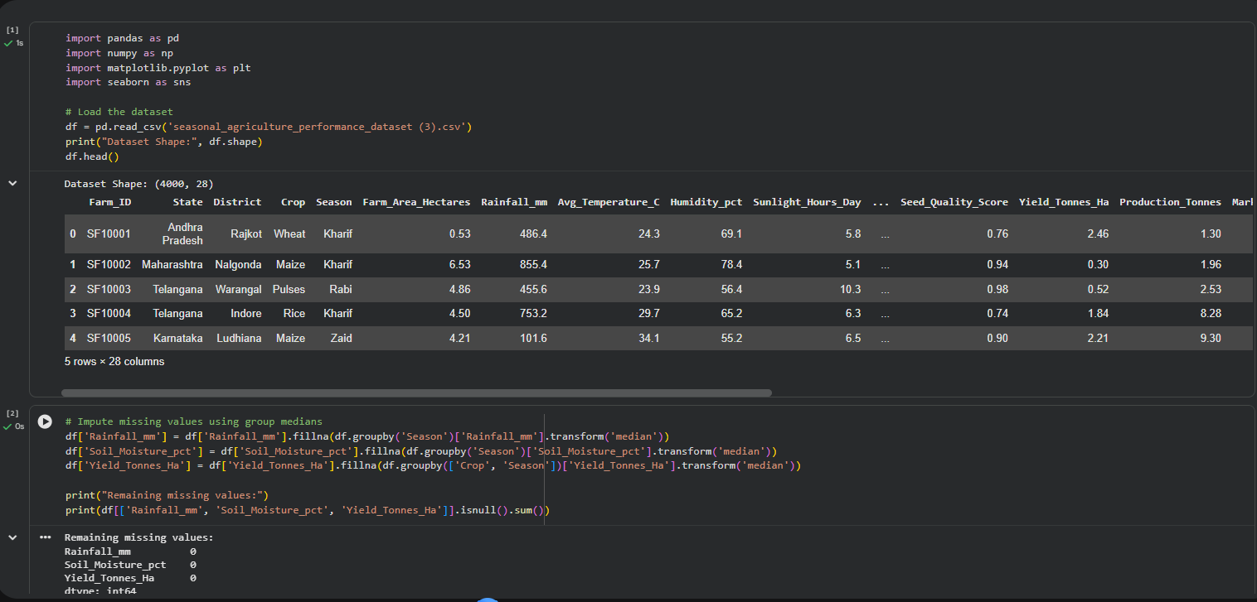
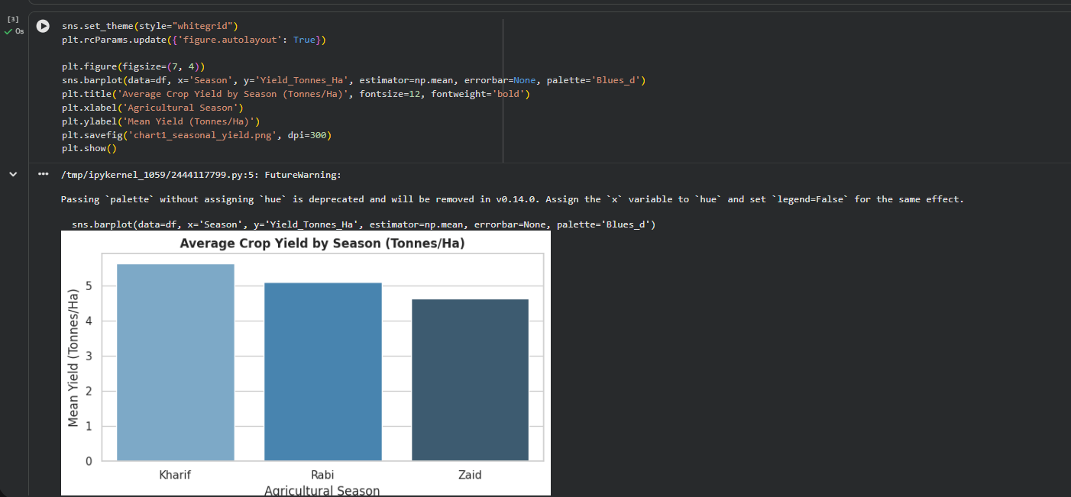
Results – Colab Code Screenshots

Slide 14
Future scope
Predictive Yield Modeling: Developing ML algorithms (e.g., Random Forest, XGBoost) to forecast crop output before planting.
IoT Weather Integration: Combining real-time automated soil-moisture telemetry with targeted irrigation alerts.
Precision Nutrient Delivery: Building algorithmic fertilizer blend recommendations based on soil pH and crop type.

Slide 15
GitHub Link
https://github.com/samyakjain790-max/Seasonal-Agriculture-Performance-Analysis
Contents Included : Colab notebook (.ipynb), cleaned dataset, Presentation PPT and generated visual plots.

Slide 16

VOIS Course completion certificate -
Course name- Data Visualization

Slide 17
THANK YOU
.
.
Samyak Jain
STU6a6cdf370fb751785519927

