Slide 1

EMPLOYEE ATTRITION PREDICTION SYSTEM
A Machine Learning Approach to Predicting Workforce Attrition
Prepared By: Samyak Jain
Internship: AIML Summer Internship 2026, IIHMF, MNNIT Allahabad
Institute: United College of Engineering and Research, Prayagraj
Academic Year : 2026 - 2027

Slide 2




The Business Problem
What is Attrition?
Why it Matters
Financial Impact
HR Challenge
The gradual, ongoing loss of employees who resign, retire, or are terminated and are not immediately replaced.
Losing skilled employees disrupts teams, delays projects, and erodes institutional knowledge built over years.
Every exit brings recruitment, onboarding, and training costs, plus lost productivity while the role sits vacant.
Traditional HR relies on exit interviews - reactive, after the employee has already decided to leave.
2

Slide 3

Project Objectives
Predict Employee Attrition
Analyze Employee Behaviour
Build a classification model that predicts whether an employee is likely to leave, using their HR profile.
Explore how satisfaction, income, overtime, and tenure relate to the decision to leave.
Compare ML Models
Deploy an Interactive App
Train and evaluate five classification algorithms, then select the best performer objectively.
Package the final model into a Streamlit web application usable by HR teams in real time.
3

Slide 4
Dataset Description
IBM HR Analytics Employee Attrition Dataset
1,470
34
1
16.1%
Employee Records
Input Features
Target Variable
Attrition Rate
Attribute | Detail
Source | Kaggle - IBM HR Analytics Employee Attrition & Performance
Target Variable | Attrition (Yes / No)
Class Balance | No: 1,233 (83.9%) | Yes: 237 (16.1%)
Feature Types | 8 Categorical, 26 Numerical
Missing Values | None
Sample Feature
Categories
Personal: Age, Gender
Job: Role, Department
Pay: Income, Daily Rate
Satisfaction: WLB, Job Sat.
Tenure: Years at Company
4

Slide 5
Project Methodology
1
2
3
4
5
6
7
8
Problem
Understanding
Data
Collection
Data
Preprocessing
Exploratory
Data Analysis
Feature
Engineering
Model
Building
Model
Evaluation
Deployment
Every phase was implemented in its own Jupyter notebook - from raw data to a deployed, working web application.
5

Slide 6

Data Preprocessing
Missing Values
Duplicate Records
Encoding
Feature Scaling
None found in 1,470 records - no imputation required.
No duplicate rows detected in the dataset.
8 categorical columns transformed using LabelEncoder, saved per-column.
All 34 features standardised with StandardScaler (zero mean, unit variance).
Final Model-Ready Dataset
1,470 rows x 34 encoded & scaled features + 1 target column (Attrition)
6

Slide 7
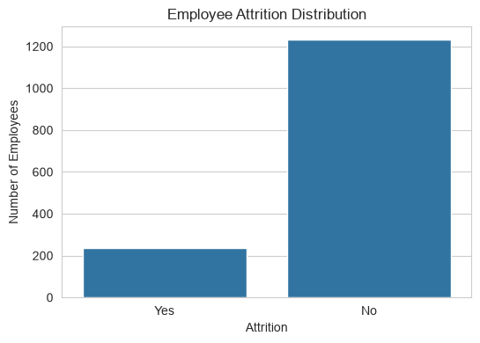
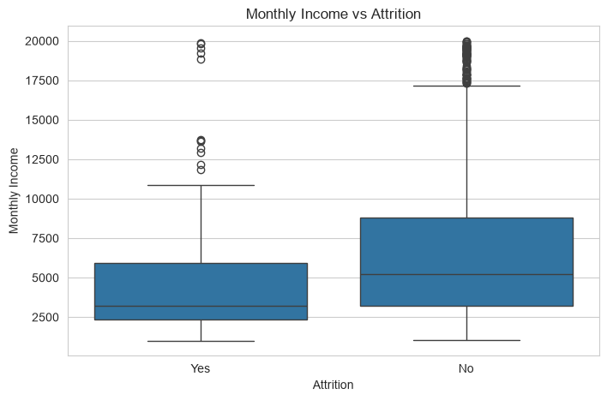
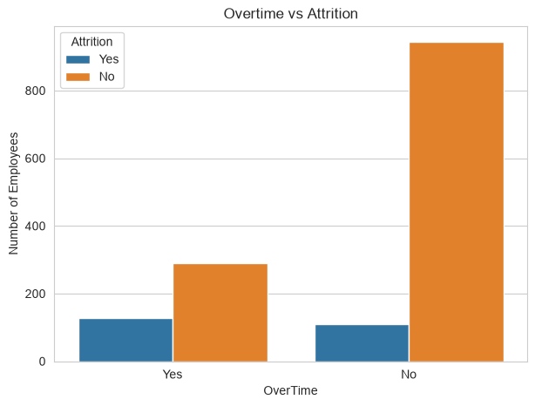
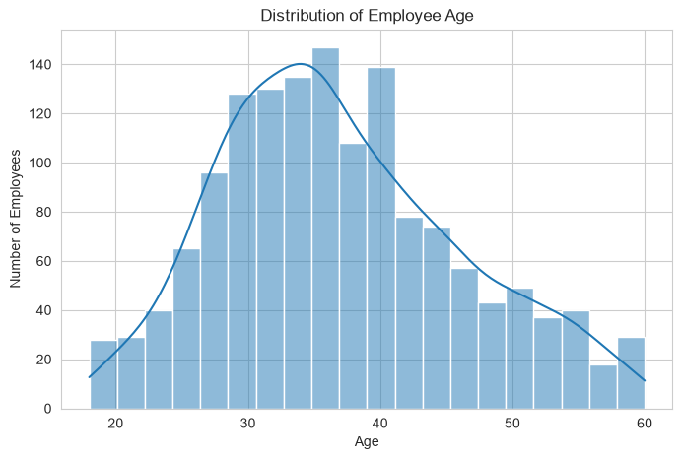
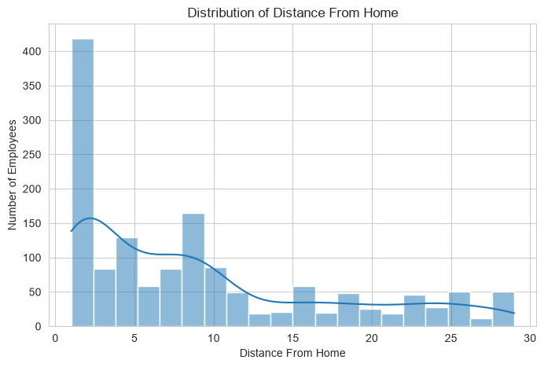
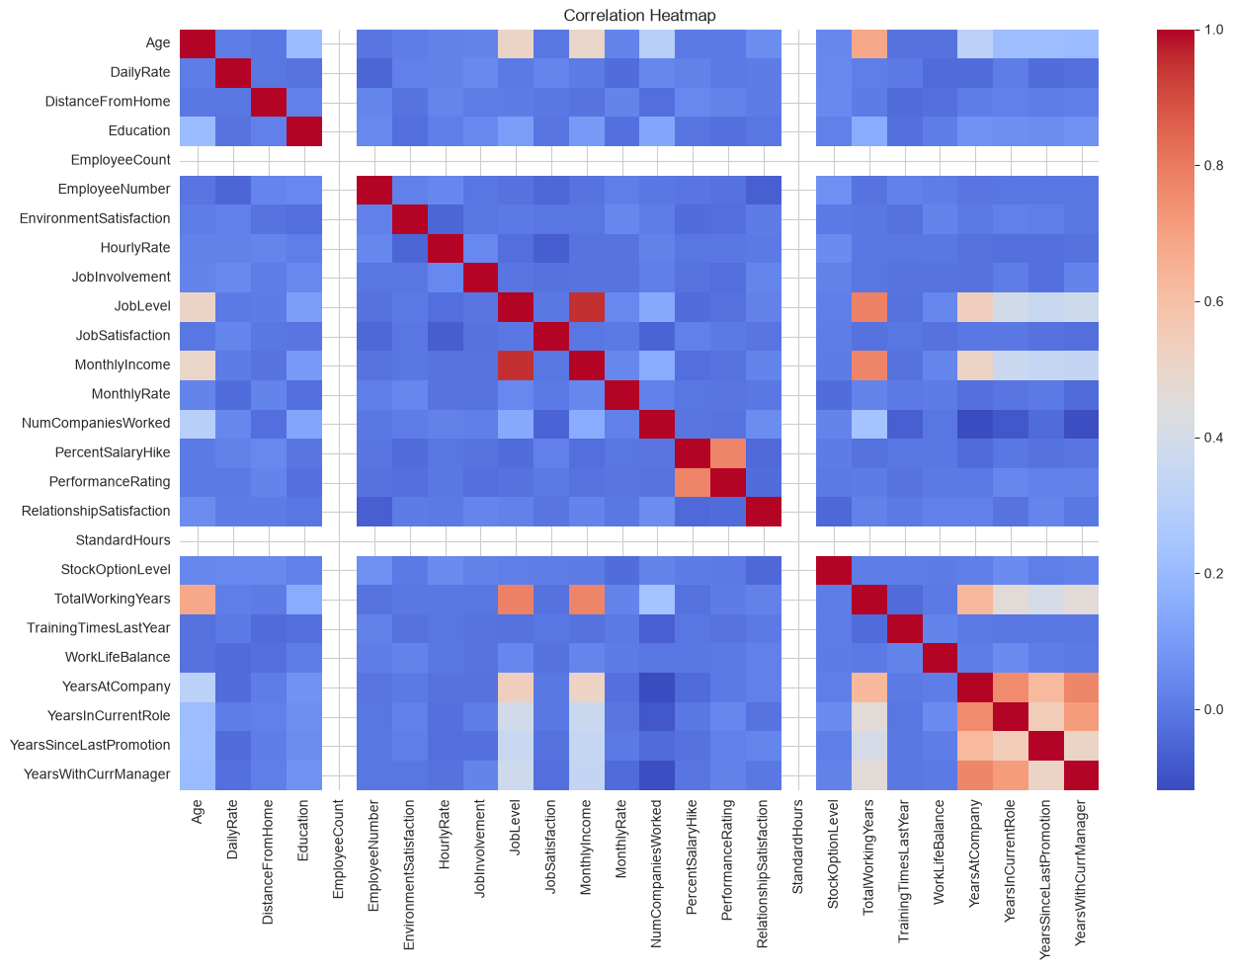
Exploratory Data Analysis
~16% of employees left - a moderately imbalanced target.
Employees who left generally earned less.
Employees working overtime leave more often.
Workforce skews younger; younger employees attrite more.
Longer commutes trend with higher attrition.
Reveals relationships across numerical HR attributes.
7

Slide 8
Feature Engineering
Label Encoding
8 categorical columns converted to numeric codes.
StandardScaler
All 34 features standardised to a common scale.
Feature Importance
Random Forest ranked features by predictive contribution.
8

Slide 9

Machine Learning Models
Five classification algorithms were trained and compared on a held-out test set (20%).
Model | Test Accuracy | Status
Logistic Regression | 87.42% | ★ Selected
Support Vector Machine | 86.39% | -
K-Nearest Neighbours | 84.01% | -
Random Forest | 82.99% | -
Decision Tree | 76.19% | -
Final Model
Logistic Regression
Selected for achieving the highest test accuracy among all five models compared, while remaining fast, interpretable, and well suited for real-time deployment.
9

Slide 10
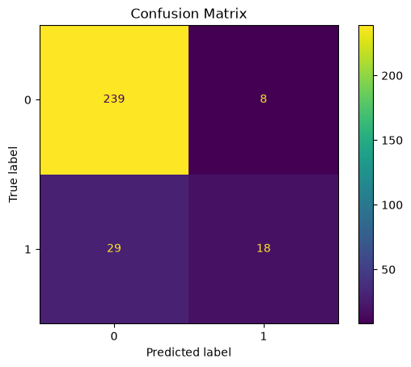
Results
87.42%
0.805
0.89
0.38
Test Accuracy
ROC-AUC Score
Precision (Stay)
Recall (Leave)
Class | Precision | Recall | F1-Score | Support
No (Stayed) | 0.89 | 0.97 | 0.93 | 247
Yes (Left) | 0.69 | 0.38 | 0.49 | 47
Business Interpretation
The model is very reliable at confirming who will stay, and reasonably effective at flagging likely leavers - useful for prioritising retention conversations, though some at-risk employees may still be missed.
10

Slide 11
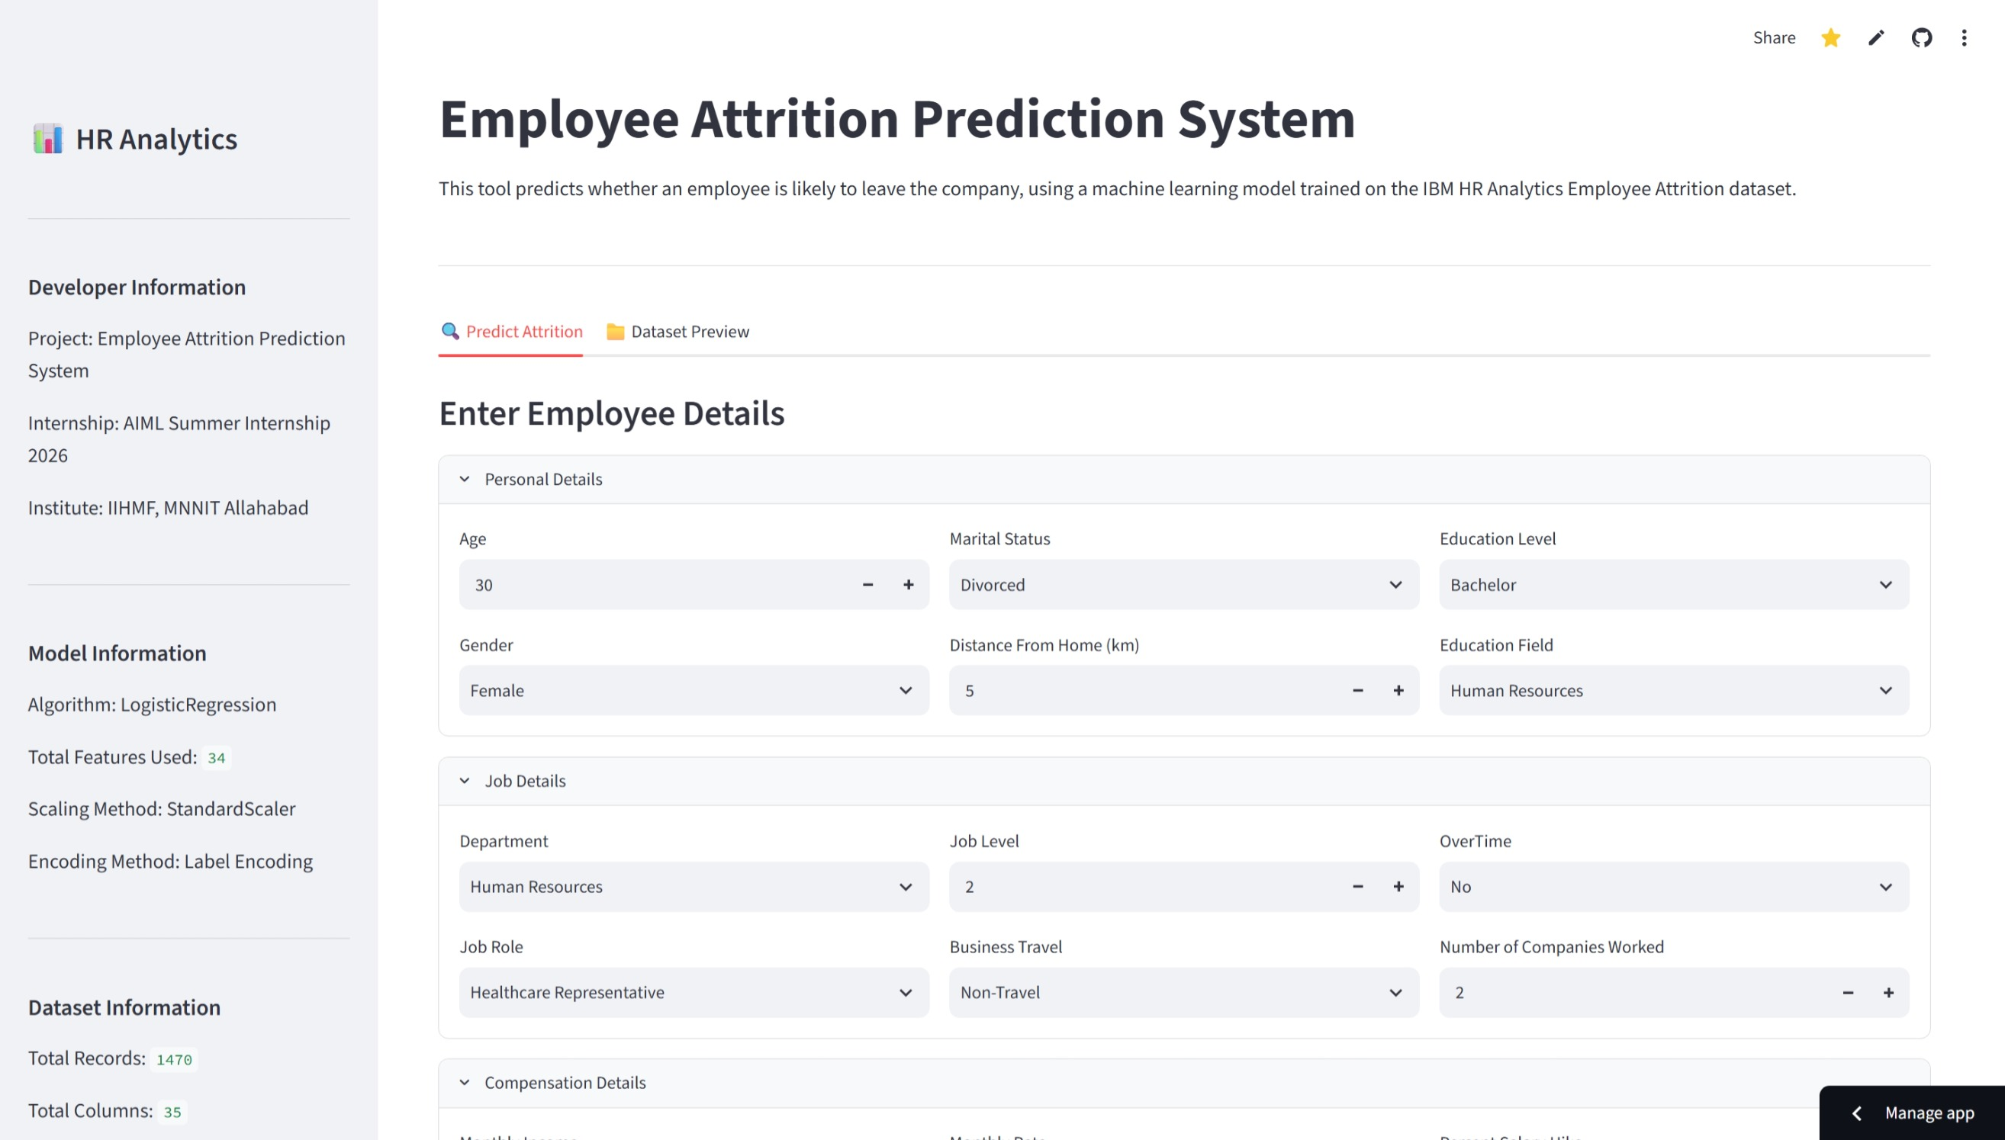
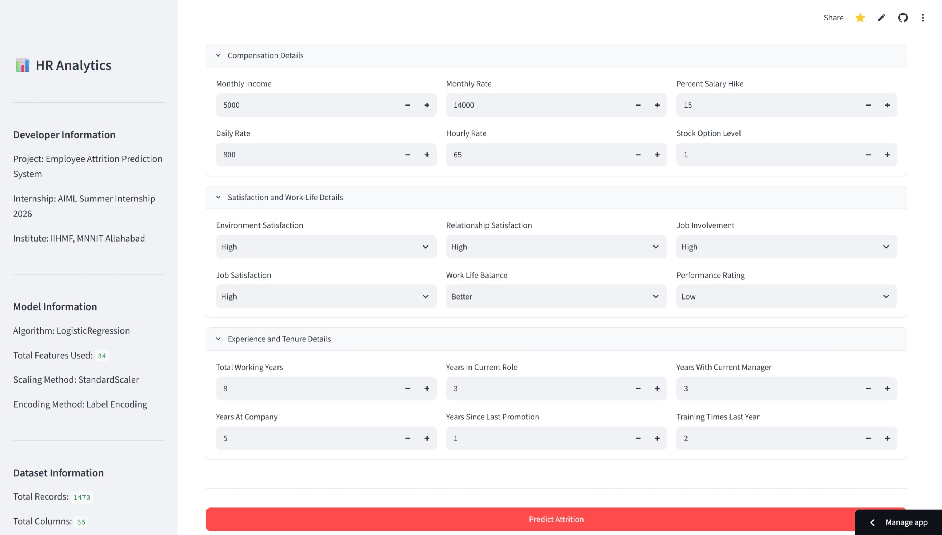
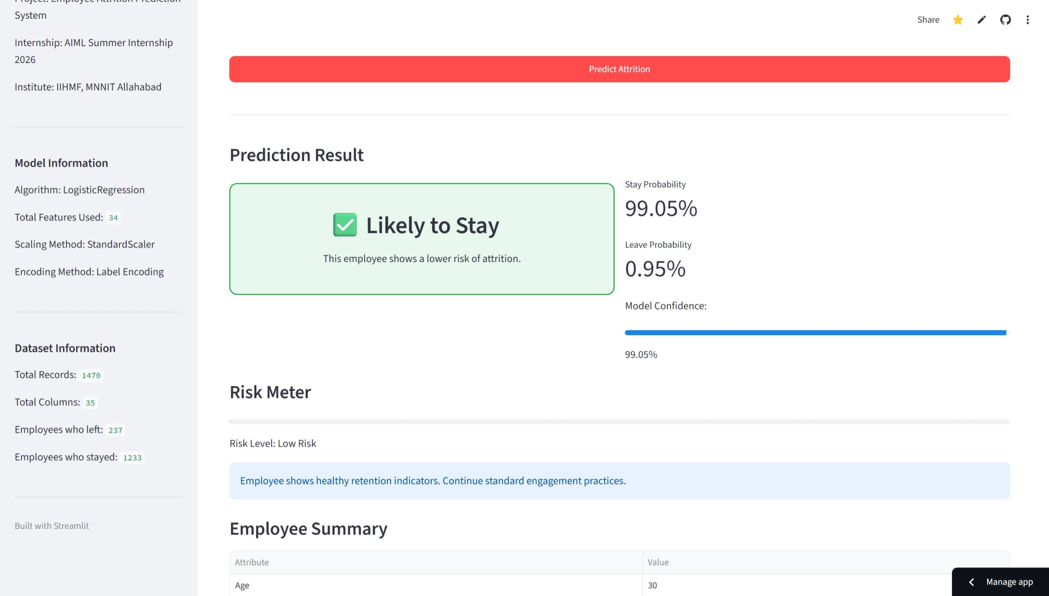
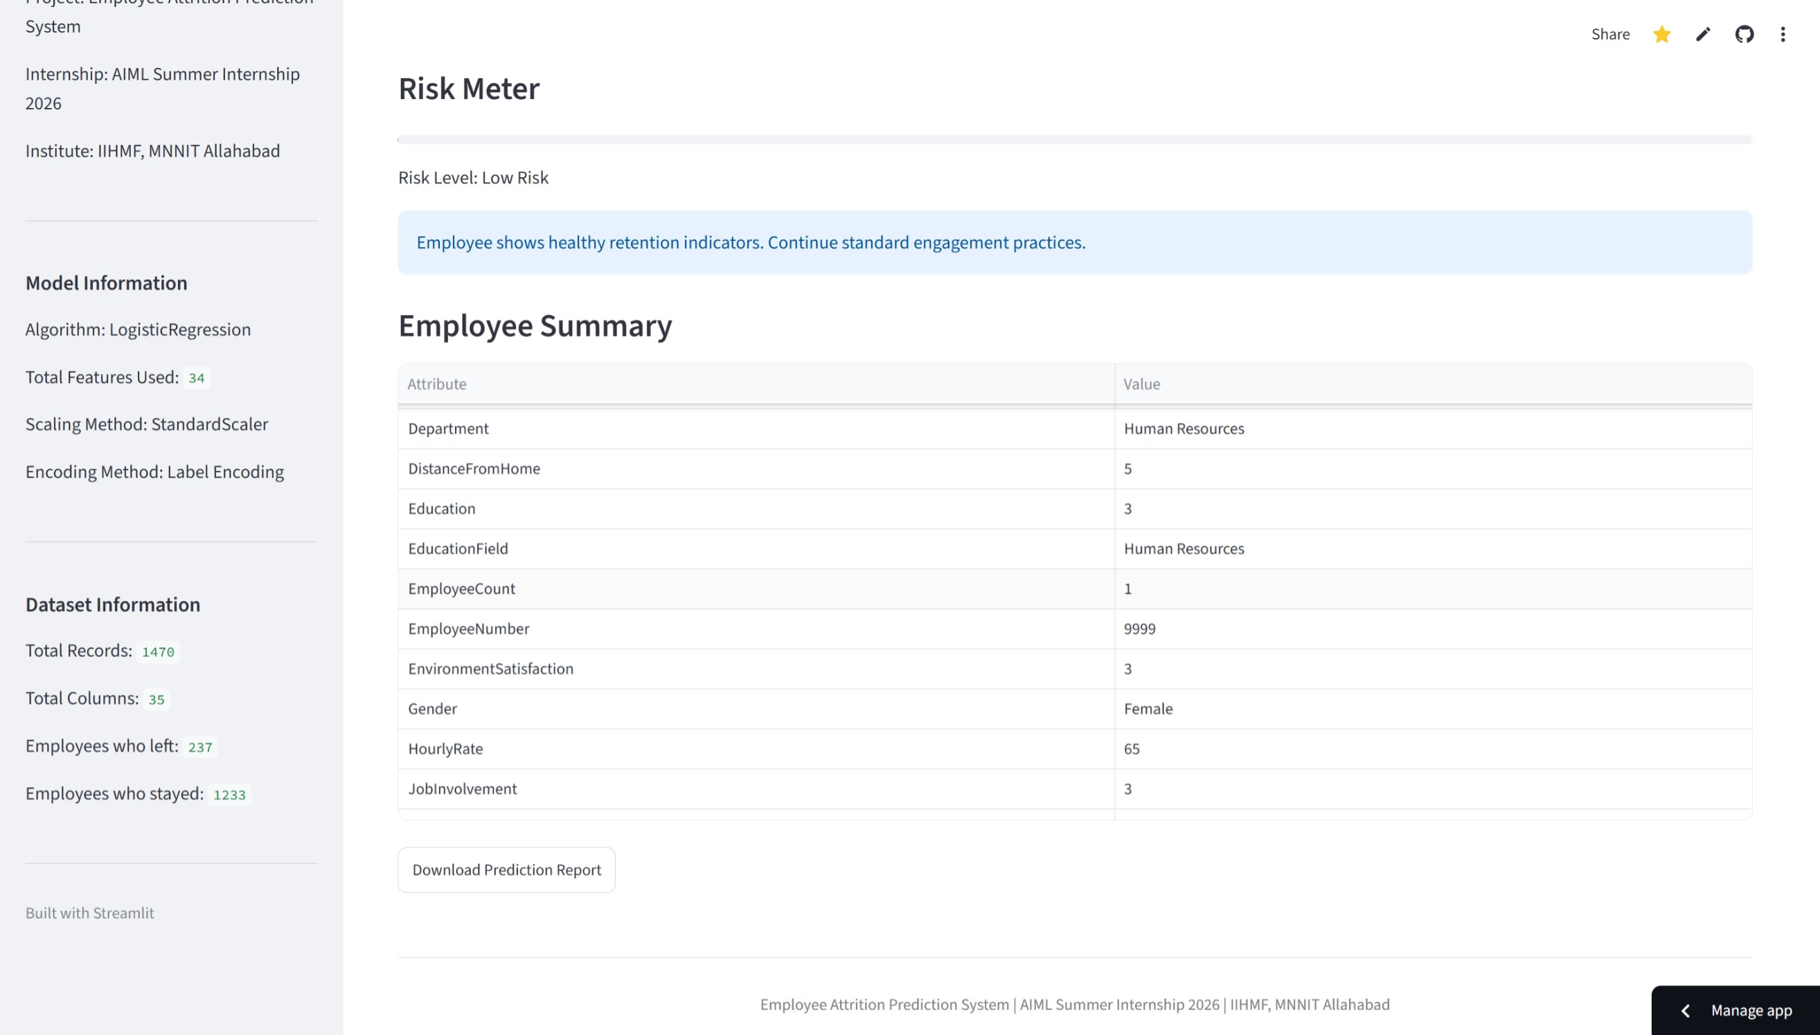

The Streamlit Application
Auto-Loaded Model
Robust Error Handling
GitHub Version Control
Live Deployment
Model, scaler, and encoders load automatically - no manual setup.
Gracefully handles unseen inputs and missing files.
https://github.com/samyakjainx/Employee-Attrition-Prediction-System
Deployed on Streamlit Community Cloud –
https://employee-attrition-prediction-system-samyakjain.streamlit.app/
11

Slide 12


Business Recommendations
Grounded in the feature importance and EDA findings from this project.
Reduce Overtime
Improve Work-Life Balance
Boost Job Satisfaction
Review Compensation
Targeted Retention Plans
OverTime ranked among the top attrition drivers - monitor workload and cap excess hours.
Employees with poor work-life balance scores show higher attrition risk.
Low satisfaction scores correlate strongly with leaving - act on regular pulse surveys.
MonthlyIncome and DailyRate are the two strongest predictors - benchmark pay bands regularly.
Use model risk scores to prioritise retention conversations for high-risk employees.
12

Slide 13
Future Scope
Explainable AI (SHAP)
Deep Learning
HR Dashboard
Database Integration
Explain individual predictions for HR trust and transparency.
Explore neural approaches as more data becomes available.
Aggregate predictions across teams and departments.
Connect directly to a live HR records database.
Authentication
Cloud Improvements
Real-Time Prediction
Role-based login for authorised HR access only.
Containerisation and CI/CD for smoother redeployment.
Trigger predictions automatically on HR record updates.
13

Slide 14
Conclusion
1
What Was Built
2
Business Value
A complete, end-to-end system - from raw HR data to a deployed prediction tool - covering the full ML lifecycle.
Gives HR teams an early, data-driven signal on attrition risk instead of relying only on hindsight.
3
Learning Outcomes
4
Practical Application
Hands-on experience with preprocessing, model comparison, evaluation, and real-world deployment.
The deployed Streamlit app is usable today to score any employee profile in seconds.
14

Slide 15


Thank You
Questions?
GitHub Repository
Deployment Link
LinkedIn
https://github.com/samyakjainx/Employee-Attrition-Prediction-System
https://employee-attrition-prediction-system-samyakjain.streamlit.app/
https://www.linkedin.com/in/samyakjain-ai/

