Slide 1




PRESENTS
Multi-Lingual Financial Security Bridge
GENERATIVE AI
TEAM Nivesh-Suraksha
K. K. Wagh Institute of Engineering, Education and Research

Slide 2



Team member details
Team Name
NIVESH-SURAKSHA
Institute name
K. K. WAGH INSTITUTE OF ENGINEERING, EDUCATION AND RESEARCH, NASHIK-422003
Team members >
1 (Leader)
2
3
4
Name
SAMYAK RAKA
RITESH SAKHARE
SAHIL KULKARNI
ISHWARI SANGLE
Batch
2022-2026
2022-2026
2022-2026
2022-2026

Slide 3
FUNCTIONALITIES OF PRODUCT
UNIQUE SELLING PROPOSITION (USP):
FINANCIAL DOCUMENTATION PROCESSING:
TAKE INPUTS IN TEXT DOCUMENTS, SCANNED IMAGES OR PDF FORMAT
USING OCR TECHNOLOGY EXTRACT CONTENT FROM DOCUMENT
2. MULTI-LINGUAL TRANSLATION:
EXTRACTED CONTENT IS TRANSLATED INTO DIFFERENT REGIONAL LANGUAGES USING THE NLP MODEL ENSURING MEANING AND CONTEXT
TEXT TO TEXT, TEXT TO SPEECH AND SPEECH TO TEXT TRANSLATIONS
SWIFT DOCUMENT ASSESSMENT:
ENABLING RAPID AUTOMATED ANALYSIS OF LEGAL TEXTS FOR IMPROVED ADHERENCE TO LEGAL STANDARDS
ENSURING OUR AI MODEL ALIGNS WITH EVOLVING LEGAL STANDARDS TO MAINTAIN THE HIGHEST LEVEL OF REGULATORY ADHERENCE

Slide 4
FUNCTIONALITIES OF PRODUCT
UNIQUE SELLING PROPOSITION (USP):
4. PODCAST EMPOWERMENT HUB:
USERS CAN SHARE THEIR DIFFERENT VIEWS AND EXPERIENCES THROUGH BLOGS AND PODCAST WHILE ACCESSING DIFFERENT SCHEMES FROM PARTICULAR FINANCIAL INSTITUTIONS
THIS CAN INCLUDE EXPERIENCE WHILE OPENING AN ACCOUNT IN A FINANCIAL INSTITUTION, THE STORY OF HOW FRAUD HAD HAPPENED WITH SOMEONE, BLOGS EXPLAINING THE ADVANTAGES AND DISADVANTAGES OF ANY PARTICULAR SCHEME, AND MANY MORE
HERE ALSO, THE TEXT-TO-TEXT, SPEECH TO TEXT AND TEXT-TO-SPEECH FACILITIES WILL BE PROVIDED
5. UNIFIED DATA STORAGE:
STREAMLINE ACCESS TO ESSENTIAL DATA FOR OUR AI-DRIVEN FINANCIAL SOLUTIONS
FACILITATING CONVENIENT AND RAPID ACCESS TO CRUCIAL DATA

Slide 5
FUNCTIONALITIES OF PRODUCT
UNIQUE SELLING PROPOSITION (USP):
6. ADVANCED FRAUD DETECTION:
AI TAPS INTO THE LOCAL LAW ENFORCEMENT DATABASES TO ENHANCE SECURITY MEASURES
THIS ALLOWS FOR EARLY IDENTIFICATION OF SUSPICIOUS ACTIVITIES BASED ON HISTORICAL FRAUD PATTERNS
SYSTEM CONSTANTLY MONITORS TRANSACTIONAL AND ACCOUNT ACTIVITIES IN REAL-TIME
INSTANTLY FLAGGING POTENTIALLY FRAUDULENT ACTIONS FOR IMMEDIATE INVESTIGATION
LEVERAGING BLOCKCHAIN TECHNOLOGY TO ENHANCE DATA SECURITY, PROVIDING AN IMMUTABLE LEDGER FOR SENSITIVE FINANCIAL INFORMATION
7. CLEAR MODEL EXPLANATIONS:
PROVIDING CLIENTS WITH EASILY UNDERSTANDABLE EXPLANATIONS OF OUR AI MODEL'S OPERATIONS, FOSTERING TRUST AND TRANSPARENCY

Slide 6
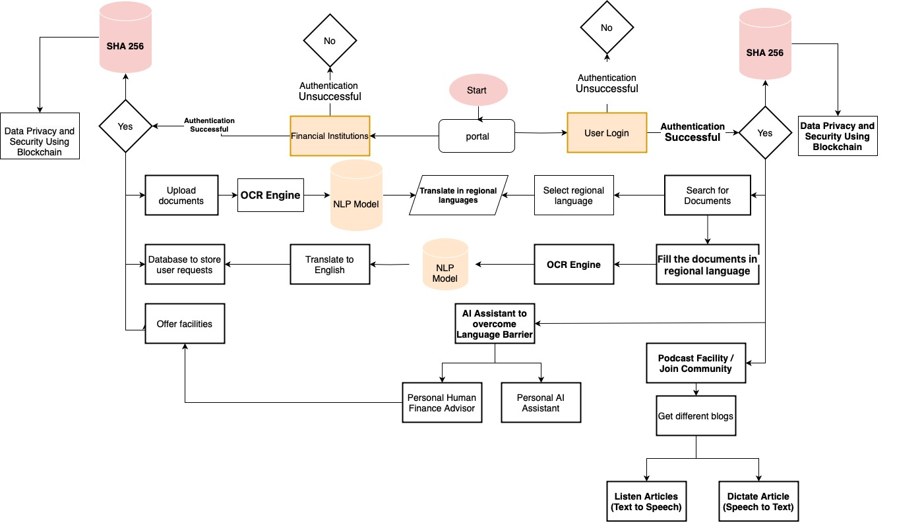
ARCHITECTURE

Slide 7
Brief on Programming Module
What programming language will be used?
Frontend: React (Web), flutter
Backend: Node.js, Express.js
Database: MongoDB,
APIs: Google Translate, Google Speech-to-Text, Microsoft Cognitive Services, Google Cloud Vision
Security: SSL/TLS, AES encryption, MFA
Collaboration: GitHub, Google Colab
What all software modules will be built?
User Interface Module(Web Interface, Chatbot Interface)
Authentication and Authorization Module(User Registration and Login)
Language Translation Module(Text Translation, Voice Translation)
Financial Document Processing Module(Form Handling, Document Storage)
Cyber Fraud Detection Module(Fraud Analysis Engine)
6. User Feedback and Reporting Module(Feedback Collection, Feedback Analysis)
If you’re using any cloud solutions, mention details about integration with that
Google Cloud Platform (GCP):
Compute: Google Cloud Compute Engine for backend servers.
Storage: Google Cloud Storage for storing documents and images.
Database: Google Cloud SQL for database management.
Translation: Google Translate API for language translation.
OCR: Google Cloud Vision API for OCR capabilities.
Authentication: Firebase Authentication for user management.
Machine Learning: Google AI Platform for ML model development and deployment.
Integration using:
Google Cloud Storage
Google Cloud SQL
Google Translate API
Google Cloud Vision API
Firebase Authentication
Google AI Platform

