Slide 1

Developing Management Skills
Chapter 12:
Motivating Others
Copyright © 2011 Pearson Education
6-<number>

Slide 2
Learning Objectives
Diagnose work performance problems
Enhance the work-related abilities of others
Foster a motivating work environment
Copyright © 2011 Pearson Education
6-<number>

Slide 3
Motivation
“I don’t motivate my players. You cannot motivate someone, all you can do is provide a motivating environment and the players will motivate themselves.”
Phil Jackson after winning his 7th NBA title as a coach.
Copyright © 2011 Pearson Education
6-<number>

Slide 4
Motivation
“Spending time and energy trying to ‘motivate’ people is a waste of effort. The real question is not, ‘How do we motivate our people?’ If you have the right people, they will be self-motivated. They key is to not de-motivate them.”
Jim Collins, Good to Great
Copyright © 2011 Pearson Education
6-<number>

Slide 5

Formula for Performance
Performance = Ability x Motivation (Effort)
Ability = Aptitude x Training x Resources
Motivation = Desire x Commitment
Copyright © 2011 Pearson Education
6-<number>

Slide 6
Diagnosing Poor Performance
How difficult are the tasks?
How capable is the individual?
How hard is individual trying to succeed at the job?
How much improvement is individual making?
Copyright © 2011 Pearson Education
6-<number>

Slide 7

Performance and Motivation
Is the problem Ability or Motivation?
Copyright © 2011 Pearson Education
6-<number>

Slide 8

Three Danger Signals of Ability Degeneration
Taking refuge in a specialty
Focusing on past performance
Exaggerating aspects of the leadership role
Copyright © 2011 Pearson Education
6-<number>

Slide 9

Five Tools for Improving Ability
Resupply
Retrain
Refit
Reassign
Release
Copyright © 2011 Pearson Education
6-<number>

Slide 10
Management Styles
Theory X: Assumes that people seek to avoid work when possible
Theory Y: Assumes that people have an intrinsic desire to do good work
Copyright © 2011 Pearson Education
6-<number>

Slide 11
Relationship Between Satisfaction and Performance
EMPHASIS ON PERFORMANCE
LOW HIGH
HIGH
LOW
Indulging
Integrating
EMPHASIS ON
SATISFACTION
Ignoring
Imposing
Copyright © 2011 Pearson Education
6-<number>

Slide 12
Four Types
Indulging: focuses on satisfaction rather than performance
Imposing: focuses on performance rather than satisfaction
Ignoring: focuses on neither performance nor satisfaction
Integrating: focuses equally on performance and satisfaction
Copyright © 2011 Pearson Education
6-<number>

Slide 13

Old View of Motivation
Satisfaction → Motivation → Performance
(Contented Cows give more Milk)
Copyright © 2011 Pearson Education
6-<number>

Slide 14

New View of Motivation
Motivation
Performance
Outcomes
Satisfaction
Copyright © 2011 Pearson Education
6-<number>

Slide 15

Motivation → Performance
Motivation begins with establishing moderately difficult goals that are understood and accepted.
Copyright © 2011 Pearson Education
6-<number>

Slide 16
Goal Setting
Characteristics of good goals:
  Specific
  Consistent
  Appropriately challenging
  Provide feedback
Copyright © 2011 Pearson Education
6-<number>

Slide 17

Motivation → Performance
After setting goals, managers should remove obstacles to performance.
Copyright © 2011 Pearson Education
6-<number>

Slide 18
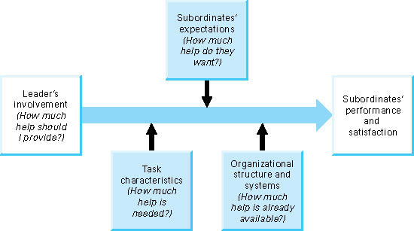
Path Goal Theory
Insert figure 6.2
Copyright © 2011 Pearson Education
6-<number>

Slide 19
Performance → Outcomes
Using rewards and discipline to encourage exceptional behaviors and extinguish unacceptable behavior.
Copyright © 2011 Pearson Education
6-<number>

Slide 20
The Best Award Programs
Give awards publicly
Use awards infrequently
Embed them in a reward process
Acknowledge past recipients in awards presentations
Match award with culture
Copyright © 2011 Pearson Education
6-<number>

Slide 21

Managers’ Actions as Reinforcers
Manager’s get what they reinforce, not what they want.
Copyright © 2011 Pearson Education
6-<number>

Slide 22
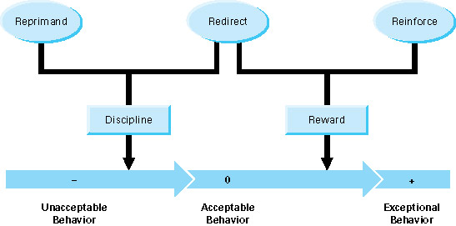
Behavior Shaping Strategies
Copyright © 2011 Pearson Education
6-<number>

Slide 23
Disciplining: responding negatively to behavior to discourage future occurrences.
Rewarding: linking desired behaviors with employee-valued outcomes.
Copyright © 2011 Pearson Education
6-<number>

Slide 24
Extrinsic Outcomes: outside the control of the individual.
Intrinsic Outcomes: experienced by the individual as a result of successful performance.
Copyright © 2011 Pearson Education
6-<number>

Slide 25
Work Design
The process of matching job characteristics and the worker’s skill and interests.
Copyright © 2011 Pearson Education
6-<number>

Slide 26
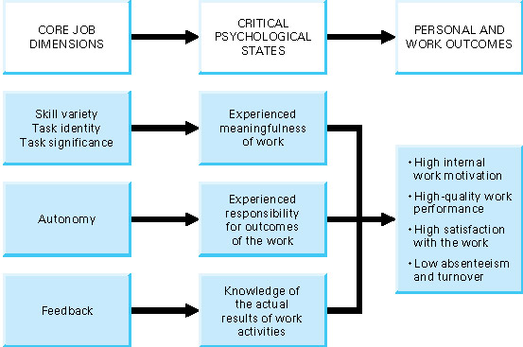
Job Characteristics Model
Insert figure 6.4
Copyright © 2011 Pearson Education
6-<number>

Slide 27
Work Design Strategies
Combine tasks
Form identifiable work units
Establish client relationships
Increase authority
Feedback
Copyright © 2011 Pearson Education
6-<number>

Slide 28
Need Theories
Hierarchy of
Needs
Maslow Alderfer
Self Actualization
Esteem Growth
Belongingness Social
Safety
Physiological Existence
Copyright © 2011 Pearson Education
6-<number>

Slide 29
Murray’s Manifest Needs
Need for Achievement: behavior toward competition with a standard of excellence
Need for Affiliation: desire to feel reassured and acceptable to others
Need for Power: desire to influence others and to control one’s environment
Copyright © 2011 Pearson Education
6-<number>

Slide 30
Needs and Attribution
Common Management Mistakes
  Assuming all employees value the same reward
  Assuming the manager’s preference for a reward is the same as employees
Copyright © 2011 Pearson Education
6-<number>

Slide 31

Cafeteria Style Systems
Allows employees to select from a “menu” of benefits, i.e. health benefits, insurance, etc.
Copyright © 2011 Pearson Education
6-<number>

Slide 32

Fairness and Equity
Workers evaluate what they get from the relationship (outcomes) to what they put in (inputs) and compare this ratio to other’s in a comparison group.
Copyright © 2011 Pearson Education
6-<number>

Slide 33
Fairness and Equity
Workers who perceive inequity are motivated to adjust their own or other worker’s inputs and/or outcomes.
Copyright © 2011 Pearson Education
6-<number>

Slide 34
Feedback
To make the connection between behavior and outcome, consider
The length of time between behavior and rewards
The explanation (feedback) for the reward
Copyright © 2011 Pearson Education
6-<number>

Slide 35
Integrative Model
Commitment
3. REINFORCEMENT
Discipline
Rewards
1. GOALS/EXPECTATIONS
Accepted
Challenging and specific
Feedback
4.EQUITY
Social comparisons
Personal expectations
+
EFFORT
(Desire and
Commitment)
OUTCOMES
(Extrinsic and
Intrinsic)
PERFORMANCE
SATISFACTION
2. ABILITY
Aptitude
Training
Resources
-
5. SALIENCE
  Personal needs
6. TIMELINESS
Absenteeism
And turnover
Copyright © 2011 Pearson Education
6-<number>

Slide 36
Behavioral Guidelines
Clearly define an acceptable level of performance or specific goals
Remove obstacles to reaching goals
Make rewards contingent on performance
Treat discipline as a learning experience
Copyright © 2011 Pearson Education
6-<number>

Slide 37
Behavioral Guidelines
Transform acceptable behaviors into exceptional ones
Identify rewards that appeal to the individual
Check subordinates perceptions of reward equity
Provide timely rewards and feedback
Copyright © 2011 Pearson Education
6-<number>

