Slide 1

COMPUTATIONAL THINKING AND PROGRAMMING

Slide 2
Course Type: | Foundation |  | L | T | P | Credits
 |  |  | 2 | 1 | 4 | 5
COURSE CREDITS

Slide 3
Topics covered till date:
Basics about Hardware and Software
Algorithm and flowchart
Literals [ string, numeric, Boolean, collection and special]
Variables and datatypes [int, float, str, complex, Boolean, collections]4.
Identifiers [Name of variables, functions, collections etc]
6. Reserved Words
7. Operators
5.1. Assignment Operator
5.2. Arithmetic Operators
5.3. Logical operator
5.4. Comparison or Relational operator
5.5. Bitwise Operator
5.6. Membership Operator
5.7. Operator Precedence and associativity
6. Selection Control [if, if-else, if-elif-else, nested if]

Slide 4
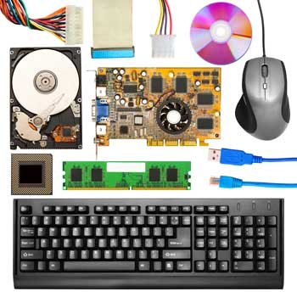
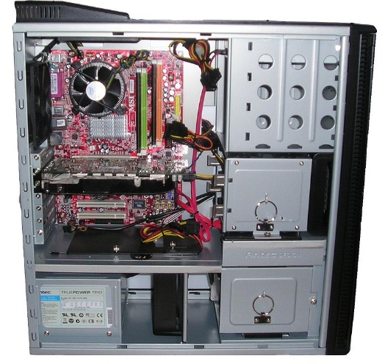
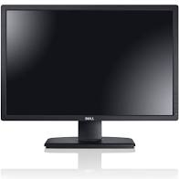
Computer Hardware
Computer hardware comprises the physical part of a computer system. It includes the all-important components of the central processing unit (CPU) and main memory.
It basically includes following peripheral components:
Input devices − keyboard, mouse, etc.
Output devices − printer, monitor, etc.
Secondary storage devices − Hard disk, CD, DVD, etc.
Internal components − CPU, motherboard, RAM, etc.

Slide 5
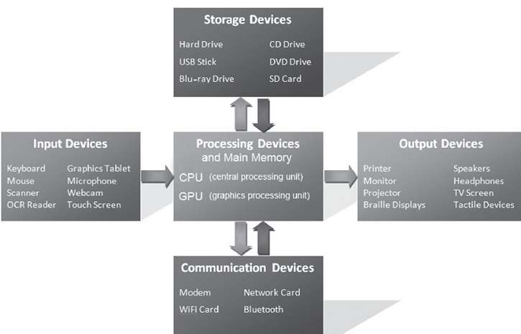
Fundamental Hardware Components

Slide 6
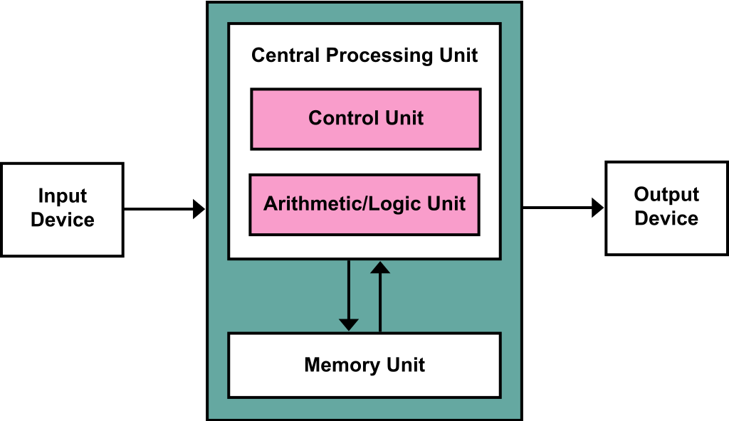
Bridging Hardware and Software
The central processing unit (CPU) is the “brain” of a computer, containing digital logic circuitry able to interpret and execute instructions.
Main memory is where currently executing
programs reside, which the CPU can directly
and very quickly access.
Secondary memory is nonvolatile,
and therefore provides long-term
storage of programs and data
Input/output devices include anything
that allows for input or output.
Buses transfer data between components
within a computer system, such as between the
CPU and main memory.

Slide 7
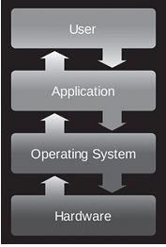
Bridging Hardware and Software
Hardware and software are mutually dependent on each other. Both of them must work together to make a computer produce a useful output.
An operating system is software that has the job of managing the hardware resources of a given computer and providing a particular user interface (interacting with the hardware resources).
An operating system is intrinsic to the operation
a computer, it is referred to as system software.
Operating system acts as the “middle man” between
the hardware and executing application programs
Limits of Integrated Circuits Technology:
Moore’s Law states that the number of transistors that
can be placed on a single silicon chip doubles roughly
every two years.

Slide 8
What Is Computer Software?
Computer software is a set of program instructions, including related data and documentation, that can be executed by computer.
Software can be in the form of instructions on paper, or in digital form.
Types of Software:
System Software: intrinsic to a computer system or platform for executing application software. Example: OS, Compiler, Interpreter, etc.
Application software: Fulfills users’ needs, such as a photo-editing program, MS office, etc.
Programming languages (called “artificial languages”) are languages just as “natural languages” such as English and Mandarin (Chinese).
Syntax and semantics are important concepts that apply to all languages.

Slide 9
What Is an Algorithm ?
An algorithm is a finite number of clearly described, unambiguous “doable” steps that can be systematically followed to produce a desired result for given input in a finite amount of time. (that is, it eventually terminates).
Computer algorithms are central to computer science. They provide step-by-step methods of computation that a machine can carry out.
Example: Write an algorithm to check a given number is even or odd.
Input N
Let N be the number to check whether it is even or odd.
2. Divides the N by 2 and check the remainder
3. If N divided by 2 provides 0 remainder, then N is even,
4. Else N is odd.
Is N%2
equal to 0
N is Odd
N is Even

Slide 10
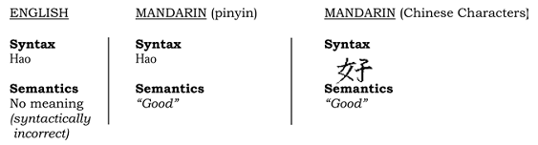
Syntax, Semantics of a Language
The syntax of a language is a set of characters and the acceptable sequences of those characters.
The semantics of a language is the meaning associated with each syntactically correct sequence of characters.
Example:
“Hello there, how are you?” -- This is not syntactically correct,
“Hello there, hao are you?” -- “hao” is not a word in the English language
“Colorless green ideas sleep furiously.” -- Syntactically correct, but semantically incorrect (no meaning).

Slide 11
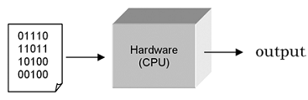
Program Translation
A central processing unit (CPU) is designed to interpret and execute a specific set of instructions represented in binary form (i.e., 1s and 0s) called machine code.
Only programs in machine code can be executed by a CPU.
Writing programs at this “low level” is tedious and error-prone. Therefore, most programs are written in a “high-level” programming language such as Python.
Since the instructions of such programs are not in machine code that a CPU can execute, a translator program must be used.
There are two fundamental types of translators: compiler and interpreter.

Slide 12
Data Types
Data Types
Mutable
Lists
Immutable
Numbers
Strings
Tuples
Dictionary
Sets
Mutable Data Types: Data types in python where the value assigned to a variable can be changed
Immutable Data Types: Data types in python where the value assigned to a variable cannot be changed

Slide 13
Example
link

Slide 14
Datatype Conversion
As a matter of fact, we can do various kinds of conversions between strings, integers and floats using the built-in int, float, and str functions
>>> x = 10
>>> float(x)
10.0
>>> str(x)
'10'
>>>
>>> y = "20"
>>> float(y)
20.0
>>> int(y)
20
>>>
>>> z = 30.0
>>> int(z)
30
>>> str(z)
'30.0'
>>>
integer ➔ float
integer ➔ string
string ➔ float
string ➔ integer
float ➔ integer
float ➔ string

Slide 15
Explicit and Implicit Data Type Conversion
Data conversion can happen in two ways in Python
Explicit Data Conversion (we saw this earlier with the int, float, and str built-in functions)
Implicit Data Conversion
Takes place automatically during run time between ONLY numeric values
E.g., Adding a float and an integer will automatically result in a float value
E.g., Adding a string and an integer (or a float) will result in an error since string is not numeric
Applies type promotion to avoid loss of information
Conversion goes from integer to float (e.g., upon adding a float and an integer) and not vice versa so as the fractional part of the float is not lost

Slide 16
Tokens
Tokens are the smallest unit of the program.
Tokens
Reserved Words
Identifiers
Literals
Operators

Slide 17
Literals
String Literals:
A string literal is a sequence of characters surrounded by quotes. We can use both single, double or triple quotes for a string. And, a character literal is a single character surrounded by single or double quotes.
Numeric Literals:
Numeric Literals are immutable (unchangeable). Numeric literals can belong to 3 different numerical types Integer, Float, and Complex.
Boolean Literals:
A Boolean literal can have any of the two values: True or False.
Collection literals:
There are four different literal collections List literals, Tuple literals, Dict literals, and Set literals.
Special literals:
Python contains one special literal i.e. None. We use it to specify to that field that is not created.
Literals
String
Numeric
Boolean
Collection
Special

Slide 18
Keywords
Python has some rules about how identifiers can be formed
Some identifiers are part of Python itself (they are called reserved words or keywords) and cannot be used by programmers as ordinary identifiers
False | class | finally | is | return
None | continue | for | lambda | try
True | def | from | nonlocal | while
and | del | global | not | with
as | elif | if | or | yield
assert | else | import | pass
break | except | in | raise
Python Keywords

Slide 19
Identifiers
Python has some rules about how identifiers can be formed
Every identifier must begin with a letter or underscore, which may be followed by any sequence of letters, digits, or underscores
>>> x1 = 10
>>> x2 = 20
>>> y_effect = 1.5
>>> 2celsius = 32
>>> 2celsius
File "<stdin>", line 1
2celsius
^
SyntaxError: invalid syntax

Slide 20
Operators
Arithmetic Operators (**, *,/,//,%,+,_)
Comparison Operators (<, <=, >, >=, ==)
Assignment Operators (=, +=, -=, *=, /=)
Logical Operators (and, or, not)
Bitwise Operators (&, |, ~, >>, <<, ^)
Membership Operators (in, not in)

Slide 21
Operator
Arithmetic operator
Low
High
Precedence
+ | - | * | / | // | % | **
Plus | minus | multiplication | Float division | Integer division | Mod (remainder) | power
3 | 3 | 2 | 2 | 2 | 2 | 1
Left to right
Right to left

Slide 22
Lets solve -
2**3**1
1**3**2
2**1**3
5/10*5+5*2
5//10*5+5*2
5%10*5+5*2

Slide 23
Comparison Operators
Boolean expressions ask a question
Produce a Yes or No result which we use to control program flow
Boolean expressions using comparison operators evaluate to:
True / False - Yes / No
Comparison operators look at variables
But do not change the variables
Operator | Description
== | Equals to
!= | Not equals to
> | Greater than
< | Less Than
>= | Greater Than Equals to
<= | Less Than Equals to

Slide 24
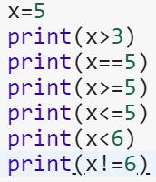
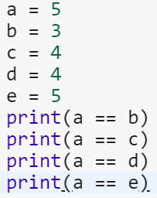


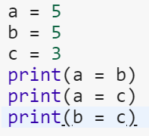
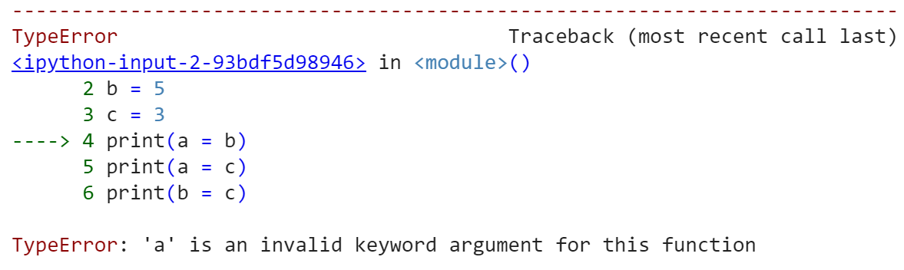
Example

Slide 25
Logical operators
Logical operators are the and, or, not operators.
Operator | Meaning | Example
and | True if both the operands are true | x and y
or | True if either of the operands is true | x or y
not | True if operand is false (complements the operand) | not x

Slide 26
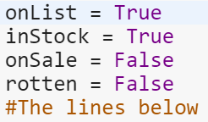
Logical operators AND/OR
AND
X | Y | Output
TRUE | TRUE | TRUE
TRUE | FALSE | FALSE
FLASE | TRUE | FLASE
FALSE | FALSE | FLASE
 | OR
X | Y | Output
TRUE | TRUE | TRUE
TRUE | FALSE | TRUE
FLASE | TRUE | TRUE
FALSE | FALSE | FLASE
>>>a=7>7 and 2>-1
>>>print(a)
FLASE
>>>a=7>7 or 2>-1
>>>print(a)
True
>>>print(7 and 0 or 5)
5
print(onList and inStock)
print(onList and onSale)
print(onSale and rotten)
print(onList and inStock and onSale)
print(onList and inStock and onList)
print(onList and inStock)
print(onList and inStock)

Slide 27
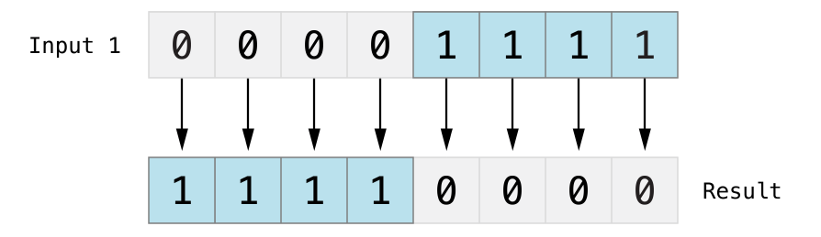
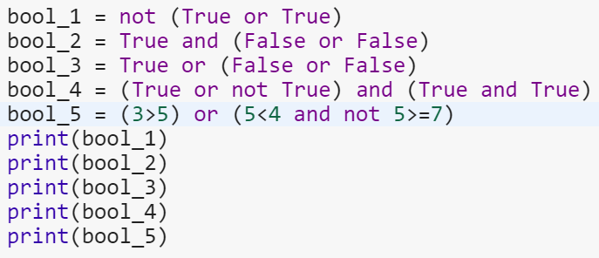
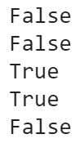
Logical operators NOT
Just the reverse of what is there.
not(true) → false

Slide 28
Bitwise operators
Operator | Description
& Binary AND | Operator copies a bit to the result if it exists in both operands
| Binary OR | It copies a bit if it exists in either operand.
^ Binary XOR | It copies the bit if it is set in one operand but not both.
~ Binary Ones Complement | It is unary and has the effect of 'flipping' bits.
<< Binary Left Shift | The left operands value is moved left by the number of bits specified by the right operand.
>> Binary Right Shift | The left operands value is moved right by the number of bits specified by the right operand.
Bitwise operators act on operands as if they were string of binary digits.
It operates bit by bit.
2 is 10 in binary and 7 is 111.
In the table below:
Let x = 10 (0000 1010 in binary) and y = 4 (0000 0100 in binary)

Slide 29
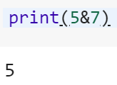
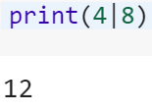
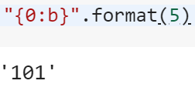
Bitwise operators AND
5 & 7
Same as 101 & 111.
This results in 101
Which is binary for 5.
Operation | Output
0 & 0 | 0
0 & 1 | 0
1 & 0 | 0
1 & 1 | 1
Operation | Output
0 | 0 | 0
0 | 1 | 1
1 | 0 | 1
1 | 1 | 1
4 | 8
Binary for 4 is 0100, and that for 8 is 1000.
After operation, output is 1100
Which is binary for 12.

Slide 30


Bitwise operators XOR
XOR (exclusive OR) returns 1
If one operand is 0 and another is 1.
Otherwise, it returns 0.
Operator | Output
0^0 | 0
0^1 | 1
1^0 | 1
1^1 | 0

Slide 31
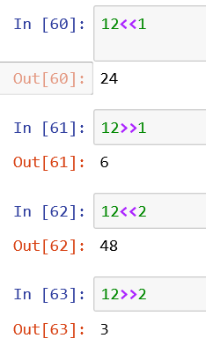
Shift operator
Left Shift (<<)
Let’s Solve
15^13
12 & 10
11|00
5<<2
5>>2
Right Shift (>>)

Slide 32
Operator Precedence
Operators | Meaning
() | Parentheses
** | Exponent
+x, -x, ~x | Unary plus, Unary minus, Bitwise NOT
*, /, //, % | Multiplication, Division, Floor division, Modulus
+, - | Addition, Subtraction
<<, >> | Bitwise shift operators
& | Bitwise AND
^ | Bitwise XOR
| | Bitwise OR
==, !=, >, >=, <, <=, in, not in, is | Comparisions, Membership operators
not | Logical NOT
and | Logical AND
or | Logical OR

Slide 33
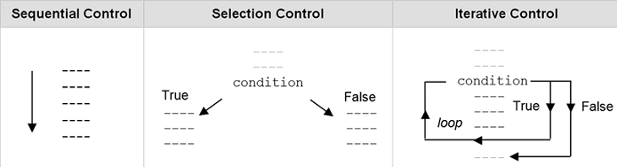
Control Structures
Control flow is the order that instructions are executed in a program.
A control statement is a statement that determines the control flow of a set of instructions.
Types of Control:
Sequential control: Instructions are executed in the order that they are written
Selection control: Selectively executes the instructions.
E.g. Decision Control
Iterative control: Repeatedly executes the instructions. E.g. Loops.

Slide 34
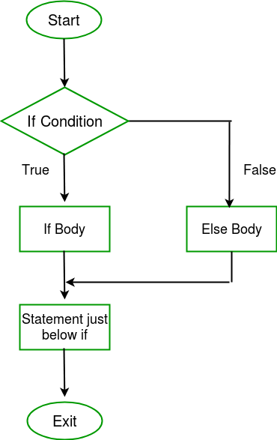
Selection Control or Decisions (It is a control statement providing selective execution of instructions)
Decisions in a Python program
if statements
if else statements
elif statements
nested if conditions

Slide 35
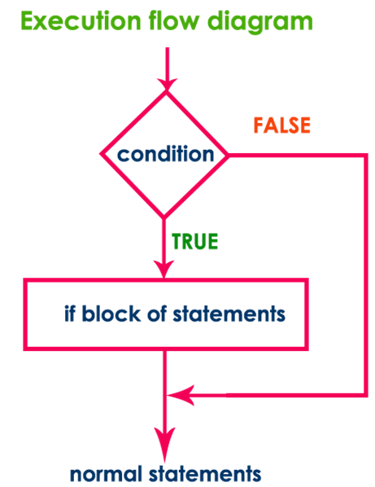
If Statement It is a selection control statement based on the value of a given Boolean expression
Syntax:
if test expression:
statement(s)
Expression’s value can be True or False.
We may want to do something only when a certain condition is true.
if statement in python takes an expression with it.
If the expression results to True
then the block of statements under it is executed.
If it results to False
then the block is skipped and control transfers to the statements after the block.
Remember to indent the statements in a block equally

Slide 36
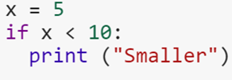
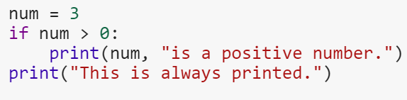
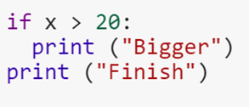
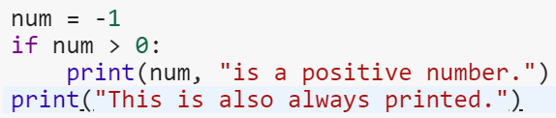

Example: What will be the output ?
1.
2.
3.
4.
5.
Output: Smaller
Output: 3 is a positive number.
This is always printed.
Output: Finish
Output: This is also always printed.
Output: yay

Slide 37
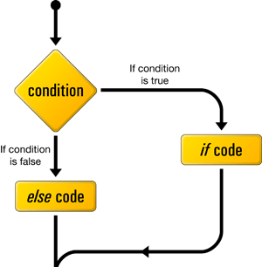
if...else Statement a.k.a. Two way decisions
What happens when the condition is untrue or false?
We can mention that it in the block after the else statement.
An ‘else’ statement comes right after the block after ‘if’.

Slide 38
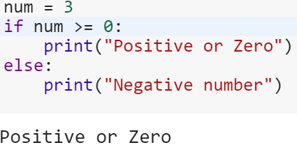
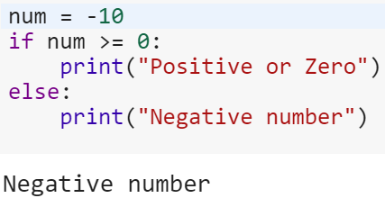
Example
Syntax:
if test expression:
Body of if
else:
Body of else

Slide 39
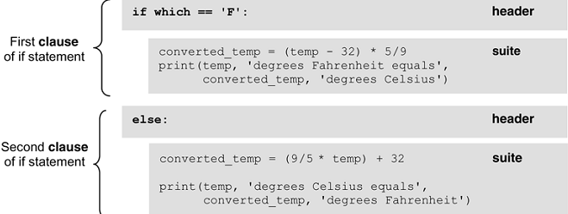
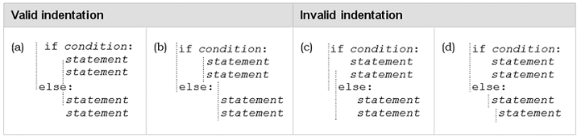
Header, Suite and Indentation
One unique aspect of Python is that the amount of indentation of each program line is significant.

Slide 40
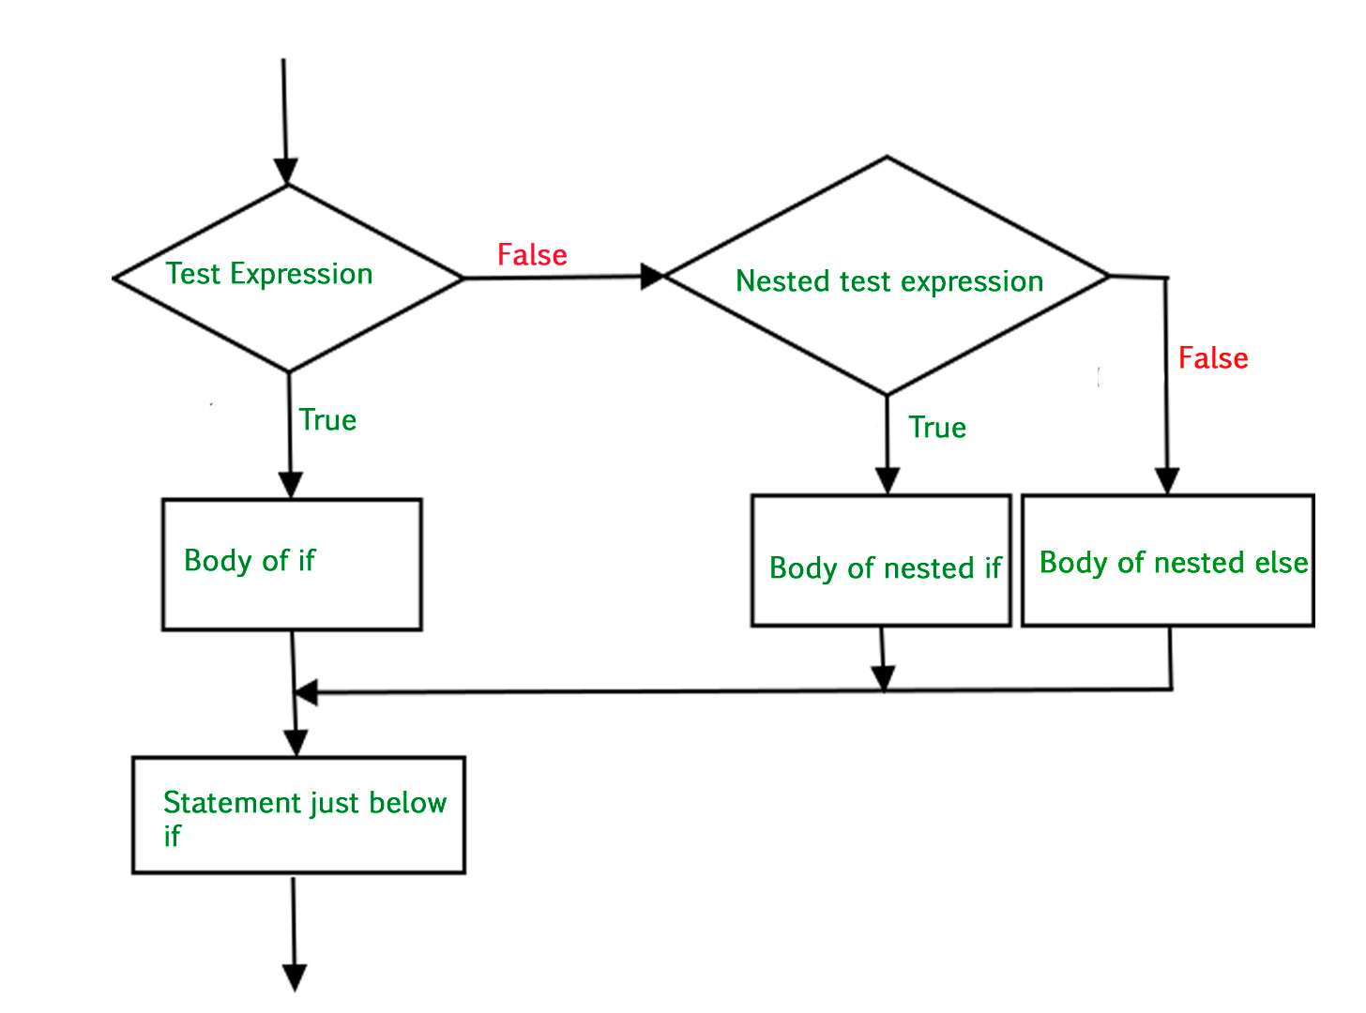
Nested if statements (multi-way selection)
You can put an if statement in the block under another if statement.
This is to implement further checks.

Slide 41
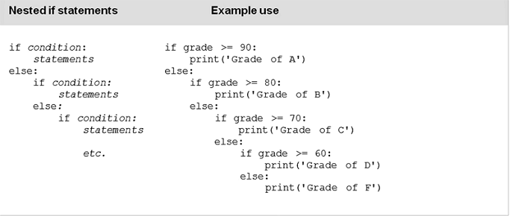
Nested if statements: Example

Slide 42
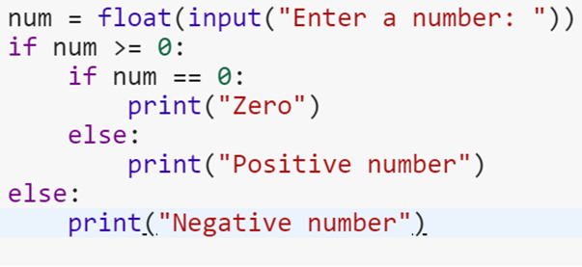

Example: What will be the output?

Slide 43
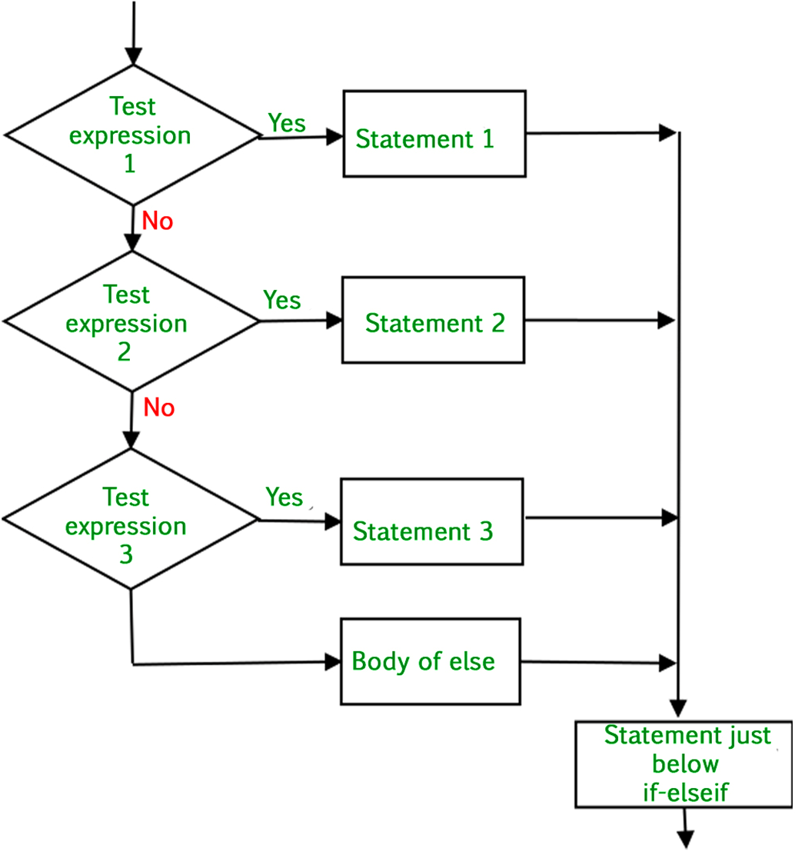
if...elif...else Statement
Replacement to the else-if statements
More than one condition to check
If condition 1 isn’t True, condition 2 is checked.
If it isn’t true, condition 3 is checked.

Slide 44
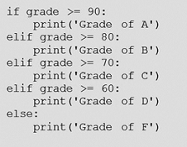
if...elif...else Statement: Example Use
Syntax:
if test expression:
Body of if
elif test expression:
Body of elif
else:
Body of else

Slide 45
Exercise
Find out the Max of three numbers

Slide 46
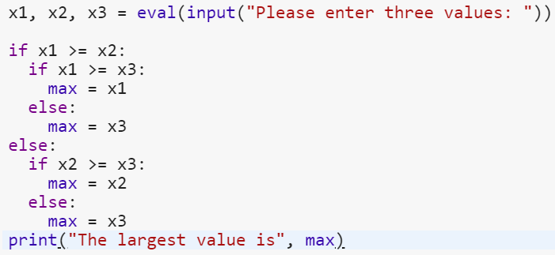
Maximum between 3 numbers

Slide 47
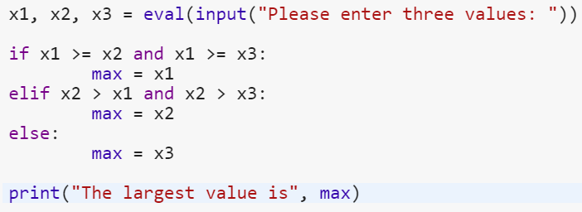
Maximum between 3 numbers

Slide 48
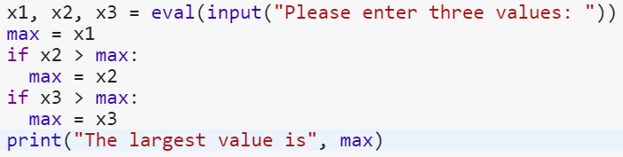
Maximum between 3 numbers

Slide 49
MCQs: Answer
A good definition of computer science is “the science of programming computers.”
TRUE
FALSE
Which of the following areas of study are included within the field of computer science?
Software engineering
Database management
Information security
All of the above
In order to computationally solve a problem, two things are needed: a representation of the problem, and an algorithm that solves it.
Leaving out detail in a given representation is a form of abstraction.
A “brute-force” approach for solving a given problem is to:
Try all possible algorithms for solving the problem.
Try all possible solutions for solving the problem.
Try various representations of the problem.
All of the above
For which of the following problems is a brute-force approach practical to use?
Man, Cabbage, Goat, Wolf problem
Traveling Salesman problem
Chess-playing program
All of the above

Slide 50
MCQs: Answers
Two general types of software are system software and application software.
The syntax of a given language is,
the set of symbols in the language.
the acceptable arrangement of symbols.
both of the above
The semantics of a given language is the meaning associated with any arrangement of symbols in the language.
TRUE
FALSE
CPUs can only execute instructions that are in binary form called machine code.
The two types of translation programs for the execution of computer programs are
compilers and interpreters.
The process of finding and correcting errors in a computer program is called program debugging.
Which kinds of errors can a translator program detect?
Syntax errors
Semantic errors
Neither of the above
Two major programming paradigms in use today are procedural programming and object-oriented programming.

Slide 51




Let’s Solve
Operators
()
**
+x, -x, ~x
*, /, //, %
+, -
<<, >>
&
^
|
==, !=, >, >=, <, <=, in, not in
not
and
Or
=,*=,/=,//=,%=
10*4>>2 and 3
10%(15<10 and 20<30)
10/(5-5)
2.5%0.15

Slide 52
MCQs: Answers
All if statements must contain either an else or elif header.
TRUE
FALSE
Which of the following statements are true regarding headers in Python?
Headers begin with a keyword and end with a colon.
Headers always occur in pairs.
All headers of the same compound statement must be indented the same amount.
Which of the following statements is true?
Statements within a suite can be indented a different amount.
Statements within a suite can be indented a different amount as long as all headers in the statement that it occurs in are indented the same amount.
All headers must be indented the same amount as all other headers in the same statement, and all statements in a given suite must be indented the same amount.
The elif header allows for,
Multi-way selection that cannot be accomplished otherwise
Multi-way selection as a single if statement
The use of a “catch-all” case in multi-way selection

