Slide 1
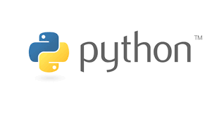





Computational Thinking with Programming
Lecture - 10
Function : Continues….
@cse_bennett
@csebennett

Slide 2
Today…
Last Session:
Functions (Definition)
Today’s Session:
Functions- Part II:
The software development process
The Python math library
Hands on Session with Jupyter Notebook:
We will practice on the user defined function in Jupyter Notebook.

Slide 3
LGB Rule
Name references search the three scopes in order:
Local
Global
Built-in
Local variable override Global
Local and global variables
can override built-in
radius = 2
Pi = 3.141592654
def area(radius):
area = pi * (pow(radius,2))
return area
Print(area(8))
Global
local

Slide 4
Indirect Function Calls
Functions can be assigned to names and passed to the other functions
def hello():
print(“Hello Bennett”)
X = hello
X()
def call(function, *args):
function(args)
call(multiply,2,2)
obj_dict = { ‘function’ : multiply, ‘args’ : (2,2)}
apply(obj_dict[‘function’],obj_dict[‘args’])

Slide 5
The Software Development Process
Writing programs requires a systematic approach to problem solving, which incorporates 7 major steps
Problem analysis, which involves studying deeply the problem at hand
Program specification, which involves deciding exactly “what” (NOT “how”) your program will do
What is the input?
What is the output?
What is the relationship between the input and the output?
Design, which involves writing an algorithm in pseudocode
This is where the “how” of the program gets worked out

Slide 6
The Software Development Process
Writing programs requires a systematic approach to problem solving, which incorporates 7 major steps
Implementation, which involves translating your pseudocode into code (e.g., using Python)
Debugging, which involves finding and fixing errors (or what are often referred to as bugs) in your program
Bugs can be of two types, syntax and semantic (or logical) bugs
Testing, which involves trying your program with an extensive set of test cases so as to verify that it works correctly

Slide 7
The Software Development Process
Writing programs requires a systematic approach to problem solving, which incorporates 7 major steps
Maintenance, which involves keeping your program up-to-date with technology and the evolving needs of your users
Most programs are never really finished!

Slide 8
Example
Problem: Write a program that translates temperatures from degrees Celsius to Fahrenheit
Solution:
Problem Analysis:
Pretty clear; some people do not understand temperatures in Celsius; there is a mathematical formula to convert Celsius to Fahrenheit
Program Specification:
Input: temperature in degrees Celsius (say, C)
Output: temperature in degrees Fahrenheit (say, F)

Slide 9
Example
Solution:
Program Specification:
Relationship between input and output:
We can do some quick figuring, after which we will realize that 0 Celsius is equal to 32 Fahrenheit and 100 Celsius is equal to 212 Fahrenheit
With this information, we can compute the ratio of Fahrenheit to Celsius; I.e., (212 – 32)/(100 - 0) = 9/5
The conversion formula will then have the form F = 9/5C + k
Plugging in 0 and 32 for C and F, we can immediately see that k = 32
Thus, the final formula will be F = 9/5C + 32

Slide 10
Example
Solution:
Design:
Pseudocode:
Input: C
Calculate F as (9/5) * C + 32
Output: F

Slide 11
Example
Solution:
Implementation:
Python Code:
def main():
celsius = eval(input("What is the Celsius temperature? "))
fahrenheit = 9/5 * celsius + 32
print("The temperature is", fahrenheit, "degrees Fahrenheit")
main()
Let us run, debug, and test this code together!

Slide 12
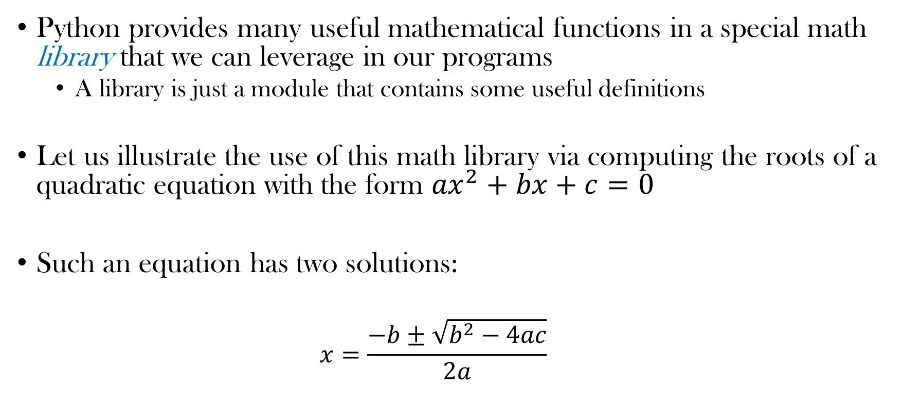
Using the Math Library
Python provides many useful mathematical functions in a special math library that we can leverage in our programs
A library is just a module that contains some useful definitions
Let us illustrate the use of this math library via computing the roots of a quadratic equation with the form ${ax}^{2}+bx+c=0$
Such an equation has two solutions:
$$x=\frac{−b±\sqrt{b^{2}−4ac}}{2a}$$

Slide 13
Using the Math Library: An Example
#The following line will make the math library in Python available for us.
import math
def rootsQEq():
print("This program finds the real solutions to a quadratic.")
print()
a = eval(input("Enter the value of coefficient a: "))
b = eval(input("Enter the value of coefficient b: "))
c = eval(input("Enter the value of coefficient c: "))

Slide 14
Using the Math Library: An Example
#To call a function from the math library, we can use the
#dot operator as follows:
s_root_val = math.sqrt(b*b - 4 * a * c)
root1 = (-b + s_root_val)/(2*a)
root2 = (-b - s_root_val)/(2*a)
print()
print("The solutions are: ", root1, root2)
#Call the function rootsQEq()
rootsQEq()

Slide 15
Using the Math Library: An Example
One sample run:
This program finds the real solutions to a quadratic.
Enter the value of coefficient a: 3
Enter the value of coefficient b: 4
Enter the value of coefficient c: -2
The solutions are: 0.38742588672279316 -1.7207592200561266

Slide 16
Using the Math Library: An Example
Another sample run:
This program finds the real solutions to a quadratic.
Enter the value of coefficient a: 1
Enter the value of coefficient b: 2
Enter the value of coefficient c: 3
Traceback (most recent call last):
File "/Users/mhhammou/Desktop/CMU-Q/Courses/15-110/Programs/Lecture4/RootsQE.py", line 22, in <module> rootsQEq()
File "/Users/mhhammou/Desktop/CMU-Q/Courses/15-110/Programs/Lecture4/RootsQE.py", line 14, in rootsQEq
s_root_val = math.sqrt(b*b - 4 * a * c)
ValueError: math domain error
What is the problem?

Slide 17
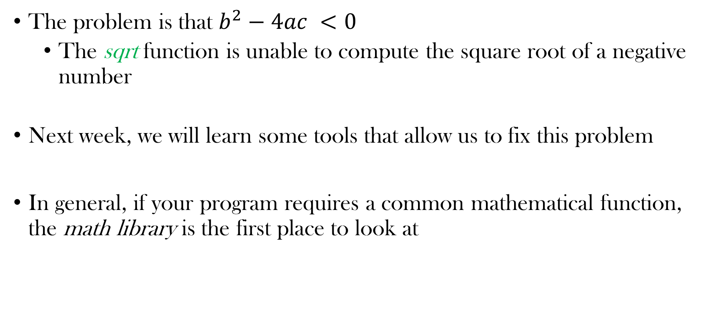
Using the Math Library: An Example
The problem is that $b^{2}−4ac <0$
The sqrt function is unable to compute the square root of a negative number
Next week, we will learn some tools that allow us to fix this problem
In general, if your program requires a common mathematical function, the math library is the first place to look at

Slide 18
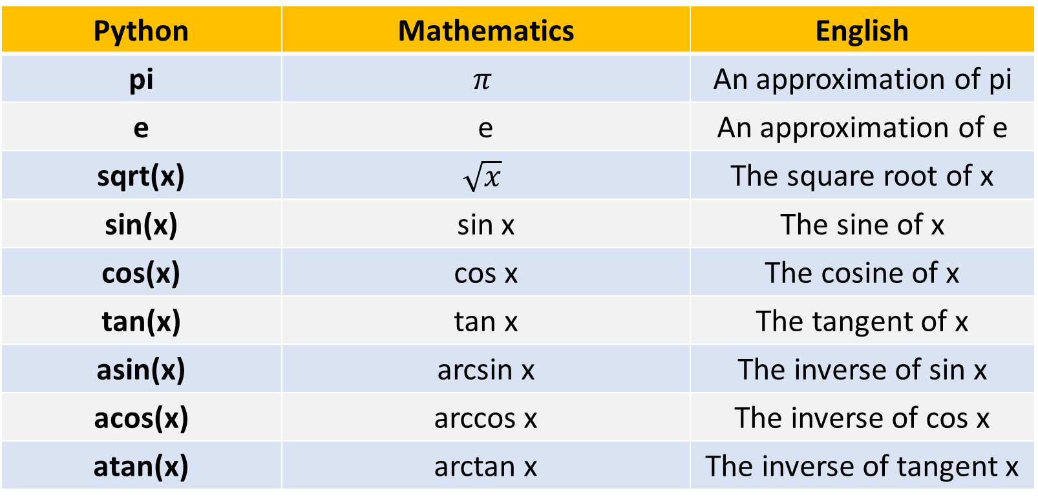
Some Functions in the Math Library
Python | Mathematics | English
pi | $$π$$ | An approximation of pi
e | e | An approximation of e
sqrt(x) | $$\sqrt{x}$$ | The square root of x
sin(x) | sin x | The sine of x
cos(x) | cos x | The cosine of x
tan(x) | tan x | The tangent of x
asin(x) | arcsin x | The inverse of sin x
acos(x) | arccos x | The inverse of cos x
atan(x) | arctan x | The inverse of tangent x

Slide 19
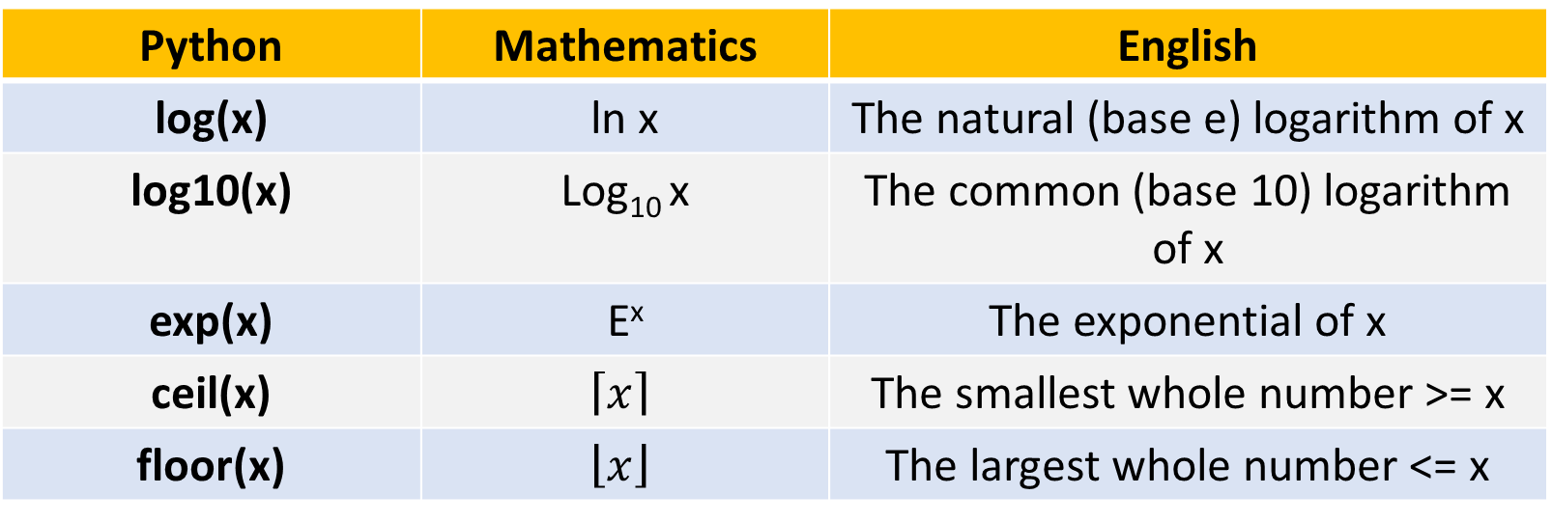
Some Functions in the Math Library
Python | Mathematics | English
log(x) | ln x | The natural (base e) logarithm of x
log10(x) | Log₁₀ x | The common (base 10) logarithm of x
exp(x) | E^{x} | The exponential of x
ceil(x) | $$\left\lceil x\right\rceil$$ | The smallest whole number >= x
floor(x) | $$\left\lfloor x\right\rfloor$$ | The largest whole number <= x

Slide 20
Summary
Programmers use functions to reduce code duplication and structure (or modularize) programs
The basic idea of a function is to write a sequence of statements that together can achieve a certain specification and give that sequence a name
Once a function is defined, it can be called over and over again
Parameters allow functions to receive different input values

Slide 21
Summary
The scope of a variable is the area of the program where it may be referenced
Formal parameters and other variables (which are not labeled as global) inside a function are local to the function (i.e., can be accessed only within that function)
Local variables are distinct from variables of the same name that may be defined elsewhere in the program

Slide 22
Summary
A function can communicate information back to a caller through returning a value (or multiple values– more on this later)
Python passes parameters by value
Writing programs requires a systematic approach to problem solving, which involves analysis, specification, design, implementation, testing, debugging, and maintenance

Slide 23
Summary
Python programmers can use common mathematical functions defined in the math library
To use any of these functions, you must first import the math library in your program

Slide 24
Thank You ?

