Slide 1
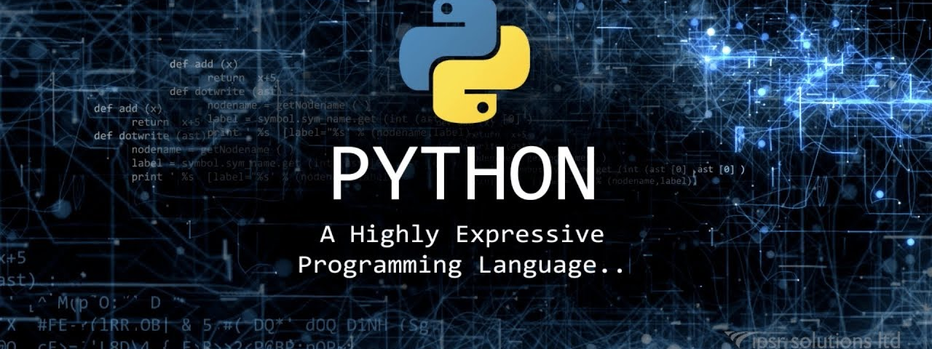




Computational Thinking with Programming
Fall 2019
@cse_bennett
@csebennett

Slide 2
Lecture Contents
Modules
Top-Down Approach
Python Modules

Slide 3
Modules
We can make complex systems more manageable by designing them as a set of subsystems, or modules.
Example: Bennett University System
Bennett University
School of Engineering and Applied Sciences
School of Management
Times School of Media
School of Law
CSE
ECE
MAE
Civil
Math
Physics
Chemistry
Bio-Tech

Slide 4
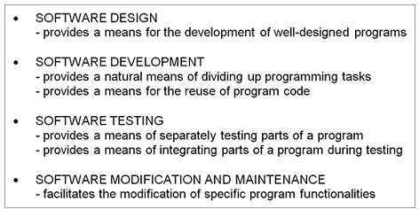
What is Module ?
Programs are designed as a collection of modules.
The term “module,” broadly speaking, refers to the design and/or implementation of specific functionality to be incorporated into a program.
While an individual function may be considered a module, modules generally consists of a collection of functions (or other entities).
Advantages of
Modules:

Slide 5

Module Specification
Every module needs to provide a specification of how it is to be used, which is referred to as the module’s interface.
Any program code making use of a given module is called a client of the module.
A module’s specification should be sufficiently clear and complete so that its clients can effectively utilize it.
A docstring is a string literal denoted by triple quotes used in Python for providing the specification of certain program elements.
Example:

Slide 6
MCQs
Which of the following is not an advantage in the use of modules in software development?
Provides a natural means of dividing up programming tasks.
Provides a means of reducing the size of a program.
Provides a means for the reuse of program code.
Provides a means of separately testing individual parts of a program.
Provides a means of integrating parts of a program during testing.
Facilitates the modification of specific program functionalities.
A specification of how a particular module is used is called the module’s_______________.
Program code that makes use of a given module is called a _______________ of the module.
Indicate which of the following are true. A docstring in Python is
A string literal denoted by triple or double quotes.
A means of providing specification for certain program elements in Python.
A string literal that may span more than one line.

Slide 7
MCQs: Answer
Which of the following is not an advantage in the use of modules in software development?
Provides a natural means of dividing up programming tasks.
Provides a means of reducing the size of a program.
Provides a means for the reuse of program code.
Provides a means of separately testing individual parts of a program.
Provides a means of integrating parts of a program during testing.
Facilitates the modification of specific program functionalities.
A specification of how a particular module is used is called the module’s Interface.
Program code that makes use of a given module is called a client of the module.
Indicate which of the following are true. A docstring in Python is
A string literal denoted by triple or double quotes.
A means of providing specification for certain program elements in Python.
A string literal that may span more than one line.

Slide 8
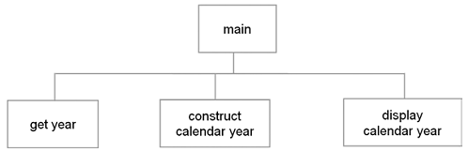
Top-Down Design
Top-down design is an approach for deriving a modular design in which the overall design of a system is developed first, deferring the specification of more detailed aspects of the design until later steps.
Example: Developing a Modular Design of the Calendar Year Program

Slide 9
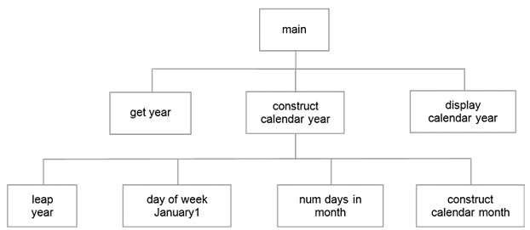
Second Stage of Modular Design
The goal of modular design is that each module provides clearly defined functionality, which collectively provide all of the required functionality of the program.
Modules get year and display calendar year are not complex enough to require further breakdown.
On the other hand, Module construct calendar year has to do most of the work, therefore, further broken down.

Slide 10
Specification of the Calendar Year Program Modules
The modular design of the calendar year program provides a high-level view of the program
Since each module is to be implemented as a function, we need to specify the details of each function.
Example:
For each function it needs to be decided if it is a value-returning function or a non-value-returning function;
what parameters it will take;
what results it will produce.
This stage of the design provides sufficient detail from which to implement the program. The main module provides the overall construction of the program.

Slide 11
MCQs
In top-down design (select one),
The details of a program design are addressed before the overall design.
The overall design of a program is addressed before the details.
All modular designs are a result of a top-down design process.
TRUE
FALSE
In top-down design, every module is broken down into the same number of submodules.
TRUE
FALSE
Which of the following advantages of modular design apply to the design of the calendar program.
Provides a means for the development of well-designed programs.
Provides a natural means of dividing up programming tasks.
Provides a means of separately testing individual parts of a program.

Slide 12
MCQs: Answer
In top-down design (select one),
The details of a program design are addressed before the overall design.
The overall design of a program is addressed before the details.
All modular designs are a result of a top-down design process.
TRUE
FALSE
In top-down design, every module is broken down into the same number of submodules.
TRUE
FALSE
Which of the following advantages of modular design apply to the design of the calendar program.
Provides a means for the development of well-designed programs.
Provides a natural means of dividing up programming tasks.
Provides a means of separately testing individual parts of a program.

Slide 13
Python Module
A Python module is a file containing Python definitions and statements.
A module allows you to logically organize your Python code.
A module can define functions, classes, variables and can also include runnable code.
Module Creation and Use: To create a module just save the code you want in a file with the file extension .py.
We can use the module we just created, by using the import statement.
Example: Module Creation
def greeting(name): print("Hello, " + name)
Example: Using a Module
import mymodule mymodule.greeting(“Bennett")

Slide 14
Module Creation and Use: Variables in Module
The module can contain functions, as already described, but also variables of all types (arrays, dictionaries, objects etc.).
Module Creation: Save this code in the file mymodule.py
person1 = { "name": "John", "age": 36, "country": "Norway" }
Module Use: Import the module named mymodule, and access the person1 dictionary
import mymodule a = mymodule.person1["age"] print(a)
Module Use: You can create the alias or rename the module while using.
Create an alias for mymodule called mx
import mymodule as mx a = mx.person1["age"] print(a)

Slide 15

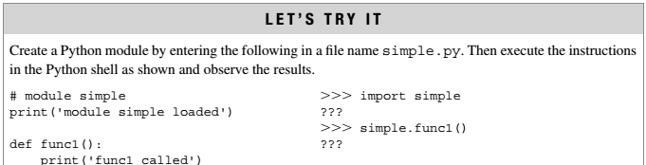
Module Creation and Use: Example 2
Note: When using a function from a module, use the syntax: module_name.function_name.

Slide 16
Library Modules
The Python Standard Library contains a set of predefined standard (built-in) modules, which you can import whenever you want.
There is a built-in function to list all the function names (or variable names) in a module, i.e. dir() function.
Example: Import and use the platform module:
import platform x = platform.system() print(x)
Example: List all the defined names belonging to the platform module:
import platform x = dir(platform) print(x)

Slide 17
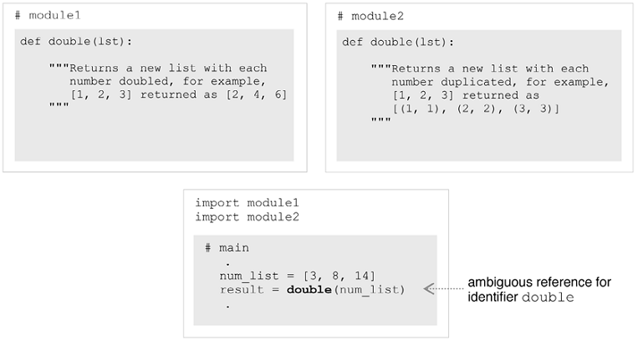
Modules and Namespaces
A namespace provides a context for a set of identifiers. Every module in Python has its own namespace.
A name clash is when two otherwise distinct entities with the same identifier become part of the same scope.
Namespaces provide a means for resolving such problems.

Slide 18
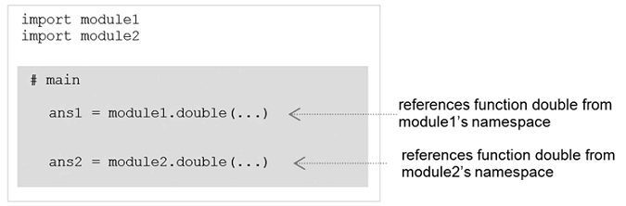
Modules and Namespaces: Use of Fully Qualified Function Names
Two instances of identifier double, each defined in their own module, are distinguished by being fully qualified with the name of the module in which each is defined: module1.double and module2.double.
Example:

Slide 19
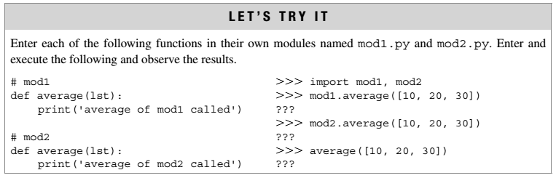
Example:

Slide 20
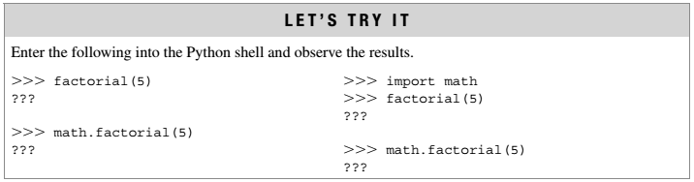
Importing Modules
In Python, the main module of any program is identified as the first (“top-level”) module executed.
With the import modulename form of import in Python, the namespace of the imported module becomes available to, but does not become part of, the namespace of the importing module.
Therefore, the identifiers of the imported module, must be fully qualified (prefixed with the module’s name) when accessed.

Slide 21
Import From Module
You can choose to import only parts from a module, by using the from keyword.
Syntax: from modulename import something
Something can be a list of identifiers, a single renamed identifier, or an asterisk:
(a), only identifiers func1 and func2 are imported.
(b), only identifier func1 is imported, renamed as new_func1 in the importing module.
(c), all of the identifiers are imported, except those which are private in module.
(a) from modulename import func1, func2
(b) from modulename import func1 as new_func1
(c) from modulename import *

Slide 22
Import From Module: Example
The module named mymodule has one function and one dictionary:
Import only the person1 dictionary from the module:
# mymodule
def greeting(name): print("Hello, " + name) person1 = { "name": "John", "age": 36, "country": "Norway" }
from mymodule import person1 print (person1["age"])
Note: When using import modulename, the namespace
of the imported module does not become part of the namespace of the importing module.
Note: With the from-import form of import, imported identifiers become part of the importing module’s namespace. Because of the possibility of name clashes, import modulename is the preferred form of import in Python.

Slide 23
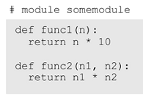
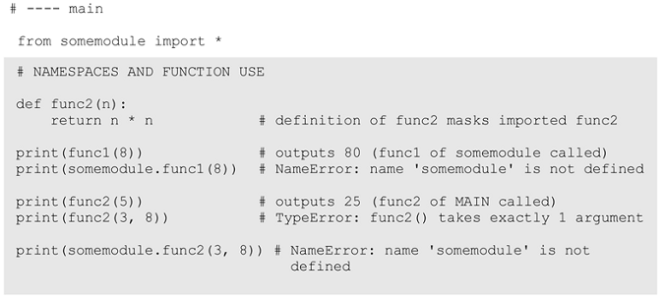
Import From Module: Example

Slide 24
Module Private Variables
In Python, all the variables in a module are “public,” with the convention that variables beginning with an two underscores are intended to be private.
Public is accessible by any other module that imports it, whereas private is not accessible in form of from modulename import *.
Python does not provide any means for preventing access to variables or other entities meant to be private.
There is a convention that names beginning with two underscores (__) are intended to be private.
Example: # mymodule
__def greeting(name): print("Hello, " + name)

Slide 25
Module Loading and Execution
Each imported module of a Python program needs to be located and loaded into memory.
When you import a module, the Python interpreter searches for the module in the following sequences −
The current directory.
If the module isn't found, Python then searches each directory in the shell variable PYTHONPATH.
If all else fails, Python checks the default path, i.e. installation-specific (e.g., C:\Python32\Lib)
The module search path is stored in the system module sys as the sys.path variable. The sys.path variable contains the current directory, PYTHONPATH, and the installation-dependent default.
If the program still does not find the module, an error (ImportError exception) is reported.

Slide 26
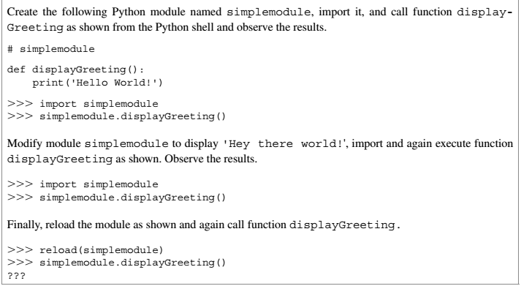
Lets Try It
When a module is loaded, a compiled version of the module with file extension .pyc is automatically produced. When using the Python shell, an updated module can be forced to be reloaded and recompiled by use of the reload() function.

Slide 27
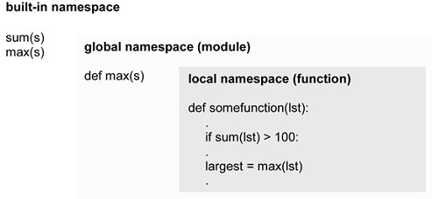
Local, Global, and Built-in Namespaces in Python
At any given point in a Python program’s execution, there are three possible namespaces referenced (“active”)—the built-in namespace, the global namespace, and the local namespace.
The built-in namespace contains the names of all the built-in functions, constants, and so on, in Python.
The global namespace contains the identifiers of the currently executing module.
And the local namespace is the namespace of the currently executing function (if any).
Example:
max([4, 2, 7, 1, 9, 6]) ➝ 9 (built-in function max)
max([4, 2, 7, 1, 9, 6]) ➝ 4 (programmer-defined function max)

Slide 28
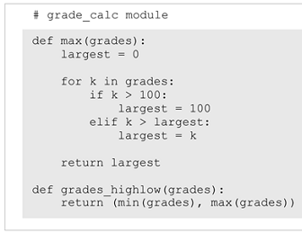
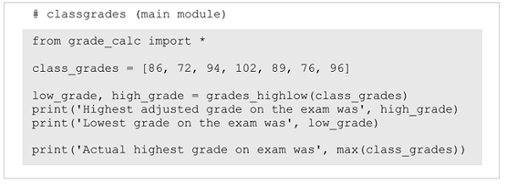
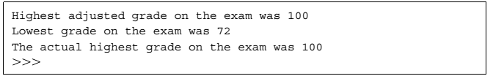
Built-In, Global: Example

Slide 29
Local, Global Example
A Python statement can access variables in a local namespace and in the global namespace.
If a local and a global variable have the same name, the local variable shadows the global variable.
Example1:
Money = 2000
def AddMoney():
Money = Money + 1
print Money
AddMoney()
print Money
Output: ?

Slide 30
Local, Global: Example
In order to assign a value to a global variable within a function, you must first use the global statement.
Example2:
Money = 2000
def AddMoney():
global Money
Money = Money + 1
print Money
AddMoney()
print Money
Example1:
Money = 2000
def AddMoney():
Money = Money + 1
print Money
AddMoney()
print Money
Output: UnboundLocalError
Output: 2000
2001

Slide 31
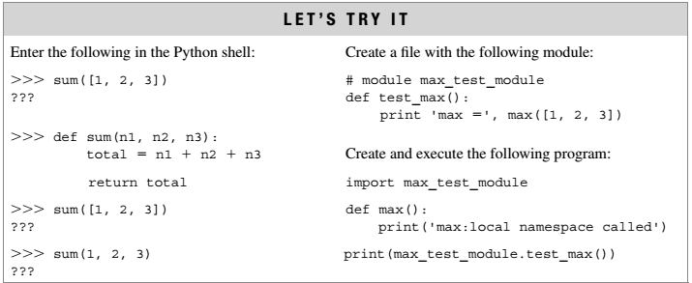
Exercise:

Slide 32
MCQs
Any initialization code in a Python module is only executed once, the first time that the module is loaded.
True
False
With the “import moduleName” form of import, any utilized entities from the imported module must be prefixed with the module name.
True
False
When importing modules, all Python Standard Library modules must be imported before any programmer-defined modules, otherwise a runtime error will occur.
True
False
By convention, variables names in a module beginning with two _______________ characters
If a particular module is imported more than once in a program, the Python interpreter will ensure that the module is only loaded and executed the first time that it is imported.
True
False
The _______________command can be used to force the reloading of a given module, useful for when working interactively in the Python shell.
The three active namespaces that may exist during the execution of any given Python program are the _______________, ____________ and ____________ namespaces.

Slide 33
MCQs: Answers
Any initialization code in a Python module is only executed once, the first time that the module is loaded.
True
False
With the “import moduleName” form of import, any utilized entities from the imported module must be prefixed with the module name.
True
False
When importing modules, all Python Standard Library modules must be imported before any programmer-defined modules, otherwise a runtime error will occur.
True
False
By convention, variables names in a module beginning with two underscores characters
If a particular module is imported more than once in a program, the Python interpreter will ensure that the module is only loaded and executed the first time that it is imported.
True
False
The reload command can be used to force the reloading of a given module, useful for when working interactively in the Python shell.
The three active namespaces that may exist during the execution of any given Python program are the built-in, global and local namespaces.

Slide 34
Thank You

