Slide 1
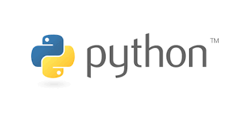





Computational Thinking with Programming
Lecture - 16
Exception Handling
@cse_bennett
@csebennett

Slide 2
Today…
Last Session:
Sequences and Strings
Today’s Session:
Error and Exceptions:
Fundamentals
Exception Handling
Hands on Session with Jupyter Notebook:
We will practice on the exception handling in Jupyter Notebook.

Slide 3
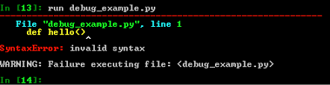
Syntax Errors
Syntax errors, also known as parsing errors, are perhaps the most common kind of error you encounter while you are still learning Python.
The parser repeats the offending line and displays a little ‘arrow’ pointing at the earliest point in the line where the error was detected. The error is detected at the token preceding the arrow. File name and line number are printed so you know where to look in case the input came from a script.

Slide 4
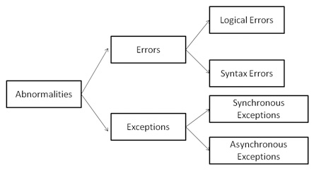
Exceptions
Even if a statement or expression is syntactically correct, it may cause an error when an attempt is made to execute it. Errors detected during execution are called exceptions and are not unconditionally fatal.
Most exceptions are not handled by programs, however, and result in error messages like “cannot divide by zero” or “cannot concatenate ‘str’ and ‘int’ objects”.

Slide 5
Exceptions (cont’d.)
Exception: error that occurs while a program is running
Usually causes program to abruptly halt
Traceback: error message that gives information regarding line numbers that caused the exception
Indicates the type of exception and brief description of the error that caused exception to be raised

Slide 6
Exceptions (cont’d.)
Many exceptions can be prevented by careful coding
Example: input validation
Usually involve a simple decision construct
Some exceptions cannot be avoided by careful coding
Examples
Trying to convert non-numeric string to an integer
Trying to open for reading a file that doesn’t exist

Slide 7
Exceptions (cont’d.)
Exception handler: code that responds when exceptions are raised and prevents program from crashing
In Python, written as try/except statement
General format:
try:
statements
except exceptionName:
statements
Try suite: statements that can potentially raise an exception
Handler: statements contained in except block

Slide 8
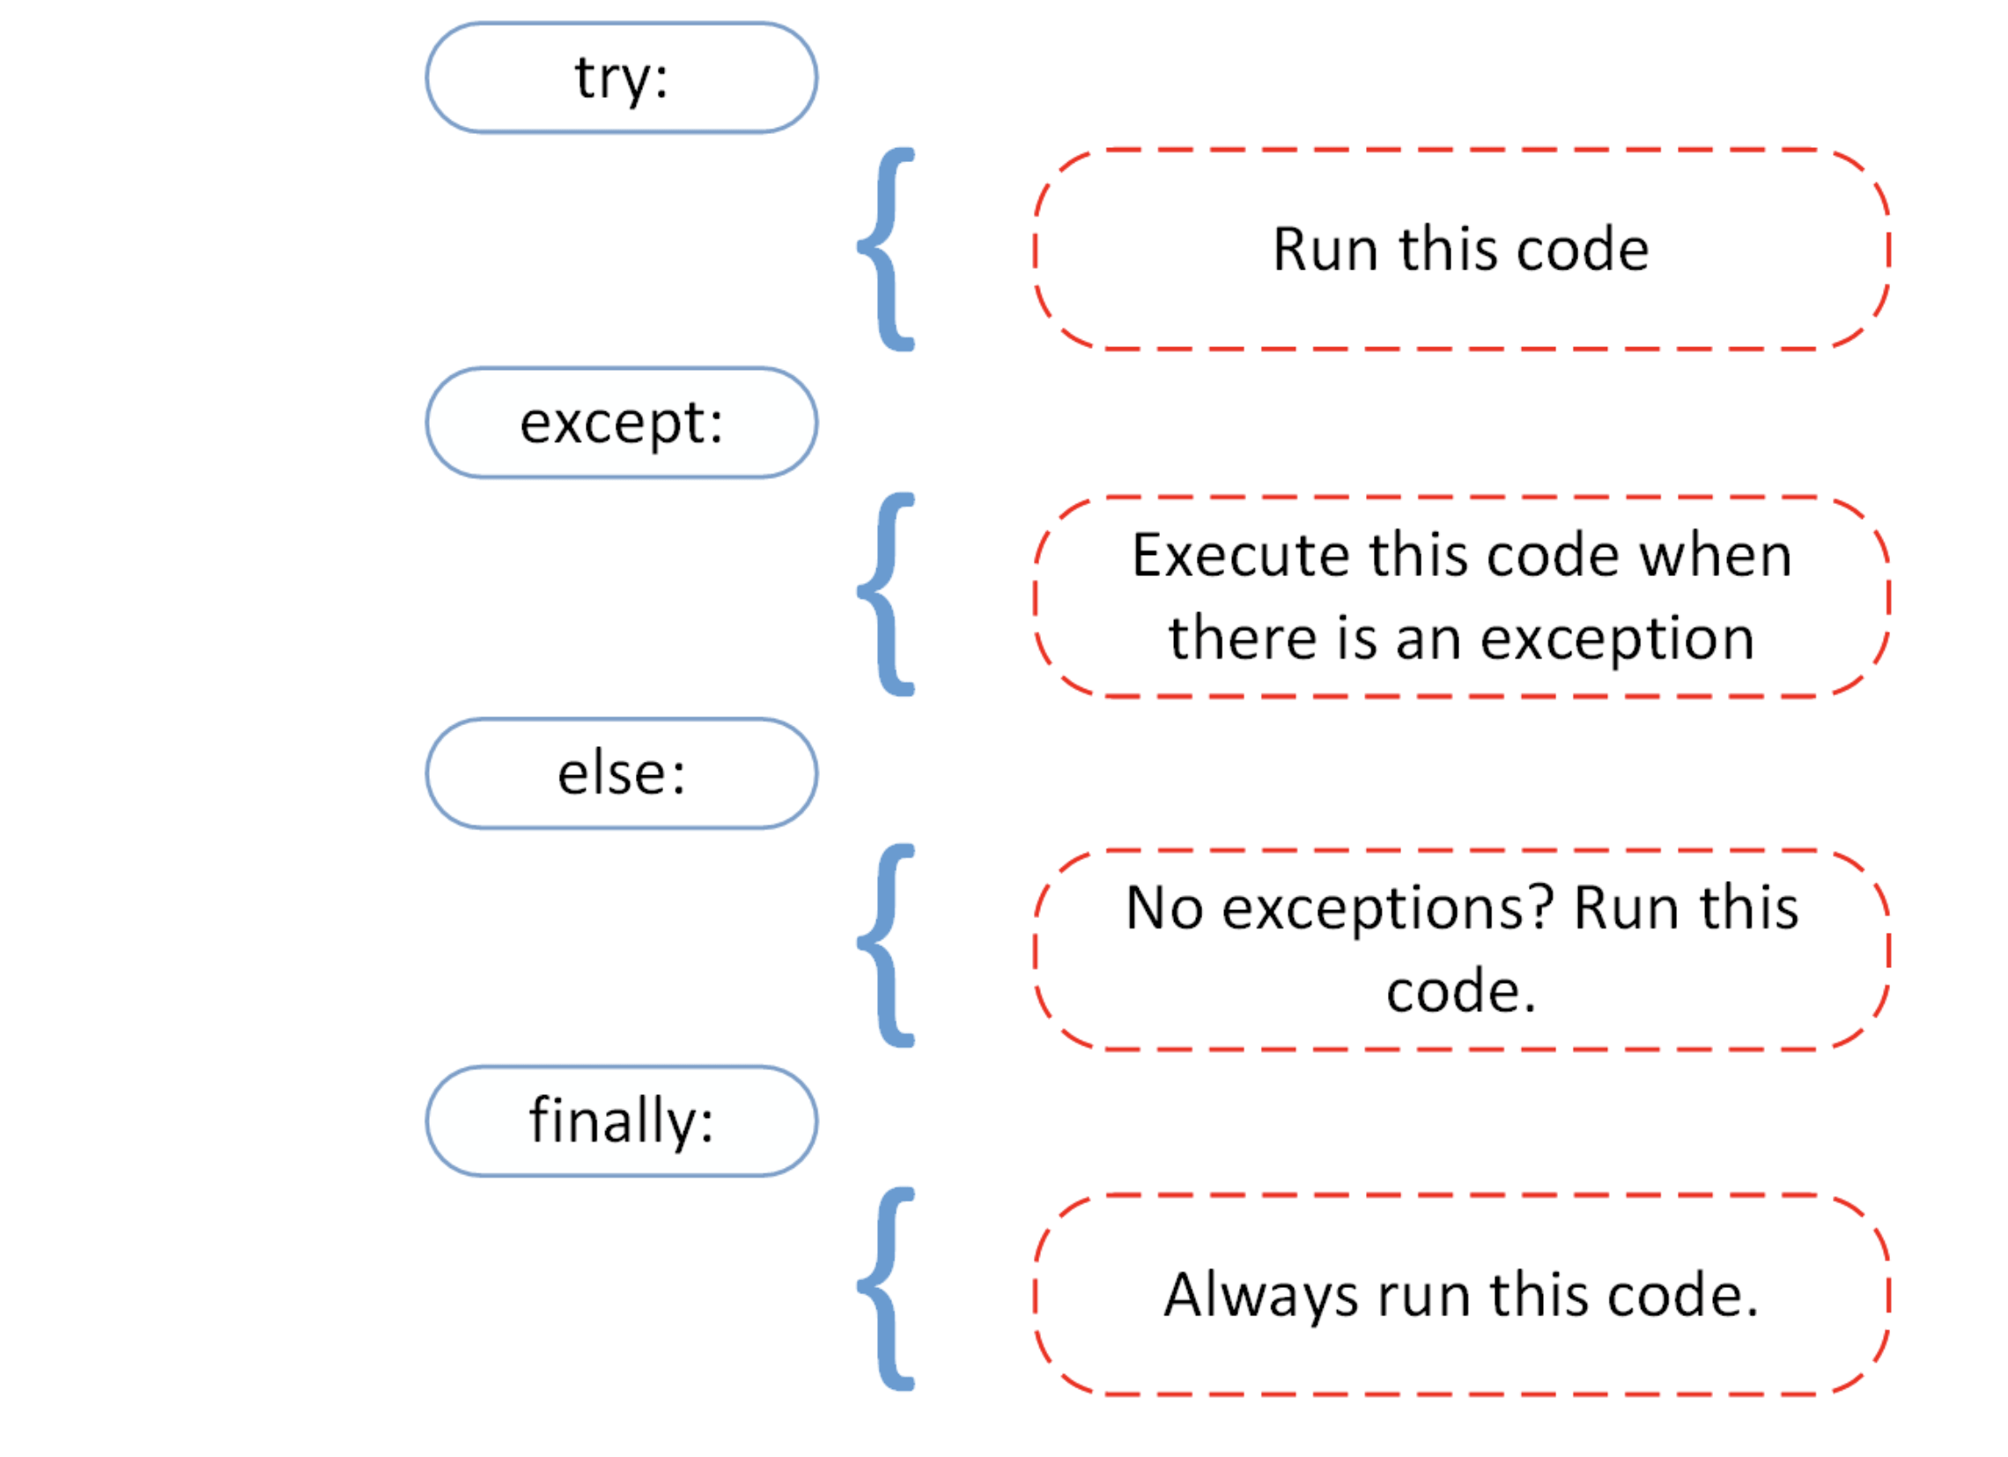
Exceptions (cont’d.)

Slide 9
Exceptions (cont’d.)
If statement in try suite raises exception:
Exception specified in except clause:
Handler immediately following except clause executes
Continue program after try/except statement
Other exceptions:
Program halts with traceback error message
If no exception is raised, handlers are skipped

Slide 10
Handling Multiple Exceptions
Often code in try suite can throw more than one type of exception
Need to write except clause for each type of exception that needs to be handled
An except clause that does not list a specific exception will handle any exception that is raised in the try suite
Should always be last in a series of except clauses

Slide 11
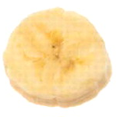
Displaying an Exception’s Default Error Message
Exception object: object created in memory when an exception is thrown
Usually contains default error message pertaining to the exception
Can assign the exception object to a variable in an except clause
Example: except ValueError as err:
Can pass exception object variable to print function to display the default error message

Slide 12
The else Clause
try/except statement may include an optional else clause, which appears after all the except clauses
Aligned with try and except clauses
Syntax similar to else clause in decision structure
Else suite: block of statements executed after statements in try suite, only if no exceptions were raised
If exception was raised, the else suite is skipped

Slide 13
The finally Clause
try/except statement may include an optional finally clause, which appears after all the except clauses
Aligned with try and except clauses
General format: finally:
statements
Finally suite: block of statements after the finally clause
Execute whether an exception occurs or not
Purpose is to perform cleanup before exiting

Slide 14
What If an Exception Is Not Handled?
Two ways for exception to go unhandled:
No except clause specifying exception of the right type
Exception raised outside a try suite
In both cases, exception will cause the program to halt
Python documentation provides information about exceptions that can be raised by different functions

Slide 15
Thank You ?

