Slide 1
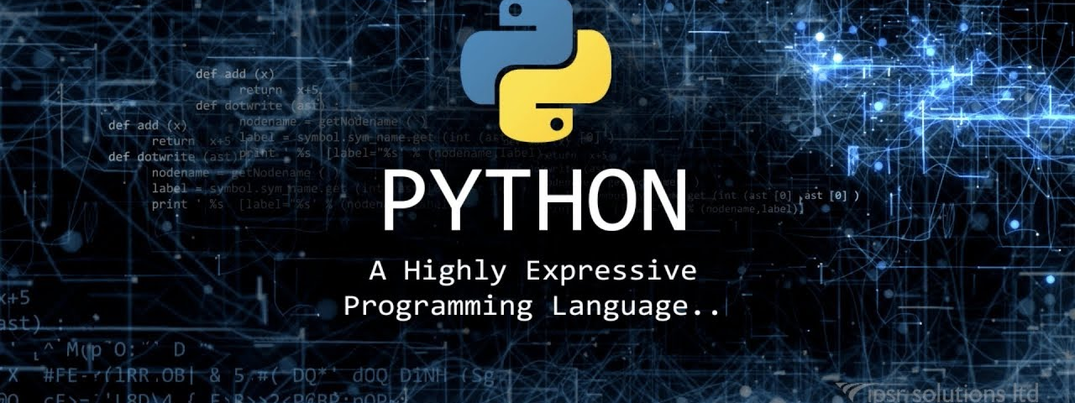




Computational Thinking with Programming
Fall 2019
@cse_bennett
@csebennett

Slide 2
Lecture Contents
Non Sequential Collections
Dictionary
Dictionary Operations

Slide 3
Non-Sequential Collections
Likes List and tuples are the sequential collections where elements are ordered accessed through by their indexes.
Python has two types of non-sequential collections.
Dictionaries
Sets

Slide 4
Python Dictionaries
Dictionaries in Python provides a concept of associative data structure, where the elements of are unordered and accessed by an associated key value instead of index.
A dictionary is a collection which is unordered, changeable (mutable) and indexed. In Python dictionaries are written with curly brackets, and they have keys and values.
Syntax for declaring dictionaries in Python:
key
Value
#Example :Create and print a dictionary
thisdict = { "brand": "Ford", "model": "Mustang", "year": 1964 } print(thisdict)
daily_temps = {
'sun’: 68.8,
'mon’: 70.2, 'tue': 67.2,
'wed’: 71.8, 'thur': 73.2,
'fri’: 75.6, 'sat': 74.0
}
Output:
{'brand': 'Ford', 'model': 'Mustang', 'year': 1964}

Slide 5
Accessing Items in Dictionaries
You can access the items of a dictionary by referring to its key name, inside square brackets or using get() method by passing key name:
Change Values: You can change the value of a specific item by referring to its key name:
#Get the value of the "model" key
thisdict = { "brand": "Ford", "model": "Mustang", "year": 1964 } x = thisdict["model"]
print(x)
#Geting value of "model" key using get():
x = thisdict.get("model")
Output is same in both case:
Mustang
#Example: Change the "year" to 2018:
thisdict["year"] = 2018
print(thisdict)
Output:
{'brand': 'Ford', 'model': 'Mustang', 'year': 2018}

Slide 6
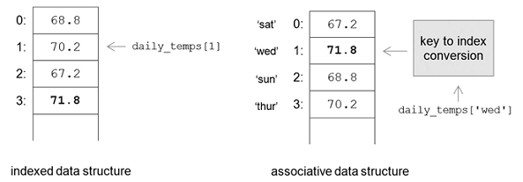
Indexed vs. Associative Data Structure
The syntax for accessing an element of a dictionary is the same as for accessing elements of sequence types, except that a key value is used within the square brackets instead of an index value: daily_temps['sun']

Slide 7
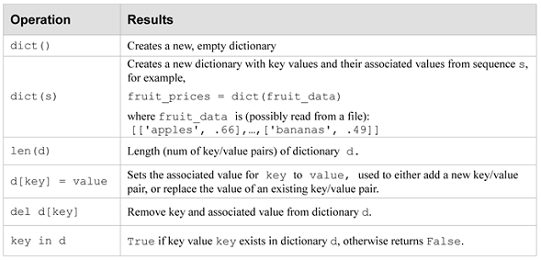
Operations for Dynamically Manipulating Dictionaries

Slide 8
Loop Through a Dictionary
You can loop through a dictionary by using a for loop.
When looping through a dictionary, the return value are the keys of the dictionary.
Python also provides methods to return the values as well.
#Print all key names in the dictionary, one by one:
for x in thisdict: print(x)
Output:
brand model year
#Print all values in the dictionary, one by one:
for x in thisdict: print(thisdict[x])
#You can also use the values() method to return values of a dictionary:
for x in thisdict.values(): print(x)
Output:
Ford Mustang 1964

Slide 9
Loop Through a Dictionary
Loop through both keys and values, by using the items() method:
#Example:
thisdict = { "brand": "Ford", "model": "Mustang", "year": 1964 }
for x, y in thisdict.items(): print(x, y)
Output:
brand Ford model Mustang year 1964

Slide 10
Dictionary Checking and Length
To determine if a specified key is present in a dictionary use the in keyword:
To determine how many items (key-value pairs) a dictionary has, use the len() function.
#Example: Check if "model" is present in the dictionary
thisdict = { "brand": "Ford", "model": "Mustang", "year": 1964 } if "model" in thisdict: print("Yes, 'model' is one of the keys in the thisdict dictionary")
Output:
Yes, 'model' is one of the keys in the thisdict dictionary
#Print the number of items in the dictionary:
print(len(thisdict))
Output:
3

Slide 11
Adding and Removing Items in Dictionary
Adding Items: It is done by using a new index key and assigning a value to it.
Removing Items: There are several methods to remove items from a dictionary.
pop(): Removes the item with the specified key name
popitem(): Removes the last inserted item (in versions before 3.7, a random item is removed instead).
del keyword: Removes the item with the specified key name as well removes the dictionary completely.
clear(): It empties the dictionary.
#Example:
thisdict = {"brand": "Ford", "model": "Mustang", "year": 1964} thisdict["color"] = "red" print(thisdict)
Output: {'brand': 'Ford’, 'model': 'Mustang’, 'year': 1964, 'color': 'red'}

Slide 12
Removing Items from Dictionary
Example1: pop()
thisdict = { "brand": "Ford", "model": "Mustang", "year": 1964 } thisdict.pop("model") print(thisdict)
Example2: popitem()
thisdict = { "brand": "Ford", "model": "Mustang", "year": 1964 } thisdict.popitem() print(thisdict)
Example3: del keyword
thisdict = { "brand": "Ford", "model": "Mustang", "year": 1964 } del thisdict["model"] print(thisdict)
Output: Example1
{'brand': 'Ford', 'year': 1964}
Output: Example2
{'brand': 'Ford', 'model': 'Mustang'}
Output: Example3
{'brand': 'Ford', 'year': 1964}

Slide 13
Delete or Empties Dictionary
Example1: del for deleting dictionary
thisdict = { "brand": "Ford", "model": "Mustang", "year": 1964 } del thisdict print(thisdict)
Output:
Example2: clear()
thisdict = { "brand": "Ford", "model": "Mustang", "year": 1964 } thisdict.clear() print(thisdict)
Output:
{}

Slide 14
Copy Dictionaries
Dictionary cannot be copied simply by typing dict2 = dict1, because: dict2 will only be a reference to dict1, and changes made in dict1 will automatically also be made in dict2.
There are ways to make a copy, one way is to use the built-in Dictionary method copy().
Another way to make a copy is to use the built-in function dict().
thisdict = { "brand": "Ford", "model": "Mustang", "year": 1964 } mydict = thisdict.copy() print(mydict)
Output: {'brand': 'Ford', 'model': 'Mustang', 'year': 1964}
thisdict = { "brand": "Ford", "model": "Mustang", "year": 1964 } mydict = dict(thisdict) print(mydict)
Output: {'brand': 'Ford', 'model': 'Mustang', 'year': 1964}

Slide 15
Nested Dictionaries
A dictionary can also contain many dictionaries, this is called nested dictionaries.
#Example: Create a dictionary that contain three dictionaries
myfamily = { "child1" : { "name" : "Emil", "year" : 2004 }, "child2" : { "name" : "Tobias", "year" : 2007 }, "child3" : { "name" : "Linus", "year" : 2011 } }
print(myfamily)
Output:
{
'child1': {'name': 'Emil', 'year': 2004}, 'child2': {'name': 'Tobias', 'year': 2007}, 'child3': {'name': 'Linus', 'year': 2011}
}

Slide 16
Nested Dictionaries
You can also do the nesting of three dictionaries that already exists as dictionaries.
#Create three dictionaries, then create one dictionary that will contain the other three dictionaries:
child1 = { "name" : "Emil", "year" : 2004 } child2 = { "name" : "Tobias", "year" : 2007 } child3 = { "name" : "Linus", "year" : 2011 }
myfamily = { "child1" : child1, "child2" : child2, "child3" : child3 } print(myfamily)
Output:
{
'child1': {'name': 'Emil', 'year': 2004}, 'child2': {'name': 'Tobias', 'year': 2007}, 'child3': {'name': 'Linus', 'year': 2011}
}

Slide 17
The dict() Constructor
It is also possible to use the dict() constructor to make a new dictionary.
Example:
thisdict = dict(brand="Ford", model="Mustang", year=1964) print(thisdict)
Output: {'brand': 'Ford', 'model': 'Mustang', 'year': 1964}
Note: 1. Note that here keywords are not string literals.
2. Note that the use of equals rather than colon for the assignment.

Slide 18
Dictionary Methods (Python provides a several of built-in methods that you can use on dictionaries.)
Method | Description
clear() | Removes all the elements from the dictionary
copy() | Returns a copy of the dictionary
fromkeys() | Returns a dictionary with the specified keys and value
get() | Returns the value of the specified key
items() | Returns a list containing a tuple for each key value pair
keys() | Returns a list containing the dictionary's keys
pop() | Removes the element with the specified key
popitem() | Removes the last inserted key-value pair
setdefault() | Returns the value of the specified key. If the key does not exist: insert the key, with the specified value
update() | Updates the dictionary with the specified key-value pairs
values() | Returns a list of all the values in the dictionary

Slide 19
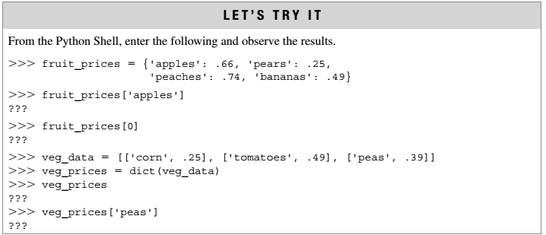
Exercise

Slide 20
MCQs
A dictionary type in Python is an associative data structure that is accessed by a _______________ rather than an index value.
Associative data structures such as the dictionary type in Python are useful for,
accessing elements more intuitively than by use of an indexed data structure
maintaining elements in a particular order
Which of the following types can be used as a key in Python dictionaries?
strings
lists
tuples
numerical values
Which of the following is a syntactically correct sequence, s, for dynamically creating a dictionary using dict(s).
s = [[1: 'one'], [2: 'two'], [3: 'three']]
s = [[1, 'one'], [2, 'two'], [3, 'three']]
s = {1:'one', 2:'two', 3:'three’}
For dictionary d = {'apples’ : 0.66, 'pears’ : 1.25, 'bananas’ : 0.49}, which of the following correctly updates the price of bananas.
d[2] = 0.52
d[0.49] = 0.52
d['bananas’] = 0.52

Slide 21
MCQs: Answers
A dictionary type in Python is an associative data structure that is accessed by a key value rather than an index value.
Associative data structures such as the dictionary type in Python are useful for,
accessing elements more intuitively than by use of an indexed data structure
maintaining elements in a particular order
Which of the following types can be used as a key in Python dictionaries?
strings
lists
tuples
numerical values
Which of the following is a syntactically correct sequence, s, for dynamically creating a dictionary using dict(s).
s = [[1: 'one'], [2: 'two'], [3: 'three']]
s = [[1, 'one'], [2, 'two'], [3, 'three']]
s = {1:'one', 2:'two', 3:'three’}
For dictionary d = {'apples’ : 0.66, 'pears’ : 1.25, 'bananas’ : 0.49}, which of the following correctly updates the price of bananas.
d[2] = 0.52
d[0.49] = 0.52
d['bananas’] = 0.52

Slide 22
Thank You
?

