Slide 1
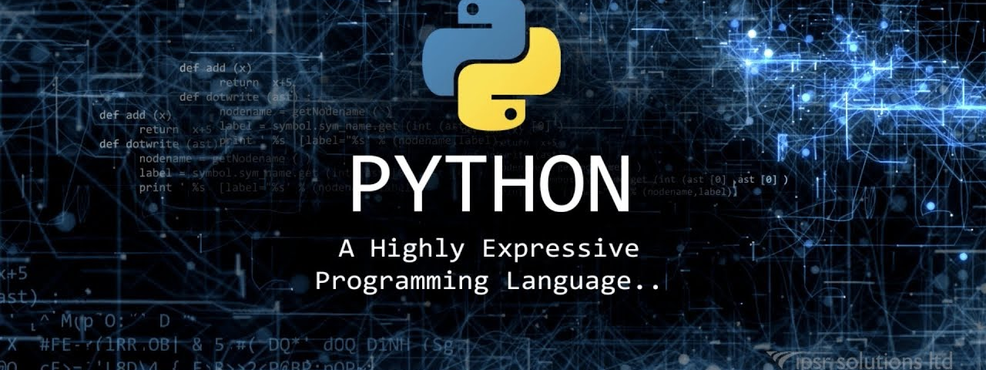




Computational Thinking and Programming
Fall 2019
@cse_bennett
@csebennett

Slide 2

What is computational thinking?

Slide 3
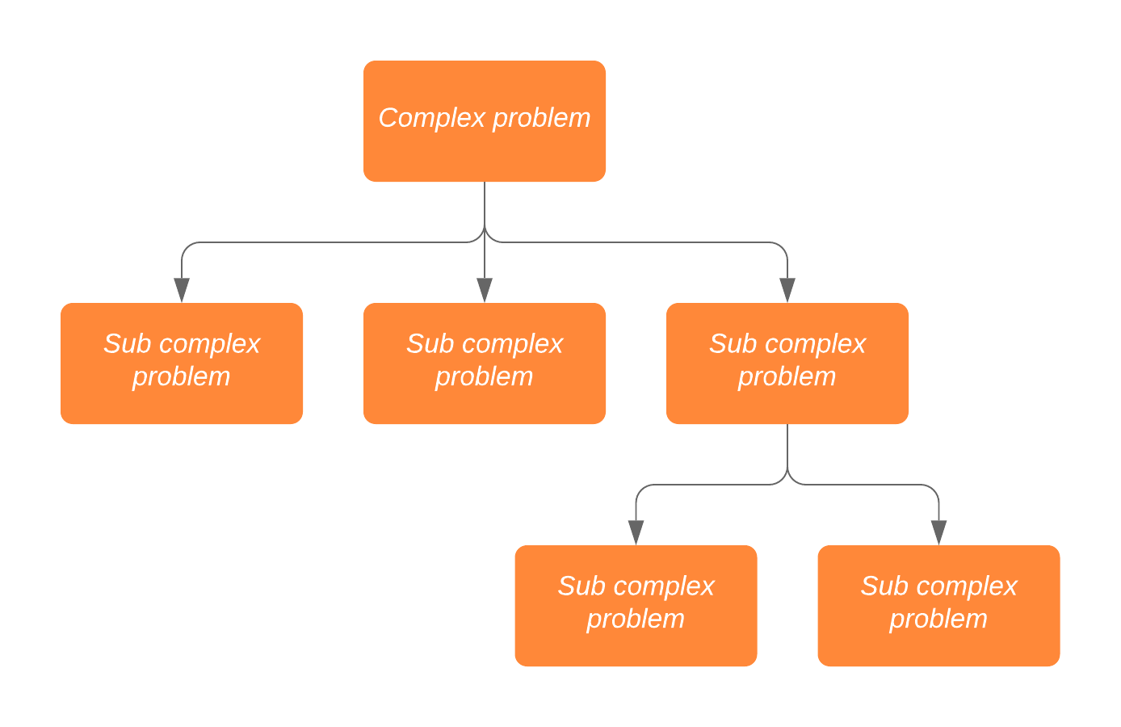

Slide 4
Example Scenario
Complex problem: Goa trip
Subcomplex 1: Convincing own parents
Not eating properly, making sad face and sadly roaming inside house for no reason
Lying to the parents that trip is about IT Industrial Visit ( in Goa ☺ )
Subcomplex 2: Getting money from Dad
Being humble in front of dad
Promising that you will not spend too much money for the trip
Subcomplex 3: Convincing friend’s parents
Promising that your friend will be safe during the trip (which never happens)
Subcomplex 4: Planning and execution
Booking travel and accommodation
Going to go go goa…

Slide 5
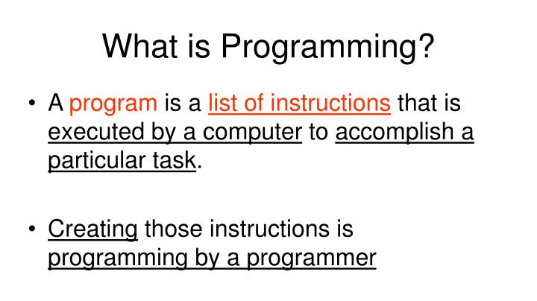

Slide 6
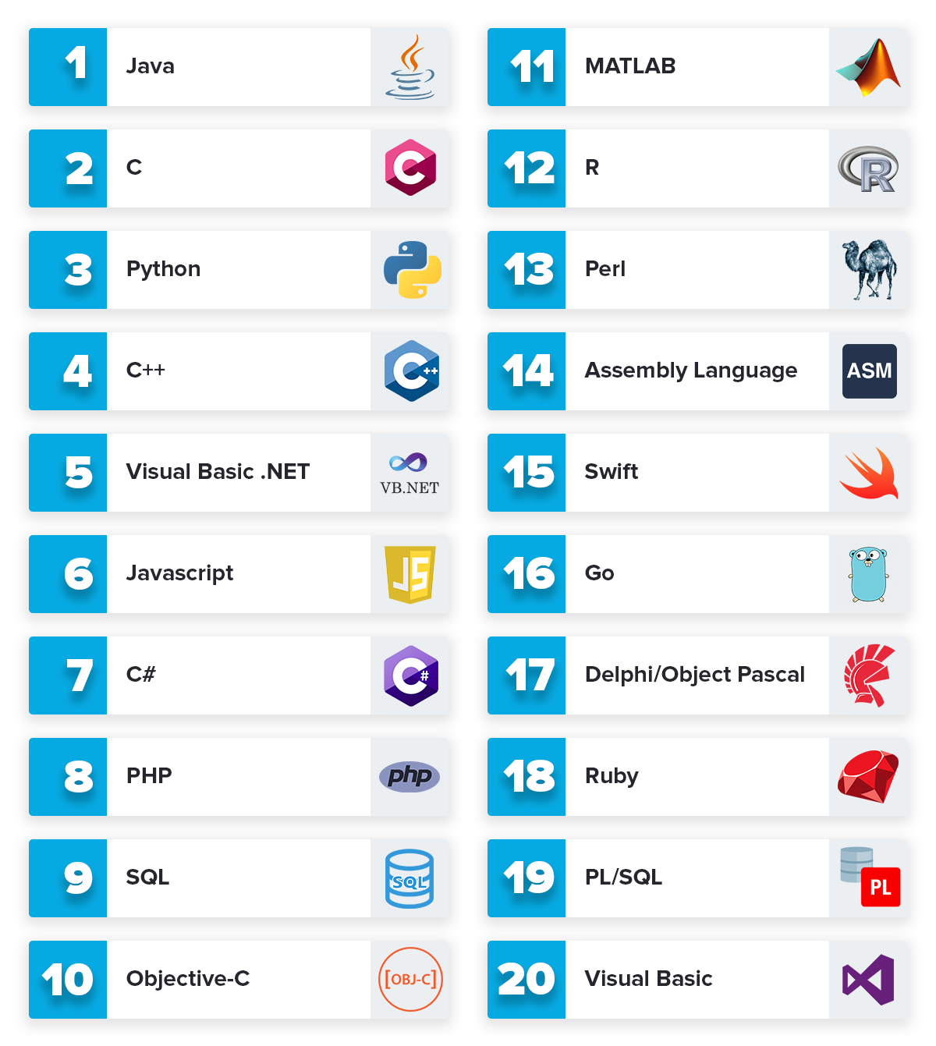
Top Programming Languages

Slide 7
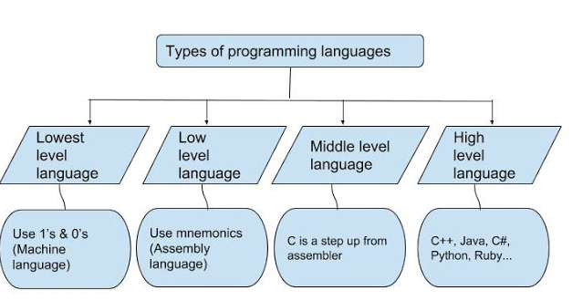

Slide 8
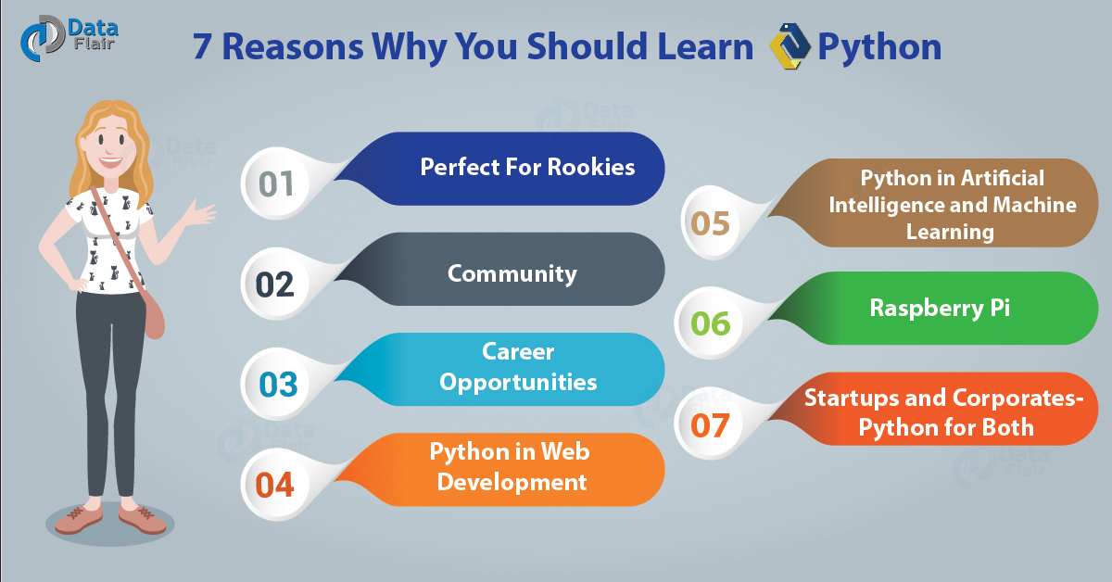
Why Python?

Slide 9
Random Notes
Python is not everything. It helps you to get started with programming.
No need to memorize any programming keywords and syntax i.e. awareness > memorization
Programming is a highly desired skill across engineering disciplines

Slide 10
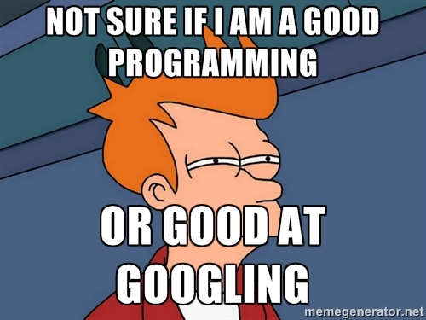
Google is a good friend

Slide 11
Common Terms
Coding, Programming
Programming language
IDE (Integrated Development Environment)
Compiler
Error, Bugs, Debugging
Variable, Function
Development, testing, deployment

