Slide 1
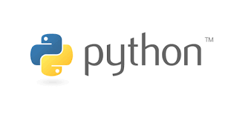





Computational Thinking and Programming
Lecture - 4
Operators, Expression and Data types
@cse_bennett
@csebennett

Slide 2
Today’s Outline
Previous Session:
Introduction to Token.
Statements and Expressions.
Today’s Session:
Data Types and Operators
Mutable and Immutable data types.
Data type conversion.
Operators.
Hands on Session with Jupyter Notebook:
We will practice on the Python basic elements in Jupyter Notebook.

Slide 3
Data Types
Data type is the classification of the type of values that can be assigned to variables.
Dynamically typed languages, the interpreter itself predicts the data type of the Python Variable based on the type of value assigned to that variable.
>>> x = 2
>>> type(x)
int
>>> x = 2.3
>>> type(x)
float
x is a variable and 2 is its value
x can be assigned different values; hence, its type changes accordingly

Slide 4
Data Types
Data Types
Mutable
Lists
Immutable
Numbers
Strings
Tuples
Dictionary
Sets
Mutable Data Types: Data types in python where the value assigned to a variable can be changed
Immutable Data Types: Data types in python where the value assigned to a variable cannot be changed

Slide 5
Data Types
Numbers: The number data type in Python is used to store numerical values. It is used to carry out the normal mathematical operations.
Strings: Strings in Python are used to store textual information. They are used to carry out operations that perform positional ordering among items.
Lists: The list data type is the most generic Python data type. Lists can consist of a collection of mixed data types, stored by relative positions.
Tuples: Tuples are one among the immutable Python data types that can store values of mixed data types. They are basically a list that cannot be changed.
Sets: Sets in Python are a data type that can be considered as an unordered collection of data without any duplicate items.
Dictionaries: Dictionaries in Python can store multiple objects, but unlike lists, in dictionaries, the objects are stored by keys and not by positions.

Slide 6
Data Types (Numbers)
The number data type is divided into the following five data types:
Integer
Long Integer (removed from py3)
Octal and Hexadecimal
Floating-point Numbers
Complex Numbers
>>> a = 0x19
>>> type(a)
int
>>> a = 2 + 5j
>>>type(a)
complex
>>> type(a)
float
>>> a = 9999999L
>>> type(a)
long
>>> a = 2
>>> type(a)
int
>>> a = 2.5
>>> type(a)
float
>>> a = 0o11
>>> type(a)
int

Slide 7
Data Types (Numbers)
We can use the following built-in functions to convert one number type into another:
int(x), to convert x into an integer value
long(x), to convert x into a long integer value
float(x), to convert x into a floating-point number
complex(x), to convert x into a complex number where the imaginary part stays 0 and x becomes the real part
complex(x,y), to convert x and y to a complex number where x becomes the real part and y becomes the imaginary part

Slide 8
Data Types (String)
Python string is an ordered collection of characters which is used to represent and store the text-based information. Strings are stored as individual characters in a contiguous memory location. It can be accessed from both directions: forward and backward.
>>> a = “Bennett”
>>> print(a)
Bennett
>>> a = ‘University’
>>> print(a)
University

Slide 9
Data Types (String)
Characters of string can be individually accessed using a method called indexing.
Characters can be accessed from both directions: forward and backward.
Forward indexing starts form 0, 1, 2…. Whereas, backward indexing starts form −1, −2, −3…
>>> a = “Bennett University”
>>> print(a[5])
t
>>> print(a[-1])
y
>>> print(a[-5])
r

Slide 10
Data Types (Tuples)
Tuple data type in Python is a collection of various immutable Python objects separated by commas.
Tuples are generally used for different Python Data Types.
A Python tuple is created using parentheses around the elements in the tuple. Although using parentheses is only optional, it is considered a good practice to use them.
>>> a = (1,2,3,4)
>>> print(a)
(1,2,3,4)
>>> a = (‘ABC’,’DEF’,’XYZ’)
>>>print(a)
(ABC,DEF,XYZ)

Slide 11
Data Types (Tuple)
To access an element of a tuple, we simply use the index of that element. We use square brackets.
Reverse Indexing by using indexes as −1, −2, −3, and so on, where −1 represents the last element.
Slicing that is, extract some elements from the tuple.
>>> a = (1,2,3,4)
>>> print(a[1])
2
>>> a = (‘ABC’,’DEF’,’XYZ’)
>>>print(a[2])
XYZ
>>> a = (1,2,3,4)
>>> print(a[-1])
4
>>> a = (‘ABC’,’DEF’,’XYZ’)
>>>print(a[1:])
(DEF, XYZ)

Slide 12
Data Types (List)
Unlike strings, lists can contain any sort of objects: numbers, strings, and even other lists. Python lists are:
Ordered collections of arbitrary objects
Accessed by offset
Arrays of object references
Of variable length, heterogeneous, and arbitrarily nestable
Of the category, mutable sequence
Data types in which elements are stored in the index basis with starting index as 0
Enclosed between square brackets ‘[]’
>>> a = [2,3,4,5]
>>> b = [“Bennett”, “University”]
>>> print(a,b)
>>> [2,3,4,5][‘Bennett’,’University’]

Slide 13
Data Types (List)
Much similar to strings, we can use the index number to access items in lists as shown below.
Accessing a List Using Reverse Indexing
To access a list in reverse order, we have to use indexing from −1, −2…. Here, −1 represents the last item in the list.
>>> a = [“Bennett”, “University”, “Computer”]
>>> print(a[0])
Bennett
>>> print(a[-1])
Computer
>>> print(a[1])
University

Slide 14
Data Types (Set)
It is an unordered collection of elements which means that a set is a collection that stores elements of different Python Data Types.
In Python sets, elements don’t have a specific order.
Sets in Python can’t have duplicates. Each item is unique.
The elements of a set in Python are immutable. They can’t accept changes once added.
>>> myset = {“bennett”, “computer”, “science”}
>>>print(myset)
{'bennett', 'computer', 'science’}
>>>myset = set((“bennett”, “computer”, “science”))

Slide 15
Data Types ( Dictionary)
Yet another unordered collection of elements.
Difference between dictionary and other unordered Python data types such as sets lies in the fact that unlike sets, a dictionary contains keys and values rather than just elements.
Unlike lists the values in dictionaries are accessed using keys and not by their positions
>>>dict1 ={“Branch”:”computer”,”College”:”Bennett”,”year”:2020}
>>>print (dict1)
{‘Branch’:’computer’,’College’:’Bennett’,’year’:2020}
>>>di = dict({1:’abc’,2:’xyz})

Slide 16
Data Types ( Dictionary)
The keys are separated from their respective values by a colon (:) between them, and each key–value pair is separated using commas (,).
All items are enclosed in curly braces.
While the values in dictionaries may repeat, the keys are always unique.
The value can be of any data type, but the keys should be of immutable data type, that is
Using the key inside square brackets like we used to use the index inside square brackets.
>>>dict1 ={“Branch”:”computer”,”College”:”Bennett”,”year”:2020}
>>>print (dict1[year])
2020

Slide 17
Datatype Conversion
As a matter of fact, we can do various kinds of conversions between strings, integers and floats using the built-in int, float, and str functions
>>> x = 10
>>> float(x)
10.0
>>> str(x)
'10'
>>>
>>> y = "20"
>>> float(y)
20.0
>>> int(y)
20
>>>
>>> z = 30.0
>>> int(z)
30
>>> str(z)
'30.0'
>>>
integer ➔ float
integer ➔ string
string ➔ float
string ➔ integer
float ➔ integer
float ➔ string

Slide 18
Explicit and Implicit Data Type Conversion
Data conversion can happen in two ways in Python
Explicit Data Conversion (we saw this earlier with the int, float, and str built-in functions)
Implicit Data Conversion
Takes place automatically during run time between ONLY numeric values
E.g., Adding a float and an integer will automatically result in a float value
E.g., Adding a string and an integer (or a float) will result in an error since string is not numeric
Applies type promotion to avoid loss of information
Conversion goes from integer to float (e.g., upon adding a float and an integer) and not vice versa so as the fractional part of the float is not lost

Slide 19
Implicit Data Type Conversion: Examples
>>> print(2 + 3.4)
5.4
>>> print( 2 + 3)
5
>>> print(9/5 * 27 + 32)
80.6
>>> print(9//5 * 27 + 32)
59
>>> print(5.9 + 4.2)
10.100000000000001
>>>
The result of an expression that involves a float number alongside (an) integer number(s) is a float number

Slide 20
Implicit Data Type Conversion: Examples
>>> print(2 + 3.4)
5.4
>>> print( 2 + 3)
5
>>> print(9/5 * 27 + 32)
80.6
>>> print(9//5 * 27 + 32)
59
>>> print(5.9 + 4.2)
10.100000000000001
>>>
The result of an expression that involves a float number alongside (an) integer number(s) is a float number
The result of an expression that involves values of the same data type will not result in any conversion

Slide 21
Operators
Arithmetic Operators (**, *,/,//,%,+,_)
Comparison Operators (<, <=, >, >=, ==)
Python Assignment Operators (=, +=, -=, *=, /=)
Logical Operators (and, or, not)
Bitwise Operators (&, |, ~, >>, <<, ^)
Membership Operators (in, not in)

Slide 22
Operator
Arithmetic operator
Low
High
Precedence
+ | - | * | / | // | % | **
Plus | minus | multiplication | Float division | Integer division | Mod (remainder) | power
3 | 3 | 2 | 2 | 2 | 2 | 1
Left to right
Right to left

Slide 23
Lets solve -
2**3**1
1**3**2
2**1**3
5/10*5+5*2
5//10*5+5*2
5%10*5+5*2

Slide 24
Comparison Operators
Boolean expressions ask a question
Produce a Yes or No result which we use to control program flow
Boolean expressions using comparison operators evaluate to:
True / False - Yes / No
Comparison operators look at variables
But do not change the variables
Operator | Description
== | Equals to
!= | Not equals to
<> | Not equals to
> | Greater than
< | Less Than
>= | Greater Than Equals to
<= | Less Than Equals to

Slide 25
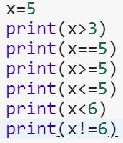
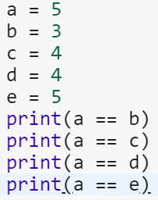


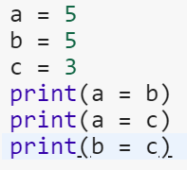
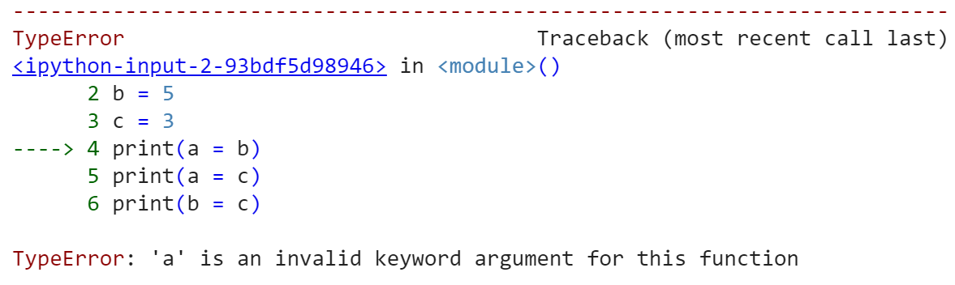
Example

Slide 26
Logical operators
Logical operators are the and, or, not operators.
Operator | Meaning | Example
and | True if both the operands are true | x and y
or | True if either of the operands is true | x or y
not | True if operand is false (complements the operand) | not x

Slide 27
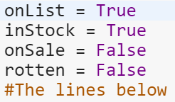
Logical operators AND/OR
AND
X | Y | Output
TRUE | TRUE | TRUE
TRUE | FALSE | FALSE
FLASE | TRUE | FLASE
FALSE | FALSE | FLASE
 | OR
X | Y | Output
TRUE | TRUE | TRUE
TRUE | FALSE | TRUE
FLASE | TRUE | TRUE
FALSE | FALSE | FLASE
>>>a=7>7 and 2>-1
>>>print(a)
FLASE
>>>a=7>7 or 2>-1
>>>print(a)
FLASE
>>>print(7 and 0 or 5)
5
print(onList and inStock)
print(onList and onSale)
print(onSale and rotten)
print(onList and inStock and onSale)
print(onList and inStock and onList)
print(onList and inStock)
print(onList and inStock)

Slide 28
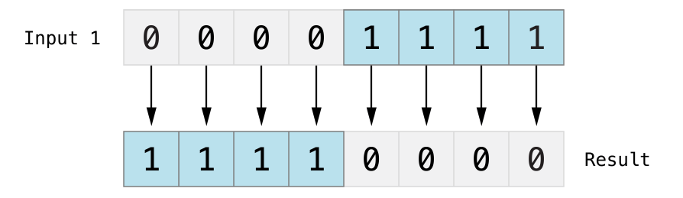
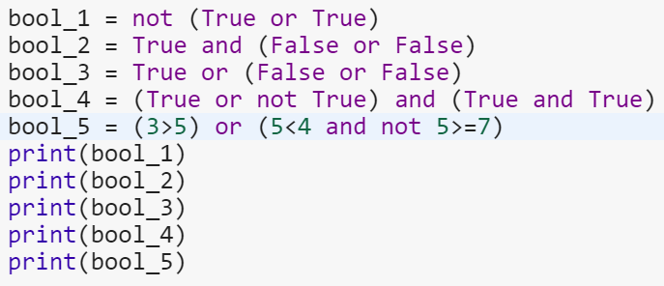
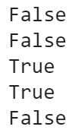
Logical operators NOT
Just the reverse of what is there.
not(true) → false

Slide 29
Bitwise operators
Operator | Description
& Binary AND | Operator copies a bit to the result if it exists in both operands
| Binary OR | It copies a bit if it exists in either operand.
^ Binary XOR | It copies the bit if it is set in one operand but not both.
~ Binary Ones Complement | It is unary and has the effect of 'flipping' bits.
<< Binary Left Shift | The left operands value is moved left by the number of bits specified by the right operand.
>> Binary Right Shift | The left operands value is moved right by the number of bits specified by the right operand.
Bitwise operators act on operands as if they were string of binary digits.
It operates bit by bit.
2 is 10 in binary and 7 is 111.
In the table below:
Let x = 10 (0000 1010 in binary) and y = 4 (0000 0100 in binary)

Slide 30
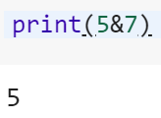
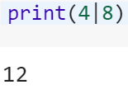
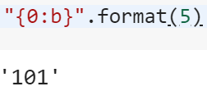
Bitwise operators AND
5 & 7
Same as 101 & 111.
This results in 101
Which is binary for 5.
Operation | Output
0 & 0 | 0
0 & 1 | 0
1 & 0 | 0
1 & 1 | 1
Operation | Output
0 | 0 | 0
0 | 1 | 1
1 | 0 | 1
1 | 1 | 1
4 | 8
Binary for 4 is 0100, and that for 8 is 1000.
After operation, output is 1100
Which is binary for 12.

Slide 31


Bitwise operators XOR
XOR (exclusive OR) returns 1
If one operand is 0 and another is 1.
Otherwise, it returns 0.
Operator | Output
0^0 | 0
0^1 | 1
1^0 | 1
1^1 | 0

Slide 32
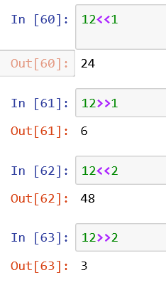
Shift operator
Left Shift (<<)
Let’s Solve
15^13
12 & 10
11|00
5<<2
5>>2
Right Shift (>>)

Slide 33
Operator Precedence
Operators | Meaning
() | Parentheses
** | Exponent
+x, -x, ~x | Unary plus, Unary minus, Bitwise NOT
*, /, //, % | Multiplication, Division, Floor division, Modulus
+, - | Addition, Subtraction
<<, >> | Bitwise shift operators
& | Bitwise AND
^ | Bitwise XOR
| | Bitwise OR
==, !=, >, >=, <, <=, in, not in | Comparisions, Membership operators
not | Logical NOT
and | Logical AND
or | Logical OR

Slide 34
DATA TYPE CONVERSION Explicit and Implicit
Explicit Data Conversion
We saw this earlier with the int, float, and str built-in functions
E.g., Adding a float and an integer will automatically result in a float value
Takes place automatically during run time between ONLY numeric values
E.g., Adding a string and an integer (or a float) will result in an error since string is not numeric
Implicit Data Conversion
Applies type promotion to avoid loss of information
Conversion goes from integer to float (e.g., upon adding a float and an integer) and not vice versa so as the fractional part of the float is not lost

Slide 35




Let’s Solve
Operators
()
**
+x, -x, ~x
*, /, //, %
+, -
<<, >>
&
^
|
==, !=, >, >=, <, <=, in, not in
not
and
Or
=,*=,/=,//=,%=
10*4>>2 and 3
10%(15<10 and 20<30)
10/(5-5)
2.5%0.15

Slide 36
Thank You ?

