Slide 1





Computational Thinking with Programming
Fall 2019
@cse_bennett
@csebennett

Slide 2

Control Structures

Slide 3
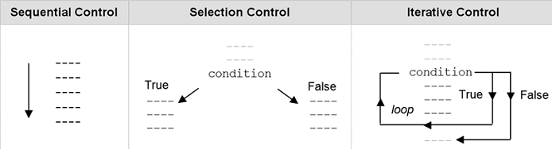
Control Structures
Control flow is the order that instructions are executed in a program.
A control statement is a statement that determines the control flow of a set of instructions.
Types of Control:
Sequential control: Instructions are executed in the order that they are written
Selection control: Selectively executes the instructions.
E.g. Decision Control
Iterative control: Repeatedly executes the instructions. E.g. Loops.

Slide 4
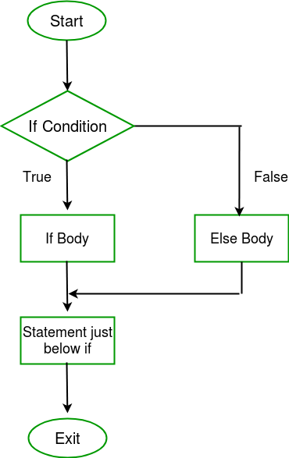
Selection Control or Decisions (It is a control statement providing selective execution of instructions)
Decisions in a Python program
if statements
if else statements
elif statements
nested if conditions

Slide 5
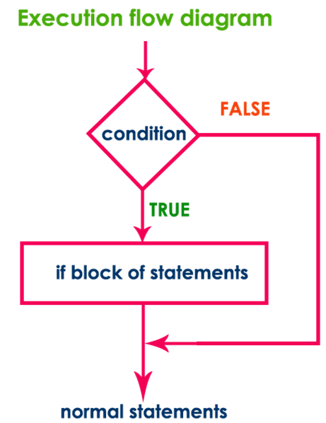
If Statement It is a selection control statement based on the value of a given Boolean expression
Syntax:
if test expression:
statement(s)
Expression’s value can be True or False.
We may want to do something only when a certain condition is true.
if statement in python takes an expression with it.
If the expression results to True
then the block of statements under it is executed.
If it results to False
then the block is skipped and control transfers to the statements after the block.
Remember to indent the statements in a block equally

Slide 6
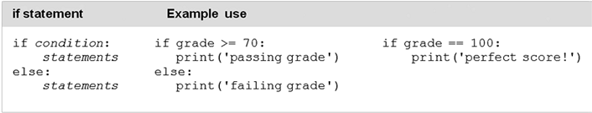
If Statement: Example

Slide 7
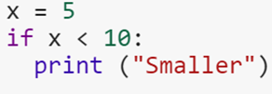
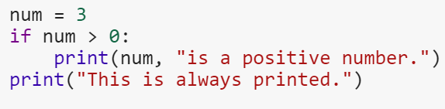
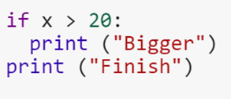
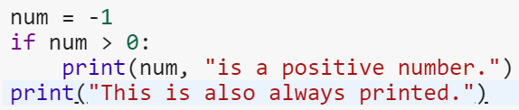

Example: What will be the output ?
1.
2.
3.
4.
5.

Slide 8
Example: What will be the output ?
1.
2.
3.
4.
5.
Output: Smaller
Output: 3 is a positive number.
This is always printed.
Output: Finish
Output: This is also always printed.
Output: yay

Slide 9
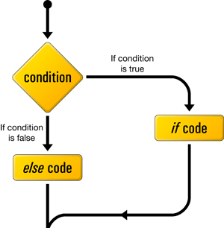
if...else Statement a.k.a. Two way decisions
What happens when the condition is untrue or false?
We can mention that it in the block after the else statement.
An ‘else’ statement comes right after the block after ‘if’.

Slide 10
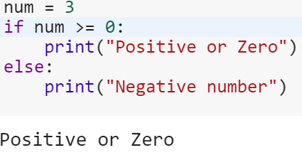
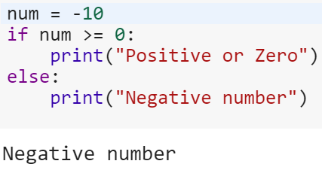
Example
Syntax:
if test expression:
Body of if
else:
Body of else

Slide 11
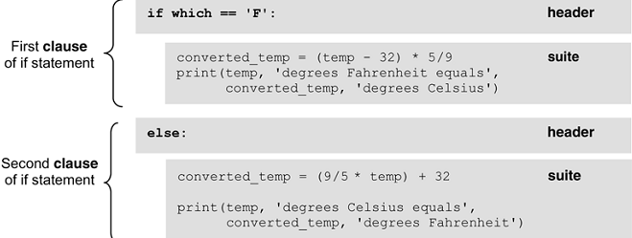
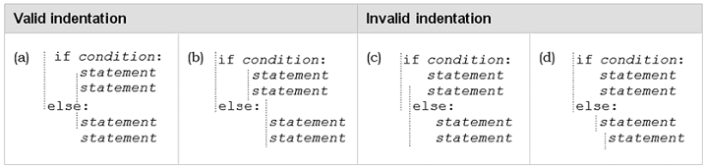
Header, Suite and Indentation
One unique aspect of Python is that the amount of indentation of each program line is significant.

Slide 12
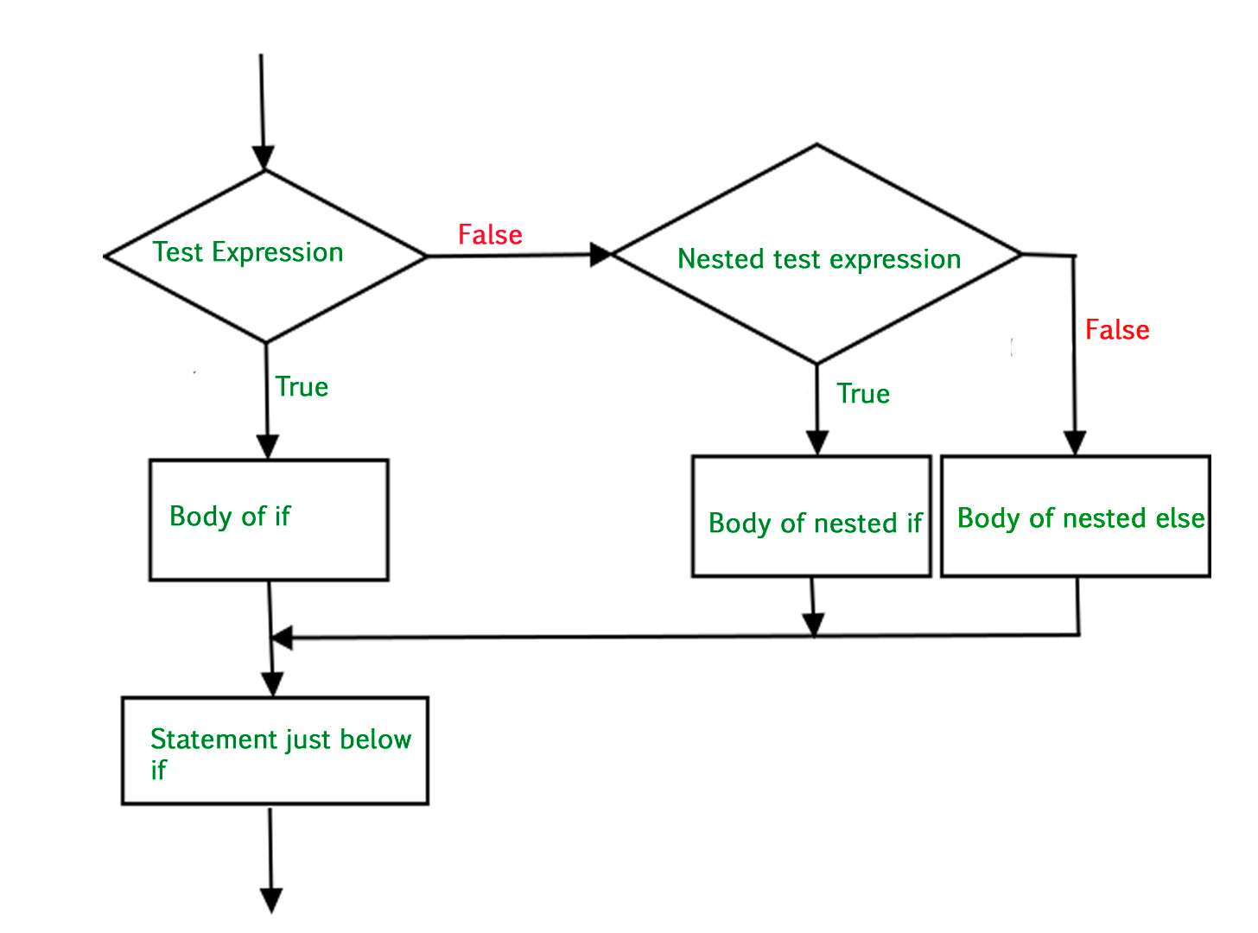
Nested if statements (multi-way selection)
You can put an if statement in the block under another if statement.
This is to implement further checks.

Slide 13
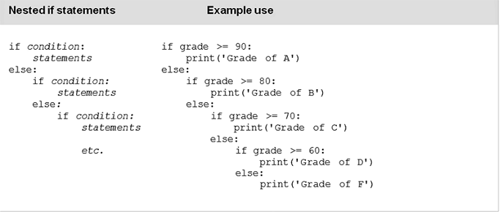
Nested if statements: Example

Slide 14
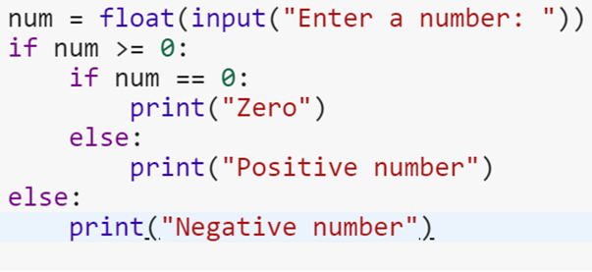
Example: What will be the output?

Slide 15

Example: What will be the output?

Slide 16
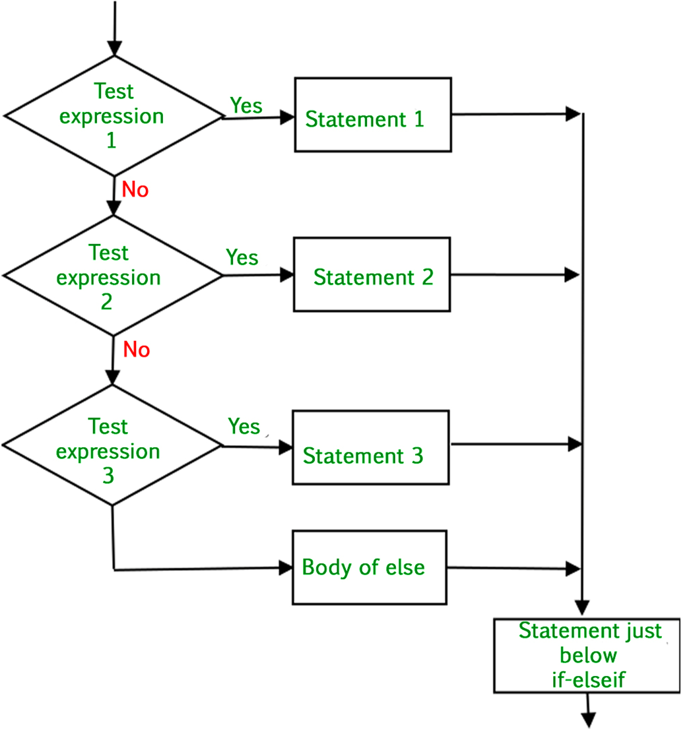
if...elif...else Statement
Replacement to the else-if statements
More than one condition to check
If condition 1 isn’t True, condition 2 is checked.
If it isn’t true, condition 3 is checked.

Slide 17
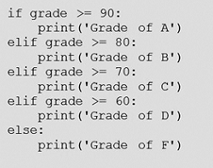
if...elif...else Statement: Example Use
Syntax:
if test expression:
Body of if
elif test expression:
Body of elif
else:
Body of else

Slide 18
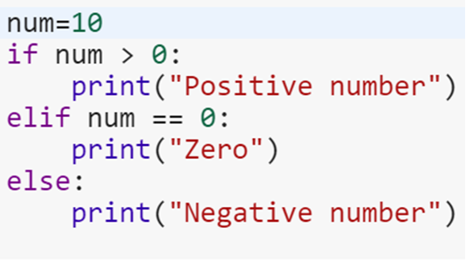
Example: What will be the output?

Slide 19
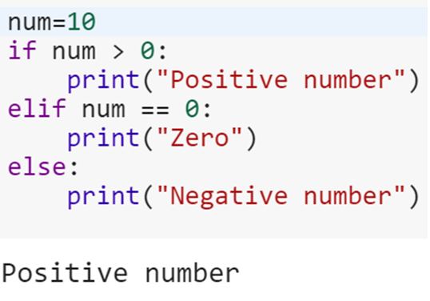
Example: What will be the output?

Slide 20
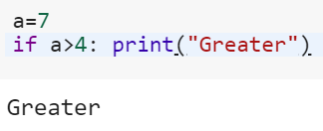
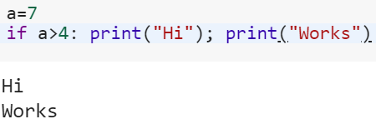
Single Statement Condition Write a single statement under if

Slide 21
Exercise
Find out the Max of three numbers

Slide 22
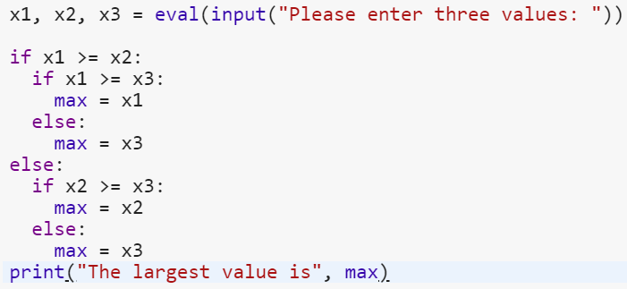
Maximum between 3 numbers

Slide 23
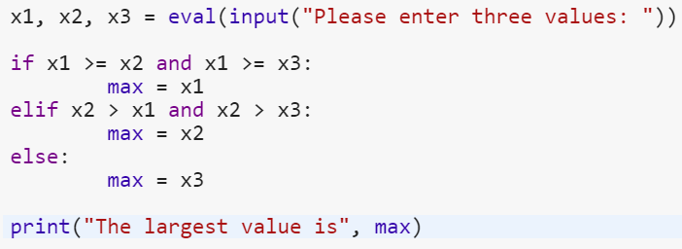
Maximum between 3 numbers

Slide 24
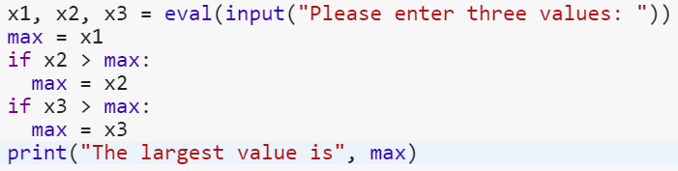
Maximum between 3 numbers

Slide 25
MCQs
All if statements must contain either an else or elif header.
TRUE
FALSE
Which of the following statements are true regarding headers in Python?
Headers begin with a keyword and end with a colon.
Headers always occur in pairs.
All headers of the same compound statement must be indented the same amount.
Which of the following statements is true?
Statements within a suite can be indented a different amount.
Statements within a suite can be indented a different amount as long as all headers in the statement that it occurs in are indented the same amount.
All headers must be indented the same amount as all other headers in the same statement, and all statements in a given suite must be indented the same amount.
The elif header allows for,
Multi-way selection that cannot be accomplished otherwise
Multi-way selection as a single if statement
The use of a “catch-all” case in multi-way selection

Slide 26
MCQs: Answers
All if statements must contain either an else or elif header.
TRUE
FALSE
Which of the following statements are true regarding headers in Python?
Headers begin with a keyword and end with a colon.
Headers always occur in pairs.
All headers of the same compound statement must be indented the same amount.
Which of the following statements is true?
Statements within a suite can be indented a different amount.
Statements within a suite can be indented a different amount as long as all headers in the statement that it occurs in are indented the same amount.
All headers must be indented the same amount as all other headers in the same statement, and all statements in a given suite must be indented the same amount.
The elif header allows for,
Multi-way selection that cannot be accomplished otherwise
Multi-way selection as a single if statement
The use of a “catch-all” case in multi-way selection

Slide 27

Iterative Control (Loop)
An iterative control statement is a control statement that allows for the repeated execution of a set of statements.
Due to their repeated execution, iterative control structures are commonly referred to as “loops.
Loop Statements:
While
For
Nested loop

Slide 28
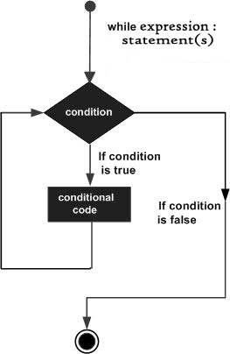
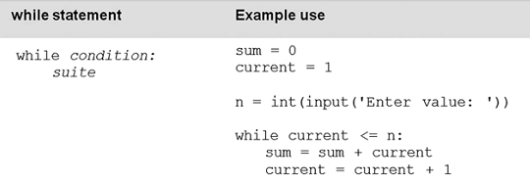
While Statement (indefinite loop)
A while statement is an iterative control statement that repeatedly executes a set of statements based on a provided Boolean expression (condition).

Slide 29
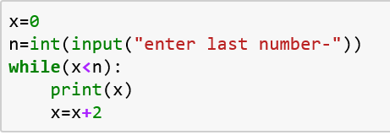
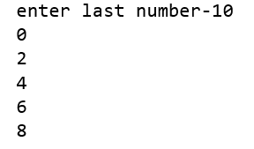
Example 1
Find all even numbers from 0 to n. where, n is given by user.

Slide 30
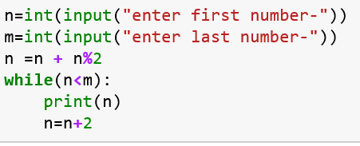
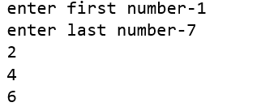
Example 2
Print all even numbers between n to m. m should be greater than n.

Slide 31
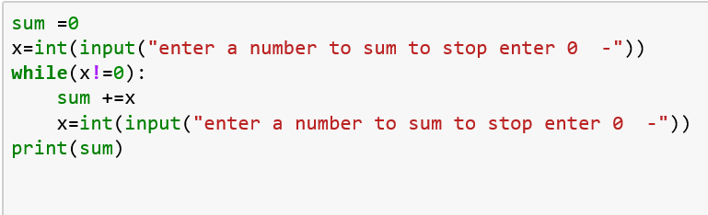
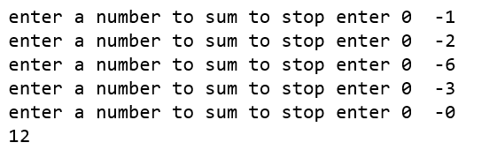
Example 3
Write a program to take numbers from the user until he enter 0 as input. then print sum of all entered number.

Slide 32
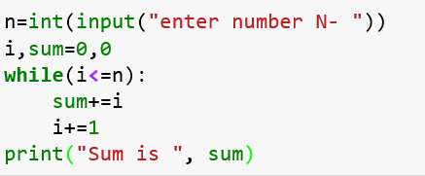

Example 4
Write an efficient program to determine sum of N natural numbers where N is given by user.

Slide 33
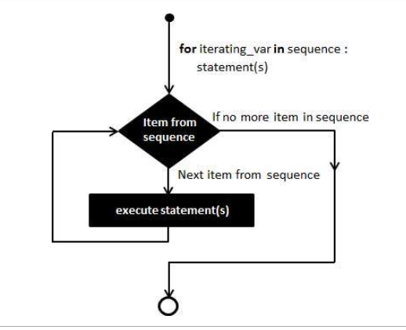
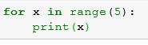
For Loop (definite loop)
Loop to read sequence
A for loop is used for iterating over a sequence (that is either a list, a tuple, a dictionary, a set, or a string). Can execute a set of statements, once for each item in a list, tuple, set etc.
Example:
Syntax:
for iterating_var in sequence:
statements(s)

Slide 34
Sequences
Sequence of character - 'QWERTYUIOPASDFGHJKL’
Sequence of words - ['abc','def','efg','ijk’]
Sequence of numbers - [1,2,3,4,5,6,7,8,9]
Sequence of mix data – [‘Suvi’, 4, “LKG”, “Bennett University”, 98.5
Sequence of numbers can also be generated as:
range(start, end, difference)
range(3) = (0,1,2)
range(1,5) = (1,2,3,4)
range(3,9,2) = (3, 5, 7)
range(9,2,-1) = (9,8,7,6,5,4,3)
range(9,2,1) = []

Slide 35

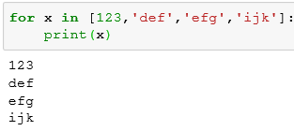



For Loop: What will be the output?
1.
2.
3.
4.
5.

Slide 36




For Loop: Answers to Previous Questions
1 2 3 4 5

Slide 37
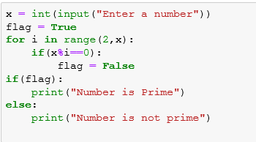
Exercise: Write a program to find whether a given number is prime or not
Solution:

Slide 38
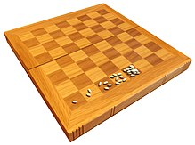
Let one grain of wheat be placed on the first square of a chessboard, two grains on the second square, four grains on the third square, eight grains on the fourth square, and so on until all square are filled in chessboard. what will be the total weight in ton of grains on whole 8×8 chessboard? If 15432 grains in one kg and 907.18 kg in one ton then.
Problem Exercise 2

Slide 39

Nested Loop
Loop inside a loop a is called nested loop.
Example:

Slide 40


Nested Loop: What will be the output?
1.
2.
3.
4.
5.

Slide 41
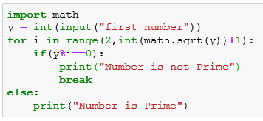
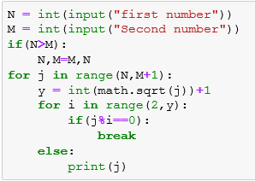
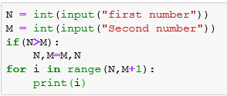
Find all prime numbers between given two numbers

Slide 42
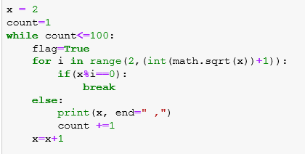
Find first 100 prime numbers start from 2.

Slide 43
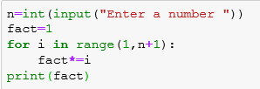
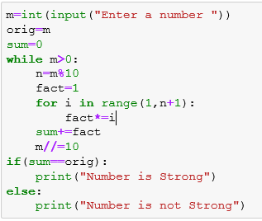
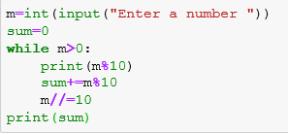
Find number is Strong or not
If the sum of the factorial of the digits in a number is equal to the original number, the number is a strong number.

Slide 44
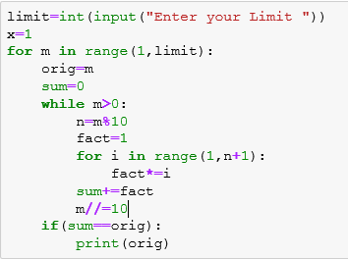
Accept the limit and print the strong numbers from 1 to the given limit.

Slide 45

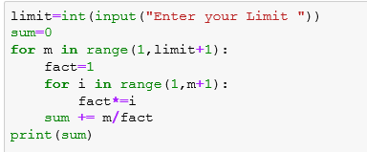

Slide 46
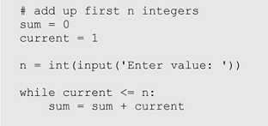
Infinite loop
An infinite loop is an iterative control structure that never terminates (or eventually terminates with a system error).
Infinite loops are generally the result of programming errors.
For example: if the condition of a while loop can never be false, an infinite loop will result when executed.

Slide 47
Loop Control Statements
Break Statement: Terminates the loop statement and transfers execution to the statement immediately following the loop.
Continue Statement: Causes the loop to skip the remainder of its body and immediately retest its condition prior to reiterating.
Pass Statement:The pass statement in Python is used when a statement is required syntactically but you do not want any command or code to execute.
Example:
for letter in 'Python’:
if letter == 'h’:
pass
print('This is pass block’)
print('Current Letter :', letter)
print(“Loop Ended!“)
Output:
Current Letter : P
Current Letter : y
Current Letter : t
This is pass block
Current Letter : h
Current Letter : o
Current Letter : n
Loop Ended
Use of pass in if:
a = 33 b = 200 if b > a: pass

Slide 48
Break and Continue: Examples
Break Statement:
Continue Statement:
Ex.1: fruits = ["apple", "banana", "cherry"] for x in fruits: print(x) if x == "banana": break
Ex.2: fruits = ["apple", "banana", "cherry"] for x in fruits: if x == "banana": break print(x)
Output:
apple banana
fruits = ["apple", "banana", "cherry"] for x in fruits: if x == "banana": continue print(x)
Output:
apple cherry

Slide 49
MCQs
A while loop continues to iterate until its condition becomes false.
TRUE
FALSE
A while loop executes zero or more times.
TRUE
FALSE
All iteration can be achieved by a while loop.
TRUE
FALSE
An infinite loop is an iterative control structures that,
Loops forever and must be forced to terminate
Loops until the program terminates with a system error
Both of the above
The terms definite loop and indefinite loop are used to indicate whether,
A given loop executes at least once
The number of times that a loop is executed can be determined before the loop is executed.
Both of the above
A Boolean flag is,
A variable
Has the value True or False
Is used as a condition for control statements
All of the above

Slide 50
MCQs: Answers
A while loop continues to iterate until its condition becomes false.
TRUE
FALSE
A while loop executes zero or more times.
TRUE
FALSE
All iteration can be achieved by a while loop.
TRUE
FALSE
An infinite loop is an iterative control structures that,
Loops forever and must be forced to terminate
Loops until the program terminates with a system error
Both of the above
The terms definite loop and indefinite loop are used to indicate whether,
A given loop executes at least once
The number of times that a loop is executed can be determined before the loop is executed.
Both of the above
A Boolean flag is,
A variable
Has the value True or False
Is used as a condition for control statements
All of the above

