Slide 1





Computational Thinking with Programming
Fall 2019
@cse_bennett
@csebennett

Slide 2
Python Collections/Sequences (Arrays)
List is a collection which is ordered and changeable. Allows duplicate members.
Tuple is a collection which is ordered and unchangeable. Allows duplicate members.
Set is a collection which is unordered and unindexed. No duplicate members.
Dictionary is a collection which is unordered, changeable and indexed. No duplicate members.

Slide 3
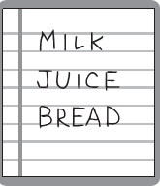
List Structures

Slide 4

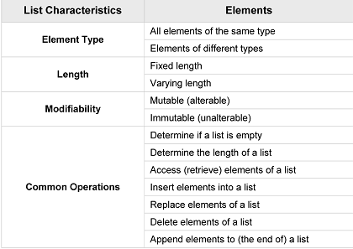
List Structures
A list is a linear data structure, meaning that its elements have a linear ordering. That is, there is a first element, a second element, and so on.

Slide 5
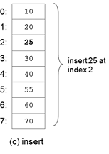
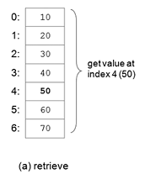
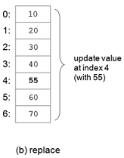
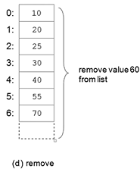
Common List Operations
Operations commonly performed on lists include retrieve, update, insert, remove, and append.

Slide 6
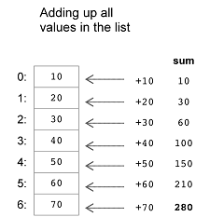
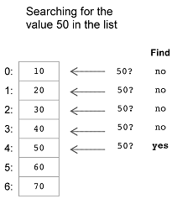
List Traversal
A list traversal is a means of accessing, one-by-one, the elements of a list either from first to last or last to first element.

Slide 7




MCQs: Answers
1. What would be the range of index values for a list of 10 elements?
(a) 0–9 (b) 0–10 (c) 1–10
2. Which one of the following is NOT a common operation on lists?
(a) access (b) replace (c) interleave (d) append (e) insert (f ) delete
3. Which of the following would be the resulting list after inserting the value 50 at index 2?
(a) (b) (c)

Slide 8
MCQs: Answers
1. What would be the range of index values for a list of 10 elements?
(a) 0–9 (b) 0–10 (c) 1–10
2. Which one of the following is NOT a common operation on lists?
(a) access (b) replace (c) interleave (d) append (e) insert (f ) delete
3. Which of the following would be the resulting list after inserting the value 50 at index 2?
(a) (b) (c)

Slide 9

Lists (Sequences) in Python
A list in Python is a mutable linear data structure, denoted by a comma-separated list of elements within square brackets, allowing mixed-type elements. Mutable means that the contents of the list may be altered.
Elements are indexed from 0 to n-1 , where n is number of elements in the list.
Example: [1, 2, 3], ['one', 'two', 'three’], ['apples', 50, True]
An empty list is denoted by an empty pair of square brackets, [].
Negative indexing, i.e, -1 and -2 refers to the last and second last items. Ex. lst[-1]=3, lst[-2] = 2.
Range Search : lst[0:2] = [1, 2]

Slide 10
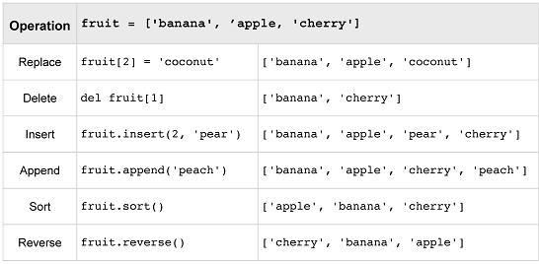
List Modification Operations in Python

Slide 11


Tuples
A tuple is an immutable linear data structure. Thus, in contrast to lists, once a tuple is defined, it cannot be altered.
Tuples are denoted by parentheses instead of square brackets.
Example: nums = (10, 20, 30)
student = ('John Smith', 48, 'Computer Science’, 3.42)
Tuples of one element must include a comma following the element. Otherwise, the parenthesized element will not be made into a tuple.
An empty tuple is represented by a set of empty parentheses, ().

Slide 12
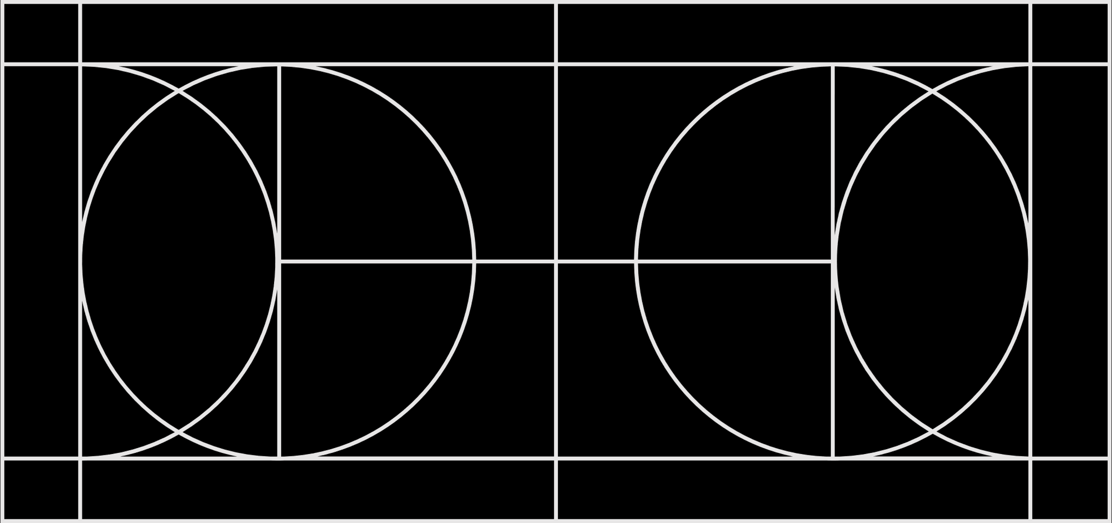
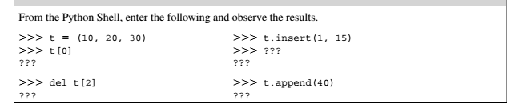
What will happen?

Slide 13
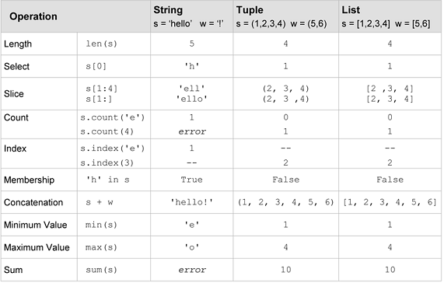
Sequences and Sequence Operations in Python
A sequence in Python is a linearly ordered set of elements accessed by an index number. Lists, tuples, and strings are all sequences.
Strings, like tuples, are immutable ; therefore, they cannot be altered

Slide 14
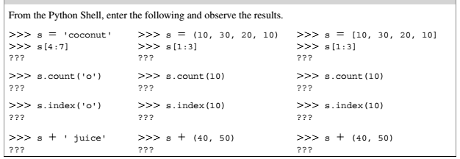
What Will Happen ?

Slide 15
Nested Lists
Lists and tuples can contain elements of any type, including other sequences.
Thus, lists and tuples can be nested to create arbitrarily complex data structures.
Example: class_grades = [ [85, 91, 89], [78, 81, 86], [62, 75, 77], ...],
Here, class_grades[0] equals [85, 91, 89], and class_grades[1] equals [78, 81, 86]

Slide 16
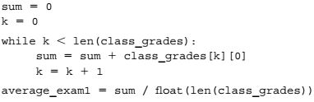
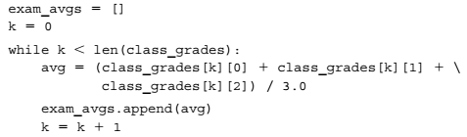
Exercise (Consider the Previous List)
Calculate the class average on the first exam: a while loop can be constructed that iterates over the first grade of each student’s list of grades.
We can produce a new list containing the exam average for each student in the class as follows

Slide 17
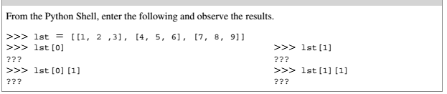
What will happen?

Slide 18
MCQs
Which of the following sequence types is a mutable type?
a) strings b) lists c) tuples
Which of the following is true?
Lists and tuples are denoted by the use of square brackets.
Lists are denoted by use of square brackets and tuples are denoted by the use of parentheses.
Lists are denoted by use of parentheses and tuples are denoted by the use of square brackets.
Lists and tuples must each contain at least one element.
True
False
For lst = [4, 2, 9, 1], what is the result of the following operation, lst.insert(2, 3) ?
[4, 2, 3, 9, 1] b) [4, 3 ,2, 9, 1] c) [4, 2, 9, 2, 1]
Which of the following is the correct way to denote a tuple of one element?
a) [6] b) (6) c) [6,] d) (6,)
Which of the following set of operations can be applied to any sequence?
len(s), s[i], s+w (concatenation)
max(s), s[i], sum(s)
len(s), s[i], s.sort()

Slide 19
MCQs: Answers
Which of the following sequence types is a mutable type?
a) strings b) lists c) tuples
Which of the following is true?
Lists and tuples are denoted by the use of square brackets.
Lists are denoted by use of square brackets and tuples are denoted by the use of parentheses.
Lists are denoted by use of parentheses and tuples are denoted by the use of square brackets.
Lists and tuples must each contain at least one element.
True
False
For lst = [4, 2, 9, 1], what is the result of the following operation, lst.insert(2, 3) ?
[4, 2, 3, 9, 1] b) [4, 3 ,2, 9, 1] c) [4, 2, 9, 2, 1]
Which of the following is the correct way to denote a tuple of one element?
a) [6] b) (6) c) [6,] d) (6,)
Which of the following set of operations can be applied to any sequence?
len(s), s[i], s+w (concatenation)
max(s), s[i], sum(s)
len(s), s[i], s.sort()

