Slide 1



Rainfall Predication
Name: Samya Malik
AICTE Student ID: STU20241908DD699384 AICTE Internship ID: INTERNSHIP_17513641056863b20937d78

Slide 2

Learning Objectives
1.Understand weather data and factors affecting rainfall.
2.Apply data preprocessing and feature selection techniques for accurate modeling.
3.Develop and evaluate machine learning models to predict rainfall.
4.Deploy the model using Flask and integrate it with a user-friendly frontend.
5.Learn practical applications of rainfall prediction for decision-making in agriculture and planning.
GOAL
Source :
www.freepik.com/

Slide 3
Tools and Technology used
1.Programming Language: Python
2.Data Analysis & Processing: Pandas, NumPy
3.Machine Learning: scikit-learn (for model building, training, and evaluation)
4.Model Serialization: Pickle (for saving and loading the trained model)
5.Web Framework / Backend: Flask
6.Frontend: HTML, CSS, JavaScript (for user interface)
7.Development Environment: Jupyter Notebook / VS Code / Google collar
8.Visualization : Matplotlib, Seaborn (for exploring data trends)

Slide 4
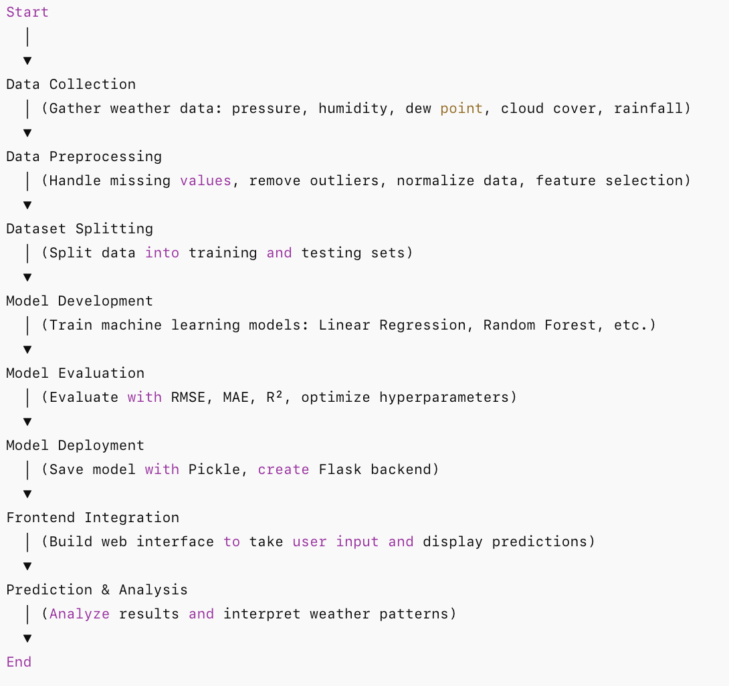
Methodology

Slide 5
Problem Statement:
Accurate rainfall prediction is crucial for agriculture, water resource management, and disaster preparedness. Traditional methods often rely on historical averages and manual observations, which can be unreliable. The challenge is to develop a system that can predict rainfall based on multiple weather parameters—such as pressure, humidity, dew point, and cloud cover—so that timely decisions can be made.

Slide 6
Solution:
The solution is a machine learning-based rainfall prediction system:
Data-Driven Approach: Use historical weather data as input features to train predictive models.
Model Development: Apply machine learning algorithms (e.g., Random Forest, Linear Regression) to learn patterns and relationships between weather parameters and rainfall.
Prediction System: Deploy the trained model using Flask so that users can input current weather conditions and receive real-time rainfall predictions.
Decision Support: The system provides actionable insights for farmers, planners, and authorities, enabling better preparation and resource management.
Github link: https://github.com/samyamalik/Rainfall-Prediction-Using-ML

Slide 7
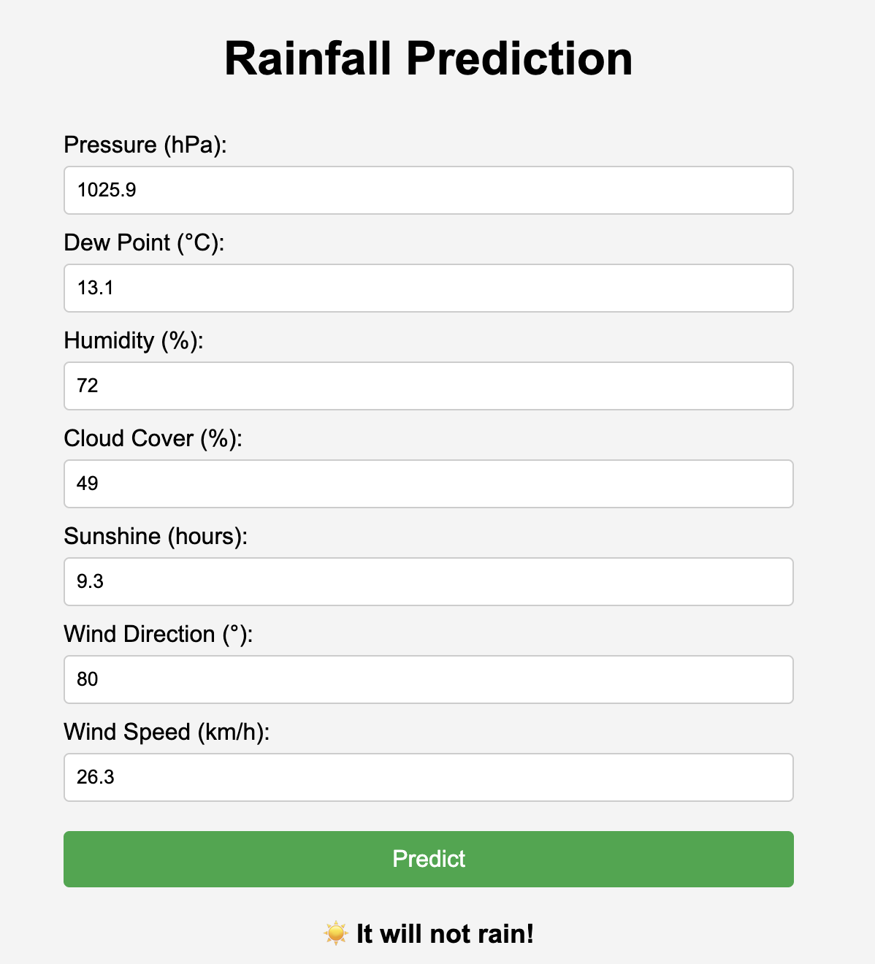
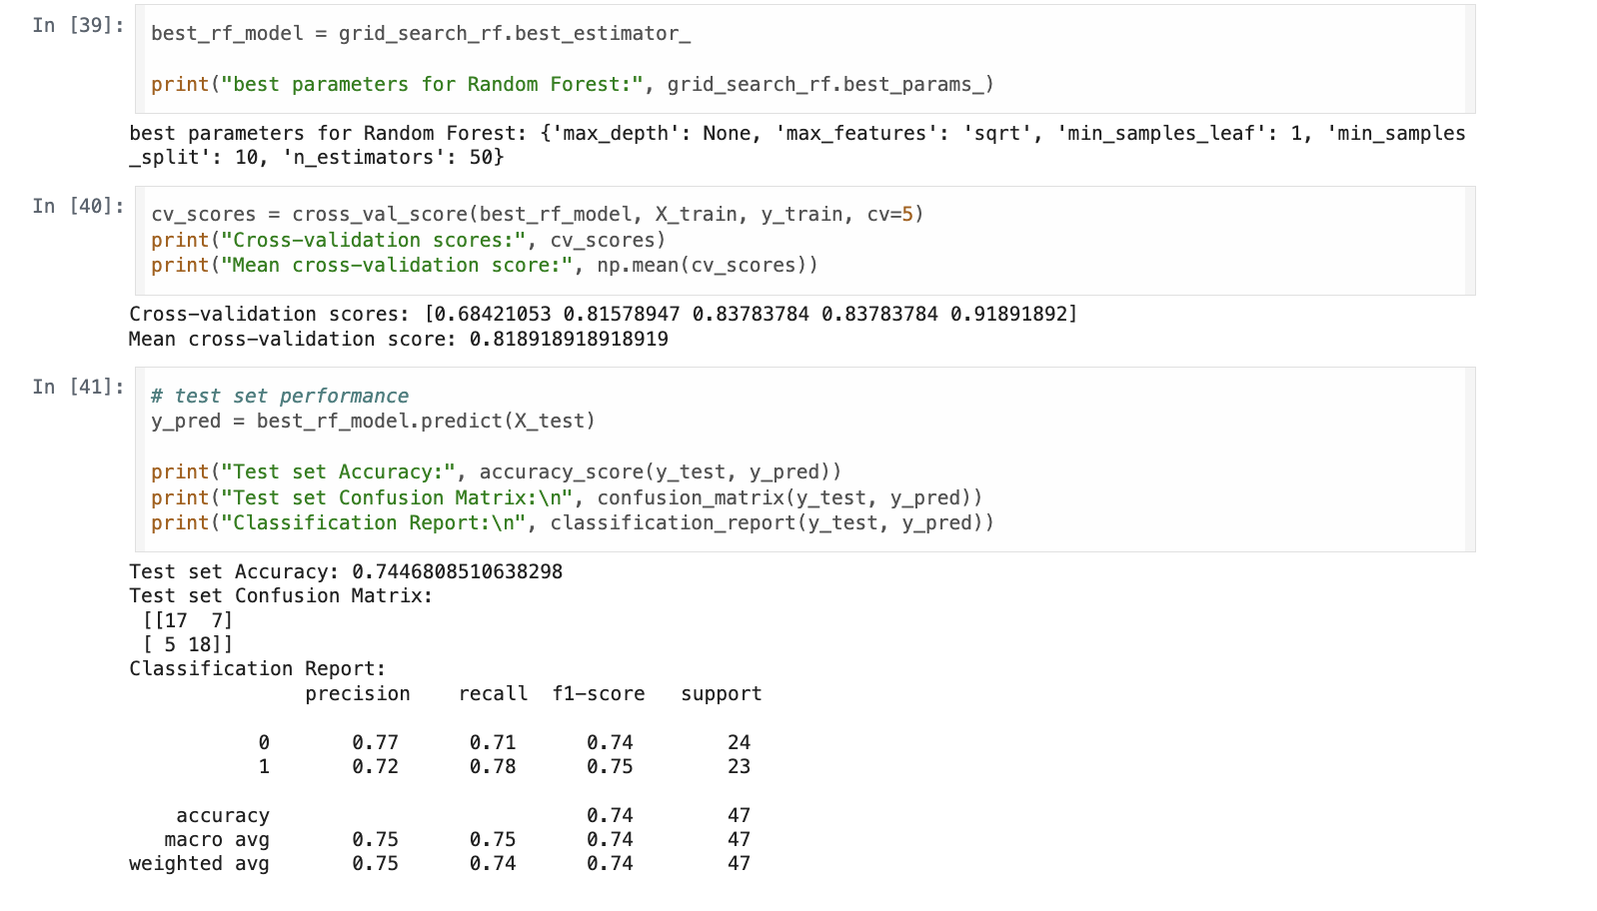
Screenshot of Output:

Slide 8
Conclusion:
Conclusion
The project demonstrates how machine learning can accurately predict rainfall using weather parameters, helping in better planning and decision-making.
Future Scope
Incorporate real-time weather APIs for live predictions.
Improve accuracy using advanced models like XGBoost or Deep Learning.
Expand to regional or seasonal forecasting for broader applicability.

