Slide 1
Car accident severity project - Seattle
Course/IBM Data Science capstone project

Slide 2

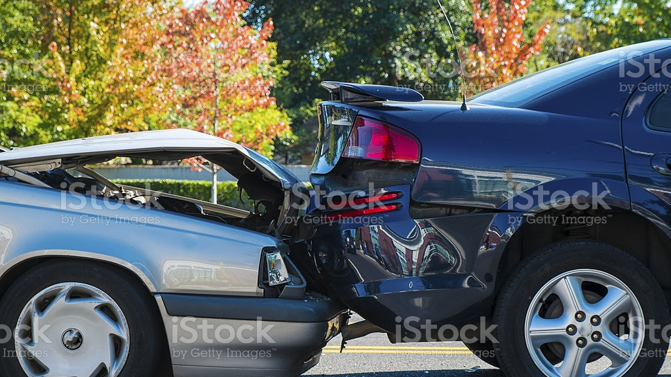

Buisness understanding
z
Traffic collisions a leading cause of death in the United States
Vast amount of data collected on collisions
Data Science can help decision-makers go from information overload to insight and understanding

Slide 3
Data collection and understanding
z
Seattle dataset of 194.673 accidents, with 38 features
Dependent - Severity code indicating “Property Damage” or “Injury collision”
Independent – 38 features

Slide 4
Feature selection
z
Selected 3 features external to driver and 3 internal driver features
External: INATTENTION, UNDERINFL, SPEEDING
Internal: WEATHER, ROADCOND, LIGHTCOND

Slide 5
Data Cleaning
z
Dropped 12.7% of the data because of missing values
Converted external features with one-hot encoding

Slide 6
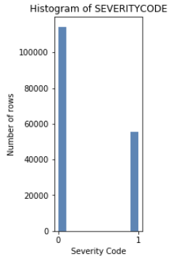
Methodology - EDA
Exploratory Data Analysis
Data is unbalanced with a bias towards less severe accidents

Slide 7
Methodology - EDA
DUI: 6.7 percentage points increase in correlation with severe accidents
Speeding: 5.6 percentage points
Inattention: 3.7 percentage points
SEVERITY | DUI | Not DUI | SPEEDING | Not SPEEDING | INATTENTIVE | ATTENTIVE
0 | 60.9% | 67.6% | 61.9% | 67.5% | 64.2% | 67.9%
1 | 39.1% | 32.4% | 38.1% | 32.5% | 35.8% | 32.1%

Slide 8
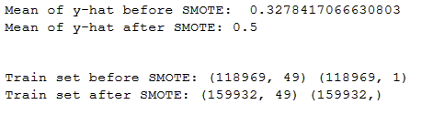
Test/Train and SMOTE
Test/train split at 30/70
Synthetic Minority Over-sampling TEchnique for balancing data

Slide 9
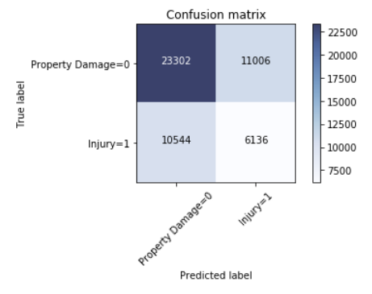
Results of Decision Tree
Precision Recall F1-score Support
0 0.69 0.67 0.68 34308
1 0.36 0.38 0.37 16680
accuracy 0.57 50988
macro avg 0.52 0.53 0.52 50988
weighted avg 0.58 0.57 0.58 50988

Slide 10
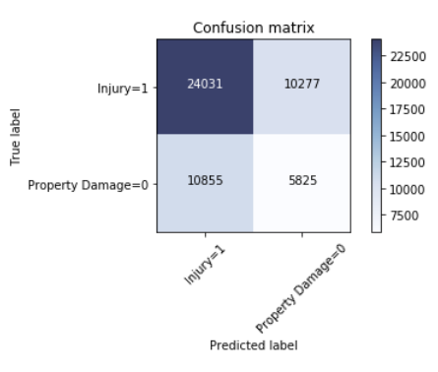
Results of Logistic Regression
Precision Recall F1-score Support
0 0.69 0.70 0.69 34308
1 0.36 0.35 0.36 16680
accuracy 0.59 50988
macro avg 0.53 0.52 0.52 50988
weighted avg 0.58 0.59 0.58 50988

Slide 11
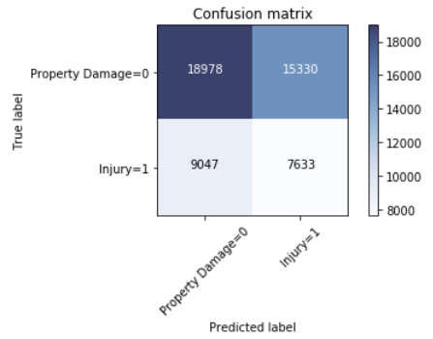
Results of K-nearest neighbor
Precision Recall F1-score Support
0 0.68 0.55 0.61 34308
1 0.33 0.46 0.39 16680
accuracy 0.52 50988
macro avg 0.50 0.51 0.50 50988
weighted avg 0.56 0.52 0.54 50988

Slide 12
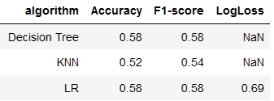
Discussion
KNN was trained using the K with highest recall, not accuracy
Logistic Regression and Decision tree perform almost identical
All models perform above chance, but needs more work

Slide 13
Recommendations to stakeholders
Models can be used to simulate accidents severity
DUI is a leading cause of accidents becoming severe
Speeding and inattentive drivers have an affect

Slide 14
Recommendations to stakeholders
12.7% of data was dropped. First responders should report more accurately
Increased data collection

Slide 15
Conclusion
Project should be considered a proof of concept
More should be done to increase the performence of the models

