Slide 1
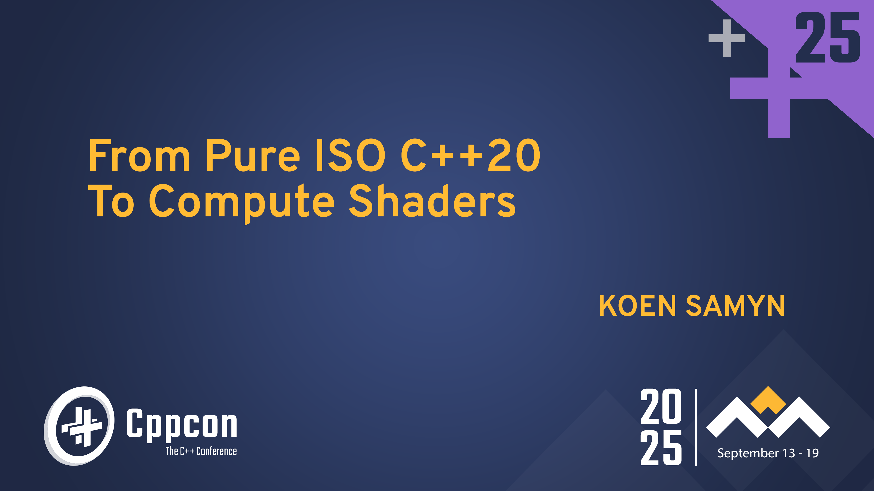

Slide 2
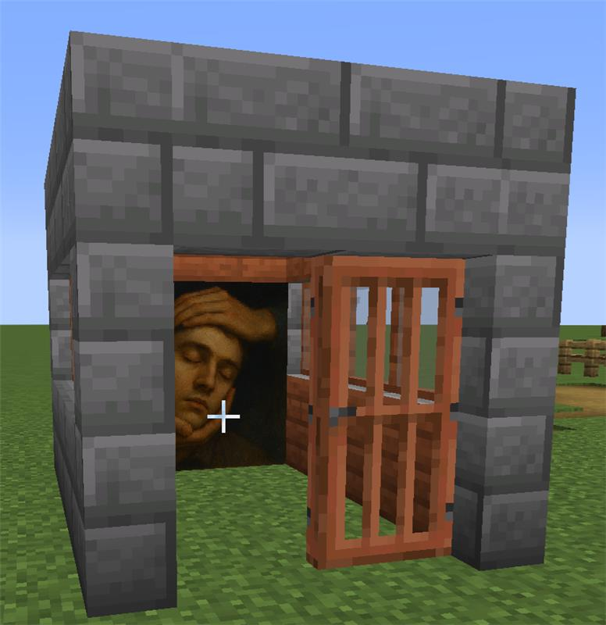



About me
Koen Samyn
Program Coordinator Game Development at DAE
Minecraft player and (recently) modder
Fan of graphic novels
Fan of science fiction and fantasy stories

Slide 3
Overview
C++ Design
Validation
(Clang/AST)
Transpilation
(Clang/AST)
GLSLangValidator
Emulation of GLSL capabilities:
Vector math (swizzles!)
Buffers/Images/Uniforms
Image format conversions
Workgroups/Threads
Unsupported C++ syntax (e.g. new/delete)
Rewriter API
Error/warning report
Export to GLSL
Error/warning report
Error/warning report (packing)
Backend system:
CPU
GPU

Slide 4
Why this project
Mental load to develop compute shaders is heavy
Still developing C++ skills.
Management layer needed for GPU resources.
Debugging GPU programs is hard.
Programming model is different
Workgroups / threads
Homogeneous parallelism: every thread performs the same task
Existing C++ code can be hard to convert

Slide 5
Is this new?
A lof of movement in this area and existing frameworks
CUDA /HIP
SyCL
CompuShady (Python)
Niche I am trying to fill:
Non-proprietary
Lightweight
Educational focus: teach transferable skills.
Focus on techniques that are transferable to graphics programming shaders: vertex/fragment/mesh shaders

Slide 6
Design goals
Start with C++20 → no new keywords
Compact code
Templates
Constexpr
Close mapping with GPU parallelism
Workgroups/threads
Equivalence between CPU and GPU execution

Slide 7
Vertical slice – Conway’s game of life
From quadruple for loop to compute shader
Rules for game of life:
Any cell with 3 neighbours → stays alive or is born
A live cell with 2 neighbours → stays alive
Any other case → cell dies
0
1
2
3
4
5
6
7
8
9
10
11
12
13
14
15
0
1
2
3
4
5
6
7
8
9
10
11
12
13
14
15

Slide 8
Vertical slice – Conway’s game of life
0
1
2
3
4
5
6
7
8
9
10
11
12
13
14
15
0
1
2
3
4
5
6
7
8
9
10
11
12
13
14
15
0
0
?
1
1
2
2
3
3
4
4
5
5
6
6
7
7
?
8
8
9
9
10
10
11
11
12
12
13
13
14
14
15
15

Slide 9
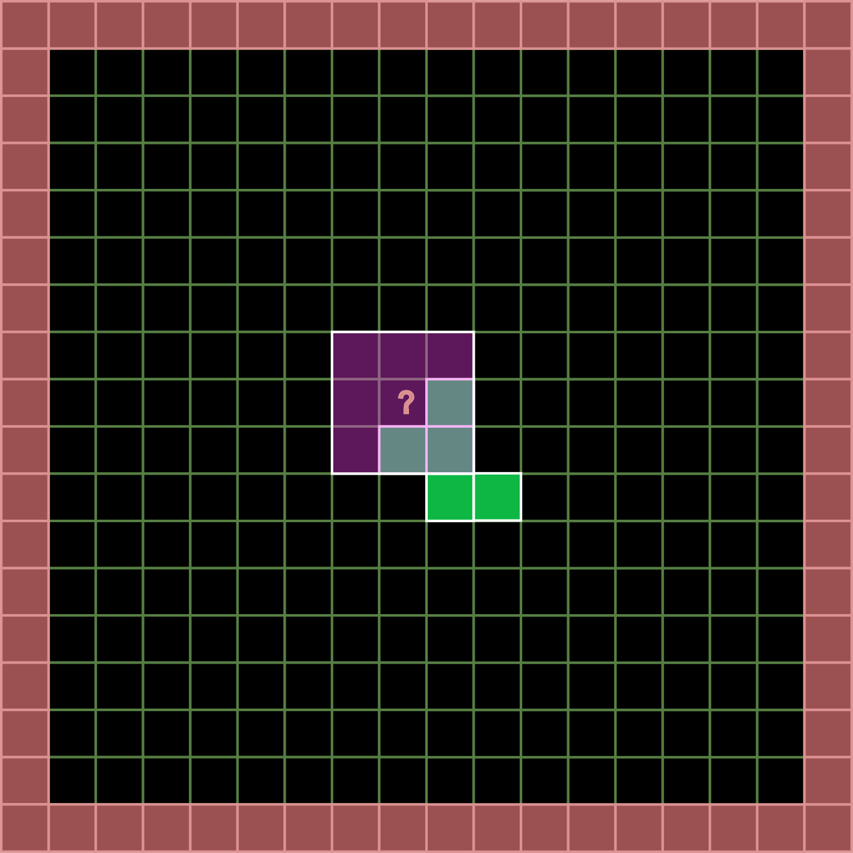
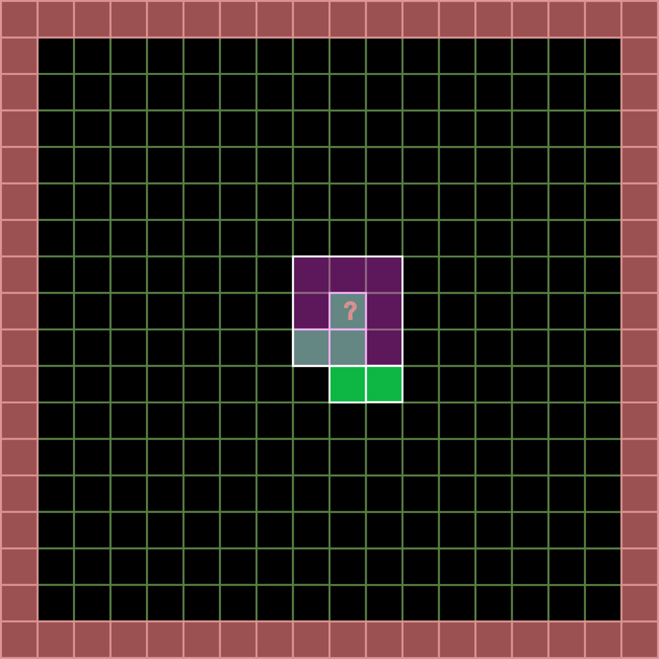
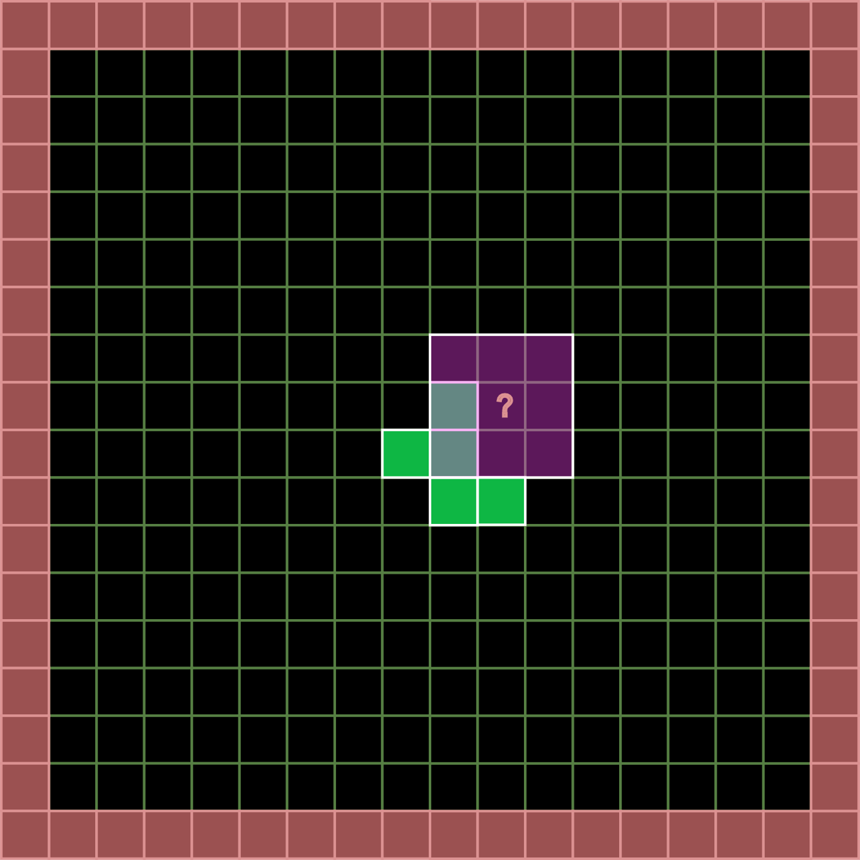
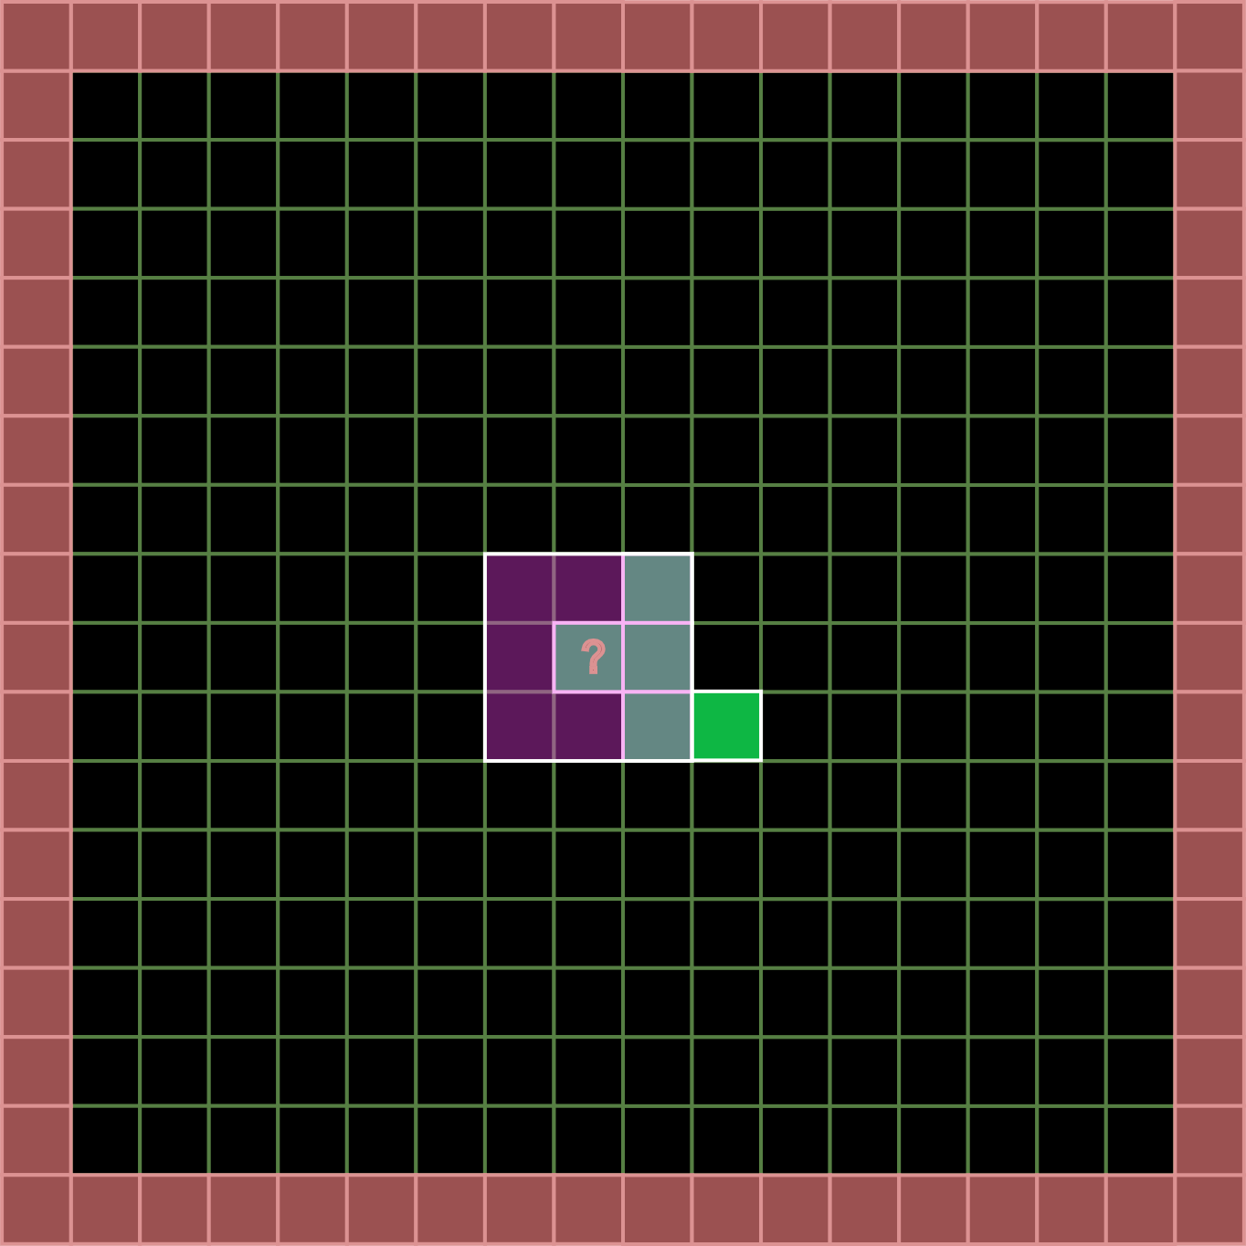
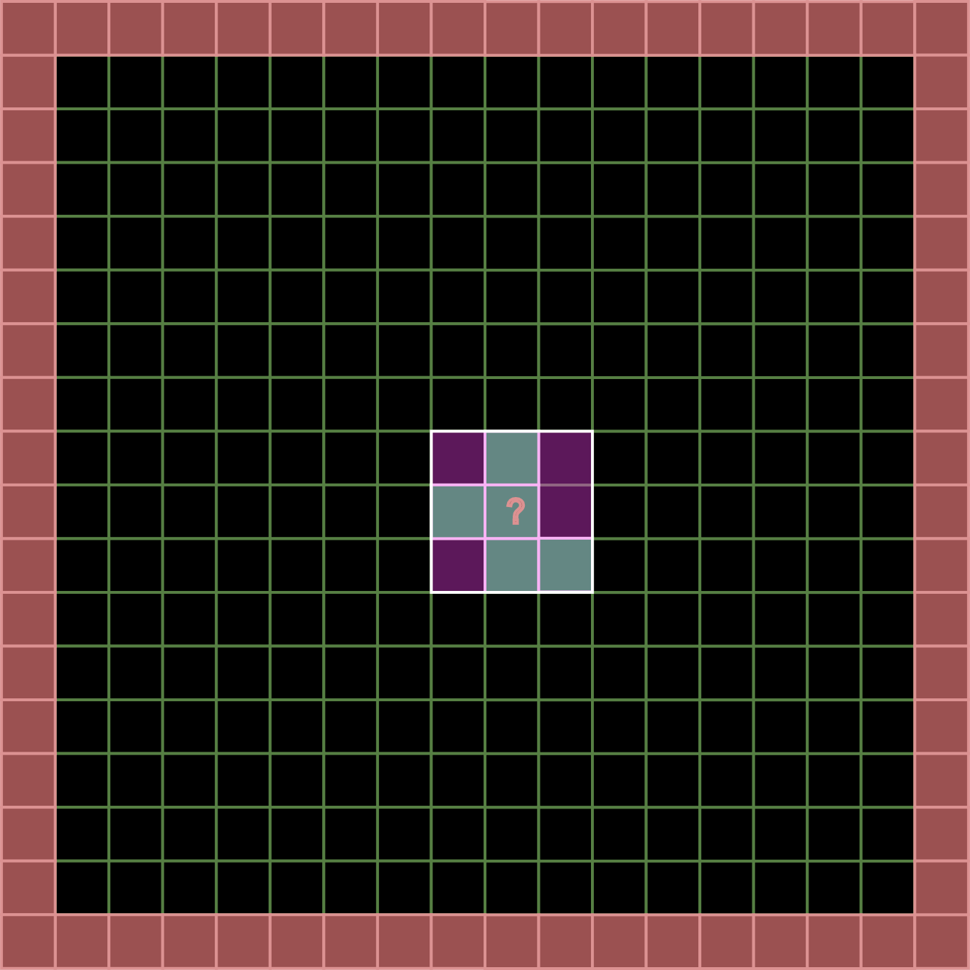
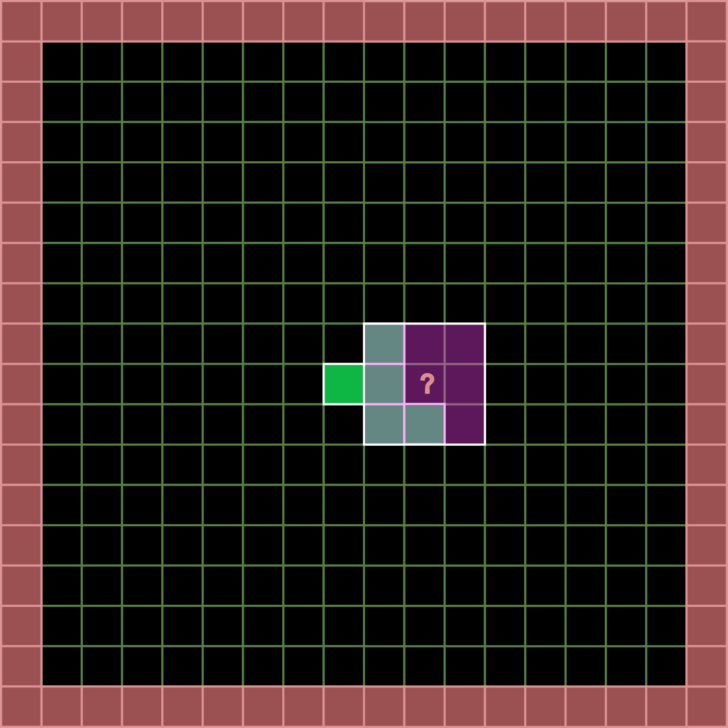
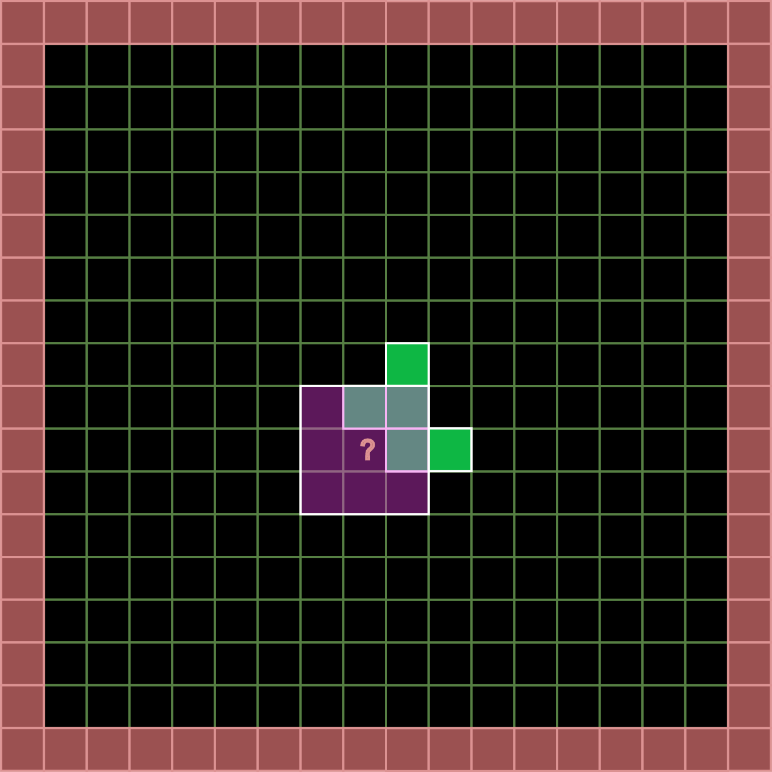
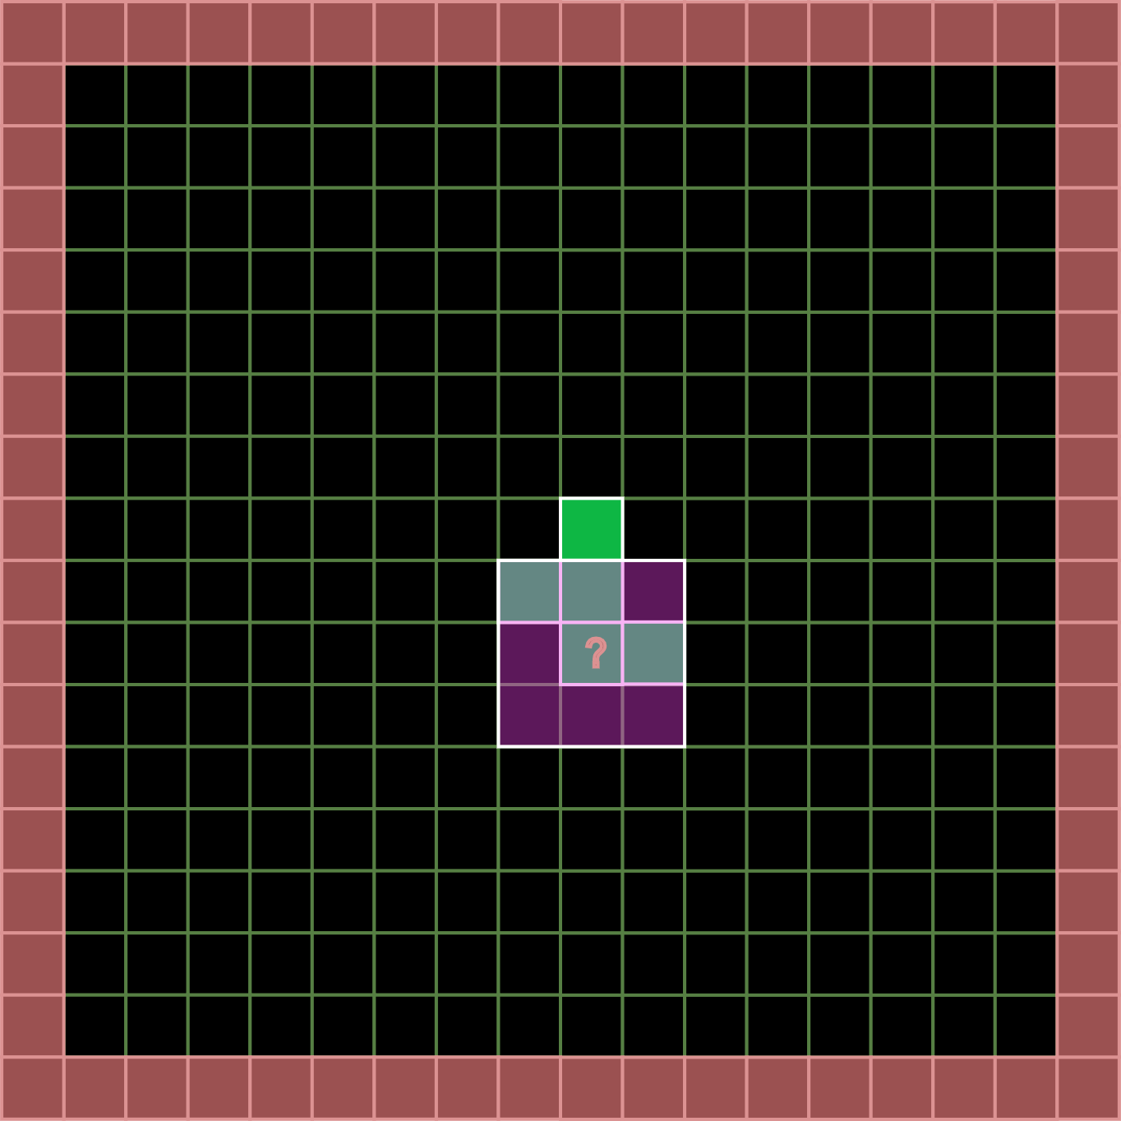
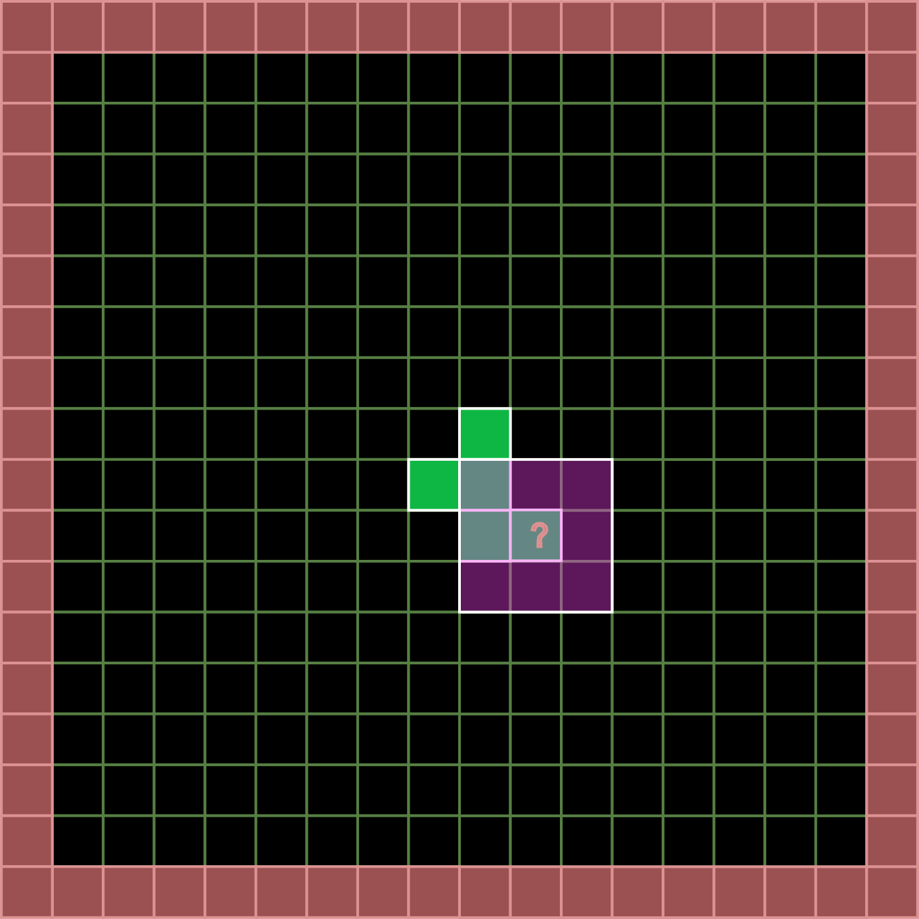
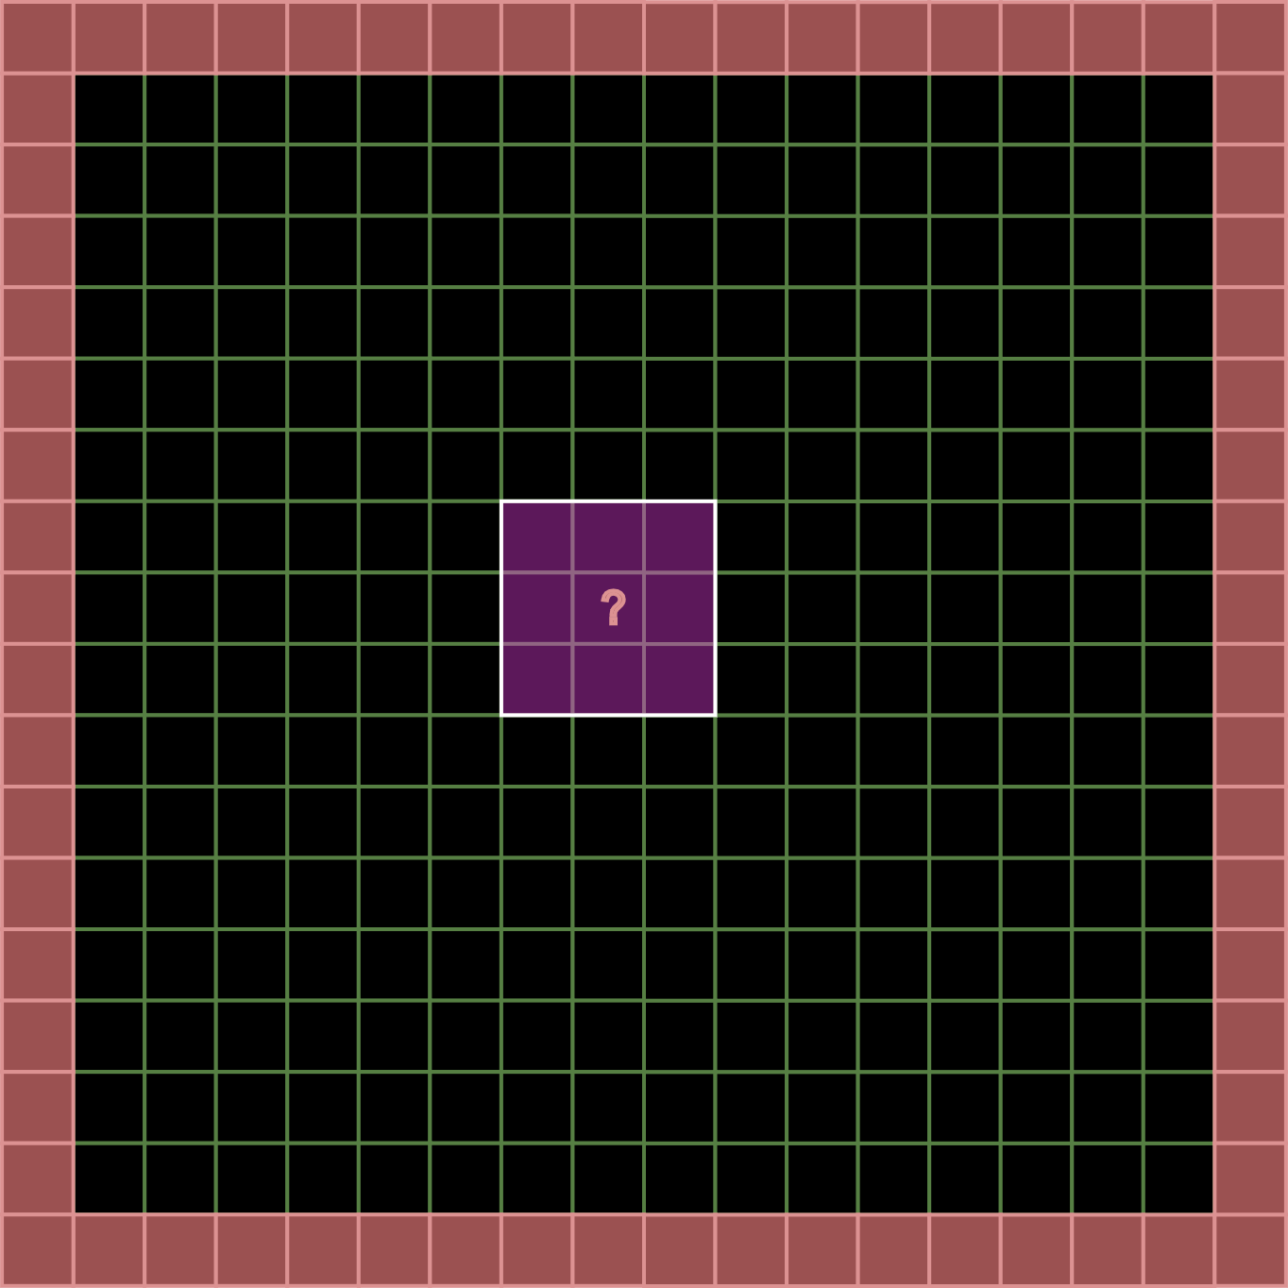
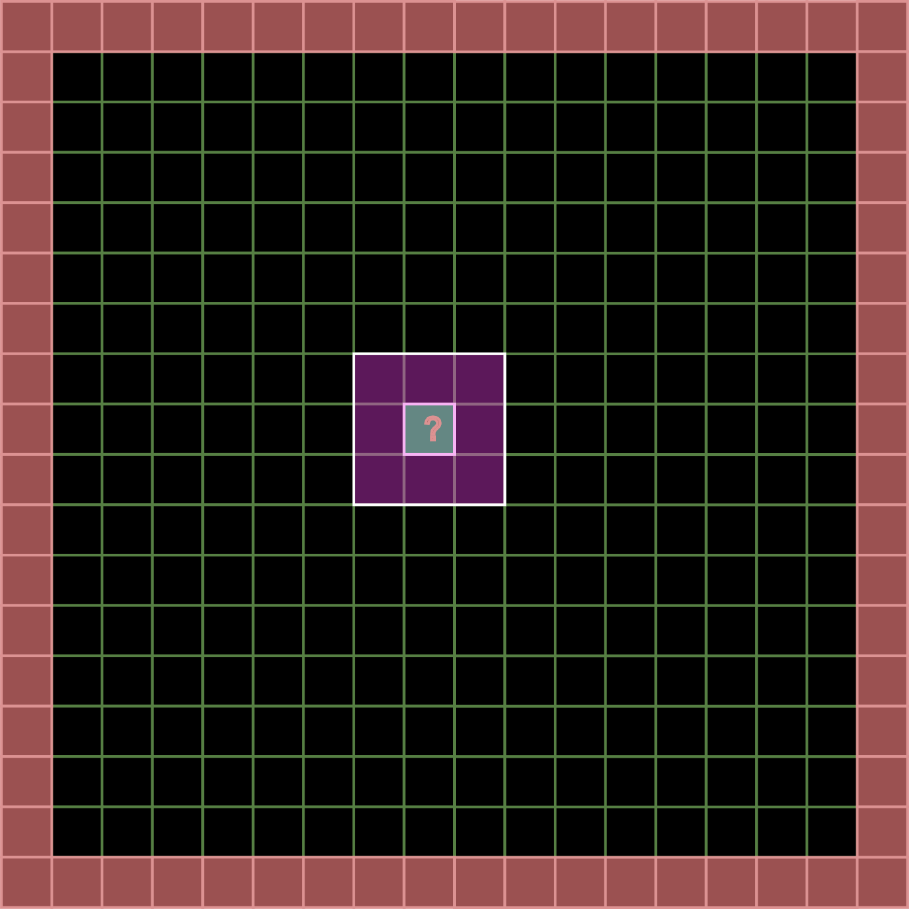
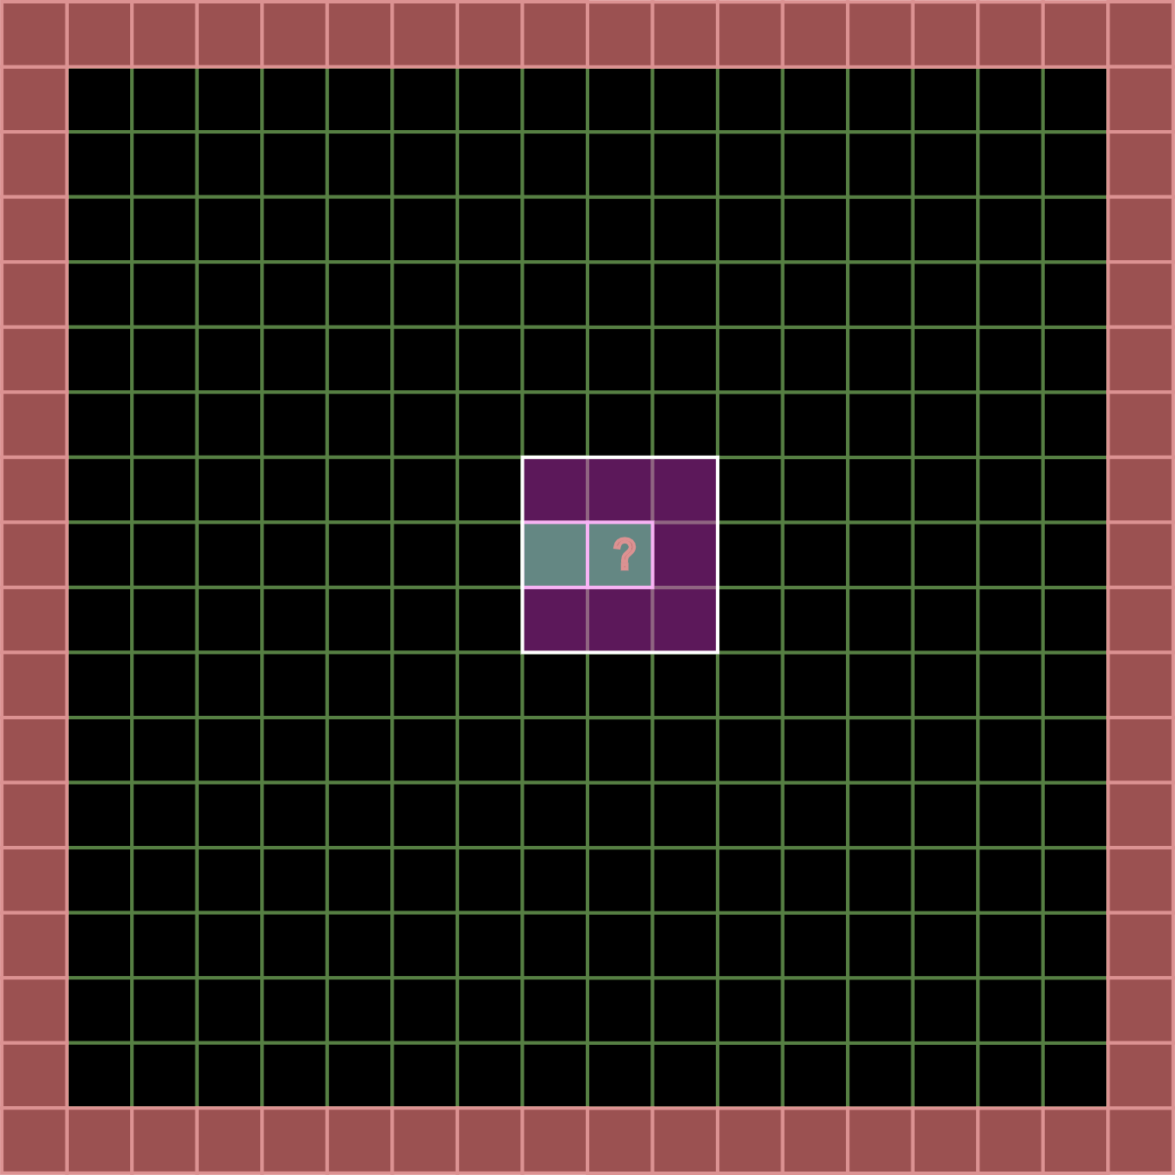
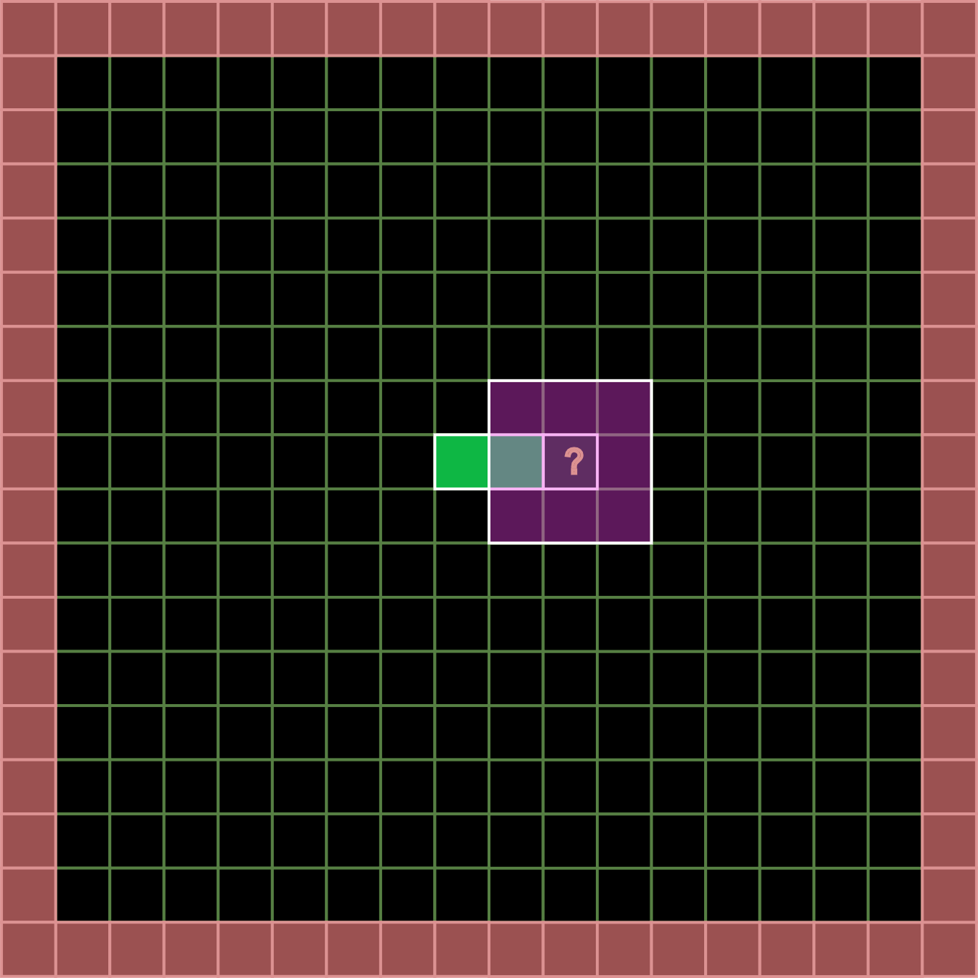
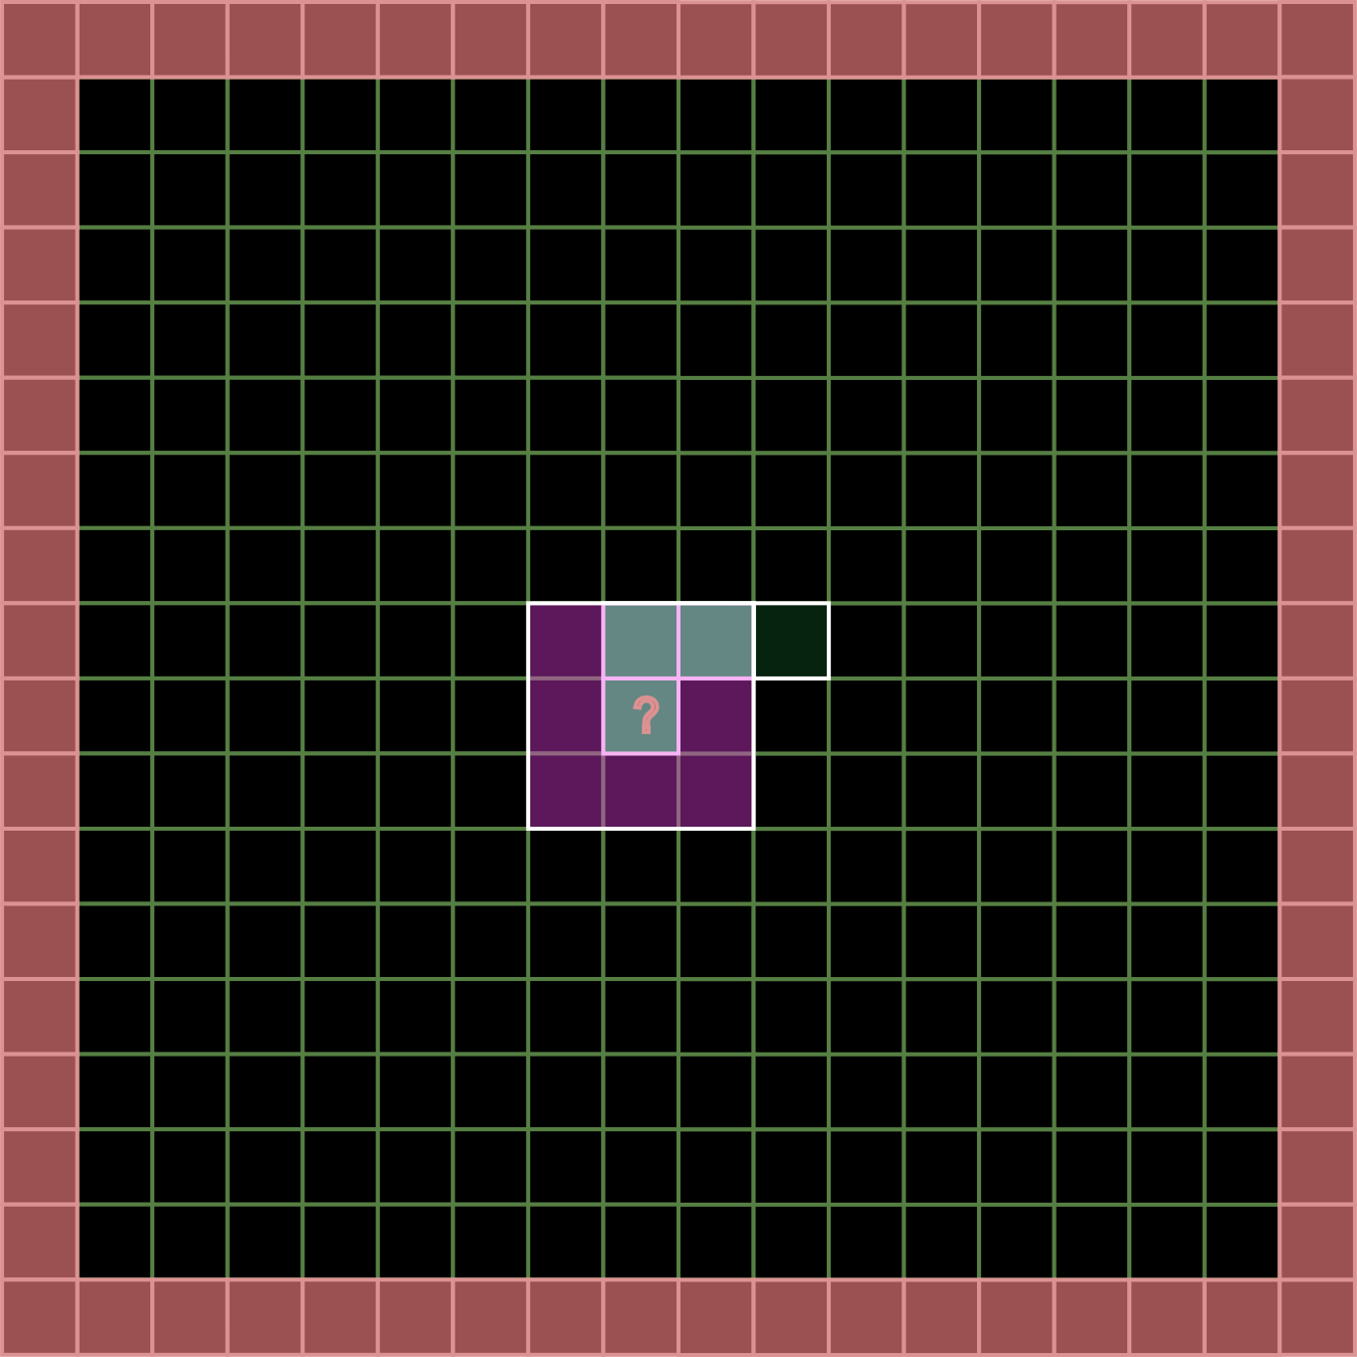
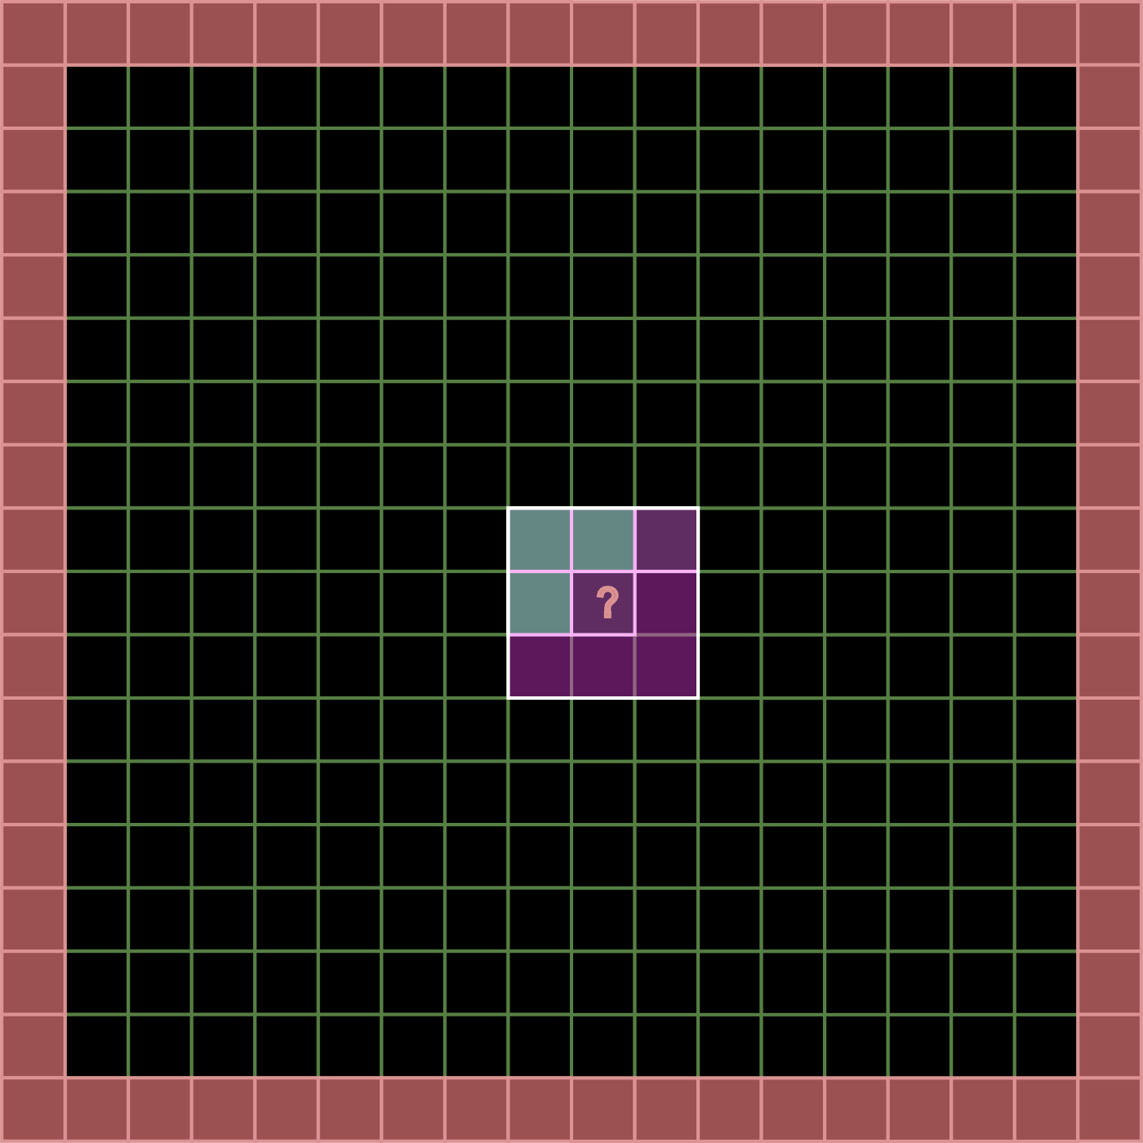
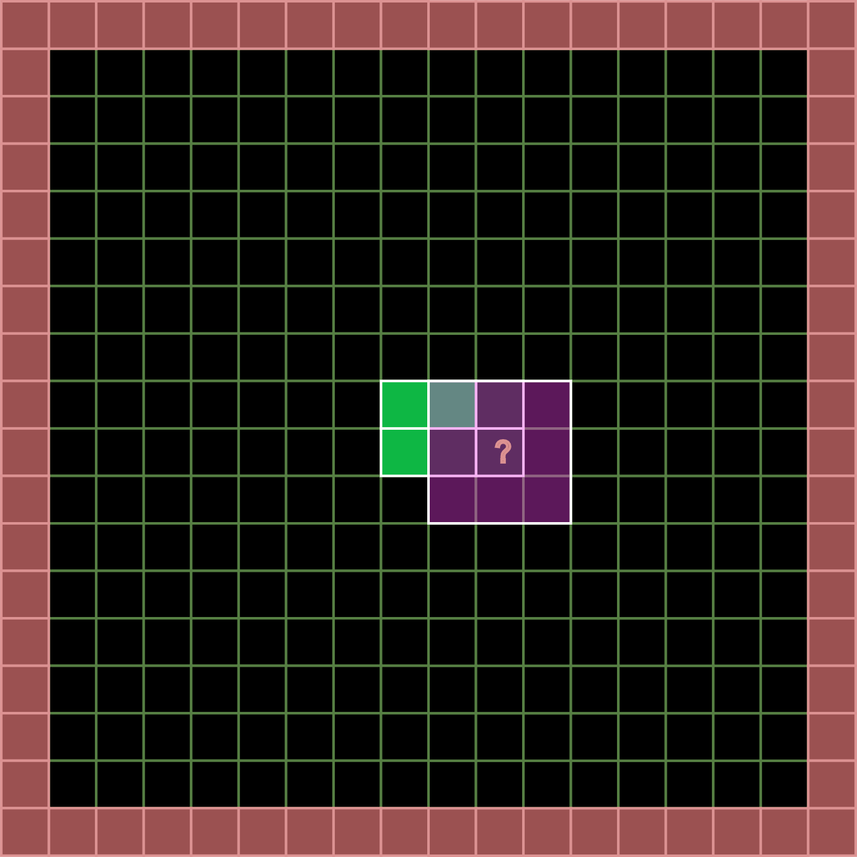
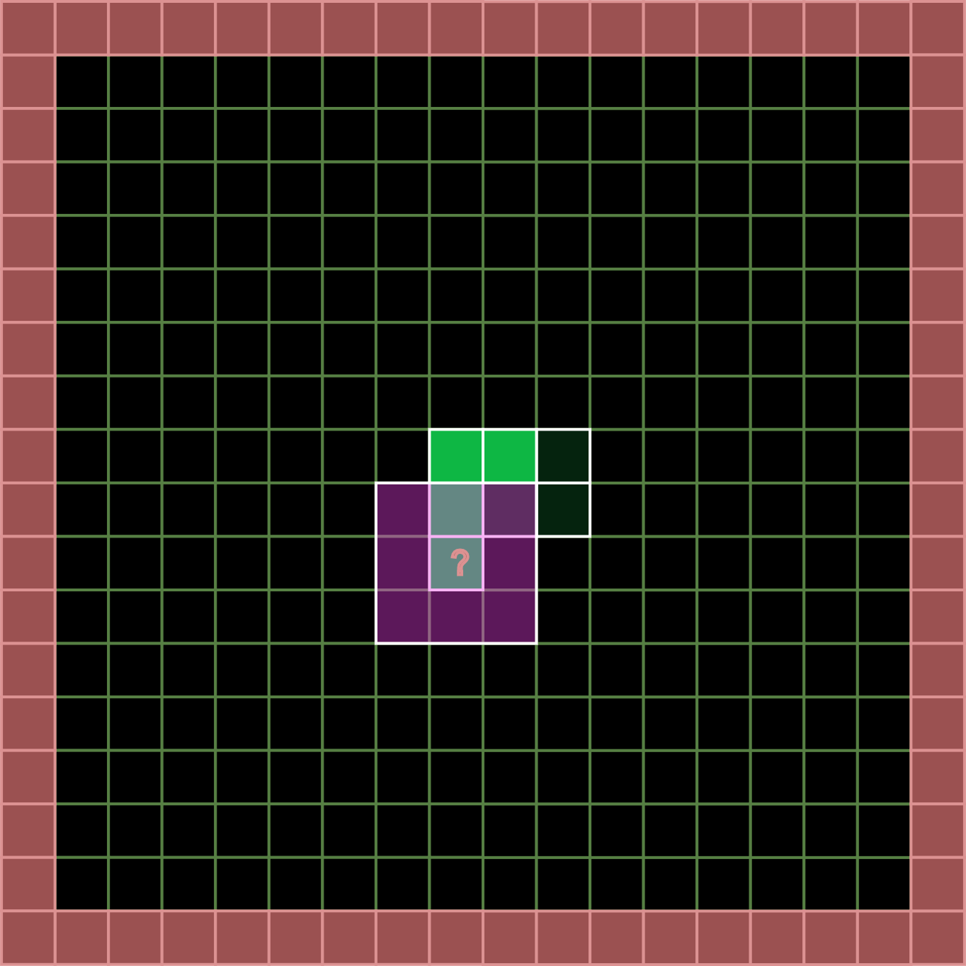

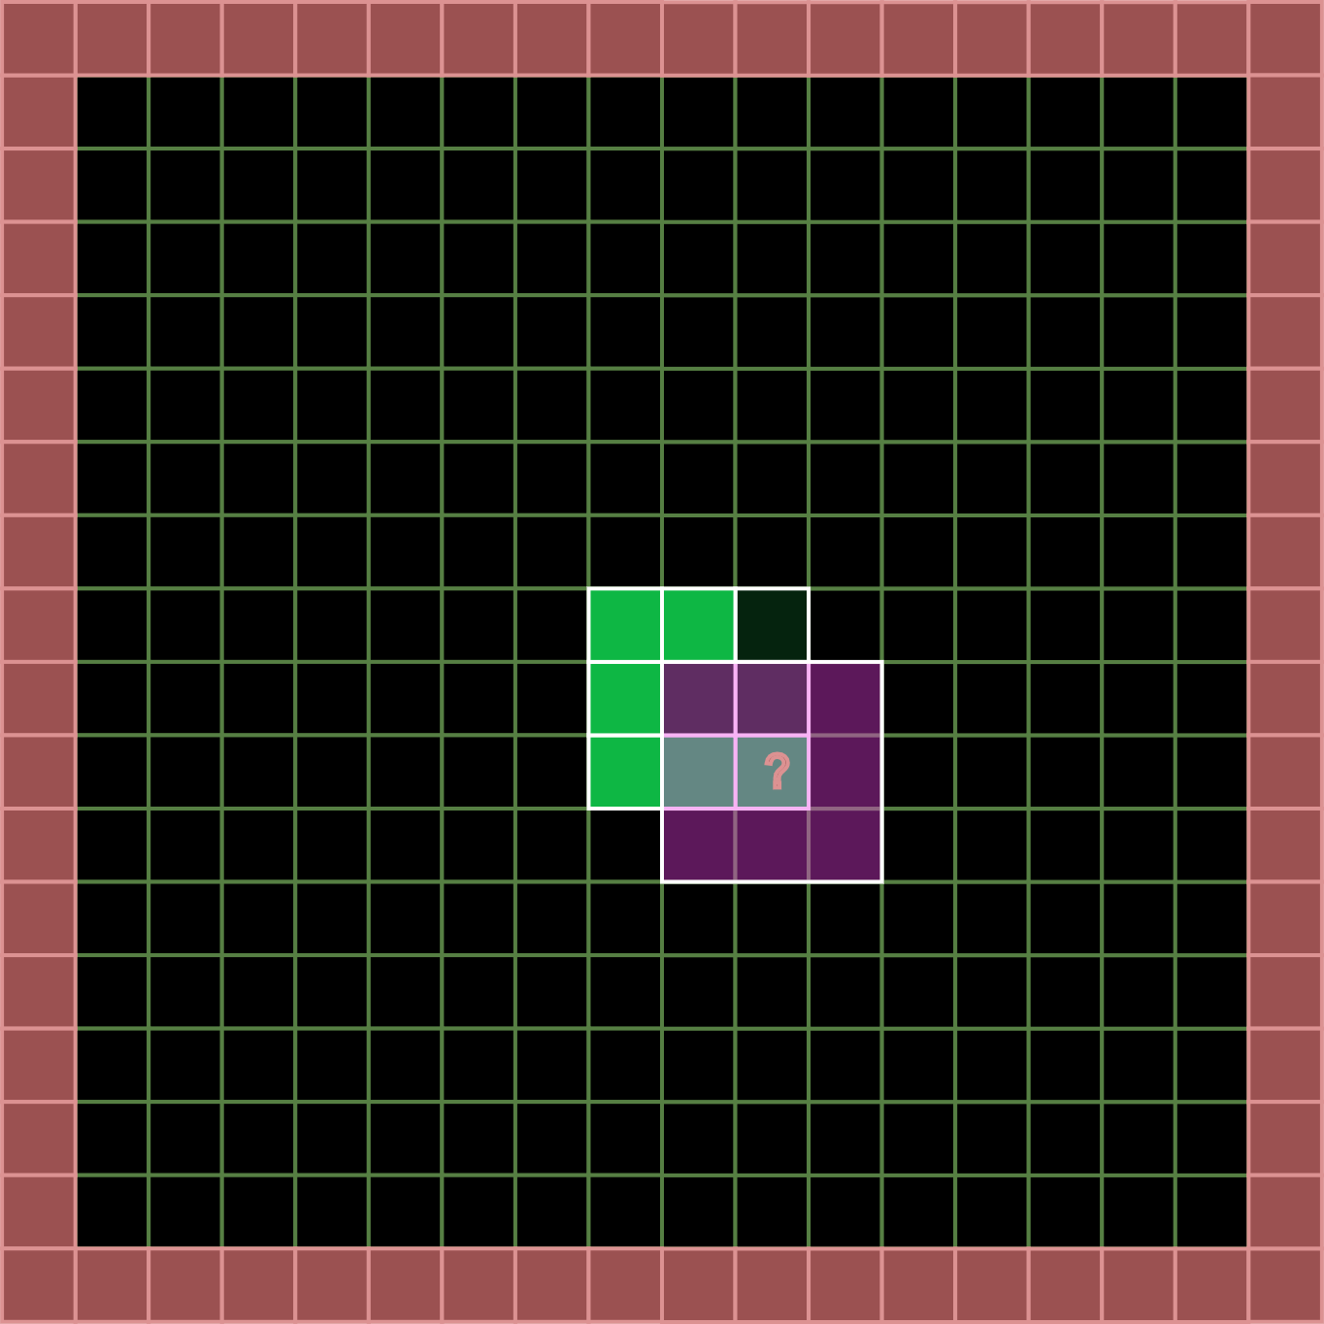
Vertical slice – Conway’s game of life

Slide 10
Approach with 4 4 loops
const size_t pad = 1; // border
const size_t width = 16;
const size_t height = 16;
std::vector<uint32_t> state0{};
std::vector<uint32_t> state1{};
state0[7][8] = 1;
state0[8][7] = 1;
state0[8][8] = 1;
state0[9][8] = 1;
state0[9][9] = 1;

Slide 11
Compute Kernel concept
namespace GameOfLife
{
class Kernel
{
public:
Kernel(size_t w, size_t h, size_t pad);
index coordinateToIndex( index cx, index cy ) const {
return (cy + m_Pad) * m_PaddedWidth + (cx + m_Pad);
}
void dispatch();
private:
size_t m_Width;
size_t m_PaddedWidth;
size_t m_Height;
size_t m_PaddedHeight;
size_t m_Pad;
std::vector<uint32_t> m_State0{};
std::vector<uint32_t> m_State1{};
};
}
state0
(1D data structure)
GameOfLife
Algorithm
State1
(1D data structure)

Slide 12
Approach with 4 for loops
void dispatch()
{
for (index r = 0; r < m_Height; ++r)
{
for (index c = 0; c < m_Width; ++c)
{
int n = 0;
int cellIndex = coordinateToIndex(c, r);
int alive = m_State0[cellIndex];
// convolution
for (index dy = -1; dy <= 1; ++dy)
{
for (index dx = -1; dx <= 1; ++dx)
{
if (dy || dx) {
n += m_State0[coordinateToIndex(c + dx, r + dy)];
}
}
}
m_State1[cellIndex] = (n == 3) || (alive && n == 2);
}
}
}
One task
(thread)

Slide 13
Visualization
OLC Engine (One Lone Coder)
https://github.com/OneLoneCoder/olcPixelGameEngine
Cross platform
Cross language (Java/Rust/C#/Lua)
bool OnUserUpdate(float fElapsedTime) override
{
for (int32_t x = 0; x < k.getWidth(); x++)
{
for (int32_t y = 0; y < k.getHeight(); y++)
{
uint32_t cell = k.get1(x, y);
olc::Pixel color = cell ? olc::GREEN : olc::BLACK;
FillRect(x * m_Scale, y * m_Scale, m_Scale, m_Scale, color);
}
}
k.dispatch();
k.swapBuffers();
return true;
}

Slide 14
Result
It works! But:
Serial execution of a parallel algorithm
Loops hide the intent of the algorithm:
For each cell:
Collect the neigbours from the old state
Update the cell in the new state.
Convolution loop
Replace by fixed list of neighbours?
Separable filter?

Slide 15
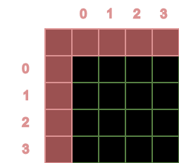
First improvement
Give each thread/task a unique id
Can be used to find the data for the task or thread
This id is a logical id
It would be nice (in this case) to have a 2-dimensional id.
t#0
t#1
t#2
t#3
t#4
t#5
t#6
t#7
t#8
t#9
t#10
t#11
t#12
t#13
t#14
t#15

Slide 16
Std::views::iota
std::views::iota : generate 1-dimensional unique id for all tasks/threads:
const uint64_t totalWork = m_Width * m_Height;
auto range = std::views::iota(uint64_t{ 0 }, totalWork);
Note : in C++23 cartesian views can be used which can generate tuples

Slide 17
std::for_each
std::for_each uses the generated id and sets a thread_local (a 3D value) that contains the id for the task/thread.
Use a parallel execution policy
uvec3 globalWorkSize{ m_Width,m_Height,1 };
std::for_each(
std::execution::par ,
range.begin(), range.end() ,
[&](const uint64_t xi) {
globalInvocationID = unflatten(xi, globalWorkSize);
main();
});
Take an id from the std::views::iota generator
Unflatten the 1-Dimensional id and store it in a thread_local

Slide 18
std::execution::par_seq
Auto vectorization of threads → think SIMD
“A standard library function is vectorization-unsafe if it is specified to synchronize with another function invocation, or another function invocation is specified to synchronize with it, and if it is not a memory allocation or deallocation function or lock-free atomic modify-write operation ([atomics.order]).”

Slide 19
Second improvement
256 Cells (16x16)
WG #0
Device manager (16 “real” cores)
WG #1
WG #2
WG #0
WG
#1
WG
#2
WG
#3
WG #3
WG #4
WG
#4
WG
#5
WG
#6
WG
#7
WG #5
WG #6
WG #7
WG
#8
WG
#9
WG
#10
WG
#11
WG #8
WG #9
WG #10
WG
#12
WG
#13
WG
#14
WG
#15
WG #11
WG #12
WG #13
WG #14
WG: workgroup
WG #15

Slide 20
Local sizes
256 Cells (16x16)
4
WG #0
WG
#1
WG
#2
WG
#3
t#0
t#1
t#2
t#3
WG
#4
WG
#5
WG
#6
WG
#7
4
t#4
t#5
t#6
t#7
WG
#8
WG
#9
WG
#10
WG
#11
t#8
t#9
t#10
t#11
WG
#12
WG
#13
WG
#14
WG
#15
t#12
t#13
t#14
t#15
Workgroup #7
Local size:
4x4x1

Slide 21
IDs
256 Cells (16x16)
4
WG #0
WG
#1
WG
#2
WG
#3
t#0
t#1
t#2
t#3
WG
#4
WG
#5
WG
#6
WG
#7
4
t#4
t#5
t#6
t#7
WG
#8
WG
#9
WG
#10
WG
#11
t#8
t#9
t#10
t#11
WG
#12
WG
#13
WG
#14
WG
#15
t#12
t#13
t#14
t#15
Workgroup #7
workGroupSize
4x4x1
Local size:
4x4x1

Slide 22
IDs
workGroupID : {3,1,0}
localID : {2,1,0}
globalInvocationID : {14,5,0}
4
WG #0
WG
#1
WG
#2
WG
#3
t#0
t#1
t#2
t#3
WG
#4
WG
#5
WG
#6
WG
#7
4
t#4
t#5
t#6
t#7
WG
#8
WG
#9
WG
#10
WG
#11
t#8
t#9
t#10
t#11
WG
#12
WG
#13
WG
#14
WG
#15
t#12
t#13
t#14
t#15
Workgroup #7
workGroupSize
4x4x1
Local size:
4x4x1

Slide 23
Kernel changes
class Kernel
{
public:
Kernel(size_t w, size_t h, size_t pad);
// loop over the workgroups
void dispatch();
// loop over the threads/tasks of a workgroup
void dispatchWorkGroup();
// execution of a single thread
void main();
private:
// the size of a workgroup
uvec3 m_LocalSize{ 4,4,1 };
// the IDs needed to lookup data
static inline thread_local uvec3 workGroupID;
static inline thread_local uvec3 globalInvocationID;
static inline thread_local uvec3 localInvocationID;
}

Slide 24
Kernel changes
class Kernel
{
public:
Kernel(size_t w, size_t h, size_t pad);
// loop over the workgroups
void dispatch();
// loop over the threads/tasks of a workgroup
void dispatchWorkGroup();
// execution of a single thread
void main();
private:
// the size of a workgroup
uvec3 m_LocalSize{ 4,4,1 };
// the IDs needed to lookup data
static inline thread_local uvec3 workGroupID;
static inline thread_local uvec3 globalInvocationID;
static inline thread_local uvec3 localInvocationID;
}
void Kernel::dispatch()
{
uint32_t workGroupSizeX = ceil_div(m_Width, m_LocalSize.x);
uint32_t workGroupSizeY = ceil_div(m_Height, m_LocalSize.y);
const uint32_t totalWorkGroups = workGroupSizeX * workGroupSizeY;
auto range = std::views::iota(uint32_t{ 0 }, totalWorkGroups);
uvec3 workGroupSize{ workGroupSizeX, workGroupSizeY, 1 };
std::for_each(
std::execution::par,
range.begin(), range.end(),
[&](const uint32_t workgroupID) {
workGroupID = unflatten(workgroupID, workGroupSize);
dispatchWorkGroup();
});
}

Slide 25
Kernel changes
class Kernel
{
public:
Kernel(size_t w, size_t h, size_t pad);
// loop over the workgroups
void dispatch();
// loop over the threads/tasks of a workgroup
void dispatchWorkGroup();
// execution of a single thread
void main();
private:
// the size of a workgroup
uvec3 m_LocalSize{ 4,4,1 };
// the IDs needed to lookup data
static inline thread_local uvec3 workGroupID;
static inline thread_local uvec3 globalInvocationID;
static inline thread_local uvec3 localInvocationID;
}
void Kernel::dispatchWorkGroup()
{
const uint32_t localThreads = m_LocalSize.x * m_LocalSize.y * m_LocalSize.z;
auto threadRange = std::views::iota(uint32_t{ 0 }, localThreads);
std::for_each(
std::execution::seq,
threadRange.begin(), threadRange.end(),
[&](const uint32_t threadID) {
localInvocationID = unflatten(threadID, m_LocalSize);
globalInvocationID.x = workGroupID.x * m_LocalSize.x + localInvocationID.x;
globalInvocationID.y = workGroupID.y * m_LocalSize.y + localInvocationID.y;
globalInvocationID.z = workGroupID.z * m_LocalSize.z + localInvocationID.z;
main();
});
}

Slide 26
Third improvement – compute shaders
Improvements to make
dispatch and dispatchWorkgroup do not belong in Kernel class → this is general functionality
Buffer concept in compute shaders
Uniform variables in compute shaders

Slide 27
Compute shader point of view
#version 430
layout (local_size_x = 4, local_size_y = 4, local_size_z = 1) in;
Definition of local_size
layout(set = 0, binding = 0) buffer _inDataLayout {uint inData[]; };
layout(set = 0, binding = 1) buffer _outDataLayout {uint outData[]; };
Buffer concept: a slot where data can be plugged in. The layout is defined by:
Set number: which collection does this buffer belong to (specific to Vulkan).
Binding number: a unique id within this set.
layout(location = 1) uniform int width;
layout(location = 2) uniform int height;
layout(location = 3) uniform int pad;
Uniform variables are constant within a dispatch. They also have a unique location.

Slide 28
Compute shader point of view
int coordinateToIndex(int cx, int cy) {
return (cy + pad) * (width+pad) + (cx + pad);
}
Convert a coordinate to a one-dimensional index into the buffer
void main() {
uint n = 0;
uvec2 cr = gl_GlobalInvocationID.xy;
int cellIndex = coordinateToIndex(int( cr.x ), int( cr.y ));
uint alive = inData[cellIndex];
for (int dy = -1; dy <= 1; ++dy) {
for (int dx = -1; dx <= 1; ++dx) {
if (bool( dy ) || bool( dx )) {
n += inData[coordinateToIndex(int( cr.x + dx ), int( cr.y + dy ))];
}
}
}
outData[cellIndex] = uint( (n == 3) || (bool( alive ) && n == 2) );
}
The main algorithm. gl_GlobalInvocationID is a glsl built in variable.

Slide 29
BufferBinding
layout(set = 0, binding = 0) buffer _inDataLayout {uint inData[]; };
layout(set = 0, binding = 1) buffer _outDataLayout {uint outData[]; };
We need a C++ representation of this concept which:
Defines the set number
Defines the binding number
Defines the data type
Template BufferBinding class
tc::BufferBinding< tc::uint , 0, 0> inData;
tc::BufferBinding< tc::uint , 1, 0> outData;
Set number
datatype
Binding id

Slide 30
BufferBinding
template<typename T, unsigned Binding, unsigned Set = 0 >
class BufferBinding
{
public:
BufferBinding(): m_pBufferData{ nullptr }
{
}
void attach(BufferResource<T>* pData) {
m_pBufferData = pData;
}
unsigned size() const {
return m_pBufferData->size();
}
BufferResource<T>* getBufferData() const {
return m_pBufferData;
}
private:
BufferResource<T>* m_pBufferData;
};
The responsibility of the BufferBinding:
Define the set and binding numbers.
Allow actual data (the BufferResource) to be attached.
The BufferBinding is not the owner of the BufferResource
A BufferBinding can only attach a one-dimensional BufferResource

Slide 31
BufferResource
template<typename T, tc::Dim D = tc::Dim::D1>
class BufferResource
{
public:
using Traits = DimTraits<D>;
using dimType = typename Traits::IndexType;
BufferResource is one-dimensional by default!
Traits principle is used to further specialize the class.
BufferResource( dimType bufferSize )
:
m_BufferSize(bufferSize),
m_Data( Traits::product(bufferSize) )
{
}
dimType corresponds to the dimension of the BufferResource:
1D: int32_t
2D: ivec2
3D: ivec3
private:
dimType m_BufferSize;
std::vector<T> m_Data;
};
Backed by a vector of the template type T

Slide 32
Uniform variables
layout(location = 1) uniform int width;
layout(location = 2) uniform int height;
layout(location = 3) uniform int pad;
We need a C++ representation of this concept which:
Defines the location
Defines the data type
Allows to set a default
tc::Uniform< tc::integer, 1> width { 16 };
tc::Uniform< tc::integer, 2> height { 16 };
tc::Uniform< tc::integer, 3> pad { 1 };
Default value
datatype
location

Slide 33
Uniform class
template<UniformValue T, unsigned Location>
class Uniform
{
public:
Uniform() :m_Value{ T(0) }
{
}
Uniform(T value) :m_Value{ value }
{
}
T& get() {
return m_Value;
}
operator T& () {
return m_Value;
}
const T& get() const {
return m_Value;
}
operator const T& () const {
return m_Value;
}
private:
T m_Value;
};
Uniform:
wraps a value
Stores the location as part of the template.

Slide 34
C++ kernel
#pragma once
#include "vec.hpp"
#include "computebackend.hpp"
struct [[clang::annotate("kernel")]] GameOfLifeKernel
{
static constexpr char fileLocation[] = "gol_v4";
tc::uvec3 local_size{ 4, 4, 1 };
tc::BufferBinding<tc::uint, 0, 0> inData;
tc::BufferBinding<tc::uint, 1, 0> outData;
tc::Uniform<tc::integer, 1> width{ 16 };
tc::Uniform<tc::integer, 2> height{ 16 };
tc::Uniform<tc::integer, 3> pad{ 1 };
int coordinateToIndex(int cx, int cy) {
return (cy + pad) * (width+pad) + (cx + pad);
}
void main() {
using namespace tc;
uint n = 0;
uvec2 cr = gl_GlobalInvocationID["xy"_sw];
int cellIndex = coordinateToIndex(cr.x, cr.y);
uint alive = inData[cellIndex];
// convolution
for (int dy = -1; dy <= 1; ++dy)
{
for (int dx = -1; dx <= 1; ++dx)
{
if (dy || dx) {
n += inData[coordinateToIndex(cr.x + dx, cr.y + dy)];
}
}
}
outData[cellIndex] = (n == 3) || (alive && n == 2);
}
}

