Slide 1
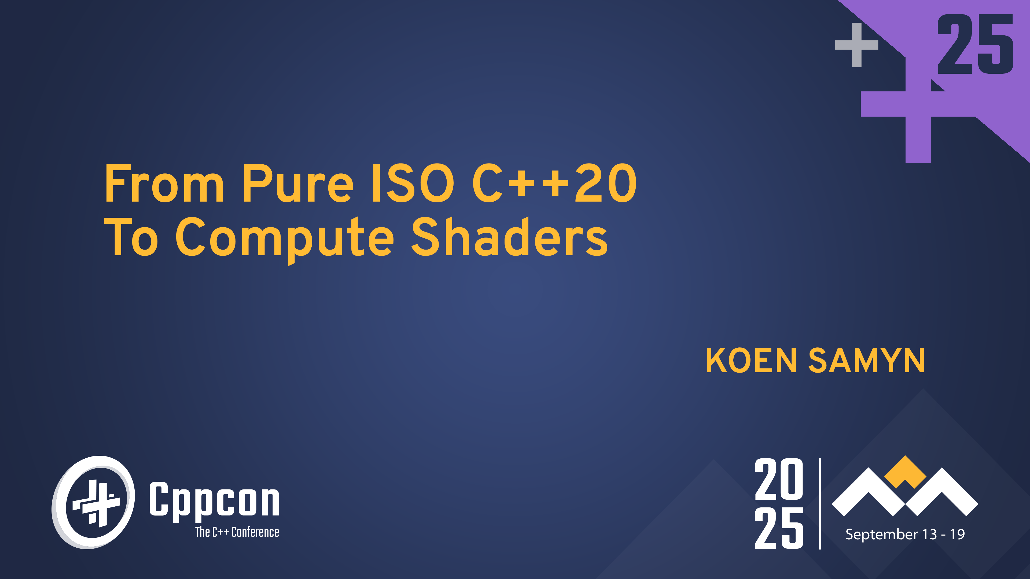

Slide 2
About me
Koen Samyn
Program Coordinator Game Development at DAE

Slide 3
Why this project?
Mental load to develop compute shaders is heavy
Still developing C++ skills.
Management layer needed for GPU resources.
Debugging GPU programs is hard.
Programming model is different
Workgroups / threads
Homogeneous parallelism: every thread performs the same task
Existing C++ code can be hard to convert

Slide 4
Is this new?
A lof of movement in this area and existing frameworks
CUDA /HIP
SyCL
CompuShady (Python)
Slang
Niche I am trying to fill:
Non-proprietary
Lightweight
Educational focus: teach transferable skills.
Focus on techniques that are transferable to graphics programming shaders: vertex/fragment/mesh shaders

Slide 5
Design goals
Start with C++20 → no new keywords
Close mapping with GPU parallelism
Workgroups/threads
Equivalence between CPU and GPU execution

Slide 6
Overview
C++ Design
Validation
(Clang/AST)
Transpilation
(Clang/AST)
GLSLangValidator
Emulation of GLSL capabilities:
Vector math (swizzles!)
Buffers/Images/Uniforms
Image format conversions
Workgroups/Threads
Unsupported C++ syntax (e.g. new/delete)
Rewriter API
Error/warning report
Export to GLSL
Error/warning report
Error/warning report (packing)
Backend system:
CPU
GPU

Slide 7
Cases
Adding two vectors of floats
Game of life
Raytracing

Slide 8
Case 1: Adding floats – Compute Shader
1
#version 430
Compute shader compatible with OpenGL version 4.3
2
3
4
5
6
7
8
9
10
11
12
13
14
15

Slide 9
Case 1: Adding floats – Compute Shader
1
#version 430
Workgroup size → defines the number of threads that will be created for one workgroup.
2
layout(local_size_x = 256) in;
3
4
5
6
7
8
9
10
11
12
13
14
15

Slide 10
Case 1: Adding floats – Compute Shader
1
#version 430
2
layout(local_size_x = 256) in;
3
layout( binding = 0 ) readonly buffer InA {
InA
R
0
4
5
};
6
7
8
9
10
11
12
13
14
15

Slide 11
Case 1: Adding floats – Compute Shader
1
#version 430
2
layout(local_size_x = 256) in;
3
layout( binding = 0 ) readonly buffer InA {
InA
R
0
4
float A[];
5
};
float A[];
6
7
8
9
10
11
12
13
14
15

Slide 12
Case 1: Adding floats – Compute Shader
1
#version 430
2
layout(local_size_x = 256) in;
3
layout( binding = 0 ) readonly buffer InA {
InA
InB
R
0
R
1
4
float A[];
5
};
float A[];
float B[];
6
layout( binding = 1 ) readonly buffer InB {
7
float B[];
8
};
9
10
11
12
13
14
15

Slide 13
Case 1: Adding floats – Compute Shader
1
#version 430
2
layout(local_size_x = 256) in;
3
layout( binding = 0 ) readonly buffer InA {
InA
InB
R
0
R
1
4
float A[];
5
};
float A[];
float B[];
6
layout( binding = 1 ) readonly buffer InB {
7
float B[];
8
};
9
layout( binding = 2 ) writeonly buffer OutC {
10
float C[];
11
};
12
13
InC
W
2
14
15
float C[];

Slide 14
Case 1: Adding floats – Compute Shader
1
#version 430
2
layout(local_size_x = 256) in;
3
layout( binding = 0 ) readonly buffer InA {
InA
InB
R
0
R
1
4
float A[];
5
};
float A[];
float B[];
6
layout( binding = 1 ) readonly buffer InB {
7
float B[];
8
};
main
9
layout( binding = 2 ) writeonly buffer OutC {
Compute
Kernel
10
float C[];
11
};
12
void main() {
13
InC
W
2
14
15
};
float C[];

Slide 15
Case 1: Adding floats – Compute Shader
1
#version 430
2
layout(local_size_x = 256) in;
3
layout( binding = 0 ) readonly buffer InA {
InA
InB
R
0
R
1
4
float A[];
5
};
float A[];
float B[];
6
layout( binding = 1 ) readonly buffer InB {
7
float B[];
8
};
main
9
layout( binding = 2 ) writeonly buffer OutC {
10
float C[];
11
};
12
Thread ID: can be used as index into arrays A,B and C
void main() {
13
uint i = gl_GlobalInvocationID.x;
InC
W
2
14
15
};
float C[];

Slide 16
Case 1: Adding floats – Compute Shader
1
#version 430
2
layout(local_size_x = 256) in;
3
layout( binding = 0 ) readonly buffer InA {
InA
InB
R
0
R
1
4
float A[];
5
};
float A[];
float B[];
6
layout( binding = 1 ) readonly buffer InB {
7
float B[];
8
};
A[i]
B[i]
main
9
layout( binding = 2 ) writeonly buffer OutC {
10
float C[];
11
};
C[i]
12
void main() {
13
uint i = gl_GlobalInvocationID.x;
InC
W
2
14
C[i] = A[i] + B[i];
15
};
float C[];

Slide 17
Case 1: C++ equivalent
1
#include "vec.hpp"
vec.hpp : for vector types: uvecn, ivecn, vecn, dvecn, nvecn
2
3
struct [[clang::annotate("kernel")]] FloatAdder
4
{
Kernel annotation: clang annotation to find kernels in the AST (see further)
5
6
7
8
9
10
11
12
13
14
};
C++ Design

Slide 18
Case 1: C++ equivalent
1
#include "vec.hpp"
2
3
struct [[clang::annotate("kernel")]] FloatAdder
4
{
5
static constexpr char fileLocation[] = “floatadder";
Where to store the generated glsl file.
6
7
8
9
10
11
12
13
14
};
C++ Design

Slide 19
Case 1: C++ equivalent
1
#include "vec.hpp"
2
3
struct [[clang::annotate("kernel")]] FloatAdder
4
{
5
static constexpr char fileLocation[] = “floatadder";
6
uvec3 local_size{ 256, 1, 1 };
Corresponds with :
7
layout(local_size_x = 256) in;
8
9
10
11
12
13
14
};
C++ Design

Slide 20
Case 1: C++ equivalent
BufferBinding<float,0>;
BufferBinding<float,1>;
1
#include "vec.hpp"
_A
_B
2
#include "computebackend.hpp"
R
0
R
1
3
struct [[clang::annotate("kernel")]] FloatAdder
BufferResource<float>A;
BufferResource<float>B;
4
{
5
static constexpr char fileLocation[] = “floatadder";
6
uvec3 local_size{ 256, 1, 1 };
7
BufferBinding< float , 0> A;
8
BufferBinding< float , 1> B;
9
BufferBinding< float , 2> C;
10
_C
W
2
11
12
BufferResource<float>C;
13
14
};
BufferBinding<float,2>;
C++ Design

Slide 21
Case 1: C++ equivalent
BufferBinding<float,0>;
BufferBinding<float,1>;
1
#include "vec.hpp"
_A
_B
2
#include "computebackend.hpp"
R
0
R
1
3
struct [[clang::annotate("kernel")]] FloatAdder
BufferResource<float>A;
BufferResource<float>B;
4
{
5
static constexpr char fileLocation[] = “floatadder";
6
uvec3 local_size{ 256, 1, 1 };
BufferBinding< float , 0> A;
7
BufferBinding< float , 0> A;
main
8
BufferBinding< float , 1> B;
9
BufferBinding< float , 2> C;
10
void main() {
11
12
_C
13
}
W
2
14
};
BufferResource<float>C;
C++ Design
BufferBinding<float,2>;

Slide 22
Case 1: C++ equivalent
BufferBinding<float,0>;
BufferBinding<float,1>;
1
#include "vec.hpp"
_A
_B
2
#include "computebackend.hpp"
R
0
R
1
3
struct [[clang::annotate("kernel")]] FloatAdder
BufferResource<float>A;
BufferResource<float>B;
4
{
5
static constexpr char fileLocation[] = “floatadder";
6
uvec3 local_size{ 256, 1, 1 };
BufferBinding< float , 0> A;
A[i]
B[i]
7
main
8
BufferBinding< float , 1> B;
9
BufferBinding< float , 2> C;
10
void main() {
C[i]
11
tc::uint i = tc::gl_GlobalInvocationID.x;
12
C[i] = A[i] + B[i];
_C
13
}
W
2
14
};
BufferResource<float>C;
C++ Design
BufferBinding<float,2>;

Slide 23
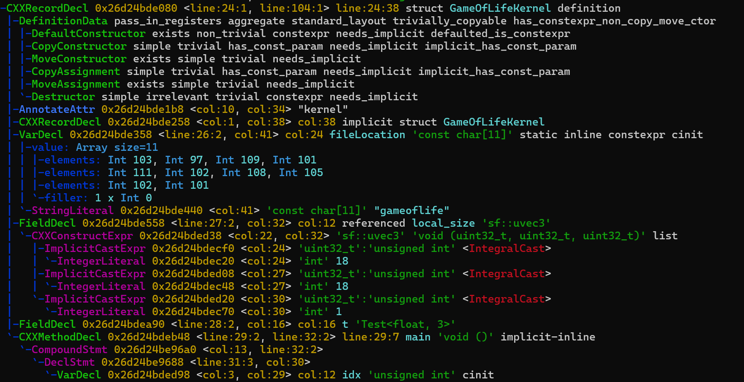
Case 1 : Validation
Clang 22.0 : matchers and visitors
Custom C++ tool called via CMake
Validation
(Clang/AST)

Slide 24
Find kernel structs via matchers
auto kernelStructMatcher = cxxRecordDecl(
isDefinition(),
).bind("kernelStruct");
1
#include "vec.hpp"
2
#include "computebackend.hpp"
hasAttr(attr::Annotate),
3
struct [[clang::annotate("kernel")]] FloatAdder
hasMethod(
cxxMethodDecl(hasName("main"))
)
4
{
5
static constexpr char fileLocation[] = “floatadder";
6
uvec3 local_size{ 256, 1, 1 };
hasDescendant(
varDecl(
hasName("fileLocation"),
isConstexpr()
).bind("fileLocation")
),
7
BufferBinding< float , 0> A;
8
BufferBinding< float , 1> B;
9
BufferBinding< float , 2> C;
10
void main() {
11
tc::uint i = tc::gl_GlobalInvocationID.x;
hasDescendant(
fieldDecl(
hasName("local_size")
).bind("localSizeVar")
),
12
C[i] = A[i] + B[i];
13
}
14
};
Validation
(Clang/AST)

Slide 25
Clang validation
C++ AST library
Visit methods
VisitFieldDecl(clang::FieldDecl* FD)
VisitCXXNewExpr(clang::CXXNewExpr* E)
…
Report errors back to the IDE
Note: only look within the found kernel structs
Validation
(Clang/AST)

Slide 26
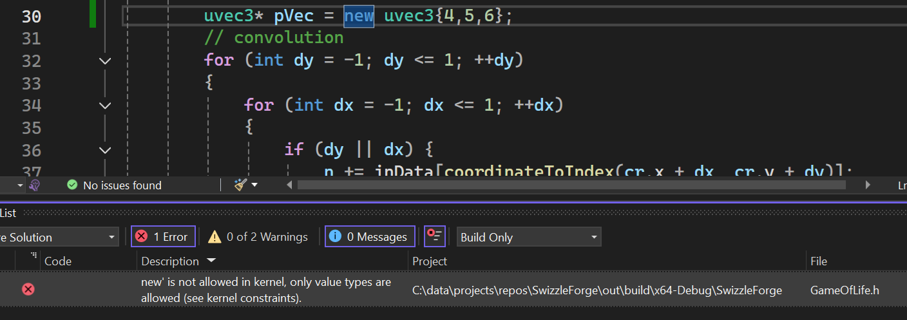
Clang validation – example 1
bool VisitCXXNewExpr(clang::CXXNewExpr* E){
llvm::errs()
<< E->getBeginLoc().printToString(Context.getSourceManager())
<< " Error: 'new' is not allowed in kernel, only value types are allowed.\n";
reportError(E->getBeginLoc(), dynamicMemory);
Valid = false;
return true;
}
Validation
(Clang/AST)

Slide 27
Case 1: Transpilation
#include "vec.hpp"
#version 430
#include "computebackend.hpp"
layout (
local_size_x = 256,
local_size_y = 1,
local_size_z = 1)
in;
struct [[clang::annotate("kernel")]] FloatAdder
{
static constexpr char fileLocation[] = “…";
uvec3 local_size{ 256, 1, 1 };
layout(set = 0, binding = 0) buffer _ALayout {
float A[];
};
BufferBinding< float , 0> A;
BufferBinding< float , 1> B;
layout(set = 0, binding = 1) buffer _BLayout {
float B[];
};
BufferBinding< float , 2> C;
void main() {
tc::uint i = tc::gl_GlobalInvocationID.x;
layout(set = 0, binding = 2) buffer _CLayout {
float C[];
};
C[i] = A[i] + B[i];
}
};
void main() {
uint i = gl_GlobalInvocationID.x;
Transpilation
(Clang/AST)
C[i] = A[i] + B[i];
}

Slide 28
Case 1: Usage
using Backend = tc::gpu::GPUBackend;
Backend compute;

Slide 29
Case 1: Usage
using Backend = tc::gpu::GPUBackend;
Backend compute;
With the definitions for m_pA, m_pB and m_pC given as:
compute.uploadBuffer(m_pA.get());
compute.uploadBuffer(m_pB.get());
compute.uploadBuffer(m_pC.get());
std::unique_ptr<tc::BufferResource<float>> m_pA;
std::unique_ptr<tc::BufferResource<float>> m_pB;
std::unique_ptr<tc::BufferResource<float>> m_pC;
CPU Memory
upload
GPU Memory
BufferResource<float>A;
float B[];
52
BufferResource<float>B;
float A[];
53
BufferResource<float>C;
float C[];
54
Note : use renderdoc

Slide 30
Case 1: Usage
using Backend = tc::gpu::GPUBackend;
Backend compute;
GPU Memory
float A[];
52
compute.uploadBuffer(m_pA.get());
compute.uploadBuffer(m_pB.get());
compute.uploadBuffer(m_pC.get());
float B[];
53
_A
_B
float C[];
54
0
1
compute.useKernel(m_FloatAdder);
A
B
main
_C
C
2

Slide 31
Case 1: Usage
using Backend = tc::gpu::GPUBackend;
Backend compute;
GPU Memory
float A[];
52
compute.uploadBuffer(m_pA.get());
compute.uploadBuffer(m_pB.get());
compute.uploadBuffer(m_pC.get());
float B[];
53
_A
_B
float C[];
54
0
1
compute.useKernel(m_FloatAdder);
A
B
main
compute.bindBuffer(m_FloatAdder.A);
compute.bindBuffer(m_FloatAdder.B);
_C
compute.bindBuffer(m_FloatAdder.C);
C
2

Slide 32
Case 1: Usage
using Backend = tc::gpu::GPUBackend;
Backend compute;
GPU Memory
float A[];
52
compute.uploadBuffer(m_pA.get());
compute.uploadBuffer(m_pB.get());
compute.uploadBuffer(m_pC.get());
float B[];
53
_A
_B
float C[];
54
0
1
compute.useKernel(m_FloatAdder);
A
B
main
compute.bindBuffer(m_FloatAdder.A);
compute.bindBuffer(m_FloatAdder.B);
_C
compute.bindBuffer(m_FloatAdder.C);
C
compute.execute(m_FloatAdder, tc::uvec3{ N,1,1 });
2

Slide 33
Case 1: Usage
CPU Memory
BufferResource<float>A;
BufferResource<float>B;
BufferResource<float>C;
using Backend = tc::gpu::GPUBackend;
Backend compute;
GPU Memory
float A[];
52
compute.uploadBuffer(m_pA.get());
compute.uploadBuffer(m_pB.get());
compute.uploadBuffer(m_pC.get());
float B[];
53
_A
_B
float C[];
54
0
1
compute.useKernel(m_FloatAdder);
A
B
main
compute.bindBuffer(m_FloatAdder.A);
compute.bindBuffer(m_FloatAdder.B);
_C
compute.bindBuffer(m_FloatAdder.C);
C
compute.execute(m_FloatAdder, tc::uvec3{ N,1,1 });
2
compute.downloadBuffer(m_pC.get());

Slide 34
Case 1: Usage
using Backend = tc::cpu::CPUBackend;
Backend compute;
CPU Memory
BufferResource<float>A;
compute.uploadBuffer(m_pA.get());
compute.uploadBuffer(m_pB.get());
compute.uploadBuffer(m_pC.get());
BufferResource<float>B;
BufferResource<float>C;
compute.useKernel(m_FloatAdder);
Everything is already in the correct memory space → log error if buffer not bound
compute.bindBuffer(m_FloatAdder.A);
compute.bindBuffer(m_FloatAdder.B);
compute.bindBuffer(m_FloatAdder.C);
compute.execute(m_FloatAdder, tc::uvec3{ N,1,1 });
compute.downloadBuffer(m_pC.get());

Slide 35
Case 2 : Game of life
0
1
2
3
4
5
6
7
8
9
10
11
12
13
14
15
Image
Source Formats
External type
Destination Formats
Internal type
GLSL Image operations
imageLoad
ImageStore
0
1
2
3
4
5
6
7
8
9
10
11
12
13
14
15

Slide 36

ImageLoad - GLSL
1D
2D
_
_
3D
int
i
i
vec4
imageLoad(
image
2DRect
,
ivec2
)
u
u
Cube
ivec3
Buffer
1DArray
2DArray
CubeArray
27 combinations!

Slide 37
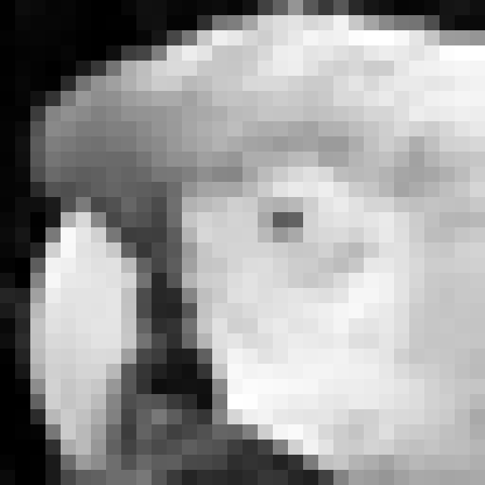
But wait! There’s more
Source: grayscale , uint8_t (R8)
Destination: image2D , RGBA float
vec4
/255.0f
R
92
0.36
R
G
0
0
G
B
0
0
B
A
255
1
A
External Format
Internal Format

Slide 38
Images in GLSL
1
#version 430
layout (local_size_x = 16, local_size_y = 16, local_size_z = 1) in;
2
3
layout(binding=0, r8ui ) uniform uimage2D inData;
Internal format
4
layout(binding=1, r8ui ) uniform uimage2D outData;
5
void main()
{
6
7
uvec4 pixelIn = imageLoad( inData, coordinate );
8
// convolution
9
imageStore( outData, uvec4(1,0,0,0) );
10
}

Slide 39
imageLoad – C++
Source ( i.e. external format )
Channels: R, RGB, RA, RGBA
Type: uint8_t, int8_t, float, float unorm, float snorm, …
Dimension
1D, 2D, 3D
Destination ( i.e internal format )
Channels: R, RGB, RA, RGBA, …
Type: uint8_t, int8_t, float, float unorm, float snorm, …
Conversions
float unorm → uint8_t
int8_t → float snorm
…
Templates
Traits
if constexpr
Can we create one version of the imageLoad free function?
C++ Design

Slide 40

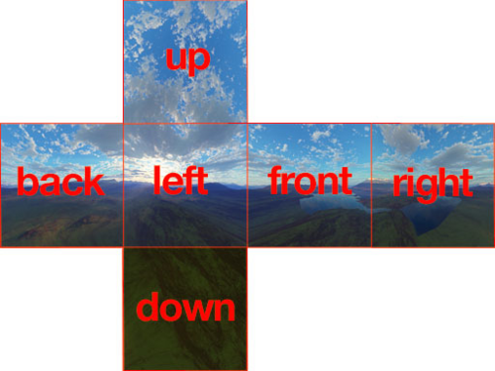
imageLoad – C++
Dimension
External format (channels +type)
Internal format (channels +type)
1D
R
UInt
Convert/Pad
R
UNorm
2D
G
UInt
G
UNorm
B
UInt
B
UNorm
Templates
Traits
if constexpr
A
A
1
3D
Can we create one version of the imageLoad free function?
C++ Design
Without runtime branching ?

Slide 41
imageLoad - BufferResource
template<typename T, Dim D = Dim::D1>
BufferResource
BufferResource(dimType bufferSize)
:m_Data( )
{
}
D
dimType
/* bufferSize (nD) → size */
D1
int32_t
D2
ivec2
const T& operator[](dimType index) const
{
return m_Data[ ];
}
D3
ivec3
/* index (nD) → 1D */
GLSL: signed int is type used in imageLoad
private:
dimType m_BufferSize;
std::vector<T> m_Data;
1D
C++ Design

Slide 42
Dimension - Traits
enum class Dim : uint8_t {
D1 = 1,
D2 = 2,
D3 = 3
};
template<Dim D>
struct DimTraits;
1
template<>
struct DimTraits<
2
Dim::D1
> {
int32_t;
3
using IndexType =
4
static constexpr int32_t flatten( IndexType coord, IndexType /*size*/) {
5
return coord;
6
}
7
static constexpr int32_t product( IndexType d ) {
8
return d;
9
}
10
};
C++ Design

Slide 43
Dimension – 2D
enum class Dim : uint8_t {
D1 = 1,
D2 = 2,
D3 = 3
};
template<Dim D>
struct DimTraits;
1
template<>
struct DimTraits<
2
Dim::D2
> {
ivec2;
3
using IndexType =
4
static constexpr int32_t flatten( IndexType c, IndexType size ) {
5
return c.y * size.x + c.x;
6
}
7
static constexpr int32_t product( IndexType d ) {
8
return d.x * d.y;
9
}
10
};
C++ Design

Slide 44
Dimension – 3D
enum class Dim : uint8_t {
D1 = 1,
D2 = 2,
D3 = 3
};
template<Dim D>
struct DimTraits;
1
template<>
struct DimTraits<
2
Dim::D3
> {
ivec3;
3
using IndexType =
4
static constexpr int32_t flatten( IndexType c, IndexType size ) {
5
return (coord.z * size.y + coord.y) * size.x + coord.x;
6
}
7
static constexpr int32_t product( IndexType d ) {
8
return d.x * d.y * d.z;
9
}
10
};
C++ Design

Slide 45
imageLoad - BufferResource
template<typename T, Dim D = Dim::D1>
BufferResource public:
using dimType = typename Traits::IndexType;
BufferResource(dimType bufferSize)
:m_Data( )
{
}
Traits::product(bufferSize)
const T& operator[](dimType index) const
{
return m_Data[ ];
}
Traits::flatten(index)
private:
using Traits = DimTraits<D>;
dimType m_BufferSize;
C++ Design
std::vector<T> m_Data;

Slide 46
imageLoad – external format
Channels
R
R
R
B
R
B
G
G
G
G
G
B
R
B
R
A
A
Semantics
Literal float or integer
Signed normal [-1,1]
Unsigned normal [0,1]
_INTEGER
Representation
uint8_t
int8_t
uint16_t
int16_t
float16_t
…
C++23!
Packing
…
R
8 bits
R
5 bits
R
10 bits
G
8 bits
G
6 bits
G
10 bits
B
8 bits
B
5 bits
B
10 bits
A
8 bits
A
2 bits
C++ Design

Slide 47
Pixel concept
1
using namespace tc;
2
enum class Channel{ R=0, G=1, B=2, A=3 };
3
4
RGB8 px{ 0.2, 0.3, 0.5 };
R
0.2
5
G
0.3
float r = px.get<Channel::R>();
6
B
0.5
float g = px.get<Channel::G>();
7
float b = px.get<Channel::B>();
8
float a = px.get<Channel::A>();
Padded value
A
1.0
9
10
EXPECT_EQ(r, 0.2);
11
EXPECT_EQ(g, 0.3);
Simple pixel: r, g and b have the same type → float
12
EXPECT_EQ(b, 0.5);
13
EXPECT_EQ(a, 1.0);
C++ Design

Slide 48
Pixel concept
using r_t = tc::cpu::RGB8::ChannelType<Channel::R>;
R
0.2
G
0.3
using g_t = tc::cpu::RGB8::ChannelType<Channel::G>;
B
0.5
using b_t = tc::cpu::RGB8::ChannelType<Channel::B>;
using a_t = tc::cpu::RGB8::ChannelType<Channel::A>;
It is possible to have a different type for each channel.
C++ Design

Slide 49
Pixel Concept
template<class P, Channel C>
concept ChannelConcept = requires(P p) {
typename P::template ChannelType<C>;
{ p.template get<C>() }
-> std::convertible_to<typename P::template ChannelType<C>>;
{ p.template set<C>( p.template get<C>() ) };
};
template<class P>
concept PixelConcept =
ChannelConcept<P, Channel::R> &&
ChannelConcept<P, Channel::G> &&
ChannelConcept<P, Channel::B> &&
ChannelConcept<P, Channel::A>;
C++ Design

Slide 50
Conversions
External format (channels +type)
Internal format (channels +type)
R
UInt
Convert/Pad
R
UNorm
G
UInt
G
UNorm
template<class Src, class Dst>
struct ChannelConverter;
B
UInt
B
UNorm
A
A
1
template<class T>
struct ChannelConverter<T, T> {
static constexpr T apply(T v) noexcept { return v; }
};
template<>
struct ChannelConverter<std::uint8_t, float> {
static constexpr float apply(std::uint8_t v) noexcept {
return float(v) * (1.0f / 255.0f);
}
};
C++ Design

Slide 51
ImageBinding
Reminder:
1
#version 430
layout (local_size_x = 16, local_size_y = 16, local_size_z = 1) in;
_C
2
W
2
3
layout(binding=0, r8ui ) uniform uimage2D inData;
BufferResource<float>C;
4
layout(binding=1, r8ui ) uniform uimage2D outData;
BufferBinding<float,2>;
5
void main()
{
6
7
uvec4 pixelIn = imageLoad( inData, coordinate );
8
// convolution
9
imageStore( outData, uvec4(1,0,0,0) );
10
}
ImageBinding< , , , >;
r8ui
r8ui
inData
D2
W
0
0
BufferResource<r8ui,D2> pixelData;
C++ Design

Slide 52
Vertical slice – Conway’s game of life
From quadruple for loop to compute shader
Rules for game of life:
Any cell with 3 neighbours → stays alive or is born
A live cell with 2 neighbours → stays alive
Any other case → cell dies
0
1
2
3
4
5
6
7
8
9
10
11
12
13
14
15
0
1
2
3
4
5
6
7
8
9
10
11
12
13
14
15

Slide 53
Vertical slice – Conway’s game of life
0
1
2
3
4
5
6
7
8
9
10
11
12
13
14
15
0
1
2
3
4
5
6
7
8
9
10
11
12
13
14
15
0
0
?
1
1
2
2
3
3
4
4
5
5
6
6
7
7
?
8
8
9
9
10
10
11
11
12
12
13
13
14
14
15
15

Slide 54
Part 1 : Bridging the gap
C++ Design
Validation
(Clang/AST)
Transpilation
(Clang/AST)
GLSLangValidator
Emulation of GLSL capabilities:
Buffers/Images/Uniforms
Workgroups/Threads

Slide 55
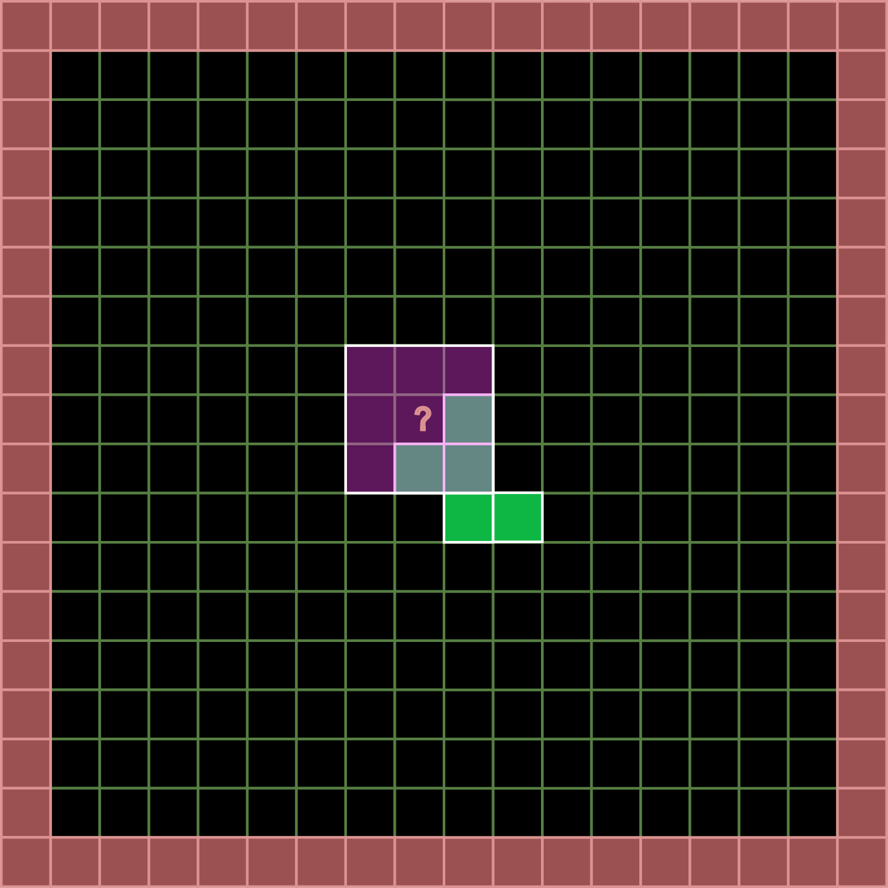
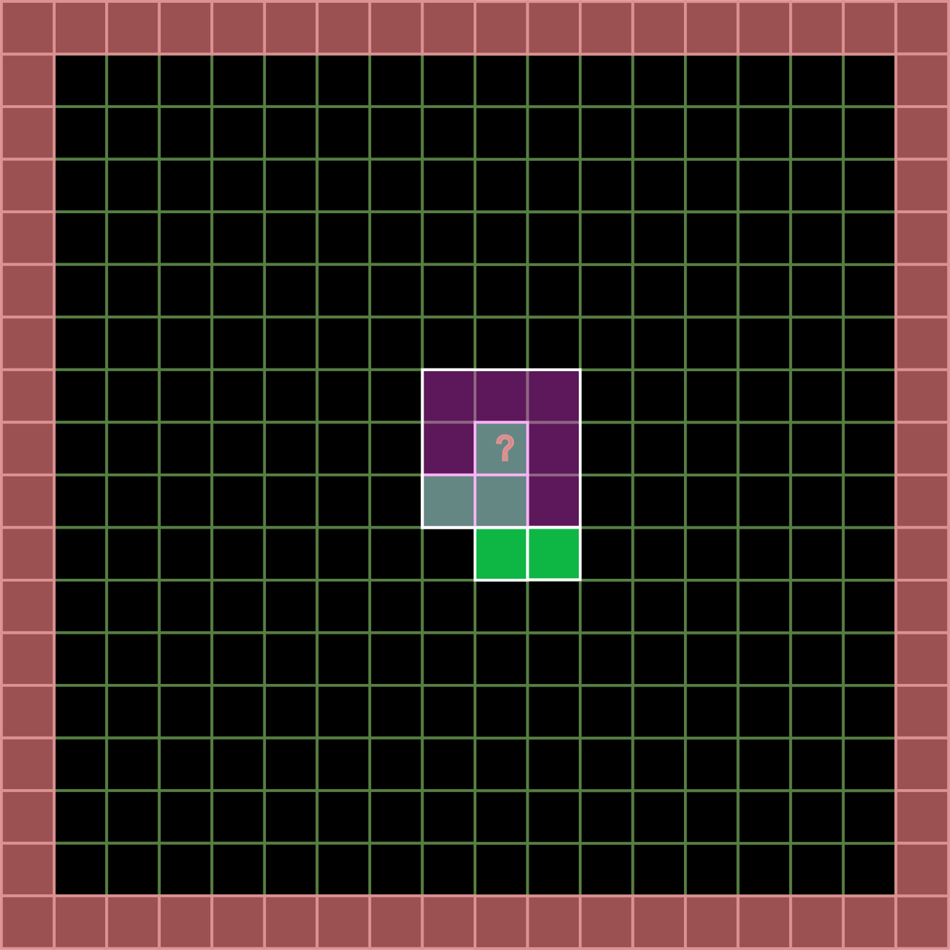
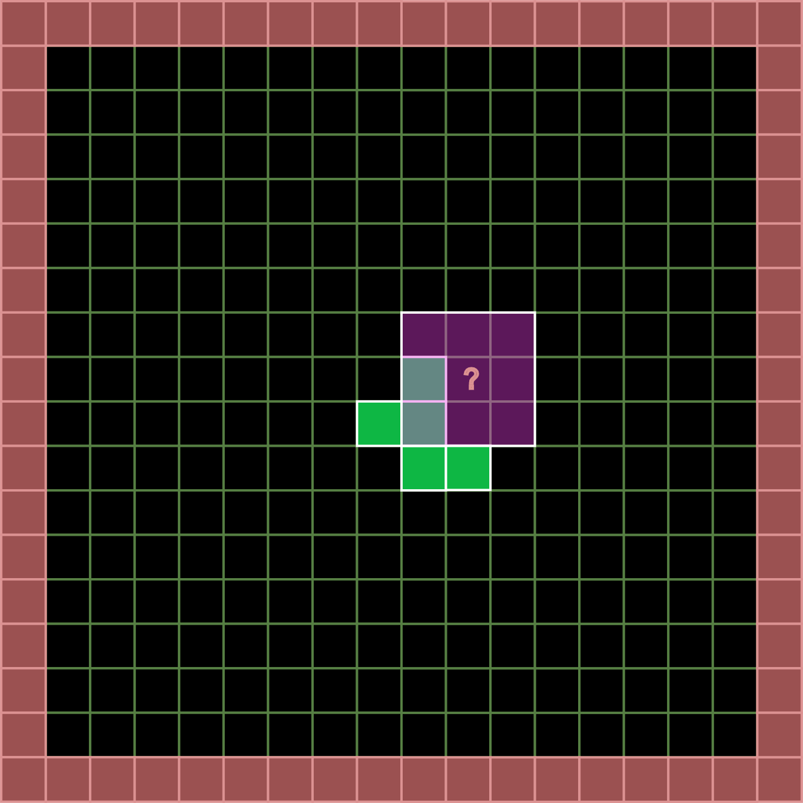
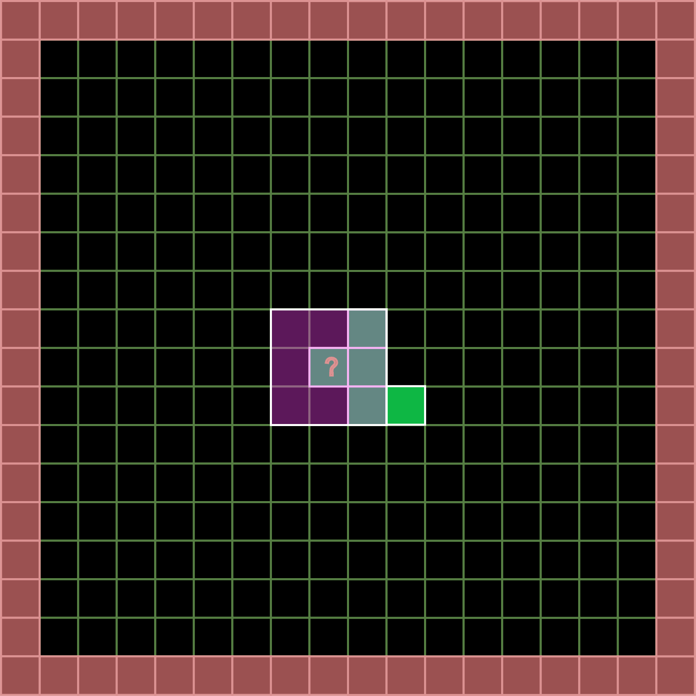
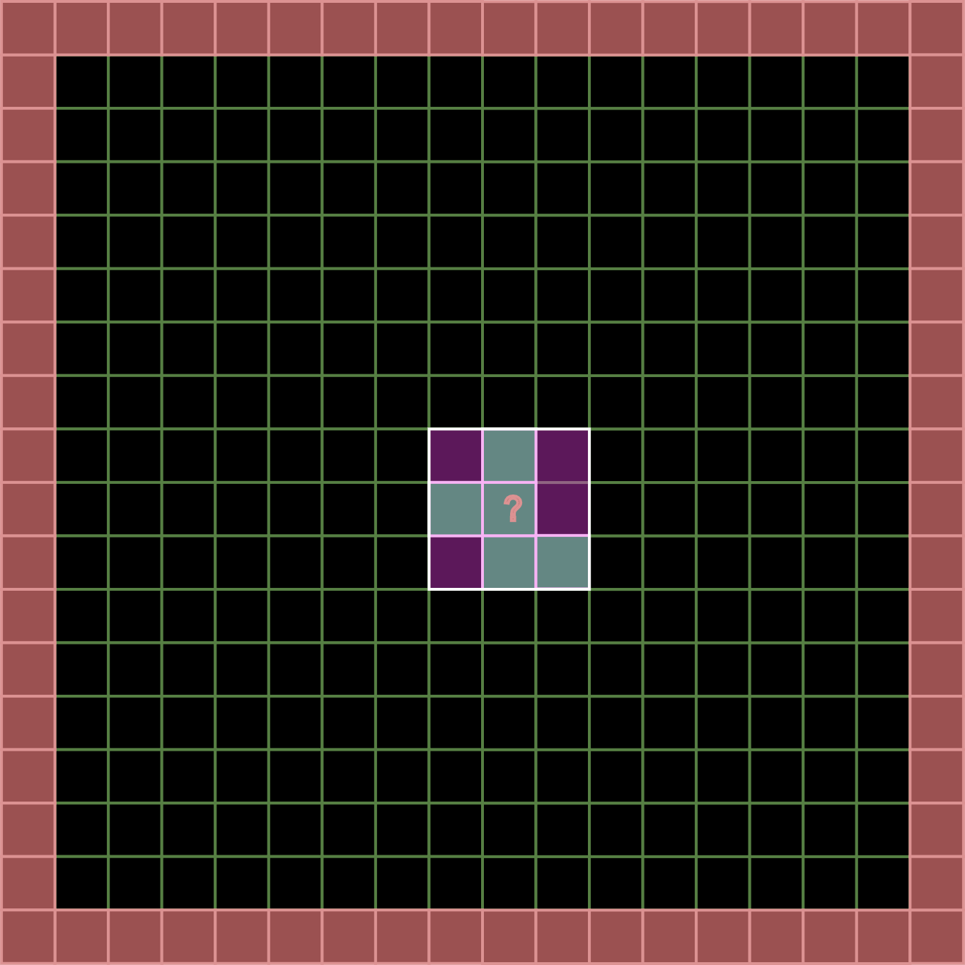
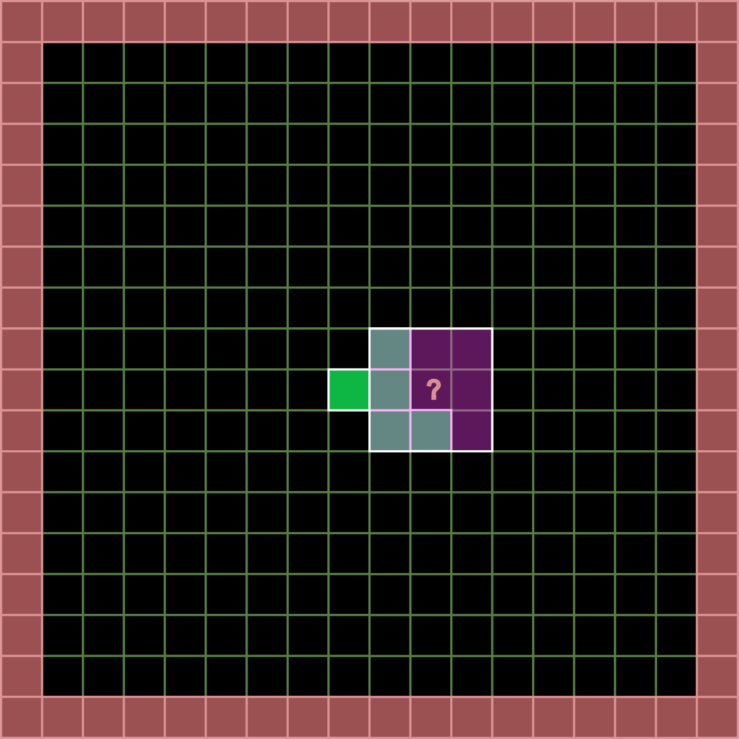
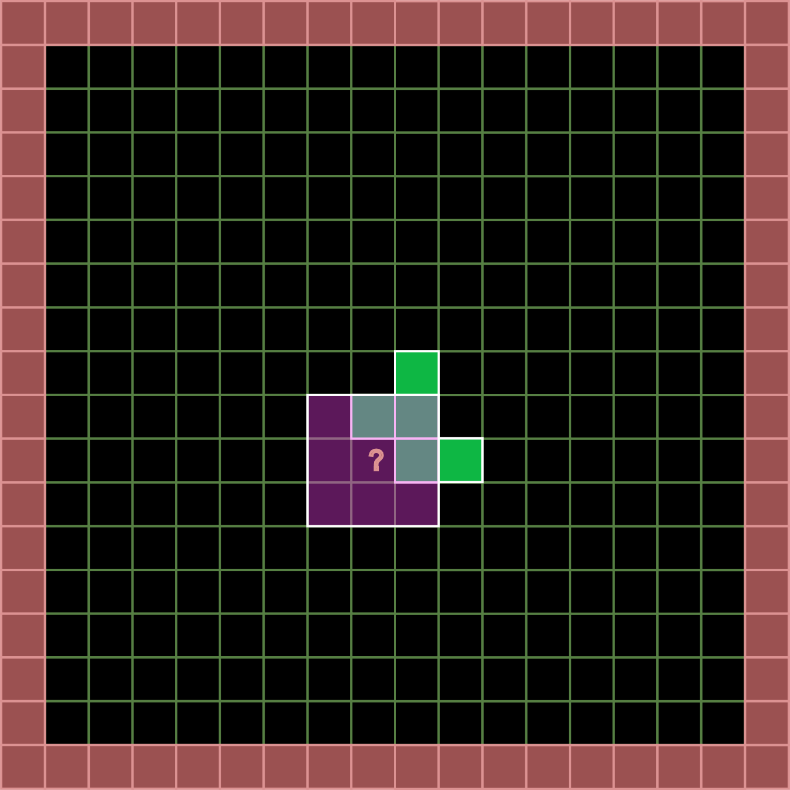
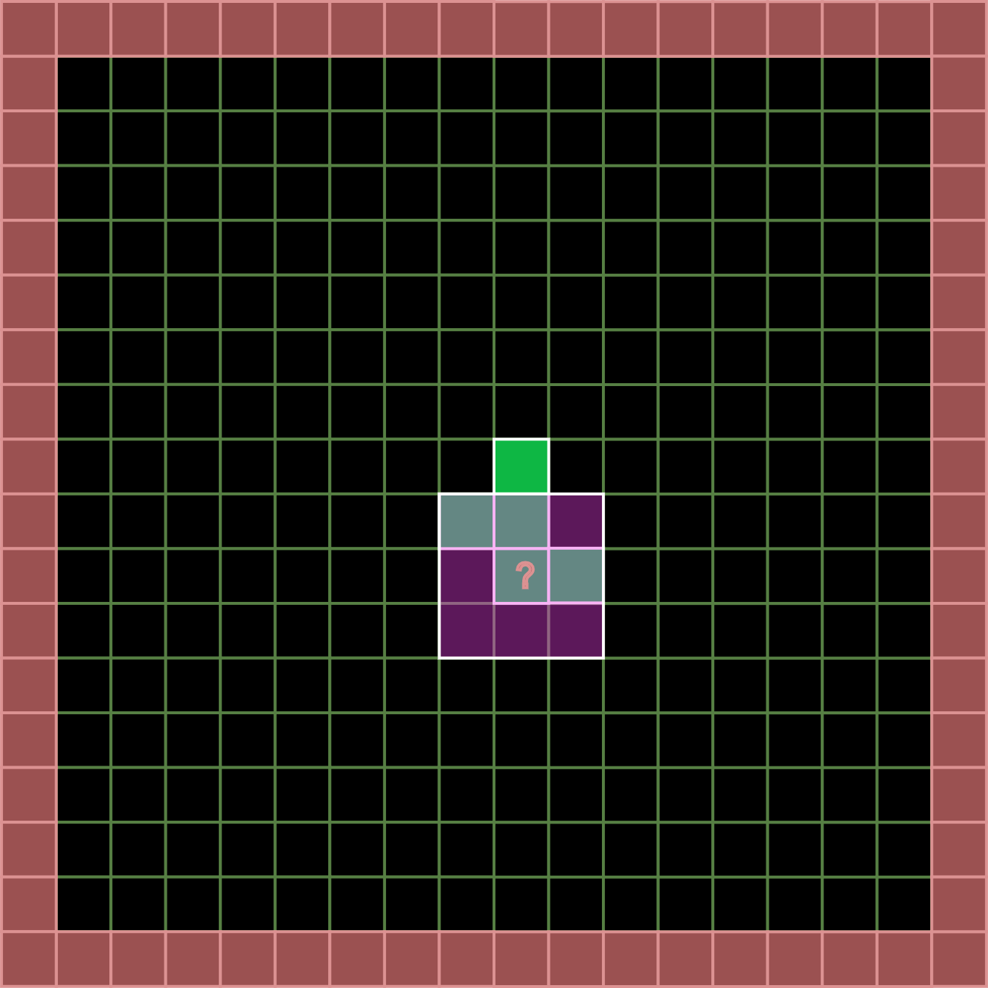
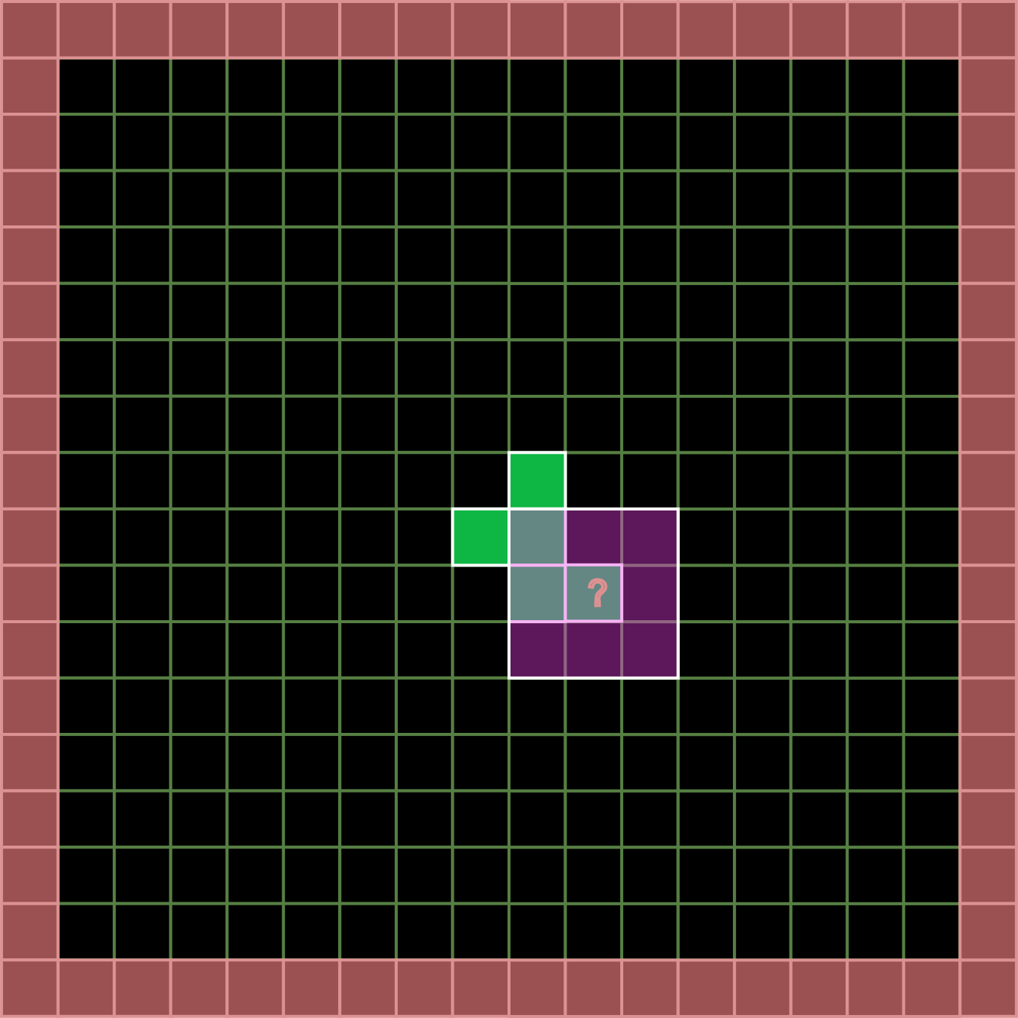
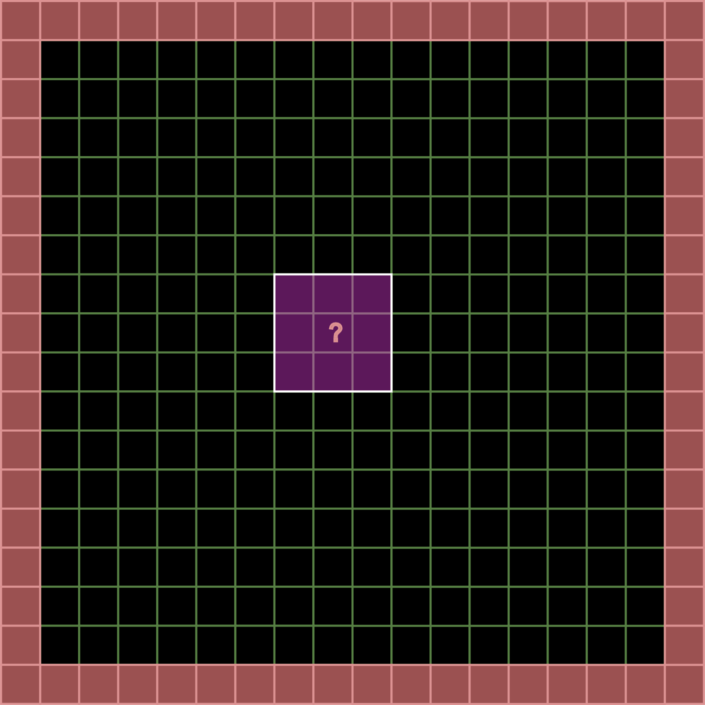
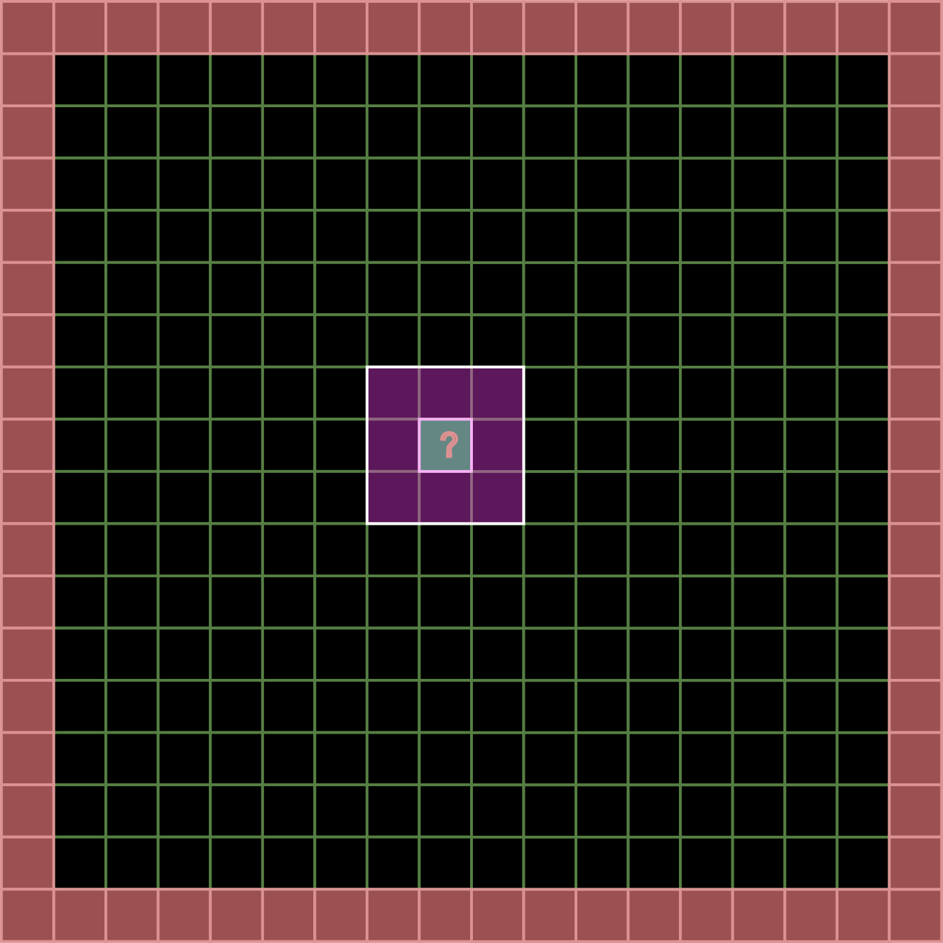
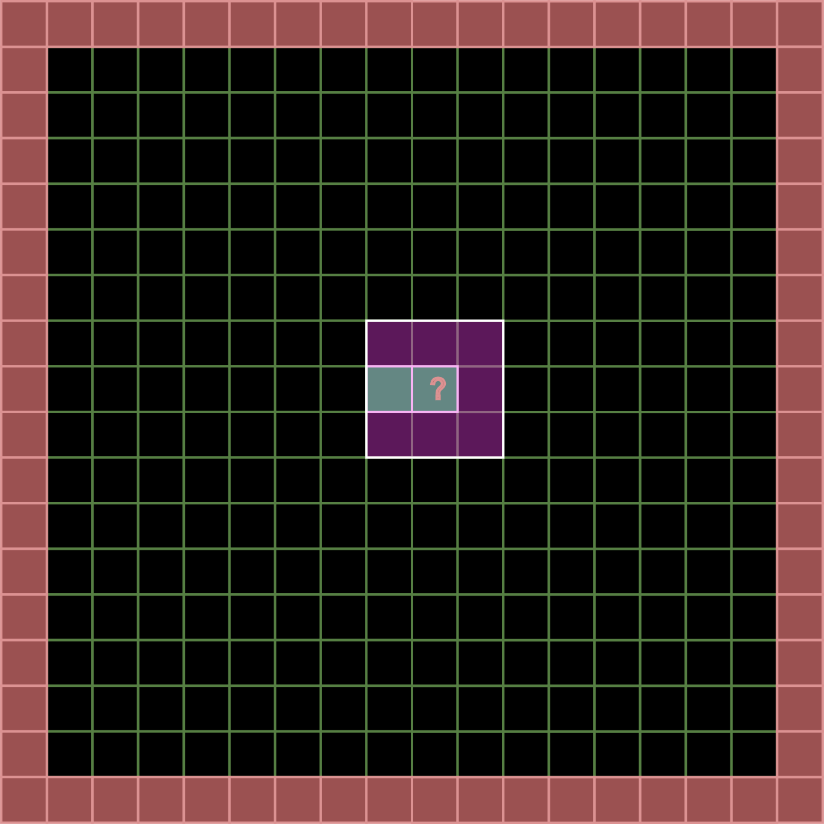
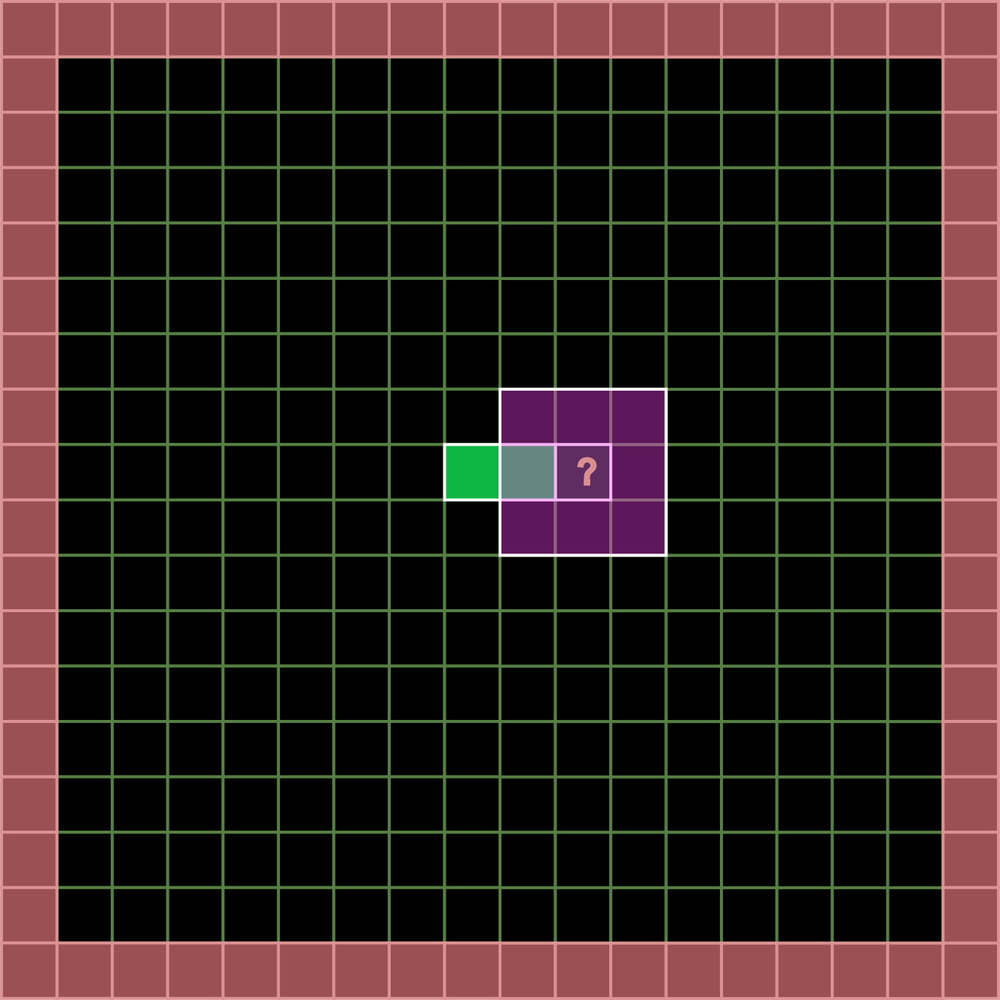
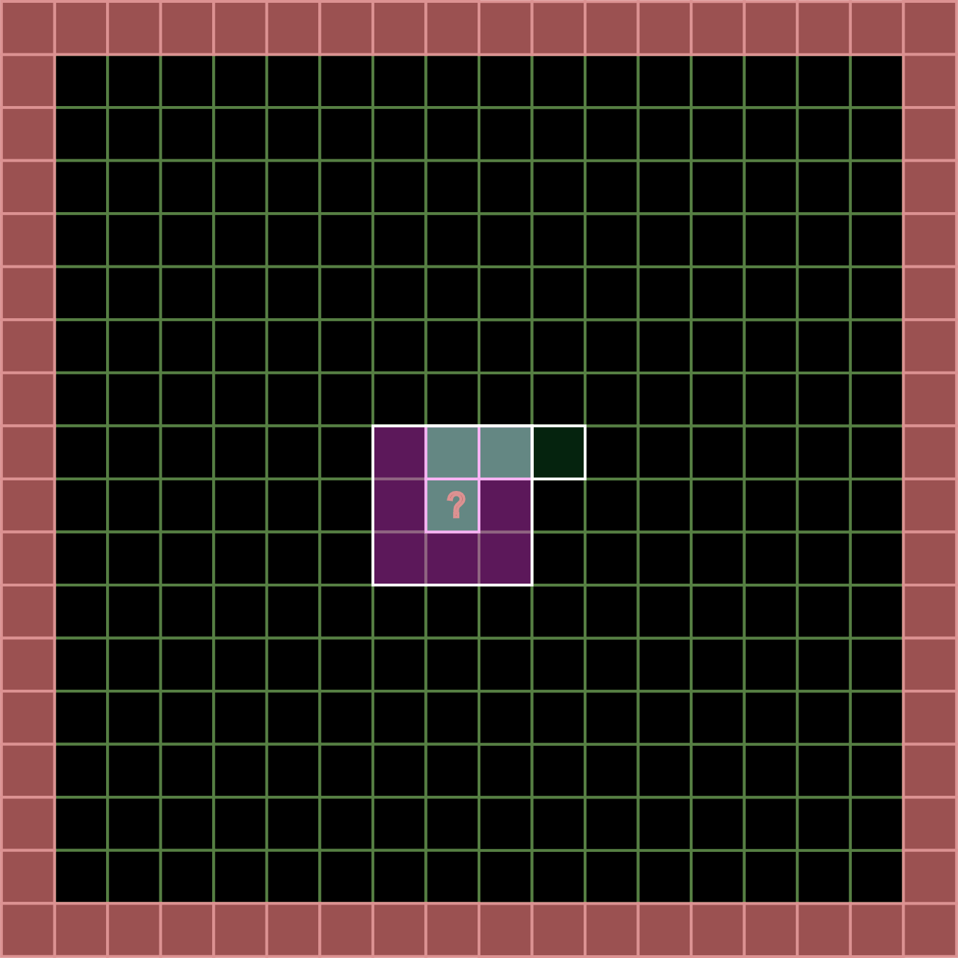
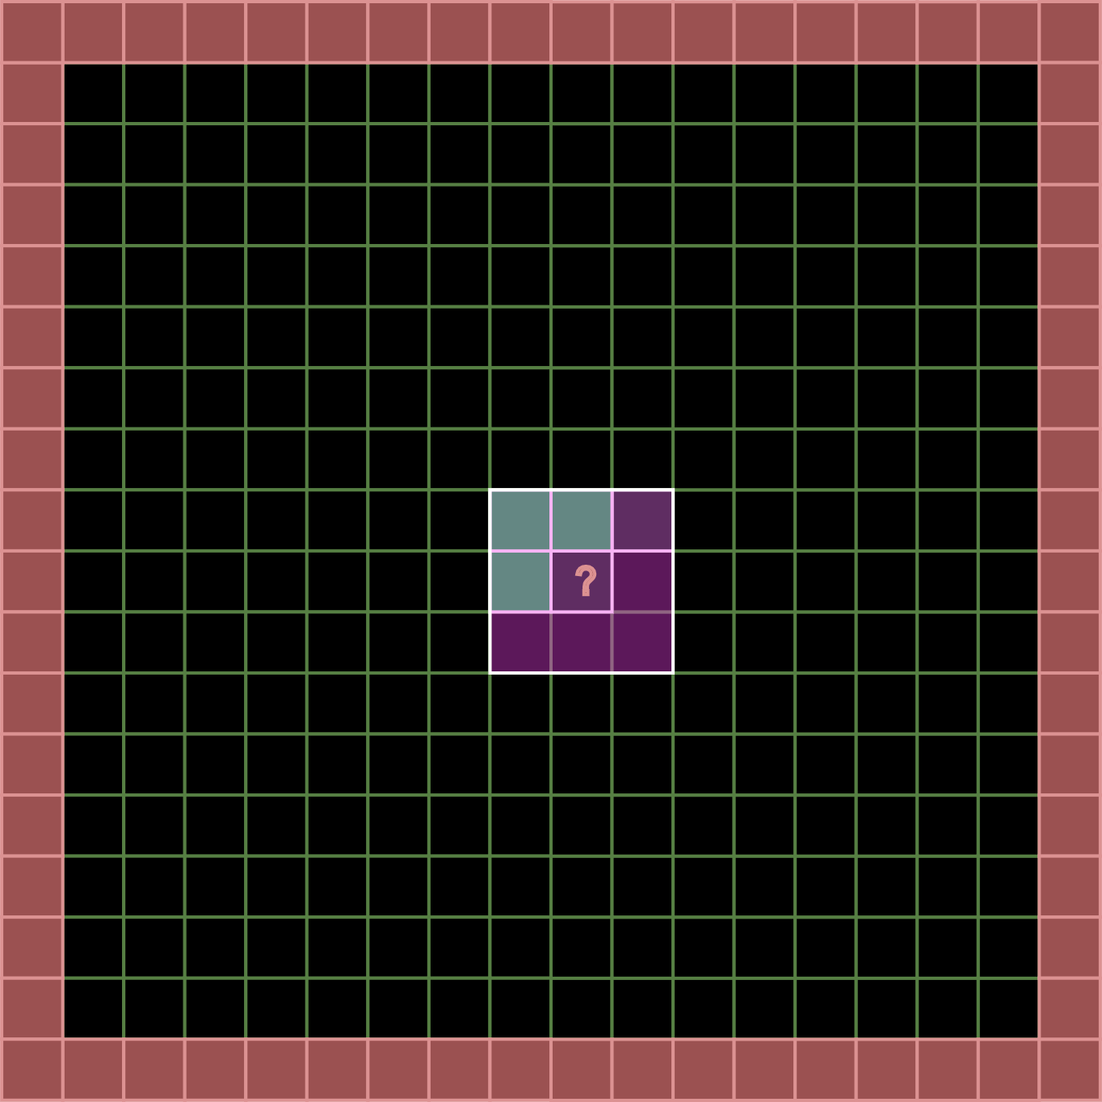
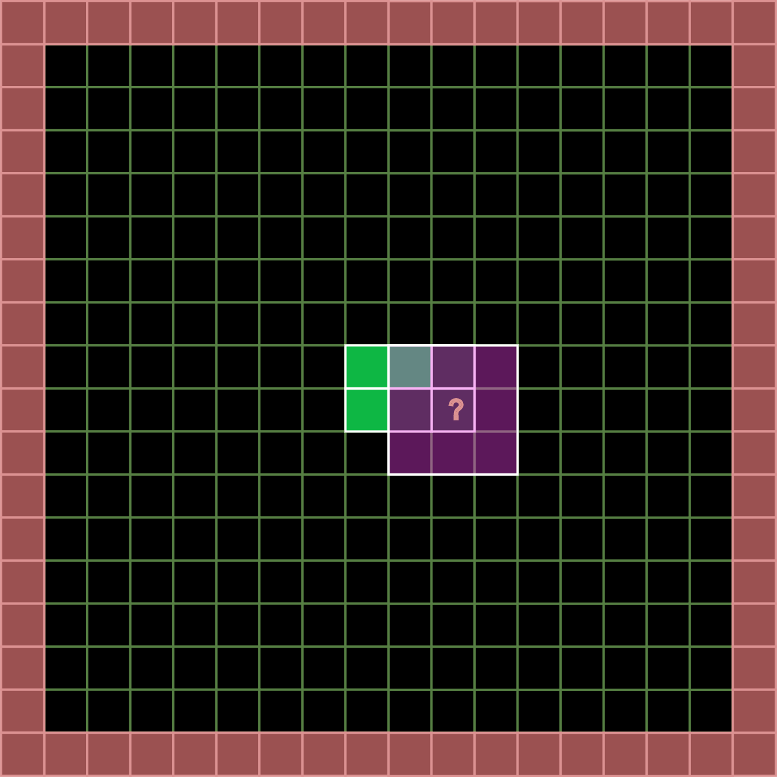
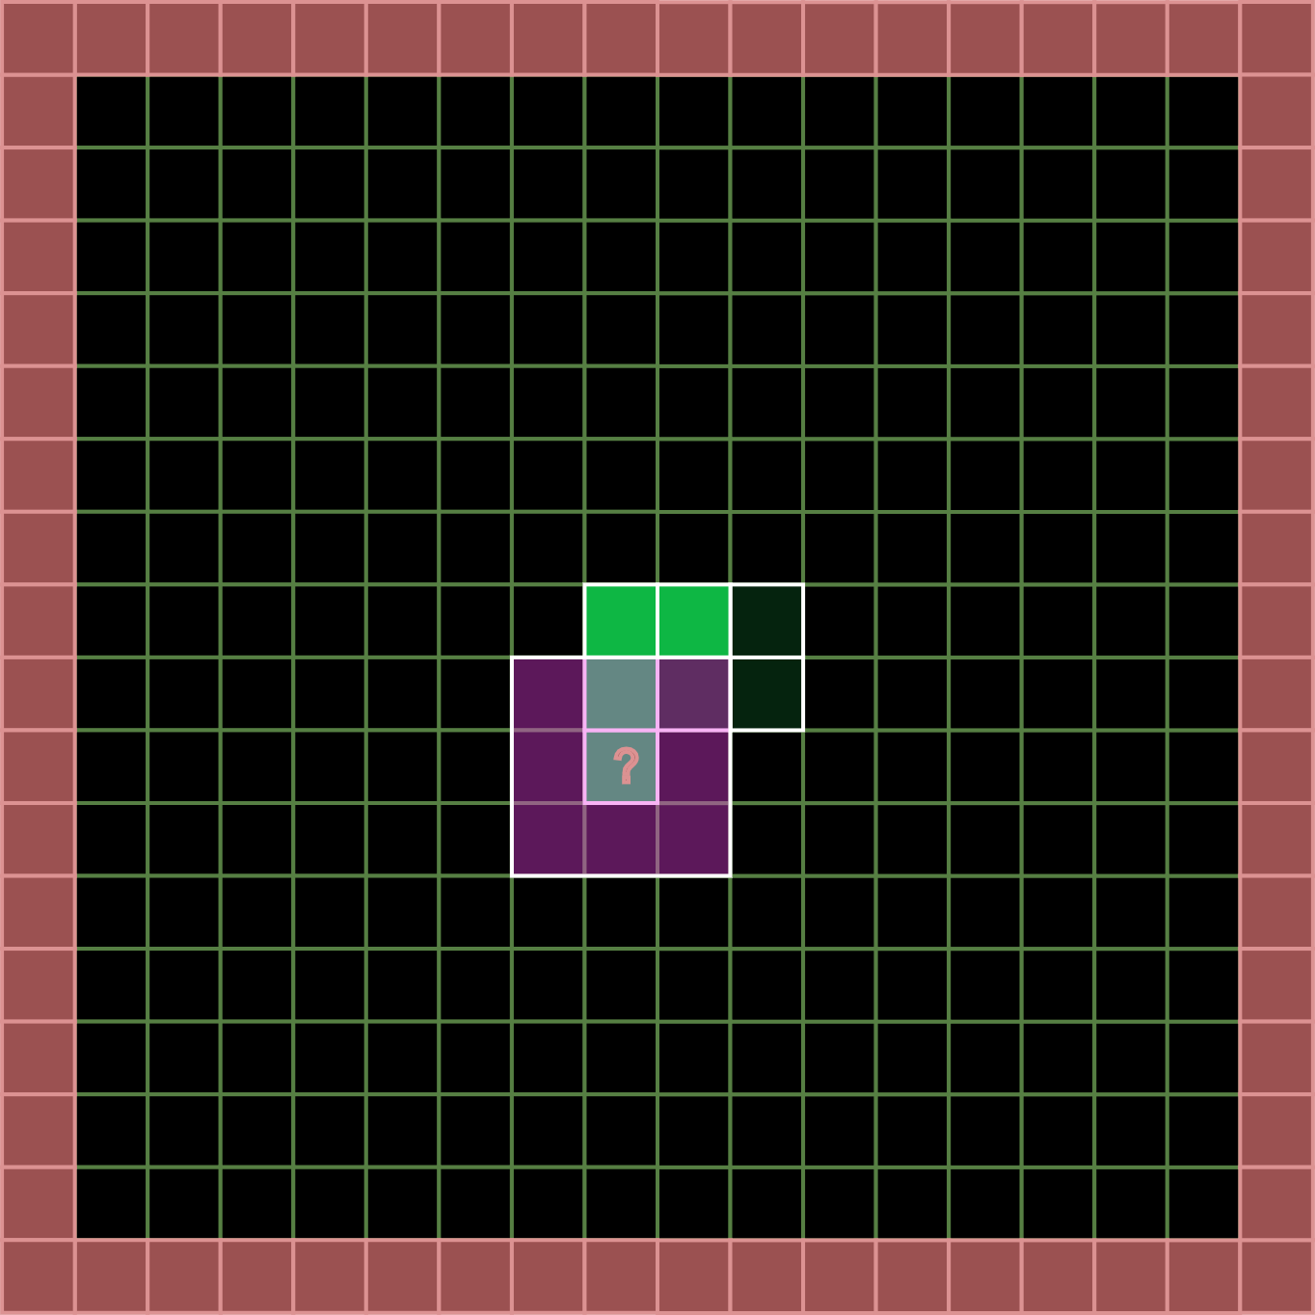

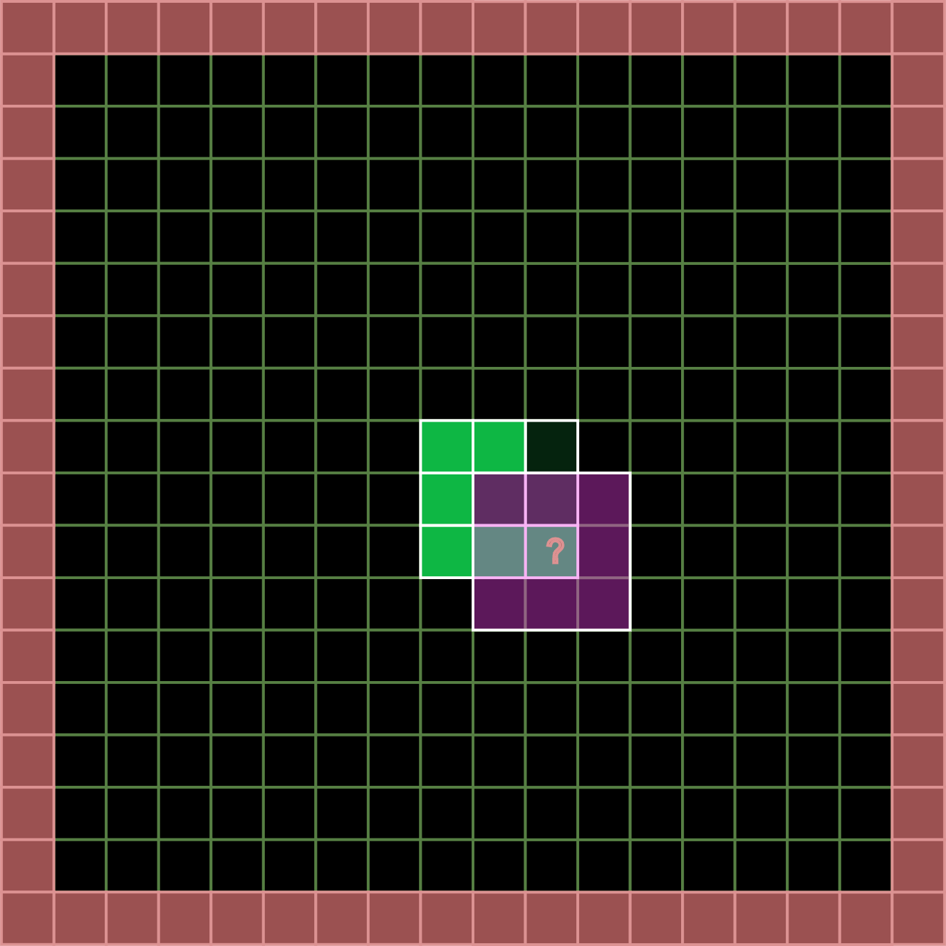
Vertical slice – Conway’s game of life

Slide 56
Approach with 4 4 loops
const size_t pad = 1; // border
const size_t width = 16;
const size_t height = 16;
std::vector<uint32_t> state0{};
std::vector<uint32_t> state1{};
state0[7][8] = 1;
state0[8][7] = 1;
state0[8][8] = 1;
state0[9][8] = 1;
state0[9][9] = 1;

Slide 57
Compute Kernel concept
namespace GameOfLife
{
class Kernel
{
public:
Kernel(size_t w, size_t h, size_t pad);
index coordinateToIndex( index cx, index cy ) const {
return (cy + m_Pad) * m_PaddedWidth + (cx + m_Pad);
}
void dispatch();
private:
size_t m_Width;
size_t m_PaddedWidth;
size_t m_Height;
size_t m_PaddedHeight;
size_t m_Pad;
std::vector<uint32_t> m_State0{};
std::vector<uint32_t> m_State1{};
};
}
state0
(1D data structure)
GameOfLife
Algorithm
State1
(1D data structure)

Slide 58
Approach with 4 for loops
void dispatch()
{
for (index r = 0; r < m_Height; ++r)
{
for (index c = 0; c < m_Width; ++c)
{
int n = 0;
int cellIndex = coordinateToIndex(c, r);
int alive = m_State0[cellIndex];
// convolution
for (index dy = -1; dy <= 1; ++dy)
{
for (index dx = -1; dx <= 1; ++dx)
{
if (dy || dx) {
n += m_State0[coordinateToIndex(c + dx, r + dy)];
}
}
}
m_State1[cellIndex] = (n == 3) || (alive && n == 2);
}
}
}
One task
(thread)

Slide 59
Visualization
OLC Engine (One Lone Coder)
https://github.com/OneLoneCoder/olcPixelGameEngine
Cross platform
Single header include
Cross language (Java/Rust/C#/Lua)
bool OnUserUpdate(float fElapsedTime) override
{
for (int32_t x = 0; x < k.getWidth(); x++)
{
for (int32_t y = 0; y < k.getHeight(); y++)
{
uint32_t cell = k.get1(x, y);
olc::Pixel color = cell ? olc::GREEN : olc::BLACK;
FillRect(x * m_Scale, y * m_Scale, m_Scale, m_Scale, color);
}
}
k.dispatch();
k.swapBuffers();
return true;
}

Slide 60
Result
It works! But:
Serial execution of a parallel algorithm
Loops hide the intent of the algorithm:
For each cell:
Collect the neigbours from the old state
Update the cell in the new state.
Convolution loop
Replace by fixed list of neighbours?
Separable filter?

Slide 61
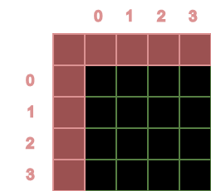
First improvement
Give each thread/task a unique id
Can be used to find the data for the task or thread
This id is a logical id
It would be nice (in this case) to have a 2-dimensional id.
t#0
t#1
t#2
t#3
t#4
t#5
t#6
t#7
t#8
t#9
t#10
t#11
t#12
t#13
t#14
t#15

Slide 62
Std::views::iota
std::views::iota : generate 1-dimensional unique id for all tasks/threads:
const uint64_t totalWork = m_Width * m_Height;
auto range = std::views::iota(uint64_t{ 0 }, totalWork);
Note : in C++23 cartesian views can be used which can generate tuples

Slide 63
std::for_each
std::for_each uses the generated id and sets a thread_local (a 3D value) that contains the id for the task/thread.
Use a parallel execution policy
uvec3 globalWorkSize{ m_Width,m_Height,1 };
std::for_each(
std::execution::par ,
range.begin(), range.end() ,
[&](const uint64_t xi) {
globalInvocationID = unflatten(xi, globalWorkSize);
main();
});
Take an id from the std::views::iota generator
Unflatten the 1-Dimensional id and store it in a thread_local

Slide 64
std::execution::par_unseq
Auto vectorization of threads → think SIMD
“A standard library function is vectorization-unsafe if it is specified to synchronize with another function invocation, or another function invocation is specified to synchronize with it, and if it is not a memory allocation or deallocation function or lock-free atomic modify-write operation ([atomics.order]).”

Slide 65
Second improvement
256 Cells (16x16)
WG #0
Device manager (16 “real” cores)
WG #1
WG #2
WG #0
WG
#1
WG
#2
WG
#3
WG #3
WG #4
WG
#4
WG
#5
WG
#6
WG
#7
WG #5
WG #6
WG #7
WG
#8
WG
#9
WG
#10
WG
#11
WG #8
WG #9
WG #10
WG
#12
WG
#13
WG
#14
WG
#15
WG #11
WG #12
WG #13
WG #14
WG: workgroup
WG #15

Slide 66
Local sizes
256 Cells (16x16)
4
WG #0
WG
#1
WG
#2
WG
#3
t#0
t#1
t#2
t#3
WG
#4
WG
#5
WG
#6
WG
#7
4
t#4
t#5
t#6
t#7
WG
#8
WG
#9
WG
#10
WG
#11
t#8
t#9
t#10
t#11
WG
#12
WG
#13
WG
#14
WG
#15
t#12
t#13
t#14
t#15
Workgroup #7
Local size:
4x4x1

Slide 67
IDs
256 Cells (16x16)
4
WG #0
WG
#1
WG
#2
WG
#3
t#0
t#1
t#2
t#3
WG
#4
WG
#5
WG
#6
WG
#7
4
t#4
t#5
t#6
t#7
WG
#8
WG
#9
WG
#10
WG
#11
t#8
t#9
t#10
t#11
WG
#12
WG
#13
WG
#14
WG
#15
t#12
t#13
t#14
t#15
Workgroup #7
workGroupSize
4x4x1
Local size:
4x4x1

Slide 68
IDs
workGroupID : {3,1,0}
localID : {2,1,0}
globalInvocationID : {14,5,0}
4
WG #0
WG
#1
WG
#2
WG
#3
t#0
t#1
t#2
t#3
WG
#4
WG
#5
WG
#6
WG
#7
4
t#4
t#5
t#6
t#7
WG
#8
WG
#9
WG
#10
WG
#11
t#8
t#9
t#10
t#11
WG
#12
WG
#13
WG
#14
WG
#15
t#12
t#13
t#14
t#15
Workgroup #7
workGroupSize
4x4x1
Local size:
4x4x1

Slide 69
Kernel changes
class Kernel
{
public:
Kernel(size_t w, size_t h, size_t pad);
// loop over the workgroups
void dispatch();
// loop over the threads/tasks of a workgroup
void dispatchWorkGroup();
// execution of a single thread
void main();
private:
// the size of a workgroup
uvec3 m_LocalSize{ 4,4,1 };
// the IDs needed to lookup data
static inline thread_local uvec3 workGroupID;
static inline thread_local uvec3 globalInvocationID;
static inline thread_local uvec3 localInvocationID;
}

Slide 70
Kernel changes
class Kernel
{
public:
Kernel(size_t w, size_t h, size_t pad);
// loop over the workgroups
void dispatch();
// loop over the threads/tasks of a workgroup
void dispatchWorkGroup();
// execution of a single thread
void main();
private:
// the size of a workgroup
uvec3 m_LocalSize{ 4,4,1 };
// the IDs needed to lookup data
static inline thread_local uvec3 workGroupID;
static inline thread_local uvec3 globalInvocationID;
static inline thread_local uvec3 localInvocationID;
}
void Kernel::dispatch()
{
const uint32_t workGroupSizeX = ceil_div(m_Width, m_LocalSize.x);
const uint32_t workGroupSizeY = ceil_div(m_Height, m_LocalSize.y);
const uint32_t totalWorkGroups = workGroupSizeX * workGroupSizeY;
auto range = std::views::iota(uint32_t{ 0 }, totalWorkGroups);
uvec3 workGroupSize{ workGroupSizeX, workGroupSizeY, 1 };
std::for_each(
std::execution::par,
range.begin(), range.end(),
[&](const uint32_t workgroupID) {
workGroupID = unflatten(workgroupID, workGroupSize);
dispatchWorkGroup();
});
}

Slide 71
Kernel changes
class Kernel
{
public:
Kernel(size_t w, size_t h, size_t pad);
// loop over the workgroups
void dispatch();
// loop over the threads/tasks of a workgroup
void dispatchWorkGroup();
// execution of a single thread
void main();
private:
// the size of a workgroup
uvec3 m_LocalSize{ 4,4,1 };
// the IDs needed to lookup data
static inline thread_local uvec3 workGroupID;
static inline thread_local uvec3 globalInvocationID;
static inline thread_local uvec3 localInvocationID;
}
void Kernel::dispatchWorkGroup()
{
const uint32_t localThreads = m_LocalSize.x * m_LocalSize.y * m_LocalSize.z;
auto threadRange = std::views::iota(uint32_t{ 0 }, localThreads);
std::for_each(
std::execution::seq,
threadRange.begin(), threadRange.end(),
[&](const uint32_t threadID) {
localInvocationID = unflatten(threadID, m_LocalSize);
globalInvocationID.x = workGroupID.x * m_LocalSize.x + localInvocationID.x;
globalInvocationID.y = workGroupID.y * m_LocalSize.y + localInvocationID.y;
globalInvocationID.z = workGroupID.z * m_LocalSize.z + localInvocationID.z;
main();
});
}

Slide 72
Third improvement – compute shaders
Improvements to make
dispatch and dispatchWorkgroup do not belong in Kernel class → this is general functionality
Buffer concept in compute shaders
Uniform variables in compute shaders

Slide 73
Compute shader point of view
#version 430
layout (local_size_x = 4, local_size_y = 4, local_size_z = 1) in;
Definition of local_size
layout(set = 0, binding = 0) buffer _inDataLayout {uint inData[]; };
layout(set = 0, binding = 1) buffer _outDataLayout {uint outData[]; };
Buffer concept: a slot where data can be plugged in. The layout is defined by:
Set number: which collection does this buffer belong to (specific to Vulkan).
Binding number: a unique id within this set.
layout(location = 1) uniform int width;
layout(location = 2) uniform int height;
layout(location = 3) uniform int pad;
Uniform variables are constant within a dispatch. They also have a unique location.

Slide 74
Compute shader point of view
int coordinateToIndex(int cx, int cy) {
return (cy + pad) * (width+pad) + (cx + pad);
}
Convert a coordinate to a one-dimensional index into the buffer
void main() {
uint n = 0;
uvec2 cr = gl_GlobalInvocationID.xy;
int cellIndex = coordinateToIndex(int( cr.x ), int( cr.y ));
uint alive = inData[cellIndex];
for (int dy = -1; dy <= 1; ++dy) {
for (int dx = -1; dx <= 1; ++dx) {
if (bool( dy ) || bool( dx )) {
n += inData[coordinateToIndex(int( cr.x + dx ), int( cr.y + dy ))];
}
}
}
outData[cellIndex] = uint( (n == 3) || (bool( alive ) && n == 2) );
}
The main algorithm. gl_GlobalInvocationID is a glsl built in variable.

Slide 75
BufferBinding
layout(set = 0, binding = 0) buffer _inDataLayout {uint inData[]; };
layout(set = 0, binding = 1) buffer _outDataLayout {uint outData[]; };
We need a C++ representation of this concept which:
Defines the set number
Defines the binding number
Defines the data type
Template BufferBinding class
tc::BufferBinding< tc::uint , 0, 0> inData;
tc::BufferBinding< tc::uint , 1, 0> outData;
Set number
datatype
Binding id

Slide 76
BufferBinding
template<typename T, unsigned Binding, unsigned Set = 0 >
class BufferBinding
{
public:
BufferBinding(): m_pBufferData{ nullptr }
{
}
void attach(BufferResource<T>* pData) {
m_pBufferData = pData;
}
unsigned size() const {
return m_pBufferData->size();
}
BufferResource<T>* getBufferData() const {
return m_pBufferData;
}
private:
BufferResource<T>* m_pBufferData;
};
The responsibility of the BufferBinding:
Define the set and binding numbers.
Allow actual data (the BufferResource) to be attached.
The BufferBinding is not the owner of the BufferResource
A BufferBinding can only attach a one-dimensional BufferResource

Slide 77
BufferResource
template<typename T, tc::Dim D = tc::Dim::D1>
class BufferResource
{
public:
using Traits = DimTraits<D>;
using dimType = typename Traits::IndexType;
BufferResource is one-dimensional by default!
Traits principle is used to further specialize the class.
BufferResource( dimType bufferSize )
:
m_BufferSize(bufferSize),
m_Data( Traits::product(bufferSize) )
{
}
dimType corresponds to the dimension of the BufferResource:
1D: int32_t
2D: ivec2
3D: ivec3
private:
dimType m_BufferSize;
std::vector<T> m_Data;
};
Backed by a vector of the template type T

Slide 78
Uniform variables
layout(location = 1) uniform int width;
layout(location = 2) uniform int height;
layout(location = 3) uniform int pad;
We need a C++ representation of this concept which:
Defines the location
Defines the data type
Allows to set a default
tc::Uniform< tc::integer, 1> width { 16 };
tc::Uniform< tc::integer, 2> height { 16 };
tc::Uniform< tc::integer, 3> pad { 1 };
Default value
datatype
location

Slide 79
Uniform class
template<UniformValue T, unsigned Location>
class Uniform
{
public:
Uniform() :m_Value{ T(0) }
{
}
Uniform(T value) :m_Value{ value }
{
}
T& get() {
return m_Value;
}
operator T& () {
return m_Value;
}
const T& get() const {
return m_Value;
}
operator const T& () const {
return m_Value;
}
private:
T m_Value;
};
Uniform:
wraps a value
Stores the location as part of the template.

Slide 80
Kernel concept
template<typename K>
concept KernelEntry = requires(K k)
{
};
{ k.main() } -> std::same_as<void>;
A C++ compute kernel should have a main function
{
[]() constexpr {
return K::fileLocation;
}()
} -> std::convertible_to<std::string_view>;
A kernel must define a file location to store the generated file. The type must be convertible to a string_view.
template<typename K>
constexpr bool HasLocalSize = requires(K k) {
{ k.local_size } -> std::convertible_to<tc::uvec3>;
};
A kernel needs to define a local size.

Slide 81
C++ kernel
#include "vec.hpp"
#include "computebackend.hpp"
struct [[clang::annotate("kernel")]] GameOfLifeKernel
{
static constexpr char fileLocation[] = "gol_v4";
tc::uvec3 local_size{ 4, 4, 1 };
void main() {
}
}
Annotation for validation and transpilation phase.
A kernel must define a file location to store the generated file. The type must be convertible to a string_view.
A kernel needs to define a local size.
A C++ compute kernel should have a main function

Slide 82
Part 2 : C++ Validation
C++ Design
Validation
(Clang/AST)
Transpilation
(Clang/AST)
GLSLangValidator
Unsupported C++ syntax (e.g. new/delete)
Error/warning report

Slide 83
Clang validation – example 2
GLSL reserved keywords:
std::unordered_set<std::string> m_ReservedGLSLKeywords = {
"sample", "input", "output", "discard", "return",
"uint", "int", "float", "bool", "vec2", "vec3", "vec4",
"mat2", "mat3", "mat4",
"uniform", "layout", "in", "out", "inout",
"sampler2D", "samplerCube", "texture",
"break", "continue", "do", "else", "for", "if", "while",
"struct", "switch", "case", "default", "subpassInput"
};

Slide 84
Clang validation – example 2
bool VisitFunctionDecl(clang::FunctionDecl* pFunction) {
std::string functionName = pFunction->getNameAsString();
if (m_ReservedGLSLKeywords.contains(functionName)) {
reportError(
pFunction->getLocation(),
invalidFunctionNameGLSL,
pFunction->getName()
);
Valid = false;
}
return true;
}

Slide 85
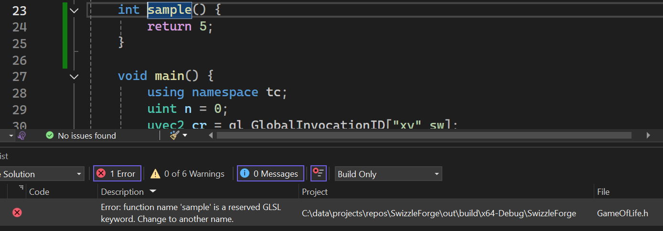
Clang validation – example 3

Slide 86
Part 3 : Transpilation
C++ Design
Validation
(Clang/AST)
Transpilation
(Clang/AST)
GLSLangValidator
Rewriter API
Export to GLSL
Error/warning report (packing)

Slide 87
Rewriter API
Not glamorous code
Match elements to replace
For each element in the AST tree:
Get the source code range
Create the replacement
Add to a list of replacements
Sort all the code changes by source location
Write the generated glsl to file

Slide 88
Examples
C++ | GLSL
tc::uvec3 | uvec3
using namespace tc; | // using namespace tc;
gl_GlobalInvocationID["xy"_sw] | gl_GlobalInvocationID.xy
tc::Uniform<tc::integer, 3> pad{ 1 }; | layout(location = 3) uniform int pad;

Slide 89
Transpiler example
C++ | GLSL
using namespace tc; | // using namespace tc;
bool KernelRewriter::VisitUsingDirectiveDecl(clang::UsingDirectiveDecl* pUsing)
{
PendingEdit edit{ pUsing->getSourceRange(), "//",true };
m_PendingEdits.emplace_back(edit);
return true;
}

Slide 90
Transpiler example 2
C++ | GLSL
gl_GlobalInvocationID["xy"_sw] | gl_GlobalInvocationID.xy
bool KernelRewriter::VisitCXXOperatorCallExpr(clang::CXXOperatorCallExpr* E) {
using namespace clang;
if (E->getOperator() != OO_Subscript) return true;
auto* UDL = dyn_cast<clang::UserDefinedLiteral>(E->getArg(1)->IgnoreParenImpCasts());
if (!UDL) return true;
auto* ID = UDL->getUDSuffix();
if (!ID || ID->getName() != "_sw") return true;
auto& SM = m_pASTContext->getSourceManager();
auto& LO = m_pASTContext->getLangOpts();
std::string repl = "." + swizzle;
SourceRange range = { beginLoc,E->getEndLoc() };
PendingEdit cast{
range,
repl
};
m_PendingEdits.emplace_back(cast);
return true;
}
Hard to write, but robust!

Slide 91
Part 4 : GLSLangValidator
C++ Design
Validation
(Clang/AST)
Transpilation
(Clang/AST)
GLSLangValidator
Error/warning report

