Slide 1
Cmp Sci 187:
Introduction to Java
Based on Appendix A of text
(Koffmann and Wolfgang)
Notes:
Notes for title slide

Slide 2
Topics of the Review
Essentials of object-oriented programming, in Java
Java primitive data types, control structures, and arrays
Using some predefined classes:
  Math
  JOptionPane, I/O streams
  String, StringBuffer, StringBuilder
  StringTokenizer
Writing and documenting your own Java classes
Notes:
Notes for objectives slide

Slide 3
Some Salient Characteristics of Java
Java is platform independent: the same program can run on any correctly implemented Java system
Java is object-oriented:
  Structured in terms of classes, which group data with operations on that data
  Can construct new classes by extending existing ones
Java designed as
  A core language plus
  A rich collection of commonly available packages
Java can be embedded in Web pages

Slide 4
Java Processing and Execution
Begin with Java source code in text files: Model.java
A Java source code compiler produces Java byte code
  Outputs one file per class: Model.class
  May be standalone or part of an IDE
A Java Virtual Machine loads and executes class files
  May compile them to native code (e.g., x86) internally

Slide 5
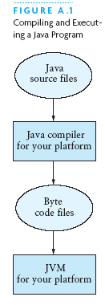
Compiling and Executing a Java Program

Slide 6
Classes and Objects
The class is the unit of programming
A Java program is a collection of classes
  Each class definition (usually) in its own .java file
  The file name must match the class name
A class describes objects (instances)
  Describes their common characteristics: is a blueprint
  Thus all the instances have these same characteristics
These characteristics are:
  Data fields for each object
  Methods (operations) that do work on the objects

Slide 7
Grouping Classes: The Java API
API = Application Programming Interface
Java = small core + extensive collection of packages
A package consists of some related Java classes:
  Swing: a GUI (graphical user interface) package
  AWT: Application Window Toolkit (more GUI)
  util: utility data structures (important to CS 187!)
The import statement tells the compiler to make available classes and methods of another package
A main method indicates where to begin executing a class (if it is designed to be run as a program)

Slide 8
A Little Example of import and main
import javax.swing.*;
// all classes from javax.swing
public class HelloWorld { // starts a class
public static void main (String[] args) {
// starts a main method
// in: array of String; out: none (void)
}
}
public = can be seen from any package
static = not “part of” an object

Slide 9
Processing and Running HelloWorld
javac HelloWorld.java
  Produces HelloWorld.class (byte code)
java HelloWorld
  Starts the JVM and runs the main method

Slide 10
References and Primitive Data Types
Java distinguishes two kinds of entities
  Primitive types
  Objects
Primitive-type data is stored in primitive-type variables
Reference variables store the address of an object
  No notion of “object (physically) in the stack”
  No notion of “object (physically) within an object”

Slide 11
Primitive Data Types
Represent numbers, characters, boolean values
Integers: byte, short, int, and long
Real numbers: float and double
Characters: char

Slide 12
Primitive Data Types
Data type | Range of values
byte | -128 .. 127 (8 bits)
short | -32,768 .. 32,767 (16 bits)
int | -2,147,483,648 .. 2,147,483,647 (32 bits)
long | -9,223,372,036,854,775,808 .. ... (64 bits)
float | +/-10⁻³⁸ to +/-10⁺³⁸ and 0, about 6 digits precision
double | +/-10⁻³⁰⁸ to +/-10⁺³⁰⁸ and 0, about 15 digits precision
char | Unicode characters (generally 16 bits per char)
boolean | True or false

Slide 13
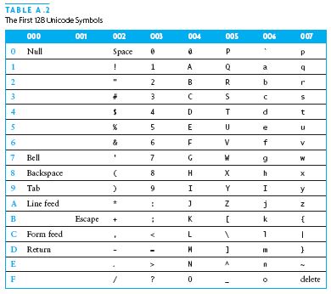
Primitive Data Types (continued)

Slide 14
Operators
subscript [ ], call ( ), member access .
pre/post-increment ++ --, boolean complement !, bitwise complement ~, unary + -, type cast (type), object creation new
* / %
binary + - (+ also concatenates strings)
signed shift << >>, unsigned shift >>>
comparison < <= > >=, class test instanceof
equality comparison == !=
bitwise and &
bitwise or |

Slide 15
Operators
logical (sequential) and &&
logical (sequential) or ||
conditional cond ? true-expr : false-expr
assignment =, compound assignment += -= *= /= <<= >>= >>>= &= |=

Slide 16
Type Compatibility and Conversion
Widening conversion:
  In operations on mixed-type operands, the numeric type of the smaller range is converted to the numeric type of the larger range
  In an assignment, a numeric type of smaller range can be assigned to a numeric type of larger range
byte to short to int to long
int kind to float to double

Slide 17
Declaring and Setting Variables
int square;
square = n * n;
double cube = n * (double)square;
  Can generally declare local variables where they are initialized
  All variables get a safe initial value anyway (zero/null)

Slide 18

Referencing and Creating Objects
You can declare reference variables
  They reference objects of specified types
Two reference variables can reference the same object
The new operator creates an instance of a class
A constructor executes when a new object is created
Example: String greeting = ″hello″;

Slide 19
Java Control Statements
A group of statements executed in order is written
  { stmt1; stmt2; ...; stmtN; }
The statements execute in the order 1, 2, ..., N
Control statements alter this sequential flow of execution

Slide 20
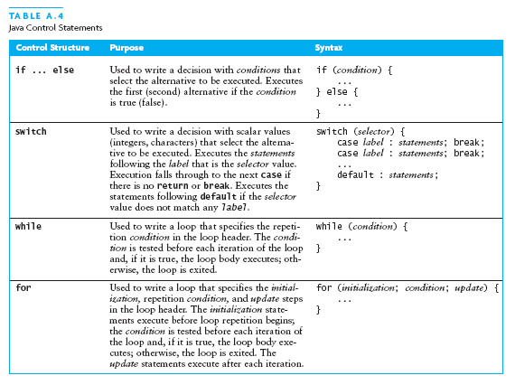
Java Control Statements (continued)

Slide 21
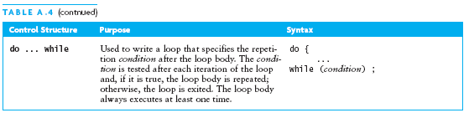
Java Control Statements (continued)

Slide 22
Methods
A Java method defines a group of statements as performing a particular operation
static indicates a static or class method
A method that is not static is an instance method
All method arguments are call-by-value
  Primitive type: value is passed to the method
  Method may modify local copy but will not affect caller’s value
  Object reference: address of object is passed
  Change to reference variable does not affect caller
  But operations can affect the object, visible to caller

Slide 23
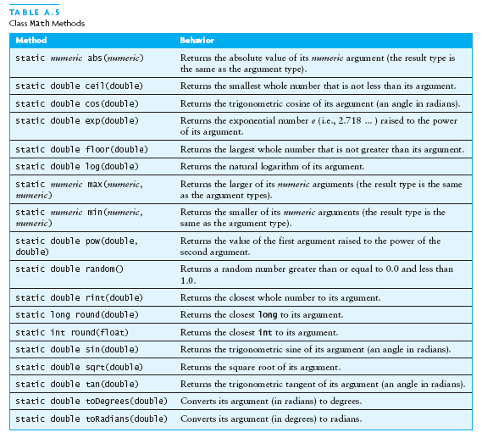
The Class Math

Slide 24
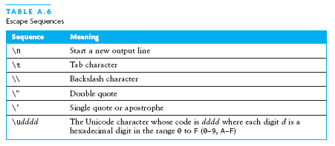
Escape Sequences
An escape sequence is a sequence of two characters beginning with the character \
A way to represents special characters/symbols

Slide 25
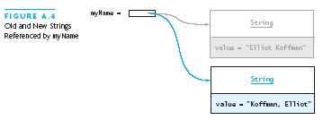
The String Class
The String class defines a data type that is used to store a sequence of characters
You cannot modify a String object
  If you attempt to do so, Java will create a new object that contains the modified character sequence

Slide 26
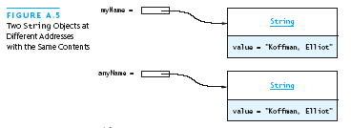

Comparing Objects
You can’t use the relational or equality operators to compare the values stored in strings (or other objects)
    (You will compare the pointers, not the objects!)

Slide 27
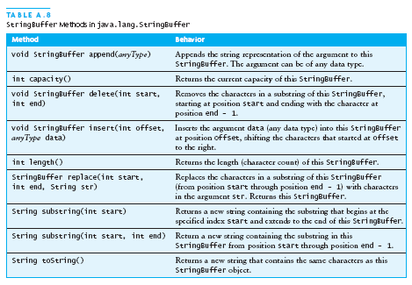
The StringBuffer Class
Stores character sequences
Unlike a String object, you can change the contents of a StringBuffer object

Slide 28
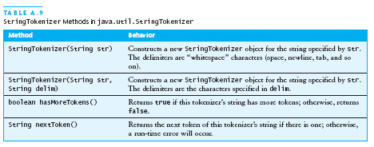
StringTokenizer Class
We often need to process individual pieces, or tokens, of a String

Slide 29
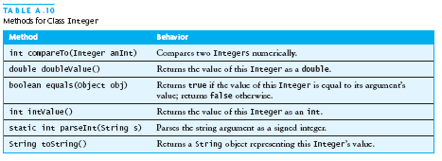
Wrapper Classes for Primitive Types
Sometimes we need to process primitive-type data as objects
Java provides a set of classes called wrapper classes whose objects contain primitive-type values: Float, Double, Integer, Boolean, Character, etc.

Slide 30
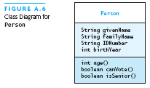
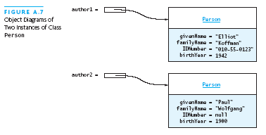
Defining Your Own Classes
Unified Modeling Language (UML) is a standard diagram notation for describing a class
Field signatures: type and name
Method signatures: name, argument types, result type
Field values
Class name
Class name

Slide 31
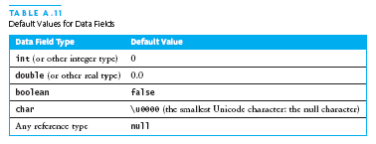
Defining Your Own Classes (continued)
The modifier private limits access to just this class
Only class members with public visibility can be accessed outside of the class* (* but see protected)
Constructors initialize the data fields of an instance

Slide 32
The Person Class
// we have omitted javadoc to save space
public class Person {
private String givenName;
private String familyName;
private String IDNumber;
private int birthYear;
private static final int VOTE_AGE = 18;
private static final int SENIOR_AGE = 65;
...

Slide 33
The Person Class (2)
// constructors: fill in new objects
public Person(String first, String family,
String ID, int birth) {
this.givenName = first;
this.familyName = family;
this.IDNumber = ID;
this.birthYear = birth;
}
public Person (String ID) {
this.IDNumber = ID;
}

Slide 34
The Person Class (3)
// modifier and accessor for givenName
public void setGivenName (String given) {
this.givenName = given;
}
public String getGivenName () {
return this.givenName;
}

Slide 35
The Person Class (4)
// more interesting methods ...
public int age (int inYear) {
return inYear – birthYear;
}
public boolean canVote (int inYear) {
int theAge = age(inYear);
return theAge >= VOTE_AGE;
}

Slide 36
The Person Class (5)
// “printing” a Person
public String toString () {
return “Given name: “ + givenName + “\n”
+ “Family name: “ + familyName + “\n”
+ “ID number: “ + IDNumber + “\n”
+ “Year of birth: “ + birthYear + “\n”;
}

Slide 37
The Person Class (6)
// same Person?
public boolean equals (Person per) {
return (per == null) ? false :
this.IDNumber.equals(per.IDNumber);
}

Slide 38
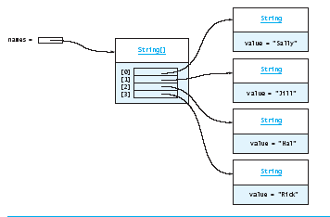
Arrays
In Java, an array is also an object
The elements are indexes and are referenced using the form arrayvar[subscript]

Slide 39
Array Example
float grades[] = new float[numStudents];
... grades[student] = something; ...
float total = 0.0;
for (int i = 0; i < grades.length; ++i) {
total += grades[i];
}
System.out.printf(“Average = %6.2f%n”,
total / numStudents);

Slide 40
Array Example Variations
// possibly more efficient
for (int i = grades.length; --i >= 0; ) {
total += grades[i];
}
// uses Java 5.0 “for each” looping
for (float grade : grades) {
total += grade;
}

Slide 41
Input/Output using Class JOptionPane
Java 1.2 and higher provide class JOptionPane, which facilitates display
  Dialog windows for input
  Message windows for output

Slide 42
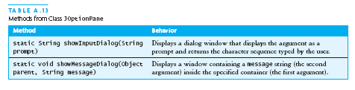

Input/Output using Class JOptionPane (continued)

Slide 43
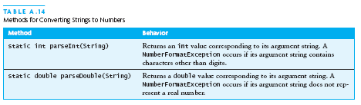
Converting Numeric Strings to Numbers
A dialog window always returns a reference to a String
Therefore, a conversion is required, using static methods of class String:

Slide 44
Input/Output using Streams
An InputStream is a sequence of characters representing program input data
An OutputStream is a sequence of characters representing program output
The console keyboard stream is System.in
The console window is associated with System.out

Slide 45
Opening and Using Files: Reading Input
import java.io.*;
public static void main (String[] args) {
// open an input stream (**exceptions!)
BufferedReader rdr =
new BufferedReader(
new FileReader(args[0]));
// read a line of input
String line = rdr.readLine();
// see if at end of file
if (line == null) { ... }

Slide 46
Opening and Using Files: Reading Input (2)
// using input with StringTokenizer
StringTokenizer sTok =
new StringTokenizer (line);
while (sTok.hasMoreElements()) {
String token = sTok.nextToken();
...;
}
// when done, always close a stream/reader
rdr.close();

Slide 47
Alternate Ways to Split a String
Use the split method of String:
  String[] = s.split(“\\s”);
  // see class Pattern in java.util.regex
Use a StreamTokenizer (in java.io)

Slide 48
Opening and Using Files: Writing Output
// open a print stream (**exceptions!)
PrintStream ps = new PrintStream(args[0]);
// ways to write output
ps.print(“Hello”); // a string
ps.print(i+3); // an integer
ps.println(“ and goodbye.”); // with NL
ps.printf(“%2d %12d%n”, i, 1<<i); // like C
ps.format(“%2d %12d%n”, i, 1<<i); // same
// closing output streams is very important!
ps.close();

Slide 49
Summary of the Review
A Java program is a collection of classes
The JVM approach enables a Java program written on one machine to execute on any other machine that has a JVM
Java defines a set of primitive data types that are used to represent numbers, characters, and boolean data
The control structures of Java are similar to those found in other languages
The Java String and StringBuffer classes are used to reference objects that store character strings

Slide 50
Chapter Review (continued)
Be sure to use methods such as equals and compareTo to compare the contents of String objects
You can declare your own Java classes and create objects of these classes using the new operator
A class has data fields and instance methods
Array variables can reference array objects
Class JOptionPane can be used to display dialog windows for data entry and message windows for output
The stream classes in package java.io read strings from the console and display strings to the console, and also support file I/O

