Slide 1

Agricultural Monitoring using LoRa
Notes:
© Copyright Showeet.com – Creative & Free PowerPoint Templates

Slide 2
Outline
01
Background
03
Tools
02
Purpose
04
Design Overview
Notes:
© Copyright Showeet.com – Creative & Free PowerPoint Templates

Slide 3
Background
01
A field must be monitored its condition. Controlled conditions may include humidity. For example, when there is more than one field, these fields must monitor the conditions of the field, where the monitoring system is applied. This process will take a long time when conducting field supervision due to distance, weather, and also having to visit each of the existing fields.
Notes:
© Copyright Showeet.com – Creative & Free PowerPoint Templates

Slide 4
Purpose
02
Utilizing LoRa technology, where it is used to send packet that has been obtained through sensors programmed through Arduino. Here time is efficient for monitoring system
Notes:
© Copyright Showeet.com – Creative & Free PowerPoint Templates

Slide 5
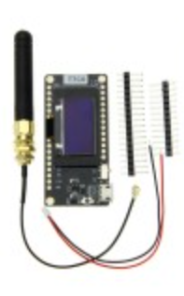
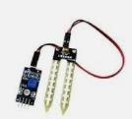

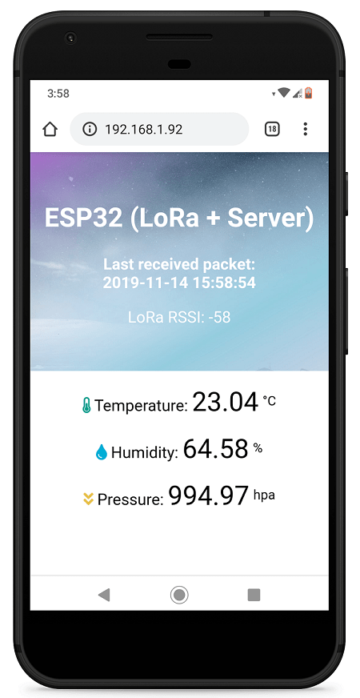
Tools
03
Lora (Sender and Transmitter)
Sensor Soil Moisture
Arduino IDE
Web server (For display the received packet)
Notes:
© Copyright Showeet.com – Creative & Free PowerPoint Templates

Slide 6
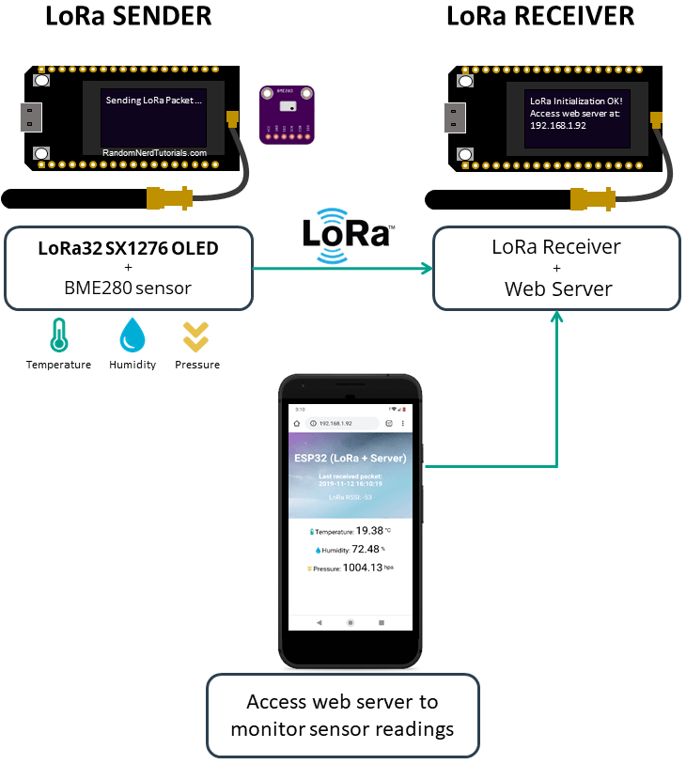
Design Overview
04
LoRa SENDER sends BME sensor data via LoRa Radio.
LoRa Receiver gets the packet from LoRa SENDER.
After received, we can monitor the result by accessing the web server.
Notes:
© Copyright Showeet.com – Creative & Free PowerPoint Templates

Slide 7
THANKYOU!
Notes:
© Copyright Showeet.com – Creative & Free PowerPoint Templates

