Slide 1
DEMAND FORECASTING AND INVENTORY DECISIONS · DATA ASSESSMENT
Service is high.
The shortages are not random.
A pharmaceutical distributor's 5,000-row demand panel: 25 products, 5 regions, 40 months. 99.18% fill rate, yet 97.6% of lost packs follow an under-forecast.
Team 2 · Group 9230 · Data Analytics for AI Business · AASTMT Graduate School of Business
Team 2 · Pharma demand panel · synthetic data
1
Notes:
Title. Verdict figures: fill rate and stockout share from stage1_3.json kpis; 97.6% from under_vs_over; 47.0% from concentration.

Slide 2
Review forecasts first: the shortages sit where the forecast misses
Fill rate looks healthy at 99.18%, but 6.44% of product-months run out of stock. The losses cluster in a way a planner can act on, so the next unit of effort belongs in forecasting, not in more safety stock.
97.6%
47%
9.19% vs 14.59%
of lost packs fall in months the baseline under-forecast
of lost revenue sits in 12 of 125 series
held-out forecast error: regression against the 3-month average
Association, not proof of cause. The regression result is a one-month-ahead test; it does not yet show lower stockouts or cost.
Team 2 · Pharma demand panel · synthetic data
2
Notes:
Answer slide. 97.6% = under_vs_over.lost_units_share_in_under_rows (stage1_3.json). 47.0% = concentration.top10pct_series_lostrev_share. 9.19% vs 14.59% = results.json model.test (held-out 500 rows).

Slide 3
One flat panel: a product, in a region, in a month
What the file lets us do
5,000
25 × 5
Separate demand from sales. Requested packs are kept even when stock ran out.
rows: one per product, region and month
products × regional warehouses = 125 series
Test a forecast. A baseline forecast sits beside the outcome.
40
60
Follow money. Revenue, cost, holding, expiry, lost revenue.
months, January 2023 to April 2026
columns: 18 descriptors, 30 inputs and outcomes, 12 indicators
Limit: Synthetic. It describes this simulation, not the industry.
Team 2 · Pharma demand panel · synthetic data
3
Notes:
Stage 0 intake. Counts from stage1_3.json (rows, cols, n_products, n_regions, n_months). Path A-P in the playbook v4.0, Section 20.

Slide 4
The file is clean, but three traps hide in the column names
15 / 15
Aliased columns. Supplier, dosage form and product family are one grouping. Channel equals customer segment. Cold storage is Family D.
cleaning checks pass, 0 missing cells, 0 duplicates
A stock is a snapshot. Summing inventory value over 40 months gives EGP 32.90M; April 2026 stock is EGP 939k.
6 / 6
A ratio is a sum over a sum. Fill rate, WAPE and margin are computed from totals, never from averaged percentages.
accounting identities hold on all 5,000 rows
Team 2 · Pharma demand panel · synthetic data
4
Notes:
Stage 1 and the 'do columns mean what they say' check. Aliases from results.json aliases; snapshot figures from stage1_3.json kpis.closing_value_wrongly_summed and closing_value_latest.

Slide 5
Fill rate is high; shortages are local to two regions
Product-months with a stockout, by region
99.18%
weighted fill rate overall
6.44%
of product-months stock out (322 of 5,000)
North and Central stock out most. West, the largest region, stocks out least (3.9%). The gap is real (p < 0.0001).
Team 2 · Pharma demand panel · synthetic data
5
Notes:
Region stockout shares from stage1_3.json segments.region_name; regional gap test T1 (chi-square p<0.0001) in results.json register.

Slide 6
Shortages happen in months the forecast was too low
Stockout rate, % of product-months
97.6%
of lost packs fall in months the three-month average under-forecast.
Caveat: a demand spike causes both the miss and the shortage. Series that are biased on average are not the ones that stock out (r = -0.12).
Team 2 · Pharma demand panel · synthetic data
6
Notes:
T6 in results.json register (chi-square 2x2, p=2e-67). Rates and 97.6% from stage1_3.json under_vs_over.

Slide 7
Planned promotions are where the baseline fails
-14.0%
baseline bias in promoted months (+2.0% otherwise)
12.8% vs 5.0%
stockout rate, promoted vs other months
Promotions are 20.4% of volume and 41% of lost revenue. The promotion is known before the month starts; the baseline ignores it.
Team 2 · Pharma demand panel · synthetic data
7
Notes:
Promotion figures from results.json promotion block and register T5a-c (permutation within series, p=0.0002 each). Bias -14.0% vs +2.0%; stockouts 12.85% vs 5.04%.

Slide 8
A forecast that uses what is known in advance cuts error by a third
9.19%
regression WAPE on 500 unseen rows (baseline 14.59%)
37.0% lower
95% interval 31.9% to 41.5%
One month ahead, four test months. It does not show fewer stockouts or lower cost: that needs a replenishment simulation. The publication's own figure is 9.07%.
Team 2 · Pharma demand panel · synthetic data
8
Notes:
results.json model.test and model.by_region: log-demand ridge, chronological split 4000/500/500, alpha chosen on validation, tested on Jan-Apr 2026. Paired bootstrap 4000 resamples CI. Publication quotes 9.07%; we measure 9.19%.

Slide 9
Lost revenue is concentrated: 12 series hold 47%
47%
of lost revenue in the top 12 of 125 series
5 of 12
recur across both halves of history (chance: 1.2)
46 series never ran out. Use the list as a review order, refreshed each quarter. Rank correlation between halves: 0.55.
Team 2 · Pharma demand panel · synthetic data
9
Notes:
Concentration from stage1_3.json (top10pct_series_lostrev_share, series_with_zero_stockouts). Stability from results.json stability (Spearman 0.55; 5 of the top 12 recur vs 1.2 by chance).

Slide 10
Stock costs are small, and unserved demand costs about the same
EGP million
33.9%
gross margin on EGP 97.14M revenue
800k vs 788k
EGP: holding plus expiry, against lost revenue
April 2026 stock is EGP 939k, about 15.5 days of demand. Contribution excludes staffing, transport, financing and tax.
Team 2 · Pharma demand panel · synthetic data
10
Notes:
Financials from stage1_3.json kpis. Contribution = gross profit - holding - expiry; not net enterprise profit. Closing value is April 2026 only.

Slide 11
We tested 18 claims: 12 are real, and the rest are listed
Survived correction (12)
Not findings
Regional stockout frequency
Regional fill rate
Regional volume
Promotion raises stockouts
Promotion raises forecast error
Baseline under-forecasts promotions
Under-forecast months hold the shortages
Series differ in shortages
Seasonality in demand
Products differ in scale
Regression beats baseline
Priority list recurs over time
Regional forecast error: noise
Family, supplier, dosage form: noise
Channel and segment: noise
Criticality class: suggestive only
Demand trend: suggestive only
Revenue digits fail Benford: the file is synthetic
Team 2 · Pharma demand panel · synthetic data
11
Notes:
results.json register. Bonferroni threshold 0.05/18 = 0.0028. T14 (Benford) documents that the file is synthetic; it is not counted as real or noise.

Slide 12
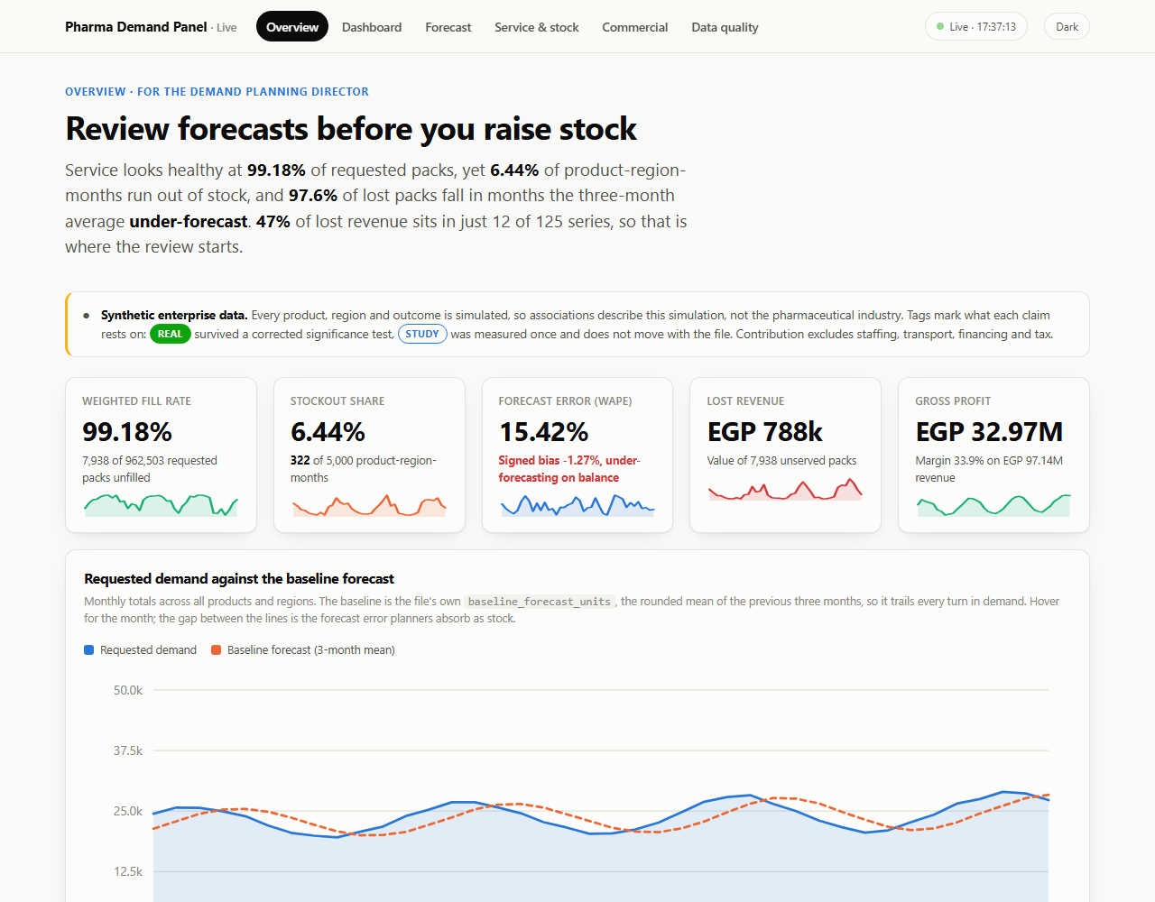
The live dashboard lets the planner explore every figure
Six pages. Overview, cross-filtered dashboard, forecast, service and stock, commercial, data quality.
Click to filter. Any bar, slice, cell or point re-filters every visual.
Live. Edit the CSV and the screen updates in under a second on average.
Honest. Every page carries the caveat and tags what is real.
Team 2 · Pharma demand panel · synthetic data
12
Notes:
Dashboard: 03_Dashboard/, six pages, one watcher, one live_data.json. Refresh measured by editing the source CSV: median 526 ms to the snapshot, pages poll every 0.5 s. Run: cd 03_Dashboard; python watcher.py; python -m http.server 8000.

Slide 13
Six recommendations, each tied to a measure
1
Make the baseline promotion-aware. Bias is -14.0% in promoted months. Track promoted-month WAPE and bias.
2
Start review with the 12 highest-loss series. 47% of lost revenue; refresh quarterly, as only 5 of 12 recur.
3
Diagnose service in North and Central. Stockouts 9.4% and 8.5% against 3.9% in West.
4
Pilot the regression as a challenger, then simulate the policy. Held-out WAPE 9.2% against 14.6%; service and cost benefit are still unproven.
5
Standardise the definitions. Ratios as sums over sums, inventory at one month end, family equals supplier equals dosage form.
6
Ask for more data. About 4,000 rows per region to settle a 25% gap; add stockout cost, backorders and batch shelf life.
Team 2 · Pharma demand panel · synthetic data
13
Notes:
Recommendations as in the report page 10. Power figures from results.json power table.

Slide 14
What this file cannot show, and what to collect next
Cannot be concluded from this data
How much data would settle a regional gap
A new ordering policy lowers stockouts or cost: needs a simulation.
Accuracy several months ahead from a fixed origin.
Anything about real pharmaceutical demand or patient need.
Net enterprise profit: staffing, transport, tax not modelled.
Why stock expired: no batch or shelf-life data.
Backorders: unserved demand is lost, not carried.
Region runs | 1,000 | 2,000 | 4,000
25% above | 27% | 48% | 84%
50% above | 81% | 99% | 100%
100% above | 100% | 100% | 100%
Share of simulated datasets in which a five-region test flagged the region (80% is the usual target). The file has 1,000 rows per region.
Next: pilot the promotion-aware forecast and simulate the policy.
Team 2 · Pharma demand panel · synthetic data
14
Notes:
Limits from the publication scope and the analysis. Power table: results.json power.table; current file 1,000 rows per region.

