Slide 1
DG INTERNS HUB
CYBERSECURITY INTERNSHIP
WEEK 2
Advanced Networking,
Analysis & Security Concepts
Technical Learning & Practical Summary
STUDENT RECORD
SAMYUKTHA S.
Intern ID: DG/SEPTEMBER/CYBER/102
Track: Cybersecurity
Wireshark • Nmap • Cisco Packet Tracer

Slide 2
01 / OVERVIEW
Week 2 at a glance
From networking foundations to practical security analysis
OBJECTIVE
TOOLS USED
Understand advanced networking concepts, analyze real network traffic, perform basic scanning, and learn security attack concepts safely.
Wireshark • Nmap • Cisco Packet Tracer
Kali Linux • Browser / Windows networking environment
LEARNING PROGRESSION
01
02
03
04
Ports & Services
Networking Devices
Security Concepts
Wireshark
05
06
07
Nmap
Packet Tracer
Safe MITM
LEARNING OUTCOME
I moved from memorizing networking terms to interpreting real packets, scan results, and simulated network behavior.

Slide 3
02 / THEORY
Ports, services & network devices
The vocabulary that made the practical tasks easier to interpret
PORTS & SERVICES
DEVICES
IP address → identifies the host
Port number → identifies the service / endpoint
ROUTER
SWITCH
FIREWALL
Layer 3 device that connects different networks and forwards IP packets using routing decisions.
Layer 2 device that connects devices on the same LAN and forwards Ethernet frames using MAC addresses.
Security control that inspects traffic and allows or denies it according to defined rules.
Key examples
22
SSH
secure remote login
53
DNS
domain name resolution
80
HTTP
web communication
KEY MEMORY
Switch connects. Router routes. Firewall controls.
443
HTTPS
TLS-protected web
3389
RDP
remote desktop
These distinctions became practical in the Packet Tracer tasks: the switch handled same-LAN connectivity, while the router represented the path between networks.

Slide 4
03 / THEORY
Network security basics
Three concepts, three different security impacts
MITM
DENIAL OF SERVICE
PACKET SNIFFING
Attacker positioned between communicating parties.
Focus: confidentiality / integrity
Prevention: HTTPS, VPN, trusted networks
Traffic or resource exhaustion makes a service unavailable.
Focus: availability
Prevention: filtering, rate limiting, firewalls
Capturing and examining network packets in transit.
Focus: information exposure
Prevention: encryption, HTTPS, VPN
CONCEPTUAL DISTINCTION
MITM
Position in the path
Confidentiality / Integrity
DoS
Resource exhaustion
Availability
Packet Sniffing
Traffic observation
Confidentiality
LEARNING REFLECTION
MITM is about position, packet sniffing is about observation, and DoS is about availability.

Slide 5
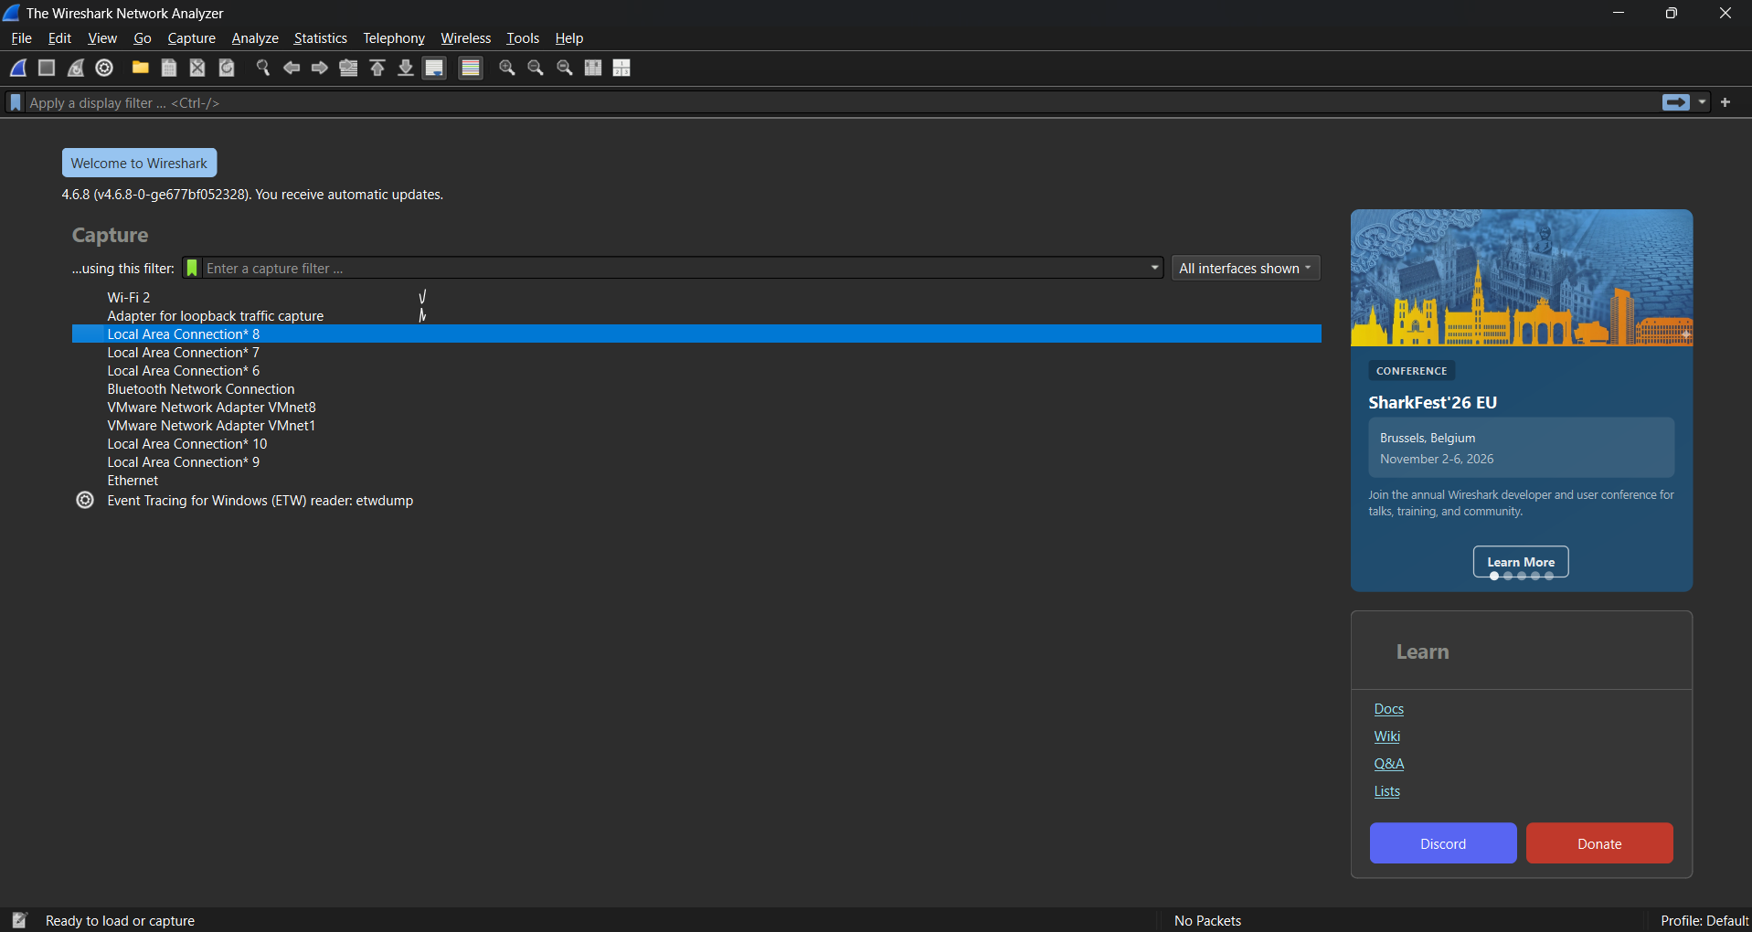
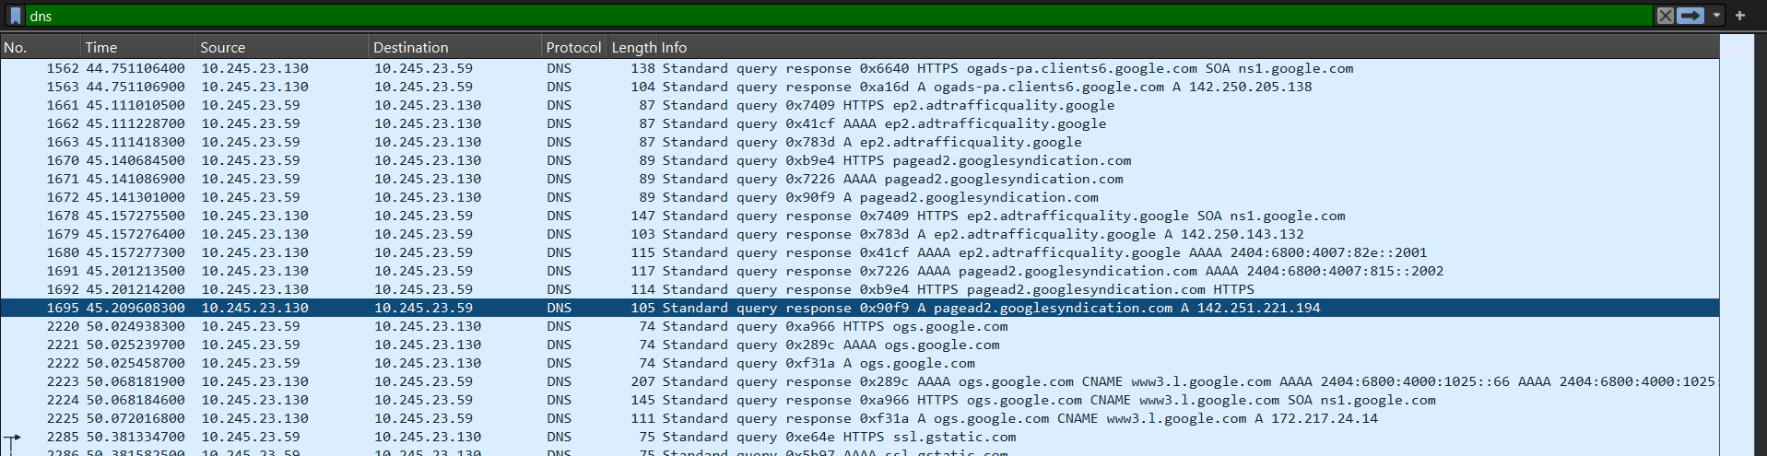
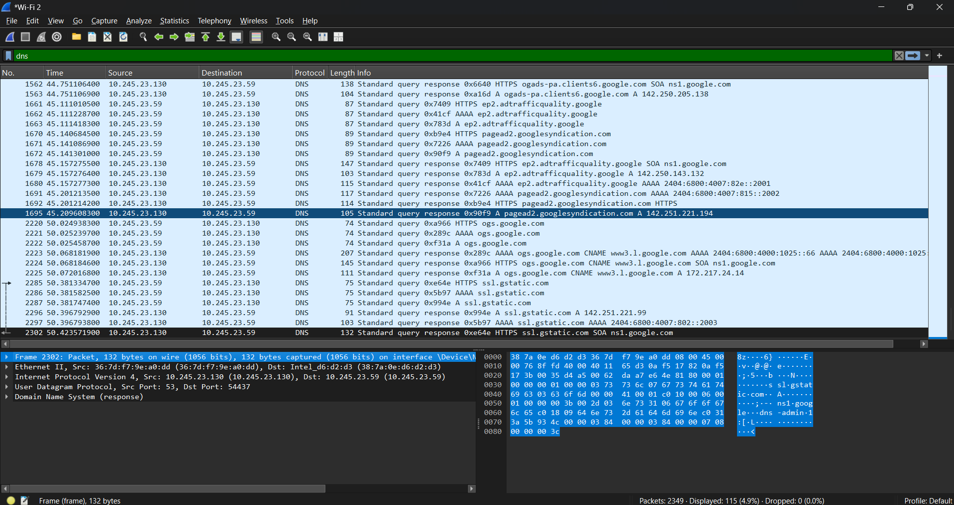
04 / PRACTICAL
Wireshark packet analysis
Reading live traffic by protocol, address and port
WORKFLOW
Select interface → generate traffic → filter DNS/TLS → interpret the packet fields
Step 1 — Wi-Fi 2 selected
Step 2 — Live browsing traffic
Step 3 — DNS filter
DNS OBSERVATION
TLS OBSERVATION
UDP port 53; source 10.245.23.130 → destination 10.245.23.59. The packet was a DNS response from the browsing session.
TLSv1.2 Application Data on source port 443. IP metadata remained visible, while the protected payload was not readable as plain text.
Learning outcome: filtering made the difference between “seeing traffic” and actually isolating the protocol evidence I needed.

Slide 6
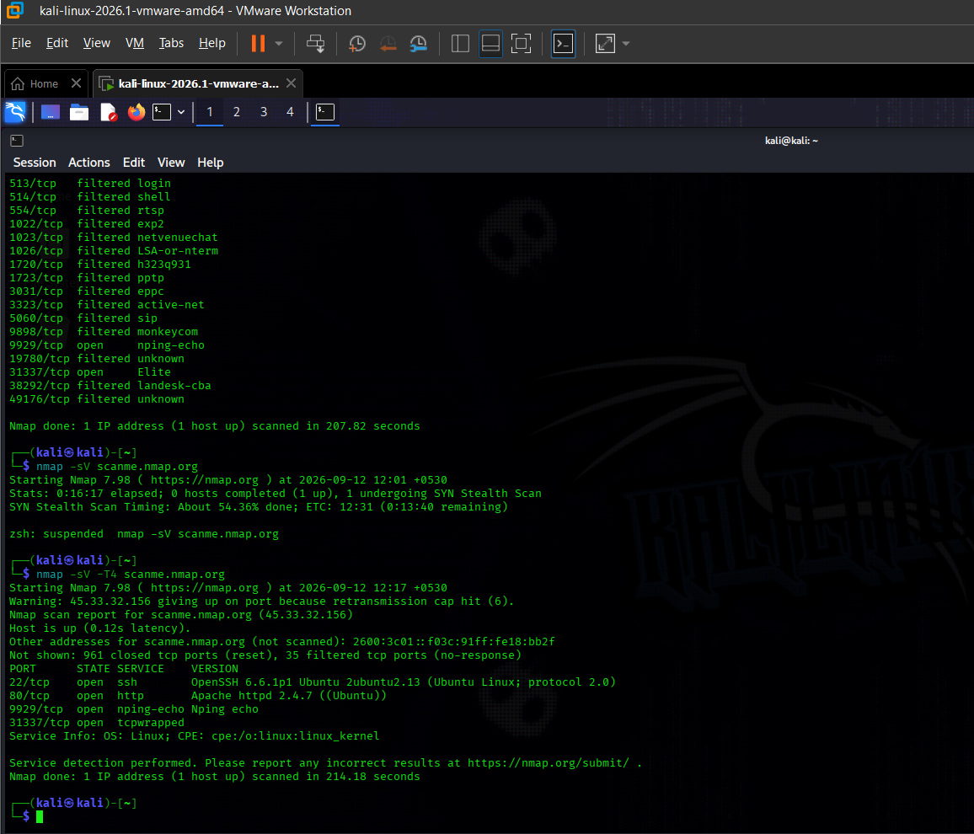
05 / PRACTICAL
Nmap network scanning
Discovering exposed ports, services and version information
PORT STATES
Open = service accepts connections
Closed = no service listening
Filtered = state cannot be determined
ACTUAL FINDINGS
22/tcp SSH • 80/tcp HTTP
9929/tcp nping-echo • 31337/tcp Elite
OpenSSH 6.6.1p1 • Apache 2.4.7
WHY -T4
The default scan stalled on retransmissions. -T4 was used with the same authorized target so the practical could complete in a reasonable time.
LEARNING REFLECTION
Version detection turns a port list into actionable service information.

Slide 7
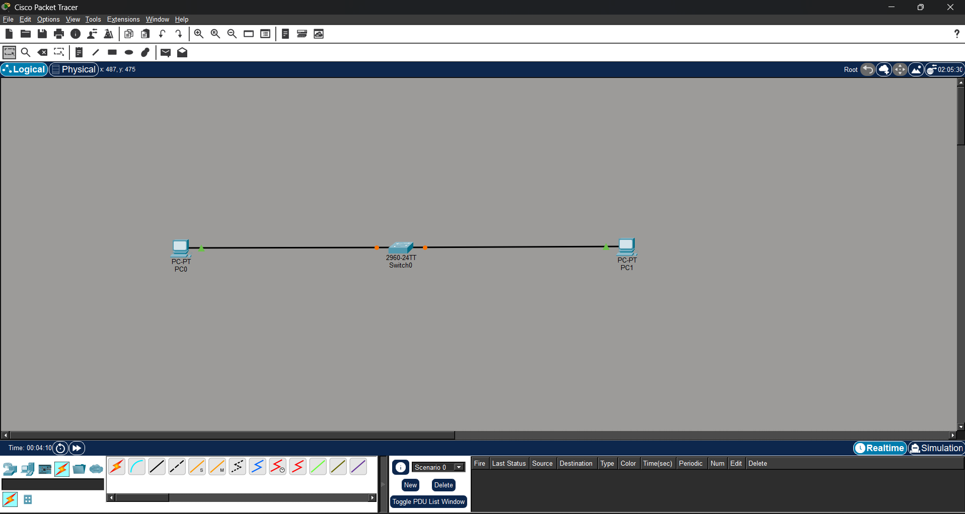
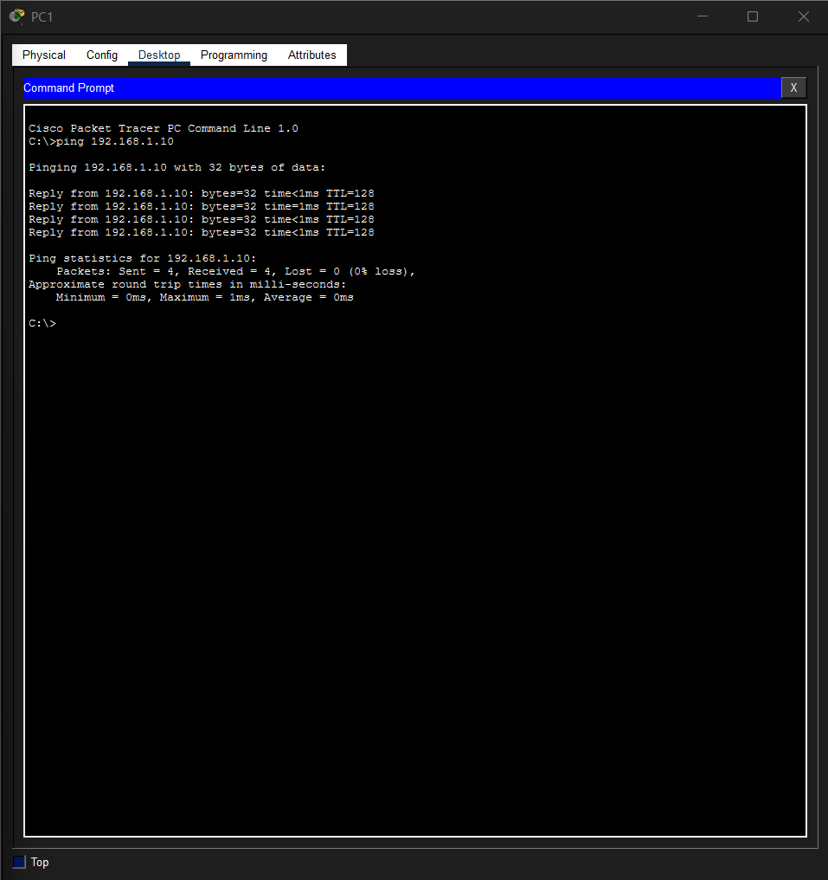
06 / PRACTICAL
Packet Tracer LAN setup
Two PCs, one switch, one same-subnet connectivity test
ADDRESSING PLAN
VERIFICATION
PC1 192.168.1.10 /24 • PC2 192.168.1.11 /24
4 packets received • 0% loss

Slide 8
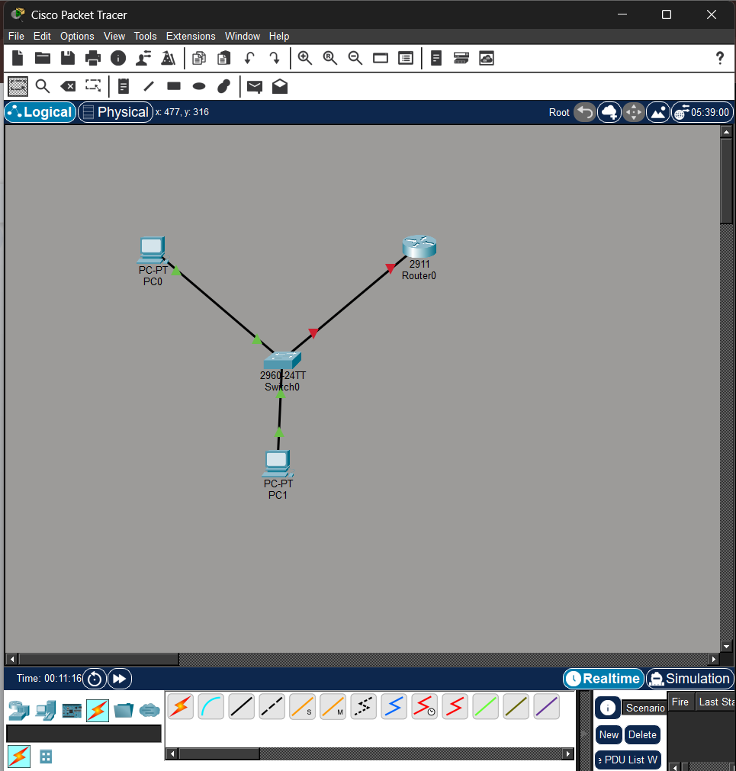
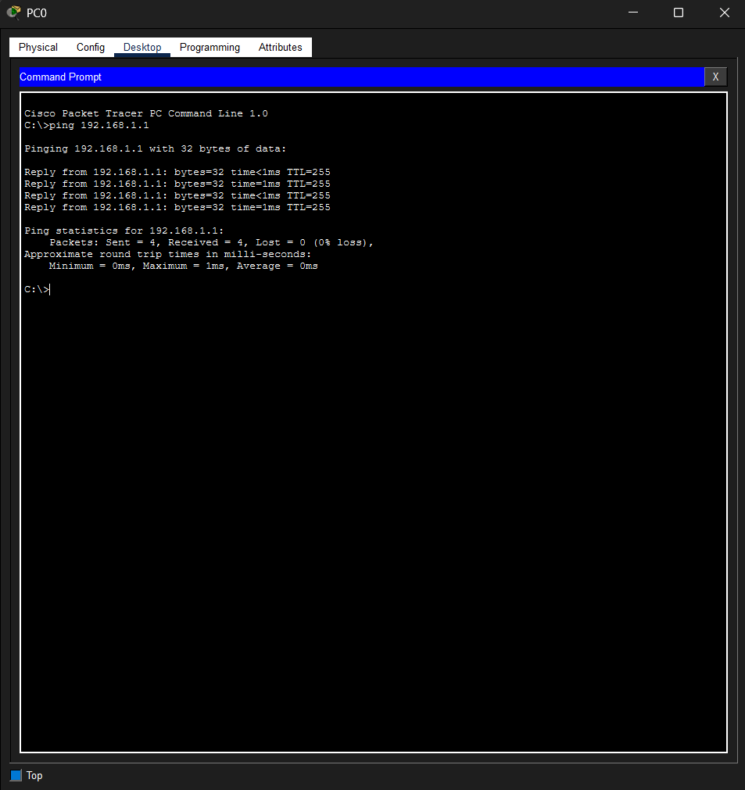
07 / PRACTICAL
Safe MITM concept simulation
Understanding attacker position without performing an actual attack
NORMAL
CONCEPTUAL MITM
SAFE BOUNDARY
PC1 → Switch → Router
PC1 → Attacker → Router
No poisoning / theft / interception

Slide 9
08 / SYNTHESIS
How the week connected together
From networking vocabulary to practical security analysis
Ports
→
Devices
→
Security
→
Wireshark
Identify services
Understand the path
Understand threats
Observe traffic
Nmap
→
Packet Tracer
→
MITM
Discover exposure
Build & verify
Reason about position
INTEGRATED LEARNING
Week 2 moved my understanding from definitions to evidence: ports made scan results meaningful, device roles explained the Packet Tracer topologies, and the security concepts became concrete once I could observe real DNS/TLS traffic and identify exposed services.
The practical value was not just running tools — it was interpreting what their output actually meant.

Slide 10
09 / CONCLUSION
Week 2 learning summary
A compact record of the skills and understanding I gained
TECHNICAL SKILLS
CHALLENGE
Identify common ports and their services.
The default Nmap scan took unusually long because of repeated retransmissions in my environment.
Differentiate router, switch and firewall roles.
Explain MITM, DoS and packet sniffing conceptually.
Capture and filter DNS/TLS traffic in Wireshark.
ADAPTATION
Interpret Nmap port states and service/version results.
I confirmed the target was responding and used -T4 timing optimization on the same authorized target, while documenting the change transparently.
Build and verify LANs in Cisco Packet Tracer.
FINAL TAKEAWAY
Week 2 connected networking theory to visible evidence. The most valuable change was learning to interpret tool output rather than only knowing the command names.
Tools used: Wireshark • Nmap • Cisco Packet Tracer
DG Interns Hub Cybersecurity Internship — Week 2

