Slide 1
DG INTERNS HUB
WEEK 5 – VAPT TOOLS
PRACTICAL LEARNING
Prepared by
SAMYUKTHA S.
Evidence-led VAPT workflow
Nmap • Nikto • Burp Suite • curl • Apache2
Advanced Vulnerability Assessment & Penetration Testing
Cybersecurity Internship
Official assignment target: testphp.vulnweb.com | Authorized practical extension: Ubuntu Apache Lab
DG INTERNS HUB | CYBERSECURITY INTERNSHIP
1

Slide 2
Objective & VAPT Methodology
Objective
Workflow used in the practical
Perform an advanced, evidence-driven VAPT workflow covering reconnaissance, web-server assessment, HTTP inspection, finding validation, hardening and post-remediation retesting.
Nmap
→
Nikto
→
Burp Suite
→
Validation
→
Hardening
→
Retesting
Assessment principle
Scope separation
A scanner alert is not automatically a confirmed vulnerability. Each candidate observation was reproduced or validated with direct evidence before being treated as a finding.
• Official target: testphp.vulnweb.com
• Authorized practical extension: Ubuntu Apache lab — 192.168.162.131
• Connectivity limitations were documented rather than interpreted as a security result.
DG INTERNS HUB | CYBERSECURITY INTERNSHIP
2

Slide 3
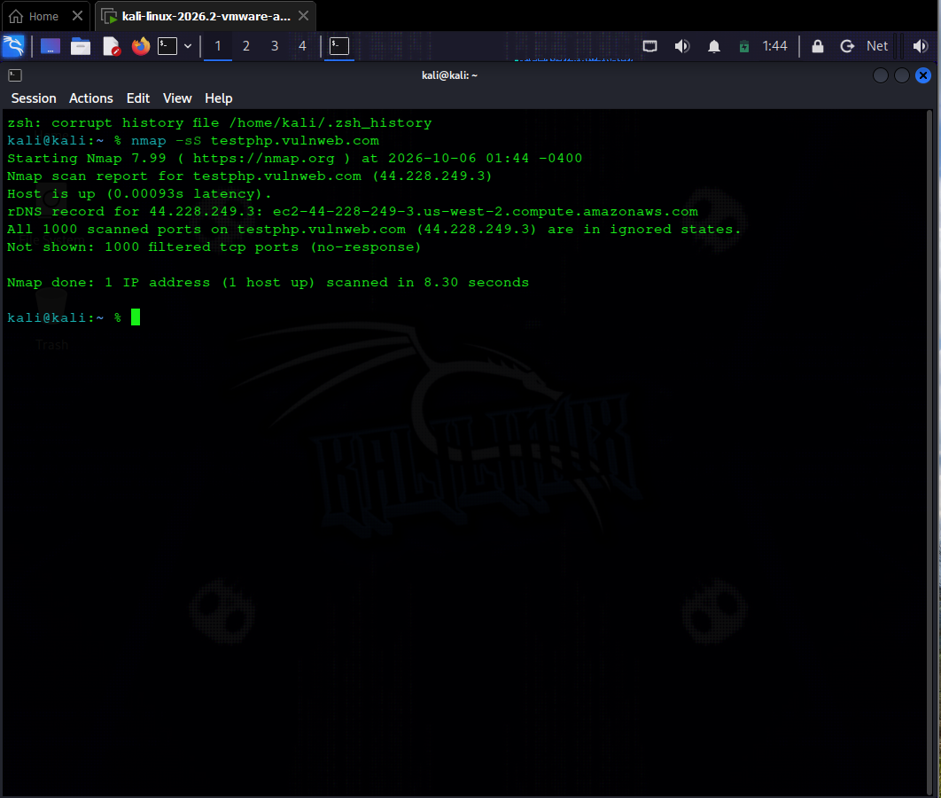
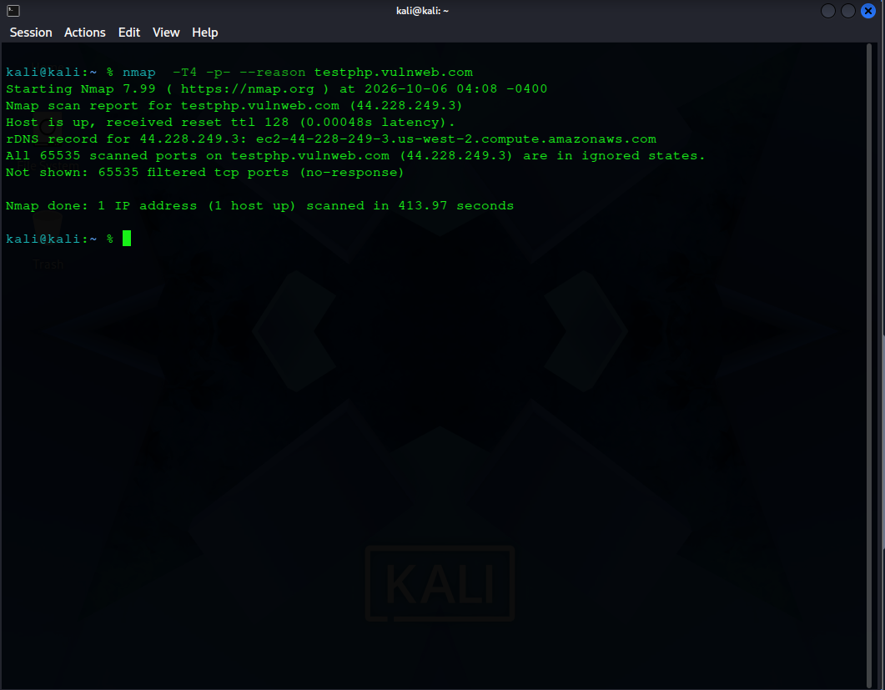
Nmap Assessment
OFFICIAL TARGET
testphp.vulnweb.com → 44.228.249.3
• SYN scan: filtered / no-response behavior
• Service/version scan: no responsive service established
• Advanced scan: filtered ports / no reliable service exposure
• Full TCP scan: all 65,535 ports observed filtered
Figure — Official-target Nmap SYN scan
Figure — Full TCP enumeration
Assessment sequence
Interpretation
nmap -sS → nmap -sV → nmap -A → full TCP enumeration
Connectivity prevented service-level vulnerability validation. No vulnerability claim was made from the scan output.
Result
Reconnaissance completed; external target remained unreachable at the service layer.
DG INTERNS HUB | CYBERSECURITY INTERNSHIP
3

Slide 4
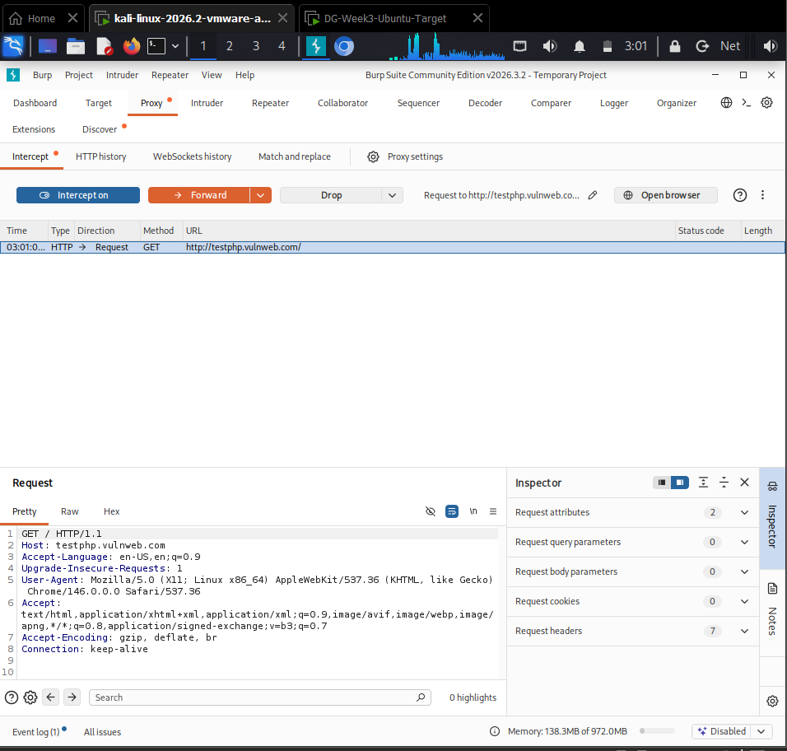
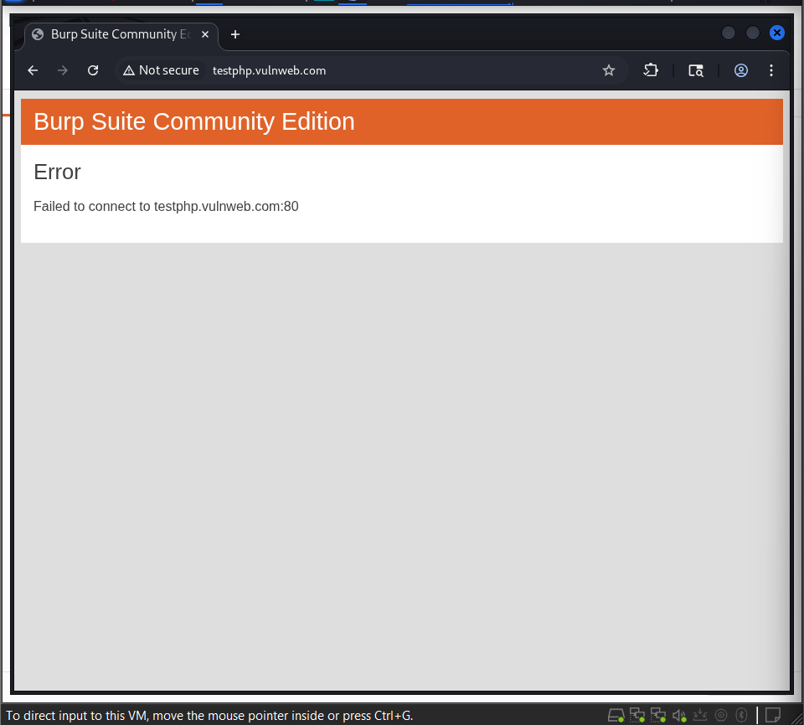
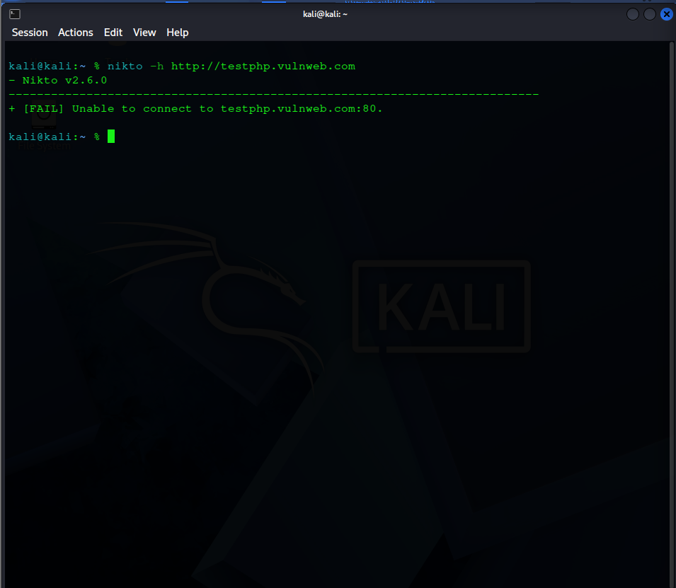
Nikto & Burp Suite
CONNECTIVITY LIMITATION
Burp Suite evidence
Nikto: Unable to connect to testphp.vulnweb.com:80
GET request intercepted successfully; forwarding then failed at target connectivity.
Critical interpretation
Actual Nikto evidence — official target connection failure
Failure to connect is a testing limitation — NOT proof that the target is secure. The report therefore makes no negative security claim about the official site.
Why the distinction matters
A professional VAPT report separates failed tests, observations, validated findings and confirmed remediation.
DG INTERNS HUB | CYBERSECURITY INTERNSHIP
4

Slide 5
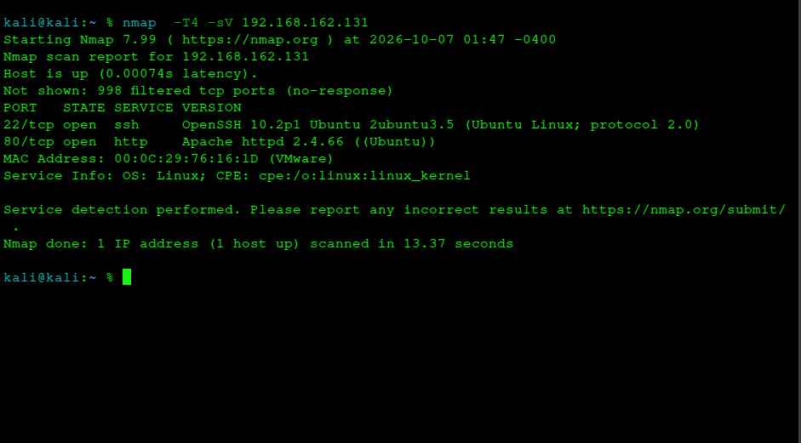
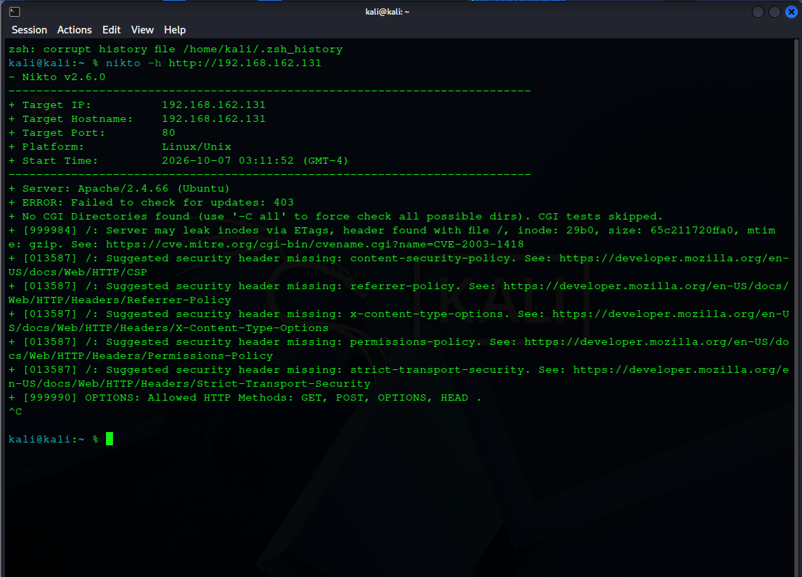
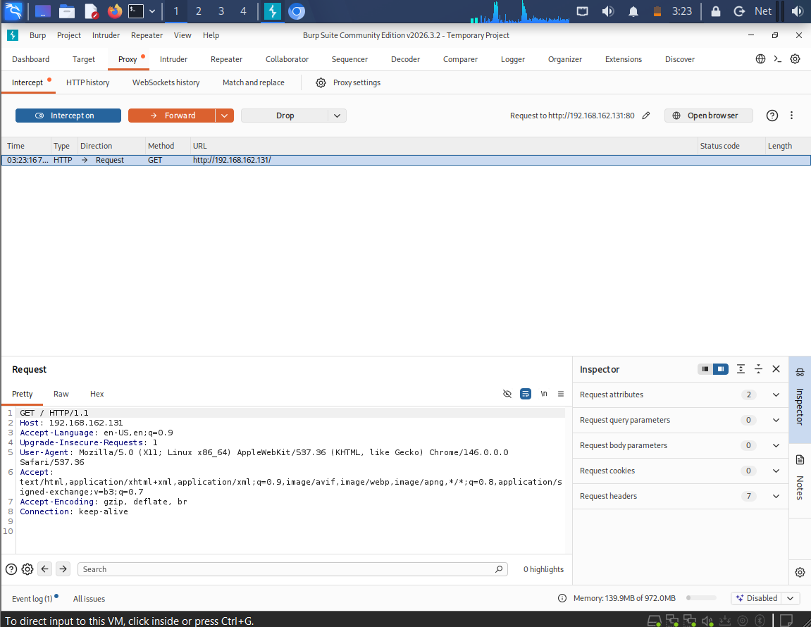
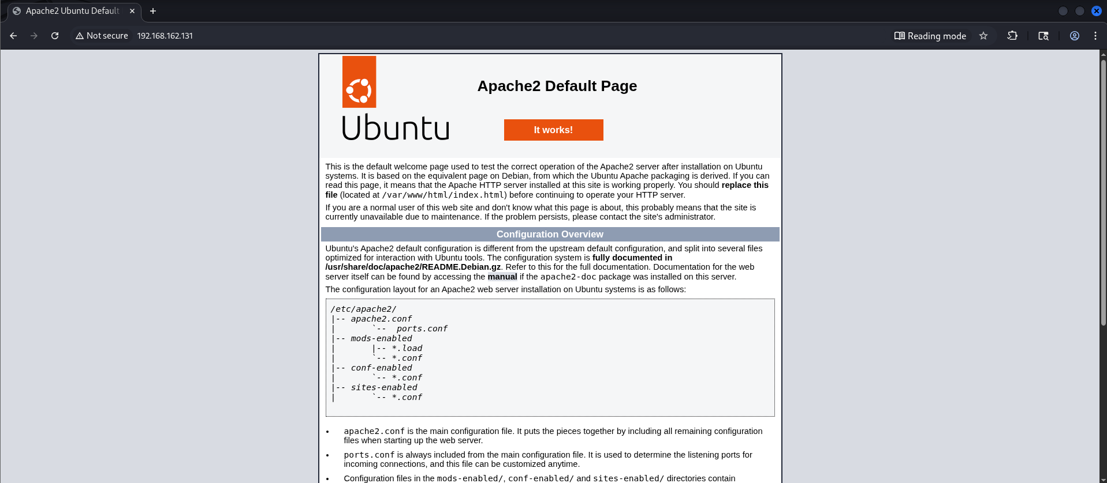
Ubuntu Authorized Lab Extension
AUTHORIZED PRACTICAL EXTENSION
Real lab evidence
Target: 192.168.162.131/24
Nmap baseline
TCP/22 open SSH
TCP/80 open HTTP
OpenSSH 10.2p1 • Apache 2.4.66
Nikto baseline
Apache fingerprinting; ETag observation; missing security headers; GET, POST, OPTIONS and HEAD observed.
Nmap service/version detection — Ubuntu target
Nikto baseline — Ubuntu Apache
Burp — captured GET request
Burp — Apache response after forwarding
DG INTERNS HUB | CYBERSECURITY INTERNSHIP
5

Slide 6
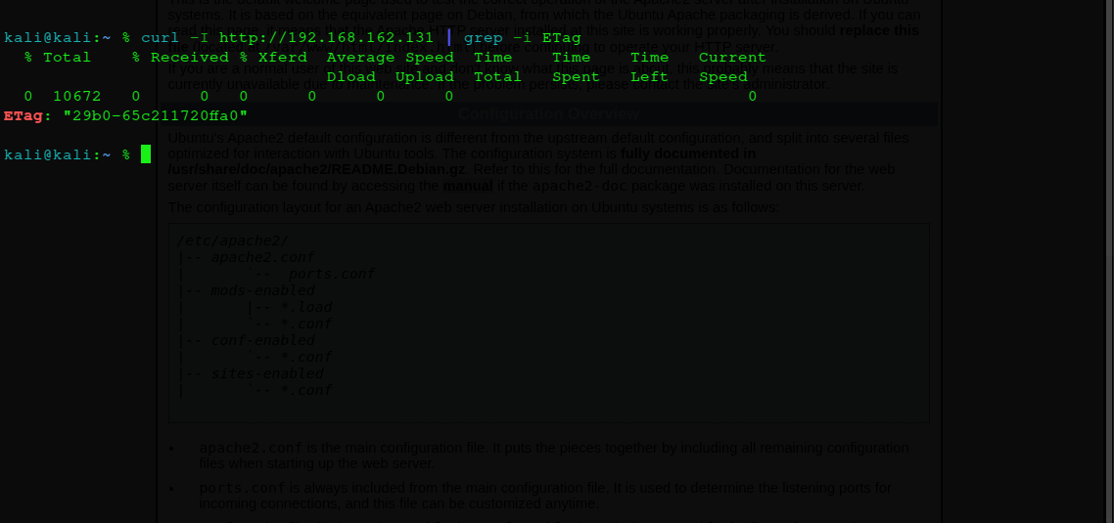
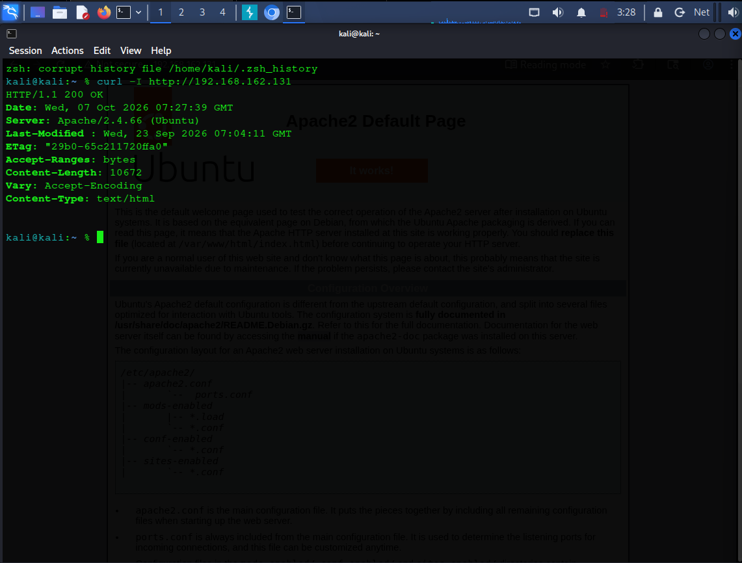
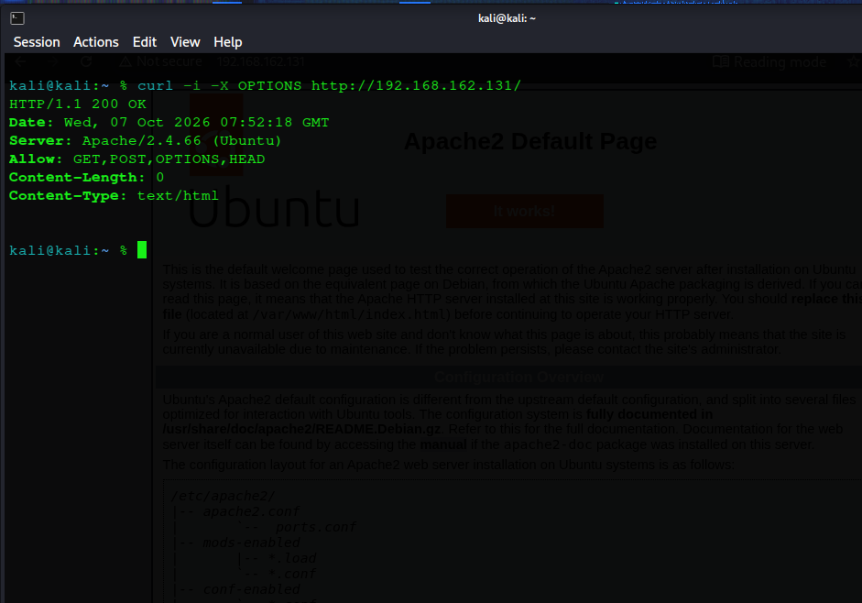
Findings & Validation
Finding
Baseline evidence
Validation
Security significance
ETag
ETag: "29b0-65c211720ffa0"
curl -I reproduced ETag
Configuration / information disclosure observation
Security headers
CSP, Referrer-Policy, X-Content-Type-Options, Permissions-Policy absent
Direct response inspection
Reduced browser-side security controls
HTTP methods
OPTIONS → 200 OK; Allow: GET, POST, OPTIONS, HEAD
Direct OPTIONS request
Unnecessary methods for simple static service
Real validation evidence
ETag validation
Header baseline
OPTIONS validation
DG INTERNS HUB | CYBERSECURITY INTERNSHIP
6

Slide 7
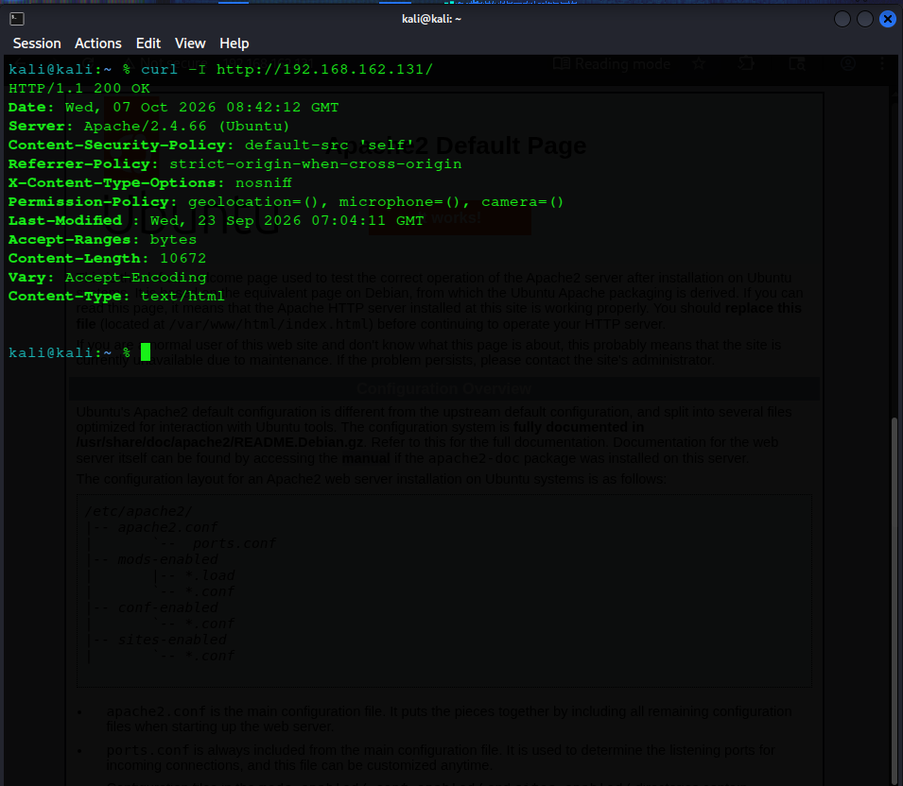
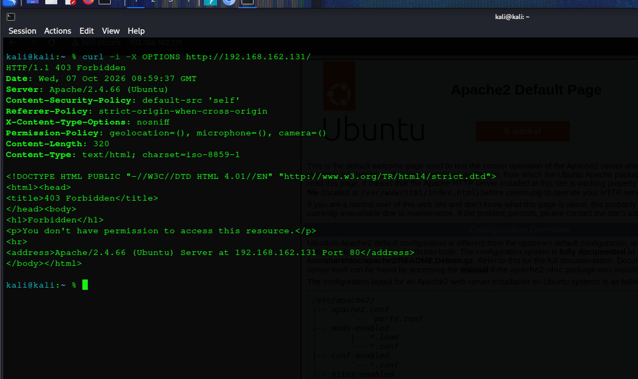
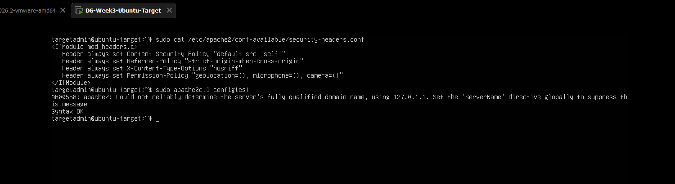
Defense, Hardening & Retesting
Remediation controls
Before → After evidence
• Security headers configured in Apache
• ETag generation disabled with FileETag None
• GET/HEAD retained; other methods restricted
• Apache configuration syntax-tested before reload
Before: ETag present
After: ETag absent
Before: headers absent
Validation discipline
The HTTP-method rule was corrected after a syntax error; the final configuration passed Syntax OK and Apache remained active after reload.
After: OPTIONS → 403 Forbidden
Apache configuration: Syntax OK
Retest result
All three validated Ubuntu-lab findings were addressed and verified with repeatable requests.
DG INTERNS HUB | CYBERSECURITY INTERNSHIP
7

Slide 8
Key Learnings & Conclusion
What I learned
Practical challenges & handling
• Reconnaissance results must be interpreted in network context.
• Scanner output requires validation before becoming a finding.
• Burp Suite exposes the exact HTTP request/response flow.
• curl provides repeatable, low-noise validation.
• Hardening is incomplete until client-side retesting confirms the change.
• Official target was unreachable from the current network path → documented as a limitation.
• Ubuntu lab used as an authorized extension → enabled complete validation and remediation.
• Apache method rule initially produced a syntax error → corrected configuration, tested, reloaded and retested.
Evidence-based VAPT
Identify → reproduce → interpret → remediate → retest. The practical value was not the scanner output alone, but converting observations into defensible, repeatable security evidence.
Conclusion
Official target assessment completed as far as connectivity permitted; Ubuntu VAPT extension, validation, hardening, retesting and before/after evidence completed.
DG INTERNS HUB | CYBERSECURITY INTERNSHIP
8

