Slide 1
DG INTERNS HUB • CYBERSECURITY INTERNSHIP
WEEK 7
WEB APPLICATION TESTING WITH BURP SUITE
Vulnerability Assessment & Penetration Testing (VAPT)
Practical Learning and Evidence Summary
SUBMITTED BY
Authorized local testing only
Target: DVWA on localhost
SAMYUKTHA S. | DG/SEPTEMBER/CYBER/102

Slide 2
Objective and Scope
OBJECTIVE
SCOPE
Use Burp Suite Community Edition to intercept web traffic, map application routes, and investigate selected input-handling weaknesses in a controlled lab.
Application: DVWA at http://127.0.0.1/dvwa/
Proxy: 127.0.0.1:8080
Testing was limited to the local, authorized training environment.
Testing principles
• Capture requests and responses before drawing conclusions.
• Use Repeater for controlled, individual request changes.
• Record confirmed behaviour separately from untested or inconclusive checks.
DG Interns Hub | Cybersecurity Internship | Week 7
02

Slide 3
Testing Workflow
01 Configure
02 Map
03 Test
04 Validate
05 Report
Set browser proxy and verify Burp interception.
Browse DVWA and review the Target site map.
Send selected requests to Repeater and inspect responses.
Confirm behaviour in the browser and capture evidence.
Document impact, limits, and practical remediation.
Evidence-led workflow: a payload or unusual response alone is not enough; conclusions are based on the observed application behaviour and the captured request/response.
DG Interns Hub | Cybersecurity Internship | Week 7
03

Slide 4
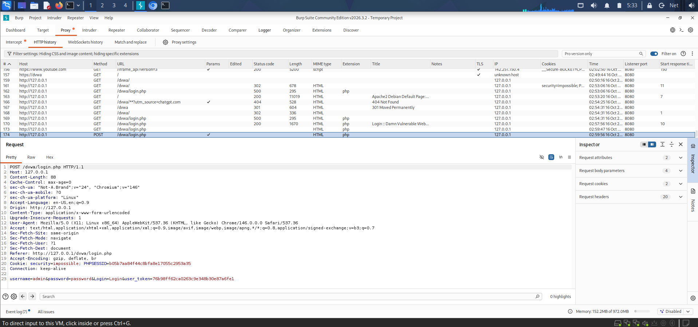
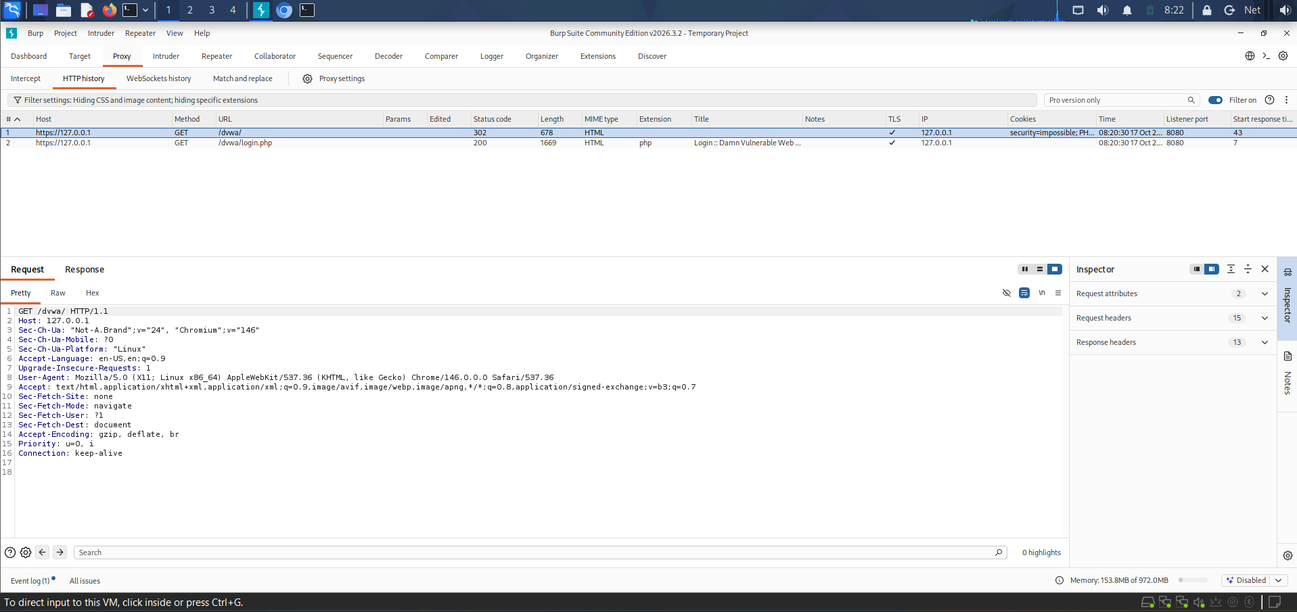
Burp Setup and Interception
PROXY CONFIGURATION
HTTPS AND LOGIN TRAFFIC
Burp proxy listener: 127.0.0.1:8080
Browser traffic was routed through Burp to inspect HTTP requests and responses.
The lab included HTTPS interception and capture of a login POST request. Review method, path, parameters, cookies, and response status.
Login POST evidence
HTTPS interception evidence
DG Interns Hub | Cybersecurity Internship | Week 7
04

Slide 5
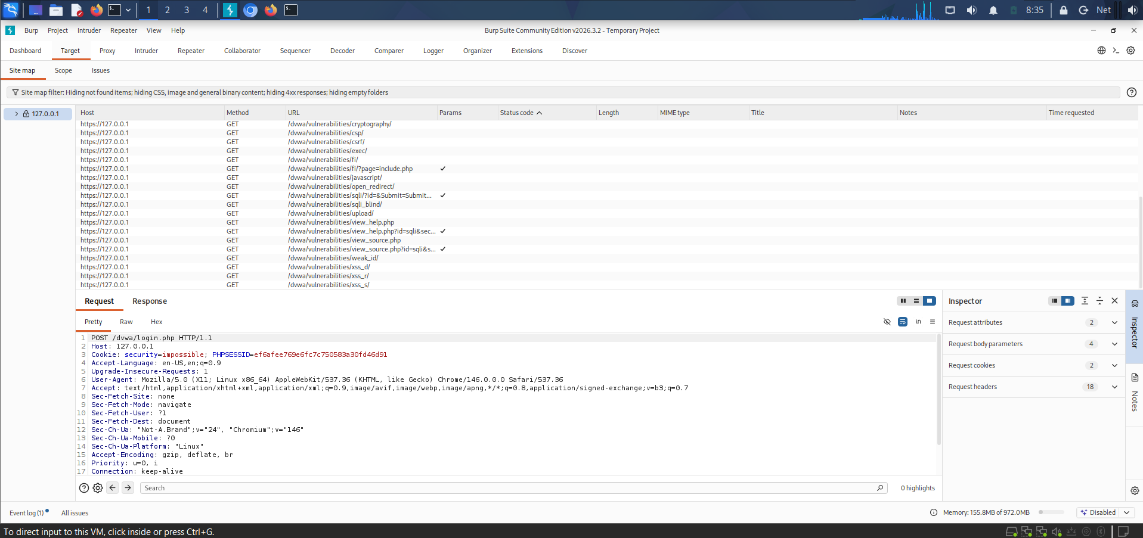
Reconnaissance and Attack Surface
SITE MAP
WHAT WAS RECORDED
The Target site map was populated by browsing the local DVWA application. It helped identify reachable routes and areas for manual review.
Observed pages included login/security areas and training modules such as SQL injection, reflected XSS, stored XSS, upload, and CSRF.
INTERPRETATION
A route appearing in the site map indicates discovery—not that the route is vulnerable.
DG Interns Hub | Cybersecurity Internship | Week 7
05

Slide 6
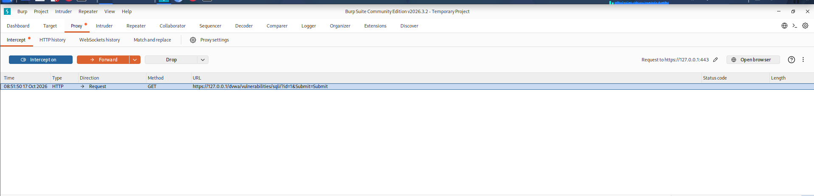
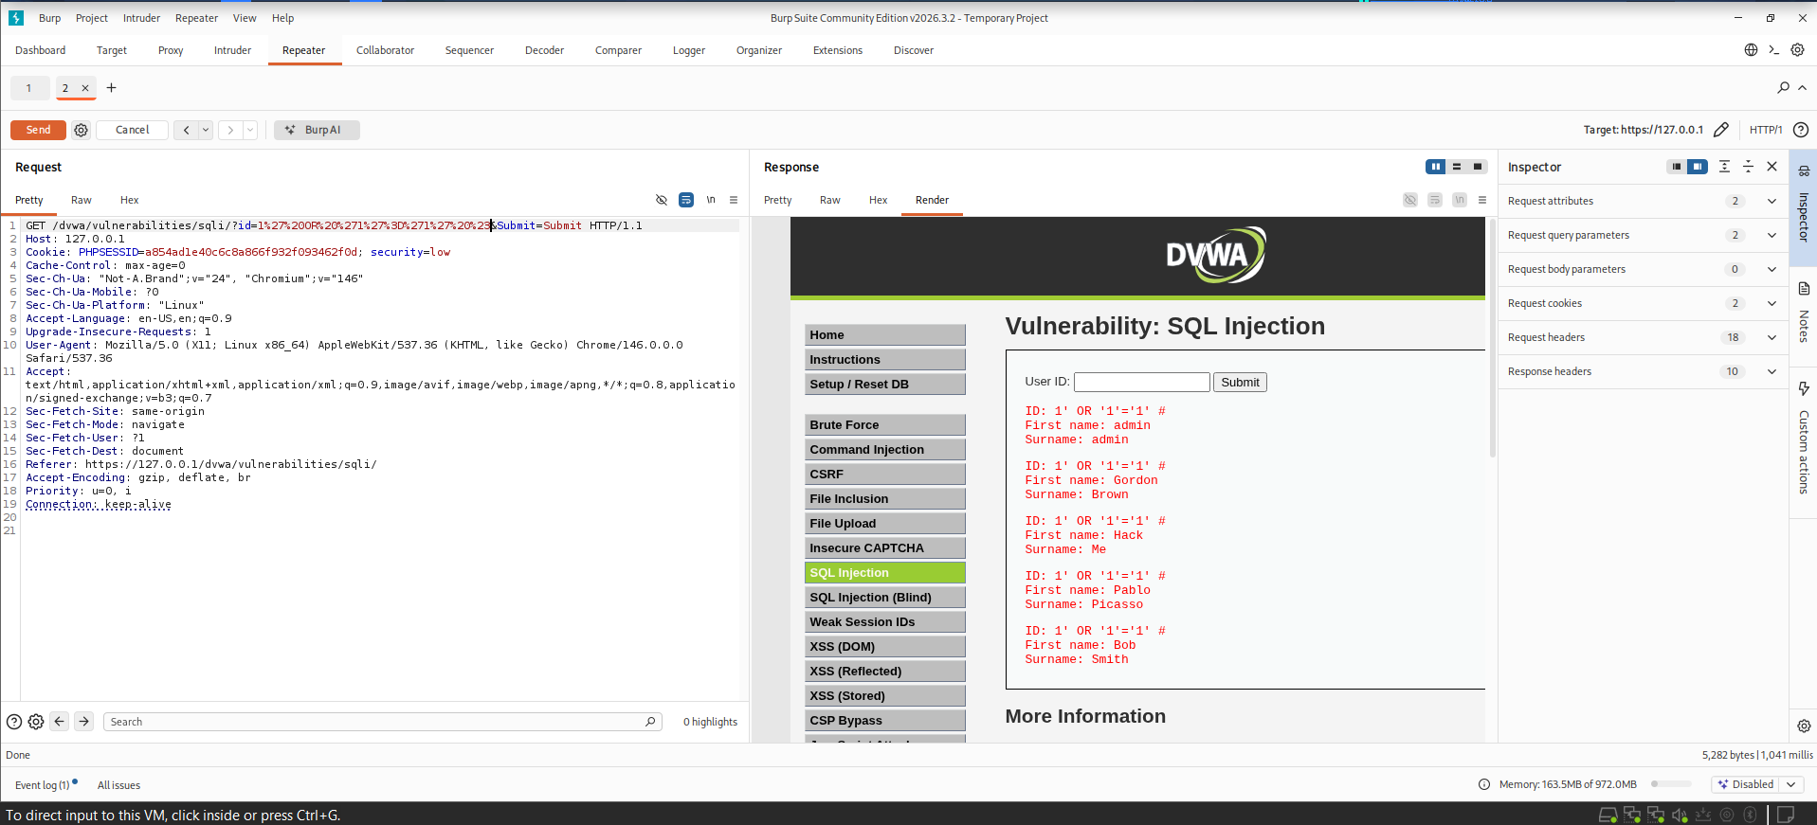
Finding 1 — SQL Injection
TEST CONTEXT
OBSERVED RESULT
DVWA security level: Low
A Boolean-style SQL injection payload was submitted in the local training module.
The response returned multiple user records rather than only the expected single record. This behaviour was consistent with SQL injection in the deliberately vulnerable lab.
Baseline request
Observed SQLi result
Risk: query logic may be altered, exposing records or bypassing intended filters. Fix with parameterized queries and least-privilege database access.
DG Interns Hub | Cybersecurity Internship | Week 7
06

Slide 7
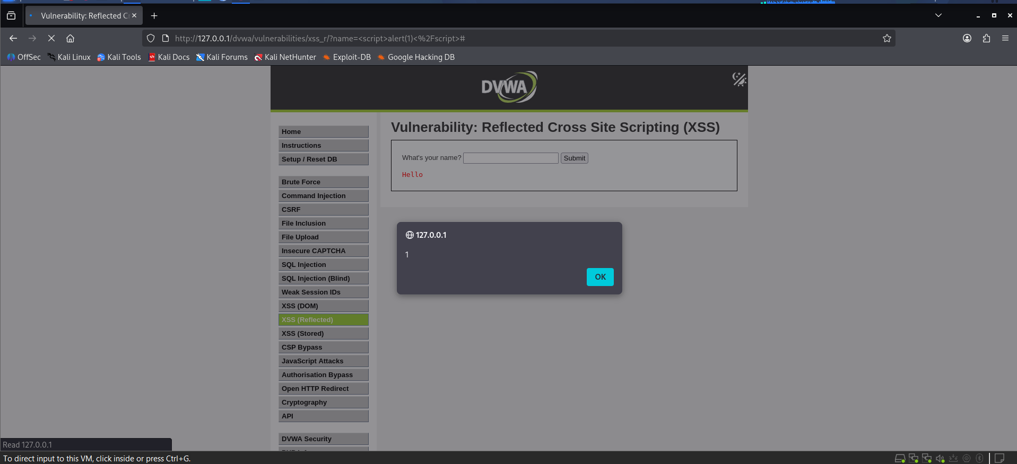
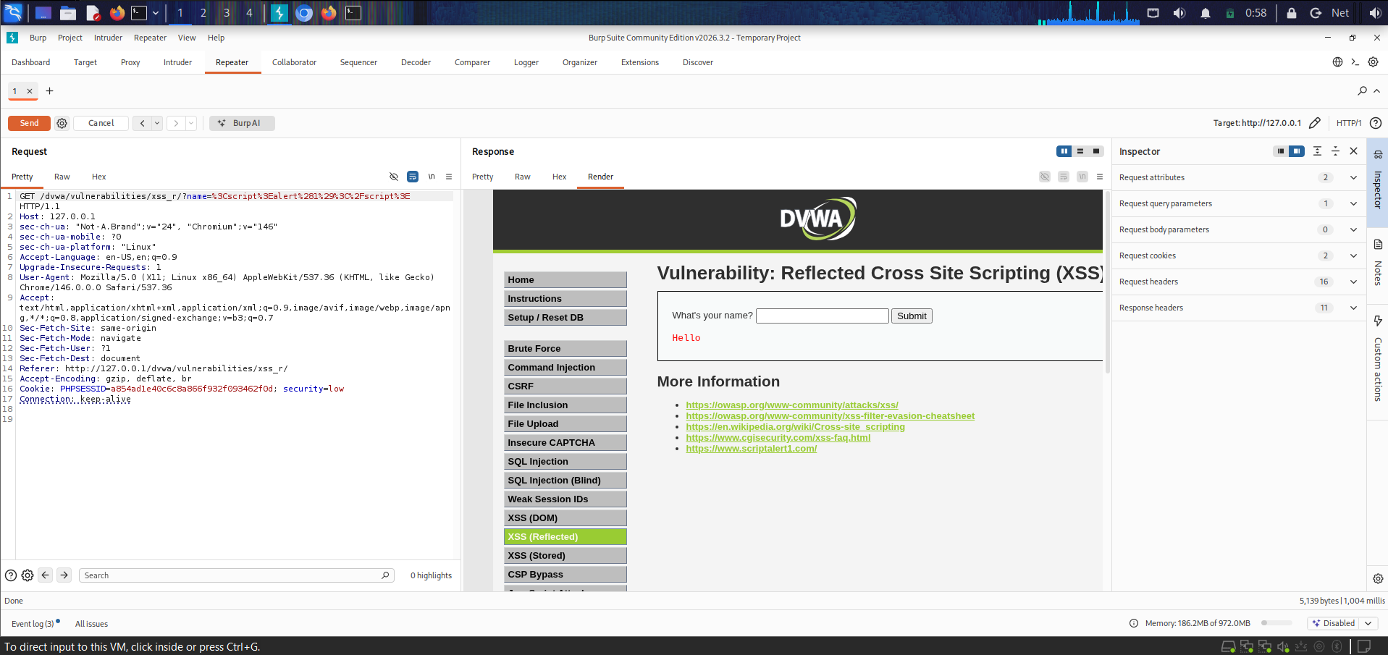
Finding 2 — Reflected XSS
TEST CONTEXT
OBSERVED RESULT
A script payload was submitted through a reflected input in the local DVWA module.
The browser displayed a JavaScript alert after the request. Burp request/response evidence was also captured to connect the input with the application response.
Browser confirmation
Burp evidence
Risk: attacker-controlled script may execute in a victim’s browser. Context-aware output encoding and safe templating are primary defences.
DG Interns Hub | Cybersecurity Internship | Week 7
07

Slide 8
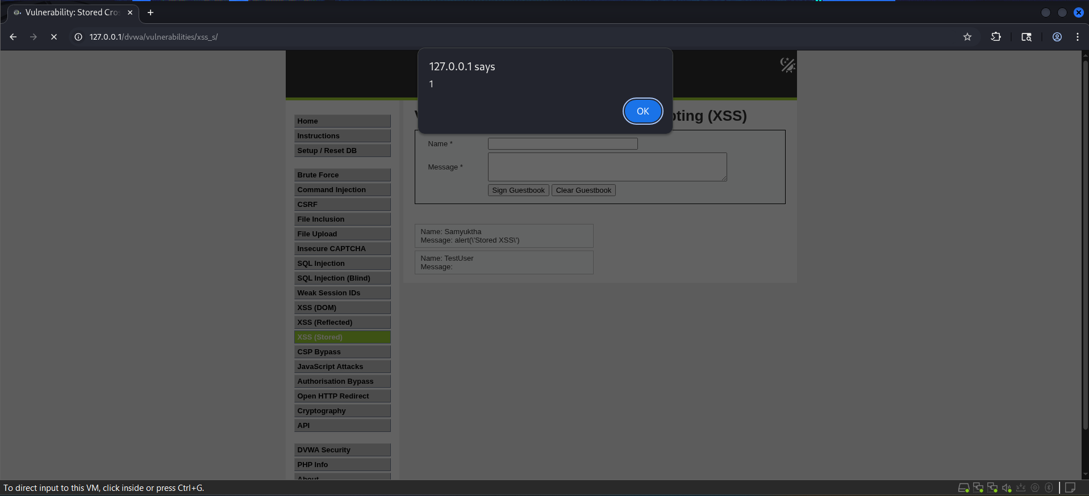
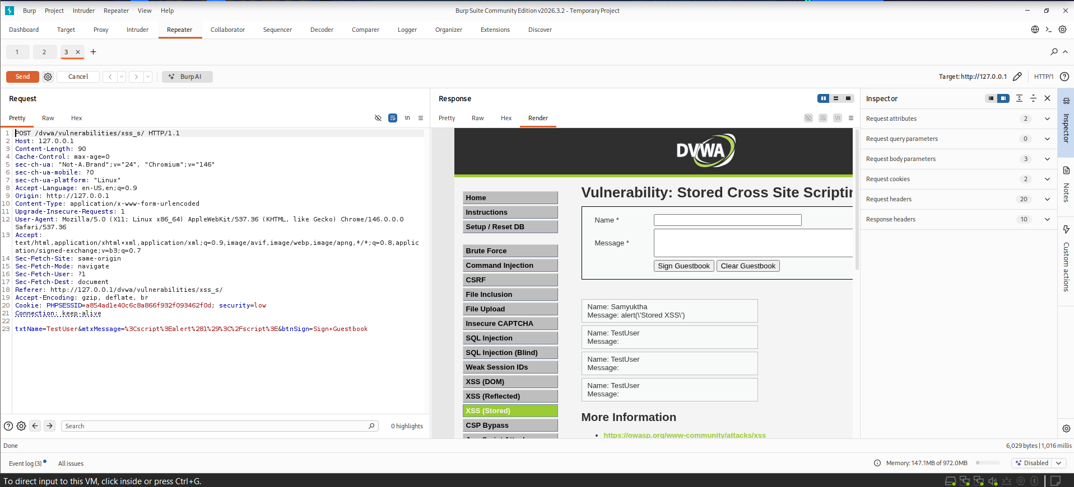
Finding 3 — Stored XSS
TEST CONTEXT
OBSERVED RESULT
A script payload was entered into the local guestbook form and stored by the training application.
The payload executed when the stored entry was rendered, and the related Burp request/response evidence was captured.
Browser confirmation
Burp request/response
Risk: stored content can affect every user who views it. Encode output by context, validate input, and avoid rendering untrusted content as HTML.
DG Interns Hub | Cybersecurity Internship | Week 7
08

Slide 9
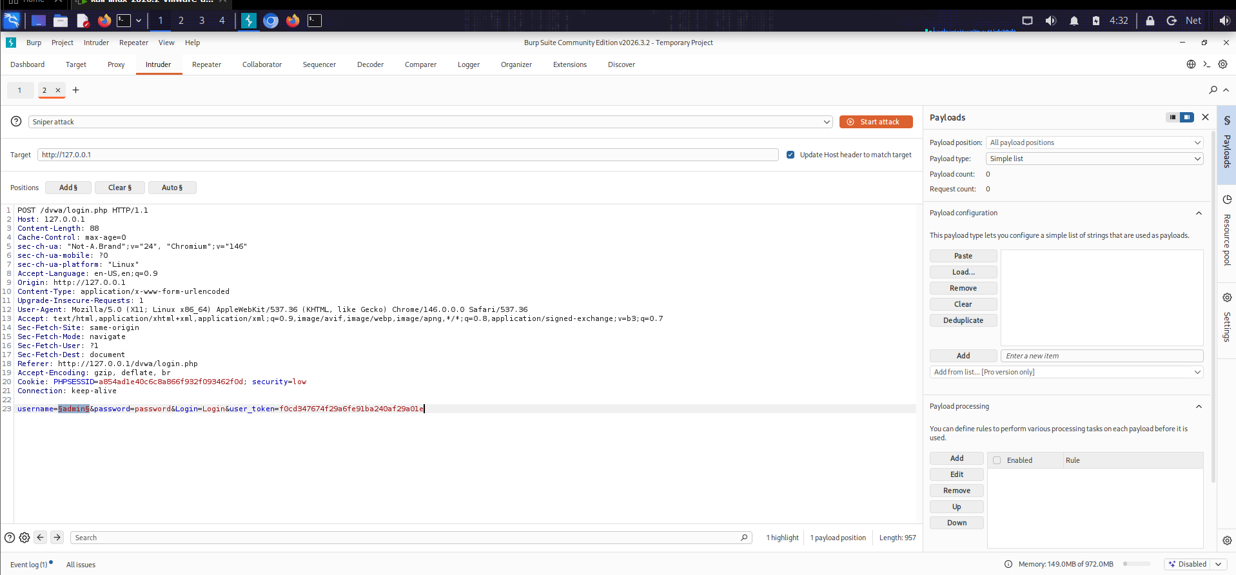
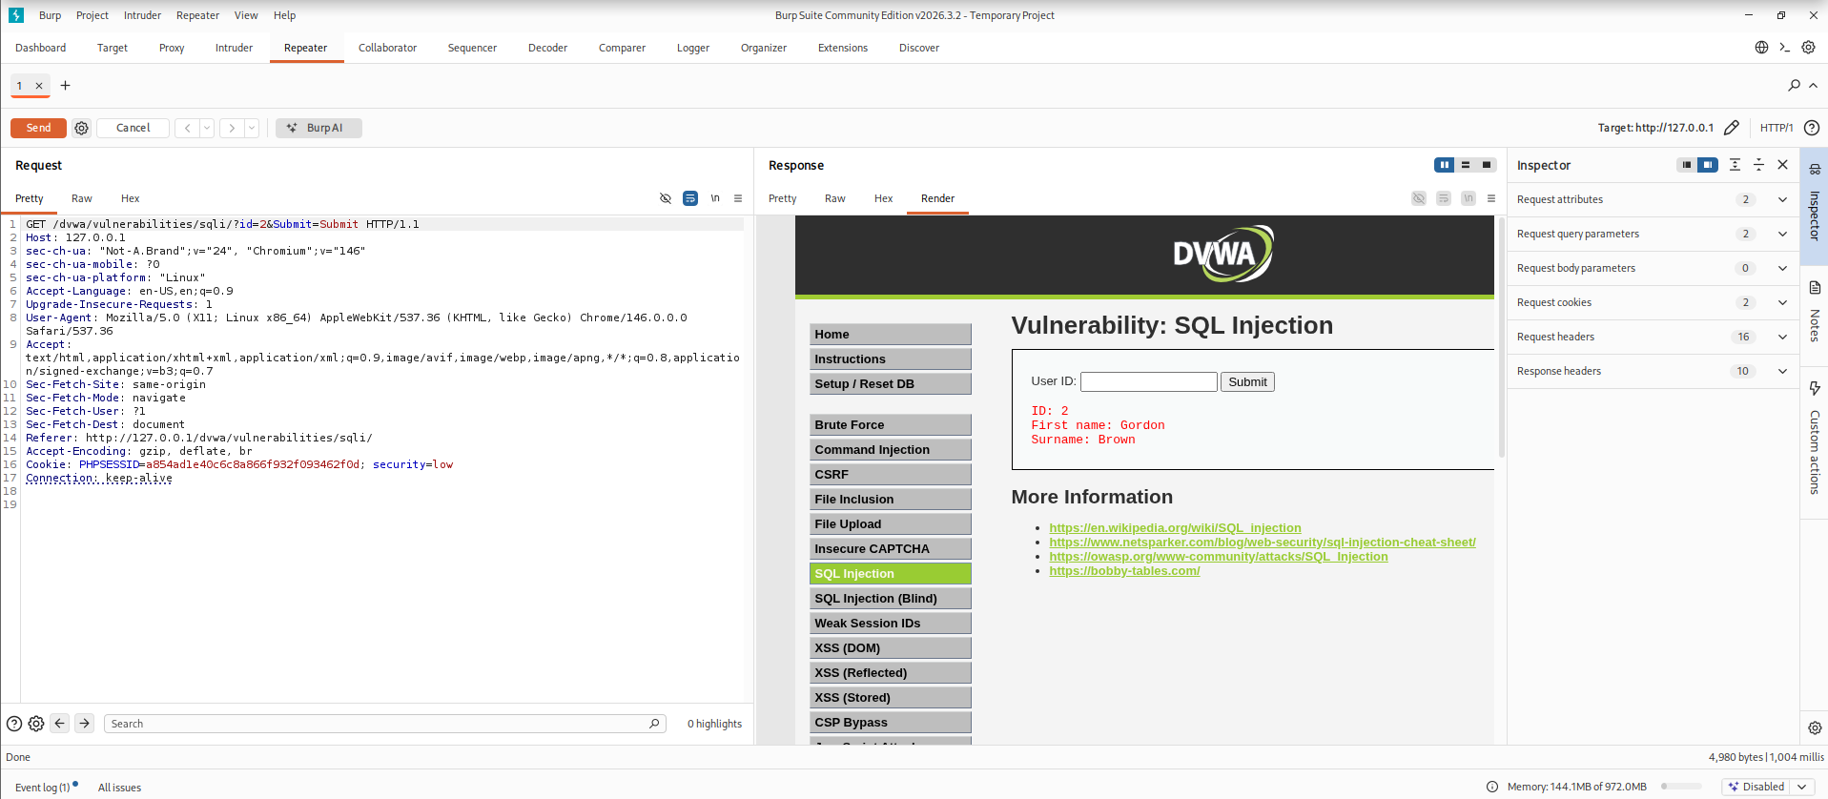
Intruder Configuration and Parameter Testing
INTRUDER POSITIONS
PARAMETER COMPARISON
A username parameter was marked as an Intruder position. Evidence demonstrates configuration only; it does not claim a password-guessing attack was completed.
A request parameter was changed from id=1 to id=2 in Repeater and a response was received. This is a test observation, not proof of broken access control.
Intruder position
Parameter change
DG Interns Hub | Cybersecurity Internship | Week 7
09

Slide 10
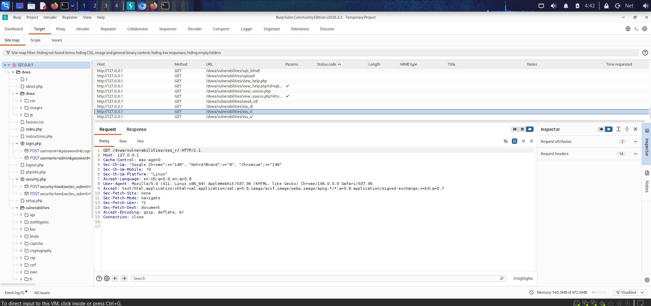
Endpoint Discovery and Evidence
METHOD USED
EVIDENCE NOTES
Manual browsing and Burp Target site-map review were used to identify visible application routes. No directory brute-force results are claimed.
Endpoint notes recorded discovered pages and potential areas for review. A discovered endpoint is not a confirmed security issue without further validation.
Next validation step
Check authorization and input handling for each route using test accounts and controlled requests.
DG Interns Hub | Cybersecurity Internship | Week 7
10

Slide 11
Recommended Remediation
SQL INJECTION
CROSS-SITE SCRIPTING
• Use parameterized queries / prepared statements.
• Validate types and expected input ranges.
• Restrict database account permissions.
• Apply context-aware output encoding.
• Sanitize rich text with a maintained allow-list.
• Use a restrictive Content Security Policy as defence in depth.
ACCESS CONTROL
BURP WORKFLOW
• Enforce authorization on the server for every object.
• Do not trust client-supplied identifiers.
• Test with separate users and expected permissions.
• Save baseline and modified requests.
• Compare status, headers, body, and application behaviour.
• Keep session tokens and credentials out of shared evidence.
DG Interns Hub | Cybersecurity Internship | Week 7
11

Slide 12
Conclusion and Learning Outcomes
KEY RESULTS
WHAT WAS PRACTISED
Three issues were demonstrated in the deliberately vulnerable local DVWA lab: SQL injection, reflected XSS, and stored XSS.
Proxy interception, HTTPS traffic review, site mapping, Repeater request modification, Intruder position setup, and evidence-based reporting.
Limitations and responsible testing
• Results apply to the local DVWA configuration and should not be generalized to other applications.
• Intruder configuration and parameter modification were documented without overstating their security conclusions.
• All testing remained within the authorized training lab; sensitive session information should be redacted before sharing.
Thank you
DG Interns Hub | Cybersecurity Internship | Week 7
12

