Slide 1
DG INTERNS HUB / CYBERSECURITY INTERNSHIP
WEEK 8 —
ADVANCED VAPT
TARGET
OWASP Juice Shop
AUTHORIZED LAB
http://127.0.0.1:3000
Attack Surface, Findings, Remediation & Retesting
Samyuktha S.
Internship ID: DG/SEPTEMBER/CYBER/102
EVIDENCE-LED
TECHNICAL SUMMARY
DG INTERNS HUB • WEEK 8 ADVANCED VAPT • LOCAL AUTHORIZED LAB
01/07

Slide 2
01 / APPROACH
Scope & testing methodology
Testing was limited to the intentionally vulnerable local application; tool versions and test timestamps were not established in the supplied archive.
01 Discover
02 Inspect
03 Validate
Application access, login/registration pages and route inventory.
Burp Suite site map, HTTP requests/responses and authentication baselines.
Product-search input handling and public-registration role assignment.
Evidence standard
Out of scope / not proven
Claims are limited to observed requests, responses and screenshots. Missing versions, dates or retest results are not inferred.
No demonstrated database extraction, proven SQL injection, or verified access to protected administrative operations.
DG INTERNS HUB • WEEK 8 ADVANCED VAPT • LOCAL AUTHORIZED LAB
02/07

Slide 3
02 / RESULTS
Two distinct findings
The evidence supports two separate test paths—not a single combined exploitation chain.
F-01 | SQL error disclosure
F-02 | Client-controlled role assignment
Normal product search: HTTP 200. Apostrophe-containing input: HTTP 500 with SQL/SQLite-related details and stack information.
Impact: internal error details exposed.
Registration request supplied role=admin; lab response returned HTTP 201 and role=admin. Challenge-success screenshot is present.
Protected admin access: not verified.
CURRENT STATUS
F-01 Pending Verification
F-02 Pending Verification
DG INTERNS HUB • WEEK 8 ADVANCED VAPT • LOCAL AUTHORIZED LAB
03/07

Slide 4
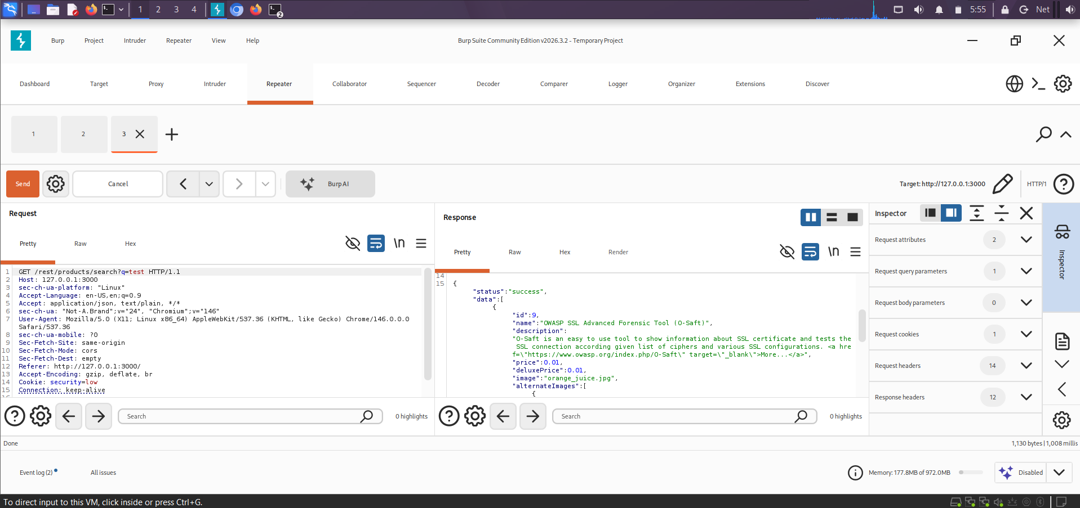
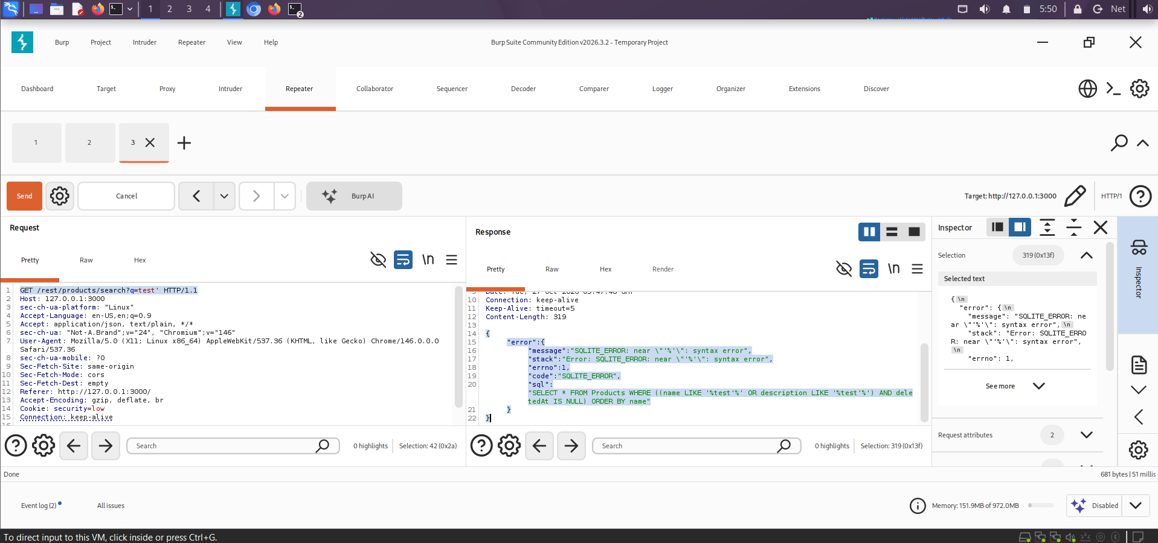
03 / FINDING F-01
Product search exposes SQL-related errors
Evidence comparison: baseline search versus special-character input. This supports error disclosure, not proof of SQL injection.
Evidence E15 — normal input
Evidence E14 — special-character input
Observed baseline
Observed error
HTTP 200 for ordinary search.
HTTP 500 with SQL-related details.
DG INTERNS HUB • WEEK 8 ADVANCED VAPT • LOCAL AUTHORIZED LAB
04/07

Slide 5
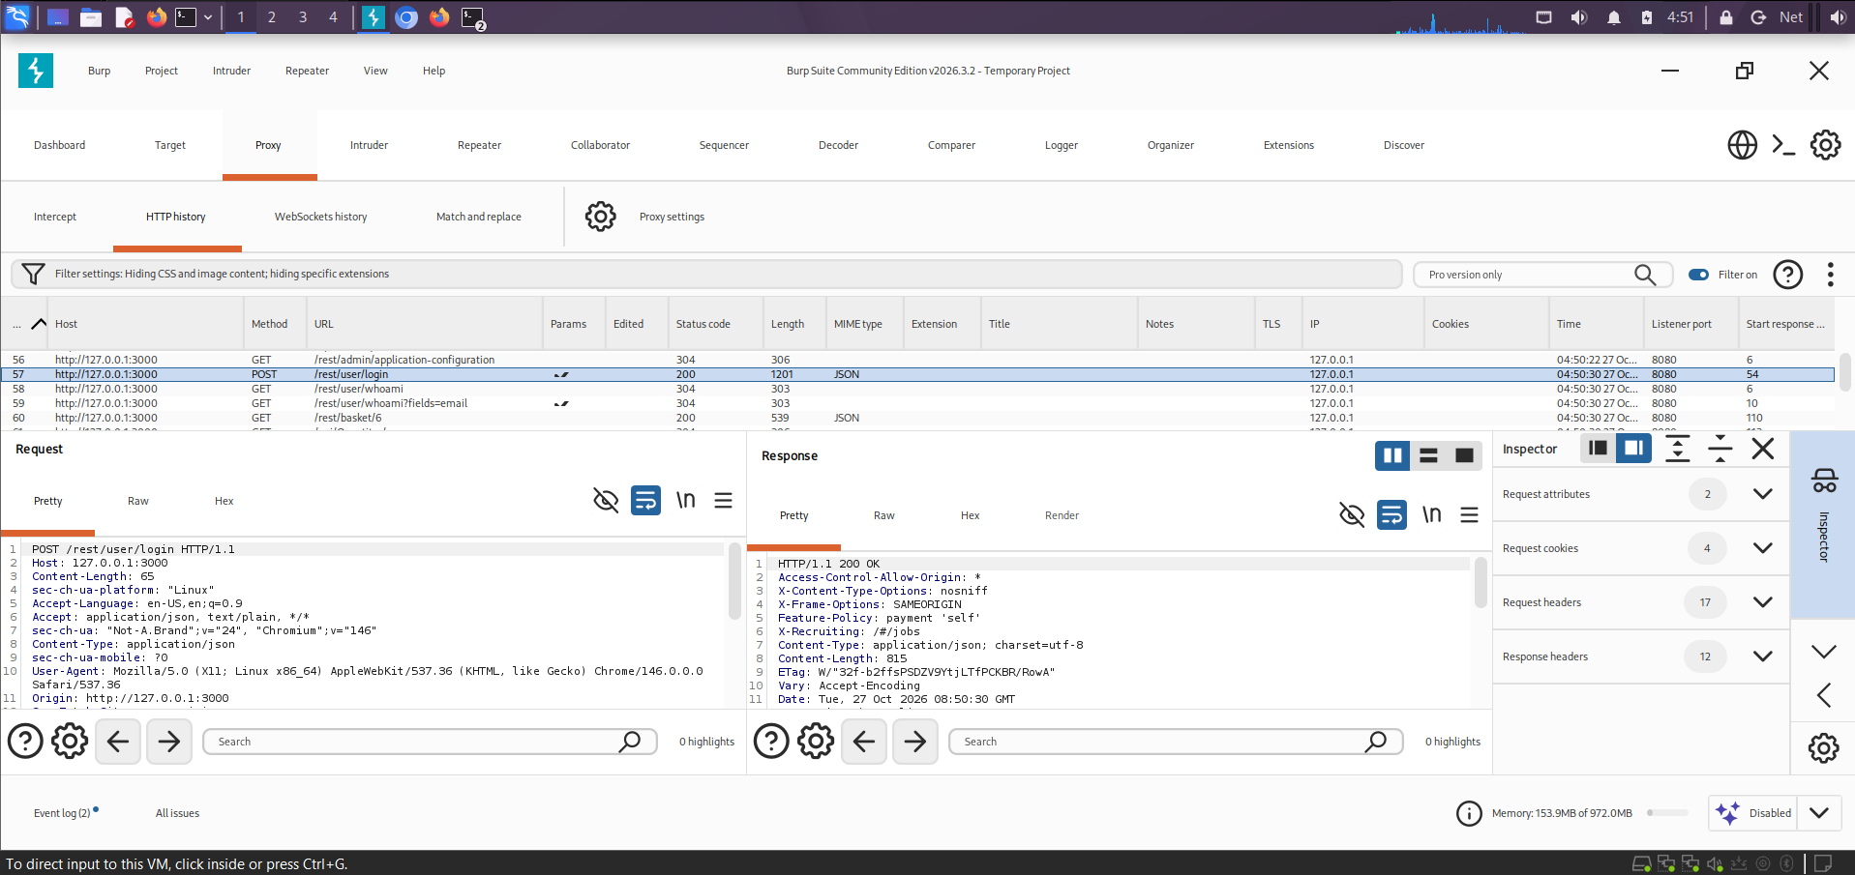
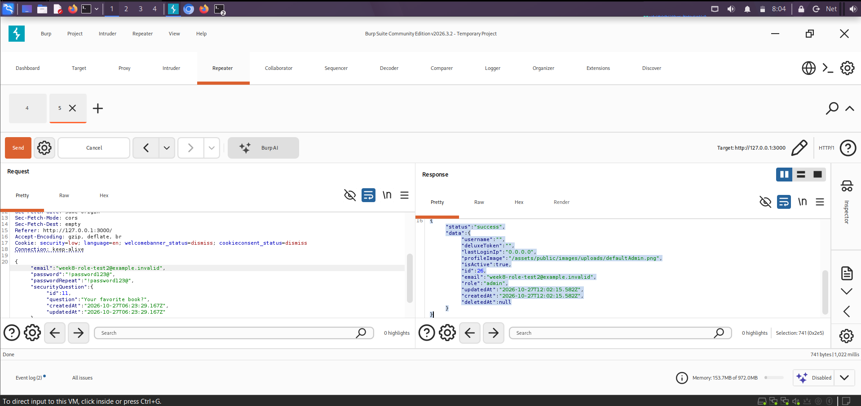
04 / FINDING F-02
Registration accepted a client-supplied admin role
Local Juice Shop lab evidence shows role assignment during registration. Do not infer access to protected admin operations.
Evidence E09 — registration request/response
F-02 — role-registration evidence
Challenge-success evidence: F-02-Admin-Registration-Challenge-Solved.png • Protected admin operations remain unverified.
DG INTERNS HUB • WEEK 8 ADVANCED VAPT • LOCAL AUTHORIZED LAB
05/07

Slide 6
05 / REMEDIATION
Fixes and retest criteria
Both findings remain Pending Verification until fixes are implemented and genuine retest evidence is captured.
F-01 | SQL error disclosure
F-02 | Role assignment
• Use prepared statements / parameterized queries.
• Avoid SQL string concatenation.
• Return generic client errors; log details securely.
• Regression-test normal and special-character searches.
• Assign customer role server-side.
• Reject or ignore client role/isAdmin fields.
• Enforce authorization on every admin operation.
• Test role tampering and customer access denial.
RETEST RESULTS — NOT YET TESTED
Finding
Retest criterion
Actual result
Status
F-01
No SQL details in errors; normal search works
Not yet tested
Pending Verification
F-02
Registration cannot grant admin; customer denied admin routes
Not yet tested
Pending Verification
DG INTERNS HUB • WEEK 8 ADVANCED VAPT • LOCAL AUTHORIZED LAB
06/07

Slide 7
06 / CLOSE-OUT
Evidence-led conclusion
The local lab demonstrated error disclosure and client-controlled role assignment. Remediation outcomes are not yet known.
Finding accuracy
Separate test paths
Verify before closure
State only what requests, responses and screenshots demonstrate.
Do not present F-01 and F-02 as one successful exploit chain.
Record build, date, request/response, actual outcome and evidence path.
NEXT ACTIONS
1. Implement the recommended fixes.
2. Execute both retest plans and capture fresh evidence.
3. Update actual results only after verification; keep status Pending Verification until then.
DG INTERNS HUB • WEEK 8 ADVANCED VAPT • LOCAL AUTHORIZED LAB
07/07

