Slide 1
DG INTERNS HUB | CYBERSECURITY INTERNSHIP
WEEK 09
SOC Introduction
and Setup
Security Operations Center Fundamentals and Snort IDS Implementation
Ubuntu Server 24.04.5 LTS | Snort 2.9.20
DG INTERNS HUB | WEEK 09 SOC
1

Slide 2
SOC Fundamentals
People, process and technology working together
• Centralized function for monitoring networks, systems and applications.
• Turns security telemetry into triage decisions and coordinated response.
• Core responsibilities: monitoring, detection, investigation, response and reporting.
• Success depends on useful telemetry, tuned detections and consistent procedures.
PEOPLE
L1 / L2 / L3 analysts
PROCESS
Triage → investigate → respond
TECHNOLOGY
SIEM • IDS • IPS
DG INTERNS HUB | WEEK 09 SOC
2

Slide 3
SOC Analyst Tiers and Workflow
A common operating model; exact responsibilities vary by organization
L1
L2
L3
Monitor & triage
Investigate & respond
Advanced analysis
Validate basic context, collect evidence and escalate.
Correlate telemetry, assess scope and support containment.
Threat hunting, root-cause analysis and detection improvement.
SOC monitoring lifecycle
Collect → Detect → Triage → Investigate → Respond → Document
An IDS alert is an investigation lead—not a confirmed incident.
DG INTERNS HUB | WEEK 09 SOC
3

Slide 4
SIEM vs IDS vs IPS
Complementary technologies with different operational roles
SIEM
IDS
IPS
Collect • correlate • analyze
Detect • alert
Detect • prevent
Aggregates logs and events from multiple sources; supports dashboards, correlation and cases.
Inspects network or host activity and generates alerts; normally passive.
Can drop or block traffic when deployed inline and configured for enforcement.
This project demonstrates Snort IDS detection and alerting only; no traffic blocking or IPS prevention is claimed.
DG INTERNS HUB | WEEK 09 SOC
4

Slide 5

Lab Environment
VMware Workstation • Ubuntu Server • Snort
• Operating system: Ubuntu Server 24.04.5 LTS (noble).
• Hostname: soc-server.
• Interface: ens33, state UP.
• Observed IPv4: 192.168.38.128/24; default gateway: 192.168.38.2.
• IDS: Snort 2.9.20 GRE, Build 82.
• VMware NAT / VMnet8 is supplied as project context; VM network-editor evidence was not included.
Figure: interface and route output from the supplied screenshot.
DG INTERNS HUB | WEEK 09 SOC
5

Slide 6
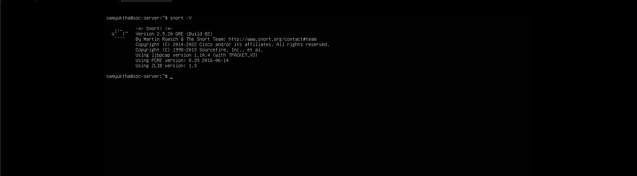
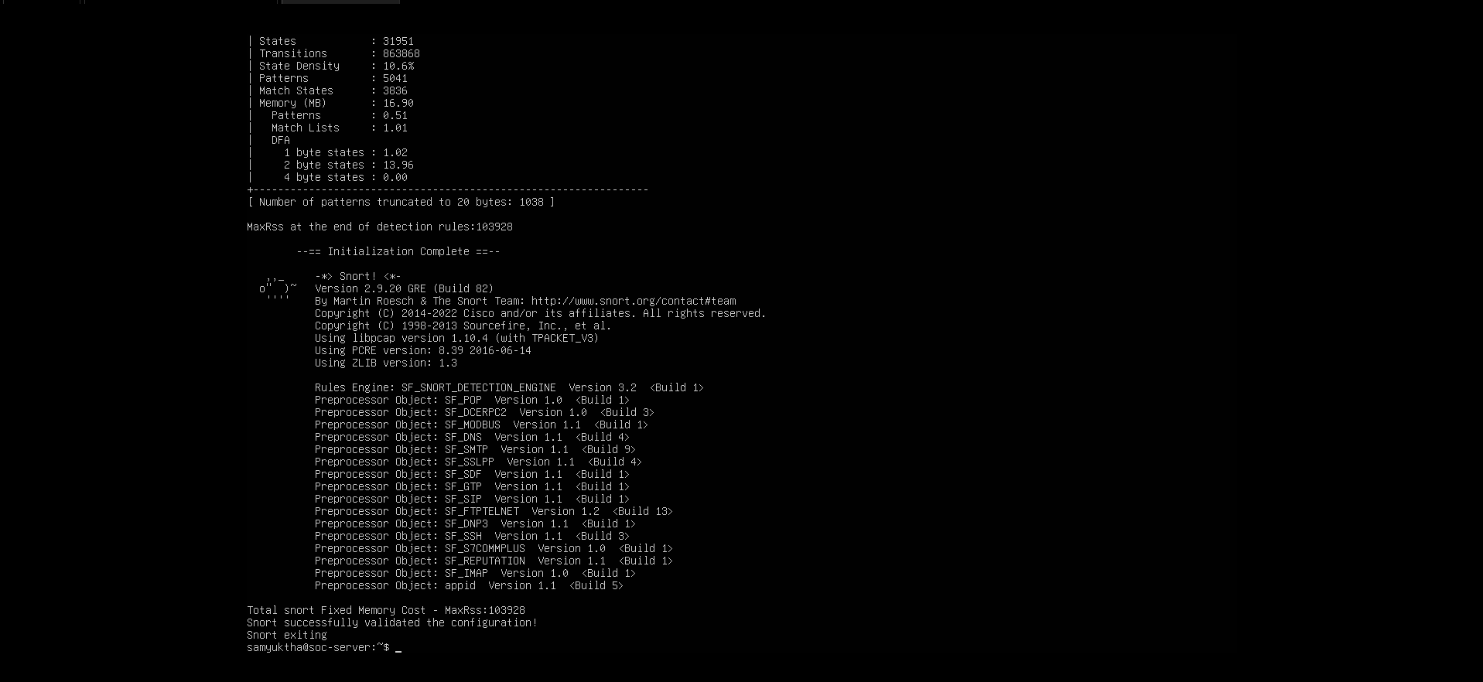
Snort Installation and Validation
Version check and configuration test
Version verification
snort -V reports Snort 2.9.20 GRE (Build 82).
Configuration validation
Test-mode output states that Snort successfully validated the configuration.
DG INTERNS HUB | WEEK 09 SOC
6

Slide 7

Custom Detection Rules
Rules displayed in /etc/snort/rules/local.rules
ICMP: alert icmp any any -> $HOME_NET any (msg:"ICMP Ping Detected"; sid:1000001; rev:1;)
HTTP: alert tcp any any -> $HOME_NET 80 (msg:"HTTP Traffic Detected"; sid:1000002; rev:1;)
ICMP SID 1000001 matches ICMP traffic; HTTP SID 1000002 matches TCP traffic to destination port 80 in $HOME_NET.
DG INTERNS HUB | WEEK 09 SOC
7

Slide 8
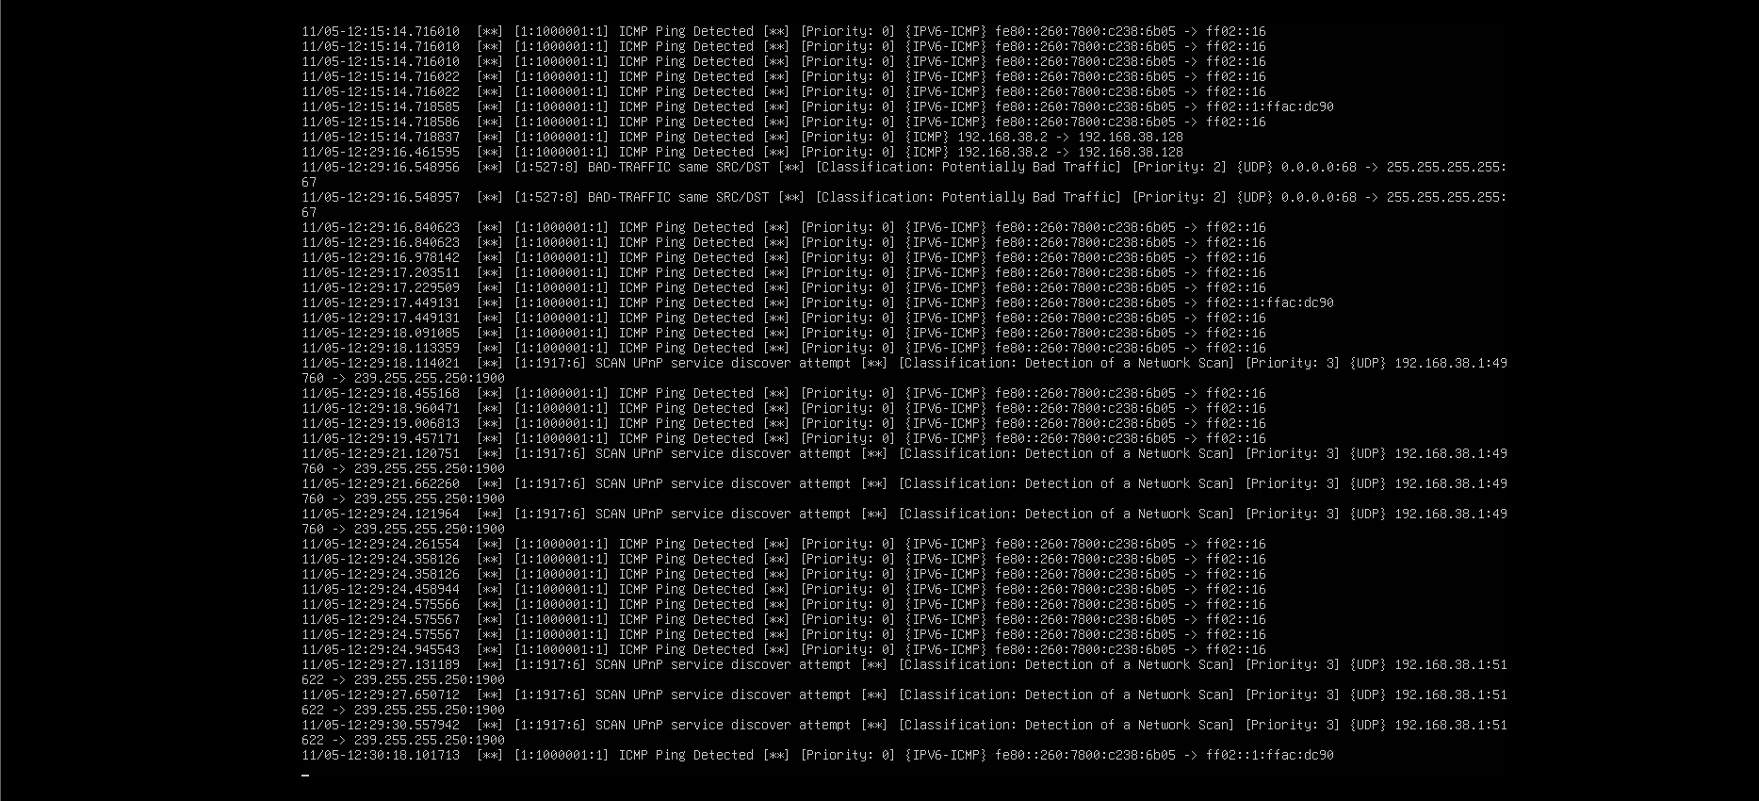
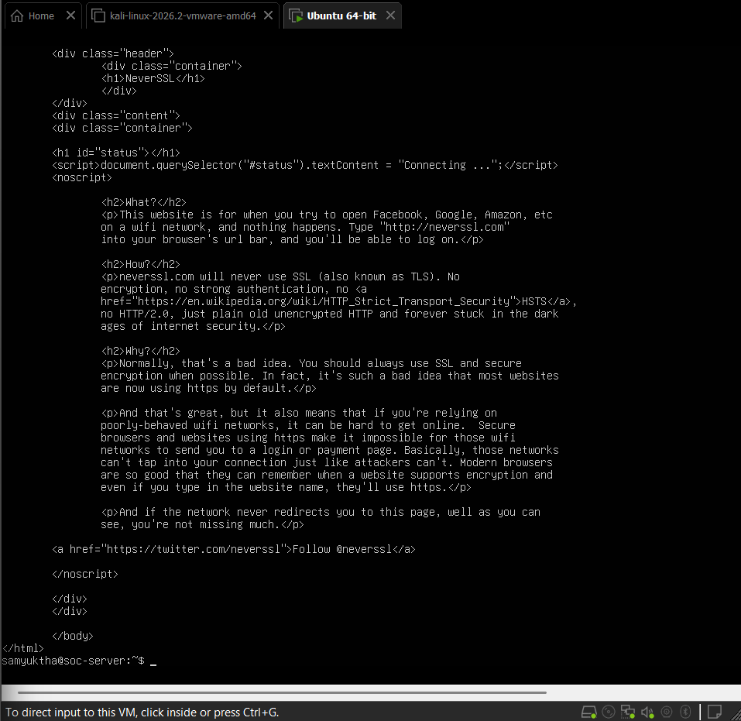
Traffic Tests, Findings and Next Steps
Evidence-based summary
ICMP
HTTP
Repeated “ICMP Ping Detected” console alerts are visible. Additional built-in alerts also require triage.
The HTTP test page and rule are evidenced; findings notes report alerts, but a dedicated HTTP alert-console screenshot is absent.
Improve evidence: export snort.conf/local.rules, save alert logs, capture the HTTP SID 1000002 alert, and record timestamps and test endpoints.
DG INTERNS HUB | WEEK 09 SOC
8

