Slide 1
WEEK 4
Advanced Network Security
Practical Assessment
Technical Learning & Practical Presentation
Assessment workflow
Core evidence
Network setup → Apache service → Nmap discovery → Wireshark analysis → Final validation
20 genuine lab screenshots across five tasks. All conclusions are based on observed results from the controlled VMware environment.
DG Interns Hub | Cybersecurity Internship
SAMYUKTHA S. | DG/SEPTEMBER/CYBER/102
DG Interns Hub | Week 4 | Authorized Lab
1

Slide 2
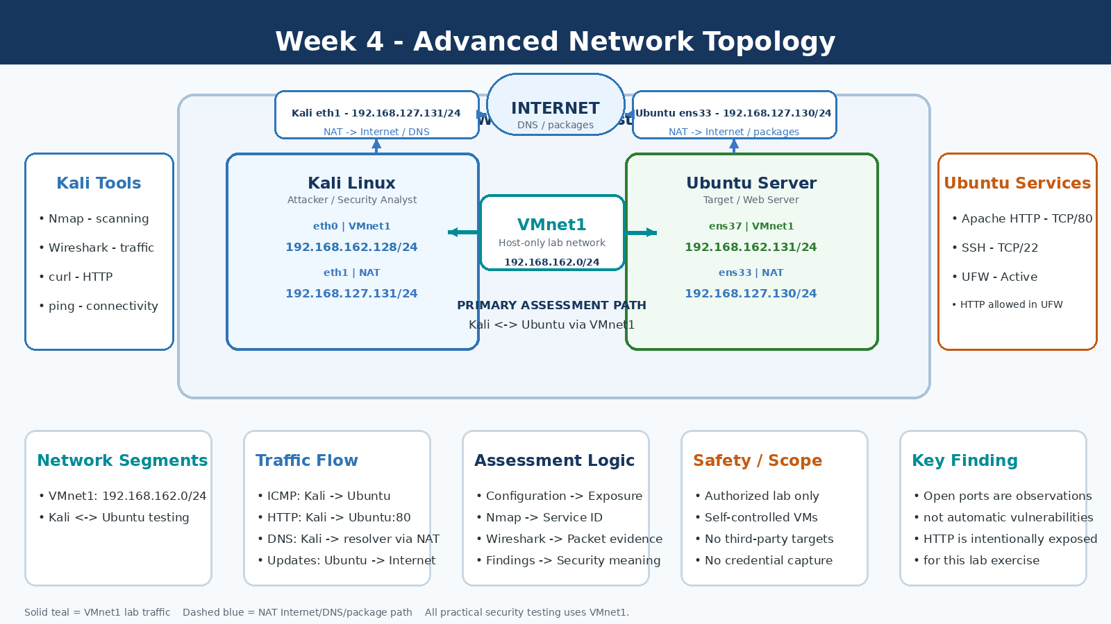
1. Lab Architecture
Exact final dual-interface topology used during the practical
VMnet1 - lab network
192.168.162.0/24
Kali eth0: 192.168.162.128
Ubuntu ens37: 192.168.162.131
Primary Kali ↔ Ubuntu assessment path.
NAT - separate path
Kali eth1: 192.168.127.131
Ubuntu ens33: 192.168.127.130
Used for Internet/DNS/package access.
Target services
SSH TCP/22 | Apache HTTP TCP/80 | UFW active
DG Interns Hub | Week 4 | Authorized Lab
2

Slide 3
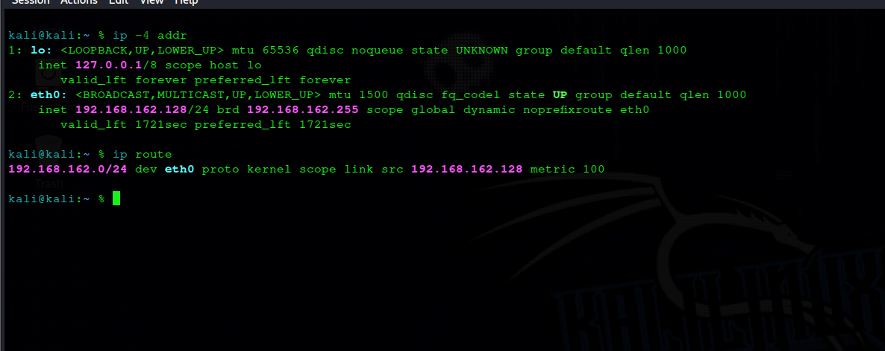
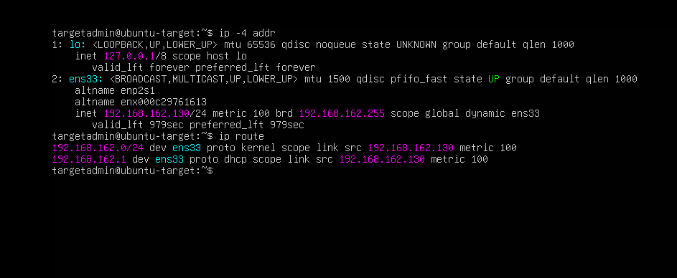
2. Network Setup & Service Configuration
Task 1 establishes the baseline; Task 2 introduces the HTTP service
Kali IP/routing configuration
Ubuntu IP/routing configuration
Connectivity
Apache state
Remote validation
Bidirectional ping tests returned 0% packet loss. This validates actual communication, not just the presence of IP addresses.
Apache was installed, verified active, and confirmed listening on TCP/80 using ss. UFW was updated to allow 80/tcp.
Kali successfully retrieved the Apache HTML over 192.168.162.131:80 after the firewall rule was added.
DG Interns Hub | Week 4 | Authorized Lab
3

Slide 4
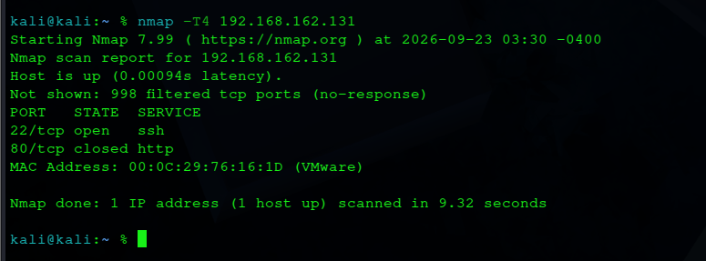
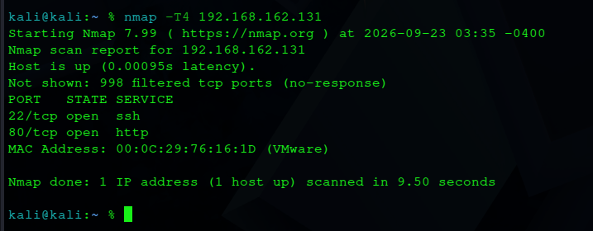
3. Nmap Controlled Before/After
Same target, same network, one intentional change: Apache service state
Apache stopped - 80/tcp closed
Apache started - 80/tcp open
22/tcp stayed open in both states. The key change was TCP/80: closed when no HTTP process was listening, then open after Apache started.
Observation
Explanation
Security meaning
80/tcp changed state.
Service state changed.
Attack surface changed.
DG Interns Hub | Week 4 | Authorized Lab
4

Slide 5
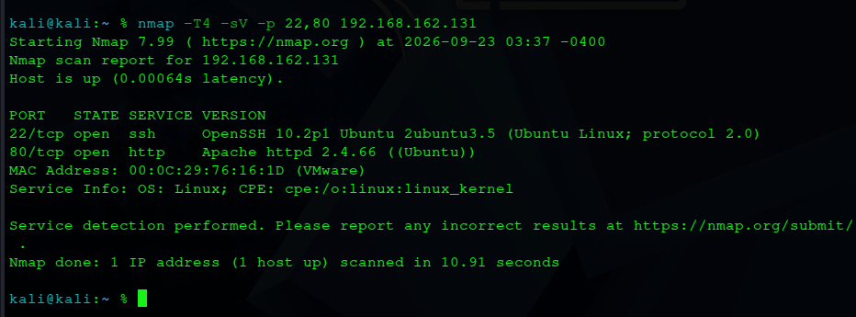
4. Nmap Service & Version Detection
From exposed port to identified software
22/tcp - SSH
OpenSSH 10.2p1 Ubuntu 2ubuntu3.5
State: open
80/tcp - HTTP
Actual Nmap -sV output
Apache httpd 2.4.66 (Ubuntu)
State: open
Interpretation
Version strings are reconnaissance observations. No confirmed vulnerability was established by this exercise.
DG Interns Hub | Week 4 | Authorized Lab
5

Slide 6
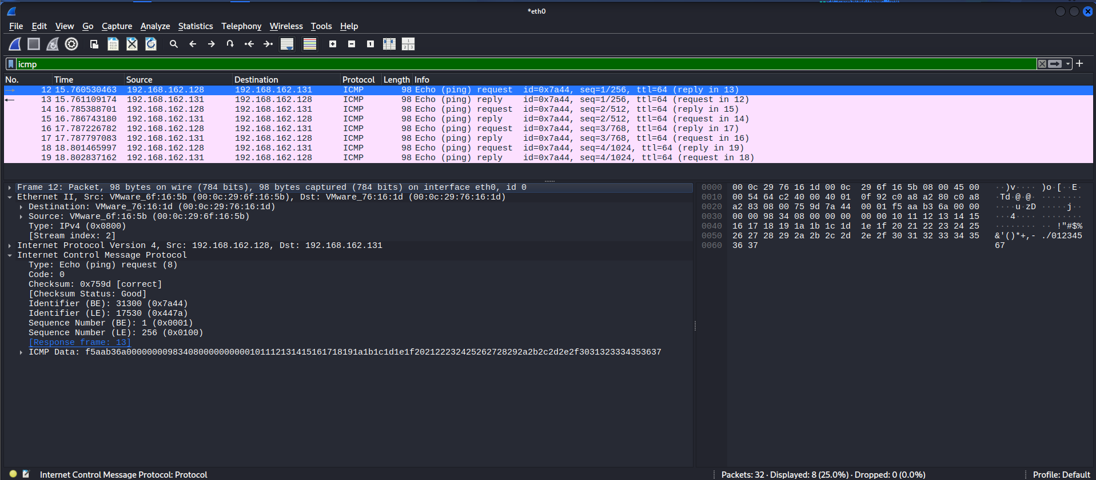
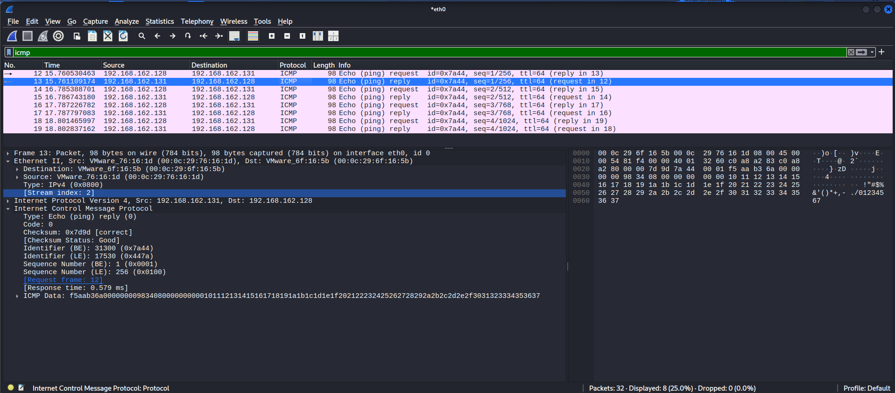
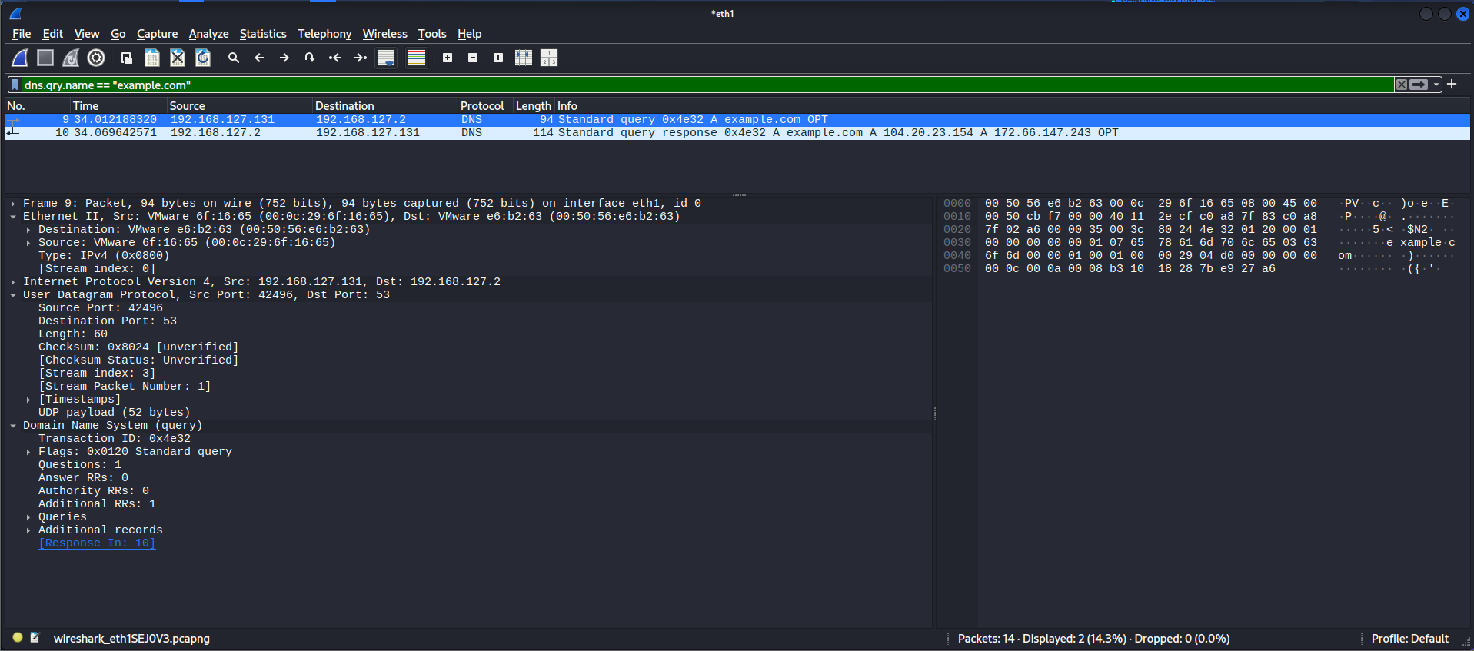
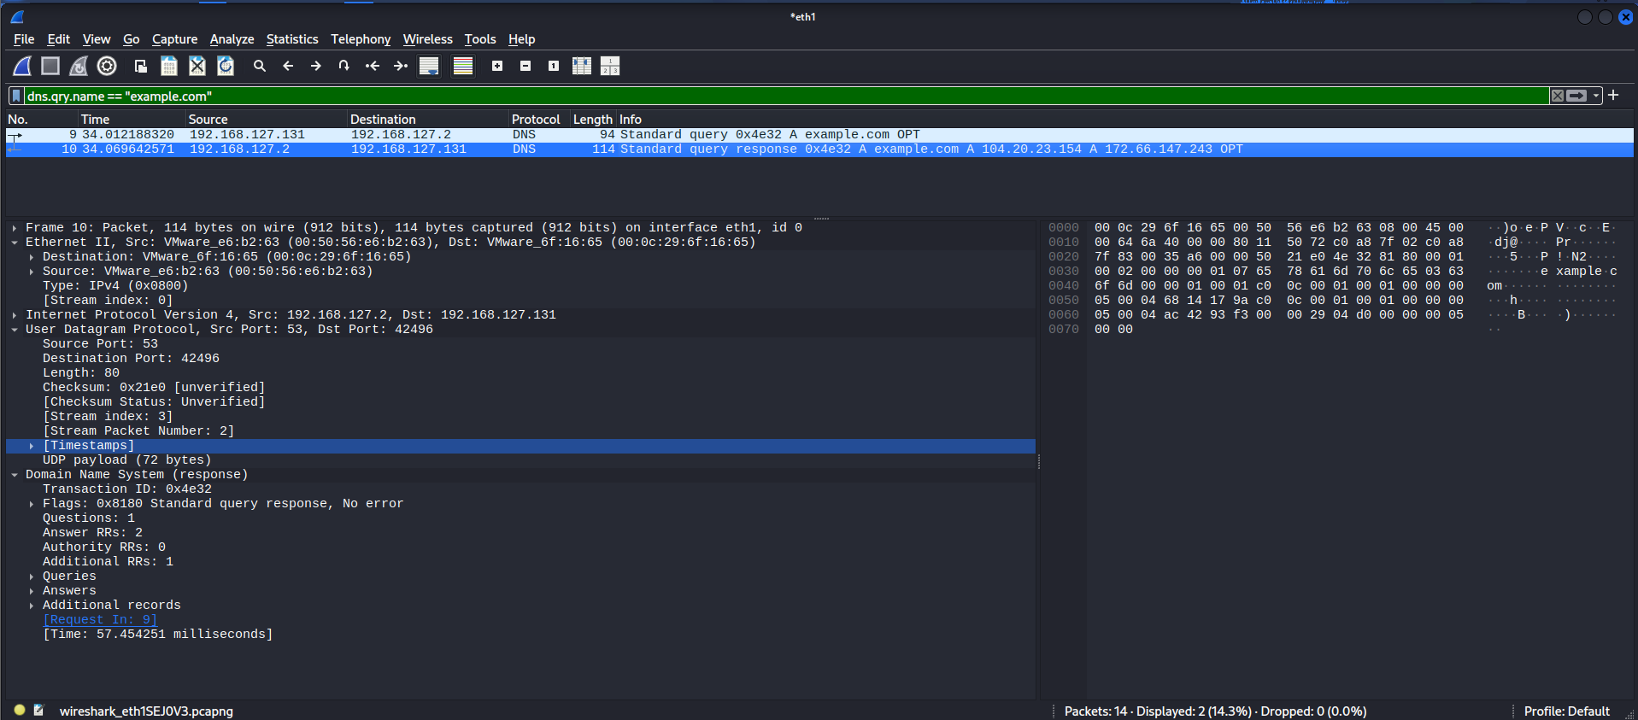
5. Wireshark - ICMP & DNS
Reading packet direction, transport, and protocol meaning
ICMP Echo Request
ICMP Echo Reply
DNS Query
ICMP
DNS
Kali 192.168.162.128 → Ubuntu 192.168.162.131. Type 8 request followed by Type 0 reply.
Controlled query/response captured through the NAT resolver path after the initial lab-interface resolver did not respond.
DNS Response
DG Interns Hub | Week 4 | Authorized Lab
6

Slide 7
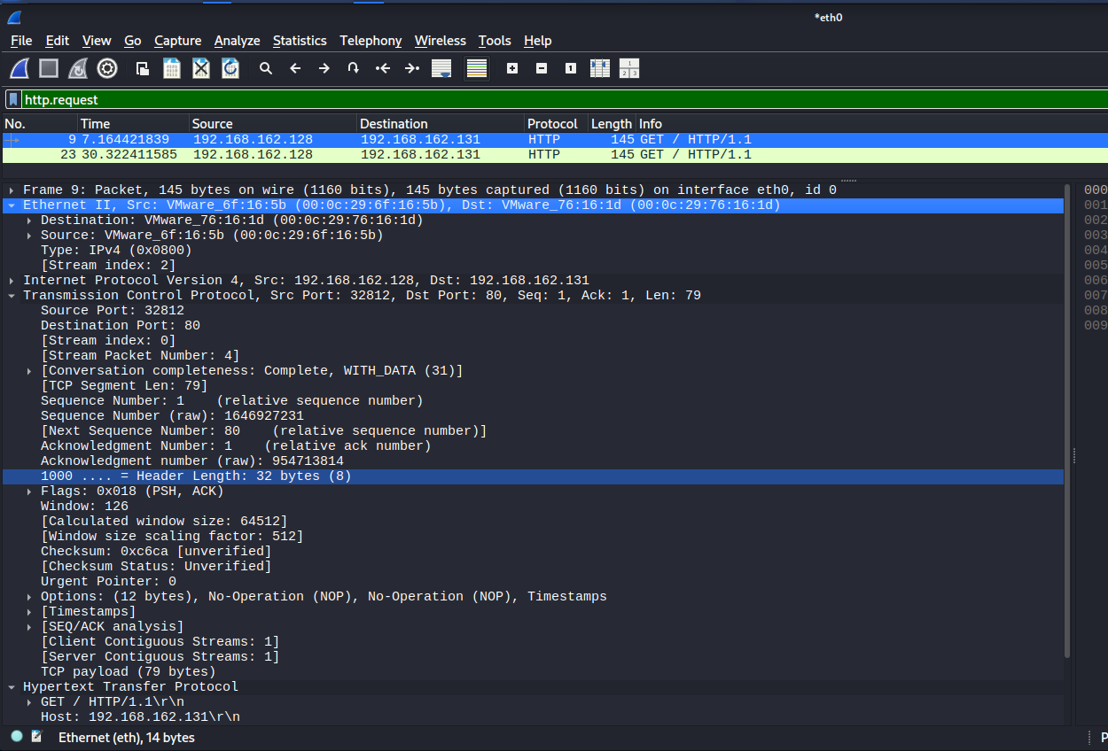
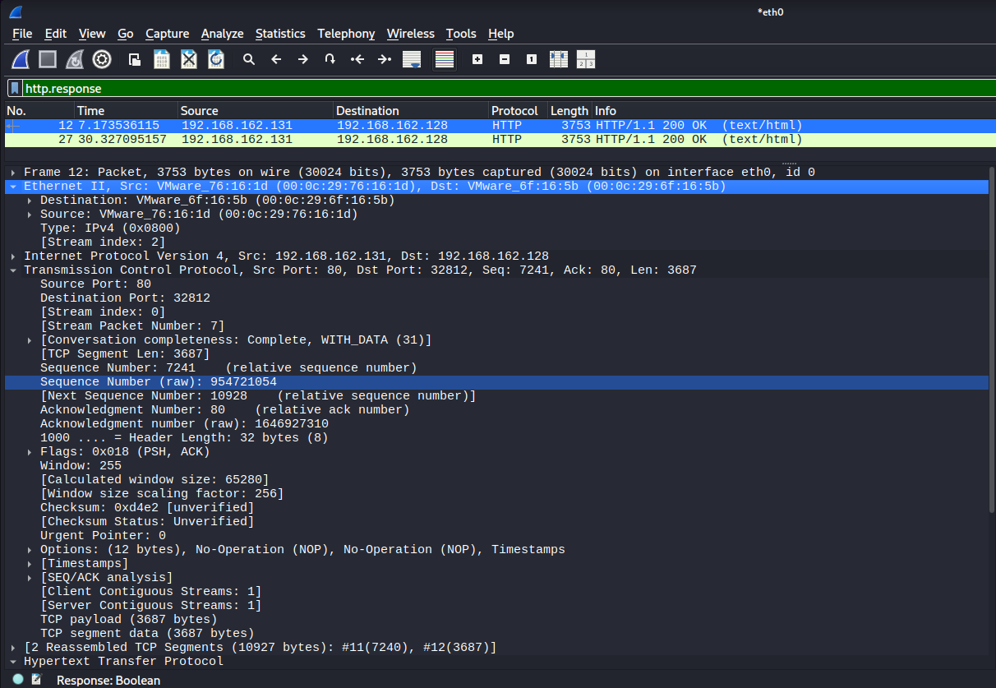
6. Wireshark - HTTP & Cross-Tool Correlation
Connecting Nmap exposure to packet-level application behaviour
HTTP GET / HTTP/1.1
HTTP/1.1 200 OK - text/html
Nmap evidence
Wireshark evidence
Correlation
80/tcp was open and -sV identified Apache httpd 2.4.66.
TCP 32812 ↔ 80 carried GET / and the server response.
Scanner observation and packet behaviour describe the same service.
Security significance: Plain HTTP application content is visible on the captured path in this controlled lab.
DG Interns Hub | Week 4 | Authorized Lab
7

Slide 8
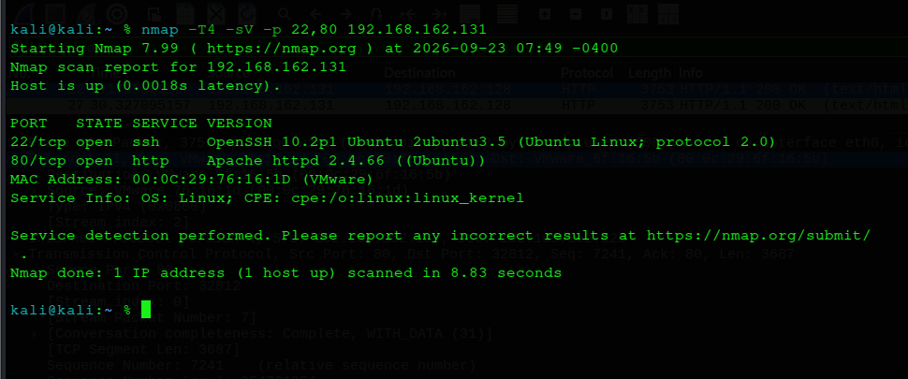
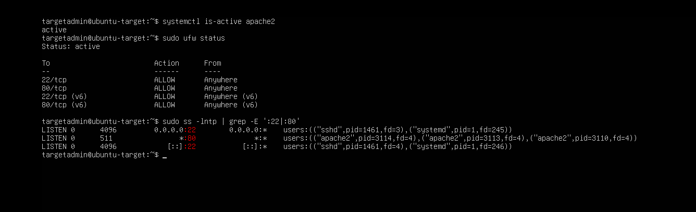
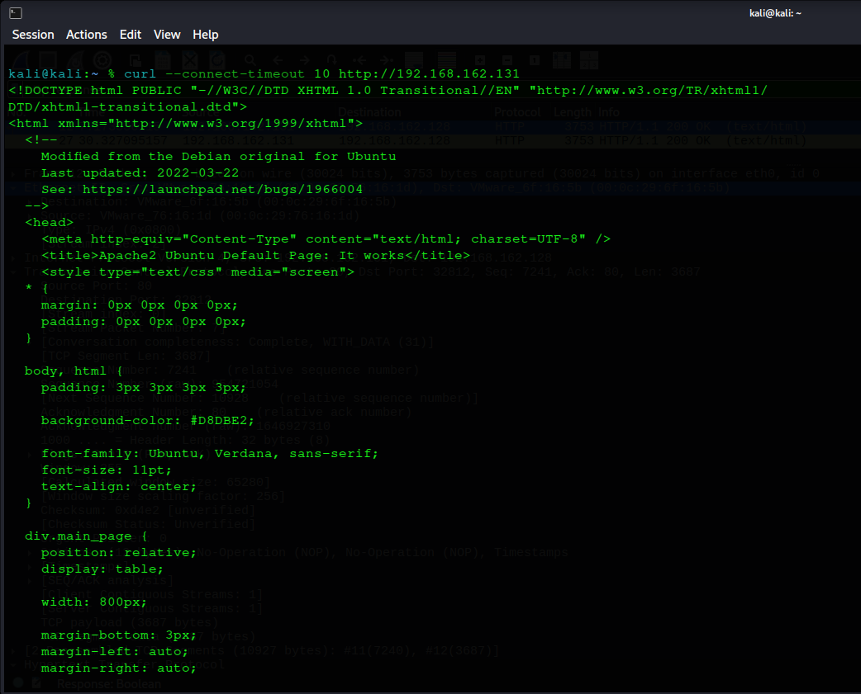
7. Final Mini Project Assessment
Evidence-based findings and learning
Observation
Potential risk
SSH and Apache were listening and reachable from Kali on VMnet1.
Reachable services add attack surface; plain HTTP exposes application-layer content.
Final Nmap assessment
Confirmed vulnerability
Cross-tool proof
None established by this exercise. Exposure was assessed without exploitation.
Target state, Nmap, Wireshark and curl agree on the HTTP service.
Learning
Final target-side service validation
The strongest lesson was correlation: understand what was configured, what the scanner observed, what packets show, and what conclusions the evidence can support.
Final HTTP validation from Kali
DG Interns Hub | Week 4 | Authorized Lab
8

