Slide 1
WEEK 3
DG INTERNS HUB
Week 3
Advanced Cybersecurity Practical Task
S
Network Security Assessment • Traffic Investigation • Hardening
AUTHORIZED LAB
ANALYSIS VM
VMware VMnet1
192.168.162.0/24
Kali Linux
192.168.162.128
ASSESSMENT HIGHLIGHTS
TARGET
ASSESSMENT
7–14
tasks completed
Ubuntu Server
192.168.162.130
Nmap + Wireshark
Tasks 7–14
22/tcp
SSH observed open
UFW
enabled + verified
SAMYUKTHA S. | DG/SEPTEMBER/CYBER/102
01

Slide 2
01 • OBJECTIVE
01 • OBJECTIVE
Assessment mission
A controlled workflow from discovery to validated hardening.
DISCOVER
01
IDENTIFY
02
INVESTIGATE
03
IMPROVE
04
Live hosts + exposed ports
Services, versions, OS clues
Packets, flags, sessions, patterns
Harden + repeat the same test
Outcome: a defensible technical story backed by real Nmap output, real packet captures, and measurable before/after hardening evidence.
AUTHORIZED SCOPE
EVIDENCE-BASED
REPEATABLE
DG Interns Hub | Cybersecurity Internship | Week 3
02

Slide 3
02 • LAB ARCHITECTURE
02 • LAB ARCHITECTURE
Advanced network diagram
Final assessment path: Windows host → VMware Workstation → isolated VMnet1 → Kali + Ubuntu.
WINDOWS HOST
Physical laptop
VMware Workstation
VMware VMnet1 • Host-only network
192.168.162.0/24 | isolated assessment plane
SCAN / CAPTURE
KALI LINUX
UBUNTU SERVER
K
U
192.168.162.128/24
192.168.162.130/24
SCANNER
WIRESHARK
TARGET
SSH : 22
LAB NOTES
• No external targets intentionally scanned • Wireshark captured on Kali eth0 • DNS capture used temporary NAT only; assessment path remained VMnet1
DG Interns Hub | Week 3 | Architecture
03

Slide 4
03 • TOOLS
03 • TOOLS USED
Toolchain for assessment and evidence
Each tool answered a different security question.
V
VMware
K
Kali Linux
N
Nmap
Lab isolation + VM lifecycle
Assessment workstation
Discovery + enumeration
W
Wireshark
U
Ubuntu
S
SSH / netcat
Packet capture + analysis
Authorized target
Controlled traffic generation
TOOLCHAIN
VMware
Kali
Nmap
Wireshark
Ubuntu
DG Interns Hub | Cybersecurity Internship | Week 3
04

Slide 5
04 • NMAP
04 • NMAP ASSESSMENT
From discovery to advanced checks
The same target was progressively profiled with multiple Nmap techniques.
1
DISCOVERY
-sn
BASELINE FINDINGS
2
BASIC
default TCP
22/tcp
OPEN • SSH
3
SERVICE
-sV
OpenSSH
10.2p1 Ubuntu 2ubuntu3.5
4
OS
-O
OS match
No exact match
5
SYN
-sS
UDP
No conclusive open port
6
UDP
-sU top-20
NSE vuln
No finding reported
7
NSE
--script vuln
Analyst rule: version detection ≠ vulnerability proof; open|filtered ≠ confirmed open.
DG Interns Hub | Cybersecurity Internship | Week 3
05

Slide 6
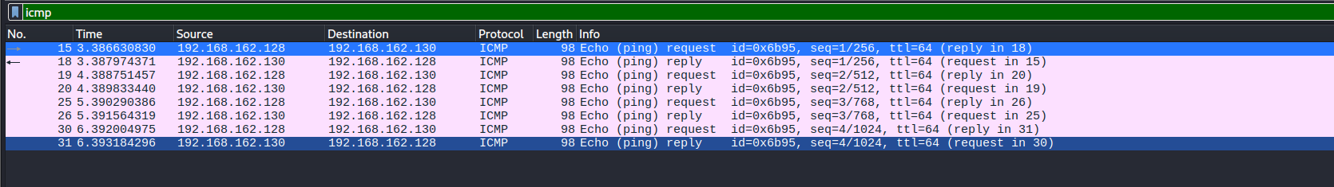
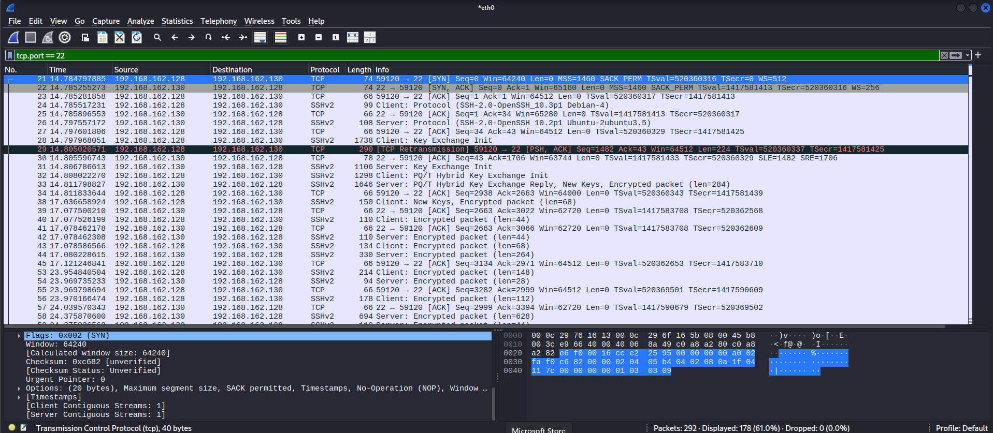
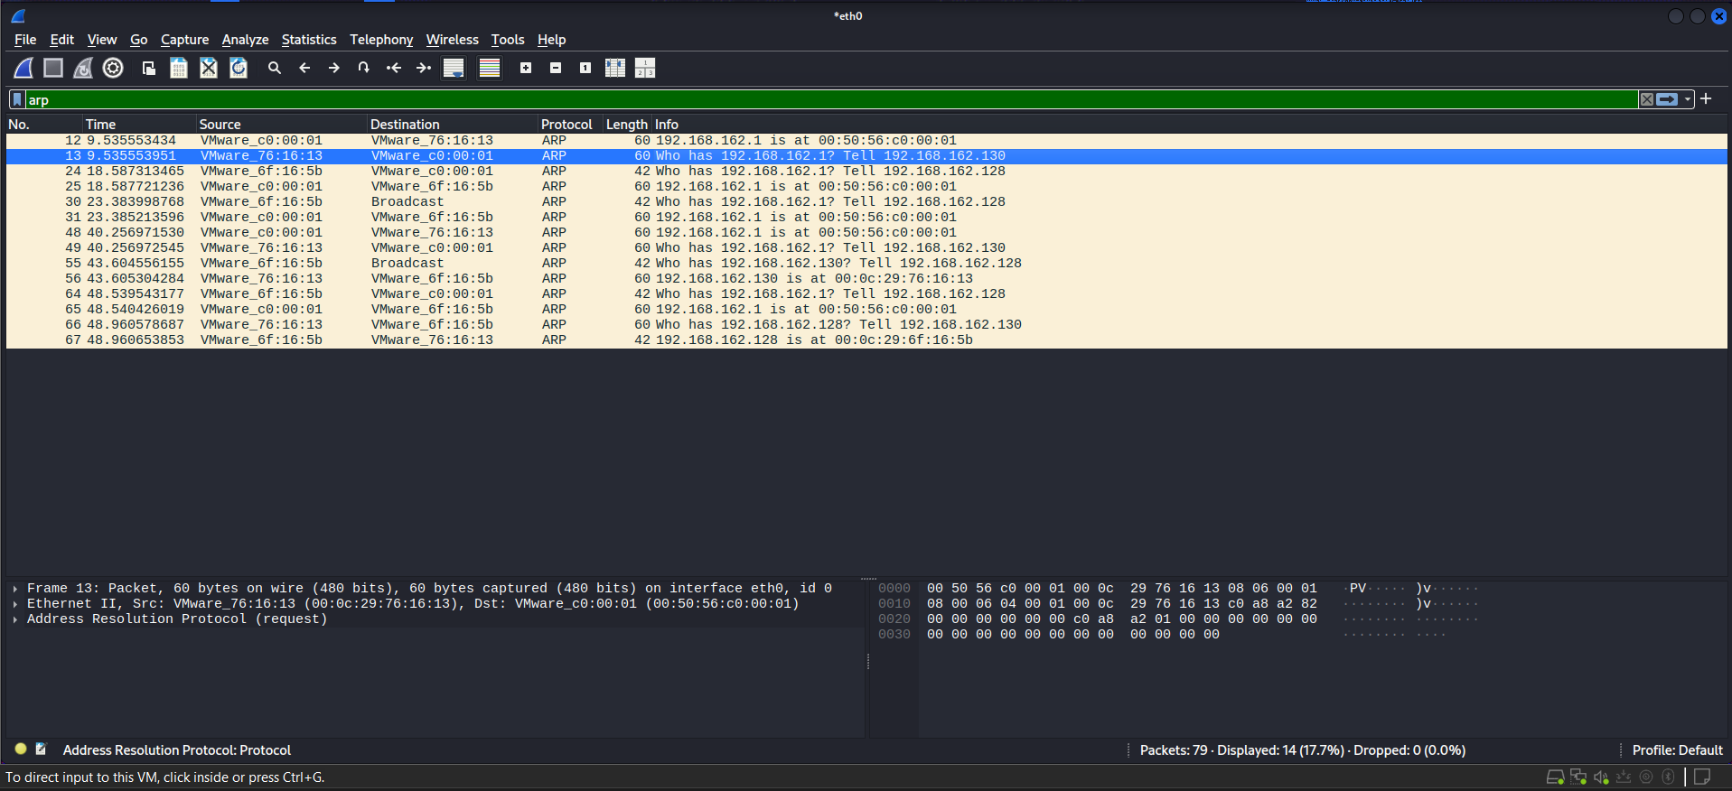
05 • WIRESHARK
05 • WIRESHARK ANALYSIS
Packet-level evidence
Captures were filtered and interpreted by protocol, flag and communication pair.
ICMP
TCP / SSH
ARP
CAPTURE COVERAGE
ICMP
DNS
TCP
UDP
ARP
SYN
RST
Observed behavior
4 ICMP requests/replies • SSH handshake + encrypted SSHv2 • UDP datagram to 9999 • ARP IP-to-MAC resolution • SYN/RST behavior • retransmission analysis
DG Interns Hub | Cybersecurity Internship | Week 3
06

Slide 7
06 • FINDINGS
06 • SECURITY FINDINGS
Evidence first, labels second
The assessment distinguished confirmed exposure, hardening gaps and positive controls.
CONFIRMED EXPOSURE
Exposure
HARDENING GAP
Gap
TCP/22 reachable and identified as SSH.
UFW was inactive in the baseline state.
HARDENING OPPORTUNITY
Gap
POSITIVE CONTROL
Control
PasswordAuthentication was enabled.
PermitRootLogin was prohibited.
POSITIVE CONTROL
Control
AUTOMATED CHECK
Check
Public-key authentication was enabled.
NSE vuln scan reported no finding.
No confirmed exploitable vulnerability was established from the evidence collected.
DG Interns Hub | Cybersecurity Internship | Week 3
07

Slide 8
07 • RISK
07 • VULNERABILITY / RISK ASSESSMENT
Risk classification from observed evidence
The lab exposed two actionable hardening gaps; no exploitable vulnerability was confirmed.
Finding 1 • Firewall inactive
RISK MATRIX
MODERATE
Impact
Impact: broadens observable inbound surface. Evidence: UFW status inactive + Nmap baseline.
!
UFW inactive
Moderate hardening priority
Finding 2 • Password SSH auth enabled
MODERATE
Impact: increases reliance on password authentication. Evidence: sshd configuration baseline.
Likelihood →
Not a confirmed vulnerability
EVIDENCE
Nmap NSE returned no finding; exposed SSH is treated as attack surface, not proof of exploitability.
DG Interns Hub | Cybersecurity Internship | Week 3
08

Slide 9
08 • HARDENING
08 • SECURITY HARDENING
A controlled change with measurable validation
The change was applied only after the baseline was recorded.
1
BASELINE
2
PROTECT
3
ENABLE
4
VERIFY
UFW inactive
allow SSH
UFW active
repeat Nmap + SSH test
HARDENING COMMANDS
VALIDATED OUTCOME
sudo ufw allow ssh
sudo ufw enable
sudo ufw status verbose
UFW active
SSH remained reachable
Non-SSH TCP ports became filtered
MEASURED CHANGE
DG Interns Hub | Cybersecurity Internship | Week 3
09

Slide 10
09 • BEFORE / AFTER
09 • BEFORE VS AFTER
Same scan, different network behavior
The firewall changed how unsolicited TCP traffic appeared to the scanner.
BEFORE UFW
INACTIVE
AFTER UFW
ACTIVE
22/tcp OPEN SSH
999 ports CLOSED
Response: RST / closed
22/tcp OPEN SSH
999 ports FILTERED
Response: no-response
→
Scanner can distinguish closed ports because the target responds.
Firewall filters unsolicited traffic while preserving authorized SSH.
MEASURABLE SECURITY IMPROVEMENT
DG Interns Hub | Cybersecurity Internship | Week 3
10

Slide 11
10 • RECOMMENDATIONS
10 • RECOMMENDATIONS
Keep the control, reduce the attack surface
Practical next steps based on the lab evidence.
01
Keep UFW enabled
02
Prefer SSH keys
Review and minimize allowed rules; avoid unnecessary inbound services.
Move toward key-based authentication and disable password authentication when operationally ready.
03
Keep systems updated
04
Monitor the network
Retain a repeatable patch check and record security update status.
Use Wireshark / logs to investigate unexpected ports, retries and repeated connection attempts.
PRIORITY
HIGH
NEXT
CONTINUOUS
DG Interns Hub | Cybersecurity Internship | Week 3
11

Slide 12
11 • CONCLUSION
11 • Conclusion
Observe → Validate → Interpret → Improve → Document
7–14
22/tcp
0
UFW
tasks completed
SSH exposure identified
NSE findings reported
hardened + verified
What the assessment established
What changed
The target exposed SSH on TCP/22. Wireshark confirmed the packet behavior behind successful and rejected TCP connections. No exploitable vulnerability was confirmed from the collected evidence.
UFW moved from inactive to active, SSH remained reachable, and non-SSH TCP ports changed from closed to filtered in the repeat scan.
FINAL TAKEAWAY • The strongest result is not a scary finding; it is a measurable, validated improvement.
SAMYUKTHA S. | DG Interns Hub Cybersecurity Internship
Safer Networks, Stronger Tomorrow
12

