Slide 1
Women Hackathon 2018 “POLICE DRONE”

Slide 2
PROBLEM STATEMENT
Today’s women are equally contributing in a nations growth.
With increasing women work force, there are significant increase in crime rate against women.
Today, women “SAFETY” is one of the major challenges to corporate houses as well as to the government.
Government provides various facilities around women safety:
She Shuttle
She team
New laws and regulations
Corporate houses address safety issues by:
Providing cab services with a security personnel
No late night working hours
Work from home facility etc.
2

Slide 3
PROPOSED SOLUTION
To increase safety measures of women we are proposing a solution “POLICE DRONE”.
What is POLICE DRONE?
POLICE DRONE helps track a person in distress.
It uses is capable of broadcasting SOS message to Police Command Centre, Emergency Contacts as well as uses Crowd GPS for quick help and response.
POLICE DRONE uses the latest drone technology for a quick response for a person in distress.
POLICE DRONE DO NOT need any special infrastructure for it’s implementation or operations and can be used on the existing resources.
3

Slide 4
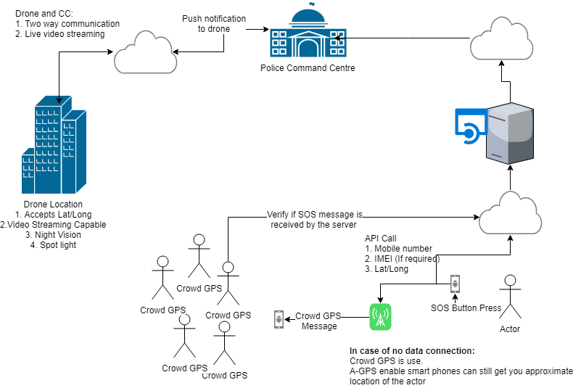
APPLICATION ARCHITECTURE

Slide 5
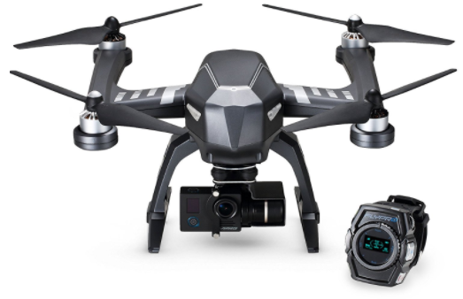
DRONE
Drone are very popular with professionals.
Today application of drone ranges from sports photography to event coverage, from spying to help armed forces.
Drones are unmanned aircraft that can be guided remotely or smart enough to navigate based on GPS way points.
It supports manoeuvres, such as:
Forward, backward, left, right, up, down movements
Still photography or video recording
Camera scoping (For Example: Changing the FOV from a higher value to a lower value to get a "zoomed" effect.
Night Vision.
Sim Card and GPS capable.
Search Light
5

Slide 6
DRONE APPLICATIONS
Search and rescue – Drones are very useful in searching and rescuing operations.
Security – Many authorities use drones to protect people during various emergencies.
Surveillance – A drone allows recording and monitoring from the sky, and therefore, they are suitable to monitor public events, protests, or any suspicious happening without being heard and seen. A great tool for the police!
Aerial photography & video – With a drone that is equipped with an HD camera, you can take the photos and great quality of live streaming video from the sky.

Slide 7
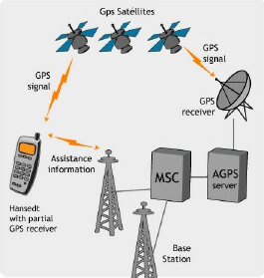
A-GPS (Assisted Global Positioning System)
AGPS is a cellular network towers that have GPS receivers (or a base station nearby)
Those receivers are constantly pulling down satellite
information and computing the data.
This data can then be passed on to the cellular phone.
Features:
Faster location acquisition
Less processing power is required by the device
Saves battery life
Location acquisition indoors or in non-optimal environmental settings

Slide 8
SOS APP AND CROWD GPS
Crowd GPS uses location shared by app to find automatically position of the cell phone, a feature that would be build into the app.
It extends number of people who can help you using your cell phones Bluetooth.
SOS App will have a feature to alert the user of an incoming SOS message where as crowd GPS helps to track the message sender.
Every user is a part of the Crowd Locate network, helping others to find where the victim is. All you need to do is leave your app running in the background to join the crowd.
SOS App has an inbuild capability to verify SOS message is received by the app server.

Slide 9
TECHNOLOGY AND ARCHITECTURE
We follow 3-tier Architecture
Design – ASP .Net
Middle Tier – WebAPI
Database - SQL Server
3rd Party API
Drone API
SMS API
Crowd GPS API
Video Streaming API

Slide 10

Thank YOU!!!!

